Slide 1


CREATING A NEW TITLES COLLECTION IN PRIMO
Jodi Craiglow
Technical Services Supervisor, Rolfing Memorial Library CARLI LAB Report ⬩ May 12, 2022

Slide 2
Process Overview
Process Overview
Roles You Need
Configuration
Analysis
Set
Collection
Updating
For More Info
Configuration
Let Alma figure out what your new titles are
Analysis
1
Bundle records together so you can use them
Set
2
Collection
updating
Show off your haul to the world
3

Slide 3
Roles You Need
Process Overview
Roles You Need
Configuration
Analysis
Set
Collection
Updating
For More Info
Configuration: Discovery Administrator or Discovery Operator - Limited
Analysis: Designs Analytics
Set: Manager/Administrator (any type)
Collection: Collection Inventory Operator and Collection Inventory Operator Extended

Slide 4
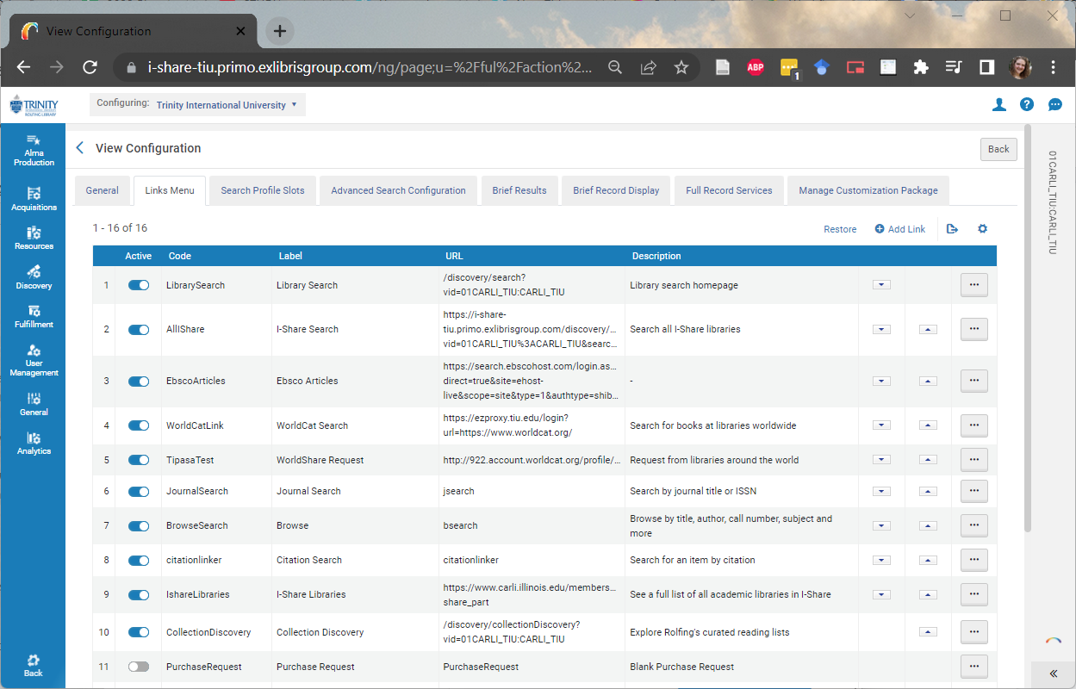
Pre-Step: Configuration
Process Overview
Roles You Need
Configuration
Analysis
Set
Collection
Updating
For More Info
Configuration > Discovery > Display Configuration: Configure Views > (Default View) Edit > Links Menu > CollectionDiscovery

Slide 5
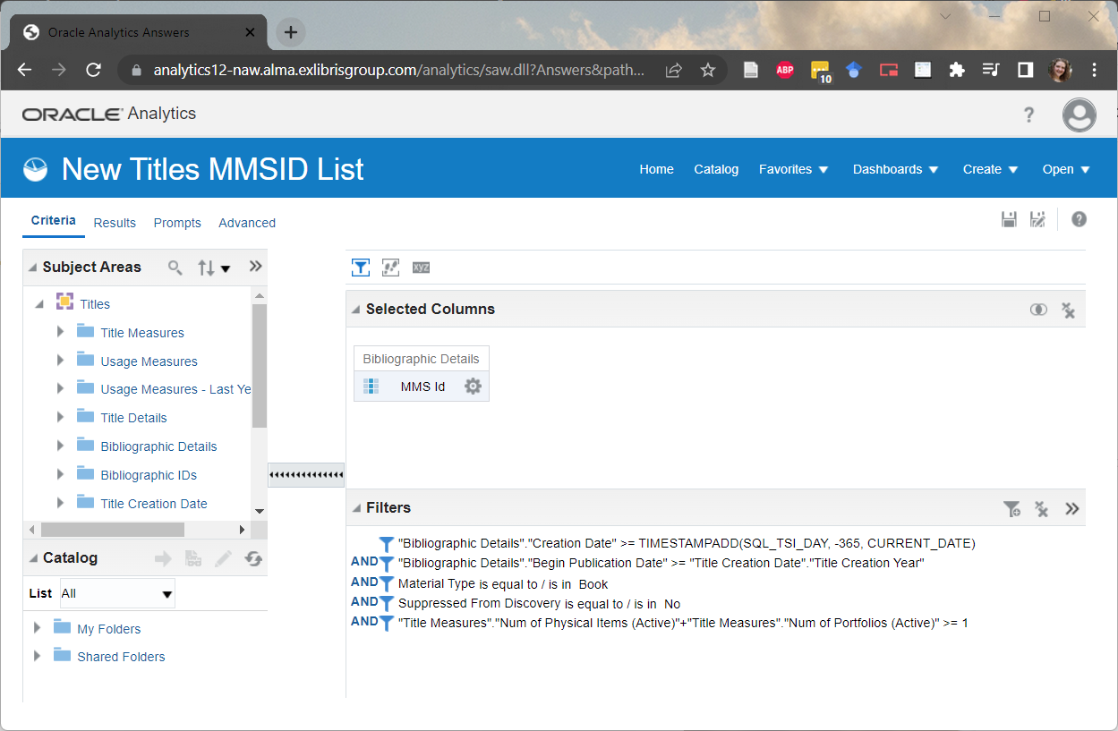
Step 1: Analysis
Process Overview
Roles You Need
Configuration
Analysis
Set
Collection
Updating
For More Info
Shared Folders > Community > Reports > Consortia > CARLI > Member Library Submissions > New Titles MMSID List

Slide 6
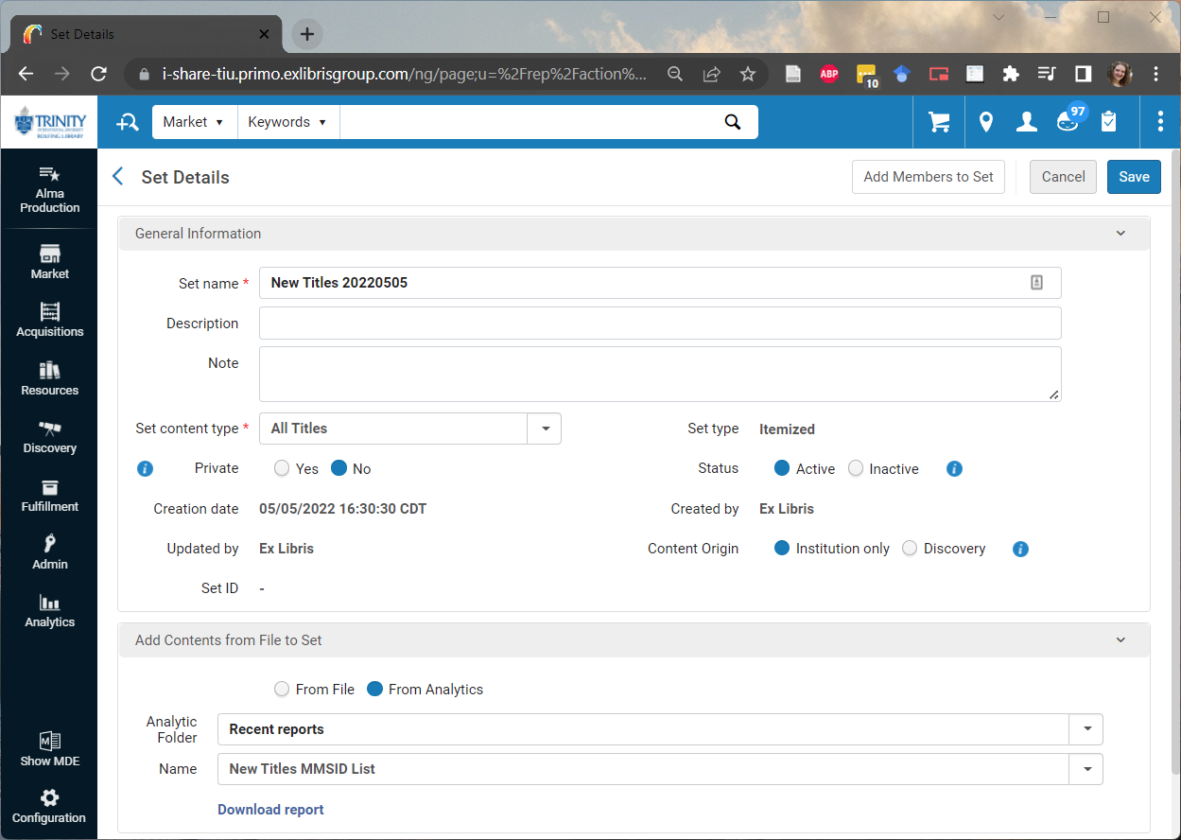
Step 2: Set
Process Overview
Roles You Need
Configuration
Analysis
Set
Collection
Updating
For More Info

Slide 7

Step 3: Collection
Process Overview
Roles You Need
Configuration
Analysis
Set
Collection
Updating
For More Info
Create collection

Slide 8
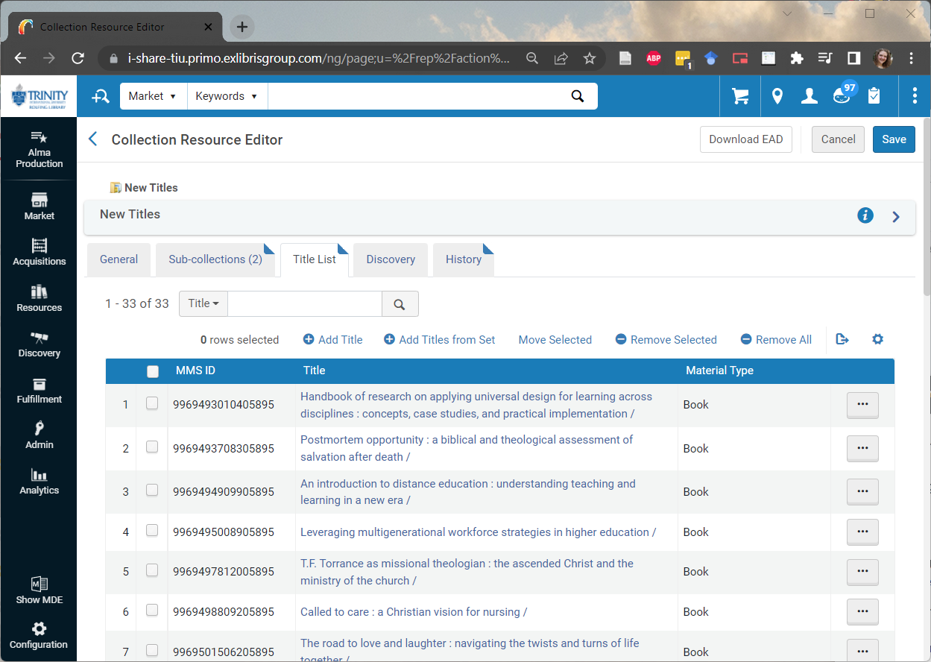
Step 3: Collection
Process Overview
Roles You Need
Configuration
Analysis
Set
Collection
Updating
For More Info
Add titles from set

Slide 9
Updating
Process Overview
Roles You Need
Configuration
Analysis
Set
Collection
Updating
For More Info
Export analysis results*
Create new set(s)
Delete titles currently in collection(s)
Add titles from new set(s)
Wait for Primo to refresh
* If you’re not creating your set directly from the analysis

Slide 10
For More Information
Process Overview
Roles You Need
Configuration
Analysis
Set
Collection
Updating
For More Info
Presentation materials: bit.ly/CARLI-New-Titles
TIU’s New Titles collection: library.tiu.edu/newbooks
Contact Jodi: jacraiglow@tiu.edu; 847-317-4020

