Slide 1
Citation Styles in Primo VE
CARLI Open Office Hours Lab Reports, May 12, 2022
Alice Creason, Lewis University and Aimee Walker, Joliet Junior College (CARLI Discovery Primo VE Task Force Co-Chairs)

Slide 2
What we’re covering
Managing existing citation styles
Adding new citation styles
ExLibris documentation related to this presentation: https://knowledge.exlibrisgroup.com/Primo/Product_Documentation/020Primo_VE/Primo_VE_(English)/120Other_Configurations/Managing_Citation_Styles_for_Primo_VE

Slide 3
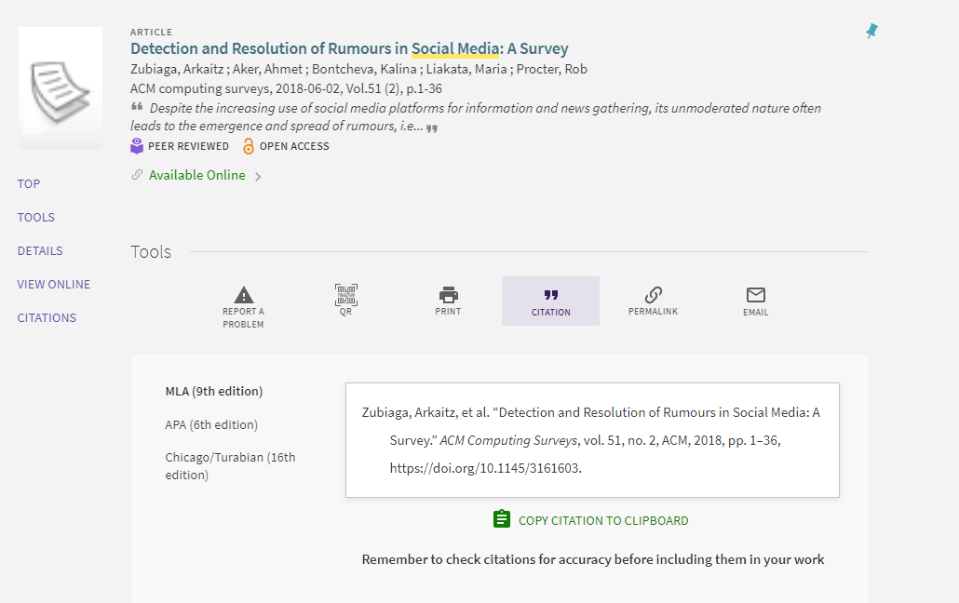
Citations in Primo VE

Slide 4
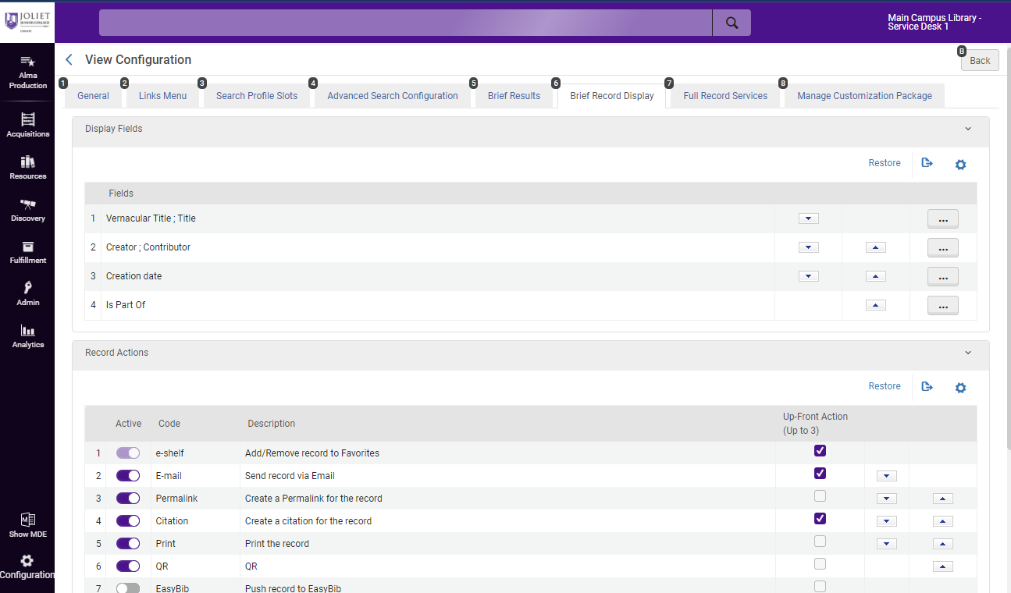
Citations in Primo VE
Must have Discovery Administrator role
Alma configuration > Discovery > Display Configuration > Configure Views > Brief Record Display > Record Actions

Slide 5
Managing citation styles
PrimoVE supports APA, MLA, Chicago/Turabian, and Harvard out of the box
Citation styles are generally kept up-to-date, but labels are not updated (known issue)

Slide 6
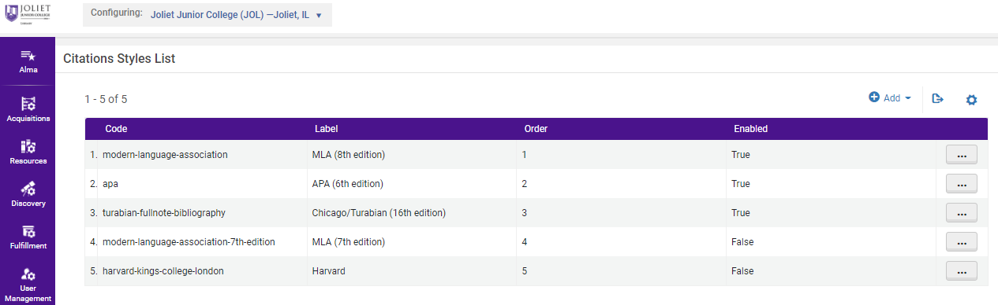
Working with existing citation styles
Must have Discovery Administrator role
Alma configuration > Discovery > Other > Citation Styles

Slide 7
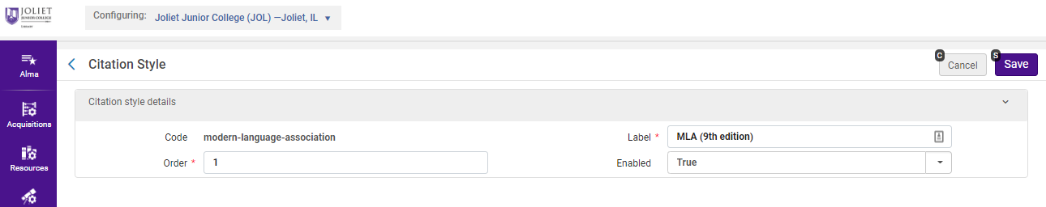
Working with existing citation styles
Must have Discovery Administrator role
Alma configuration > Discovery > Other > Citation Styles

Slide 8
Adding a New Citation Style to Primo VE

Slide 9
Adding New Citation Styles
Primo VE supports the open source Citation Style Language (CSL)
The CSL project maintains a citation style repository on GitHub
Resources: https://citationstyles.org/

Slide 10
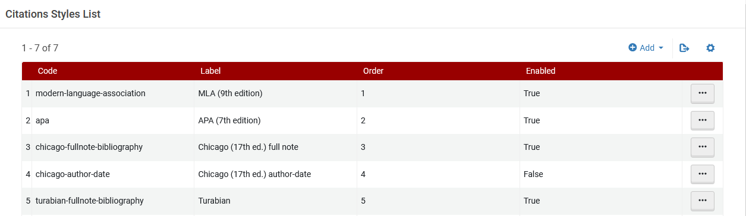
Adding New Citation Styles
Must have Discovery Administrator role
Alma configuration > Discovery > Other > Citation Styles

Slide 11
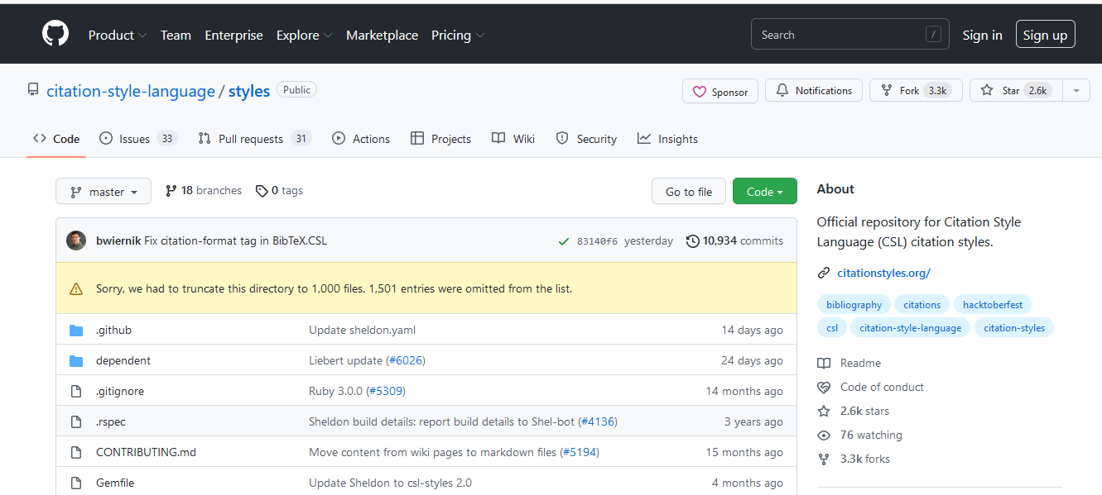
Adding New Citation Styles
Go to the CSL GitHub repository at https://github.com/citation-style-language/styles

Slide 12
Adding New Citation Styles
Browse or search for a citation style by clicking “Go to File” and entering search terms in the search bar that appears.
Notes:
–tricky to search because there are so many styles; need to know how it is named in the repository
–sometimes easier to browse
–use example: American Chemical Society

Slide 13
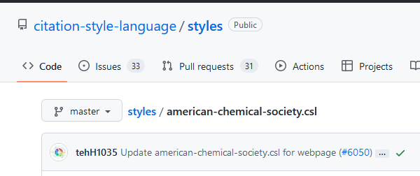
Adding New Citation Styles
Once you find the citation style you want, copy the name of the style as it appears in the repository, but leave off the “.csl” suffix.

Slide 14
Adding New Citation Styles
In Alma, go to Alma configuration > Discovery > Other > Citation Styles and click “Add.”

Slide 15
Adding New Citation Styles
In the pop-up box that appears, complete the following fields:
Code: Paste the citation style name here that you copied from GitHub, ie. american-chemical-society
Label: Describe how you want the citation style to display in Primo VE, ie. American Chemical Society (ACS)
Order: Where do you want this citation style to appear in the list in Primo VE? Need to put last unless you adjust positions of other styles first. (Position must be unique. Cannot have two citation styles as “3” (or third position).
Enabled: Set to “True” to activate the style in Primo VE.

Slide 16
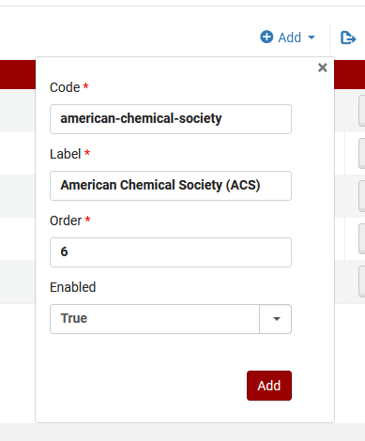
Adding New Citation Styles
Click “Add” to complete the set-up.

Slide 17
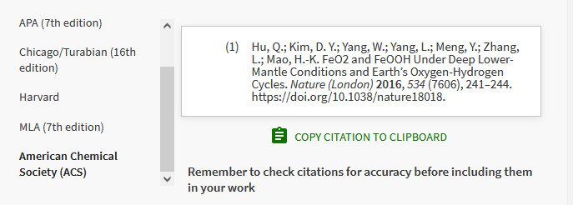
Adding New Citation Styles
Citation styles are active in Primo VE immediately after adding.
Perform a search in Primo VE to view and test your new citation style.

Slide 18
Thank you!
Aimee Walker, Joliet Junior College
Alice Creason, Lewis University

