Slide 1
I-Share Alma Primo VE Office hours will start shortly
Welcome!
Office Hours will start at 2pm and run until 3pm.
Please mute your microphone.
As time permits, we will respond to questions typed in the chat box, and offline afterwards, as needed.
This session will be recorded and made available on the CARLI website both as PDF slides and as a recording, with live links to all referenced resources.

Slide 2
Alma Primo VE Open Office Hours
May 12, 2022
“Lab Reports” on Primo VE
Notes:
Jen

Slide 3
Agenda Office Hours
Agenda – 5/12/2022
Announcements and Reminders
“Lab Reports” sessions:
Jodi Craiglow (TIU) – Creating a new titles list Collection
Aimee Walker (JOL) and Alice Creason (LEW) – Managing Citation styles and Adding citation options to Primo VE
Lori Thompson (SIM) – Resource Recommender in Primo VE

Slide 4
Announcements
Announcements/Reminders
  Upcoming Office Hours
  2022 Office Hours have been scheduled – 2nd Thursday of each month, 2pm-3pm.
  Next session: June 9, 2022
  Technical Services Q&A Sessions
  Scheduled for once a month from 10:30am-12:00pm
  Upcoming Dates: Thursday, May 26
  Registration open and available on the CARLI Calendar
Let’s Talk about Fulfillment (I mean Alma, not life’s purpose)
  Sessions are scheduled for every other week, alternating between Tuesday mornings at 10:30am and Friday afternoons at 2pm.
  Registration open and available on the CARLI Calendar
  NOTE: May 13 session is CANCELED. See you May 24!

Slide 5
Announcements
Announcements/Reminders
CARLI Instruction Committee: 10th Annual Instruction Showcase
  Friday, May 20, 9:30am-2:00pm
  Held virtually via Zoom
  Register via the event on the CARLI Calendar
  The CARLI Office will be closed on Monday, May 30 in observance of Memorial Day.

Slide 6
Announcements
Retirements at CARLI
  Kristine Hammerstrand, Director of CARLI User Services, is retiring at the end of May!
  Gordon Fellows, Assistant Director of CARLI System Services, is retiring at the end of June!
  Please add your voice to our celebration of their many accomplishments and contributions to our consortium by contributing a message, photo or video to our digital group card via Kudoboard.
  Kudos to Kris: https:/www.kudoboard.com/boards/3p0Nkfhy
  Kudos to Gordon: https:/www.kudoboard.com/boards/gfaxryHS

Slide 7
Reminders
Shared Document Depository
https://www.carli.illinois.edu/products-services/i-share/i-share-documentation/shared-documentation
The depository contains documentation submitted by CARLI member libraries for the benefit of the broader community.
  Workflow topics include: Acquisitions, Analytics, Cataloging, eResources, Fulfillment, Primo VE, SIS, Users and more.
  Note: The documentation is not peer-reviewed; it is up to those using the documentation to determine whether the information is still valid, accurate, and of use for their purpose.
Notes:
Why reinvent the wheel? Projects are easier to begin with some inspiration! Start your next local project by reviewing other libraries’ documentation first.
Over 50 shared documents from I-Share libraries!
And if you have local documentation to share, please do! It’s easy to submit via the link on the page.

Slide 8
Lab Reports
Jodi Craiglow (TIU) – Creating a new titles list Collection
Aimee Walker (JOL) and Alice Creason (LEW) – Managing Citation styles and Adding citation options to Primo VE
Lori Thompson (SIM) – Resource Recommender in Primo VE

Slide 9

Your Questions
Notes:
Please type any questions in the chat, or feel free to unmute to ask questions.

Slide 10
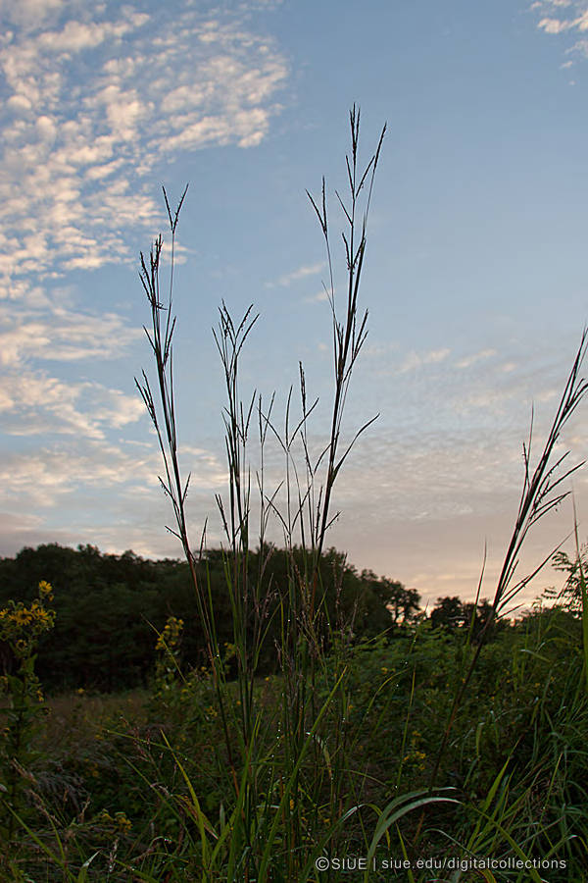
I-Share Alma Primo VE Office hours
Join us June 9
at 2pm for another
Office Hour session.
Contact CARLI at
support@carli.illinois.edu
POS1008170080, Big bluestem; Plants of SIUE (Southern Illinois University Edwardsville) https://collections.carli.illinois.edu/digital/collection/sie_plants/id/73/rec/11

