Slide 1
Technical Services Q&A will start shortly
The webinar will start at 10:30 am and run until noon. Please mute your microphone and webcam. As time permits, we will respond to questions typed in the chat box, and offline afterwards, as needed.
This session will be recorded and made available on the CARLI website both as PDF slides and as a recording, with live links to all referenced resources.
Welcome!
Today’s slides: https://www.carli.illinois.edu/tech-services-qa-4
Past webinars: https://go.illinois.edu/CARLItsqa

Slide 2
Tech Services Q&A 4/28/2021 Timely Acquisitions Topics

Slide 3
Today’s Agenda
Implementing Acquisitions in Alma series
Brief Fiscal Period Rollover refresher
Q&A
Reminders:
ELUNA virtual conference coming up in May
Registration is required for access to the recorded sessions
Next Alma Monthly Release is May 1
Release schedule changes to quarterly after this
CARLI Surveys are still open
I-Share Alma/Primo VE Confidence Survey
CARLI Technical Services Committee Cataloging Survey
Today’s slides available on the event page:
https://www.carli.illinois.edu/tech-services-qa-4
Notes:
https://go.illinois.edu/CARLItsqa
https://knowledge.exlibrisgroup.com/Alma/Training/Webinars/Implementing_Acquisitions_in_Alma
https://knowledge.exlibrisgroup.com/Alma/Release_Notes/Release_and_Maintenance_Schedule
https://knowledge.exlibrisgroup.com/Alma/Release_Notes/2022/May_2022
https://www.surveymonkey.com/r/almaconfidencesurvey
https://www.surveymonkey.com/r/TSCcataloging

Slide 4
Implementing Acquisitions in Alma
Webinar series of six parts, focusing on basic acquisitions in an IZ
https://knowledge.exlibrisgroup.com/Alma/Training/Webinars/Implementing_Acquisitions_in_Alma
April 28: Automating the Acquisitions Process and Upcoming Improvements to the PO Line
Automate tasks in part or in full
Order in Alma and send EDI order to vendor
Order in vendor and send EOD records to Alma
Receive vendor invoices via EDI into Alma
Send/receive claims via email or EDI
Finance integration with your campus ERP (e.g., Banner)
Alma may do both one-way (Alma -> ERP) or two-way if ERP cooperates
Requires you to coordinate with your campus IT.
Roadmap, Improvements to PO Lines
Notes:
https://knowledge.exlibrisgroup.com/Alma/Product_Materials/010Roadmap/Alma_Roadmap_Highlights_-_January_-_2022/Acquisitions

Slide 5
Questions
Q&A on Implementing Acquisitions + Automating + PO Line Improvements
Has anyone connected Alma with the campus ERP yet?

Slide 6
Introduction to fiscal period close
What is Fiscal Period Close and What does it Accomplish in Alma?
Multi-step process that creates new Fiscal Period, Copies Ledger Structure, and Copies Open POLs to that new Fiscal Period/Ledger Structure.
Why Bother?
In Alma Fiscal Periods are set on a strict 365 (or 366) day year.
Fiscal Period Close/Rollover moves your ledger structure and open POLs to the next year.
Who does this?
In Alma you need the Fiscal Period Manager Role
You may ask CARLI staff to run these jobs
You are responsible for the data
Notes:
For a broad stroke overview let’s take a step back… In Alma the Fiscal Period Close or Rollover (I tend to use these two words interchangeably as a holdover from Voyager, and honestly to refer to the process as a Rollover is a bit more accurate, you are moving your Ledger Structure from one fiscal period to the next). This process is broken down into several steps in Alma, so what are those steps and what do they accomplish? First of all the steps create a new fiscal period and copy your current ledger structure into that new fiscal period. Once that is complete the next step is to copy your open Purchase order lines into the new Fiscal Period/ledger structure.
Why do we bother with this?
In Alma fiscal periods are strictly a year long, 365 or 366 days. We learned at our migration last year we can set up GRACE PERIODS to allow us to use our Ledgers longer than our Fiscal Periods if needed. The Fiscal Period Close activities moves your ledger structure to a new fiscal period and any open POLs (In particular those continuations you want to to use year after year) to the next year.
Who does this?
In Alma you need the Fiscal Period Manager Role to accomplish these tasks.

Slide 7
fiscal period close Process Overview
Run ledger and fund rollover in DRAFT mode.
Required to create new fiscal period in Alma
Preview how current structure and allocations will roll
Change status of new ledger from Draft to Active
Alternatives exist here
Run PO Line rollover in REPORT mode.
Identifies which PO lines are “open” and eligible to roll
Identifies which transactions will roll into new ledger
Run PO Line rollover in active mode

Slide 8
Ledger Rollover
Manual job that copies current fiscal period with all summary details and allocated funds to new fiscal period which is created as part of the job.
Run in DRAFT MODE in order to edit Fiscal Period Name
New ledger and funds are also editable, use caution
Create Allocation From options
None – new funds have $0.00 as starting allocation
Current Allocation – new funds start with the active allocation of existing fund
Cash Balance – new funds start with any remaining money from existing fund
Current Allocation + Cash Balance
Notes:
Ok, back to the process in Alma specifically. Let’s talk about the first step… The Ledger Rollover.
As part of the fiscal period closure, the Ledger Manager runs a manual job (meaning it cannot be scheduled to run at a specific time). This job creates a new fiscal period, then copies the ledger of the current fiscal period with all the summary details and allocated funds to the new fiscal period,. No changes to the ledger or allocations are made during this process.
It is important to run this job in DRAFT Mode so you can edit the Fiscal Period Name which will initially be named the dates that encompass the Fiscal year – as shown here.
Rolling over ledgers is performed on the Rollover Ledgers page (Acquisitions > Advanced Tools > Rollover Ledgers)

Slide 9
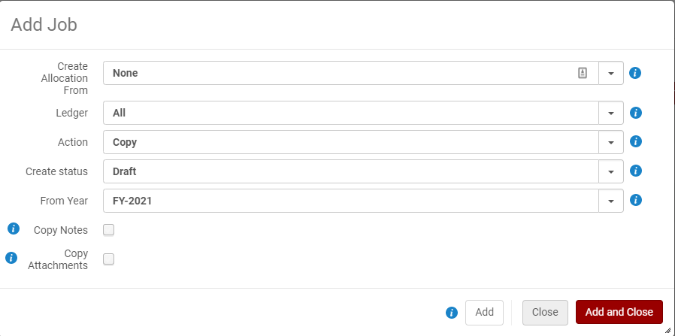
Ledger Rollover, continued
To Run Ledger Rollover:
Acquisitions > Advanced Tools > Rollover Ledgers
Notes:
OK, I’ll do this live, but here is a screenshot of the add job for ledger rollover. And a very important Note: When you click Add, or Add and Close: That starts the Job process. It doesn’t add it to a list to then start. It kicks it off, so be sure your ready to roll (literally and figuratively) ;)
<<GO TO ALMA RMC SANDBOX>>
Login >> Navigate to Acq > Advanced Tools > Rollover Ledgers.
Any Previous run of the job will be listed here. Click “Add Job” to be presented with the Add Job screen.
You have a number of choices to make now.
Create Allocation From:
Allocation Balance - The allocated funds are copied with their allocations to the new ledger for the new fiscal period.
None - No allocations are created for the new fiscal period. This means you can enter the allocations when you find out your budget numbers. Start with a Zero budget.
Cash Balance - The cash balance of the ledger fund populates the allocation balance in the new fiscal period.
Both - The cash balance of the ledger fund and the allocated balance are both added to the allocation balance for the new fiscal period.
Ledger: Select the Ledger you want to Roll. IF you select ALL even draft or inactive ledgers in the fiscal year will be rolled, so you are better off selecting the actual ledger you wish to roll. Additionally if you have ledgers that have modifications that are different depending on the type of funds managed in them they should be rolled separately, for example:
if your operating budget ledger should start next year with the same allocations, but your gift and endowed funds should only start with whatever money is left from this year, those ledgers should be rolled separately.
Action: Copy or Delete. Generally speaking you will select COPY here.
FPC (%) : This field appears only if you select Yes in the Create allocation field and Copy in the Action field. The increase/decrease percentage of the new allocated funds when they are copied from the source ledger. If no percentage is entered, the value defaults to 0%.
Create Status: DRAFT – as noted we need to create this in Draft form so we can edit the Fiscal Period Name, also, Draft is always a good choice when we’re learning new processes
From Year: Select the Current Year to Roll .
Copy Notes: Check these options to copy any notes and attachments during the Rollover.
Copy Attachments:
Note: any settings, including Rules regarding encumbrances and Grace periods are copied when the ledger is copied.
Review Reports. The reports show any problems in the creation of your new ledger.
Rename Fiscal Year in Configuration > Acquisitions > General >Fund and Ledger Fiscal Period. In order to keep things standardized this is where we’ll go in and rename our Fiscal Year to match the formats of previous fiscal years.
Since we rolled the Ledger in DRAFT mode, when we are ready to roll our POLs we will need to ACTIVATE the Ledgers and funds.
Go to Acquisitions > Acquisitions Infrastructure >Funds and Ledgers
Clear the Facets and find the New Fiscal Year – Select it and then Select the Ledger, Click ACTIVATE. This will activate the Ledger and all subordinate Funds.
You must have an active Ledger/Fund structure to Roll the POLs

Slide 10

Fiscal Period Update
Alma creates a new fiscal period that needs editing
Alma will always create a 365-day fiscal period
The name may not follow your existing conventions
To Rename Fiscal Period:
Configuration > Acquisitions > General > Fund and Ledger Fiscal Period
Edit the fiscal period name
Make sure the fiscal period is Active
Click Save
Notes:
We’re doing all of this first so that we can more easily find the new ledger in Alma searches. Remember that Alma’s default behavior on ledger and fund searches is to show the current fiscal period and active ledgers only.

Slide 11
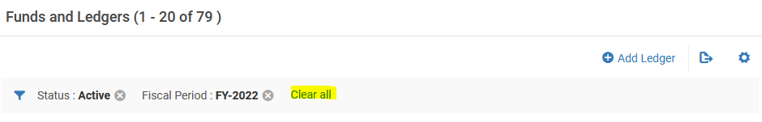
Reviewing Draft Ledgers
Alma:
Acquisitions > Acquisitions Infrastructure > Funds and Ledgers
Click Clear All on the filter bar
Select new fiscal period and ledger from facets on left
What to check:
Did new allocations get created according to parameters?
Are the correct funds created?
Funds you added
Funds you disabled

Slide 12
Activating Ledgers
New ledger must be active to receive transactions
Do not run the Rollover Ledger job again.
Go to the top level of the ledger
Click Activate
Unless you don’t want to use this draft
To delete a draft ledger, start the rollover job again
Acquisitions > Advanced Tools > Rollover Ledgers
Select Delete as the action

Slide 13
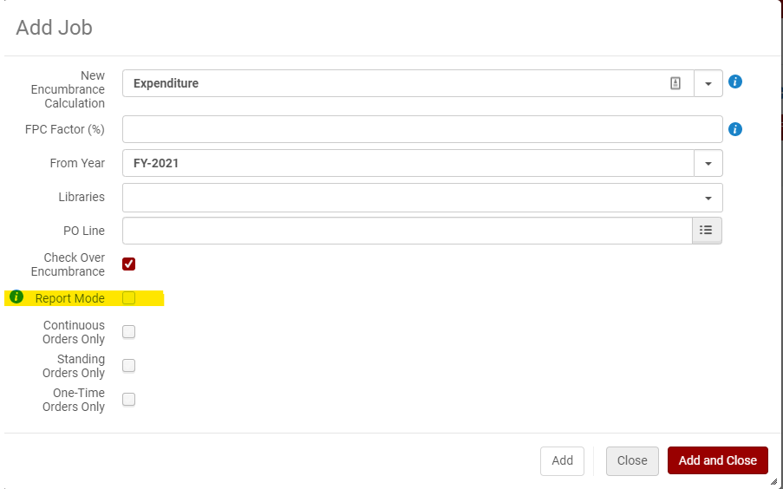
Rollover PO LInes
To Run PO Line rollover:
Acquisitions > Advanced Tools > Rollover PO Lines
Notes:
OK, let’s talk a little about rolling PO Lines.
This job can also be found in Acquisitions > Advanced Tools > Rollover PO Lines
Once your Ledger & Funds are set up and Active you can use this in REPORT MODE to check and see WHAT POLs will be rolled – in the same manner you would have used the Open Orders Report in Voyager. There appear to be some shared Analytics reports to find Open Reports as well – For One-Time Orders Alma is looking for lines that are ordered but not yet invoiced. However, the nice thing about the Rollover PO lines job is that you can use it as a “Open Orders Report” AS LONG AS YOU CHECK REPORT MODE! ☺
Let’s take a look at how that would work.
As with the Ledger Rollover Job you are presented with a number of options on the Add Job screen, again, Add and Add and Close will Run the job, not just add the job to a queue.
New encumbrance calculation
The way to calculate the encumbrances in the new fiscal period. When working with continuous PO lines, you can base this calculation on:
Encumbrance – Adds all the encumbrances and moves them to the new fiscal period (plus or minus the FPC factor %). Alma then runs the dis-encumbrance on the entire expenditure.
Expenditure – Calculation is based on the sum of all expenditures related to the fiscal period (plus or minus the FPC factor). The encumbrance is relative for each fund. If this option is selected and the PO line does not have expenditures, calculation is instead based on encumbrance.
Calculation for one-time PO lines is always based on Encumbrance, but the FPC factor % is not calculated.
FPC factor (%) The increase/decrease percentage of the encumbrance when the PO lines are copied to the new fiscal period. If no percentage is entered, the value defaults to 0%. This FPC factor is designed to help with continuation line increase “expectations” – you do not have to use it, but it can help encumberance expectations.
From year The year from which to copy the PO line. Select from the current or previous fiscal period.
Libraries A library or libraries for which the PO line rollover is to take effect. If you do not select a value in this field, rollover is performed for the entire institution.
PO Line You can select a single PO line. If you do not, all PO lines are rolled over. Check over encumbrance Whether to ensure that checking over-encumbrance rules of the fund/ledger are performed. Clear this option if you do not want over-encumbrance rules to be checked, If you chose no allocations for your funds and have not yet allocated funds be sure to uncheck Over encumbrance.
Report mode This option will show any errors and what lines will roll.
Continuous Order Only –
Standing Order Only
One-Time Order Only
If none of these options are selected, or if all of them are selected, then encumbrances for all PO lines types are rolled over. Otherwise, only the selected type/types are rolled over.
I think it is useful to run each type of order separately especially in Report Mode to see what orders are going to roll, particularly for One-Time Orders.
Once you roll each order type you can view download the reports and see what will roll-over and any problems with current POLs.

Slide 14
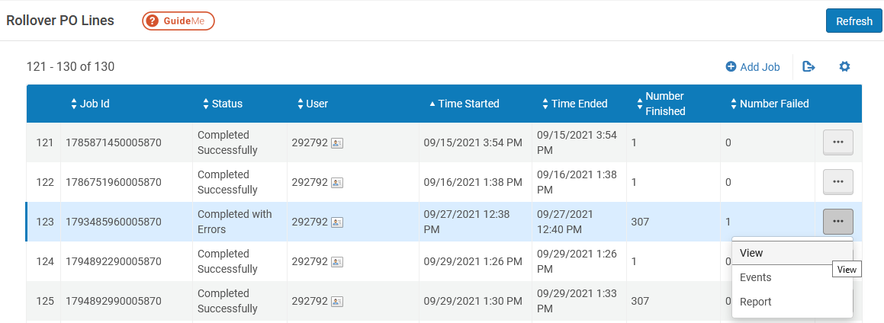
Reports from Rollover PO Lines
Rollover reports appear on the jobs page
Locate the job, click the actions menu, then View.
Notes:
All the reports from previously run Report mode and actual Rollovers appear at the Add Job Screen. Under the “More Actions” menu you can see the options: View, Events & Report.
View: Gives an overview of the results.
Job Events: Counts of successes and Issues. Clicking each one will show a POL list. This is very useful in Report mode as you can download the list to address any issues (POLs you may want to invoice before rollover, etc)
Counters: shows your selections for the rollover job
Report table: counts the number of POL types for the job
Events & Report: Provides a more detailed look at what happened with each POL. When everything goes OK this section is less interesting, but if there are issues it can be useful to download the Excel format and view there.
(yes these do the same thing).

Slide 15
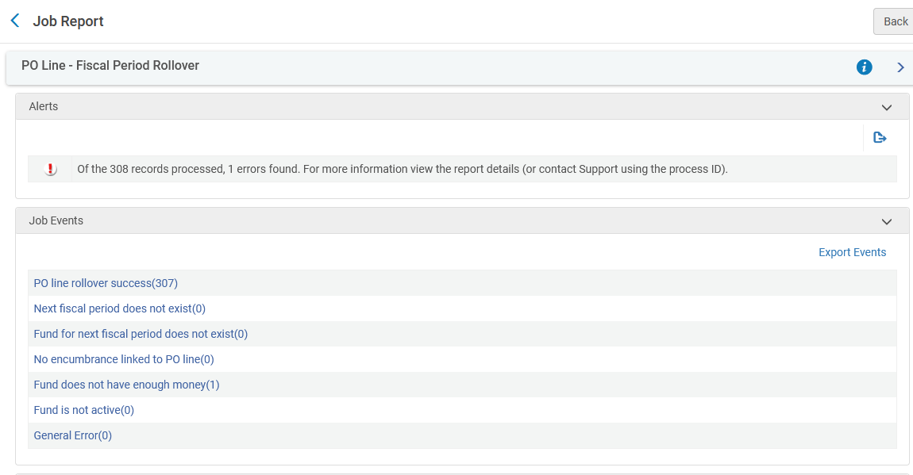
Reports from Rollover PO Lines, details
The job view is the most interesting option
Alerts: Any issues encountered and the number of them
Job Events: Links to lists of rolled PO lines or POLs with issues
Counters: The parameters for the job and numbers of POLs that would succeed or fail to roll.
Notes:
All the reports from previously run Report mode and actual Rollovers appear at the Add Job Screen. Under the “More Actions” menu you can see the options: View, Events & Report.
View: Gives an overview of the results.
Job Events: Counts of successes and Issues. Clicking each one will show a POL list. This is very useful in Report mode as you can download the list to address any issues (POLs you may want to invoice before rollover, etc)
Counters: shows your selections for the rollover job
Report table: counts the number of POL types for the job
Events & Report: Provides a more detailed look at what happened with each POL. When everything goes OK this section is less interesting, but if there are issues it can be useful to download the Excel format and view there.
(yes these do the same thing).

Slide 16
Evaluating PO Line Rollover
You may run PO line rollover in Report mode as much as you want
Look for PO lines that should be closed
Look for PO lines that should be open and rolled, but aren’t rolled
Check encumbrances to be recalculated correctly
Clean these PO lines up: follow-up with vendor, cancel orders, etc.
When you are ready and the timing is appropriate, run the PO Line rollover job without report mode
Close to your actual fiscal period cutover
After you’ve resolved as many inconsistencies as possible
Within the grace periods for both new and old ledgers

Slide 17
Resources for Fiscal Period Close
Interactive lesson from Ex Libris:
http://exl-edu.com/01_Alma/Extended%20Training/Fiscal_Period_Closure/#/
Fiscal Period Closure Documentation from Ex Libris:
https://knowledge.exlibrisgroup.com/Alma/Product_Documentation/010Alma_Online_Help_(English)/020Acquisitions/100Advanced_Tools/020Fiscal_Period_Closure

Slide 18
Questions & Answers
Is there an analytics report that we can use to review open POLs before we run the Report mode to clean them up?
"Ex Libris - Orders sent within the last year and not marked as invoiced in Alma".
Shared Folders/Community/Reports/Shared Reports/Reports/Acquisitions - Misc Reports/Open Orders - Various Iterations
If I do have a fund code that I want to change for next year, is it OK to do it if I know all orders with the previous code have been received?
Yes. Be aware that anything left over might need manual updating.
I know we touched on this, but if we don't use Acquisitions would we still configure the fiscal year?Under configurations-acquistions-fund and ledger fiscal period for analytics purposes?
CARLI staff will check on this.

Slide 19
Questions & Answers, part 2
We have a number of standing order and subscription items that haven't been received in Alma yet. Does that all have to be done before rollover?
Standing orders and continuations are rollable because of their PO line types, receiving is not as connected to rollover status as might be for one-time orders.
Not related to rollover, but we have started seeing French language subject headings added by OCLC in our bib records/search results. We haven't been deleting them but are concerned they will confuse patrons (esp. those using screen readers). We've considered looking to see if we can configure Primo VE to not display the 650 _ 6 fields, but wanted to ask 1st: does CARLI have recommendations on how to deal with these?
Don’t delete access points
Do – if you want – modify PVE record display to exclude these values.

Slide 20
Questions & Answers, part 3
Does anyone have a procedure for processing claims for periodicals, without having publication patterns set up?
Claiming is less robust in Alma without publication patterns and prediction.
Good question for additional follow-up. (Alma-L, Techsig, etc.)
I have been looking at the DARA suggestions and noticed a bunch of things related to our record cleanup. Have any suggestions been made for how to use that to do record cleanup?
CARLI is starting to work on P2E record recommendations

