Slide 1
I-Share Alma Primo VE Office hours will start shortly
Welcome!
Office Hours will start at 2pm and run until 3pm.
Please mute your microphone.
As time permits, we will respond to questions typed in the chat box, and offline afterwards, as needed.
This session will be recorded and made available on the CARLI website both as PDF slides and as a recording, with live links to all referenced resources.

Slide 2
Alma Primo VE Open Office Hours
April 14, 2022
Setting up and Using SUSHI in Alma
Presentation by the E-Resources Management Task Force
Notes:
Jen

Slide 3
Agenda Office Hours
Agenda – 4/14/2022
Announcements & Reminders
Setting up and Using SUSHI in Alma
  Q&A

Slide 4
Announcements
Announcements/Reminders
  Upcoming Office Hours
  2022 Office Hours have been scheduled – 2nd Thursday of each month, 2pm-3pm.
  May 12 – "Lab Reports" - ideas and solutions from your I-Share colleagues.
  Technical Services Q&A Sessions
  Scheduled for once a month from 10:30am-12:00pm
  Upcoming Dates: April 28 and May 26
  Registration open and available on the CARLI Calendar
Let’s Talk about Fulfillment (I mean Alma, not life’s purpose)
  Sessions are scheduled for every other week, alternating between Tuesday mornings at 10:30am and Friday afternoons at 2pm.
  Registration open and available on the CARLI Calendar

Slide 5
Announcements
Announcements/Reminders
Volunteer to Serve on a CARLI Committee! https://www.carli.illinois.edu/wanted-carli-committee-volunteers
  The application period closes May 4
  Thank you to those who have already volunteered
We want to hear from you! Fill out the Alma/Primo Use Survey. https://www.surveymonkey.com/r/almaconfidencesurvey
  The survey closes May 2
  Thank you to those of you who have already responded!

Slide 6
E-resources Management Task Force
Amy Fry | University of Illinois at Urbana-Champaign
Aaron Harwig* | College of DuPage
Andrea Imre** | Southern Illinois University Carbondale
Rachel Park | Illinois State University
Sara Rizzo* | National Louis University
Megan Ruenz** | Wheaton College
Cynthia Scott** | North Central College
Lisa Wallis** | Northeastern Illinois University
* Task Force Co-chairs
** Task Force contributors to this presentation
Notes:
I’d like to just take a minute to thank the members of the Electronic resources Management Task force, listed here.
In Particular the members of the Analytics subcommittee who worked on this presentation and associated documentation: Andrea Imre, Megan Ruenz, Cindy Scott and Lisa Wallis. Also, my CARLI colleagues who serve as liaisons to the task force with me: Denise Green and Nicole Ream-Sotomayor.
If you would like to serve on the newly minted E-Resources Management Committee please volunteer on the form mentioned on the previous slide.

Slide 7
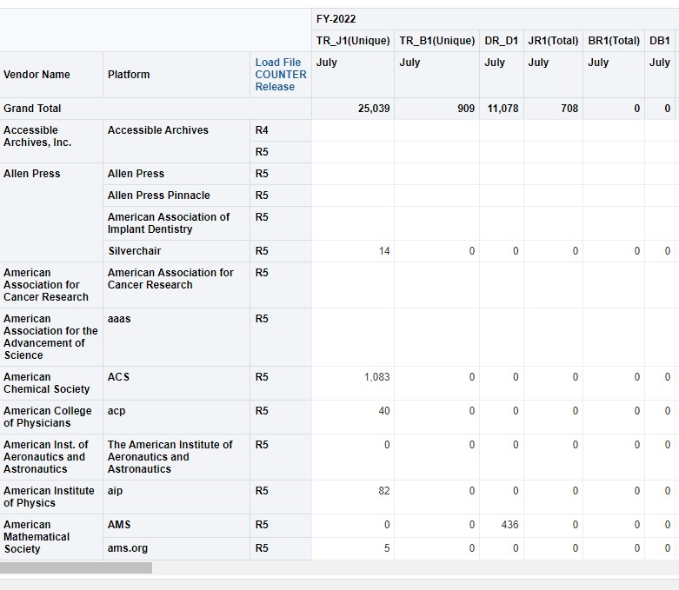
WHY SET UP SUSHI IN ALMA ??
It replaces the time-consuming user-mediated collection of COUNTER usage data reports and spreadsheet downloads.
SUSHI protocol provides automated harvesting of e-resource usage data.
Setting up SUSHI harvesting in Alma provides for reporting in Analytics:
  Analytics usage reports for IPEDs and ACRL
  Analytics usage reports for Institutional Annual Reports
  Analytics cost per use analysis (if using Alma Acquisitions)
Moving SUSHI harvesting (and statistical data) from other systems to centralize your ERM activity (if applicable).
Notes:
Let’s get started by talking about the Why! Why should we take the time to set up SUSHI harvesting in Alma? Setting up the automated harvesting of your COUNTER data replaces the time consuming user-mediated collection of those COUNTER usage data reports and spreadsheet downloads.
The SUSHI (Standardized Usage Statistics Harvesting Initiative) Protocol provides automated harvest of the reports you have set up to harvest. You can then use that data to run Analytics for your IPEDS and ACRL reports, for any institutional annual reports, and even get cost per use data if you have set up alma acquisitions.
<Float in snippit of report> Here is an example of a report in Analytics, All of this data is prepopulated, Depending on the vendors you’ve set up SUSHI for, and the COUNTER reports you’ve loaded. The process of setting up your SUSHI connections and accessing the data in Analytics will be discussed in today’s presentation.

Slide 8
OVERVIEW
Alma Roles
Setting up a SUSHI Subscriber
Setting up Vendor records
Adding SUSHI accounts on vendor records and testing SUSHI connections
Harvesting usage data
Running reports via Alma Analytics
See ExLibris Documentation:
https://knowledge.exlibrisgroup.com/Alma/Product_Documentation/010Alma_Online_Help_(English)/020Acquisitions/090Acquisitions_Infrastructure/010Managing_Vendors/Managing_COUNTER-Compliant_Usage_Data
Notes:
We’ll start by reviewing the alma roles needed for this process, then walk through each step needed to set up a SUSHI connection.
You’ll need to set up a SUSHI subscriber
You’ll need a vendor record for each vendor you wish to harvest SUSHI data for
On the vendor record you will add SUSHI account information, and test the connection.
Once the testing is complete you can harvest usage data
Finally you can use that data to run reports in Alma Analytics!
Let’s get started.

Slide 9
Setting up SUSHI Connections - ROLES
Acquisitions Administrator - Configure COUNTER subscribers and activate, deactivate, or manually run the automatic harvesting job.
Vendor Manager - View usage data related to a particular vendor, manually harvest data for the vendor, manually upload data for the vendor, and manage any uploaded data files.
Usage Data Operator - Manually upload or delete data for any vendor, manage the uploaded data files, and view missing COUNTER data.
General System Administrator - Activate, deactivate, schedule, or monitor the automatic harvesting job, view the job's history, report, and events, and configure email notifications for the job.
Notes:
On this slide we have shared the various roles you may need to set up SUSHI harvesting. Ideally you will have all four roles but if you don’t have General System Administrator role the tasks that are done with that role are infrequent and can be done by whomever does have that role at your institution.

Slide 10
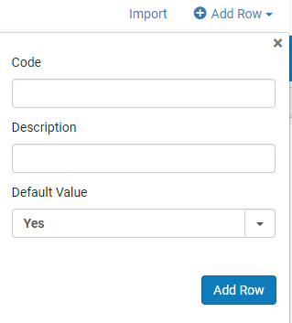
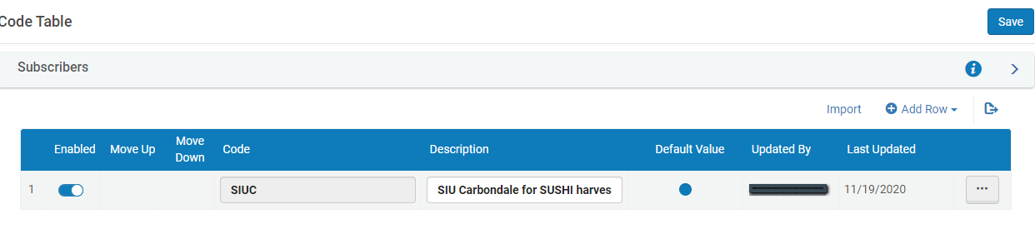
Setting up SUSHI Connections – CONFIGURE SUBSCRIBER(S)
Configuration Menu > Acquisitions > General > Subscribers Must configure at least one subscriber > click on Add a row
Notes:
The first step in setting up the SUSHI connection is to configure a subscriber for your institution. This needs to be done once, and typically an institution only needs one subscriber.
In Configuration > Acquisitions > General >Subscribers
Click Add Row and add the Code and description leave Default Value as “Yes”.
Select whatever code you desire here – your library’s 3 letter I-Share code, your “typical” initials, etc.
In this example you can see Southern Illinois U Carbondale selected the code SIUC; Description “SIC Carbondale for SUSHI harvest”

Slide 11
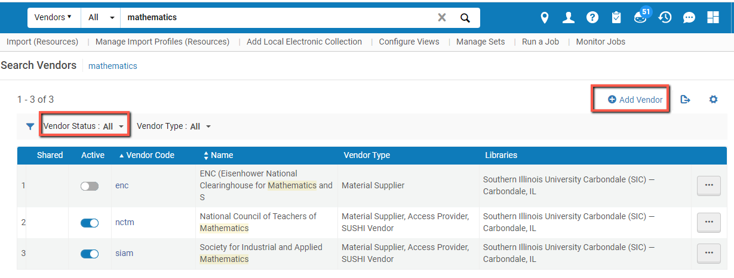
Setting up SUSHI Connections – VENDOR RECORDS
Must have a vendor record in Alma to set up SUSHI harvesting for that vendor
Search Alma Vendors with vendor status = All
If no vendor exists, click on Add vendor and create a new vendor for the publisher/platform.
Notes:
The next step in setting up your SUSHI connection is to set up / verify you have a vendor record for the vendor(s) you wish to harvest.
First check to see if you have a vendor. Search Alma for Vendor, Vendor Status All, and some part of the vendor Name.
If no vendor exists click on Add vendor and create a new vendor for the publisher/platform.
When adding a new vendor you Must select a Vendor Type, if you are setting up a new Vendor for SUSHI only select "Licensor" - if not planning on using acquisitions in the future.
For tracking future purchases (for Cost Per Use, etc) Best Practice suggests setting up as Access Provider and providing all details about the vendor.

Slide 12
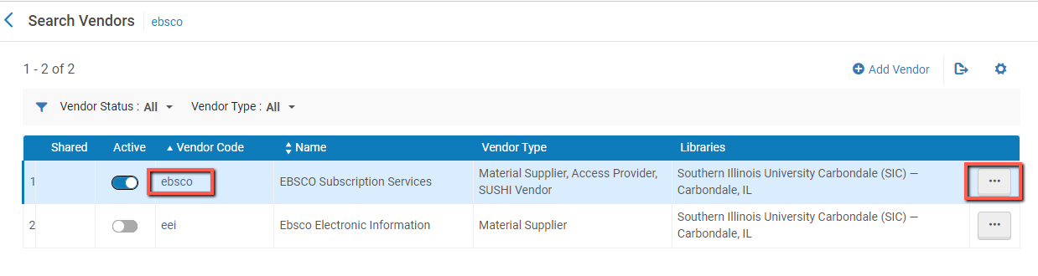
Setting up SUSHI Connections – VENDOR RECORDS
Edit Vendor record:
click on Vendor code OR
select Edit in the row actions list for the vendor
Notes:
If you are editing an existing vendor you can click on the vendor code or click the Row actions ellipsis and click Edit.

Slide 13
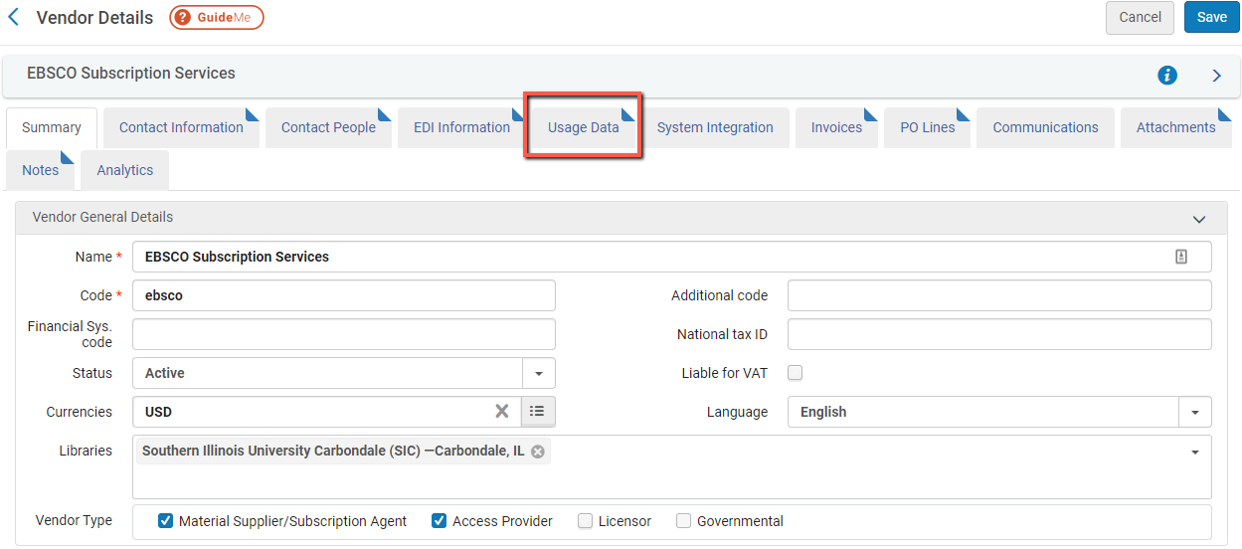
VENDOR RECORDS
Click on Vendor Details’ Usage Data Tab
Notes:
Once you have added a vendor or selected to edit an existing vendor click the Usage Data tab.

Slide 14
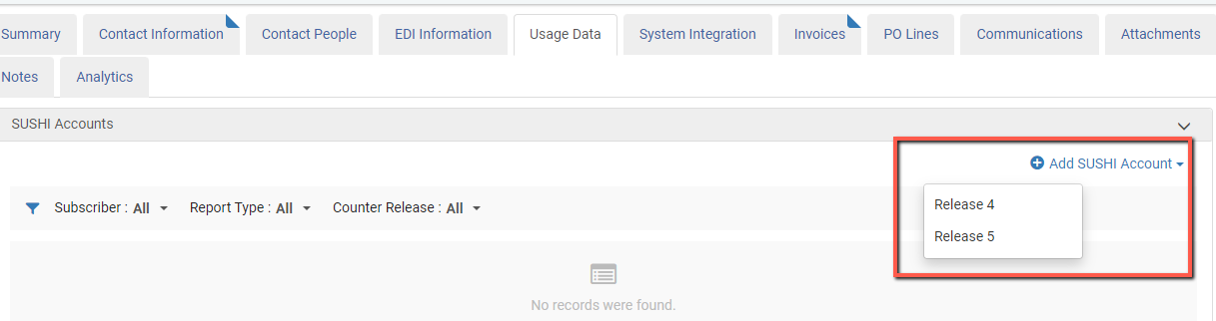
Add SUSHI ACCOUNT TO VENDOR RECORD
On Usage Data:
Click on Add SUSHI Account
Select Release 4 or Release 5
(Note: most vendors provide stats in COUNTER Release 5 and many have phased out provision of COUNTER Release 4)
Notes:
On the Usage data table click Add SUSHI account. At this point you need to know if your vendor will be providing release 4 or release 5 counter stats. Most vendors are providing COUNTER release 5 stats at this point, in addition to the credentials your vendor requires – which we’ll discuss on the next slide.

Slide 15
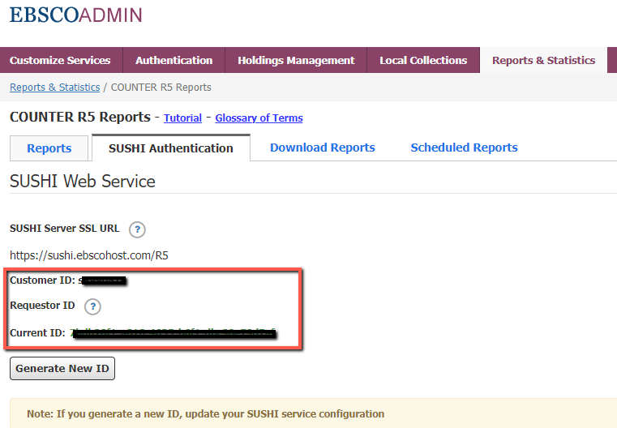
GET SUSHI CONNECTION INFO FROM VENDOR
Log into vendor admin account
Locate SUSHI Connection info, this example is for EBSCO
See https://www.carli.illinois.edu/products-services/i-share/electronic-res-man/sushicreds with information on finding SUSHI connection information for other platforms/vendors
Notes:
Once you are ready to set up your SUSHI connection in your vendor record you should find your vendor admin account and get the SUSHI Connection information. The ERMTF has put together a web page that lists common vendors and how to find their SUSHI credentials, as well as links to other helpful web pages on this topic.

Slide 16
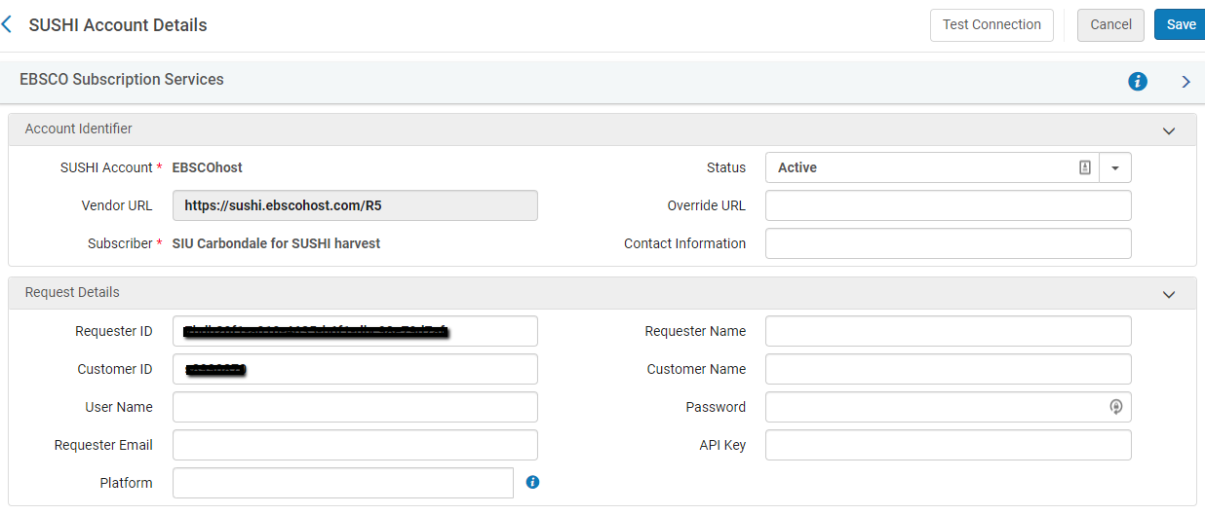
ADD SUSHI REQUEST DETAILS
Paste SUSHI Connection info on vendor’s Alma SUSHI Account Request Details
Connection details vary by vendor/platform. Most often used fields are:
Requester ID, Customer ID, and many also require an API Key.
!!! DO NOT FILL OUT FIELDS NOT REQUIRED BY VENDOR/PLATFORM !!!
Notes:
Paste your SUSHI Connection information from your vendor’s webpage into the Alma vendor record “Request Details “ section. Connection details vary by platform, but the vendor platform SUSHI connection information page should make it clear what credentials you need.
Be sure to ONLY fill in the information required – other information filled in the request details section can cause the connection to fail.
Save the information.

Slide 17
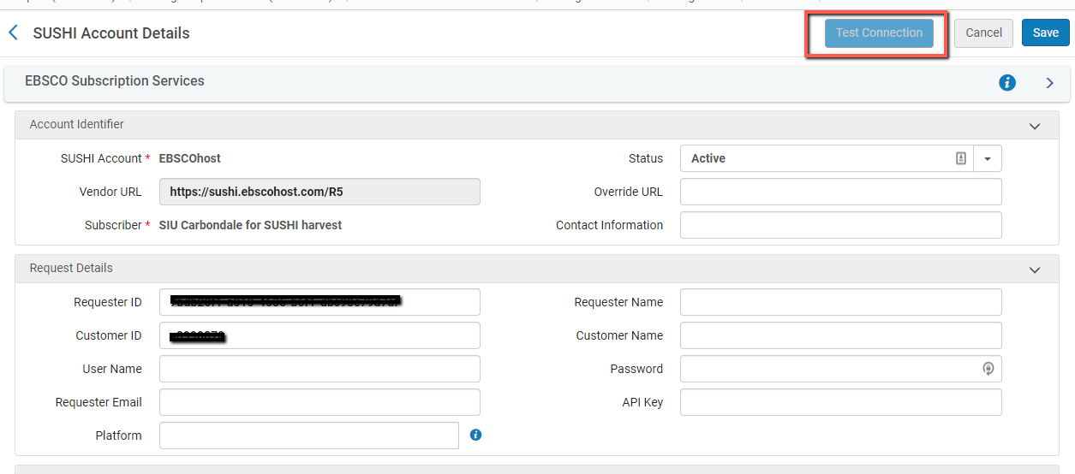
TEST SUSHI CONNECTION
Test SUSHI Connection
Notes:
Once you have entered your institutions credentials, Click to Test Connection.

Slide 18
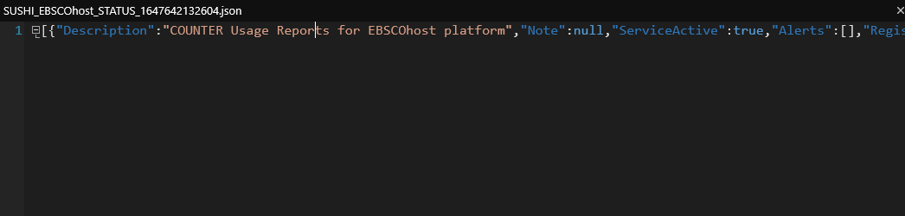
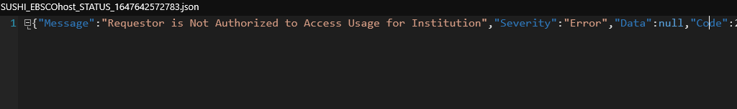
SUSHI CONNECTION MESSAGES
For Release 5, a JSON file is generated
Successful response includes: "Service_Active": true
Problem with SUSHI connection info results in an error. Check ExLibris documentation for troubleshooting tips, e.g. how to manually test the SUSHI request.
Notes:
For Counter Release 5 a JSON file is created to save locally. If you have not previously saved and opened a JSON file you will receive an error message if you attempt to simply open the file. You can open a text editor and browse to the file to open it, or open it using your web browser. I’ll demo this in a moment.
Successful tests will say Service Active: True
Errors often pop up directly in Alma OR may end up with an error such as this one in the JSON file “Requestor is not authorized to access usage for Institution”
Ex Libris has documentation we’ve shared here to troubleshoot these problems and manually test your SUSHI requests.

Slide 19
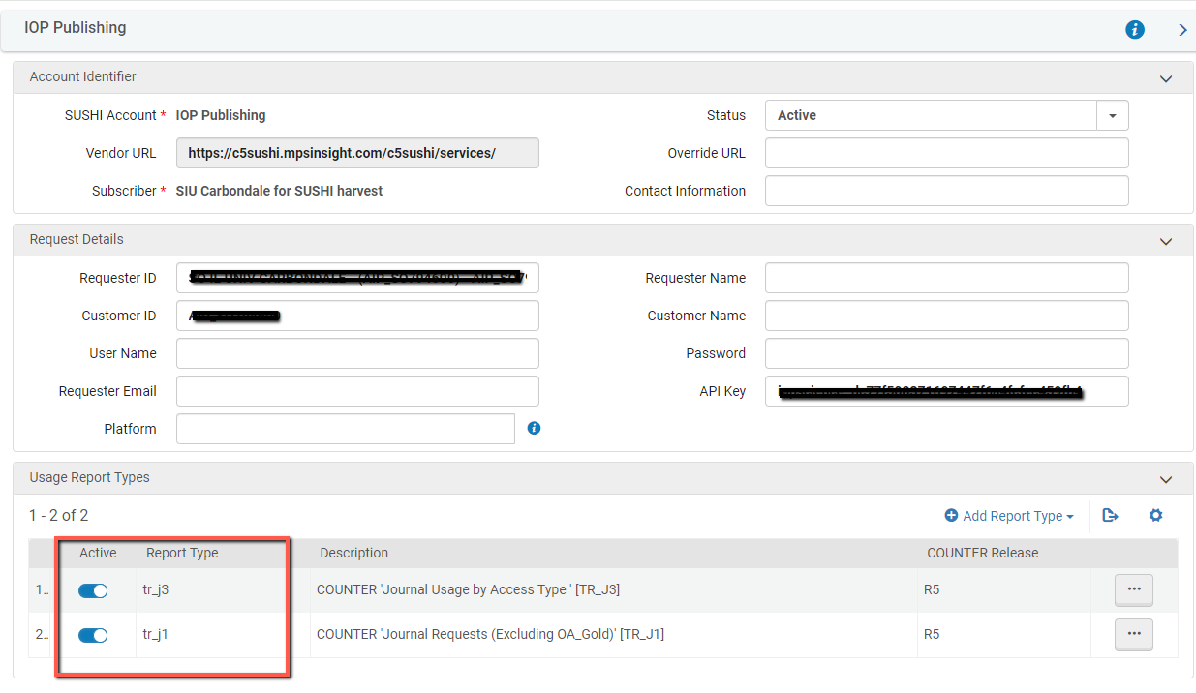
ADD REPORT TYPES
Add report types appropriate for each vendor/platform
https://knowledge.exlibrisgroup.com/Alma/Product_Documentation/010Alma_Online_Help_(English)/020Acquisitions/090Acquisitions_Infrastructure/010Managing_Vendors/Managing_COUNTER-Compliant_Usage_Data
Notes:
For this Vendor – note that three pieces of information were required for SUSHI connection.
Vendors will indicate what information they require.
Once you have successfully tested your SUSHI Connection you can Add the USAGE report types you want to harvest. Click Add Report type and a list of Counter Report types will pop up. If you are not familiar with the Counter Report types you can visit https://knowledge.exlibrisgroup.com/Alma/Product_Documentation/010Alma_Online_Help_(English)/020Acquisitions/090Acquisitions_Infrastructure/010Managing_Vendors/Managing_COUNTER-Compliant_Usage_Data
For more information.

Slide 20
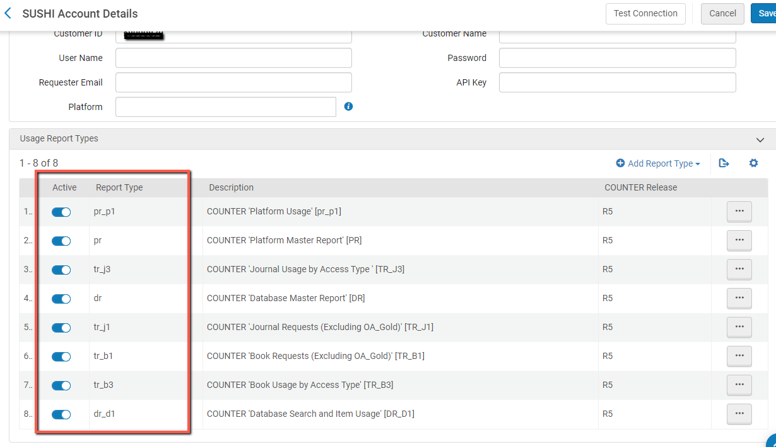
ADD REPORT TYPES
Add report types appropriate for vendor / platform
Notes:
In this example for EBSCO the institution has selected many more report types; so they are accessible and easily analyzed in Analytics via any report whenever they are needed.

Slide 21
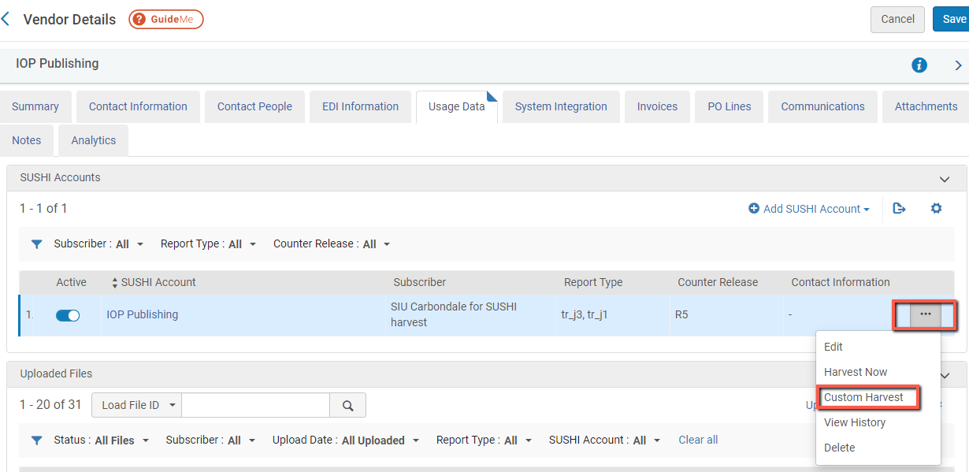
RUN SUSHI HARVEST
Go back to Vendor Details and in row actions select Custom Harvest > enter desired date range to harvest data
(Harvest now will only harvest most recent 12 months)
Notes:
Once you have added the Counter reports you want to harvest you Can choose to get as many stats as are available to start (I.e. since 2019). In the Vendor Details > Usage Data Tab > SUSHI Accounts > select more actions and choose Custom Harvest. Choosing since 2019, or since June 2020 (when we went live on Alma), will allow you to have a good backfile of counter stats.
After first harvest Alma will continue capturing data based on your schedule, based on recent month (only newest data is retrieved after first harvest).

Slide 22
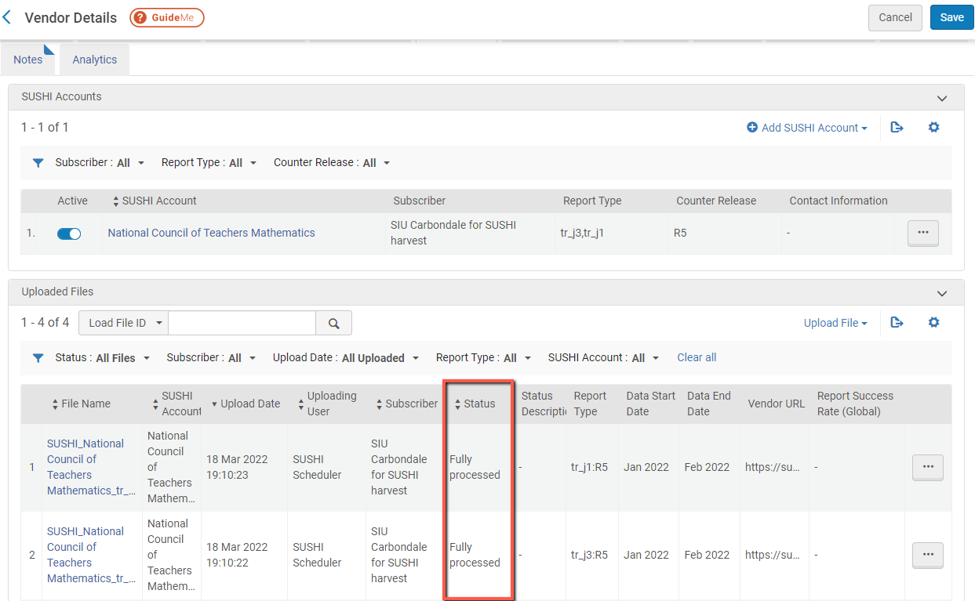
RUN SUSHI HARVEST
Check harvested data: example of successful harvests
Notes:
You can verify the Harvested data by looking under Vendor Details > Usage Data > and see the uploaded files section.

Slide 23
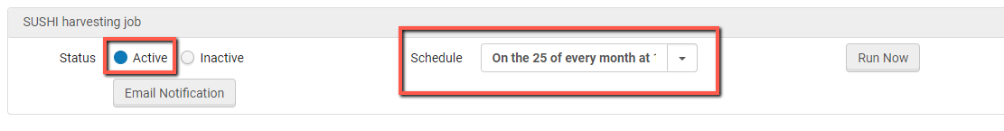
AUTOMATED HARVESTING
Set up automated harvests:
Go to Configuration Menu > Acquisitions > General > Acquisition Jobs Configuration
Set Status to Active
Select from 5 available Scheduling options
Set up email notifications to receive job reports in your mailbox
Notes:
Once you have harvested your “back dated” statistics you can set up your automated harvest. Go to Configuration > Acquisitions > General > Acquisitions Job Configuration.
Set Status to Active.
There are 5 available schedule options. Definitely adjust default Schedule to be a monthly schedule. It was the consensus on the ERMTF that choosing the 25th of each month would allow for those vendors who are slow to get their monthly status out (and result in fewer errors to check on the institutions end).
Email notifications especially important for errors, be sure to set up email notifications to those who are “in the know” about the process and the statistics.

Slide 24
Check SUSHI harvesting job REPORTS
Check job reports
Emailed reports with SUBJECT line “SUSHI harvesting job - Completed with Errors” if set up in configuration (See previous slide)
Reports via Alma > Admin > Manage jobs and sets > Monitor jobs > Scheduled > SUSHI harvesting job > job history from row actions
Check errors that may require you to fix problems, see common error messages and recommended actions at this web page:
https://www.carli.illinois.edu/products-services/i-share/electronic-res-man/sushierror
Notes:
Once you get regular harvesting set up you can check the job reports – either through the emailed reports as indicated on previous slides, and or on the Alma Admin >Manage Jobs and sets > Monitor Jobs > Scheduled> SUSHI Harvesting job > job history from row actions.
If there are errors you can review the common error messages and recommended actions at this new web page.

Slide 25
Accessing sample REPORTS FROM ALMA ANALYTICS
Shared Folders > Carli NETWORK 01CARLI_NETWORK >
E-Resource Usage Reports
  Electronic Usage by FY and Platform – COUNTER 4 and 5
  Electronic Usage by Month and Platform – COUNTER 4 and 5
  ACRL Q60 Total Digital/Electronic Collection Circulation or Usage
  ACRL Q63 eSerial Usage
  Cost Per Use for eBooks
Roles Required for Analytics:
  Design Analytics
  Analytics Administrator, or
  General System Administrator
**Make sure to follow the instructions to copy the reports to your institutions folder (https://www.carli.illinois.edu/products-services/i-share/alma-analytics/copy_reports) for further customization
***Usage data loaded into Alma will be available via Alma Analytics by the beginning of the following work day.

Slide 26
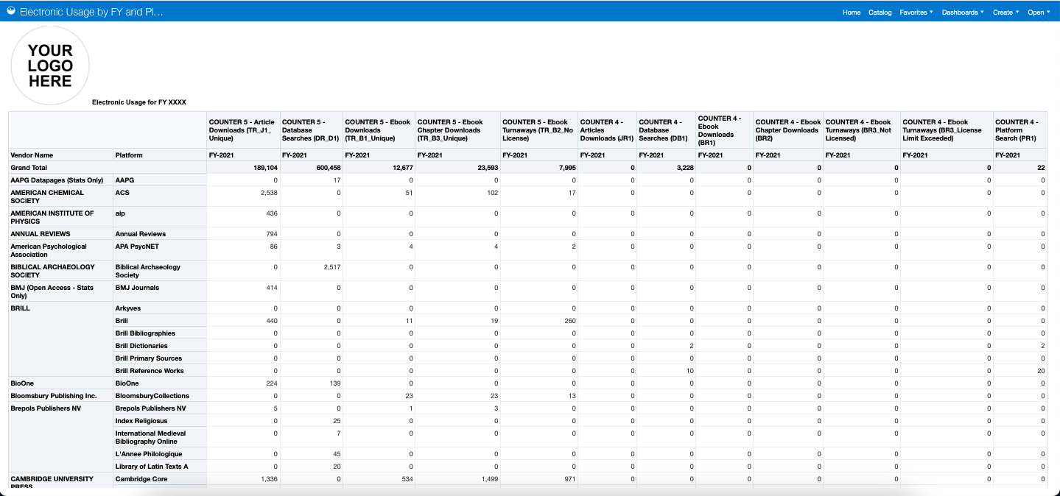
Sample REports Pulled from Alma ANALYTICS
Reports used to calculate annual statistics

Slide 27
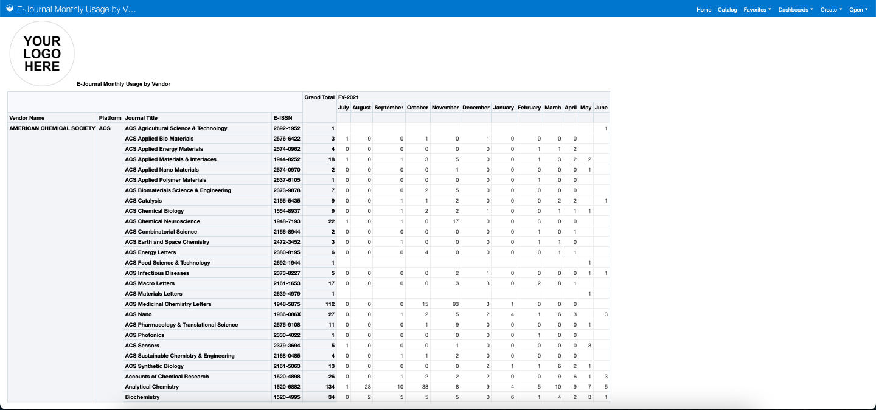
Sample REports Pulled from Alma analytics
Report to calculate monthly usage by title

Slide 28
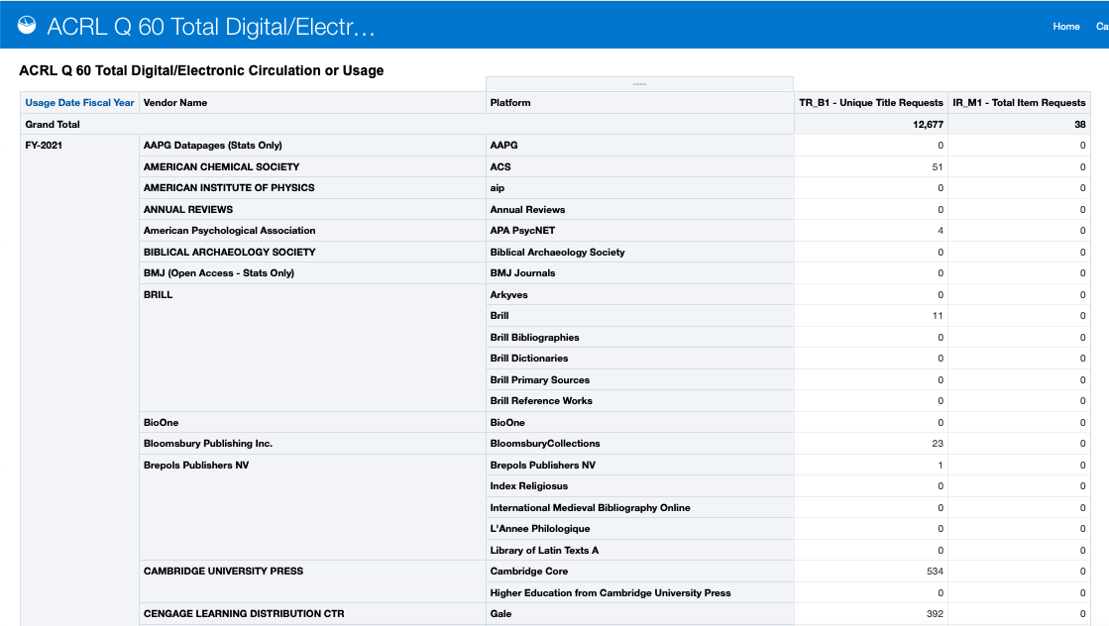
Sample REports Pulled from Alma analytics
Report to answer ACRL Questions (Q60 – Digital Lending)
Notes:
mention IPEDS

Slide 29
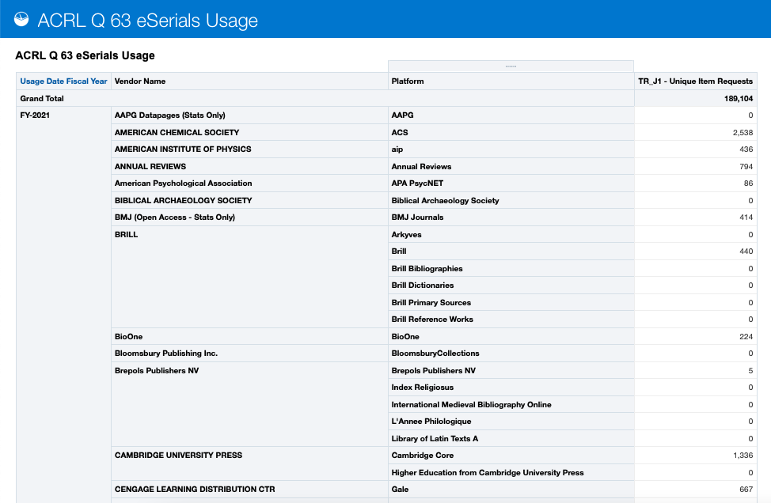
Sample REports Pulled from Alma analytics
Report to answer ACRL Questions (Q63)
Notes:
Mention IPEDS

Slide 30
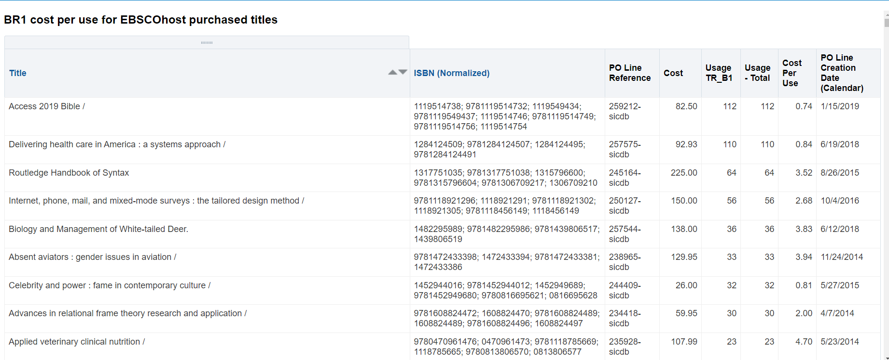
Sample REportS Pulled from Alma analytics
Report to calculate cost per use for e-books in a collection

Slide 31

Your Questions
Notes:
Please type any questions in the chat, or feel free to unmute to ask questions.

Slide 32
DEMO
Notes:
Test connection
Analytics

Slide 33
WRap-up
Assign Alma Roles​
Configure SUSHI Subscriber​
Set up Vendor records​
Add SUSHI accounts on vendor records and test SUSHI connections​
Create Automated Harvest job
Run reports via Alma Analytics​
Notes:
Setting up now and in summertime – ready for next years stats!
Take your time and get big vendors in. Double check your SUSHI accounts when you are checking other vendor settings.

Slide 34
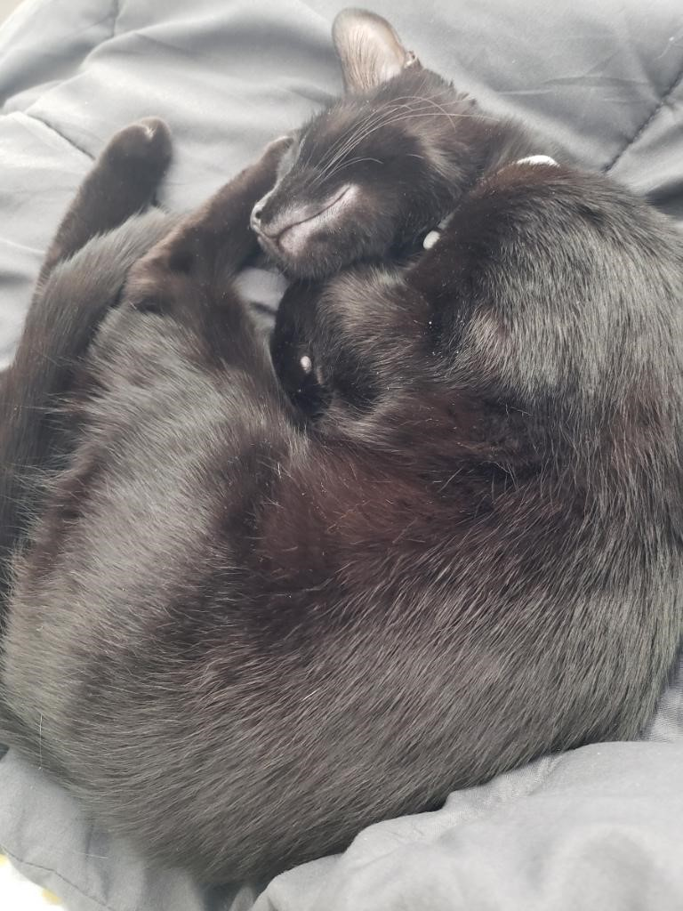
I-Share Alma Primo VE Office hours
Join us May 12
at 2pm for another
Office Hour:
“Lab Reports” from your CARLI Colleagues
Contact CARLI at
support@carli.Illinois.edu

