Slide 1
Digitization in Alma for CARLi I-Share
Digitization activities included in the CARLI I-Share contract:
Document delivery – Electronic resources are “digitally copied”
Digitization - Physical resources are scanned into digital form
The user who requested the material is emailed with:
  A file attachment of the requested material, or
  A link to the file online
No descriptive metadata or digital resources/representations are created or stored in Alma.
This digitization will be the topic of today’s discussion!
Notes:
There are two kinds of “Digitization” functionality in Alma. One is included in CARLI’s Alma contract, and one is not and actually requires an added subscription to the Alma Digital product which CARLI I-Share institutions do not have. We want to alert I-Share institutions to the difference between them so that you can be confident in your Digitization work.
The Fulfillment-related Digitization workflows listed here are included in the CARLI I-Share contract for Alma and Primo VE.
They do NOT require the creation of digital representations in Alma, and therefore do not require an Alma Digital subscription.
Document delivery – Electronic resources are ”digitally copied”
Digitization - Physical resources are scanned into digital form
In both cases, the user is emailed through Alma as a response to their Request, either with a file attachment or as a link to view the material online.
The key here is that no descriptive metadata records for digital resources--also known as digital representations--are created in Alma by these workflows.
This kind of Digitization will be the topic of discussion today!

Slide 2
Digitization Requiring Subscription to Alma Digital
Digitization activities that are not part of the CARLI I-Share contract and should not be performed in Alma:
Add Representation – The one-by-one addition of digital resources to Alma by staff.
Digital Uploader – The bulk upload of digital resources to Alma by staff.
Digitization – Physical resources are scanned and the digital resources are added to the Alma repository.
End user deposit of digital resources to Alma.
API-based creation of digital resources in Alma.
Harvesting of metadata from a remote digital asset management system into Alma. (Not to be confused with External Data Sources in Primo VE!)
Notes:
When digital resources are managed directly in Alma--either the metadata only or together with the digital object itself--as part of the Alma Repository, this requires a full subscription of Alma Digital.
The workflows described on this slide result in the creation of digital resources in Alma and should be avoided by I-Share institutions:
Add Representation – The one-by-one addition of digital resources by staff
Digital Uploader –the bulk upload of digital resources by staff
Digitization – Physical resources are scanned and the digital resources are added to the Alma repository.
End user deposit of digital resources into Alma.
API-based creation of digital resources in Alma.
Harvesting of metadata from a remote digital asset management system into Alma. Not to be confused with External Data Sources in Primo VE, which are something else entirely!

Slide 3
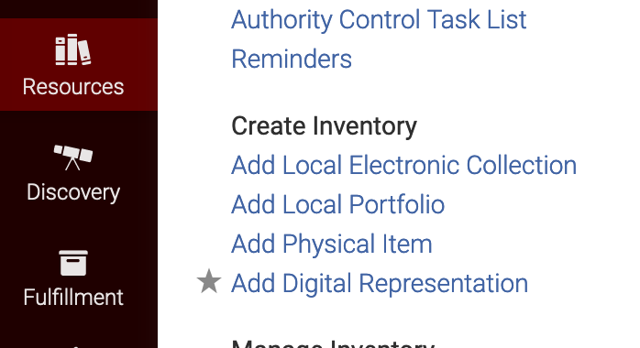
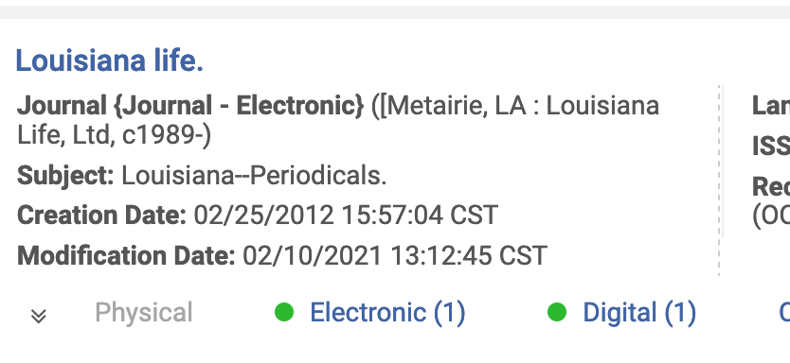
Digitization Requiring Subscription to Alma Digital
Digital Representations are not part of the CARLI I-Share contract and should not be used in Alma:
Notes:
Unfortunately, I-Share library staff users may be assigned the necessary roles for these Alma Digital workflows and may be able to perform these tasks in Alma without the Alma Digital subscription. CARLI has requested that Ex Libris block access to the roles and functions of Alma Digital in Alma without a subscription to Alma Digital, but at this time, it is currently not possible to disable these functions. Therefore, we want to educate I-Share institutions that these types of Digitization that should not be undertaken in Alma.
In Alma, with the proper roles, you may see an “Add Digital Representation” option in Resources > Create Inventory. A created Digital Representation will appear in the same holdings area in Alma search results that physical holdings and electronic holdings do.
If your institution has created any digital resources of this type in Alma, CARLI recommends that you do not create any more and contact support@carli.Illinois.edu as soon as possible so that we can investigate it further with you.

