Slide 1
I-Share Alma Primo VE Office hours will start shortly
Welcome!
Office Hours will start at 2pm and run until 3pm Please mute your microphone As time permits, we will respond to questions typed in the chat box, and offline afterwards, as needed
This session will be recorded and made available on the CARLI website both as PDF slides and as a recording, with live links to all referenced resources
Notes:
Start Recording before Going to the Next Slide

Slide 2
Today’s Agenda
SIS (Student Information System) Recap/Overview
Account Types and Data Requirements
S/FTP Definitions and Integration Profile Options
Managing Patron Expiration and Purge Dates
Importance of Designating a Preferred Address
Implications of Processing Full vs. Partial Extracts of Patrons
Troubleshooting a SIS Synchronization Job
Tips for Automating the Creation and SFTP of the XML File
Notes:
Good Afternoon! I’m Chris Saunders. I did an Office Hours presentation last year to introduce everyone to Alma’s SIS Integration. At this point, many Libraries have their synchronizations running and CARLI has been supporting this activity for months….So, collectively, we have all been moving along the learning curve. I want to highlight some things that CARLI has learned and would like to share. The look and feel of Alma has changed since my last presentation, so the screens I show and walkthroughs I do will reflect the current Alma experience.
To Start, I’ll quickly go over the basic concepts that were covered in my previous presentation.
Second, we will cover Alma’s account types and Data Requirements for SIS Synchronization.
Then, I’ll show you the 2 key screens in Alma where SIS Integration is defined: FTP Definitions and Integration Profile and explain how They can be adjusted to fit your needs.
Expiration Dates and Purge Dates are set through the SIS Synchronization and they are very important. I’ll talk about what CARLI considers best practices and what I’ve seen in practice in different Alma instances.
Designating at least one Address of a patron record is important for resource sharing and I will try to explain why.
Next, I’ll go over the implications of extracting a full set of patrons from your SIS on each run versus a targeted subset
Next, we will cover how to assess a synchronization job’s results and if something goes wrong, how to troubleshoot it.
Finally, I will share some ways to automate the XML file transfer to the CARLI FTP server

Slide 3
SIS Synchronization Recap/Overview
Institution
Institution
Convert file to XML and send to FTP server
Alma
Pull XML file from FTP server
Create file with updated patron data from Student Information System (SIS) and other data sources (ie. Payroll)
Alma
Integrate updated data into Alma
Notes:
I’ll start with a basic review of what SIS is. Many of you are familiar with this, but for those that aren’t, I want to give you the background so you can follow along later when we get deeper into the details….. SIS or S - I - S stands for Student Information System. It might be called Jenzabar or Banner or Colleague. There are many different kinds of SIS Software. A Student Information System is a local system that is the authoritative source for your patron data. Likely, your institution has already created a process that regularly extracts patron data from your SIS into an xml file that is sent to the CARLI FTP server. An Alma process called SIS Synchronization then runs to keep the patron data in Alma current.
This is a recycled slide, but it does a decent job of showing one iteration of the SIS Synchronization process from start to finish. Your institution creates a file that contains patron data from your Student Information System. The file may also contain patron data from a peripheral system like a Payroll or Enrollment software. That file then needs to be converted into an XML file that fits the CARLI and Ex Libris specification. Then the handoff occurs…the file is sent by the institution to an intermediary FTP server. Once the XML file is there, Alma can pick it up and process the file in your Alma instance to update the patron data.
One of the pieces that has to be in place on the Alma side for the synchronization to work is the SFTP definition which tells Alma where to look for the XML file.
Another key screen in Alma that is key to the synchronization is the on the Alma side is the Integration Profile. If your Alma login has the General Administrator role, then you can make changes to the Integration Profile.

Slide 4
Account Types and Data Requirements
Account Types:
Internal Users - Details are managed in Alma. They are created manually by library staff and updated only within Alma.
External Users - Stored and managed outside the library’s scope, usually in another system maintained by the institution (for example, in a Student Information System). These users’ information is loaded into Alma and is synchronized on a regular basis. It is possible to update an external user’s information manually in Alma, but these updates are overwritten by the next synchronization with the user information system.
Notes:
Account Types are Important. There are 2 distinct account types and Only users that have an External Account can be successfully updated by a SIS Synchronization:
Internal accounts are wholly managed within Alma. Updates to these are manual and only done through the Alma interface. If an internal account is included in an XML file, the SIS Synchronization will refuse to process it and a warning message to that effect will appear for that record in the job report.
External accounts use the Student Information System as the authoritative source of their details. They can be created in Alma as they come from the SIS initially and continue to be updated by subsequent SIS synchronizations.

Slide 5
Account Types and Data Requirements
Data Requirements:
1) I-Share Mandatory Fields for User Records
https://www.carli.illinois.edu/products-services/i-share/alma/user_mandatory_fields
Ex Libris User Record Data Dictionary
https://developers.exlibrisgroup.com/alma/apis/docs/xsd/rest_user.xsd
Notes:
There are 2 resources that outline the content and the format for the XML files to be used in SIS Synchronization.
The first page is a list of what CARLI considers to be the most important fields in the user record for resource sharing and thus, has made it mandatory to include these fields in your XML files.
The second page is the Ex Libris data dictionary which lists all the possible fields for the user record along with their definition, data type, and possible values. All these fields can be optionally added or included in the SIS XML file according to the discretion of each Library.
Both of these resources will be updated and maintained over time. It’s not very likely that big changes will occur with these, but it is possible that a future Alma release may cause the requirements or details to change, so these resources can be thought of as living documents.
(Cut Away to Show Each Link’s Content ina Browser)

Slide 6
S/FTP Definitions
CARLI has pre-configured 2 S/FTP definitions:
CARLI FTP Server (unscoped)
CARLI FTP Server (key authentication)
There is a new option that Ex Libris made available in December:
Ex Libris Secure FTP Service
Developer Network - Ex Libris S/FTP Service
Notes:
It’s important for Alma to be able to have a designated place to pick up files. Alma is designed to use an FTP server for this purpose. In all of your Alma instances, CARLI has created 2 FTP definitions…
One is called CARLI FTP Server (unscoped) and this one uses the same login that your library has been using since the Voyager days. The login name here is the 3-letter institution code + ftp. For example, University of Illinois – Urbana would be uiuftp. To configure this definition for use, someone at your library has to input the password that correlates to your particular login and save the definition.
The second definition allows Alma to connect without needing a password. Instead of a password, it uses a key which is many times more secure. This definition is ready to go and needs no additional information.
The third definition is one that is now incorporated into to Alma and it uses Ex Libris’ FTP server in the Alma Cloud. In order to use this FTP server, you have to download a key and install it on your local computer. Then you can connect the same way by using an sftp command or an ftp client. You just have to give it some very specific parameters that are described best on Ex Libris’ Developer network.

Slide 7
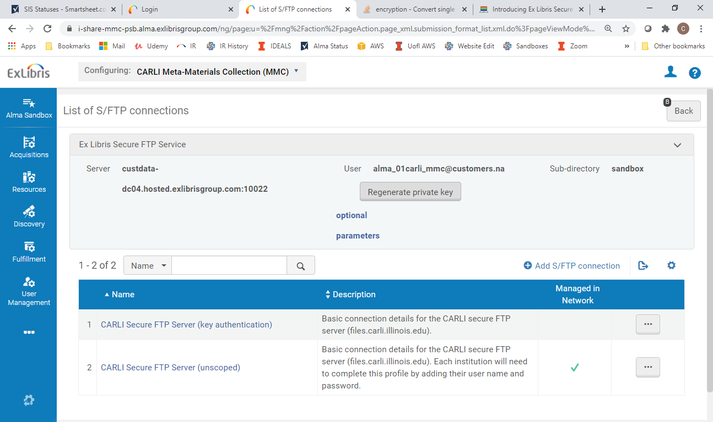
Alma -> Configuration -> General -> External Systems -> S/FTP Definitions
Notes:
Here is the screen that displays each of the definitions. At the top, you can see the Ex Libris option that’s part of the software. A private key can be generated for you to use. You just want to be careful not to press that “regenerate” button once you have it set up or it will invalidate any older keys. Below that, you’ll see the 2 definitions that CARLI created.
Of all these options, my preference is the CARLI FTP server using key authentication….and so it’s what I would recommend using. It’s already completely configured, so you just have to point to it. Also, CARLI has visibility to your files to provide support if needed. There are also no limits on size (within reason) and files are kept for 60 days before they are deleted. Those same limits on the Ex Libris FTP server are 1GB in total size and 30 days of retention.
Having said that, any of these three options are available to you as well as creating a new S/FTP definition that can use any FTP server, whether it’s your own or a third party’s that you have access to. Also note that FTP or SFTP terms are interchangeable in this context. File Transfer Protocol is an old standard which is no longer allowed on any of these servers. Secure File Transfer Protocol is what will really be used, even if we are calling it an FTP server.

Slide 8
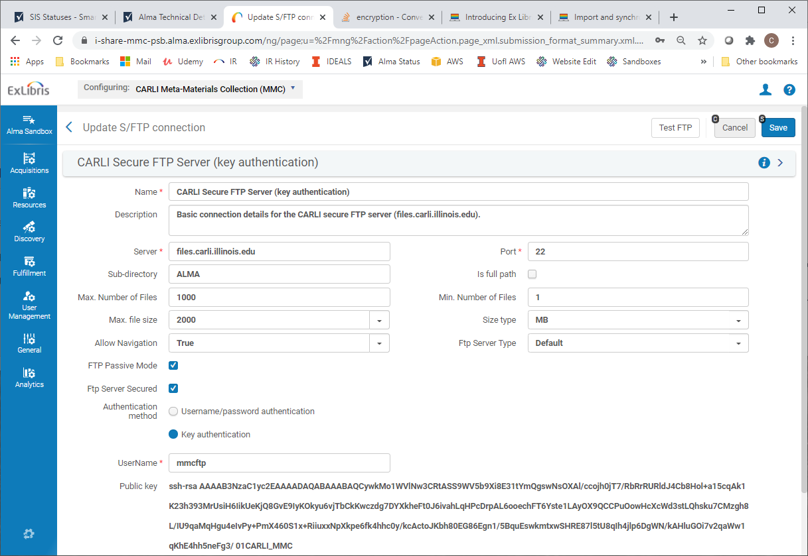
Alma -> Configuration -> General -> External Systems -> S/FTP Definitions -> Edit
Becomes /home/mmcftp/upload/ALMA
Notes:
This is the detail for the “CARLI FTP Server – Key Authentication” definition. We got here from clicking the ellipsis next to that definition and selecting Edit. There are lots of parameters here that you won’t really need to change. Most of them has to do with resource limits, but the thing I want to highlight is the Sub-Directory field.
Your institution’s FTP account (and I’ll just use MMC as it’s in the example screen) You can see the username being used to connect is MMCFTP. Well, that user is going to have a default home directory on the CARLI FTP server which will be /home/mmcftp/upload … The Sub-Directory field will be appended to the user’s home directory and so specifying the Sub-directory of ALMA will result in the full, defined path for files to be delivered to or collected from being /home/mmcftp/upload/ALMA….. You will see later that a SIS Integration profile will use this directory definition.

Slide 9
SIS Integration Profile Options
S/FTP Connection Type
Input File Path
Match ID
Schedule (to Automate Run)
Email Notifications (One-Time or Scheduled Run)
Notes:
The SIS Integration Profile is the other thing that needs to be created and configured in order to perform a SIS Synchronization. There’s a screen to manage the profile that I will show in the next slide and I will explain them all in detail. But the options in this list are going to be the levers that you can pull to configure and customize your SIS synchronization process.

Slide 10
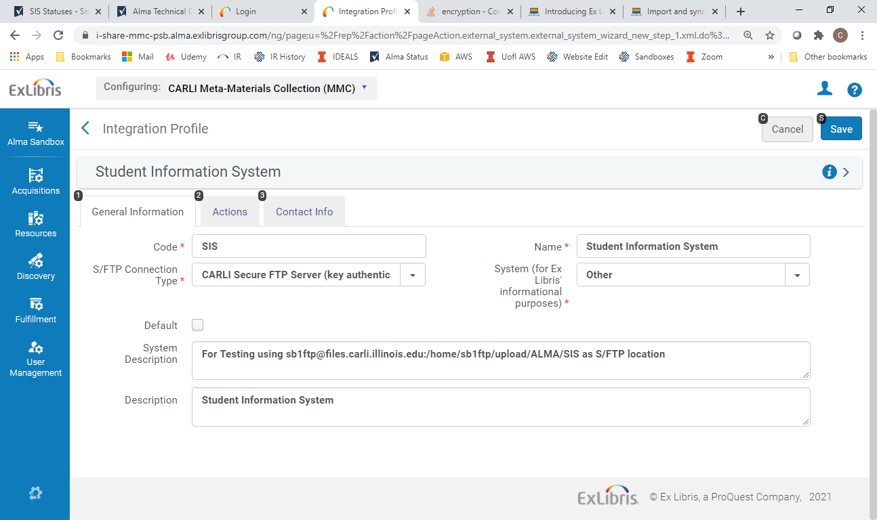
Alma -> Configuration -> General -> External Systems -> Integration Profiles
Notes:
The SFTP connection type is where you specify which SFTP definition to use, so there will be a drop-down that let’s you pick one of the SFTP definitions

Slide 11
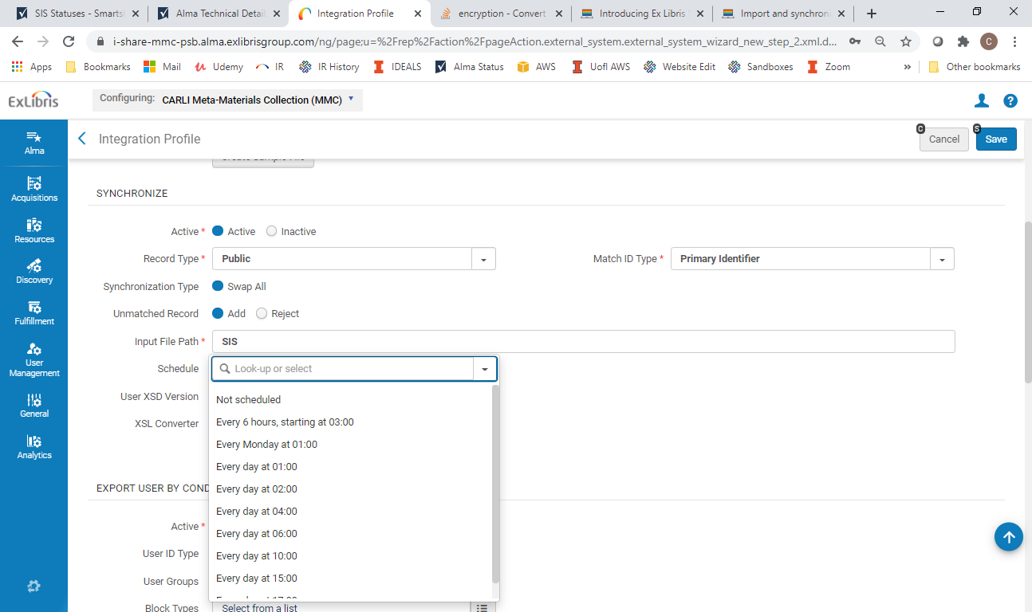
Alma -> Configuration -> General -> External Systems -> Integration Profiles -> Actions Tab
/home/mmcftp/upload/ALMA + SIS = / home/mmcftp/upload/ALMA/SIS
Notes:
The Match ID is a unique identifier chosen to be the match point between SIS records and Alma records. Most often, it is the primary_id, but it can also be the barcode, the INST_ID or …NetID
The Input File Path is a sub-directory that is appended to the Path that was defined in the SFTP definition. In this case, we are giving it a value of capital “SIS”. The SFTP definition in our example had a value of /home/mmcftp/upload/ALMA …..So now the path to deliver XML file and where Alma will look for them is /home/mmcftp/upload/ALMA/SIS
Schedule is where you can turn the synchronization into a background job that will run on a regular basis. Not Scheduled is the default which means that there is nothing set to run as a job. The “Run” button is obscured by the schedule drop-down menu, but you can press the run button to do an on- demand synchronization regardless of whether there is a job scheduled or not.
Among the options for setting up a regular synchronization are: 4 Times a day staring at 3AM , Every Monday at 1AM (which is essentially your only weekly option), And then all the daily options; Once a day at 1AM, 2AM, 4AM, 6AM, 10AM, 3PM…..and then there is a 5PM option that is just beyond what we can see in the slide. All these times are given in military time in the Alma screens.
When you make adjustments in this screen, remember to click “Save” in the upper right so that change takes.

Slide 12
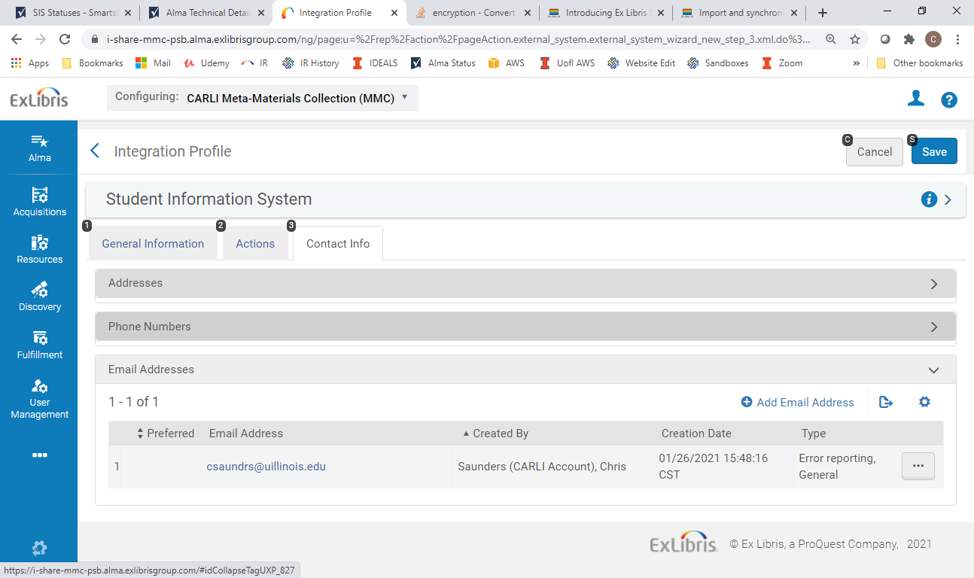
Alma -> Configuration -> General -> External Systems -> Integration Profiles -> Contact Info Tab
Notes:
There is a handy way to get notifications when a synchronization job runs:
From the Integration profile screen, click the “Contact” info tab and there’s a form that lets you add an email address. From then on, when you click the “Run” button …..the synchronization will run and when it completes, it will email you the results.

Slide 13
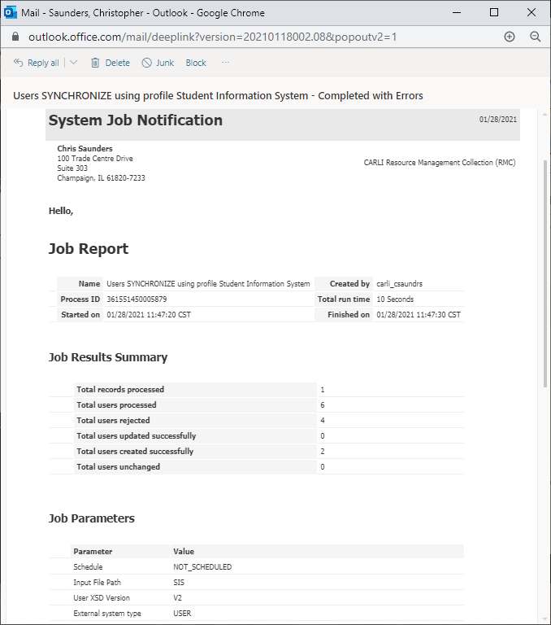
Notes:
Here’s an example report that got emailed. I kind of has an overview, but not much detail. For Details you really will want to look at the Job Report using Alma

Slide 14
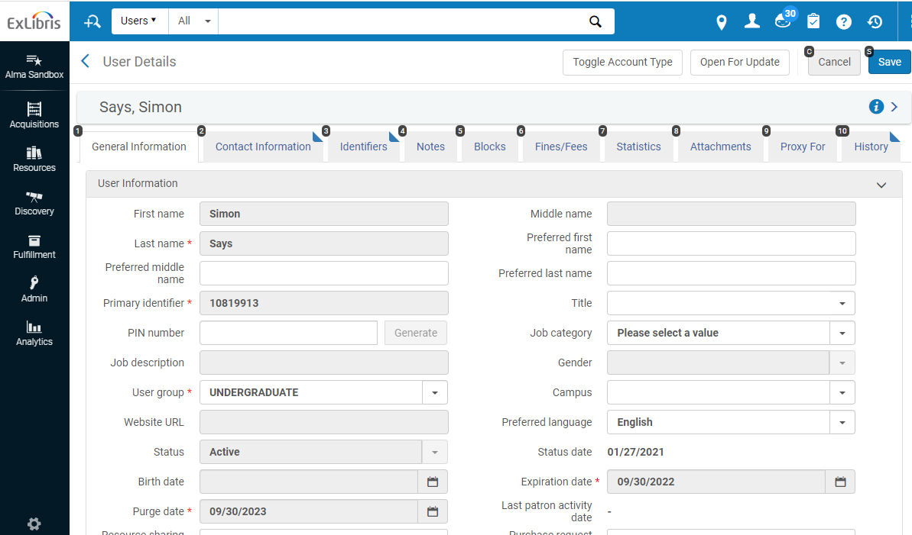
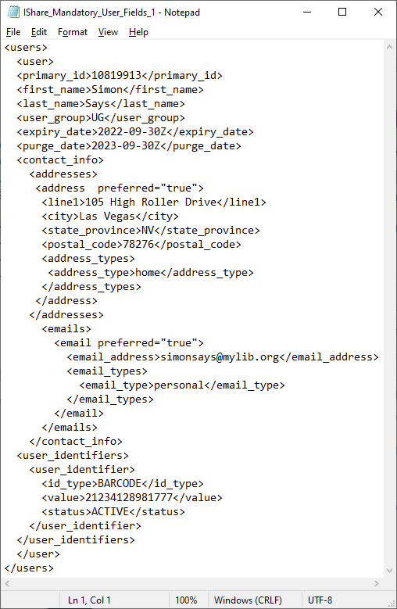
Managing Patron Expiration and Purge Dates
Alma -> Admin -> Manage Users -> User Details -> General Information Tab
Example XML File
Notes:
Here in the User Details (on the left) is where you are likely to view the expiration and purge dates in Alma. On the right, you can see how these dates are specified in the XML file that comes from your SIS….expiry_date and purge_date. You’ll notice that the date string in each has a capital Z appended to it. The “Z” designates Zulu or GMT so that Alma’s underlying database stores time data in that universal format. This is an Ex Libris best practice recommendation and avoids any conflicts in using Alma across time zones.

Slide 15
Managing Patron Expiration and Purge Dates
Expiration Date: The date after which library staff users can no longer log into Alma, and/or, users with the Patron role assigned are prevented from further circulation activity (without the intervention of library staff).
Purge Date: Date used in Alma as criteria for when not-in-use user records can be batch-deleted.
Considerations for selecting dates:
- Frequency of SIS loads to update records
- Type of institution/nature of patron population
- Length of maximum renewal periods/loan periods
Notes:
For some background, patron records in Voyager also had both an expiration date, and a purge date.
The expiration date is the date after which a patron can no longer perform circulation transactions (without staff intervention, such as extending the due date, or performing an override).
The purge date in Voyager made it possible for library staff to enter a second date, which could be either identical to, or later than the patron record’s expiration date for use as a second option when performing patron record purges.
The patron record process makes it possible for library staff to delete patron records that are no longer needed by the library. As the CARLI Privacy Policy states, we want to only “store personal information in our systems for the shortest amount of time necessary to complete transactions or provide service.”
When library staff submit the CARLI Work request (WRO) for Voyager patron record purges, you’ve had the option to use EITHER the patron record expiration date OR the patron record’s purge date as criteria for deleting patron records. Since libraries could use either date for the purge process, not many libraries put much thought into the Purge Date in Voyager; they’d instead purge patron records using the Expiration Date.
Now in Alma, the purpose of the Expiration date and Purge date are much the same.
One major exception to keep in mind is that in Alma, ONLY the Purge date can be used as criteria to delete patron records in batch. So in Alma, the purge date matters, unlike so often in our Voyager data.
So, what factors can libraries take into consideration when setting the expiration dates and purge dates to be exported in our SIS loads?
What you choose to initially set these dates to is a matter of your local policies, but CARLI recommends that for the patron record purge date, since this date actually matters in Alma, most libraries will likely elect for the value to be the same date as the expiration date, or, a year, maybe two later than the expiration date. Remember, you want the purge date to be useful for removing patron records from Alma; we do not want to retain personally identifiable information longer than we need. As you reload and update patron records, as the expiration date is updated, the purge date can be updated as well.
For expiration dates, a few factors may come into consideration.
First, think about the frequency with which you will be able to do a batch update. If your institution will only update your user records once a year, you’ll want your user’s expiration dates to be further out, so that they can charge and renew materials at least until the next load will be completed the following year, assuming they will be a returning patron.
If you can update records more frequently, say, each season, you can know that users who are still at your institution will be updated by the next load, so their expiration date doesn’t need to be quite as long.
Consider also your type of institution, and the type of user record you’ll be uploading. Faculty typically stay at the institution longer than undergraduates; patrons at a doctoral institution typically stay enrolled for more years than a patron at a community college. I’ve seen cases where student records are set to expire at the end of the next semester or at the end of their projected last semester or a date that is one or four years into the future. That’s all just fine, but I have also seen cases where student records get updated daily with an expiration date that is perpetually incremented to a date that is current_date + 1 year, for example. This may be ok as long as the SIS extract program is smart enough to set these dates to the current day once a student is no longer active in the SIS…. It may also age out in a year if no new updates are sent. But if this type of record is not managed carefully, it could leave patrons out there that are active in Alma that are not intended to be.
You’ll also want to take into consideration the length of your maximum loan period in Alma, with the frequency of your record updates, to make sure that user record expiration dates will allow patrons to borrow materials as expected.
The goal in selecting the expiration date is to balance access for the patron, with responsibility for not allowing patrons who are no longer affiliated with our institutions to still perform circulation or I-Share transactions.
Regarding access to electronic resources, typically it’s your identify management provider as part of the authentication system that manages whether patrons who’ve separated from the institution still have access to your e-resource subscriptions. It’s not the expiration date in Alma that manages e-resource access.

Slide 16
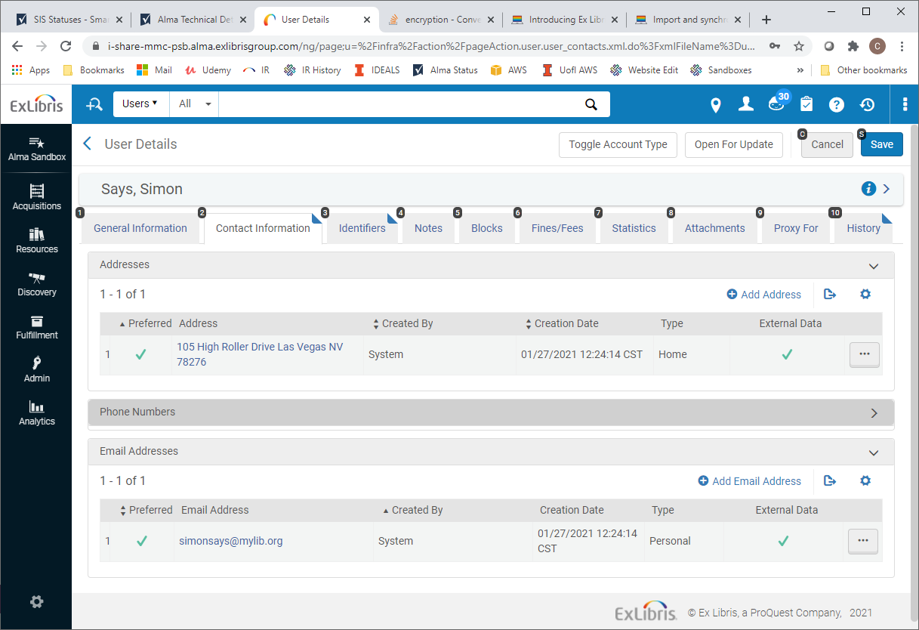
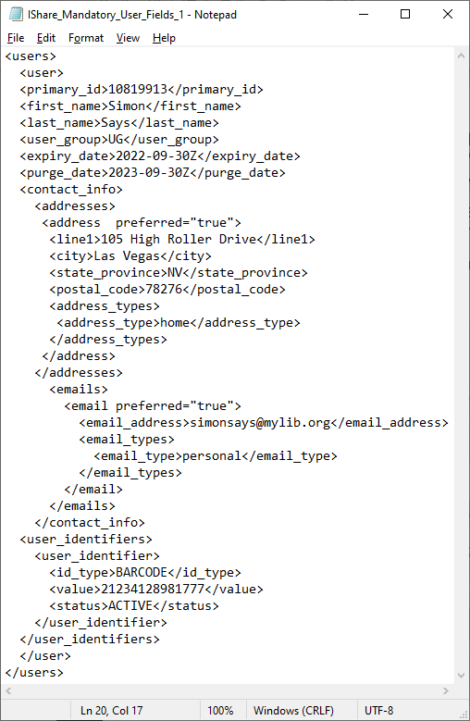
Importance of Designating a Preferred Address
Alma -> Admin -> Manage Users -> User Details -> Contact Info Tab
Example XML File
Notes:
Each user record in Alma should contain both an email address and a mailing address designated as "preferred." ​
When adding and updating your patron's user records via SIS, please make sure that the records contain that designation. ​ You can see this above with the check mark in the Alma screen on the left and the XML file on the right that adds the attribute “preferred = true” to each.
This is important for I-Share member libraries. When a patron requests or borrows material from another I-Share library, Alma saves a copy of a patron's home record in other I-Share library's institution zone, as a "Linked User" record. ​
When a patron from Library A, requests material from Library B, for pick up at Library C, a part of the workflow for Library C involves library staff needing to save the patron's user record to their Alma database in order to check the item out to that requesting patron.​
Also, when a patron from Library A walks into Library B, to check material out in person, the same process happens; staff at Library B need to save the patron's user record to their Alma database, in order to check the material out to that patron as well.​
In both of these cases, when the linked user record is retrieved for saving by library staff, Alma only copies over the addresses set as "preferred" in the patron's home library; the contact information that is NOT set as preferred is NOT copied into the copy of the patron's record for saving at the other I-Share library. The address fields for the patron are copied over "blank."​
Since an email address and a mailing address are mandatory in Alma, this means, that the library staff at other I-Share libraries are prevented from saving the patron's record when the email/mailing addresses are not set as preferred in the patron's home library. Alma alerts the staff to those missing mandatory fields, and will not permit the record to be saved without them, and since the patron is not their home patron, they do not know what values to fill for those fields.​
This causes frustration and confusion for library staff at both institutions, as well as the patron. ​
So, just to help clarify what designating a preferred address looks like, if you refer to the picture on the right side of the slide, you’ll see the line underneath the Addresses tag, you’ll see the Address tag with the preferred attribute. This is the way it should look. If it did not contain the preferred designation the address tag would simply be “less than character”, address, then “greater than” character. If we omitted the preferred attribute, the address would not have the checkmark next to it like the Alma screen on the left. The same applies to the email tag.

Slide 17

Implications of Processing Full vs. Partial Extracts of Patrons
METHOD | Ease of Creation | Logging / Troubleshooting | Processing Time | Functional Flexibility | Ability to Skip
Full
Partial
Notes:
Implications of Processing Full vs. Partial Extracts of Patrons
Here, I just want to explain some of the pros and cons of submitting a full extract of patrons from your SIS for each Synchronization versus extracting a targeted subset of patrons from the SIS and submitting that. First, there are only a few institutions that seem to be sending a small subset of patrons in their XML files. In most cases, a full set, or at least a full set of students is being sent in each extract.
If an institution is sending a smaller, more targeted file, it might include only the records that had changes since the last synchronization OR They might be only records from a certain user_group per file and run in separate integration profiles to keep them organized.
In any case, there are advantages and disadvantages to each method
With Ease of Creation, creating a full extract from the SIS is almost always going to be more straight forward as creating a partial file requires there to be some logic or parsing in the program that extracts the data from the SIS.
Logging / Troubleshooting, When you look at the job report from a sync that had a full run you may be able to have a regular expectation of what the numbers will be, but if you have a targeted subset, then there is much less to sort through, especially if you have to troubleshoot the XML file itself. So there is a lot more clarity if something goes wrong with a partial file.
Processing Time. This one is a bit counter-intuitive….You might think that a smaller file is going to save you lots of processing time (albeit this is really just waiting time since all the processing is on the Alma cloud), but these Synchronization jobs really run pretty fast. Tens of thousands of records can be processed in 15 – 30 minutes, and that is on the high side. So really, having a targeted file is not a big time saver.
Functional Flexibility. This is a big difference. A partial extract, or at least separate files for different user groups allows you to create 2 or more integration profiles that you can use to process the files with different parameters or schedule them on different intervals.
Ability to Skip – This is an advantage if you do a full load. If, for some reason, a particular daily file fails, you are likely ok because the next day’s file will catch things up. On the other hand, if you process files that have a partial set of your patrons, every file is important because it may contain unique changes that cannot be passed over.
Overall, I would encourage everyone to keep doing what you are doing if it is working for you. If you see an advantage in changing the way you do the patron extracts, you might want to contact CARLI for guidance.

Slide 18
Troubleshooting a SIS Synchronization Job
File Related Problems:
File encoding (UTF8) ->Error= “invalid byte 1 of 1-byte UTF-8 sequence.”
Zipping methods ->Error~“invalid END header (bad central directory offset)
SFTP modes (binary vs. ASCII)
No file present or No file with .zip extension
Common Error Messages Due to XML Content:
Invalid value
Case sensitivity
Record with 2 occurrences in same run (based on Match ID)
Account type is Internal (Will not process)
Mandatory field missing
Primary ID already taken by other user
XML parsing problems
Problematic characters
Notes:
Here, maybe I can cut away to a browser where I load a problematic XML file into the sandbox that has a variety of problems and can view the job report that gives a variety of errors. I will work on that.

Slide 19
Q and A

Slide 20
Contact
Chris Saunders – CARLI Contact for SIS Synchronization
support@carli.Illinois.edu
Thank you!
The next Open Office Hours will be on February 11th.
Notes:
Thank you for joining us in this presentation and remember that the next meeting will be in 2 weeks

