Slide 1
Cost Analysis and Vendor Comparison
On behalf of the I-Share Acquisitions and Serials Team
January 11/12, 2011

Slide 2
Personal Introduction
My name is Andy Meyer and I’m the Acquisitions Coordinator at North Park University
I’m relatively new to the job
This project started because I was curious and wanted to use the library resources well
I’m not exactly sure how other libraries do things
I was a math major and, at one time, a math teacher
I have a tendency to talk quickly…

Slide 3
Introduction to the Presentation
Today’s webinar can be divided into 4 sections:
Methodology and the structure of the project
The prices and some brief conclusions
A few observations about the trends within the data
Beyond prices – looking at other factors
Best Practices for Webinars
Feel free to ask questions via chat, I will repeat them aloud and try to answer them
I’m also available after the webinar – in the room or via email
Technical details.

Slide 4
Methodology and Structure

Slide 5
Scope of the Project
I compared the book prices for three of our NPU vendors:
YBP
Amazon
Vendor C – a small, family-owned book vendor
On the cost of books we ordered this fall.
ISBN specific
Same availability from each vendor
Only Firm Orders
For North Park University and Seminary – small, Christian, and liberal arts
Lots of opportunities to explore other questions!

Slide 6
Jumping into the Data
The first step is getting solid information
I used the following bibliographic information from YBP, via GOBI, as the skeleton of this project:
Title
Author/Editor
Publisher
Year
ISBN
Binding (Paper/Cloth)
List Price

Slide 7
Going from GOBI to Excel
Enter ISBNs or otherwise mark the correct titles
I use the ‘brief’ view in GOBI
“Save to disk” and save in Notepad
Open Excel and import the data
On the ribbon, select Data tab
“Get from text” and select the correct text document
Follow the import steps
To format the data and maintain consistency, I created a macro in Excel to delete rows, format numbers, etc.
I used the user-friendly ‘record macro’ function to create it
The next slide shows the macro in visual basic if you want to tweak it

Slide 8
VBA code for Excel Macro
Sub Webinar1()
'
' Webinar1 Macro
'
Columns("B:F").Select
Selection.Delete Shift:=xlToLeft
Columns("D:D").ColumnWidth = 21
Columns("E:E").ColumnWidth = 10.29
Columns("E:E").ColumnWidth = 9.14
Columns("F:F").Select
Selection.NumberFormat = "0000000000000"
Columns("H:U").Select
Selection.Delete Shift:=xlToLeft
Columns("I:M").Select
Selection.Delete Shift:=xlToLeft
Columns("J:FD").Select
Selection.Delete Shift:=xlToLeft
Range("H1").Select
ActiveCell.FormulaR1C1 = "List"
Cells.Replace What:="USD", Replacement:="", LookAt:=xlPart, SearchOrder _
:=xlByRows, MatchCase:=False, SearchFormat:=False, ReplaceFormat:=False
Range("I1").Select
ActiveCell.FormulaR1C1 = "A"
Range("J1").Select
ActiveCell.FormulaR1C1 = "B"
Range("K1").Select
ActiveCell.FormulaR1C1 = "C"
Range("L1").Select
ActiveCell.FormulaR1C1 = "D"
Range("I1").Select
Range("A1:L1").Select
Selection.Font.Bold = True
Range("A1").Select
End Sub
This macro simply formats the raw data from GOBI into something a bit more tidy. Not essential at all, just makes the process easier.

Slide 9
Still More Data…
There are other methods to get the bibliographic data
Using Access to pull data from Voyager to retroactively look at pricing
Same information is provided by different vendors – only in a different format.
Getting pricing information from other vendors
Look up each title individually
Load a bunch of ISBNs
Request a price quote
Labor intensive, many student worker hours.

Slide 10
If I had to do it again…
I would have kept all the titles
For consistency, I limited inclusion to books that were available through all three vendors
Keeping a record of which vendor had which book might have been very helpful
I would have kept fund codes
Different levels of ordering for the undergraduate and graduate programs
Keeping the data might have revealed other trends
Think about what you would like to see in your data!

Slide 11
The Data!
Enough with the methodology, let’s get to…

Slide 12
The Data
1,178 titles – books ordered 9/1/2010 to 12/1/2010

Slide 13
Quick Observations
Prices vary quite a bit between vendors!
A total of 1,178 books
Only 13 books (1.1%) had the exact price from all three vendors
For 11 books, the price difference was over $50
Biggest difference was $87.77
Average difference was $8.16
Variation in Prices =MAX(I2:K2)-MIN(I2:K2)
=COUNTIF(?,”<=50”)
=MAX(?)
=AVERAGE(?)

Slide 14
The Bottom Line
 | Total | Percent Off
List Price | $ 50,240.57 | -
YBP | $ 42,359.25 | 15.69%
Amazon | $ 43,021.31 | 14.37%
Vendor C | $ 46,003.43 | 8.43%
$7,881 in savings from list price!
In terms of pure pricing, YBP was the cheapest
…for North Park University…
…between 9/1/2010 and 12/1/2010.
=SUM(-)
=1-(SUM(vendor)/SUM(list)) – format as percent

Slide 15
Brief mathematical reminder
Two Books
Book A is $25 at a 40% discount rate
Book B is $75 at a 10% discount rate
Average Percent Discount
Actual Percent Discount
Price of book A = $15
Price of book B = $67.50
$\frac{15+67.50}{25+75}=\frac{87.50}{100}=\$87.50$
Actual discount is 12.5%!
$\frac{(40\%+10\%)}{2}=25\%$
Average discount is 25%!

Slide 16
The Bottom Line
Actual discount is the aggregate or sum discount
Average discount determines each individual discount and then determines the average
 | Total | Actual | Average
YBP | $ 42,359.25 | 15.69% | 16.32%
Amazon | $ 43,021.31 | 14.37% | 16.61%
Vendor C | $ 46,003.43 | 8.43% | 11.20%
ACTUAL = 1-(SUM(vendor)/SUM(list)) – format as percent
AVERAGE = AVERAGE(item discounts) – format as a percent

Slide 17
You’ve got to shop around
So far, we’ve been assuming that we’ve placed all the orders with only one vendor.

Slide 18
The REAL Bottom Line
 | Total | Actual Discount
List | 50,204.57 | -
YBP | 42,359.25 | 15.69%
Amazon | 43,021.31 | 14.37%
Vendor C | 46,003.43 | 8.43%
Cheapest | 39,044.86 | 22.28%
YBP & Amazon | 39,553.54 | 21.27%
YBP & Vendor C | 40,770.47 | 18.85%
Amazon & Vendor C | 41,445.94 | 17.51%
Cheapest = MIN()

Slide 19
The REAL Bottom Line …in the REAL World
So far, this project discovered that buying books from the cheapest vendor saves money.

Slide 20
The REAL Bottom Line …in the REAL World
So far, this project discovered that buying books from the cheapest vendor saves money.
Duh.

Slide 21
The REAL Bottom Line …in the REAL World
So far, this project discovered that buying books from the cheapest vendor saves money.
Duh.
In the real world, it is not always possible or practical to compare prices from 3 (or more) vendors:
Discount might not be reckoned at point of order
Simple time constraints
So…

Slide 22
Make Informed Decisions
The data shows that comparing YBP and Amazon and selecting the cheaper of the two should yield a saving of 21.27% relative to the list price of the books
Or, to put it another way: relative to only YBP (the best of the individual vendors), an additional savings of 5.58%
Furthermore, comparing to Vendor C would only yield an additional 1% in savings
Therefore, a reasonable workflow might be:
Select books with YBP
Compare to Amazon
Order whichever is cheaper

Slide 23
To Summarize our Savings:
 | Total | Actual Discount
List | $10,000.00 | -
YBP | $8,431.28 | 15.69%
Amazon | $8,563.06 | 14.37%
Vendor C | $9,156.62 | 8.43%
Cheapest | $7,771.57 | 22.28%
YBP & Amazon | $7,872.83 | 21.27%
YBP & Vendor C | $8,115.05 | 18.85%
Amazon & Vendor C | $8,249.50 | 17.51%
For every $10,000 (list price)
Old Method of Ordering: $9,156.62
New Method of Ordering: $7,872.83
Savings: $1,283.79

Slide 24
Trends within the data
Are there clear correlations between vendors and formats? Between vendors, pricing, and publishers?
Which vendor is cheaper more of the time?

Slide 25
Vendor Rankings
How often did each vendor offer the cheapest price?
 | YBP | Amazon | Vendor C
Offered Lowest Price | 473 (40.1%) | 448 (38.0%) | 293 (24.9%)
Offered Middle Price | 390 (33.1%) | 484 (41.1%) | 380 (32.3%)
Offered Highest Price | 315 (26.7%) | 246 (20.9%) | 505 (42.9%)
=RANK()
=COUNTIF()

Slide 26
Vendor Rankings
How often was YBP cheaper than Amazon?
Amazon cheaper than YBP?
 | YBP | Amazon | Same
Offered Cheaper Price | 528 (44.82%) | 694 (58.91%) | 44 (3.73%)
Offered Higher Price | 650 (55.18%) | 484 (41.09%)
If cheaper, how much cheaper?
 | YBP | Amazon
On average, how much cheaper? | $6.57 | $4.04

Slide 27
The $50 Question
 | List Price ≤ 50 898 books (76%) |  | List Price > 50 280 book (24%)
 | Average Actual Discount | Offered Cheapest Price* | Average Actual Discount | Offered Cheapest Price**
YBP | 16.61% | 361 (40.2%) | 14.75% | 166 (59.3%)
Amazon | 18.20% | 557 (62.0%) | 10.48% | 137 (48.9%)
* YBP and Amazon had the same price for 21 books (2.3% of sample)
** YBP and Amazon had the same price for 23 books (8.2 % of sample)
=IF(), COUNTIFS(), AVERAGEIFS(), SUMIFS(), etc.

Slide 28
Summary
Even though YBP is cheaper overall, Amazon usually has the lower price!
For nearly 59% of the books, Amazon had the cheaper price (when compared to YBP and including the 44 times that YBP and Amazon had the same price)
YBP’s static discount rate of 18%:
Hurt YBP’s performance for the cheaper books when other vendors could offer a higher discount rate,
But, for the more expensive books, made YBP the most economical vendor because the other vendors offered these books at a much lower rate.
Still, you’ve got to compare each time…

Slide 29
On to other things:
Okay. We are done with mathematics and done with price comparison.

Slide 30
How accurate are the list prices?
That is, how does the price estimate at the point of order compare to the invoice price?

Slide 31
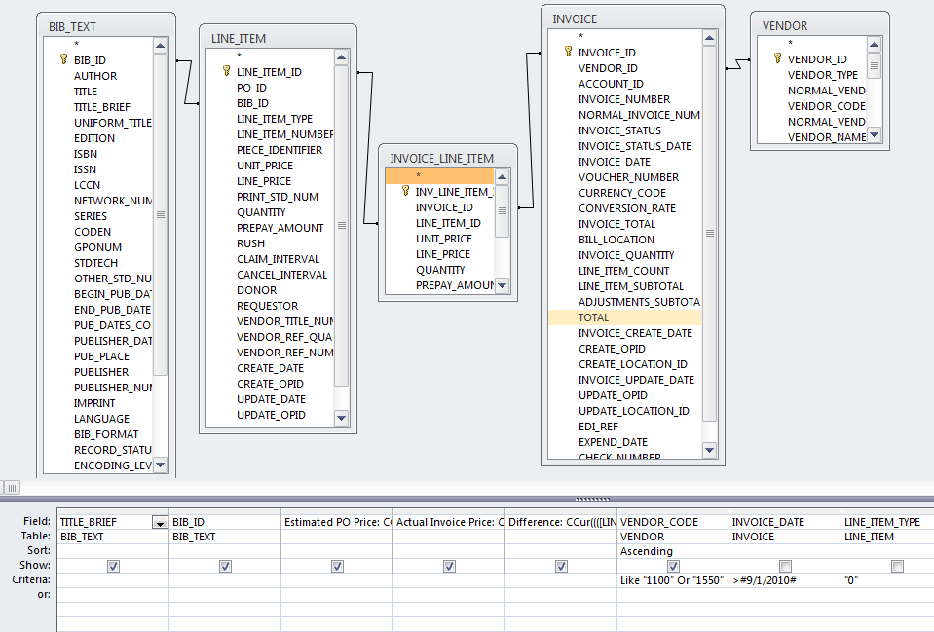
Design View of Estimate to Invoice Price Query
Selects all the bib records associated with a certain VENDOR_CODE and after a certain INVOICE_DATE and gives the List Price, the Invoice Price, and the difference between them.

Slide 32
SQL view of Estimate to Invoice Price Query
SELECT BIB_TEXT.TITLE_BRIEF, BIB_TEXT.BIB_ID, CCur([LINE_ITEM].[UNIT_PRICE]/100) AS [Estimated PO Price], CCur([INVOICE_LINE_ITEM].[UNIT_PRICE]/100) AS [Actual Invoice Price], CCur((([LINE_ITEM].[UNIT_PRICE])-([INVOICE_LINE_ITEM].[UNIT_PRICE]))/100) AS Difference, VENDOR.VENDOR_CODE
FROM ((BIB_TEXT INNER JOIN (INVOICE_LINE_ITEM INNER JOIN LINE_ITEM ON INVOICE_LINE_ITEM.LINE_ITEM_ID = LINE_ITEM.LINE_ITEM_ID) ON BIB_TEXT.BIB_ID = LINE_ITEM.BIB_ID) INNER JOIN INVOICE ON INVOICE_LINE_ITEM.INVOICE_ID = INVOICE.INVOICE_ID) INNER JOIN VENDOR ON INVOICE.VENDOR_ID = VENDOR.VENDOR_ID
WHERE (((VENDOR.VENDOR_CODE) Like "1100" Or (VENDOR.VENDOR_CODE)="1550" Or (VENDOR.VENDOR_CODE)="10164") AND ((INVOICE.INVOICE_DATE)>#9/1/2010#) AND ((LINE_ITEM.LINE_ITEM_TYPE)="0"))
ORDER BY VENDOR.VENDOR_CODE;
Text in red should be changed for your institution.

Slide 33
How accurate are the list prices?
If vendors provide real price estimates, they tend to be quite accurate
For YBP: the average invoice price was $0.15 above the estimated price
For Amazon: the average invoice price was about $0.02 less than the estimated price
Caveats and asides:
Not a huge sample – repeating query in a few months might have different results
Use this information for workflow details when invoicing.
Vendor C, for example, does not provide the discount price at the point of order, only at the invoice. For vendors like that, this query provides the rough data to figure the actual discount rate.
My data was within 0.1% - pretty good!

Slide 34
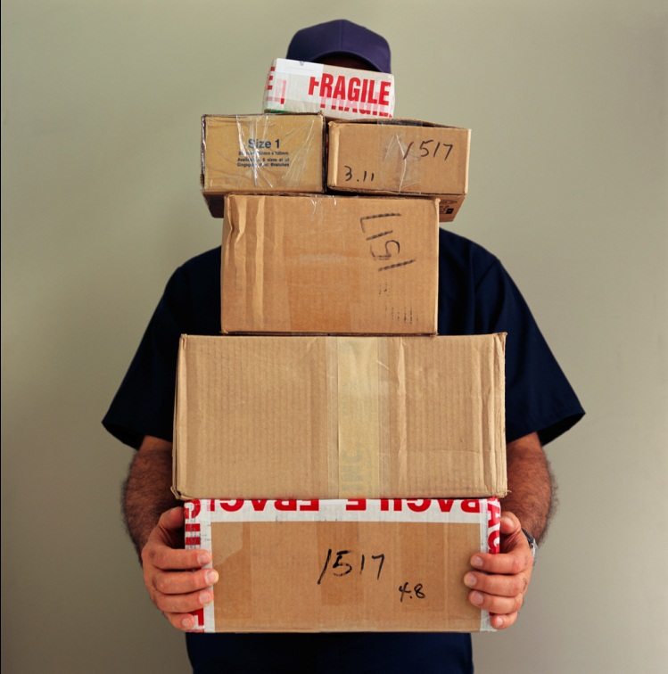
Shipping Costs…
…are a nightmare to consider!
They are complicated, ever-changing, and unpredictable.

Slide 35
Pop Quiz!
You need to order a book that is $40; which option is cheaper? How much cheaper?
Ordering it direct from the publisher that offers a 40% discount and $8 shipping and handling.
Ordering it normally with YBP’s standard 18% discount and getting free shipping and handling.

Slide 36
Pop Quiz!
You need to order a book that is $40; which option is cheaper? How much cheaper?
Ordering it direct from the publisher that offers a 40% discount and $8 shipping and handling.
Ordering it normally with the standard 18% discount and getting free shipping and handling.
Answer: A! But only by $0.80.
For me, it is very helpful to convert everything to like terms:
Express the $8 as a percent of the book (20%)
A: 40% - 20% (shipping expressed as percent) = 20% savings

Slide 37
Shipping Costs…
All three vendors promised free shipping on all normal orders.
Access allows us to take a look at the actual data.
INVOICE_NUMBER | INVOICE CREATE DATE | VENDOR CODE | VENDOR NAME | NOTE | Adjustments | REASON_TEXT | Itemized Adjustments | FUND_NAME
101083051692 | 18-Oct-10 | 1100 | Amazon |  | $3.99 | shipping charge | $3.99 | Korean Studies - Books
102869098191 | 18-Oct-10 | 1100 | Amazon |  | $6.59 | shipping charge | $3.29 | Christian LT - Books
102869098191 | 18-Oct-10 | 1100 | Amazon |  | $6.59 | shipping charge | $3.30 | SemR - Books
113591152426 | 15-Sep-10 | 1100 | Amazon |  | $3.99 | shipping charge | $3.99 | Library - Books
218654252735 | 15-Nov-10 | 1100 | Amazon |  | $7.94 | shipping charge | $7.94 | Library - Books
298304030661 | 15-Sep-10 | 1100 | Amazon | Rush shipping | $3.99 | shipping charge | $3.99 | SemG - Books
418480 | 28-Nov-10 | 1550 | Vendor C | Rush shipping | $4.49 | shipping charge | $4.49 | SemG - Books
418481 | 28-Nov-10 | 1550 | Vendor C | Rush shipping | $4.49 | shipping charge | $4.49 | CLT - Books
038401554275 | 15-Nov-10 | 1100 | Amazon |  | $2.98 | shipping charge | $2.98 | French - Media
055015760097 | 20-Oct-10 | 1100 | Amazon |  | $2.98 | shipping charge | $2.98 | Library - Film
059462861163 | 15-Sep-10 | 1100 | Amazon |  | $1.46 | shipping charge | $1.46 | Spanish - Media
307211 | 03-Dec-10 | 10164 | YBP |  | $4.16 | shipping charge | $4.16 | SemG - SO
309063 | 21-Nov-10 | 10164 | YBP |  | $4.10 | shipping charge | $4.10 | SemG - SO

Slide 38
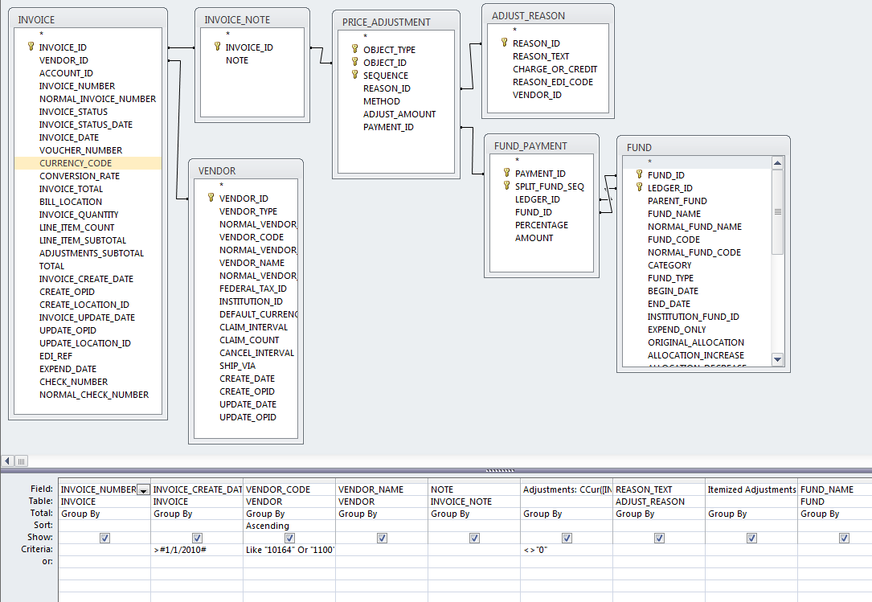
Design View of Adjustment Query
Selects all the invoices created with a given time frame and from certain vendors that have some adjustment – lists them with the adjustment and the matching fund code.

Slide 39
SQL of Adjustment Query
SELECT INVOICE.INVOICE_NUMBER, INVOICE.INVOICE_CREATE_DATE, VENDOR.VENDOR_CODE, VENDOR.VENDOR_NAME, INVOICE_NOTE.NOTE, CCur([INVOICE].[ADJUSTMENTS_SUBTOTAL]/100) AS Adjustments, ADJUST_REASON.REASON_TEXT, CCur([PRICE_ADJUSTMENT].[ADJUST_AMOUNT]/100) AS [Itemized Adjustments], FUND.FUND_NAME
FROM ((((INVOICE INNER JOIN VENDOR ON INVOICE.VENDOR_ID = VENDOR.VENDOR_ID) INNER JOIN INVOICE_NOTE ON INVOICE.INVOICE_ID = INVOICE_NOTE.INVOICE_ID) INNER JOIN PRICE_ADJUSTMENT ON INVOICE_NOTE.INVOICE_ID = PRICE_ADJUSTMENT.OBJECT_ID) INNER JOIN ADJUST_REASON ON PRICE_ADJUSTMENT.REASON_ID = ADJUST_REASON.REASON_ID) INNER JOIN (FUND_PAYMENT INNER JOIN FUND ON (FUND_PAYMENT.FUND_ID = FUND.FUND_ID) AND (FUND_PAYMENT.LEDGER_ID = FUND.LEDGER_ID)) ON PRICE_ADJUSTMENT.PAYMENT_ID = FUND_PAYMENT.PAYMENT_ID
GROUP BY INVOICE.INVOICE_NUMBER, INVOICE.INVOICE_CREATE_DATE, VENDOR.VENDOR_CODE, VENDOR.VENDOR_NAME, INVOICE_NOTE.NOTE, CCur([INVOICE].[ADJUSTMENTS_SUBTOTAL]/100), ADJUST_REASON.REASON_TEXT, CCur([PRICE_ADJUSTMENT].[ADJUST_AMOUNT]/100), FUND.FUND_NAME
HAVING (((INVOICE.INVOICE_CREATE_DATE)>#1/1/2010#) AND ((VENDOR.VENDOR_CODE) Like "10164" Or (VENDOR.VENDOR_CODE)="1100" Or (VENDOR.VENDOR_CODE)="1550") AND ((CCur([INVOICE].[ADJUSTMENTS_SUBTOTAL]/100))<>"0"))
ORDER BY VENDOR.VENDOR_CODE;
Text in red should be changed for your institution

Slide 40
Shipping Costs
At some point, each vendor charged a bit for shipping:
YBP: charged $8.26
Amazon: charged $198.52
Vendor C: charged $17.96
However, it’s really hard to fairly compare.
Conclusion: shipping costs are a factor for Amazon, but…
They affect the bottom line by about 0.4%
Are always clear and predictable
Are the only ‘overhead’ cost – compare with YBP’s fees.
Worth it for the broad range of items available

Slide 41
Shipping Times
Question: “How many days is it on order?”
Two CARLI queries provide the data to answer this question:
Vendor Copy Order/Receipt Dates
This query gives the date an item was ordered, the date it was received, and calculates the difference between those two dates.
Vendor Performance - Days to Receipt
This query takes that data and gives the statistical analysis of it for a given date range.
Because the best ideas are always ‘stolen’, I used the first query and tweaked the parameters.
Limit to the three vendors and limit by PO create date

Slide 42
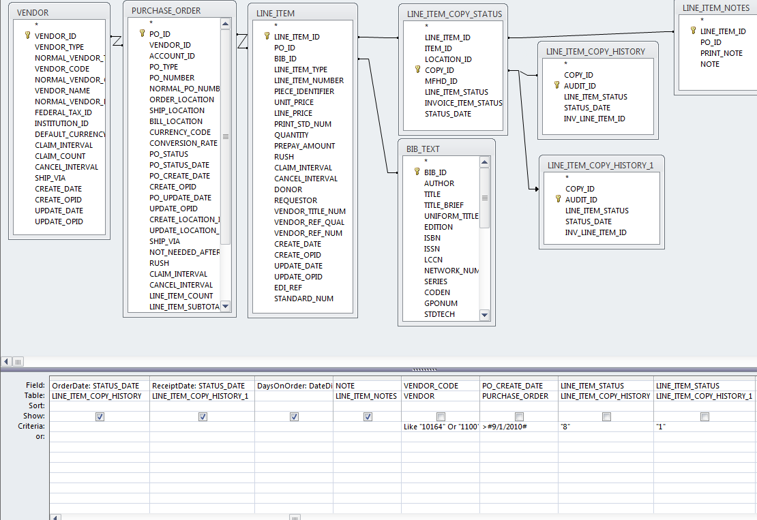
Design View of Dates between Order and Receipt Query
From all the POs created after a certain date and for 3 particular vendors, it takes the order date and the receipt date and then calculates the number of days between.

Slide 43
SQL of Dates between Order and Receipt Query
SELECT VENDOR.VENDOR_NAME, BIB_TEXT.TITLE, LINE_ITEM.BIB_ID, LINE_ITEM_COPY_HISTORY.STATUS_DATE AS OrderDate, LINE_ITEM_COPY_HISTORY_1.STATUS_DATE AS ReceiptDate, DateDiff("d",[OrderDate],[ReceiptDate]) AS DaysOnOrder, LINE_ITEM_NOTES.NOTE
FROM (((LINE_ITEM_COPY_HISTORY INNER JOIN (((VENDOR INNER JOIN PURCHASE_ORDER ON VENDOR.VENDOR_ID = PURCHASE_ORDER.VENDOR_ID) INNER JOIN LINE_ITEM ON PURCHASE_ORDER.PO_ID = LINE_ITEM.PO_ID) INNER JOIN LINE_ITEM_COPY_STATUS ON LINE_ITEM.LINE_ITEM_ID = LINE_ITEM_COPY_STATUS.LINE_ITEM_ID) ON LINE_ITEM_COPY_HISTORY.COPY_ID = LINE_ITEM_COPY_STATUS.COPY_ID) LEFT JOIN LINE_ITEM_COPY_HISTORY AS LINE_ITEM_COPY_HISTORY_1 ON LINE_ITEM_COPY_STATUS.COPY_ID = LINE_ITEM_COPY_HISTORY_1.COPY_ID) INNER JOIN BIB_TEXT ON LINE_ITEM.BIB_ID = BIB_TEXT.BIB_ID) INNER JOIN LINE_ITEM_NOTES ON LINE_ITEM_COPY_STATUS.LINE_ITEM_ID = LINE_ITEM_NOTES.LINE_ITEM_ID
WHERE (((VENDOR.VENDOR_CODE) Like "10164" Or (VENDOR.VENDOR_CODE)="1100" Or (VENDOR.VENDOR_CODE)="1550") AND ((PURCHASE_ORDER.PO_CREATE_DATE)>#9/1/2010#) AND ((LINE_ITEM_COPY_HISTORY.LINE_ITEM_STATUS)="8") AND ((LINE_ITEM_COPY_HISTORY_1.LINE_ITEM_STATUS)="1"));
Text in red should be changed for your institution

Slide 44
Shipping Times
Preferred to do the statistical analysis in Excel.
Weed out bad data points.
Item is ordered on Friday, PO created on Monday
Item is not due to be published for weeks or months
NETWORKDAYS(-,-) – This can take into account weekends and holidays
 | Average Days on Order
YBP | 29.5
Amazon | 9.1
Vendor C | 31.4

Slide 45
To summarize our results:
We changed our ordering workflows:
Instead of ordering through Vendor C, we now order from either YBP or Amazon – whichever is cheaper.
For every $10,000, we expect an additional savings of $1,283.79 relative to our old workflows.
Over the whole fiscal year, I would project total savings to approach $16,000.
The other queries attempted to measure some difficult to quantify aspects of the ordering process: shipping costs and times.
These results largely supported our decisions and assumptions.

Slide 46
In conclusion:
It is a really complicated institutional decision!
Different schools will almost certainly have different results
There are so many other factors to consider:
Return policy
Ease of ordering
Ease of invoicing
Full and correct bibliographic information
etc…

Slide 47
The End
Feel free to use and/or change any formulas or queries found in this presentation.
Questions? Comments?
Thanks!
Cost Analysis and Vendor Comparison
On behalf of the I-Share Acquisitions and Serials Team
Andy Meyer
Acquisitions Coordinator
North Park University
ameyer@northpark.edu

