Slide 1
Patron Services

Slide 2
Fulfillment User Roles
Role | Description
Circulation Desk Operator – Limited | limited functions: loan, return, search & view catalog and inventory
Circulation Desk Operator | all rights of the “Limited” role; edit rights for user notes, due dates, some user blocks; view users, manage fines, mark items lost, backdate returns
Circulation Desk Manager | same privileges as Circulation Desk Operator; more extensive user edit and analytics rights; blocks can be configured to require manager override
Fulfillment Services Operator | manages the library's fulfillment services related to course reserves and reading lists, as well as move requests
Fulfillment Services Manager | manages the library's authoritative fulfillment services actions, such as the course reading list assignments
Work Order Operator | manages internal library requests such as digitization activities
Requests Operator | manages the steps of the requests fulfillment, including creating requests, picking up items from shelves, placing items in transit and on hold shelves
Fulfillment Administrator | manages fulfillment-related configurations, such as policies, terms of use, fulfillment units, and circulation desks

Slide 3
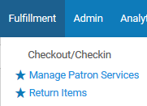
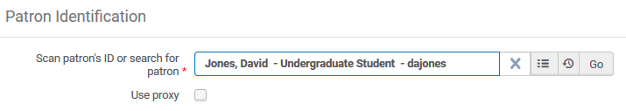
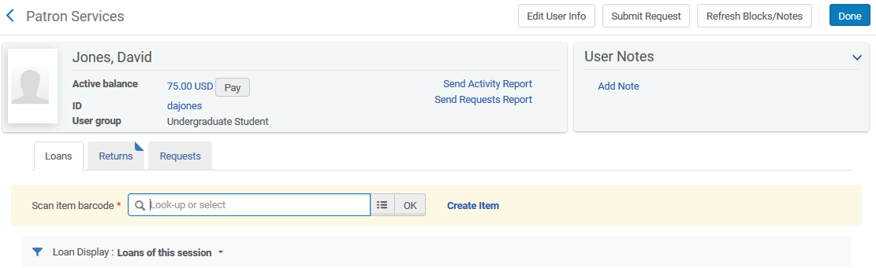
Loan Items via Manage Patron Services

Slide 4
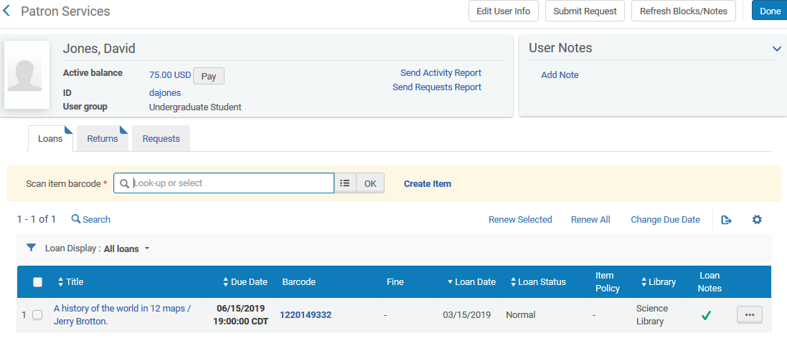
Loaned Items

Slide 5
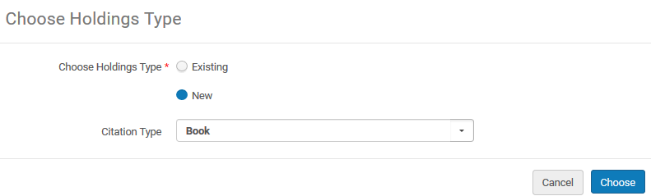
Create Item (If Necessary)

Slide 6
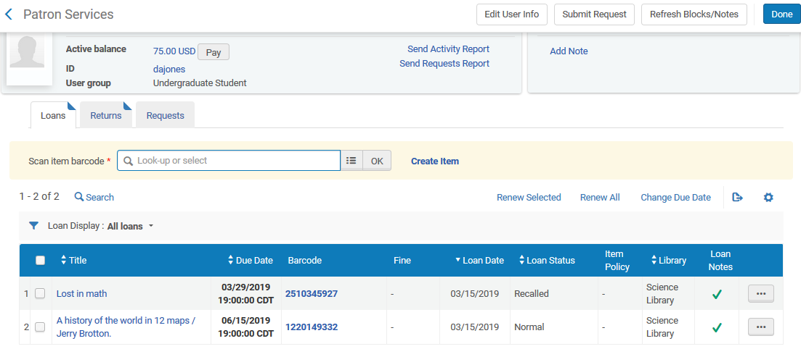
View All Loans

Slide 7
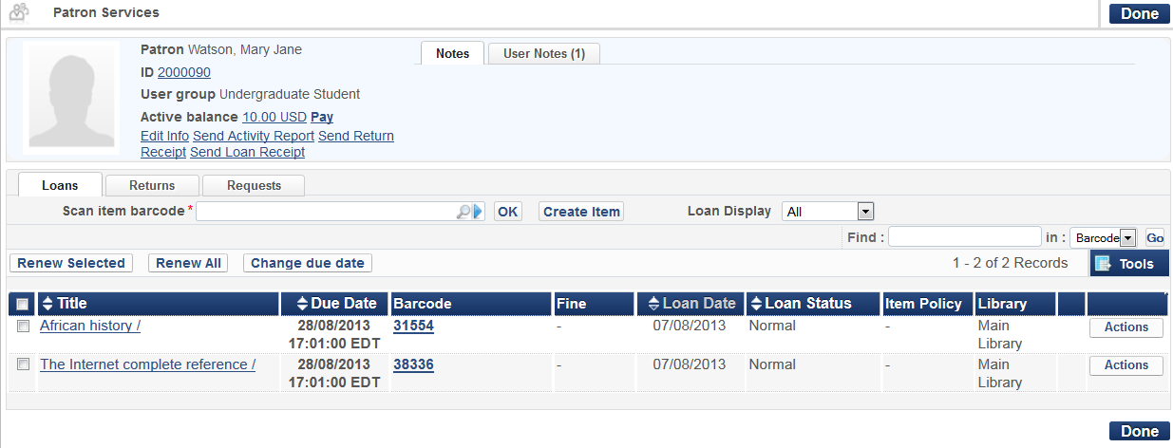
Loan Items
View all loans on user record by changing loan display to All:
Notes:
Notice that the Loan Display will default to “This session”, meaning that the item or items that were just loaned.
It is possible to view all loans on a patron’s record by changing the Loan Display dropdown to All rather than this session only.

Slide 8
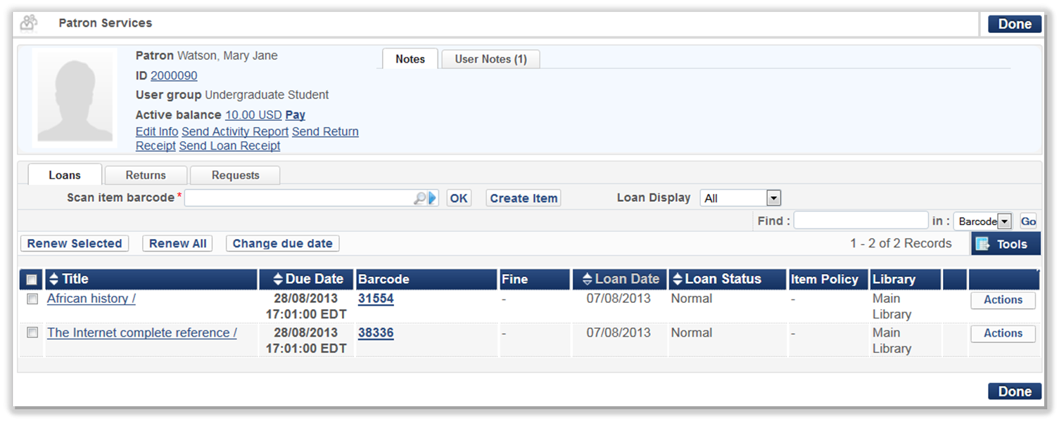

Loan Items
View additional options for item via Actions button:
Notes:
By clicking on the Actions button it’s also possible to:
renew the item from here,
mark it as lost or claimed returned,
look at the loan history for this particular loan,
change the due date,
place a work order request (which might be because the item needs repair),
view the request queue for the item to see if there are other requests for it,
and view, add and edit notes on the loan.

Slide 9
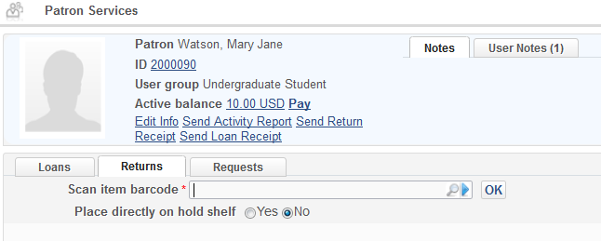
Return Items
Return items via Manage Patron Services, second tab:
Notes:
Let’s talk about returns next.
One way items can be returned is from the Patron’s record by clicking on the Returns tab.
We can scan in the item barcode that’s being returned, or use the magnifying glass button to search for the item in the Repository if the barcode isn’t available.
The “Place directly on hold shelf” field is in the case of items that have been requested by users. We’ll talk more about requests and the hold process in a later session.

Slide 10
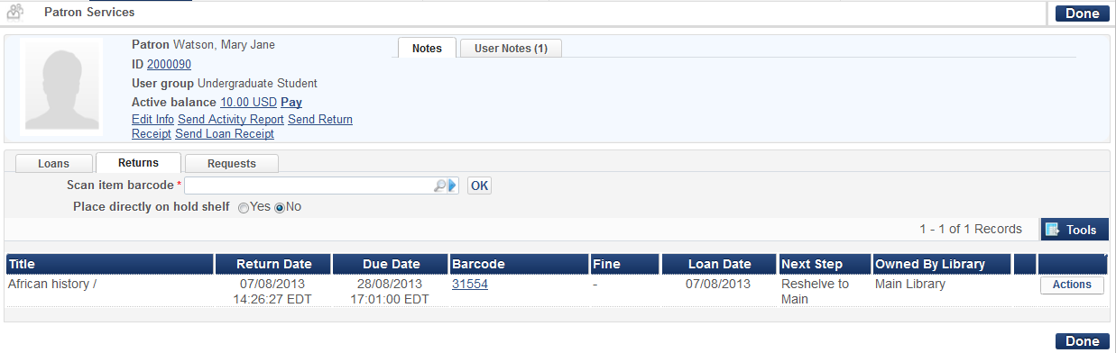

Return Items
Returns: View additional options under Actions button at far right
Notes:
Similar to when you loan books, when you return them from the patron’s record, an Actions button will display. It’s possible to look at the loan history for this particular loan, place a work order request on it, view the request queue and view, add and edit notes about the loan.
One of the options you have is that you can decide if you want only items to display that are returned during that current session – or whether you want to be able to see the loan history, meaning all of the returns the patron has done. It looks very similar to the “Loans Display” drop-down in the Loans tab, will be a drop-down field marked “Returns Display” with options for “this session” or “all”.
Again, this is configurable so you can decide if you want to see that Returns history or not.
Similar to loan receipts, it’s also configurable whether you want to send a Return receipt via email to the patron or print-out the return receipt at the Circulation desk for the patron.

Slide 11
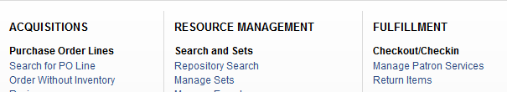
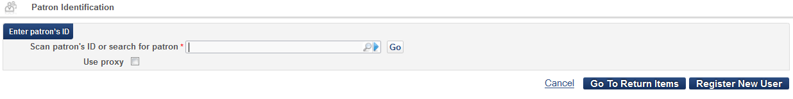

Return Items
Return Items link under Fulfillment in Alma menu OR from Manage Patron Services:
Manage Item Returns:
Notes:
As an alternative for returns, you can return items directly by either using the Return Items link under the Alma main menu OR going to Manage Patron Services and clicking on the “Go To Return Items” link. Each will take you to the same place.
This is particularly useful if you have a pile of items to return or are unaware of the patrons who returned them.
The Manage Item Returns screen will display and you can scan in item barcodes one after another. Note again the magnifying glass option, so in case the item is missing it’s barcode there is the chance to search for it.
Also, note the ‘Change Return Date’ button. This allows the returning of the item at a different date and time from the current date and time, for example, for book return boxes. Alma will record the return as if it was done according to this setting.
The place directly on hold shelf checkbox would be, again, in the case of books that have been requested by users. We’ll talk more about requests and the patron hold process in a later session.

Slide 12
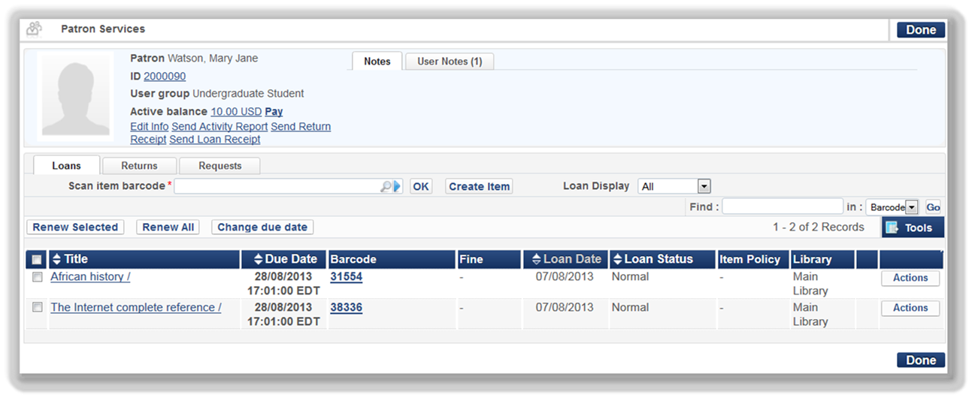

Renew Items
Renew loans from Manage Patron Services
Loan Display: All
Renew individual or multiple items
Notes:
For renewals, items are renewed in the patron’s record through the Manage Patron Services workbench.
In the Loans tab, select All Loans from the Loan Display drop-down.
It’s possible to renew several ways:
use the Action button to the right of an individual loan and click on the renew option
use the check boxes to the left of the loans and click on the Renew Selected button above
renew all of the items in the list by selecting the checkbox in the header of the list; this will select all loaned items. Then use the Renew All button to perform the renew.

Slide 13
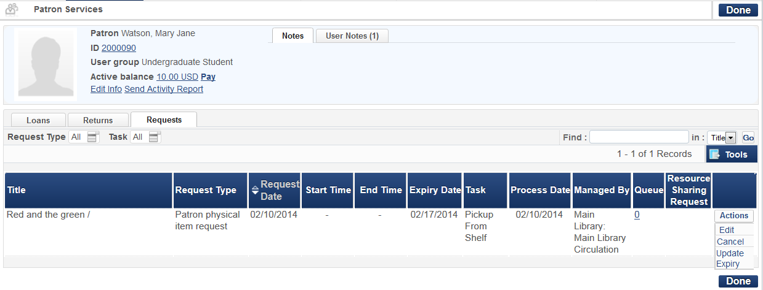
View Requests
View requests patron has made
Edit/update or cancel requests
Notes:
You can view requests the patron has made from Manage Patron Services by clicking on the last tab, Requests.
From there, you can edit the request, cancel the request, or update the expiration on the request as needed.
More information about requests can be found in a later session.

Slide 14

Hands-On Activity
Practicing Loans and Returns:
Log into your Alma sandbox environment as a Circulation staff member for Main Library Circulation
Loan item:
  Click “Manage Patron Services” link in Fulfillment Menu
  Search for patron’s name to loan an item, or enter patron’s ID if known; click Go button.
  In Loans tab: Enter barcode 16591 for item The Adventures of Huckleberry Finn by Mark Twain – or search for an item title using the magnifying glass icon if barcode is unknown. Click OK; loan is made.
Return item for same patron:
  Click on Returns tab in Patron Services screen - OR click Return Item link from Fulfillment menu.
  Enter item barcode or search for item title; click OK.
Notes:
At this point, I encourage you to pause the recording and practice loaning and returning an item in Alma.
The instructions are on the slide. Remember to make sure your “Currently At” location is the Main Library Circulation desk.
Feel free to experiment on your own; for example, add a note in the patron’s record by clicking on their ID from the Patron services screen, or add a note for a loaned item by clicking on Actions > View Notes in the Loans tab.
In a real-world situation, you would scan in the barcode for the patron, or scan in the item barcode to loan or return an item, but for this hands-on activity you’ll just need to search for a patron’s name, or type in the barcode for an item.
When you’re finished, feel free to continue on with the recording.

Slide 15
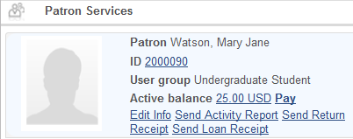
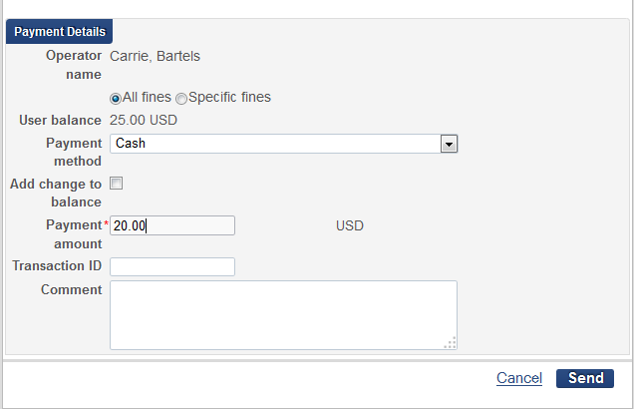
Fines and Fees
View and pay active balance via patron record:
Notes:
Within the Patron Services workbench, it’s also possible to see any fines and fees and to pay for them.
Clicking on the Pay link opens up a payment window where you can choose a payment method (cash, credit card, online, or check are the options that can appear in the drop-down, but you can decide which of those options you would like to appear in the Payment Method drop-down), enter a payment amount and enter a comment if necessary.
Note that the payment can be applied towards a specific fine, or towards all fines that the patron owes. Additionally, if the patron chooses to pay more than what he or she owes, the extra amount can be added as credit to the patron’s balance.
This immediately updates the amount owed on the payment record. When the full amount is paid, all outstanding fines and fees are closed. When a lesser amount is paid, the active balance will display the remaining balance. In the event the patron had multiple fines and fees, any fines and fees that add up to the amount paid are closed; the rest will remain open until they are paid.

Slide 16
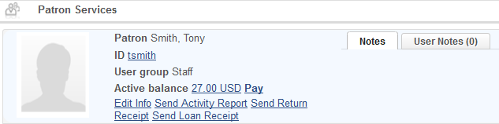
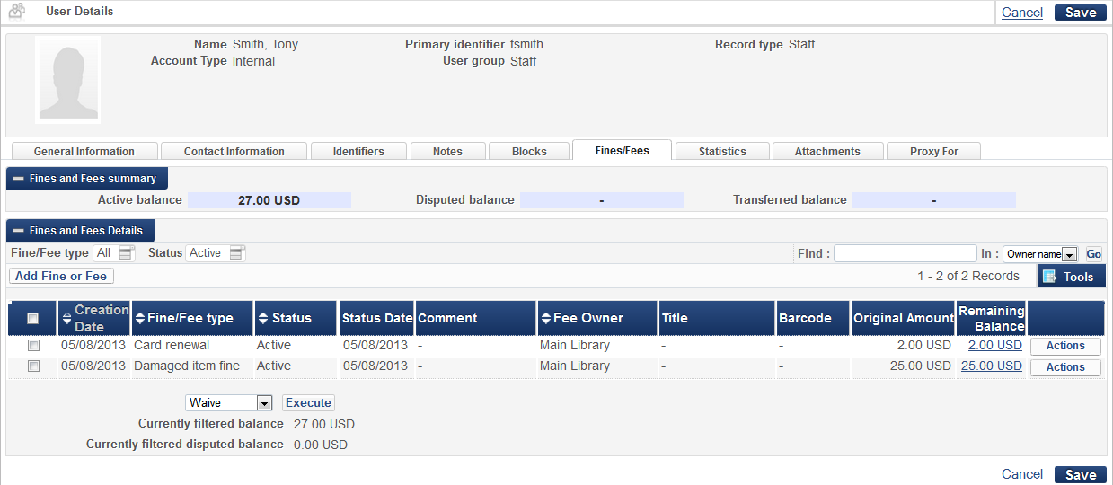
Fines and Fees
For more detail about Fines and Fees, click active balance link to go to Fines and Fees tab of patron record:
Notes:
To find more information about the outstanding active balance, click on the amount link. This links to the Fines and Fees tab of the patron’s full record allowing more details to be seen and transactions to be added, waived or disputed.
Multiple transactions can be selected by using the check boxes - then use the Actions dropdown to handle the multiple transactions in batch. You can also use the Actions button to update a single transaction.
Lastly, a message indicating a user block will appear if you try to loan something to a patron and they have a block on their account.
(Alma Demo: Attempt to loan something to Peter Parker). Depending on your access rights, you may be able to override the block.

