Slide 1
Letter Configuration in Alma

Slide 2
Introduction
The "Letters Configuration" page
Labels, Template and Letter Example
Labels
Template
Letter examples
Components Configuration
WYSIWYG (What You See Is What You Get)

Slide 3
Introduction
As of the August 2019 release of Alma a new methodology and set of options exist in Alma for letter configuration.
As we will see this new functionality provides a more intuitive and easy-to-use method, the most prevalent of which is the WYSIWYG (What You See is What You Get) feature when configuring the XSL.

Slide 4
The "Letters Configuration" page

Slide 5
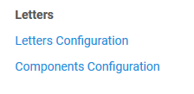
The "Letters Configuration" page
All Alma letters can be accessed for configuration via the Letters Configuration page
This page is accessed via "Configuration > General > Letters > Letters Configuration"

Slide 6
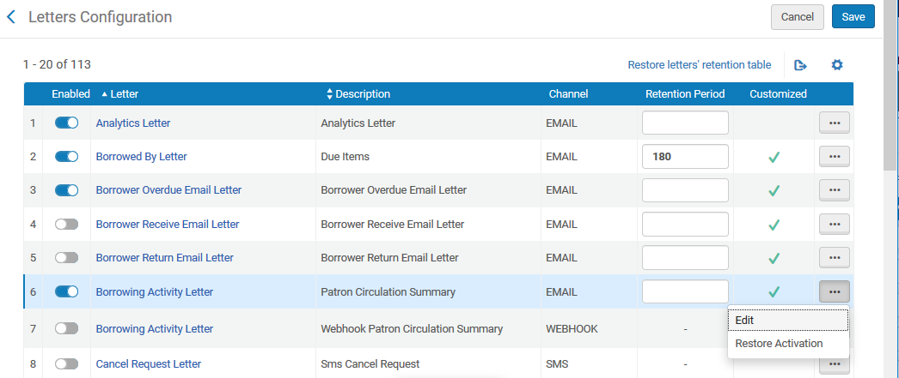
The "Letters Configuration" page
The Letters Configuration Page
Set letter retention
Access the Labels, Template and Letter Examples for the specific letter
Enable / Disable a letter

Slide 7
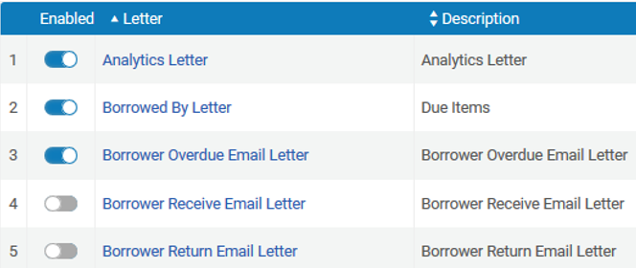
The "Letters Configuration" page (enabling a letter)
If a letter is enabled, it will print, and if it is disabled, it will not print

Slide 8
The "Letters Configuration" page (retention period)
The retention period determines how long the letter will remain in the attachments tab of the patron
If there is no retention period then the letters will remain in the attachments tab indefinitely

Slide 9
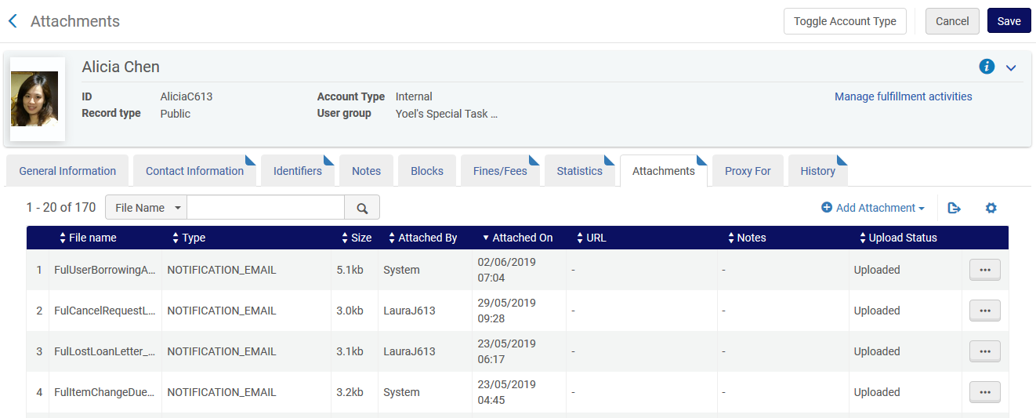
The "Letters Configuration" page (retention period)
If these letters have a retention period then then they will be removed from this list when older (in days) than the retention period

Slide 10
The "Letters Configuration" page (retention period)
Letters are purged (removed) when the weekly scheduled job "Letters purge with retention" runs

Slide 11
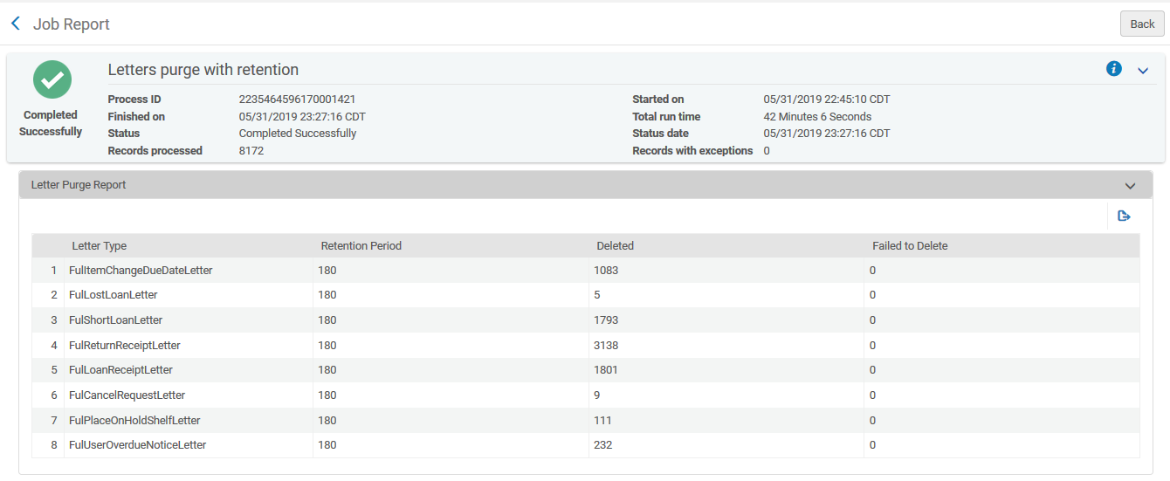
The "Letters Configuration" page (retention period)
In the report, we can see how many of each letter type was deleted

Slide 12
The "Letters Configuration" page (retention period)
In this example, we can see letters as far back as 2012 (beginning of Alma) because no retention period was defined

Slide 13
Labels, Template and Letter Example

Slide 14
Labels, Template and Letter Example
When selecting “Edit" from the "Letters Configuration" page, editor goes to the …

Slide 15
Labels, Template and Letter Example
Page of labels, templates and examples for the specific letter

Slide 16
Labels

Slide 17
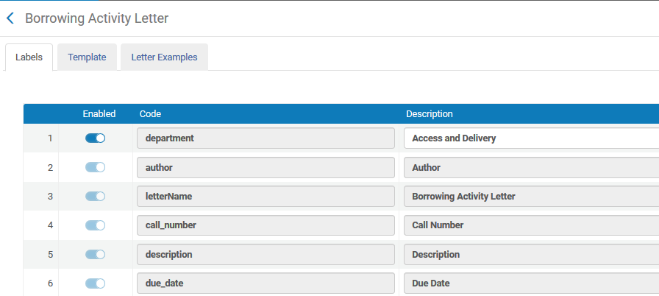
Labels
Labels on this page…

Slide 18
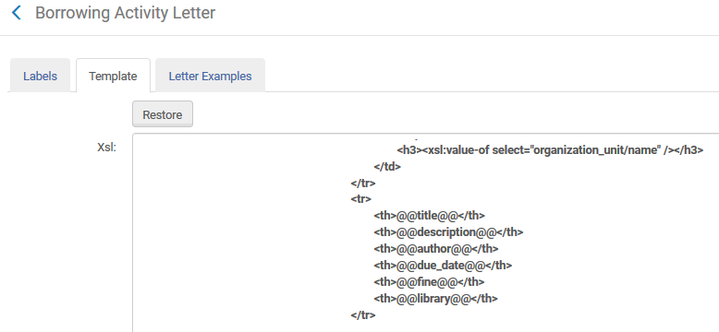
Labels
…correspond to all places in the XSL template where there are two @ signs opening and closing a textual value

Slide 19
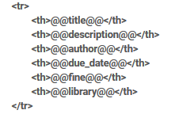
Labels
Where it states @@description@@ in the XSL, the label shows "Description" in the label
In the labels
In the XSL

Slide 20
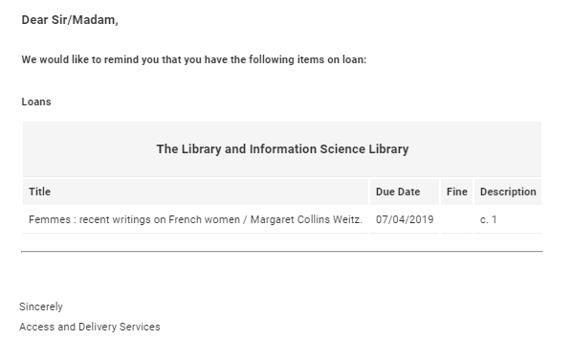
Labels
Here it is in the letter to the user

Slide 21
Labels
Using the labels to change text of a letter is an easy way to edit letters without needing to edit the actual XSL
Instead of editing XSL, simply change the text in the label
If the letter should state "Item Description" instead of just "Description," change it here in the labels:

Slide 22
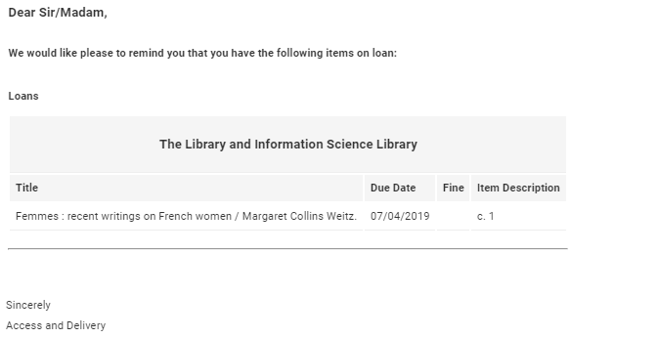
Labels
Now the text of the letter has changed

Slide 23
Template

Slide 24
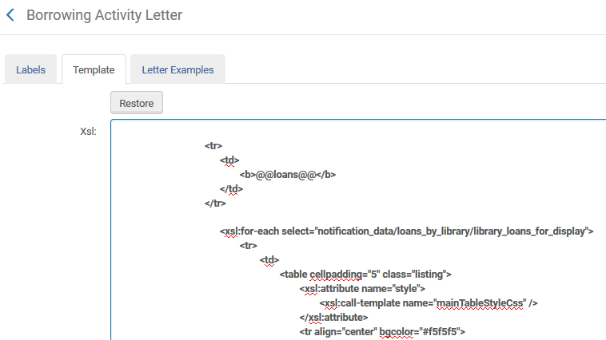
Template
From the template tab it is possible to view and edit the template (XSL style sheet) of the specific letter

Slide 25
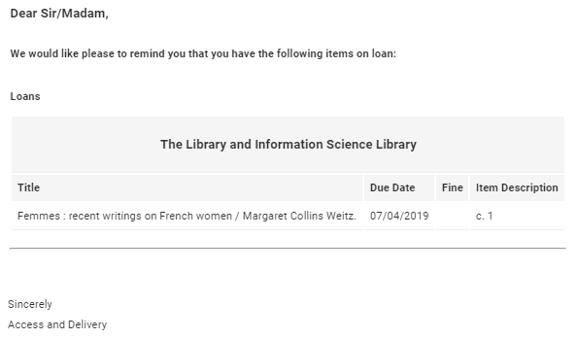
Template
Perhaps we want to change the format and or text of this letter where it states "Loans"

Slide 26
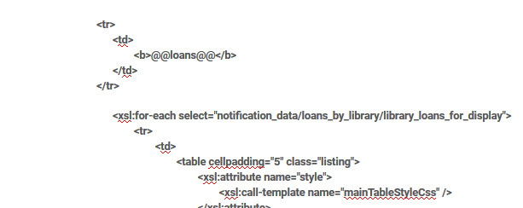
Template
In this case, we change this part of the XSL

Slide 27
Template
Instead of this…
<tr>
<td>
<b>@@loans@@</b>
</td>
</tr>

Slide 28
Template
We can put this…
<tr> <td>
Please remember to return these items <font color = "red"> <u> <b>on time </b> </u> </font>
</td> </tr>
<tr> <td>
If you have a question, please <a href = "mailto:circulation_desk@library.edu">contact the Circulation Department</a>
</td> </tr>

Slide 29
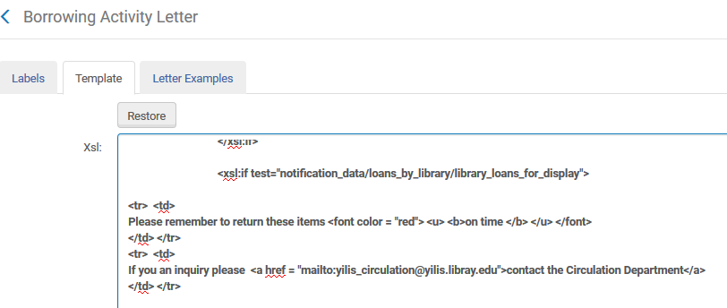
Template
Here it is in the XSL…

Slide 30
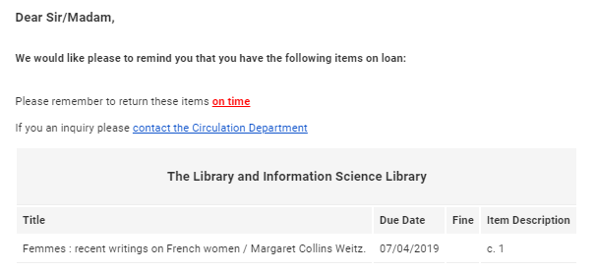
Template
And here it is in the letter
Note: Later we will see how the "Preview Letter" option can be used to test the edited changes of the XSL without sending the letter.

Slide 31
Letter Examples

Slide 32
Letter examples
We will return to the "Letter Examples" tab later; more relevant after we review the section "WYSIWYG"

Slide 33
Components Configuration

Slide 34
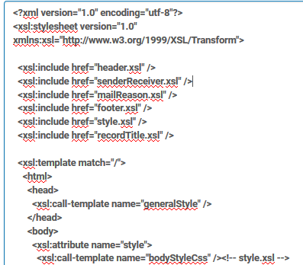
Components Configuration
Many letters in Alma consist of "calls" to other letters
Here is the beginning of the Borrowing Activity Letter

Slide 35
Components Configuration
These calls to common letters save the need to repeat "coding" for each letter
Most letters start with the following (example on next slide)
An icon
Name of letter
Date
By having the reference to these "common values" all in one referenced letter, the design and configuration of the letter mechanism is efficient and easy to maintain

Slide 36
Components Configuration
This is an example whereby most all letters start with an icon, name of letter and date:

Slide 37
Components Configuration
Reference to the logo, letter name and date is all in the one header
It does not need to be in each separate xsl; only a call to the header is needed
This is header.xsl
…
<!-- LOGO INSERT -->
<tr> <xsl:attribute name="style">
<xsl:call-template name="headerLogoStyleCss" /> <!-- style.xsl -->
</xsl:attribute>
<td colspan="2">
<div id="mailHeader">
<div id="logoContainer" class="alignLeft"> <img src="cid:logo.jpg" alt="logo"/>
</div> </div> </td>
</tr>
<!-- END OF LOGO INSERT -->
<tr> <xsl:for-each select="notification_data/general_data">
<td> <h1><xsl:value-of select="letter_name"/> </h1> </td>
<td align="right"> <xsl:value-of select="current_date"/> </td> </xsl:for-each>
</tr>
…
Logo
Letter name
Date

Slide 38
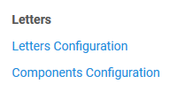
Components Configuration
Common XSL files are accessed via the "Components Configuration"

Slide 39
Components Configuration
Here, the header can be changed; will immediately affect all letters that use the header

Slide 40
Components Configuration
Change this…
<!-- LOGO INSERT -->
<tr>
<xsl:attribute name="style">
<xsl:call-template name="headerLogoStyleCss" /> <!-- style.xsl -->
</xsl:attribute>
<td colspan="2">
<div id="mailHeader">
<div id="logoContainer" class="alignLeft">
<img src="cid:logo.jpg" alt="logo"/>
</div>
</div>
</td>
</tr>
<!-- END OF LOGO INSERT -->

Slide 41
Components Configuration
…to this…
<!-- LOGO INSERT -->
<tr align="right">
<xsl:attribute name="style">
<xsl:call-template name="headerLogoStyleCss" /> <!-- style.xsl -->
</xsl:attribute>
<td colspan="2">
<div id="mailHeader">
<div id="logoContainer" class="alignLeft">
<img src="cid:logo.jpg" alt="logo"/>
</div>
</div>
</td>
</tr>
<!-- END OF LOGO INSERT -->

Slide 42
Components Configuration
…and, this…

Slide 43
Components Configuration
…to this…

Slide 44
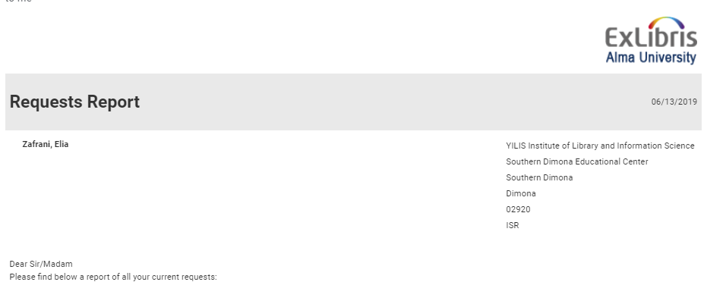
Components Configuration
This change will effect for all other letters that "call" header.xsl
Both "Borrower Activity Letter" and "Requests Report" use "header.xsl" so both were changed.

Slide 45
WYSIWYG

Slide 46
WYSIWYG

Slide 47
WYSIWYG
It is possible to test the configuration changes to XSL
Without even saving the XSL (just editing)
Based on real actual raw XML of letters which have been sent in the past
In other words: What you see is what you get
What is configured in the XSL is what you see on the screen when clicking "Preview“; no need to send a letter and no need to save the XSL – just start configuring and click "Preview“; when satisfied with the configuration, click "Save"
Let’s see how it works

Slide 48
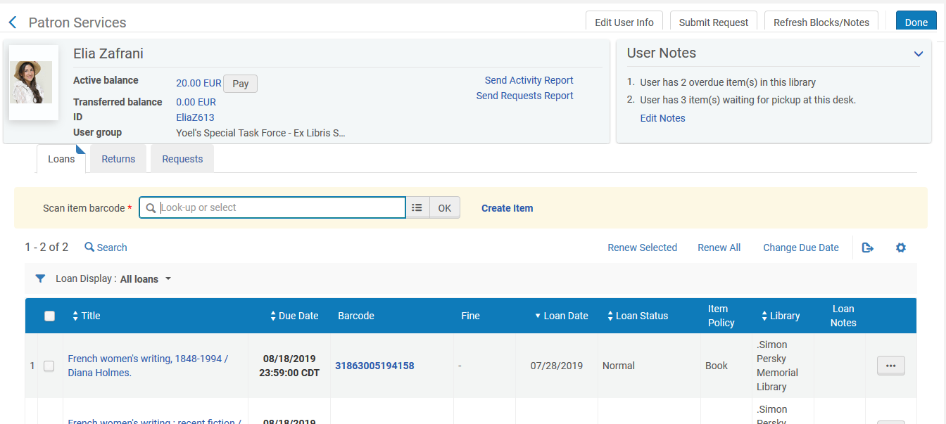
WYSIWYG
Sending an activity report to a patron

Slide 49
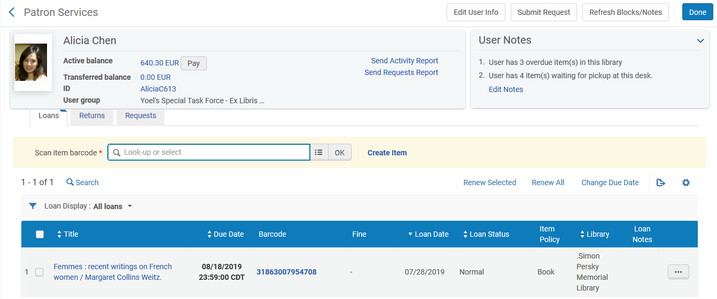
WYSIWYG
Sending an activity report to another patron

Slide 50
WYSIWYG
Let’s go to "Configuration > General > Letters > Letters Configuration"
Then, “Edit" the "Borrowing Activity letter" and switching to the "Letter Examples" tab

Slide 51
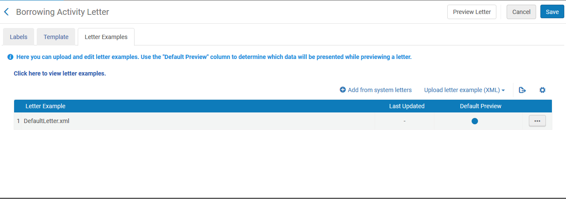
WYSIWYG
We see the default letter and choose "Add from system letters"

Slide 52
WYSIWYG
We see the letters we have already sent and can choose which ones for which we want to view the raw XML; these letters were automatically added
These are the two letters we just sent a moment ago

Slide 53
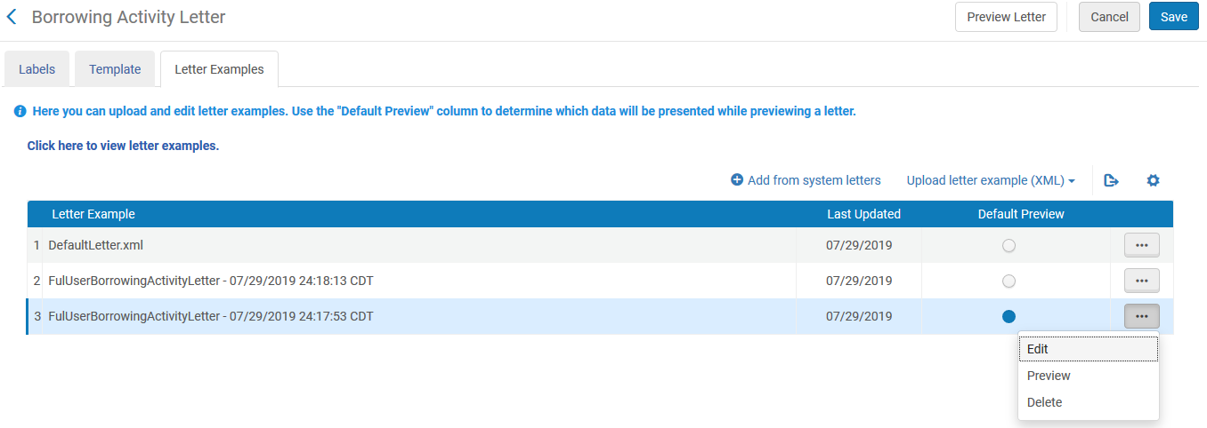
WYSIWYG
For each raw XML version chosen, we can edit, preview or delete

Slide 54
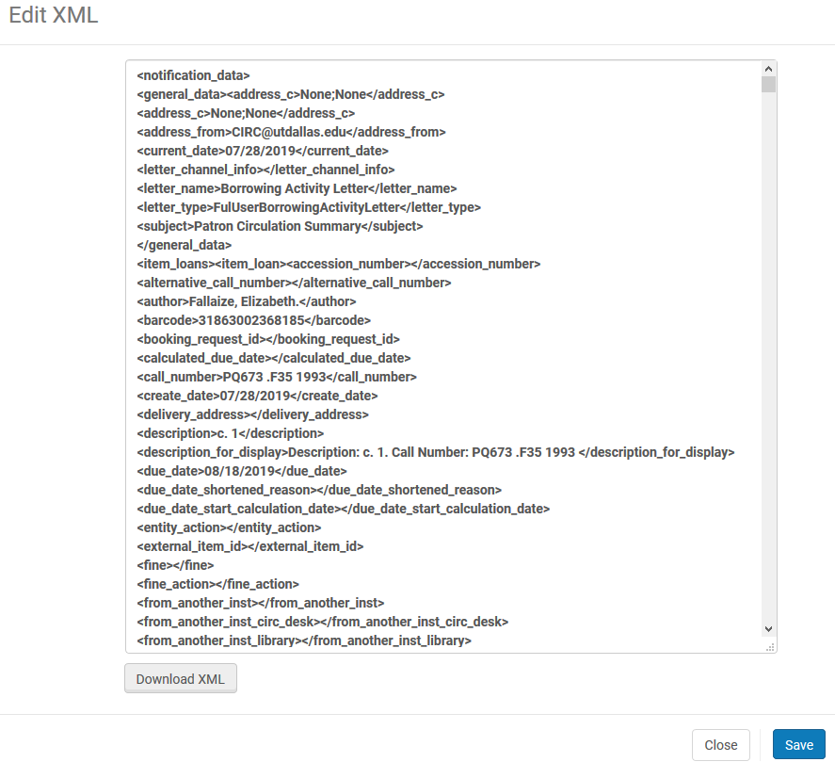
WYSIWYG
When choosing edit we can view, edit and download the XML

Slide 55
WYSIWYG
We can also determine in the "Letter Examples" tab which XML example will be used as the default when we use the WYSIWYG option in the "Template" tab

Slide 56
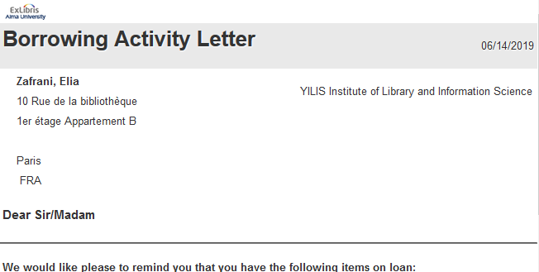
WYSIWYG
Editing the XSL and utilizing the WYSIWYG feature
In this example, we see that the phone number of the institution is not included with the address in the default letter; let’s check the XML to see if it is possible to add it
No phone number

Slide 57
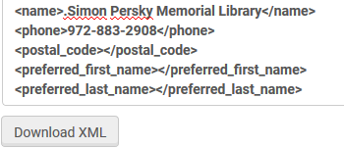
WYSIWYG
The phone number of the institution is in the XML and can be added to the letter

Slide 58
WYSIWYG
To add it to the XSL, we need the name and path of the field
There are many ways to get the path. Here we are using a Notepad ++ plugin after downloading the XML

Slide 59
WYSIWYG
This is the path we need to add to the XSL
/notification_data/loans_by_library/library_loans_for_display/item_loans/overdue_and_lost_loan_notification_display/physical_item_display_for_printing/owning_library_details/phone

Slide 60
WYSIWYG
We add the phone to the XSL by replacing this…
<xsl:if test="notification_data/item_loans/item_loan or notification_data/overdue_item_loans/item_loan">
<tr>
<td>
<b>@@reminder_message@@</b>
<br/><br/>
</td>
</tr>

Slide 61
WYSIWYG
With this…
<xsl:if test="notification_data/item_loans/item_loan or notification_data/overdue_item_loans/item_loan">
<tr>
<td>
<b>@@reminder_message@@</b>
<br/><br/>
</td>
</tr>
<tr> <td> <b>We can be reached by phone at: <xsl:value-of select="notification_data/loans_by_library/library_loans_for_display/item_loans/overdue_and_lost_loan_notification_display/physical_item_display_for_printing/owning_library_details/phone"></xsl:value-of></b> <br/><br/> </td> </tr>
This is the path of the value (phone number) we found in the XML

Slide 62
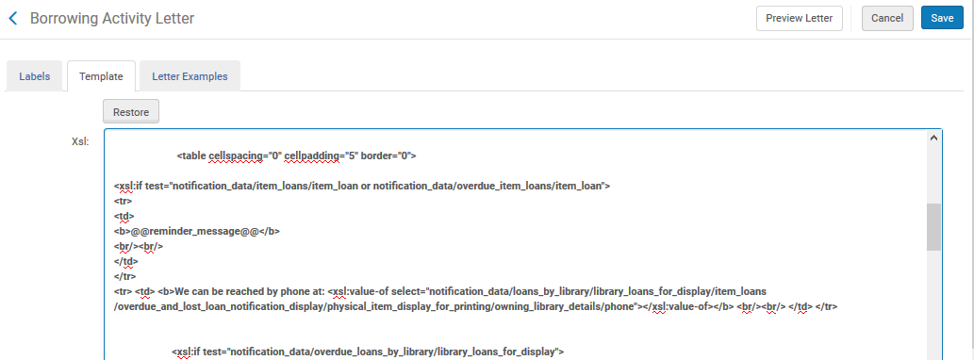
WYSIWYG
We have added this phone number to the XSL and can preview how it will appear without actually sending it to a recipient and without even saving the XSL
Clicking "Preview" we will experience WYSIWYG: However the XSL has been edited is how the letter will appear.

Slide 63
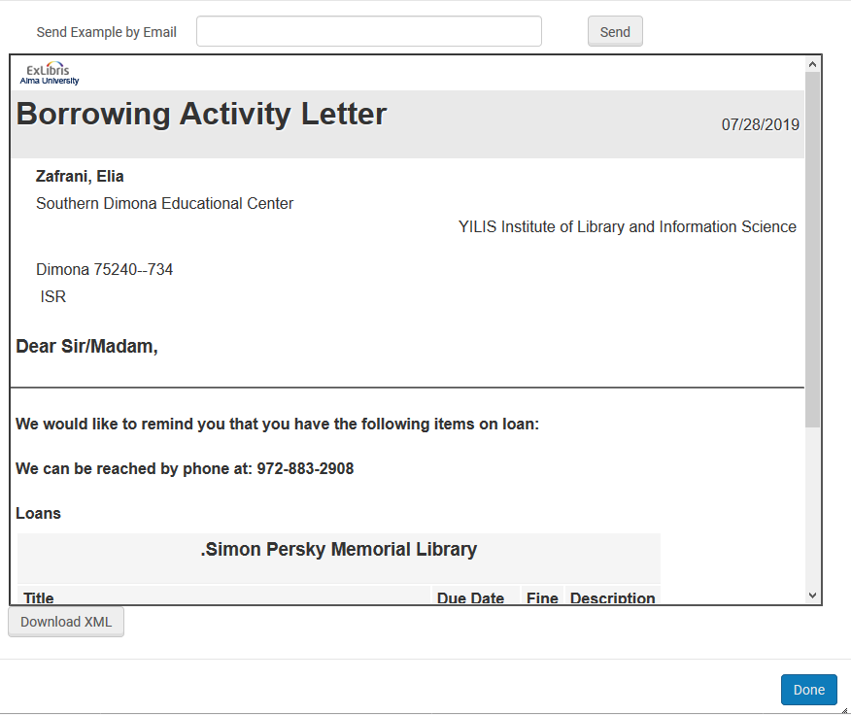
WYSIWYG
What we see is what we get from the current XSL configuration: WYSIWYG
If we like the results, save the XSL and move on
Or, we continuing editing the XSL and testing until satified

Slide 64
WYSIWYG – Summary
When we sent the Borrowing Activity Letter to the patron the XML versions of the letters were automatically added and we could define which one would be used as the default preview when testing the XSL; this was done via the "Letter Examples" tab
Via the "Template" tab, we could edit the XSL and "Preview" until satisfied after which we could save it, knowing it will be sent according to how it appeared in the "Preview"

