Slide 1
Course Reserves and Reading Lists

Slide 2
User Roles
Course Reserves Operator – Manages courses, lists, and associated inventory
Course Reserves Manager – As above, with the ability to reassign reading list ownership
Fulfillment Services Operator & Manager – Course & list management plus additional request management rights

Slide 3
Course Reserves Workflow
Citations added to Alma
Resolve citations
Staff chooses action
Link to list with no change
Move items to reserves
Digitize
Create temporary item
Publish to Discovery
Enter into CMS

Slide 4
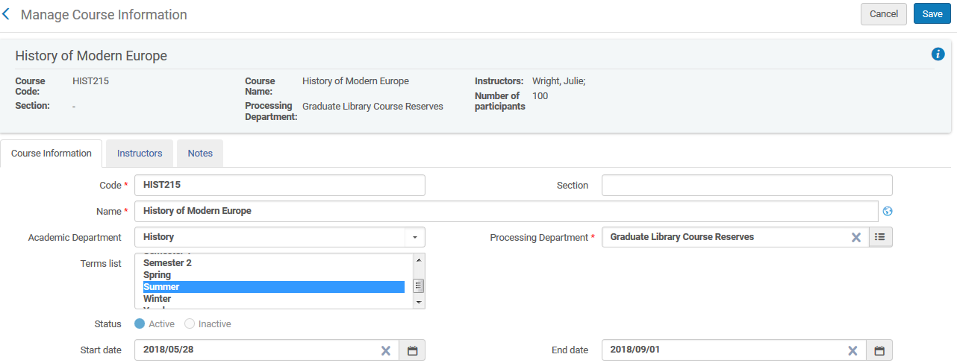
Course Records
Store basic information about a course
Are searchable via the discovery interface
May be updated and reused

Slide 5
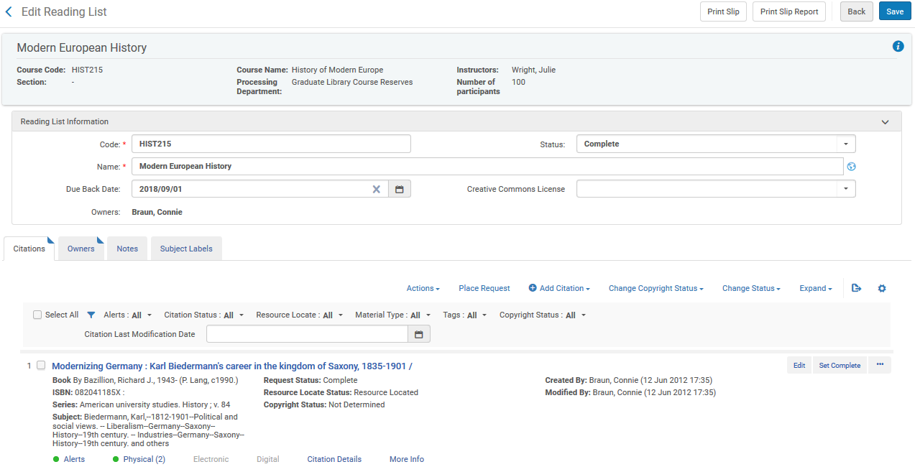
Reading Lists
Attach to course records
Store a series of citations of requested items
Have a global status bound to the start and end dates

Slide 6
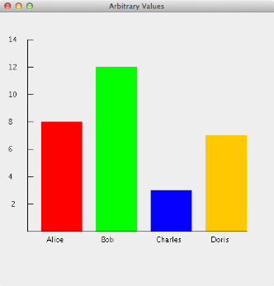
Citations and Resources
Citations
Represent requested items
Are not yet bound to inventory
May be bound to inventory by choosing a fulfillment method
Will not be published to discovery
Resources
May be bound to citations to fulfill requests
Are published to discovery

Slide 7
Citations and Resources
Determine how to fulfill item: Locate item in inventory and move to course reserves? Link to item in inventory? Digitize item? Create temporary item?

Slide 8
Reading List Workflow
Create or import a list of citations in reading list
Move citations to a status of “in process”
Choose a management action
Link to list (no action; set as complete)
Move to reserves (move request; updates policies)
Digitize (digitization request)
Create temporary item (faculty copy)
Complete and publish (automatic at course start)

Slide 9
Other Options: Add to Reading List

Slide 10
Other Options: Scan-In Items

