Slide 1
Invoicing Workflows

Slide 2
User Roles
Invoice Operators: create and review invoices
Invoice Operator Extended: confers privilege to delete/cancel invoices
Invoice Managers: create, review and approve invoices
Receiving Operator: manages arrival of purchased physical items; may perform post-receiving processing tasks in appropriate receiving department
Acquisitions Administrator: manages invoice configuration rules

Slide 3
Invoicing Workflow Overview
Manages how an invoice is handled from point of receipt to point it is paid
Invoices can be created:
Manually
Automatically via EDI
Receiving may be handled as part of workflow
Payment requests may optionally be exported to institution’s ERP
Lifecycle of the invoice depends on your needs for review and exporting to a financial system

Slide 4
Workflow Considerations
Some considerations…
Do you export/import invoices to/from an ERP?
Do you invoice via EDI?
Do staff operators to have separate invoicing roles or does one staff operator perform all tasks?
Do you have an Invoice approval process?
Invoice Review Rules and Invoice Approval Rules may be configured to handle any of these options

Slide 5
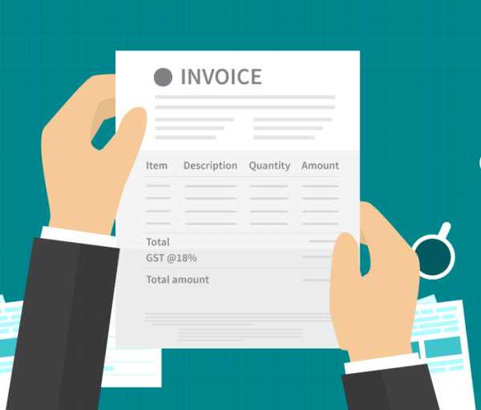
Invoice Creation
An invoice is created in one of four ways:
Manually
by entering the invoice details manually
from the PO using the PO details
from a formatted Excel file
Automatically
via Electronic Data Interchange (EDI)

Slide 6
Create an Invoice Manually

Slide 7
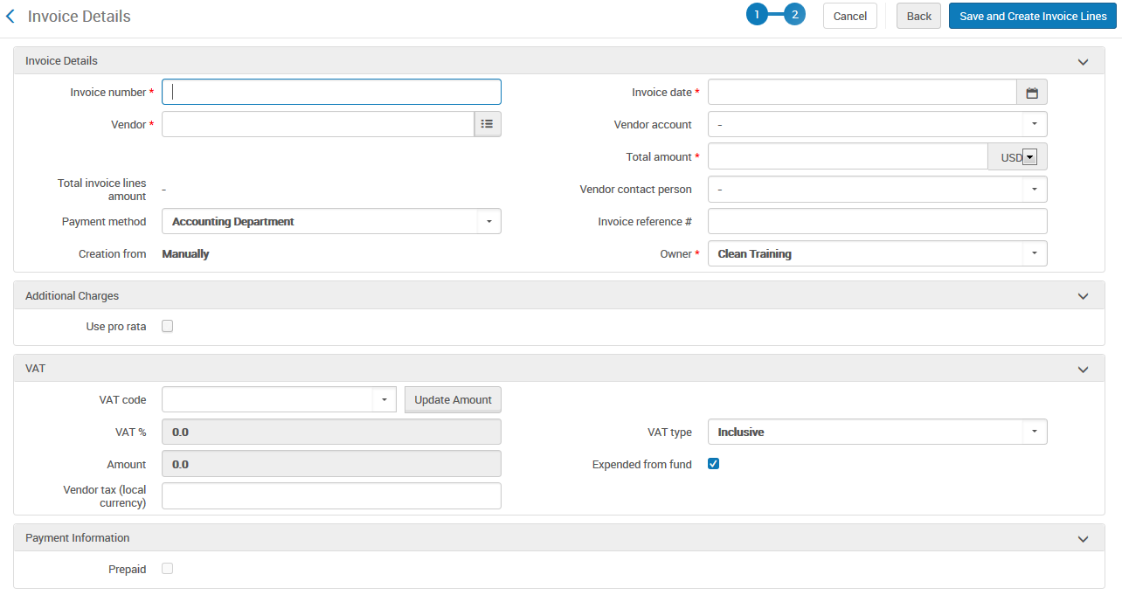
Invoice Details

Slide 8
Prepaid
The Prepaid function is enabled only when the Payment method is something other than Accounting department

Slide 9
Internal Copy
Using the Internal Copy option indicates that the invoice is to be loaded into Alma for internal documentation or tracking purposes
Note: The Internal Copy option appears only if Alma is configured to send invoices via ERP when the invoice_skip_erp parameter is set to false

Slide 10
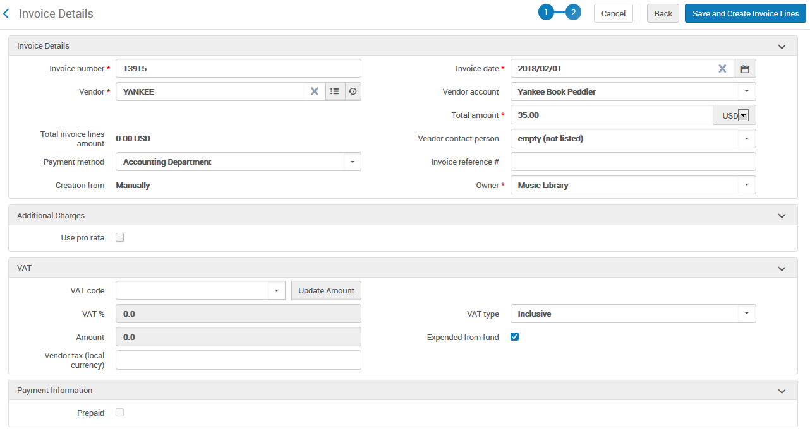
Create Invoice Lines

Slide 11
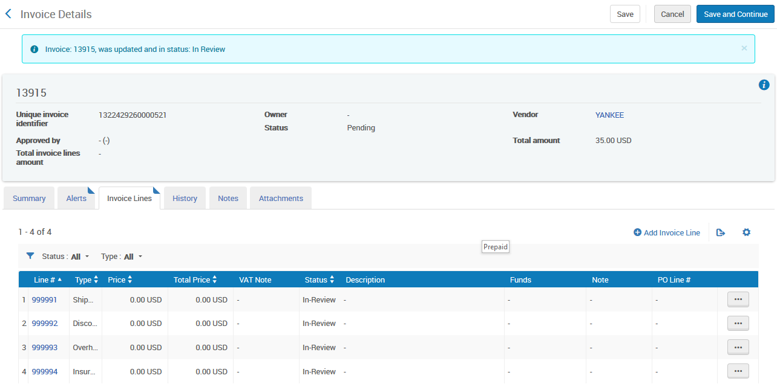
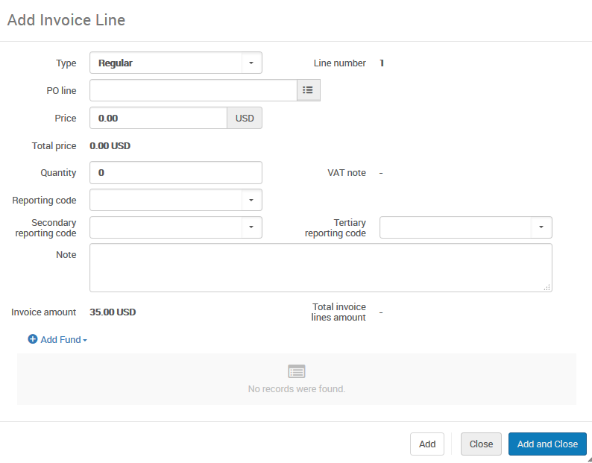
Add Invoice Lines Manually

Slide 12
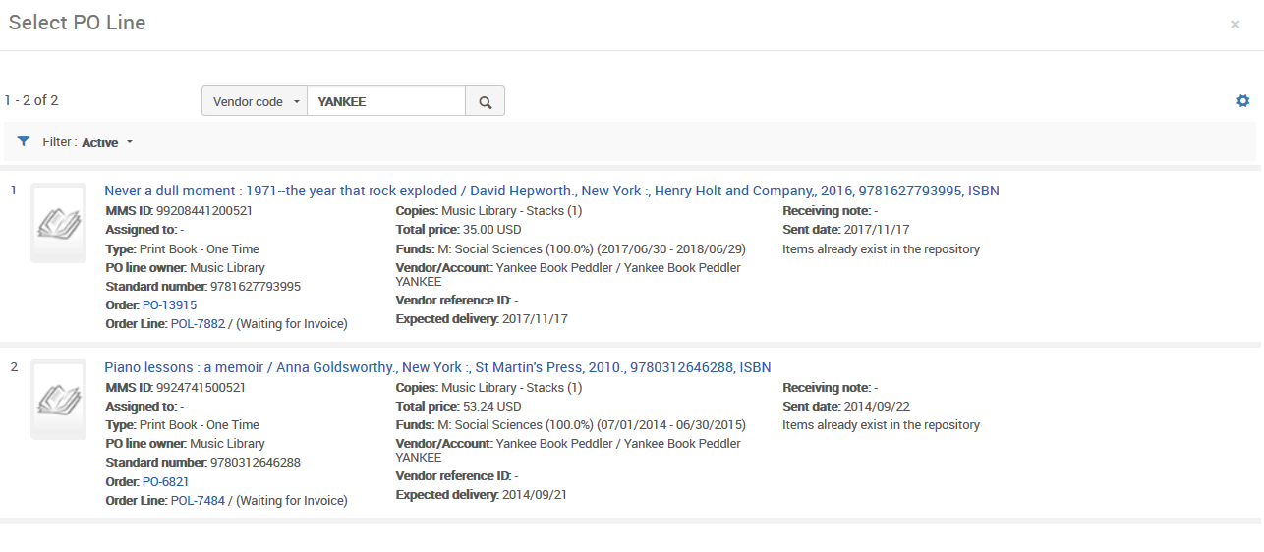
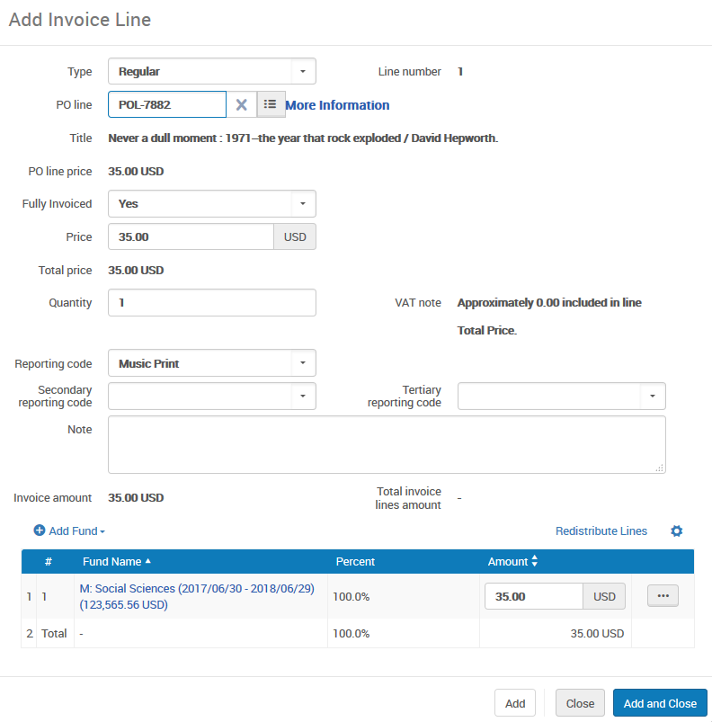
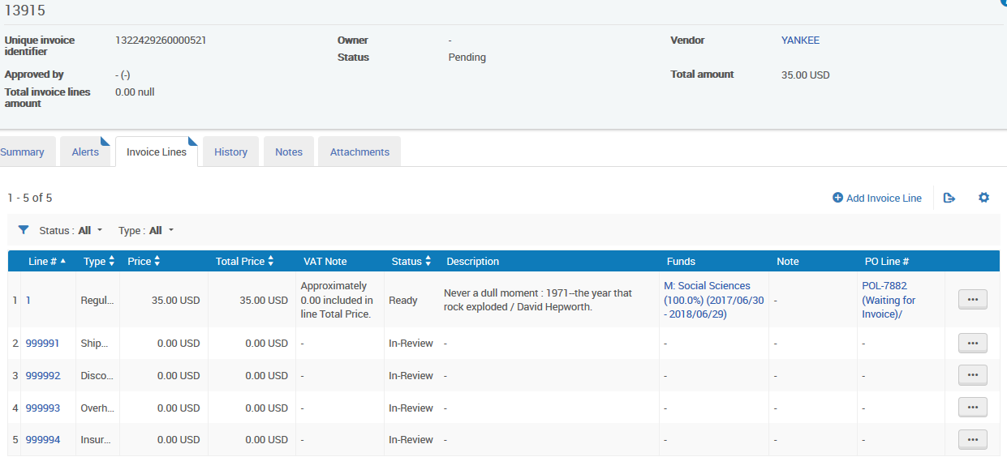
Add Invoice Lines Manually

Slide 13
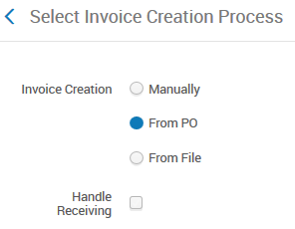
Create Invoice From PO

Slide 14
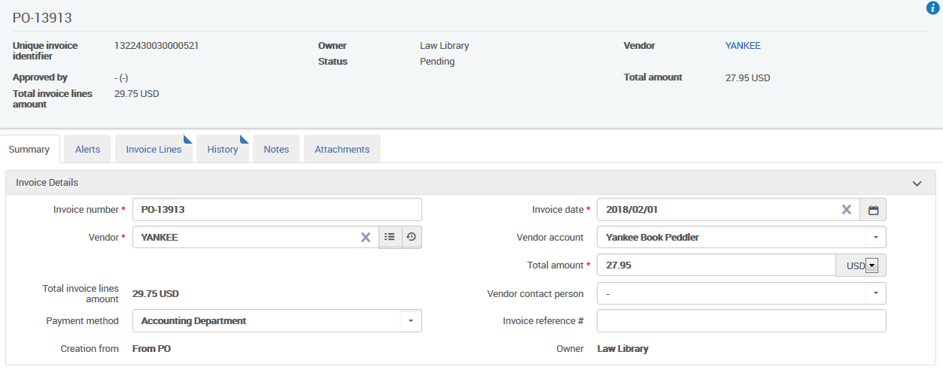
Create Invoice From PO

Slide 15
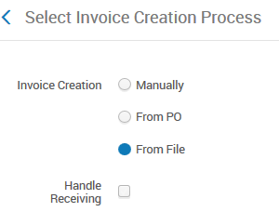
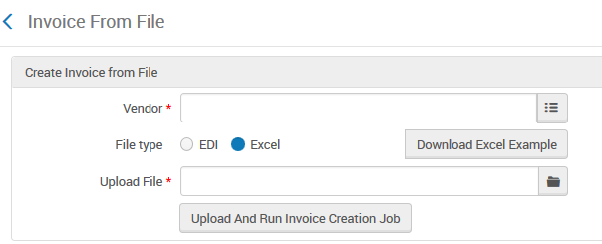
Create Invoice From File

Slide 16
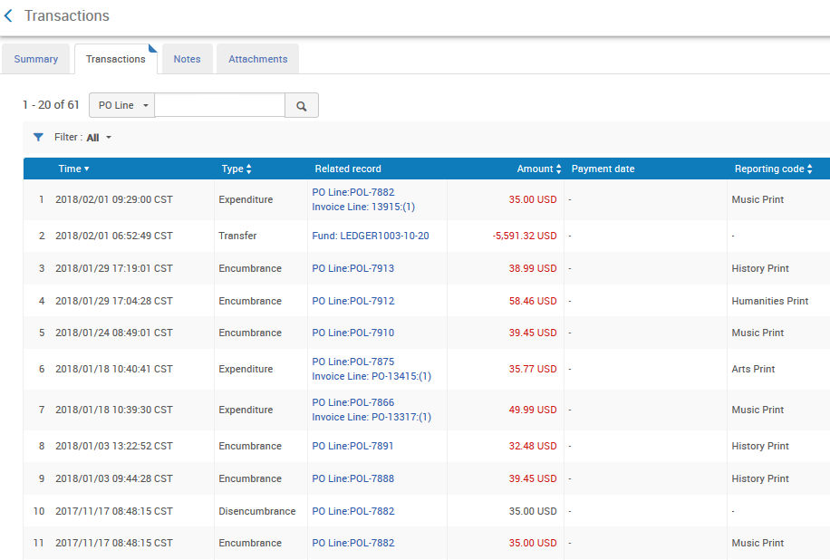
Create Invoice – Fund Transaction
Following invoice creation, two transactions will be entered in the fund to complete the purchase process:
Disencumbrance
Expenditure

Slide 17
Invoicing Via EDI
EDI files created for invoices are based on international standards for EDI transmission
For details, see EDI integration in Alma at https://developers.exlibrisgroup.com/alma/integrations/edi/
Talk with your Ex Libris project team to build a testing plan

Slide 18
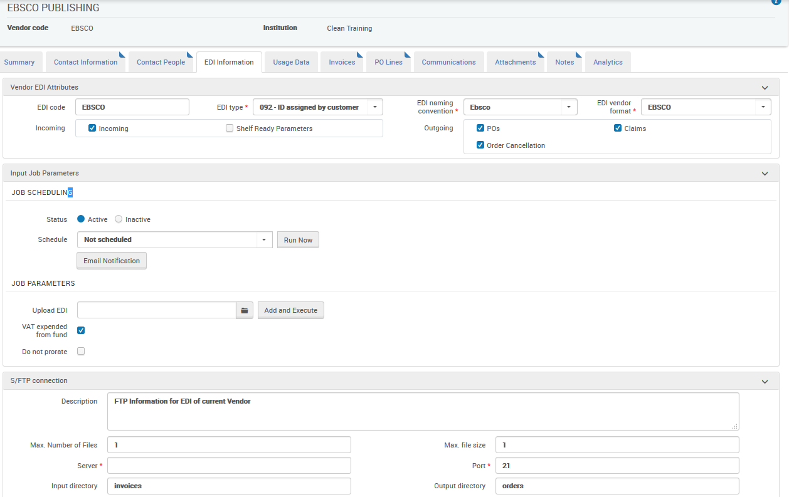
Vendor EDI Information

Slide 19
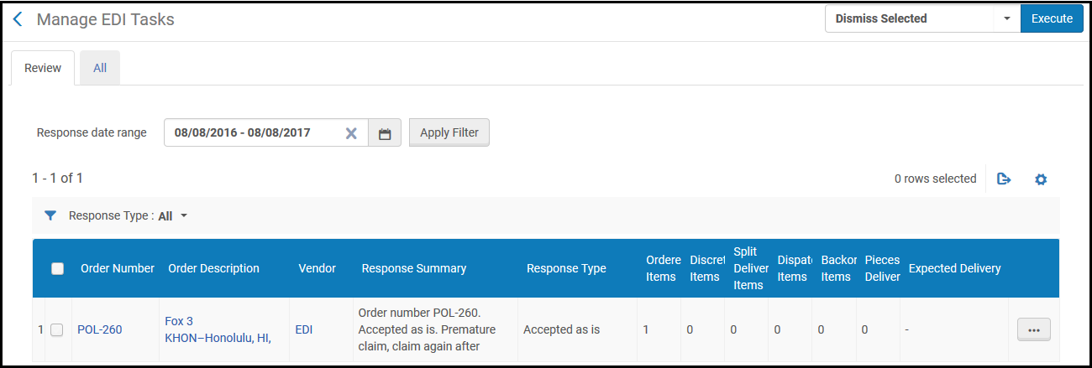
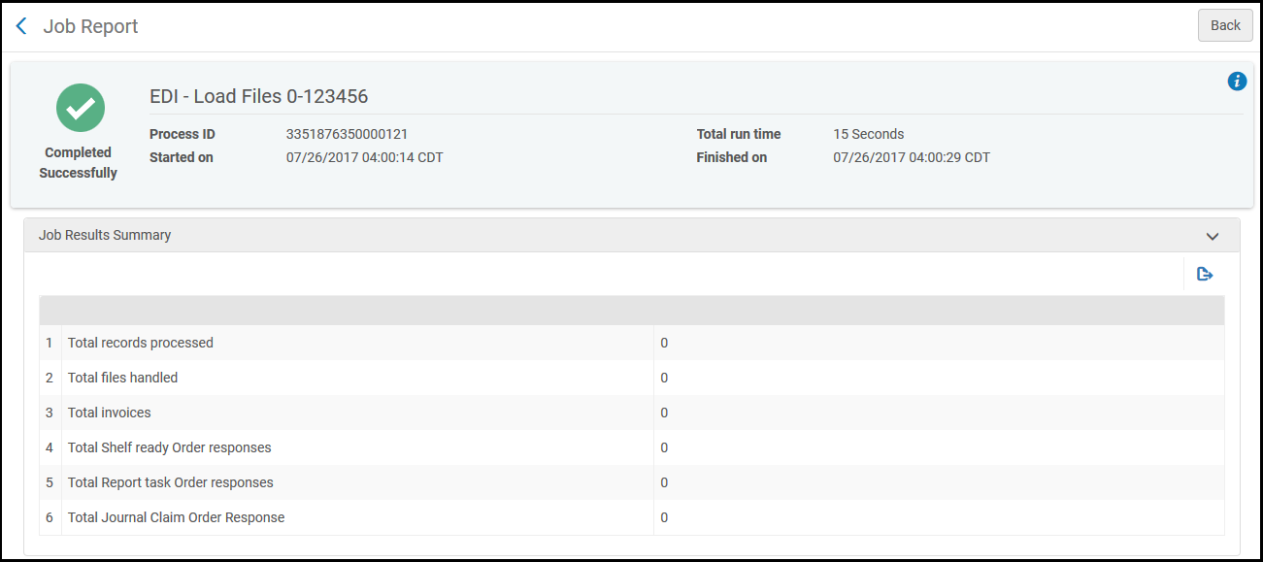
Manage EDI Tasks

Slide 20
Reviewing Invoices
Create Invoice
(EDI, .xls, manually, from PO)
Review
Approve
(OPTIONAL)
Invoices are sent to Review status if:
Review rules are configured to require manual review in certain circumstances
Save is used instead of Save and Continue during invoice creation process
Data issues or alerts are discovered during processing

Slide 21
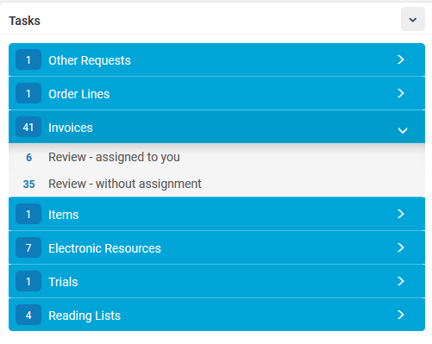
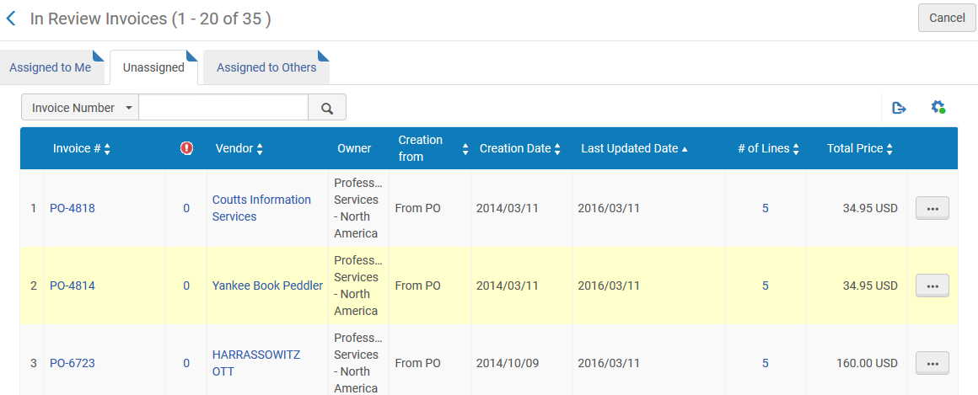
Reviewing Invoices

Slide 22
Reviewing Invoices
Alerts tab displays a list of alerts and provides guidance to edit data appropriately
Invoice lines may be edited before clicking on Save and Continue button to go to next step of workflow

Slide 23
Approving Invoices
Create Invoice
(EDI, .xls, manually, from PO)
Review
Approve
(OPTIONAL)
Invoices are sent to Approve status if:
Approval rules are configured to require manual review in certain circumstances
Data issues or alerts are discovered during processing
Approval step may not be needed depending on library’s process

Slide 24
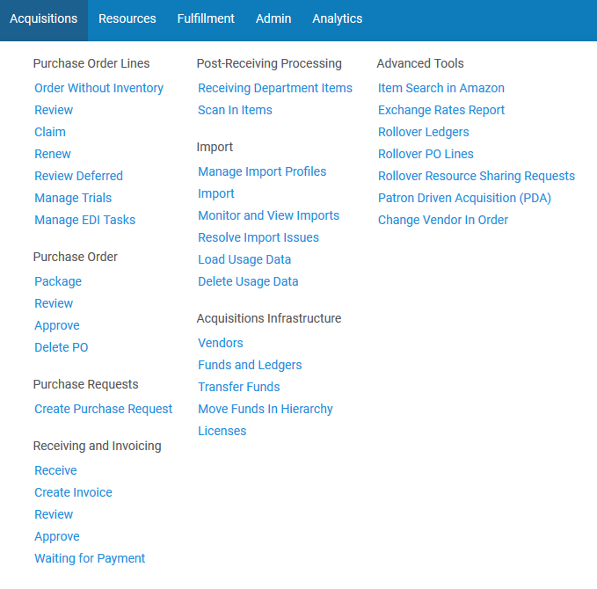
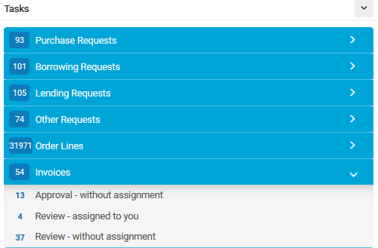
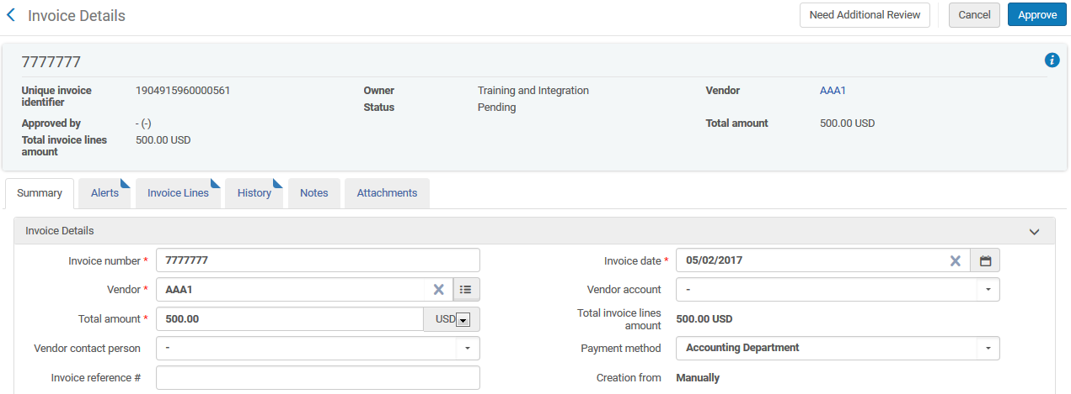
Approving Invoices

Slide 25
Invoice Payment
Status: Ready to be Paid
(No action needed)
Status: Waiting for Payment
Status: Paid
(No action needed)
Status: Closed
(No action needed)
When an invoice reaches the payment stage, it awaits payment-processing
Can set an invoice to Waiting for Payment manually or via ERP

Slide 26
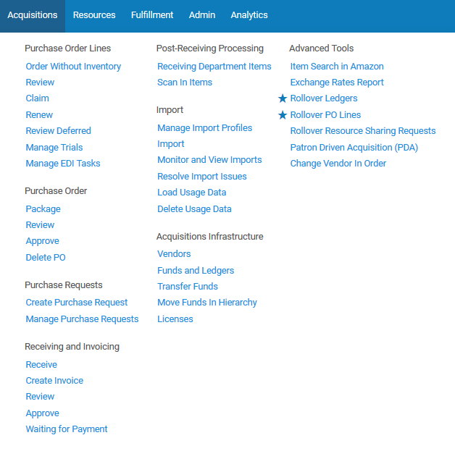
Invoice Payment

Slide 27
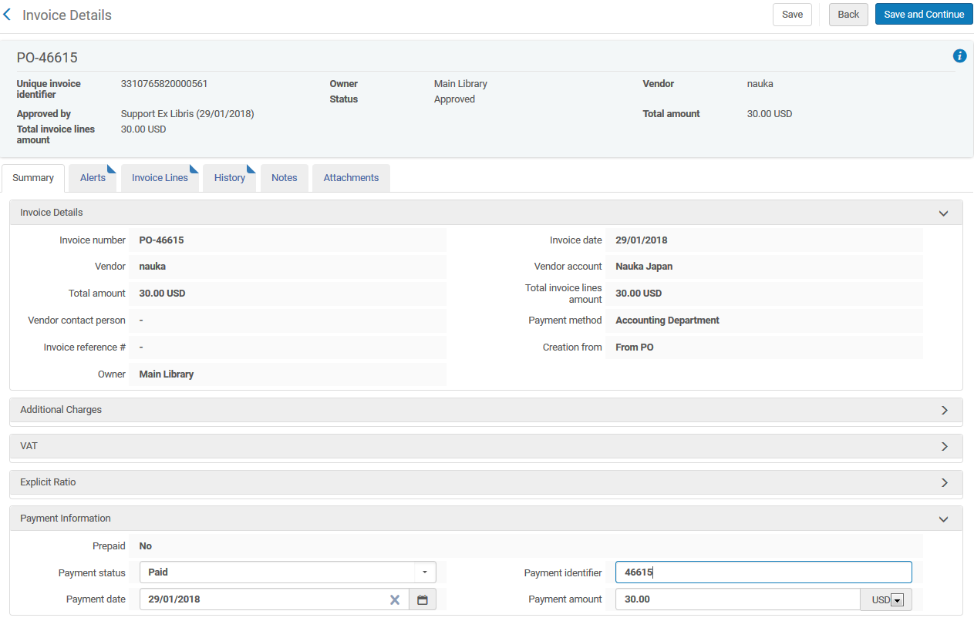
Invoice Payment

Slide 28
Closed Invoice

