Slide 1
Import Profiles

Slide 2
User Roles
Cataloger Administrator, Catalogers – Import and edit bibliographic records; manage import profiles
Electronic Inventory Operator, Physical Inventory Operator – Import and edit respective inventories
Purchasing Operator, Purchasing Manager – Import bibliographic records (for EOD)
General Administrator – Manage import profiles

Slide 3
Import Profiles
Import profile – Defines settings for importing records and creating inventory/orders
New order – use to import records and create new orders and inventory
Update inventory – use to import records and update existing inventory
Repository – use to import Bib records and create new physical or electronic inventory
Digital – use to load digital objects or Bib records as remote representations
Collection – use to load a collection tree and related Bib records
Discovery – use to load records from external systems for discovery

Slide 4
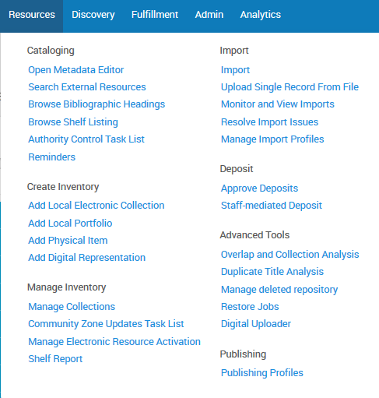
Create Import Profiles

Slide 5
Metadata Import Workflow
Bib Records
EOD
Shelf-ready
Normalize/
Validate/
Enrich
Handle
Import
Issues
Match/
Merge
Save to Repository

Slide 6
Run Import

Slide 7
Monitor Import
7

Slide 8
Handling Import Issues
8

