Slide 1
Fulfillment Overview

Slide 2
Fulfillment User Roles
Fulfillment administrator
Fulfillment services manager
Circulation desk manager
Course reserves manager
Resource sharing partners manager
Circulation desk operator and limited
Course reserves operator
Fulfillment services operator
Instructor
Requests operator
Work order operator
Notes:
There are roles for each Fulfillment-related area in Alma. These roles are assigned to users depending on the type of Fulfillment tasks they perform in Alma. Some operators at your institutions will have some or all of the roles mentioned here. Look for more detail about these roles to be covered during the subsequent Fulfillment sessions.

Slide 3
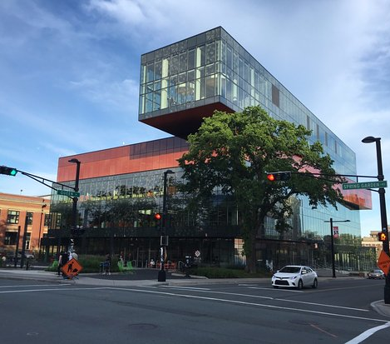
Institution
Each Alma institution is established with one or more libraries
Institution details include:
General information
Library details
Contact information
Calendar details (global)
Notes:
Each Alma institution begins at the institution level with one or more associated libraries.

Slide 4
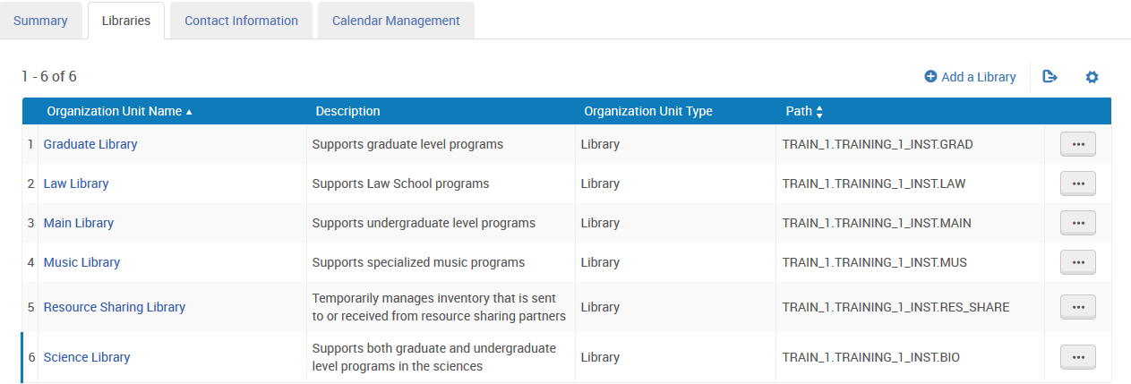
Libraries
Each library is uniquely identified in Alma so that the specific needs of that library may be addressed
Notes:
While each library is uniquely identified, we may also establish relationships among them.

Slide 5
Relationships Among Libraries
Relationships comprise:
Deliver to – the library that you are configuring is able to deliver requested items to a requesting library
Circulate for – the library that you are configuring is able to check in and check out items for the designated library
Acquire for – the library that you are configuring is able to acquire items for the designated library
Notes:
Relationships are used to define services that one library is able to perform for another library within the institution.

Slide 6
Locations
Locations are physical places where items are stored
For this reason, locations are associated with libraries, not with institutions
Notes:
Locations, sometimes known as a shelving location, holding location, or storage location are places where physical items are stored.

Slide 7
Fulfillment Units, Terms of Use, Policies
Fulfillment Units
A grouping of locations that use similar Terms of Use
A grouping of similar policies (loan-related policies, request-related policies, booking policies, etc.)
Policies are the smallest elements; they comprise all options for how fulfillment ultimately works in your institution
Terms of Use (ToU)
Policies
Notes:
Very important to fulfillment activities are Fulfillment Units, Terms of Use and Policies, as they govern things such as loan periods, what happens when an item is requested or recalled, fines and fees, and much more.

Slide 8
Fulfillment Units
Comprise sets of rules that apply to one or a group of locations using identical policies
Includes separate definitions for
Loans
Requests for
Physical items
Digitization
Utilize one or more Terms of Use (ToU)
Notes:
Fulfillment units are configured to define the behaviours for loans and requests. Fulfillment units depend heavily on one or more Terms of Use to implement appropriate rules for locations.

Slide 9
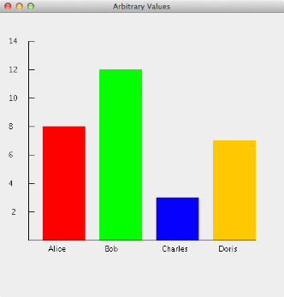
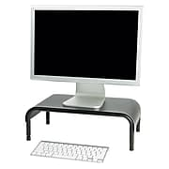
Terms of Use and Policies
Are used as part of fulfillment units in connection with
Loans
Requests
Physical Items
Digitization
Booking
Resource sharing
Lending
Borrowing
Includes fulfillment policies
Notes:
Terms of Use (ToU) may be one of:
loans (used in fulfillment unit)
requests (used in fulfillment unit)
resource sharing
We recommend that Terms of Use (as with policies) should be set at the institution level where they can be ‘shared’ by multiple libraries, again for simplicity and on-going management.
When creating a new Terms of Use, it is possible to choose from a list of the existing relevant policies for that ‘type’ of terms of use, so creating a loan terms of use, will present only those policies related to loaning.
So once the policies have all been created we can start to group those together into Terms of Use. Terms of Use are a grouping of various different policy types. An example is, yes, this item is loanable, it can be loaned for 4 weeks and it can be renewed.
Terms of Use are related to particular service types. Policies for loaning are separated from policies for requesting and user registration

Slide 10
Policies
Policies define attributes and parameters that are applied when a patron receives service
When an institution wants to update an out-of-the-box policy, configuration changes are made to create this customization
Used later as an integral part of TOU
Notes:
Customization of policies will apply at the organizational level for which they were configured and be inherited downward. Policies such as whether or not loans may be renewed, items may be loaned, requested or recalled, as well as the length of the loan period, among others are included.

Slide 11
Item Policies
Are used to create exceptions within fulfillment unit rules
Mean that some items may be configured to circulate differently than most items stored in this location
Provide an opportunity to “override” Alma’s location-based fulfillment rules
Notes:
We may configure items policies to create exceptions for use within fulfillment unit rules. An example: every item in the Main Library stacks may be loaned to undergraduate students for two weeks, except for any items to which the item policy “DVD” has been applied. In this case, the loan period is for three days.
To configure policies, the role of Fulfillment Administrator is required.

Slide 12
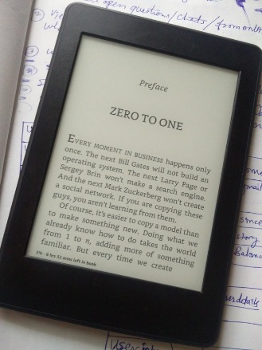
Loan Limits
Libraries may opt to restrict the number of concurrent loans any user may have
Loan limit rules may be applied in different ways…
By Library
By Location
By Material type
By User group
Notes:
To configure loan limit rules, the role of Fulfillment Administrator is required. Ultimately, Loan Limits relates to maximum number of active loans at one time.

Slide 13
Patron Limits
Applies to any patrons who use library services
Upon reaching a defined limit, patron is blocked from further borrowing until resolved
Based on user group to which patrons are assigned
Relates to maximum cash value of overdue fines maximum number of overdue items permitted at one time
Notes:
Whenever a patron attempts to borrow an item, patron limits are checked and applied as is appropriate.
To configure patron limit rules, the role of Fulfillment Administrator is required.

Slide 14
Block Preferences
Determine how blocks are handled at all Circulation Desks
Are configured at the institution level, and,
Apply to all libraries within the institution
Notes:
The list of available handlers and actions is predefined, and varies from scenario to scenario. At institutions with two or more libraries, consensus will need to be reached before configuration is completed.

