Slide 1
Electronic Resource Fundamentals

Slide 2
Terminology
Electronic Collection includes…
Aggregator Packages
Selective Packages
Databases
Portfolios: Serial or monograph titles
Can be standalone entity or within a package
Service:
Services an electronic collection offers in its portfolios (e.g., full-text) and connection/linking information

Slide 3
Inventory Model
Bib Record/Title
Electronic Collection
e.g. Gale Science in Context
Service
e.g. Gale fulltext
Portfolio
Adolescence: 1993 - 2009
Portfolio
Habitat: 1997 - present
Portfolio
Storm data: 2004 - 2008

Slide 4
How the Levels Relate…
Electronic Collection
Gale Science in Context
Service
Fulltext
Portfolios
720 e-journals
Portfolio Title
Genes and immunity
ISSN 1476-5470
Date Coverage: 2001 –
(most recent year not available)
Notes:
To put the levels into a little more context, here is a more concrete example of an Electronic Collection, Service, and Portfolio:
The package EBSCOhost Academic Search Premier is an example of an Electronic Collection.
EBSCOhost Academic Search Premier has a full text service, meaning that we’re asking it to link, or connect, to full text.
There are (for example) 6,101 Portfolios, or e-journal titles, in Academic Search Premier.
One of those portfolio titles is Publisher’s Weekly.

Slide 5
Community Zone
INVENTORY
reflecting holdings and institutional structure
INSTITUTION ZONE
reflecting private bibliographic and authority records
COMMUNITY ZONE
reflecting global, shared bibliographic and authority records
Notes:
Let’s now talk about how the Community Zone factors into electronic collections. You have your local holdings (i.e., your inventory), then your library’s private bibliographic records in the Institution Zone, and finally, we have the Community Zone. The Community Zone contains a knowledgebase of shared records – all of which are maintained by Ex Libris.

Slide 6
Linking to the Community Zone
Electronic Collections, services, and portfolios in Institution Zone can link to Community Zone records
Benefit: Provides updates to Institution Zone record automatically
Records may be unlinked from the Community Zone, or you may create your own local packages, services, or portfolios; however, need to maintain resource
Notes:
Electronic collections, services, and portfolios in your Institution Zone can link to Community Zone records.
Since Community Zone records are maintained by ExLibris, when the records are linked, the benefit (click) is that any updates that happen to the Community Zone record will also be reflected in the record in your Institution zone.
For example: If there are any record or configuration updates in the Community Zone for a package, if that electronic collection record is also in your Institution Zone and linked to the Community Zone record, those changes will also be reflected in your Institution zone record.
Or another example: If any portfolios are added to or removed from a package by the vendor, it will be updated in the Community Zone record and will then be reflected in your Institution zone as well. You can choose to activate any new portfolio titles as needed.
(click) You can also choose to unlink a record in your Institution from the Community Zone record or create your own local electronic collection, but the caveat is that you will need to maintain that record on your own going forward. We’ll talk more about local electronic collections shortly.

Slide 7
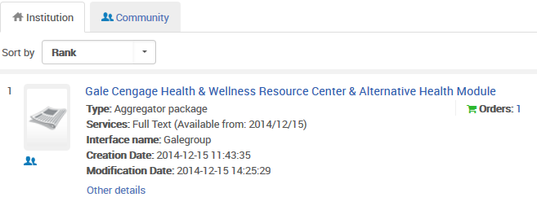
Repository Search Institution Linked to CZ
Notes:
Icon in Community Zone: Indicates that the record is in the Institution Zone and linked to the CZ record

Slide 8
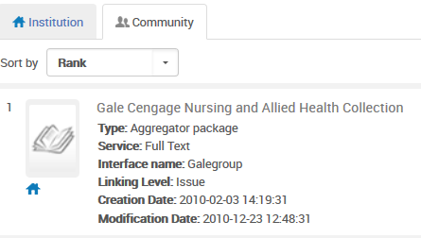
Repository Search CZ Linked to Institution
Notes:
Icon in Community Zone: Indicates that the record is in the Institution Zone and linked to the CZ record

Slide 9
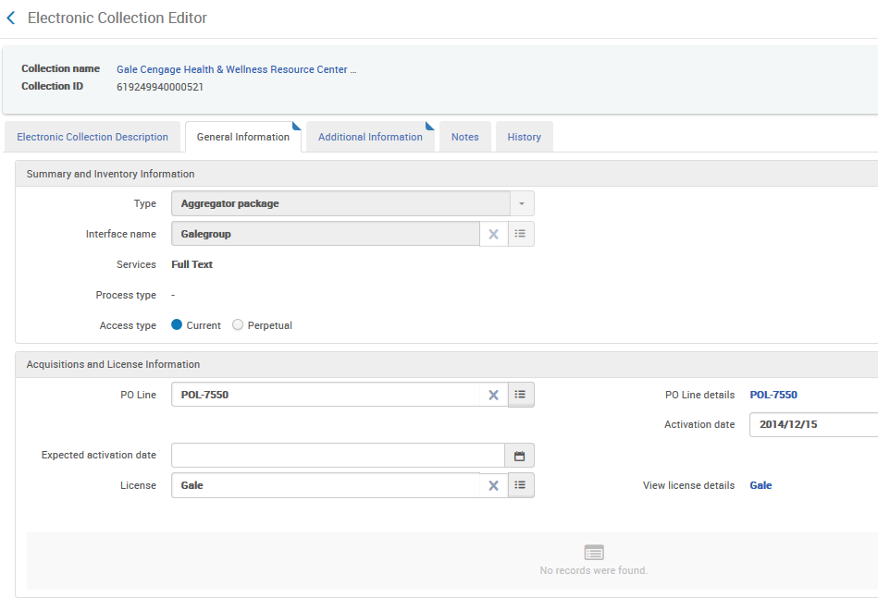
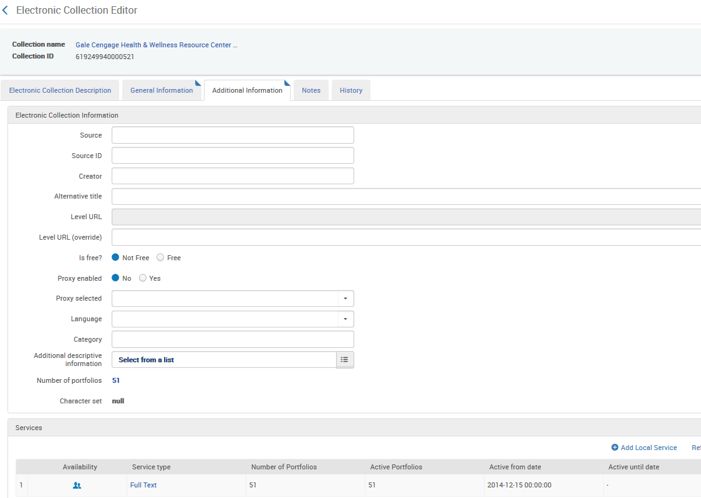
Electronic Collection Level
Notes:
Let’s talk now about how each level looks in Alma – and what each level does.
Searching for a package (again, an electronic collection in Alma terms) will ultimately take you to the Electronic Collection level. We will look at another electronic collection that we have in our Institution Zone. Click the “Edit” link after you search for the package in the Institution Zone; the screen will have Electronic Collection Editor at the top so you know what level you are at.
From the Electronic Collections level, you will be able to:
change basic information such as the public name in the Description tab
in the General Information tab, view the PO line that was created to order the package, attach license information which you have the option of displaying to users in Primo when they view the resource, or add notes about the package
in the Additional Information tab, can you choose to link the electronic collection to a bibliographic record for display in Primo using the Additional descriptive information field, or include a URL to the electronic collection itself.
Also in the Additional Information tab: See the number of portfolio titles associated with the package and drill down to the 2nd level, the Service level.
Also notice the Notes tab, as you see in other places in Alma, and the History tab which will be a log of all edits that happen at the Electronic Collection level.

Slide 10
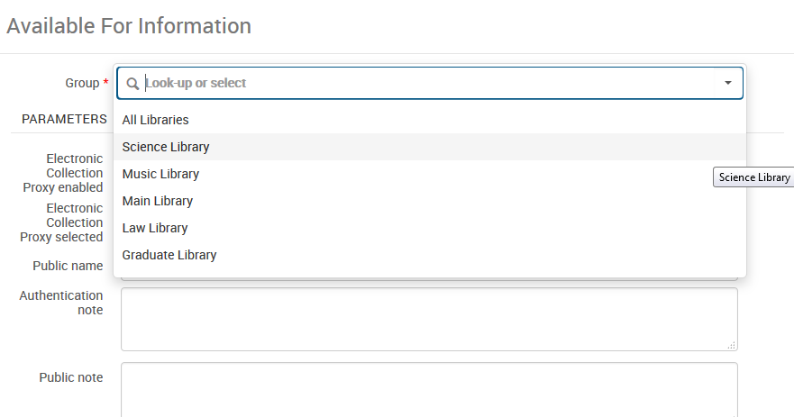
Electronic Collections – Access Rights
Notes:
Before we talk about service level, let’s talk a little about access rights… In some cases, access to electronic resources may be restricted to certain campuses and/or libraries within an institution – so they may not be available to all the patrons across the institution.
It is possible to restrict access to electronic resources through the use of setting up Groups. There is some configuration set-up that is required for this so you’ll want to talk to your project team if this is something you are interested in. Once the configuration is completed, you will see a Group Settings tab appear as the last tab in the electronic collection level, where you can select which campus or library the electronic resource is restricted to.
More information on electronic resource access rights using Group Settings can be found in the Resource Management Guide.

Slide 11
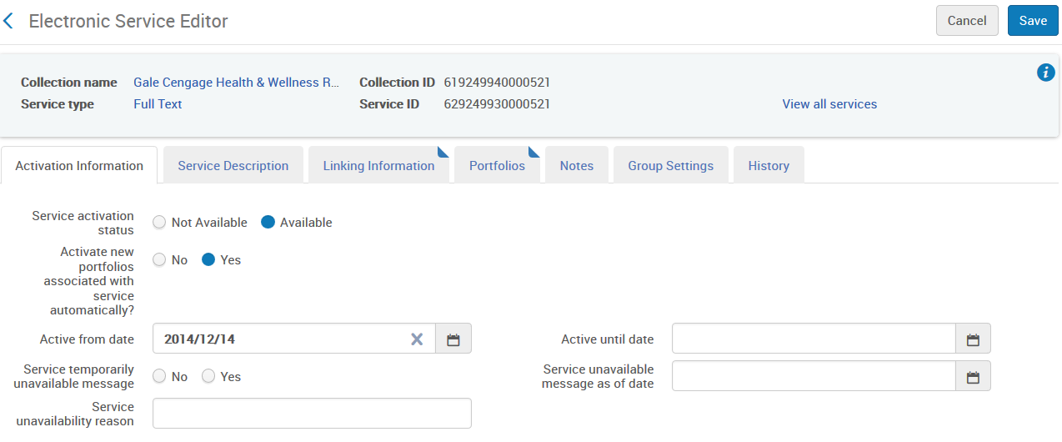
Service Level
Notes:
The next level we will look at is the Service level. The Service level is a very important level because it contains linking, or connection, information for the resource, and it’s where you make the electronic resource available or unavailable to the public.
From the Electronic Collection level, you can drill down to the Service level by clicking on the hyperlinked Service name in the Additional Information tab. The Service level screen will have Electronic Service Editor at the top.
The Activation Information tab is where you can make the resource available or unavailable to the public.
In the Linking Information tab, let’s review some of the more important fields:
There are programs behind the scenes called ‘parsers’ that are used to extract metadata in the openURL and create the URL to the specific article or ebook in the electronic resource. Parse parameters are used in these programs in order to connect to the fulltext from the electronic resource. If you are using the record from the Community Zone, this information will already be populated.
The CrossRef checkbox determines if Alma can reach out to CrossRef if it needs additional information about an article in order to link to the article in the electronic resource.
You also can determine whether proxy needs to be enabled. For example, you may not need to enable proxy for free resources.
Linking level refers to what level the electronic resource can link to. In many cases you will see book or article level, but in some cases you may see journal level, meaning that the closest it can link to is the Journal title; not the article itself.
Linking parameters are authentication information needed in order to connect to the electronic resource. An example is username and password information. When and what linking parameters are needed varies from vendor to vendor.

Slide 12
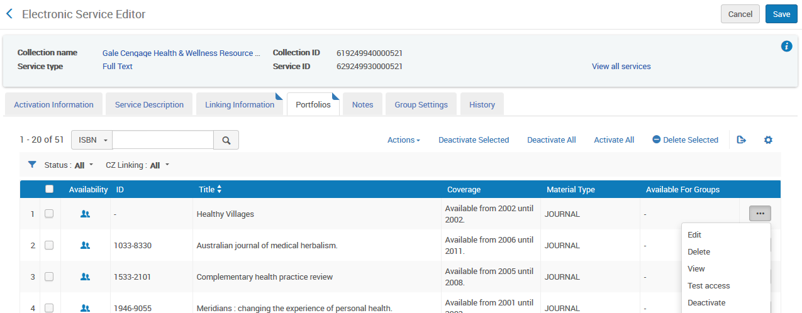
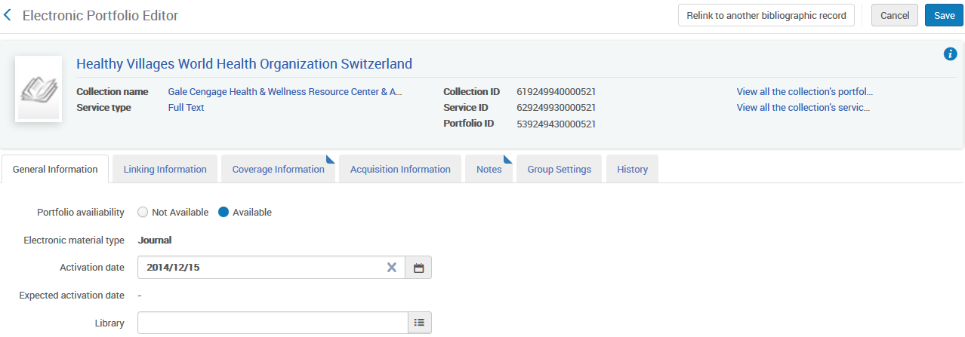
Portfolio Level
Use to
test access
change date coverage/ embargo information
update linking information for each title
Notes:
Let’s now look at the last level, the Portfolio level.
From the Portfolios tab in the Service level, you can drill down to the Portfolio level to see the list of titles contained in package. The Portfolio-level screen will have Electronic Portfolio Editor at the top.
For each portfolio title, you can:
test access by selecting Actions > Test access. Patrons will typically view titles in Primo, which is why we can test access at the portfolio level.
select Actions > Edit to make individual portfolio titles available or not available to the public in the Portfolio Information tab. Note this is for the individual portfolio title; not the package itself.
view linking and parse parameter connection information for each title in the Linking Information tab
add or edit date Coverage/Embargo Information in the Coverage Information tab – which will display in Primo. In some cases, your institution may not subscribe to the default date coverage that the vendor has, so you can choose the “Only Local” radio button and edit the date coverage or embargo information as needed.

Slide 13
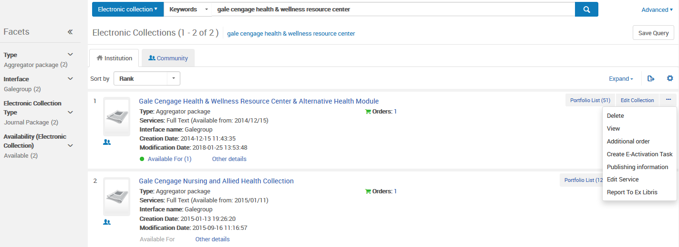
Navigating the Levels
Electronic Collection Level
Portfolio Level
Service Level
Notes:
An alternative way to navigate to the 3 levels for electronic collection, service, and portfolio is from Repository search results for an electronic collection displaying in the Institution Zone.
The Edit link will allow you to access the Electronic Collection level – for example, if you need to change the public name of the resource, or attach license information.
The Edit Service link will allow you to access the Service level – for example, if you need to edit any linking/connection information, enable or disable proxy for instance, or make the resource active/inactive to the public.
The Portfolio list link will allow you to access the Portfolio level. The link will show you the entire list of portfolio titles. From there click on a specific title link, and that will be the Portfolio level. This is if you need to update date coverages or embargoes for any titles, or test access to a title.
Also, an additional note that the Send to Ex Libris link will help you to open a support case if you are experiencing issues with the electronic resource.

Slide 14
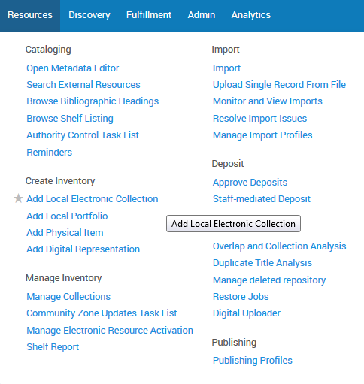
Local Electronic Collections
Use when:
you cannot find the eResource in the Community Zone
the CZ record does not contain adequate metadata
Create local electronic collection record and add portfolios:
Import multiple portfolios
Load portfolios using an Excel file
Add local portfolios individually
Can link to bibliographic record to display in Primo
Notes:
You can create your own local electronic collection from the Resource Management menu by clicking Add Local Electronic Collection in the Create Inventory section.
(click) Typically, you would create your own local electronic collection in a couple of situations: (1) if (click) you cannot find the electronic collection in the Community Zone, or (2) if (click) the Community Zone record doesn’t contain adequate metadata for your institution.
(click) When you create a local electronic collection, you will have the option to add portfolio titles if there are portfolios within your local collection. (click) Portfolios can be imported using an import profile, (click) loaded using an Excel file, or (click) added individually.
(click) Also, you have the option to link the local electronic collection to a bibliographic record, so that the electronic collection will display to users if they search for the electronic collection in Primo.
(click) Lastly, note that the icon for a locally-created electronic collections (or locally-created portfolios, as we’ll talk about next) in the Institution Zone looks a little different than the other electronic resource icons we have seen. Because it is locally-created, it does not link to a Community Zone record. However, there is the option to link to the community zone record by clicking on the “Link to community” link.

Slide 15
Local Standalone Portfolios
Use for a portfolio only (e.g., ejournal or ebook title); not a package
Often just a URL; often used for ebooks
Indicate linking/URL information, enable proxy as applicable, add date coverage/embargo information at portfolio level, test access
Can be linked to a Community Zone record later, if and when a Community Zone record exists
Notes:
Similar to local electronic collections, you can also create your own local standalone portfolio. This is done in the Resource Management menu, in the Create Inventory section by clicking on the Add Local Portfolio link.
(click) Standalone portfolios are used when you subscribe to a portfolio only. In this case you’re not subscribing to a package – just a portfolio title. There will be no Electronic Collection level; just a portfolio-level – and (click) the portfolio will typically be just a URL.
(click) When creating the standalone portfolio, you will indicate the URL and other linking information, whether proxy needs to be enabled, and you can test access before making it publicly available.
(click) Additionally, there is an ability to link to the Community Zone record if a Community Zone record exists. (for example, if a Community Zone record doesn’t exist currently, but maybe it will exist at a later date.) The benefit of linking to a Community Zone record is to take advantage of any Community Zone updates to the record so you don’t have to manage your own local portfolio record.

Slide 16
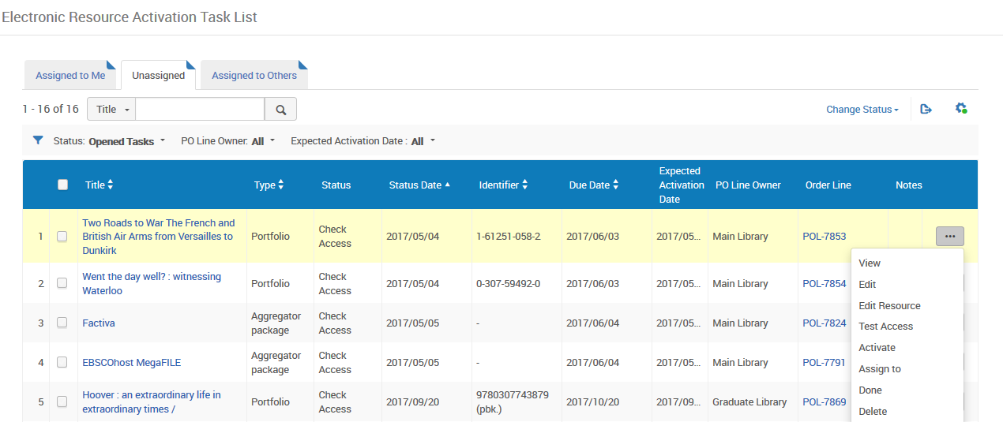
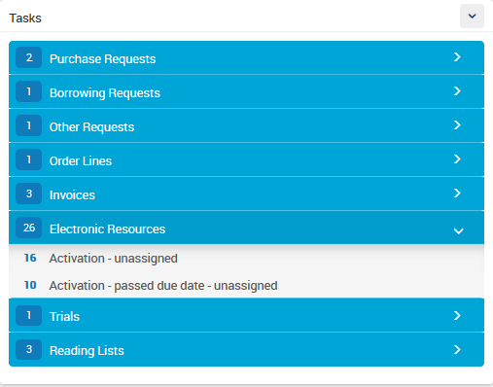
Electronic Resource Activation
Notes:
Regardless of the type of electronic resource, they need to be activated in Alma in order to be accessible to users in discovery.
The Acquisitions session on Ordering and Activating Electronic Subscriptions, and the End-to-End Workflows for Acquiring Electronic Resources sessions will go into more detail on the Activation process for various types of electronic resources.

