Slide 1
User Roles and Tasks

Slide 2

Users and Roles Defined
User:
  An individual who interacts with Alma in some way and is represented by a record that includes core details plus repeatable segments for such areas as multiple addresses
Role:
  A grouped set of rights assigned to a user that grants privileges and tasks

Slide 3
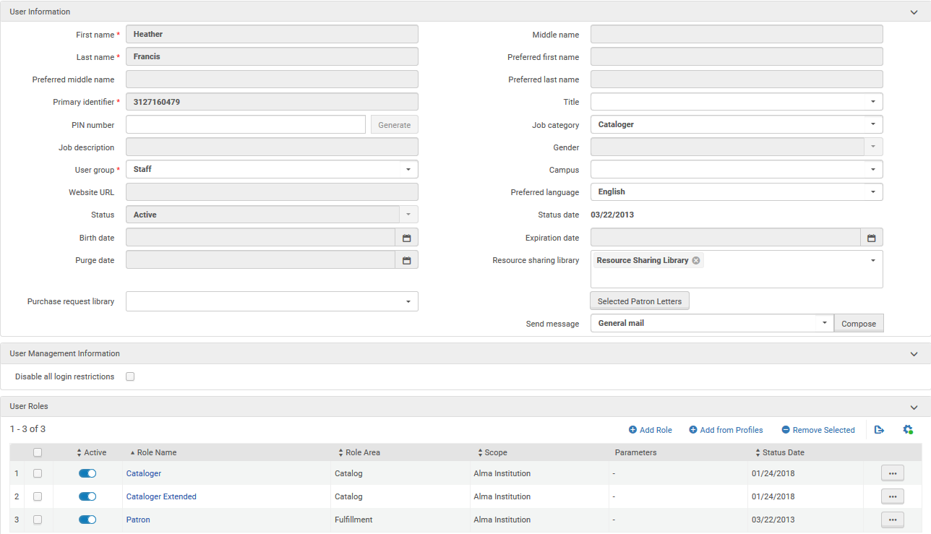
User Roles
Notes:
This screenshot shows a user record for Heather Francis. The user record stores info such as name and email address, etc. on different tabs. Heather’s user record also shows that certain roles have been attached. These roles can be mixed and matched, and define the rights that Heather has to interact with Alma.
In this example, Heather has a roles for a cataloger, which means that she can work in the metadata editor and perform authority control tasks. She also has the role of a patron, which means she can request and check out books, as well as view electronic and digital resources. Each of these roles comes with its own set of rights. To add further rights you just keep adding roles.
While each role comes with a certain set of rights, it’s important to note that Alma does not have a restriction on assigning these roles. It’s perfectly possible, for example, to have a patron with extensive rights across many functional areas of Alma—user simply has a lot of roles in different functional areas.

Slide 4

User Roles
Having a role alters:
  What areas of Alma a user may access
  What data a user may discover and view
  What actions a user may take on that data (e.g., view, edit, delete)

Slide 5
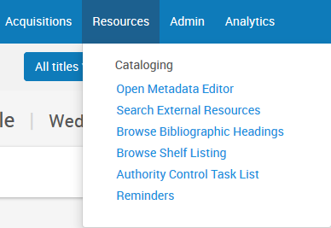
Tasks
Notes:
Here you can see the task types that are available for Heather with her Cataloging roles.

Slide 6

Tasks Defined
Task:
  An operation performed by a staff operator to move an item along in its lifecycle
Notes:
To help you understand how we explain workflows and tasks in Alma terms, I have defined them here.
Workflows comprise a series of steps that a resource goes through, either automatically or manually, to complete a process. When a resource goes through the steps automatically, staff participation is likely to be very limited. When a resource goes through the steps manually, a staff operator is involved in moving the resource from one step to the next. Examples of such a workflow, either automatic or manual, are invoicing or a digitization request.
Tasks are individual steps in a workflow where staff action is required. One workflow may involve several tasks that are performed by different staff operators. Examples of a task are approving a digitization request or picking up an item from the shelves.

