Slide 1
Receiving Print Materials

Slide 2
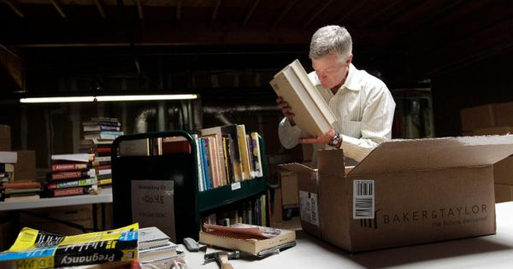
User Roles
Receiving Operator: Receives the library’s one-time and continuous physical resources; may place work orders for post-receiving processing
Receiving Operator Limited: Receives the library’s one-time and continuous physical resources; usually, a student operator

Slide 3
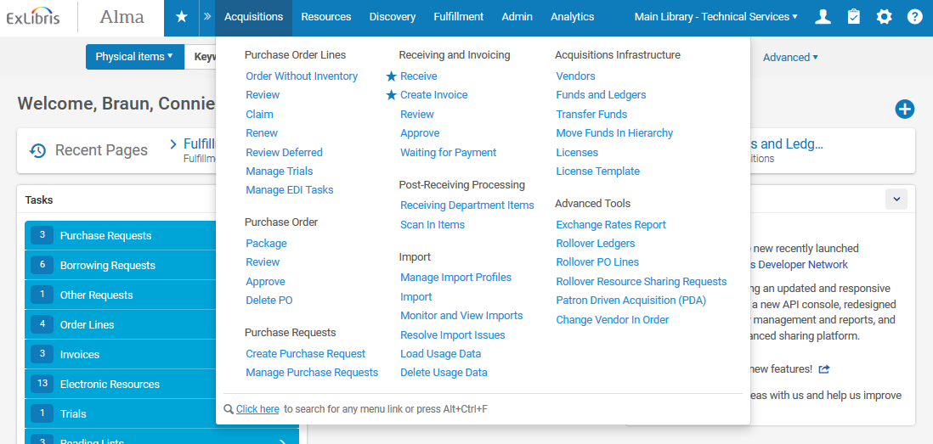
Receiving
Currently At location needs to reflects the correct Acquisitions / Receiving department

Slide 4
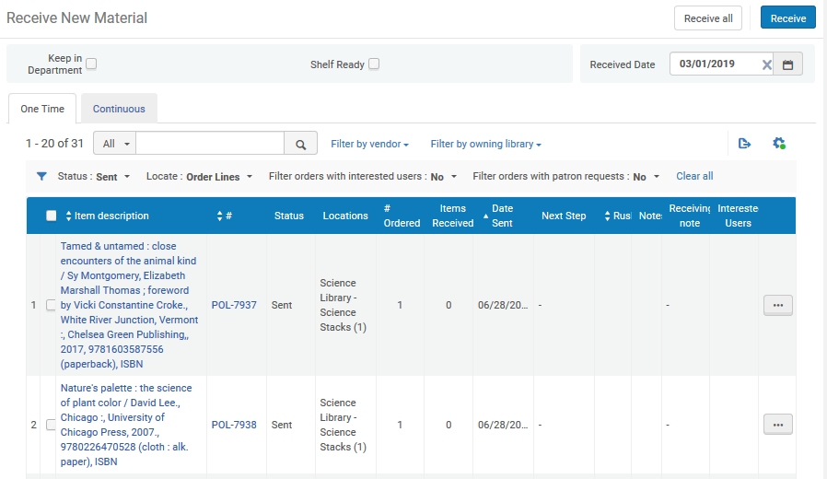
Receive One-Time Items
Select One Time tab
Use filters and search fields to find specific title to receive

Slide 5
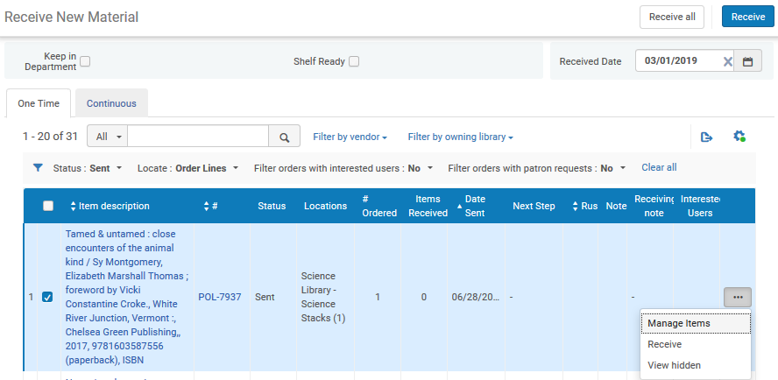
Receive One-Time Items

Slide 6
Keep in Department

Slide 7
Post-Receiving Processing
Select Receiving Department Items to see list of all items in the Department that need further work

Slide 8
Post-Receiving Processing
Use filters to narrow list by status/steps
Change status for each item as needed

Slide 9
Post-Receiving Processing
When processing is completed, Scan In Item and select Done=Yes
Item is sent to designated Circulation Desk for shelving

Slide 10
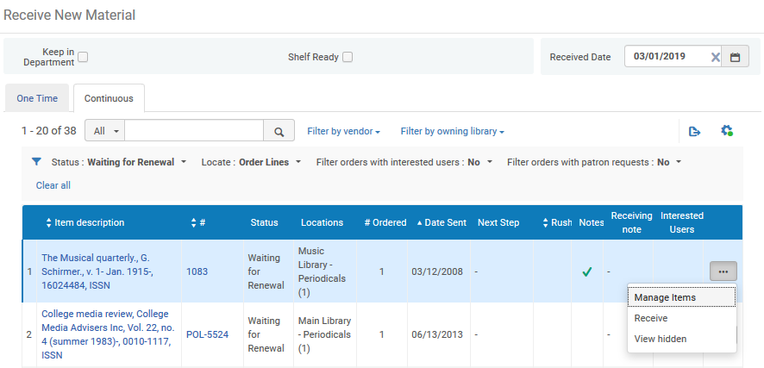
Receive Continuous Orders
Select Continuous tab in Receiving page
Use filters and search fields to find specific title to receive

Slide 11
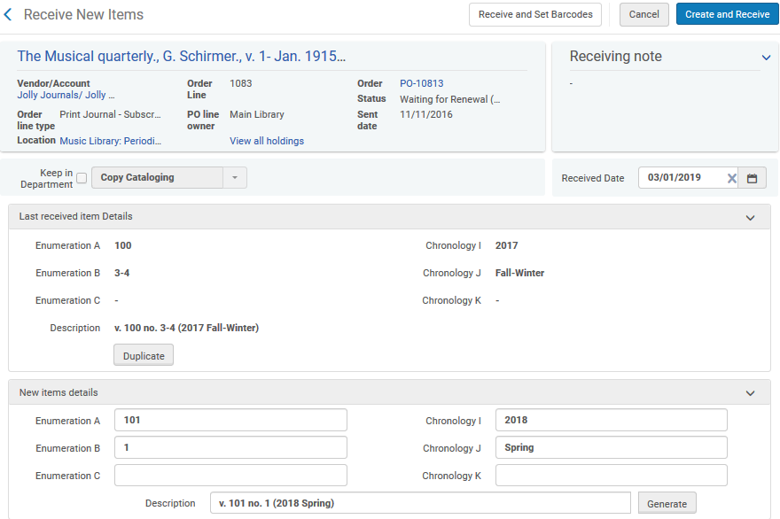
Receive Continuous Orders
Duplicate last received issue and modify for new issue received
Generate Description statement: What user sees
Receive - with option to set barcode

Slide 12
A Quick Note on Claims
View items with claims from Acquisitions menu > Purchase Order Lines > Claim or Claims Task List
PO Claiming job runs on a nightly basis to identify items that have not been received yet
Once item is received, it is removed from the Claims list

