Slide 1
Ordering Process

Slide 2
User Roles
Purchasing Operator – Creates and reviews order lines and purchase orders
Purchasing Operator Extended – Cancel and delete order lines
Purchasing Manager – Creates, reviews, and approves order lines and purchase orders
Acquisitions Administrator – Manages configurations and processes

Slide 3
Overview of the Purchasing Process
Ordering
Create PO lines, POs, encumber funds, and generate inventory; may originate from EOD
Receiving/Activation
Physical: Mark items as received; route for processing or to shelf Electronic: Activate, test access, make available
Funds are disencumbered and expended; order payment is requested; invoice may be loaded via EDI
Invoicing
Complete descriptive cataloging is found or created; may be unnecessary or happen as bulk import
Cataloging
Physical Processing
Physical: Theft protection, barcode, and spine label are added

Slide 4
Purchase Order Lines
Order lines are the basis of many later processes as they
Create inventory
Encumber funds
Are bundled into Purchase Orders and sent via email or EDI
Trigger
receiving (physical)
e-activation tasks (electronic)
invoicing
claims
Can launch other workflows (e.g., trials, renewals, etc.)

Slide 5
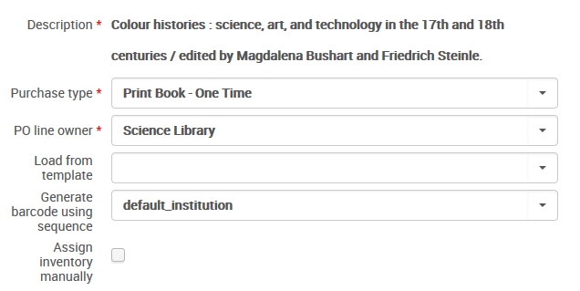
Purchase Type
Purchase type defines:
Inventory format
Physical
Electronic
Continuity
One-time
Continuous
Standing
Acquisition/item material type

Slide 6
Choosing Purchase Type
 | One time | Continuous / Subscription | Standing
Physical | Closed when received & invoiced One holding created per location One item created per copy Use for print books, media, microfilm… | Open until canceled One holding created per serial run One item created per issue Use for serial subscriptions | Open until canceled Inventory created manually Not received through receiving workbench Use for approval plans, memberships, series monographs…
Electronic | Closed when invoiced/activated Standard activation; activated indefinitely Use for single-payment e-resources | Open until canceled Standard activation; can be activated for range of subscription Use e-resource subscriptions | N/A; use electronic subscription

Slide 7
Lifecycle and Data Updated
Purchase order lines (created) Funds (updated) Purchase orders (created) Inventory (created)
Ordering
Receiving/Activation
Inventory (updated)
Invoicing
Invoices (created) Funds (updated)
Cataloging
Bibliographic record (updated)
Physical Processing
Inventory (updated)

Slide 8
Acquisition Methods
Acquisition Method | List Price Optional? | Send via EDI / Email?
Approval
Depository (i.e., Gov docs) | X
Exchange | X
Gift | X
Purchase |  | X
Technical | X
Purchase at Vendor System

