Slide 1
Inventory Model – Network

Slide 2
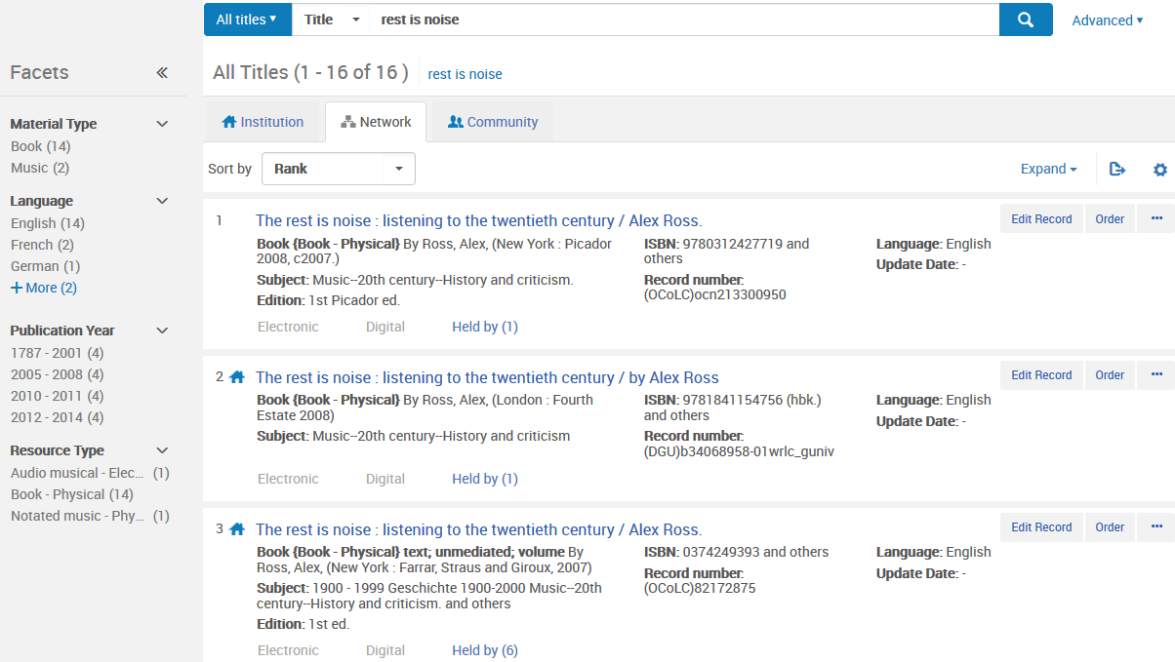
The Zones
Community Zone
(Alma Knowledge Base)
Network Zone
(Consortium)
Institution Zone
(Member)

Slide 3
Network Zone – Organizational Hierarchy
Network
NZ catalog
Shared e-resources
Grouping for all institutions; contains shared catalog (discovery) and collections (delivery)
Institution
IZ catalog
Link resolution
Users
Individual member institution
Library
(e.g., Law, Main, Archives)
Inventory
Orders (optional)
Invoices (optional)
Sub-units within an institution that share fulfillment policies, locations, and ordering units

Slide 4
Network Metadata Environment
Community Zone
Network Zone
Institution Zone
Global Authorities
Shared repository of standard authority files
Shared Catalog
Shared records managed by all institutions
Institution Catalog
Records not shared; will include local extensions
Community Catalog
Shared records managed by Ex Libris
Currently e-resources only
Shared Inventory
Shared resources available to multiple institutions
Initially focused on e-resources & PDA program
Local Inventory
Can link to the Institution, Network, or Community Catalog
Defines what resources (across all catalogs) are managed by your library
Central KnowledgeBase
Shared administrative information for e-resources

Slide 5
Network Record Relationships
Network Zone
Shared Record
Shared Record
Catalog
Local Extensions
Inventory
Catalog
Catalog
Inventory
Inventory
The rest is noise
The rest is noise

Slide 6
Inventory Model
Descriptive Metadata descriptive information for items such as author, title, ISBN, publication details and more
Middle Level
grouping level for different types of resources physical: holdings electronic: service digital: representation
Item inventory level for fulfillment and usage physical: item electronic: portfolio digital: file

Slide 7
Another Way to Look At the Inventory Model
Bibliographic Record /
Descriptive Metadata
Physical Inventory
Inventory
Physical
Electronic
Digital
Digital Inventory
Electronic Inventory

Slide 8
Print Book – One Copy
Kahneman, Daniel
Thinking, fast and slow
Main Library
Circulating Stacks
Item
Barcode

Slide 9
Print Book – Two or More Copies
Foer, Joshua
Moonwalking with Einstein
Main Library
Circulating Stacks
Item
Barcode Copy 1
Graduate Library
Circulating Stacks
Item
Barcode Copy 2

Slide 10
Print Journal
Journal of cellular biochemistry
Science Library Periodicals
Item Issue 1
Item Issue 2
Item
Issue 3…

Slide 11
Electronic Resource Offered by One Vendor
Bulletin of glacier research
Single Package Service
Service
Portfolio
1984 – present

Slide 12
Electronic Resource – Offered by Two or More Vendors
Canadian social trends
Single Package Service
from Gale Cengage Academic ASAP
Service
Full-text
Service
Full-text
Portfolio
2012 – 2012
Portfolio
1998 – 2012
Single Package Service
from ProQuest Pharma Collection New Platform
Single Package Service
from Free E-Journals
Service
Full-text
Portfolio
1998 – present

Slide 13
Digital Resource
World music clips
Representation
(master)
File1.mp3
File2.mp3
File3.mp3
Etc…
File4.mp3

