Slide 1
Acquisitions Overview

Slide 2
Acquisitions Operator Roles
Acquisitions administrator
Vendor manager
Ledger manager, viewer
Fund manager, viewer
License manager
Purchasing manager, operator and extended
Receiving operator, limited
Invoice manager, operator and extended
Purchasing request manager, operator, extended
Trial manager, operator, participant
Notes:
There are roles for each Acquisitions-related area in Alma. These roles are assigned to users depending on the type of Acquisitions tasks they are doing in Alma. The roles are just mentioned here, but each will be covered more in-depth during the subsequent Acquisitions sessions.

Slide 3
Acquisitions Overview
Alma generates inventory and associated data during purchasing
Once started, Alma workflows automate additional data creation
Choices made when purchasing can impact all downstream data and workflows
Staff working in any tech services role should understand the impact of initial purchasing decisions

Slide 4
Ledger/Fund Management
Ledgers contain:
Summary information
At least one allocated fund
Funds contain:
Summary funds (optional) to provide aggregate reporting on subordinate funds
Allocated funds have money used encumber funds for and/or pay for purchase
Notes:
In order to conduct Acquisitions ordering and invoicing workflows, we have to have funds available. There are two terms that are related to Fund management in Alma: Ledgers and Funds:
1. Ledgers: Contain summary information – they are the top-level in the fund management hierarchy.
You must have a Ledger, and ledgers have to contain at least 1 allocated fund. The ledger defines the fiscal period that the funds are active, and defines the library or libraries which will be able to access it and use the funds.
2. Funds: Reside within Ledgers, and they are where transactions are performed. There are two types of funds:
A Summary fund is not used for ordering or invoicing, but instead used to provide reporting on the subordinate funds within it. Summary funds are optional, and do not have actual allocations. Instead, they contain information about allocated funds. They are the parent, or linked to, to allocated funds.
Allocated funds are where the money is! They are where transactions are performed and where the real work happens to order and purchase items.
How the ledgers and funds are set up and named in Alma is decided by your institution, depending on your situation. This is one example of how they could be set-up:
We have a ledger called Science and Technology.
Within that ledger, there are funds.
We have 1 summary fund called Electronic Resources.
The allocated funds that roll into that Summary fund for reporting purposes are:
Allocated fund: Biology
Allocated fund: Chemistry
Perhaps we have another Summary fund within the Ledger called Monographs with allocated funds for the Science departments rolled into that. Or we could just have several ledgers and allocated funds with no summary funds – since summary funds are optional. Again, this will all depend on your institution’s situation.

Slide 5
Ledgers/Funds
Hierarchy of three types of funds:
Ledger: container that groups all other funds; single-layer
Summary: groups allocated funds to see summary transaction amounts; can be nested for different levels of summary; optional; recommended
Allocated: the only funds against which transactions can occur (allocations, transfers, encumbrances, and expenditures); single-layer
All funds have no more than one parent

Slide 6
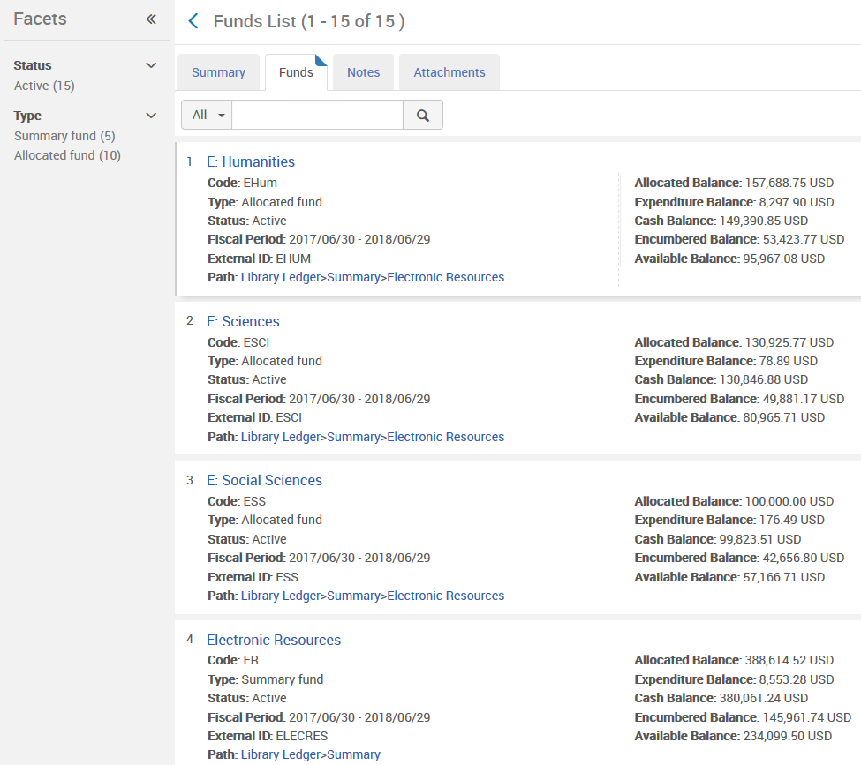
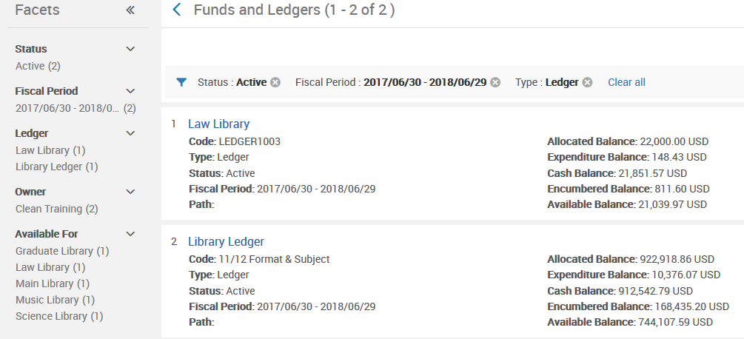
Ledgers/Funds
Notes:
Now that we know the terms associated with fund management, let’s take a look at ledgers and funds in Alma.
To do this, we use the Funds and Ledgers link in the Alma Acquisitions menu. The Funds and Ledgers screen will display.
At the Funds and Ledgers screen, we see the list of funds and ledgers together on one screen, plus the ability to navigate to the next pages of funds and ledgers. You will see a Find option in the upper right corner to locate specific funds and ledgers based on search criteria.
Facets are on the left side for filtering the list of funds/ledgers by:
Status (Active – where they can be used for PO lines and invoices, Inactive or Draft),
Type (Ledger, Allocated fund, or Summary fund)
Fiscal period
Ledger name
Library for which the ledger or funds can be used
For each fund that is in the list, you will see details about balance information as well as actions to manage the fund.
Lastly, you will see an Add Ledger button to create a new ledger and add funds to it. We will talk about that shortly.

Slide 7
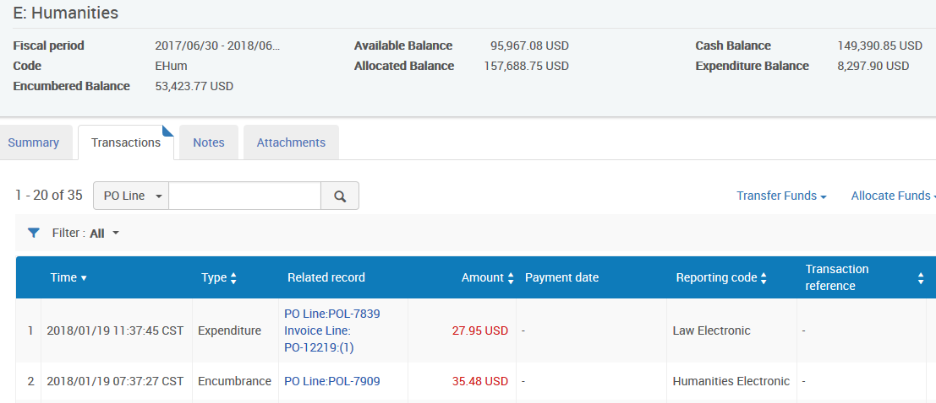
Ledgers/Funds
Notes:
We will see E: Humanities allocated fund details displayed in four tabs. Remember, we are looking at an Allocated fund now.
Summary tab: Very similar to the Ledger and Summary Fund, we see:
mandatory fund/ledger information: Name and Code (code cannot be changed once created) + fiscal period dates
fund balance: expended, encumbered, allocated
rules: at the bottom of the page (will be discussed shortly)
2. The Transactions details tab will only appear if the displayed fund is an Allocated Fund. This is the big difference between Allocated fund records, and Ledger and Summary fund records. Allocated funds are where the money is; where the ‘real’ work happens, meaning transactions – so that’s why we see the Transactions tab.
We see the list of transactions (encumbrances, disencumbrances, expenditures, allocations) associated with this fund
There’s a Find search box to filter transactions by search criteria
Also displayed are:
Links to view the associated PO Lines and Invoices
Transaction amounts (Expenditure/encumbrance amounts are in red, allocations and disencumbrances are in black), Reporting code if that was selected for the PO line during the ordering process, Notes (a green checkmark is displayed if a Note field is available in the transaction)
View button to display the linked transaction.
In terms of the transactions, Encumbrances are transactions that help us to avoid going over budget when we’re placing an order. An encumbrance is placed on the fund, indicating that cost of the order has been reserved so we don’t over-expend. Once the order is invoiced and paid for, the encumbrance is removed from the fund (it is Disencumbered) and replaced with an Expenditure.
The last two tabs are, again, for Notes and Attachments.

Slide 8
Vendors
Vendor
Account
Interface
Material Supplier
Access Provider
Licensor
Order Line
License
Notes:
Let’s talk about the data model for vendors, which is considered infrastructure in Alma. Rather than simply having a vendor record in Alma, you have a basic vendor record, which is an umbrella record, that gathers together different account-based records.
[CLICK] For example, if it is a material supplier, you might have one or more vendor accounts. Or if it is an electronic resource platform, you might have one or more interfaces.
[CLICK] The vendor account and interface records, which are based on the roles that vendors perform, hook up to purchase order lines.
For example, let’s take the vendor YBP, Yankee Book Peddler. YBP is a vendor and they have an array of different services. You may have an account with them to manage your approval plans, and you may have another different account for firm orders. You might pay each account separately or the same, you may have the same or different contact information for each, but because there is slightly different data for these accounts, you have the umbrella vendor that is YBP, and then you have your Approvals account, your Firm Order account, and so on. They would be used as the Material Supplier on the purchase order line.
Another example - this time for an electronic vendor that you use as a platform for accessing other materials: Let’s use the example of the vendor Gale. You can order materials from Gale (so it could be a material supplier), but perhaps you also pay Gale a platform fee so you can find additional content and make it available on Gale’s discovery platform. Although you may be paying one vendor as the material supplier of the content, Gale serves as the interface or the platform through which that content is discovered. One is the organization to whom you are paying for the content, and the other is the organization that is providing the access. Both of these pieces of information are included on a purchase order line.
[CLICK] Vendors can also be licensors. When you are working with a license record in Alma, you can identify which vendor you are negotiating the license rights with.

Slide 9
Vendor Roles
Role | Sub-Unit | Used In | Definition
Material Supplier / Subscription Agent | Vendor Account | Order Lines | Receives orders and payment for resources in all formats
Access Provider | Interface | Order Lines | Provides access to electronic resources
Licensor | None (linked directly) | Licenses | Negotiates licenses for electronic resources
Notes:
This is a summary of the different vendor roles. Vendors can have up to 3 roles:
Material Supplier - with one or more vendor accounts, which are used in purchase order lines to indicate who will receive the order and payment for the resource being ordered.
Access Provider – which can have one or more interfaces, which are also used in purchase order lines to indicate who will be providing access to the electronic resource being ordered.
You can also identify if the vendor is a Licensor – which is used for licenses in Alma.

Slide 10
Acquisitions Data Structure
Bibliographic record
Holdings and Items
POLine (POL)
Vendors
Invoice
Purchase Order
Ledgers and Funds

