Slide 1
I-Share Alma Primo VE UPDATE will start shortly
Welcome!
The feature release webinar will start at 11am and run until 12pm. Please mute your microphone. As time permits, we will respond to questions typed in the chat box, and offline afterwards, as needed.
This session will be recorded and made available on the CARLI website.
Slides and release notes links are available on our event page: https://www.carli.illinois.edu/alma/primo-ve-quarterly-feature-release-update-1

Slide 2
I-Share quarterly alma primo ve update: MaY 2025 Feature release highlights May 2, 2025

Slide 3
Today’s Agenda
Announcements and Reminders
May Quarterly Release Features
Alma
Primo VE
Q&A

Slide 4
Announcements and Reminders (1 of 3)
Today at 5pm is the deadline to volunteer for a CARLI Committee to start July 1, 2025!
Sign up for CARLI Email Lists to get the latest news, discuss topics and issues, and ask questions of your CARLI member library peers.
The Technical Services Committee encourages submissions to the Shared Documentation Depository, a vital resource for the I-Share community, providing accessible and collaborative documentation to support library operations and services.
Notes:
Announcements and Reminders
Today is the deadline to volunteer for a CARLI Committee to start July 1! The work of the CARLI committees and task forces is vital to the successful operation and continued evolution of CARLI. To function effectively, CARLI committees and task forces rely upon broad based and active participation from member institutions of all sizes and types. We can’t do this without you!
Sign up for CARLI Email Lists to get the latest news, discuss topics and issues, and ask questions of your CARLI member library peers.
Please consider contributing to the Shared Documentation Depository! We invite new contributors like you to share your expertise by submitting valuable documentation and resources to expand our collective knowledge base. If you have created or maintained documentation, templates, or guides in your library, we encourage you to share them with the community. Your contributions can make a significant difference to other libraries facing similar challenges or exploring new opportunities.

Slide 5
Announcements and Reminders (2 of 3)
Upcoming CARLI Events are listed on the CARLI Calendar including:
May 14-15 – Building Digital Archives with Minimal Staffing webinars
May 21 – CARLI Instruction Committee Annual Showcase webinar
May 30 – CARLI Resource Sharing Committee In-Person Discussion, Harper College (WRH) and College of DuPage (COD)
June 6 – Behind the Scenes: an Introduction to Archive Processing in-person workshop
Several Professional Development Alliance (PDA) events on various topics every month
CARLI News, April 30, 2025 – CARLI’s monthly newsletter
Notes:
More Announcements and Reminders
Don’t forget to check the CARLI Calendar for upcoming events like those listed here! Register today!
In addition, the monthly CARLI newsletter provides an excellent summary of things going on across CARLI.

Slide 6
Announcements and Reminders (3 of 3)
CARLI Staff are sharing the updates we feel are most important to the I-Share environment.
Staff at I-Share libraries can review the full set of release notes available from the Alma and Primo VE Support Pages:
Alma Release Notes
Primo VE Release Notes

Slide 7
User Interface Updates
The new user interface for Manage Patron Services and Return Items will now be the default with no opt-out
There are the following enhancements to the Title Searches page:
You can now save multiple facet combinations and apply them to your searches
In title and holdings searches catalogers can now view, add, edit, and delete notes directly without opening the Metadata Editor.
The new title search UX includes single-click links to additional related entities, such as Related Records, Courses, Licenses, and Reminders
The old Title Search interface will be sunset in August
The text appearance in the record view and sections of the new user interface across Alma was updated. Labels now have bold font, and values appear as regular text rather than bold.
Notes:
[Adrienne] Saved facets appear in the Saved drop-down list, where you can also set a default that is automatically applied to searches.
Users who previously saved facets in title searches before this update will find them in the drop-down list, labeled Pre-saved.
Notes are only accessible for viewing or editing when available to the user in the Metadata Editor: if the cataloger has permission in the Metadata Editor and the record is not locked. Additionally, notes can only be managed within the search scope where the record is maintained (institution, network, or community).
The new title search UX includes single-click links to additional related entities, such as Related Records, Courses, Licenses, and Reminders, along with a link to the new Notes section for catalogers. These fields are now included in search exports to Excel, just like existing navigation links for Orders and Requests

Slide 8
AI Indication for Community Zone Enriched Records
New title search user interface with a red arrows pointing to the AI indication icons that identify that this Community Zone record was enriched by AI. The AI indication icon is a square with sparkles.
In the new title search user interface, the AI Indication (a square with sparkles) is now displayed for Community Zone records enriched by the Community Zone AI generator.
Notes:
[Adrienne]

Slide 9
Search Queries
After an advance search is performed, the search query keywords are displayed near the top of the screen along with a magnifying glass icon, which can be clicked on to quickly update the query.
Ex Libris has introduced a new search query design with an updated interface to improve the visibility and usability of search options across different workflows. The new design includes a refreshed search query display and a magnifying glass icon for quick access to update the query via the Advanced Search.
Notes:
[Adrienne] The redesigned search query and new icon make it easier for users to understand the search query and locate and utilize Advanced Search functionalities. The enhanced UI elements and structured design improve navigation, benefiting all users, including those using assistive technologies.

Slide 10
Physical Holdings Search
In the physical holdings search, viewing title information now opens the full title details instead of just the bibliographic record. The screen capture shows an example of the title details.
In a previous release, Alma gave users the capability to add local repository search labels to records. Previously, a single privilege controlled label management for both the physical holdings search and the new title searches. Now, separate privileges exist for bibliographic and physical holdings search labels.
The Physical Holdings Search view, showing the full title details on the right-hand side after clicking to view the title information (on the left-hand side).
Notes:
[Adrienne] …and physical inventory operators are able to manage physical holdings search labels by default, without affecting title search labels

Slide 11
Persistent Sorting Routine for Physical Items List
A red rectangle is highlighting the selected sort method on the search result list for a Physical Items search.
When users select a sort method different from the default, their choice will now be saved. The selected sorting will persist the next time they view a physical items list.
Notes:
[Adrienne]

Slide 12
NZ Records Can Be Added to Reading List
You can now add NZ records to a Course Reserves Reading List!
A red rectangle highlights a Network Zone record that has been added to a Course Reserves Reading List.
Notes:
[Adrienne] This enables you to add Wiley eBooks, etc. to a reserves reading list.

Slide 13
Metadata Editor Enhancements
Delete portfolios from View Inventory list
AI Metadata Assistant developments
Enrich portions of a record using AI assistant and data files.
Administrator control of types of metadata that the assistant may provide
Accept more file types as uploads: PDF, Word, JPG/JPEG, PNG
New Titles Search Indexes for AI application
Processed with Alma AI tools
Enriched with AI metadata by CZ
Notes:
[Ted]
The metadata editor sees a few updates this release.
First, it will be possible to delete a portfolio while viewing the related bibliographic record in the metadata editor. Alma already had a similar function for deleting physical inventory.
Next, there are a group of developments for the AI metadata assistant, which may create or modify bibliographic records using images of the work and its details. The assistant makes a couple steps forward in that it is now capable of enhancing specific parts of a record, such as content, summary, or subjects. Previously, the AI metadata assistant attempted to produce data for the entire record.
This improvement is accompanied by new configuration settings that allow an administrator to select what types of metadata may be requested from the metadata assistant. For example, an administrator may choose to disable the option for the assistant to attempt creation of control numbers or classification.
The AI metadata assistant now accepts more file types. In addition to JPEG and PNG files, the assistant will now accept uploads of PDF and Word documents.
Finally, there are two new search indexes to help you search for records that have been modified by AI. The Processed with Alma AI tools will let you find the records that catalogers created or modified in either the institution or network zone. The Enriched with AI metadata by CZ focuses on records in the community zone. Ex Libris is beginning work on applying AI tools to these data in the near future.

Slide 14
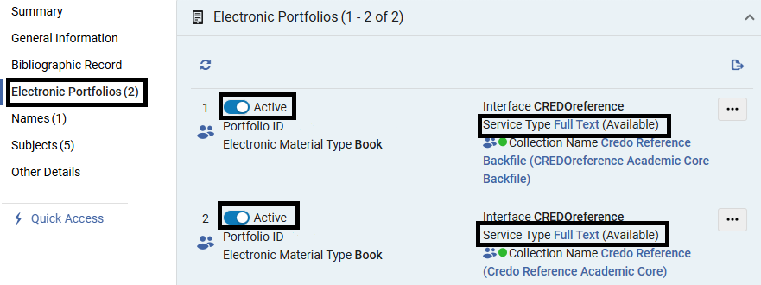
Enhancement of Availability Information
Electronic expanded tab
The black rectangles show where the availability and service type display when viewing portfolios from the
title search results.
Electronic portfolios - view section
TITLE SEARCHES – ELECTRONIC PORTFOLIOS
Notes:
(Marisa)
In title searches, the electronic expanded tab and the electronic portfolios – view section both contain a calculated availability indication and service status. These updated features are also included when you export to Excel.

Slide 15
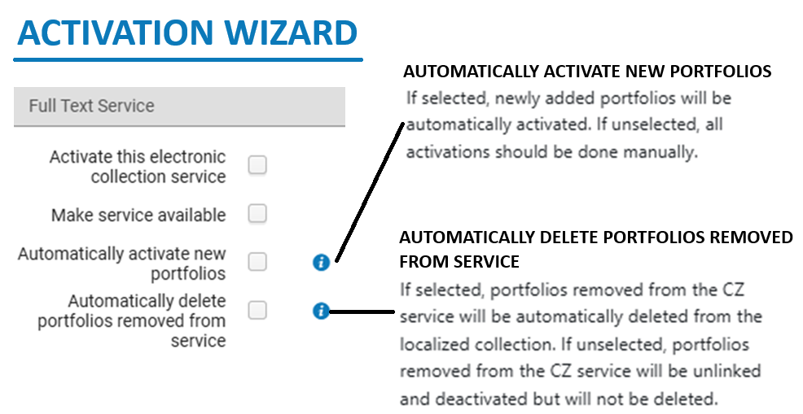
NEW ELECTRONIC COLLECTION SETTINGS
There are two new settings when activating electronic collections
Two new full text service options in the Activation Wizard
Notes:
(Marisa)
When you activate a Community Zone electronic collection, there are now two new options for full text service in the Activation Wizard.
The first option is: automatically activate new portfolios. When checked, newly added portfolios will automatically be added to your IZ collection when linked to the Community Zone.
The second option is: automatically delete portfolios removed from service. When checked, the portfolios removed from the CZ service will be automatically deleted from the localized collection. If this box is unchecked, the portfolios removed from the CZ will be unlinked and deactivated but not deleted from the IZ collection.

Slide 16
Perpetual Access Titles
There is now a “Has Perpetual Electronic Access” field available in Titles > Title Details that now includes perpetual electronic access!
For more information on Title Details, see: https://knowledge.exlibrisgroup.com/Alma/Product_Documentation/010Alma_Online_Help_(English)/080Analytics/Alma_Analytics_Subject_Areas/Titles#Title_Details
ELECTRONIC TITLE LEVEL INFORMATION
Notes:
(Marisa)
If you have active electronic collections that have perpetual access titles, then this enhancement should help! The perpetual access field indicates the right to permanently access titles in an electronic collection, when the entire electronic collection is not perpetually accessible. This is a title level enhancement and affects active electronic collections where access types of the portfolios vary. For more information on this enhancement, visit the URL in the chat.

Slide 17
Alma User Record Updates – Removal of Gender field and data
A red rectangle highlights the Gender data field on the User Details screen for a patron.
With the August release, Ex Libris will remove all Gender data recorded in user records and will no longer permit the addition of Gender field data.
Notes:
[Debbie]
To be in compliance with the European General Data Protection Regulation (aka the GDPR), Ex Libris will remove all gender information from the user records in Alma in the upcoming August release, for all countries.
Ex Libris explains that “Since gender is not essential for product functionality, retaining it poses unnecessary compliance risks according to GDPR requirements that personal data be collected and processed only when there is a clear legal basis and business need.”

Slide 18
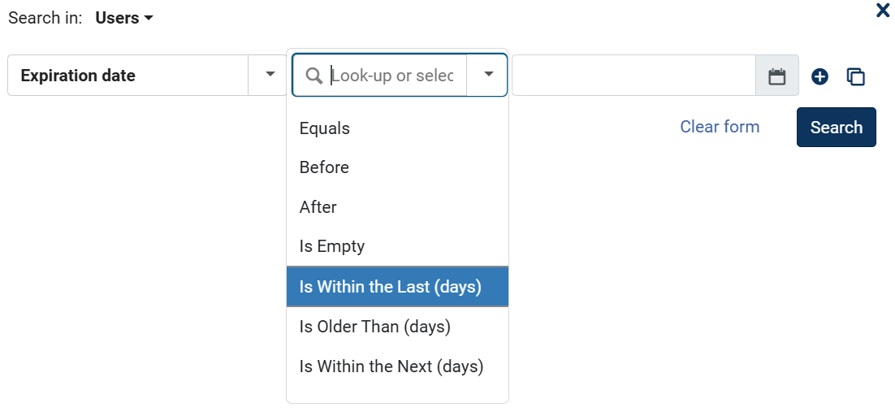
Alma User Record Updates- User Search
Alma Advanced Search for Users, with the new Expiration date search options shown.
Date-related user searches now include relative searches:
Is Within the Last (days)
Is Older Than (days)
Is Within the Next (days)
Allows for Logical Sets to be saved with a moving date range.
Notes:
[Debbie]
Date-related search indexes in the Users advanced search, such as Purge Date, Last Activity Date, Expiration Date, etc., now include the following options to search within a moving range of days:
Is Within the Last (days)
Is Older Than (days)
Is Within the Next (days)
This allows staff to save a Logical Set to be built and saved with a moving date range, such as “Users with Purge Dates older than 30 days.”

Slide 19
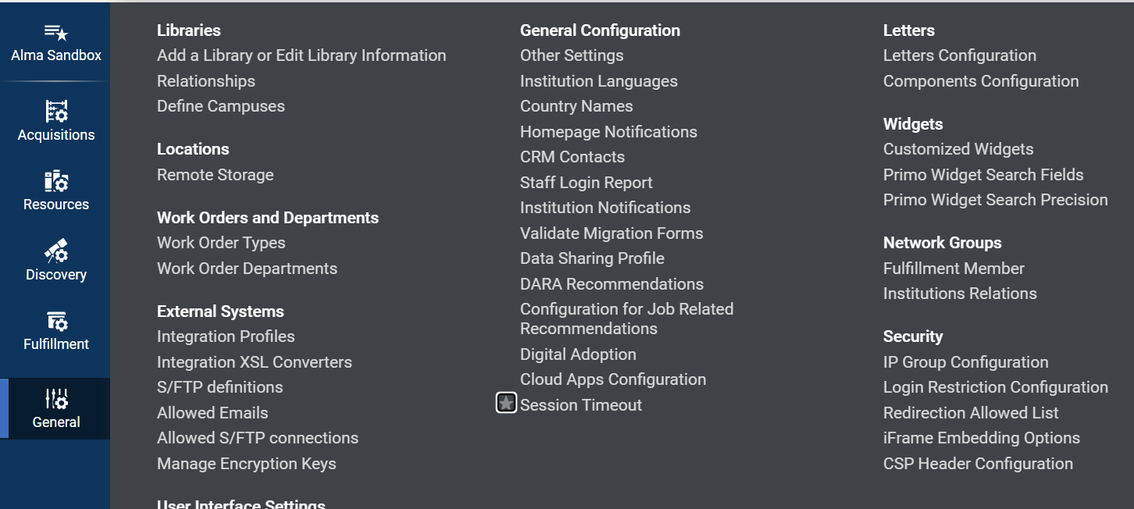
Alma – Configurable Default Session Time Out
Alma > Configuration > General Screen with a red rectangle highlighting “Session Timeout”
Institutions can now set a default session timeout duration ranging from 15 to 150 minutes (the default remains 60 minutes).
Notes:
[Debbie]
All Ex Libris platform products now include a configurable session timeout feature in response to community feedback from the Idea Exchange.
Institutions can now set a default session timeout duration ranging from 15 to 150 minutes (default remains 60 minutes).
This is in a new "Session Timeout" configuration page (Configuration at the Institutional Level> General > General Configuration > Session Timeout).
This page is accessible to General System Administrators.

Slide 20
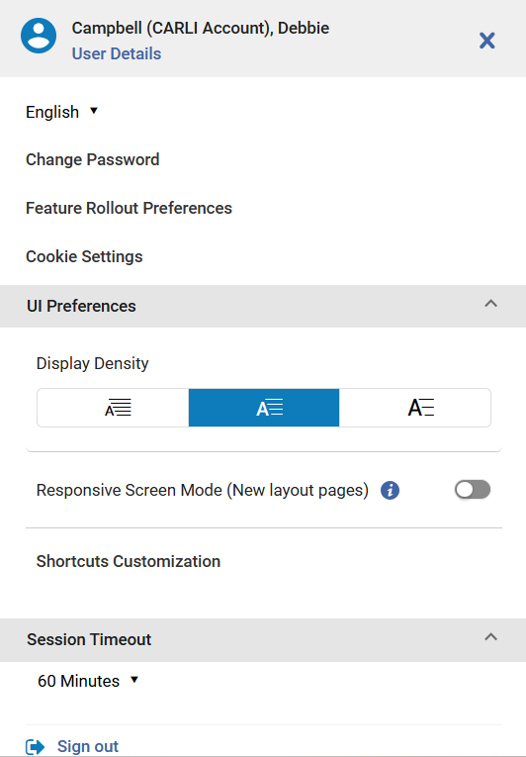
Alma – Configurable Default Session Time Out, Continued
Institutions can decide whether to allow individual users to override the default.
Option is listed under the logged in user details> UI Preferences> Session Timeout.
If your institution allows the default to be changed, and you do not see the option, adjust your screen’s zoom.
A user's Session Timeout setting preference is shown,
highlighted with a red rectangle.
Notes:
[Debbie]
In addition, institutions can choose whether to allow individual users to override this default setting by selecting the Allow users to override the default session timeout checkbox in the configuratrion menu.
When enabled, the user-level options also range from 15 to 150 minutes.
Option is listed under the logged in user details> UI Preferences> Session Timeout.
If your institution allows the default to be changed, and you do not see this option, adjust your screen’s zoom.

Slide 21
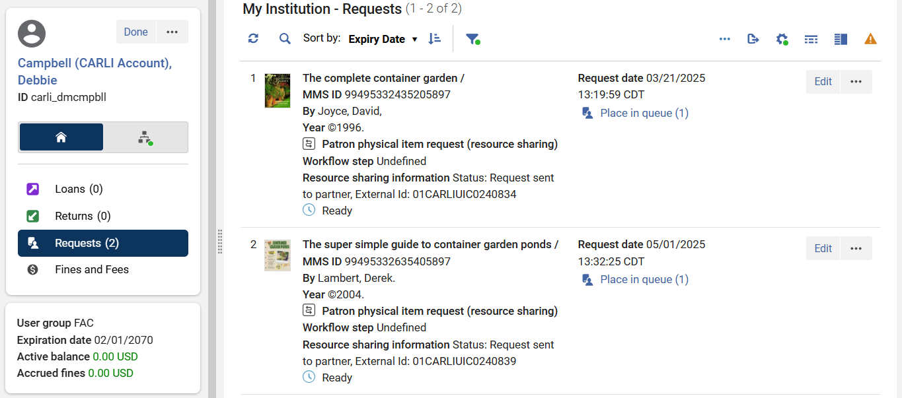
Alma – I-Share Requests in the New UI- Reminder
On the left-hand side, the user’s local/Institutional/home tab is highlighted with a red rectangle. On the right-hand side, red rectangles are highlighting the place in the queue and also that the request status is not updated and is still showing as “Request sent”
Directions under “Determining the current status of your patron's request”: https://www.carli.illinois.edu/products-services/i-share/alma/fulfillment/how-to_AFN
Notes:
[Debbie]
Next, a reminder about reviewing the status of an I-Share request in the new UI in Alma.
So, in Alma in both in the New Manage Patron Services UI, and in the "old" UI, the requests that patrons place for material from other I-Share libraries show in two places/tabs.
They are cross-listed on the local/Institutional requests tab, as well as on the Network/I-Share requests tab. The confusing thing is that the status of the I-Share request never updates on the local/Institutional tab- it always says "not started" with a symbol for "Ready", and "Place in queue (1)".

Slide 22
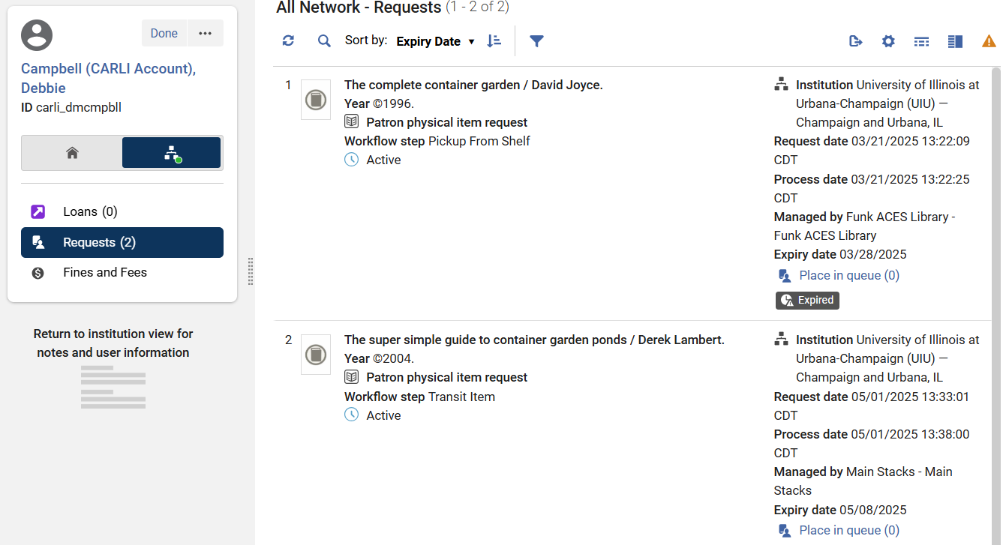
Alma – I-Share Requests in the New UI- Reminder – SLIDE 2
On the left-hand side, the user’s Network/I-Share activity tab is highlighted with a red rectangle. On the right-hand side, red rectangles are highlighting the place in the queue and also that the request status is updated to reflect the current status in Alma.
Notes:
[Debbie]
So if staff are looking on the local requests area for the status of a patron's request placed for an I-Share item, they will not see the updated status.
BUT, it does update to display the current status on the Network/I-Share tab.
In the new UI, this means clicking from the home/house button over to the networked computer button, then clearing the auto-applied filter so the requests will show.
Ex Libris has agreed that the filter should not be auto-applied when clicking over to the Network Activity tab; it will be fixed in a future Alma update.
You’ll notice that our same two requests that said “Request sent” on the House tab, now have more details as to the workflow step- With these two examples, we see Pickup from shelf (meaning it is still not yet processed by staff) and Transit item- which means it is enroute to the patron’s pickup location, but not yet on hold.

Slide 23
Adding Titles from Network Zone to IZ Collections
You can now add titles from the Network Zone to your local Institution Zone Collections!
This will enable libraries to add resources shared centrally from the NZ.
Two methods:
From a Title search of the Network > on a title in the Results list > ellipsis button > Add to Collection
From the Collection itself, do a search of the Network and select title(s) to add.
Ex Libris video provides a demo of both methods (1:37)
Notes:
[Jessica]
Libraries can now add titles from the Network Zone to your local IZ Collections! This will enable you to add resources shared centrally from the NZ if you desire.
As a reminders, a collection is not an electronic collection. A Collection is an entity you create in Alma Resource Management that aggregates bibliographic records that have a relationship of some kind. A collection can be based on topic or subject matter. Records grouped in a Collection are then available for Discovery in Primo VE.

Slide 24
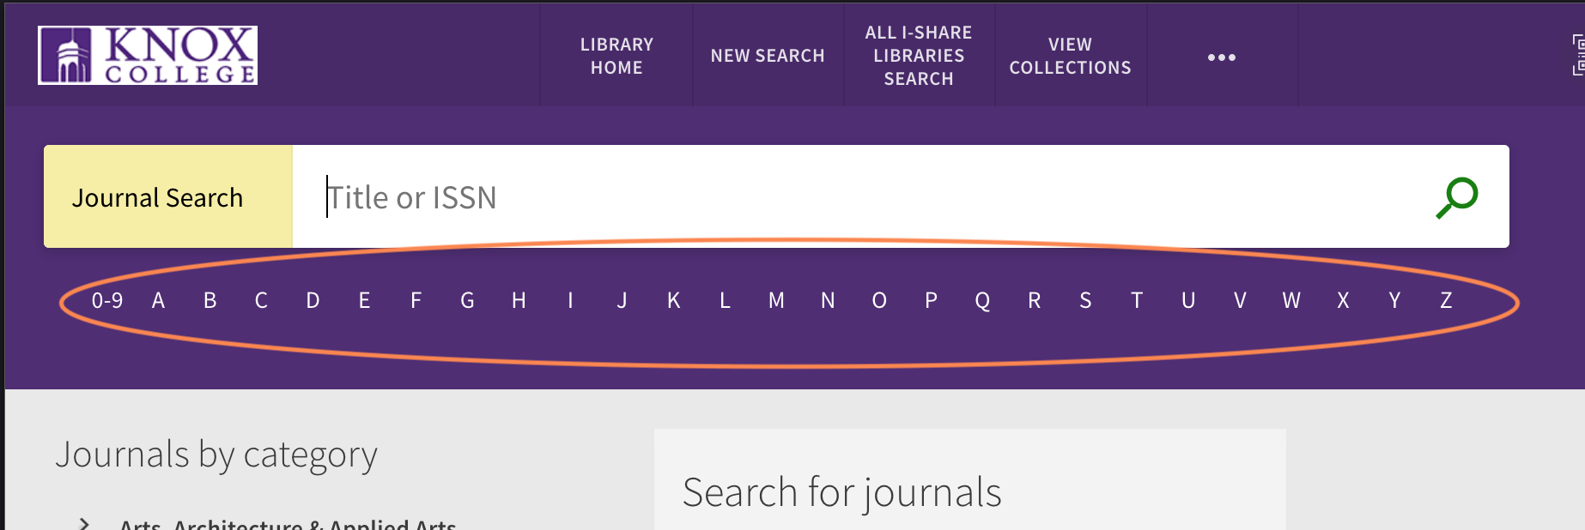
New A-Z List available for Database and Journal Searches
Libraries can now display an A-Z list for the Journal Search and Database Search pages enabling users to search titles by a specific leading character or number (excluding non-filing characters)
Disabled by default and requires configuration in Alma Configuration > Discovery > Other > AZ DB and Journal Search Configuration
Primo VE Journal Search Box with A-Z list
Notes:
[Jessica]
Primo customers have been asking for this enhancement for some time, and now, finally, libraries can enable an A-Z list to appear in the Primo VE Journals Search and Database Search pages beneath the search box. This allows users to perform a browse search by the first letter or number of the title.
This was a common feature from the SFX link resolver that Ex Libris has finally broken down and implemented in Primo.

Slide 25
Primo VE Next Discovery Experience (NDE) Background
In 2023, Ex Libris announced it had started development on the Next Discovery Experience or NDE project. It has four components:
“A new, sleek, intuitive user interface”
More integration of Linked Open Data to “reveal connections” between topics
AI-based Research Assistant to guide users - available now in Primo VE and continuing into the NDE UI
A new user engagement analytics tool for libraries (Mixpanel) coming with the NDE UI to help libraries “track and optimize the discovery experience”
Notes:
[Jessica]
As you may have heard, Ex Libris has been developing the Primo Next Discovery Experience, or NDE. This will eventually replace the Primo VE Views that all libraries currently use. The NDE has four components:
“A new, sleek, intuitive user interface”
More integration of Linked Open Data to “reveal connections” between topics
AI-based Research Assistant to guide users – this is available now in Primo VE and will continue into the NDE UI
And s new user engagement analytics tool for libraries (Mixpanel) coming with the NDE UI to help libraries “track and optimize the discovery experience” that will replace the existing Oracle-based Analytics for Primo

Slide 26
Primo VE Next Discovery Experience UI (NDE UI)
I-Share libraries should not have signed up for “Managed General Release” with Ex Libris.
I-Share libraries will be able to switch to Primo NDE UI in summer 2026 or later!
NDE UI scheduled to be ready for consortia in late 2025 but will require testing before switching.
CARLI will provide more guidance, documentation, and training beginning in spring 2026.
I-Share libraries may choose when to go live with Primo NDE, e.g. summer 2026, Jan. 2027, or summer 2027.
If your library would like to be in the summer 2026 “cohort,” please email CARLI Support to let us know!
Notes:
[Jessica]
Recently, Ex Libris announced a “Managed General Release” program that libraries could sign up for to implement the NDE UI. I-Share Libraries SHOULD NOT have signed up for this “Managed Release Option”. If you did, please contact Ex Libris to withdraw from that program. The reason for this is that not all of the consortial features needed for a network environment like I-Share will be ready until late 2025, and then CARLI will need to test those features to make sure they are working as expected. As the saying goes, trust but verify!
I–Share libraries will be able to switch to the new Primo NDE UI starting in summer 2026, and CARLI will start providing more information about that next year. You won’t have to go live in summer 2026; your library may choose to go live over holiday break, or summer 2027, or even in the middle of the year if that’s what you really prefer to do! If your library would like to be in the first cohort of I-Share libraries to go live in summer 2026, please contact CARLI to let us know. We are keeping an informal list right now, but CARLI will put out a formal survey, probably later this year, for libraries to indicate when they would like to plan to migrate.
For libraries with few extra customizations to your Primo VE View—that is custom CSS and JavaScript--this should be a straightforward migration; however, if your library has heavily customized your Primo VE View, you should plan to dedicate some staff time to migration and plan a timeline accordingly.

Slide 27
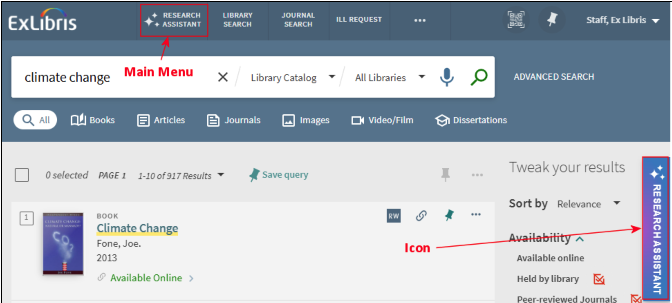
Primo VE Research Assistant Improvements in May
1. The May 2025 Primo VE Release Notes list many accessibility improvements for the Research Assistant in this update!
2. Ex Libris is removing the word “Beta” from the Research Assistant icon and widget:
Research Assistant without Beta label in Primo VE interface
Notes:
[Jessica]
There have been several changes to the Primo Research Assistant in the May release.
First, Ex Libris continues its commitments to accessibility by making many improvements. You can find a full list in the Primo VE May 2025 Release Notes!
Second, Ex Libris is declaring the Research Assistant tool to be out of “beta” and is removing the “beta” label from the main menu and the side icon.

Slide 28
Primo VE Research Assistant Improvements in May
3. Beginning May 7: New option to Filter by Online Availability allowing users to refine the results of search queries in the Research Assistant to only those that they have access to.
Primo Research Assistant search box
Notes:
[Jessica]
Third, after the CDI update that will occur on May 7, the option to Filter by Online Availability will be given to users using the Research Assistant. Previously, the Research Assistant returned results from all of the Central Discovery Index, which often included resources that users didn’t have direct access to. Now users will be able to limit results to those things that they can immediately access through your library.

Slide 29
Primo VE Research Assistant Improvements in May
4. Beginning May 7: New Institutional-level option and a new User-level option to allow users to save Research Assistant search history.
Enabled by default (that is, set to true)
The new save_users_RA_search_history parameter controls whether Research Assistant search history can be saved between sessions for signed-in users at the institution level.
When save_users_RA_search_history parameter and the new display_user_setting parameters are both set to true, users can enable/disable the ability to save their Research Assistant search history between sessions in their My Account settings in Primo VE
If disabled at the institutional or user level, existing RA search history is still displayed, but no new history will be recorded.
Previously, Research Assistant searches were always saved automatically between sessions.
Notes:
[Jessica]
And fourth, again after the CDI update occurs on May 7, there will be two new options for Research Assistant search history: and institutional-level option, and a user-level option. Previously, all Research Assistant searches were always saved automatically between sessions.
Both new options will be enabled by default, so if your library is ok with allowing users to control whether or not their Research Assistant search history is saved, there is nothing more to do.
The institution-level option, if disabled, would prevent any Research Assistant history from being saved for all users going forward.

Slide 30
“A Second Look at Primo VE Research Assistant”
Tuesday, June 10, 2025 from 11am-noon
Register to attend from the CARLI Calendar.
Join the CARLI Discovery Primo VE Committee to explore how the tool has evolved since its initial September 2024 release, revisit takeaways from the committee's Primo VE Research Assistant: First Impressions webinar, and discuss how I-Share libraries are approaching the tool. This webinar will not be recorded to encourage open discussion.
Notes:
[Jessica]
Finally, with all of the changes and improvements to the Research Assistant since its surprise release last September, the CARLI Discovery Primo VE Committee is going to hold another webinar where I-Share libraries can share their experiences, ask questions of each other, and discuss the pros and cons of the Primo VE Research Assistant! Please plan to join us on Tuesday, June at 11am for this meeting of the minds! Registration is available now on the CARLI Calendar.

Slide 31
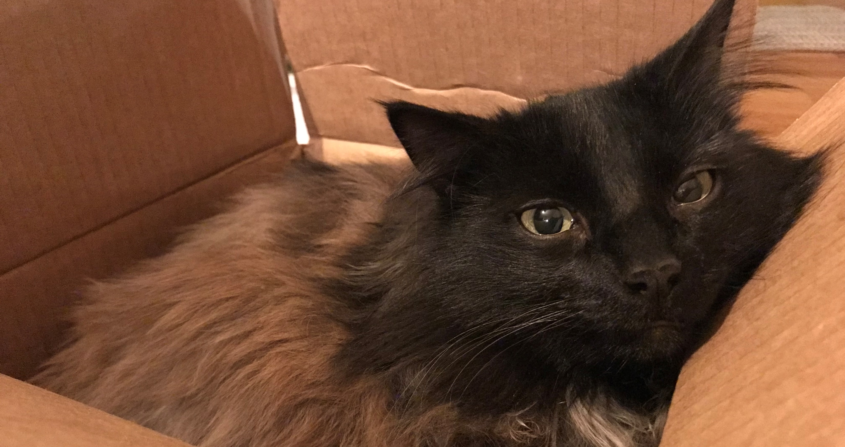
Questions & Answers
This is a decorative image of a long-haired black cat resting inside a cardboard box.
Notes:
(Rotating nice picture) ☺

