Slide 1
Making cents of Usage Statistics: One library’s Methodology for assessing a Return on Investment of E-Resources
Dennis Krieb
Director of Institutional Research and Library Services – Lewis & Clark Community College

Slide 2
Making cents of Usage Statistics: One library’s Methodology for assessing a Return on Investment of E-Resources
About Lewis & Clark
Data apples to data apples
What are we assessing?
Designing a methodology for assessment
Assessment findings
Assumptions and limitations
A peek into the future?

Slide 3
About Lewis & Clark Community College

Slide 4
Data apples to data apples
Project COUNTER
(Counting Online Usage of Networked Electronic Resources)
Publishers, aggregators, and vendors are audited to become COUNTER compliant.
Data definitions from the COUNTER Code of Practice for e-Resources serve to create uniformity.

Slide 5
What are we assessing?
Cost-benefit analysis to assign a value measure.
Value is locally defined.
Methodology is locally designed.
Cannot be linked to a specific student (but it’s the best we can do).
Correlational evidence linking electronic resource usage to specific-students.
Grades, retention, and completion are commonly understood values for assessment.
Very difficult and labor-intensive to link student usage of electronic resources to student success measures.
Return on
Investment
Student
Impact

Slide 6
What are we assessing?
E-resources and Student Impact
EZProxy (OCLC) is an authentication system used by many libraries for outside access to library databases.
Log files can be retrieved within EZ Proxy that contain an authorization number (Student ID).
Labor intensive to retrieve.
Not database specific.
Only off-campus use.

Slide 7
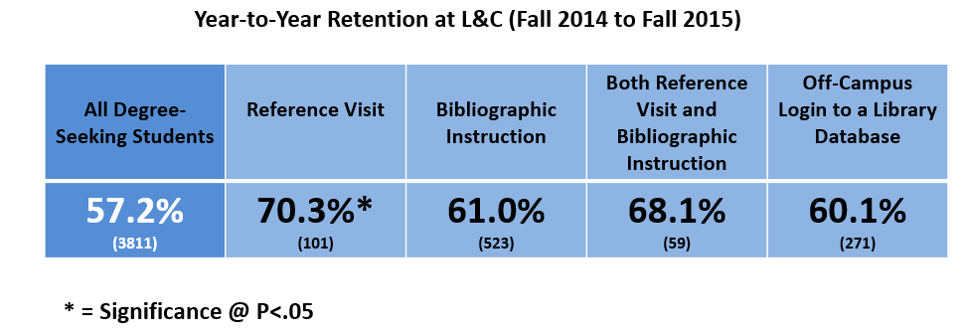
What are we assessing?
Results from 2014 to 2015 at Lewis and Clark.
Positive (but not significant) correlation between off-campus access to library databases and retention.
Not comprehensive because it is limited to only off-campus access.
We don’t know what the students are accessing e.g. databases, articles,…
Did I mention this is very labor intensive to do?
(More to come about future developments with this later in the presentation)

Slide 8
What are we assessing?
Cost-benefit analysis to assign a value measure.
Value is locally defined.
Methodology is locally designed.
Cannot be linked to a specific student (but it’s the best we can do).
Correlational evidence linking electronic resource usage to specific-students.
Grades, retention, and completion are commonly understood values for assessment.
Very difficult and labor-intensive to link student usage of electronic resources to student success measures.
Return on
Investment
Student
Impact

Slide 9
What are we assessing?
All e-resources at Lewis & Clark Community College
Cost
Public Facing
x
x
Free
Non-Public Facing

Slide 10
Designing a methodology for assessment
What is the overarching goal for determining a
Return on Investment (ROI) for e-resources at Lewis & Clark?
To help determine the value of a public facing e-resource as measured by its use relative to its subscription cost.
Assessing expected costs against actual costs.
Important: Data doesn’t always tell the entire story.

Slide 11
Designing a methodology for assessment
Public Facing E-resources with an Annual Subscription Cost at Lewis & Clark
Academic Universe
APA Style Central
ARTstor
CINAHLPlus
Credo
Ebooks Collection
Education Resource Complete
History Reference Center
Literature Resource Center
MagillOnLiterature
Nursing Made Incredibly Easy
Opposing Viewpoints
PsycARTICLES
Science in Context
Testing & Education Reference Center

Slide 12
Designing a methodology for assessment
Overview
Academic Universe
APA Style Central
ARTstor
CINAHLPlus
Credo
Ebooks Collection
Education Resource Complete
History Reference Center
Literature Resource Center
MagillOnLiterature
Nursing Made Incredibly Easy
Opposing Viewpoints
PsycARTICLES
Science in Context
Testing & Education Reference Center

Slide 13
Designing a methodology for assessment
Student Facing E-resources
Available at Lewis & Clark with a Subscription Cost
All Students | Academic Universe APA Style Central Credo Ebooks Collection Opposing Viewpoints
Academic Universe
APA Style Central
ARTstor
CINAHLPlus
Credo
Ebooks Collection
Education Resource Complete
History Reference Center
Literature Resource Center
MagillOnLiterature
Nursing Made Incredibly Easy
Opposing Viewpoints
PsycARTICLES
Science in Context
Testing & Education Reference Center
Art Students | ARTstor
Education Students | Education Resource Complete
English Students | Literature Resource Center MagillOnLiterature
Crosswalk
e-resources to student cohorts
History Students | History Reference Center
Nursing Students | CINAHL Plus Nursing Made Incredibly Easy Testing & Education Ref. Center
Psychology Students | PsycARTICLES
Science Students | Science in Context

Slide 14
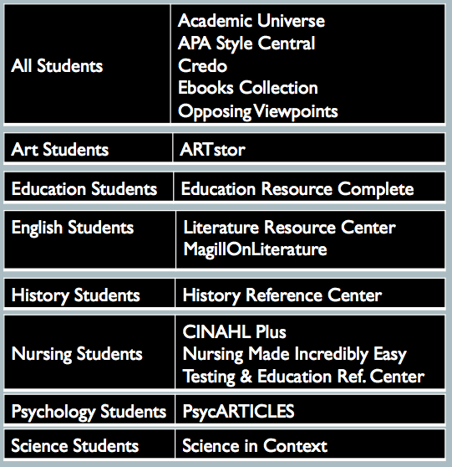
Designing a methodology for assessment
Overview
Academic Universe
APA Style Central
ARTstor
CINAHLPlus
Credo
Ebooks Collection
Education Resource Complete
History Reference Center
Literature Resource Center
MagillOnLiterature
Nursing Made Incredibly Easy
Opposing Viewpoints
PsycARTICLES
Science in Context
Testing & Education Reference Center

Slide 15
Designing a methodology for assessment
Expected Cost Formula
Annual subscription cost
Expected cost
per search
# of students in cohort
* Search as defined by COUNTER Code of Practice

Slide 16
Designing a methodology for assessment
Expected Cost Formula
Example
$5000
$5 – Expected cost per search
1000 students
* Search as defined by COUNTER Code of Practice

Slide 17
Designing a methodology for assessment
Process Overview
Academic Universe
APA Style Central
ARTstor
CINAHLPlus
Credo
Ebooks Collection
Education Resource Complete
History Reference Center
Literature Resource Center
MagillOnLiterature
Nursing Made Incredibly Easy
Opposing Viewpoints
PsycARTICLES
Science in Context
Testing & Education Reference Center
Expected cost
per search

Slide 18
Designing a methodology for assessment
Actual Cost Formula
Annual subscription cost
Actual cost per search
Total searches
* Search as defined by COUNTER Code of Practice

Slide 19
Designing a methodology for assessment
Actual Cost Formula
Example
$5000
$10 – Actual cost
per search
500
* Search as defined by COUNTER Code of Practice

Slide 20
Designing a methodology for assessment
Overview
Academic Universe
APA Style Central
ARTstor
CINAHLPlus
Credo
Ebooks Collection
Education Resource Complete
History Reference Center
Literature Resource Center
MagillOnLiterature
Nursing Made Incredibly Easy
Opposing Viewpoints
PsycARTICLES
Science in Context
Testing & Education Reference Center
Higher Value
V
Expected cost
per search
V
Actual cost
per search
Lower Value

Slide 21
assessment findings
E-resources Associated for all L&C Students
E-resource | All L&C Students (N) | Expected Cost Per Search Actual Cost ÷ N (EC) | Actual Cost Per Search Search (AC) | Difference EC - AC
Academic Universe | XX | .45 | 16.55 | -16.10
APA Style Central | XX | .29 | 3.73 | -3.44
Credo | XX | .32 | .96 | -.64
Ebooks Collection | XX | 1.74 | 9.86 | - 8.12
Opposing Viewpoints | XX | .47 | .53 | -.06

Slide 22
assessment findings
E-resources Associated for L&C Art Students
E-resource | L&C Art Students (N) | Expected Cost Per Search Actual Cost ÷ N (EC) | Actual Cost Per Search Search (AC) | Difference EC - AC
ARTstor | XX | 1.51 | .08 | 1.43

Slide 23
assessment findings
E-resources Associated for L&C Education Students
E-resource | L&C Education Students (N) | Expected Cost Per Search Actual Cost ÷ N (EC) | Actual Cost Per Search Search (AC) | Difference EC - AC
Education Resource Complete | XX | 10.77 | 1.89 | 8.88

Slide 24
assessment findings
E-resources Associated for L&C English Students
E-resource | L&C English Students (N) | Expected Cost Per Search Actual Cost ÷ N (EC) | Actual Cost Per Search Search (AC) | Difference EC - AC
Literature Resource Center | XX | 3.18 | .99 | 2.19
MagillOnLiterature | XX | 1.06 | 3.86 | - 2.80

Slide 25
assessment findings
E-resources Associated for L&C History Students
E-resource | L&C History Students (N) | Expected Cost Per Search Actual Cost ÷ N (EC) | Actual Cost Per Search Search (AC) | Difference EC - AC
History Reference Center | XX | 3.14 | 1.66 | 1.48

Slide 26
assessment findings
E-resources Associated for L&C Nursing Students
E-resource | L&C Nursing Students (N) | Expected Cost Per Search Actual Cost ÷ N (EC) | Actual Cost Per Search Search (AC) | Difference EC - AC
CINAHL Plus | XX | 24.62 | .78 | 23.84
Nursing Made Incredibly Easy | XX | 5.92 | 5.08 | .84
Testing and Education Reference Center | XX | 6.18 | 42.03 | -35.85

Slide 27
assessment findings
E-resources Associated for L&C Psychology Students
E-resource | L&C Psychology Students (N) | Expected Cost Per Search Actual Cost ÷ N (EC) | Actual Cost Per Search Search (AC) | Difference EC - AC
PsycARTICLES | XX | 3.32 | .69 | 2.63

Slide 28
assessment findings
E-resources Associated for L&C Science Students
E-resource | L&C Psychology Students (N) | Expected Cost Per Search Actual Cost ÷ N (EC) | Actual Cost Per Search Search (AC) | Difference EC - AC
Science in Context | XX | 6.75 | 8.26 | -1.51

Slide 29
assessment findings
10000
ARTstor
9000
Opposing Viewpoints
CINAHL Plus
S
E
A
R
C
H
E
S
8000
7000
Literature Resource Center
6000
PyscARTICLES
5000
4000
Testing & Education Reference Center
Science in Context
Education Resource Complete
3000
Credo
2000
Ebooks
1000
APA Style Central
Nursing Made Incredibly Easy
Academic Universe
MagillOnLiterature
$-40 $-35 $-30 $-25 $-20 $-15 $-10 $-5 0 5 $10 $15 $20 $25 $30 $35 $40
$
L o w e r V a l u e
H i g h e r V a l u e

Slide 30
assessment findings
Mean =-1.81
10000
ARTstor
Standard Dev. 12.66
Left = -14.47
Right = 10.85
9000
Opposing Viewpoints
CINAHL Plus
S
E
A
R
C
H
E
S
8000
7000
Literature Resource Center
6000
PyscARTICLES
5000
4000
Testing & Education Reference Center
Science in Context
Education Resource Complete
3000
Credo
2000
Ebooks
1000
APA Style Central
Nursing Made Incredibly Easy
Academic Universe
MagillOnLiterature
$-40 $-35 $-30 $-25 $-20 $-15 $-10 $-5 0 5 $10 $15 $20 $25 $30 $35 $40
$
L o w e r V a l u e
H i g h e r V a l u e

Slide 31
Assumptions and Limitations
What are the of limitations and assumptions?
Formula assumes one search per student to calculate the expected cost per search.
We assume that all searches are equally weighed.
We assume that subject specific databases were only searched by those enrolled in a related course.
We cannot infer any conclusions related to the impact of e-resources to academic success.

Slide 32
A peek into the future?
IMLS Grant - Connecting Libraries and Learning Analytics for Student Success (CLLASS).
Recently met at OCLC headquarters in Dublin, Ohio to discuss harvesting electronic resources usage data using EZProxy and Caliper Analytics.

Slide 33
A peek into the future?
Caliper Analytics

Slide 34
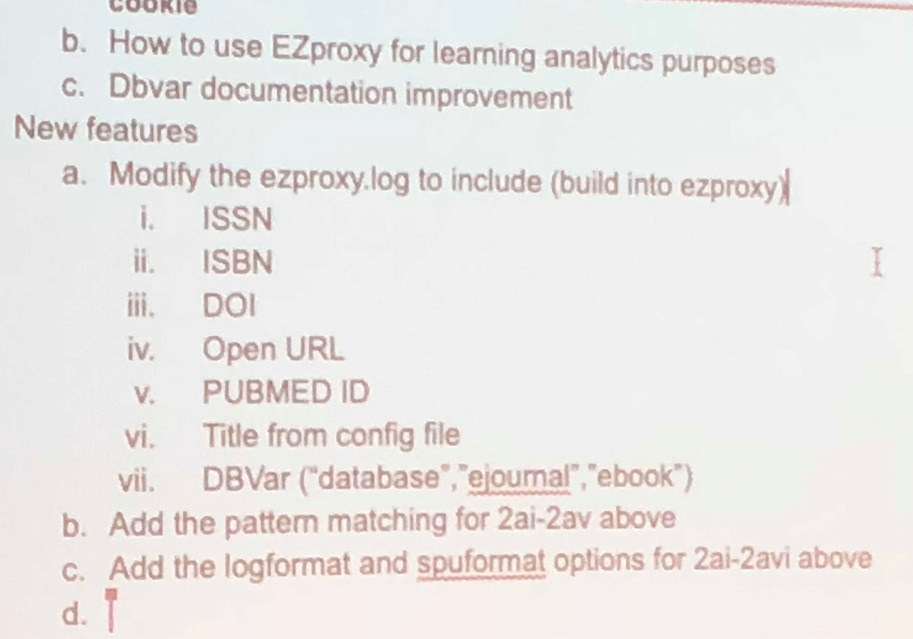
A peek into the future?
Caliper code would be imbedded within EZProxy stanzas to capture meta data that could be harvested by libraries to provide granular data about how e-resources are used:
Student ID
ISSNs Accessed
ISBNs Accessed
DOIs Accessed
Databases Accessed
Article Titles Accessed
????

Slide 35
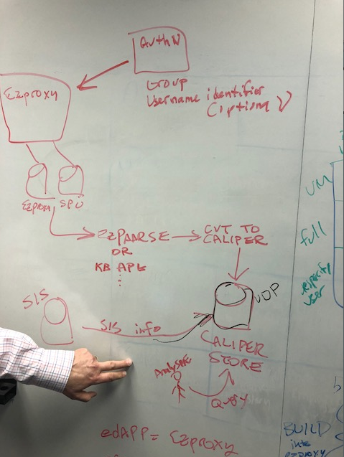
A peek into the future?
This is a proposed schema for how EZProxy would be configured to integrate with Caliper to capture meta data on individual users that access e-resources.
You are seeing the actual plan as was drawn up by an OCLC developer when I was in Dublin, Ohio a few weeks ago. I promised I would be discrete about sharing this so please keep this on the down-low ; )

Slide 36
Questions
Thank you all for the
opportunity to speak today!

Slide 37
Limitations
 |  | Library Database Searches | Students | Cost | Searches | Actual Average Cost per Search | Average Cost by Student Enrollment
All |  | Academic Universe | 9615 | 4353 | 263 | $16.55 | $0.45
All |  | APA Style Central | 9615 | 2755 | 738 | $3.73 | $0.29
Art |  | ARTstor | 859 | 1295 | 15494 | $0.08 | $1.51
Nursing |  | CINAHLPlus | 272 | 6696 | 8637 | $0.78 | $24.62
All |  | Credo | 9615 | 3053 | 3171 | $0.96 | $0.32
All |  | Ebooks Collection | 9615 | 16753 | 1699 | $9.86 | $1.74
Education |  | Education Resource Complete | 79 | 5692 | 3007 | $1.89 | $72.05
History |  | History Reference Center | 850 | 2668 | 1604 | $1.66 | $3.14
English |  | Literature Resource Center | 2027 | 6450 | 6536 | $0.99 | $3.18
English |  | MagillOnLiterature | 2027 | 2155 | 559 | $3.86 | $1.06
Nursing |  | Nursing Made Inrcredibly Easy | 272 | 1610 | 317 | $5.08 | $5.92
All |  | Opposing Viewpoints | 9615 | 4538 | 8553 | $0.53 | $0.47
Psychology |  | PsycARTICLES | 1343 | 4454 | 6496 | $0.69 | $3.32
Science |  | Science in Context | 519 | 3504 | 424 | $8.26 | $6.75
Nursing |  | Testing & Education Reference Center | 272 | 1681 | 40 | $42.03 | $6.18
 |  |  | 9615 | 67657 | 57538 | $1.18 | $7.04

