Slide 1
Best Practice for improving access to EBSCO content: Technical solutions overview
Lisa Jones | Senior Customer Engagement Manager
Kate Hill | Library Services Engineer

Slide 2
Primary Access Methods to EBSCOhost
EBSCOhost native interface
EBSCOhost API (Application Programming Interface)
EIT – EBSCO Integration Toolkit
Note that the EIT Toolkit is used for EBSCO content only and does not include metadata from Licensed Secondary Databases.

Slide 3
Technical Solutions: overview
Completed by CARLI – Link Resolver API
Completed by CARLI - Central Discovery Index is matching resources
Completed by CARLI –Created Scoped Search in Primo VE
CARLI gave instructions - Enabling EBSCO databases & eBook Subscriptions in Alma Community Zone
Marc Records are added in ALMA when EBSCO collections are activated in institution zone
EBSCO Links, boxes and connections -
Configuration of Scoped Search
Link to EBSCO - link within Primo, adding EBSCO under the Primo searchbox, EBSCO search boxes on libguides, other sites, etc.
Additional options that can be discussed

Slide 4
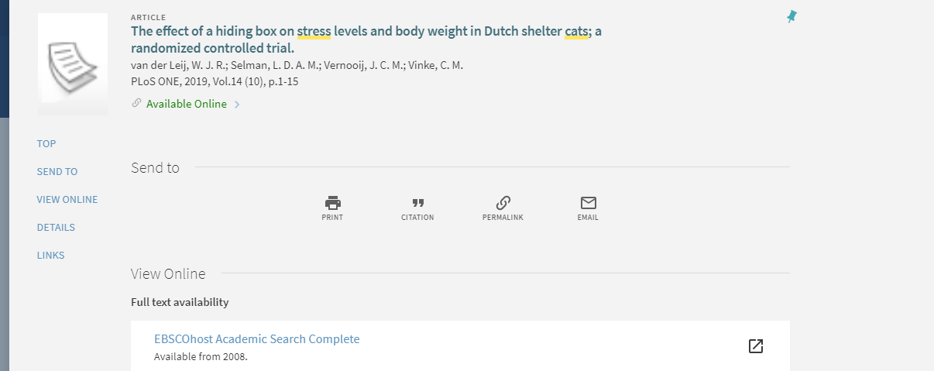
Configuring the EBSCO API for Link Resolvers
This will help to address Full Text linking problems, often inherent in OpenURL. Will improve:
- metadata mismatches between OpenURL & EBSCO targets
- incomplete coverage in some EBSCO targets (only some articles available in FT)
It is also helpful for libraries to prioritise their EBSCO links
Uresolver can use APIs on EBSCOHOST to pre-check the availability of an item and get an accurate URL.
Uresolver will only show the full text link if the API provides a positive response.
This is already configured for you by CARLI

Slide 5
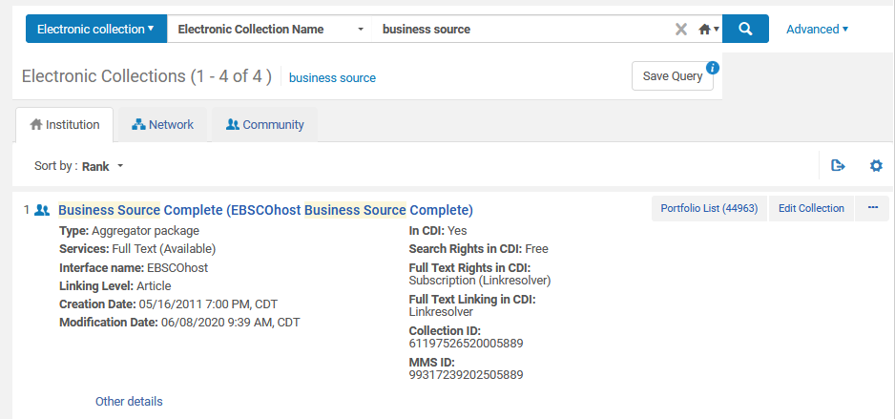
Enabling Alternative Coverage Resources
The Community Zone lets you enable content from EBSCO to be part of your holdings in order for it to be searched by the EBSCO API
These need to be enabled and brought into the Institutional Zone to work with the link resolver connection
https://knowledge.exlibrisgroup.com/Primo/Content_Corner/Product_Documentation/Primo_Central_Indexing

Slide 6
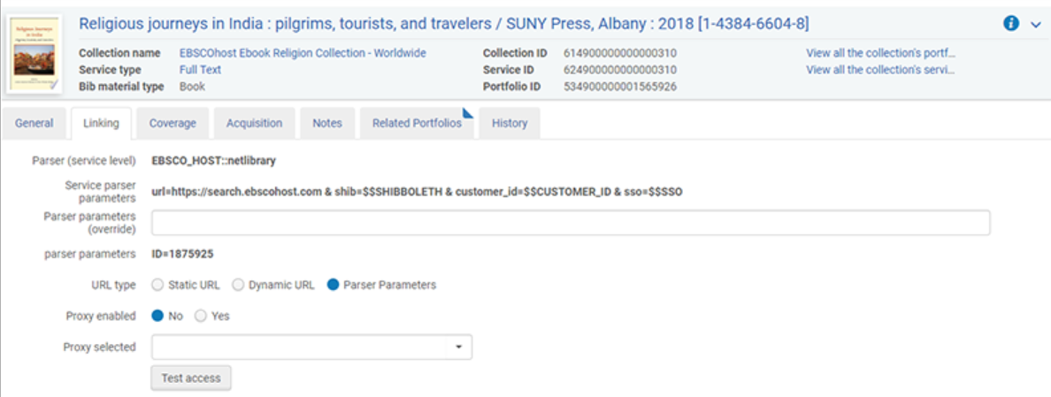
EBSCO eBook Subscription Collections
EBSCO now provides Alma with a KBART feed of EBSCO eBook Subscription Collections to load into the Community Zone once a week. Customers who subscribe to EBSCO eBook subscription collections can now select these collections in the Community Zone.
Refer: https://connect.ebsco.com/s/article/EBSCO-eBooks-in-Alma-Community-Zone-Frequently-Asked-Questions?language=en_US

Slide 7
EBSCO Scoped Search for Primo-Configured
The EBSCO scoped search enables Primo to query and receive results from the EBSCO Database API (EIT). End users that are logged on to Primo, or using an on-campus terminal, do not need to log on to EBSCO to search for EBSCO content.

Slide 8
Why do I need an EBSCO Scoped Search?
When you search “All” you are searching thin meta-data for your EBSCO resources within the Central Discovery Index which usually means you will miss out on resources from EBSCO.
The Scoped Search is a way to not miss out on resources from EBSCO because you are searching the full meta-data of your EBSCO resources.

Slide 9
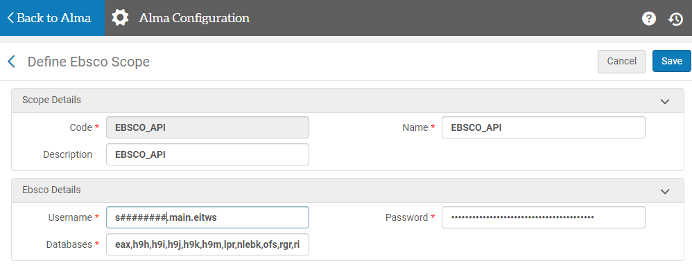
EBSCO Scoped Search for Primo
Alma Configurations --> Discovery Search Configuration -->Search Profiles --> Other Indexes tab. Then....
1. Click on Edit under row actions on EBSCO_API to Define EBSCO Scope
2. Edit Databases list to align with the EBSCOadmin list of databases on the profile defined (see username to find profile)
Instructions: https://www.carli.illinois.edu/products-services/i-share/alma/EBSCO-API

Slide 10
Where to find Database Codes in EBSCOadmin
What Databases work well: https://connect.ebsco.com/s/article/EBSCOhost-Database-Short-Names-List?language=en_US

Slide 11
EBSCOhost API/EIT configuration information
The EBSCO Integration Toolkit (EIT) is a flexible, XML-based web service designed to seamlessly integrate EBSCOhost into other third-party tools, like Primo. It is already set up for you!
Be sure to match EIT to EBSCOhost searching:
* Limiters/Expanders
Configuration information for the EBSCO Information Toolkit is available below:
http://support.ebsco.com/eit/ws.php
http://support.ebsco.com/eit/ws_api_info.php#b
More information about the EIT Toolkit is available here: https://connect.ebsco.com/s/article/What-is-the-EBSCO-Integration-Toolkit-EIT?language=en_US

Slide 12
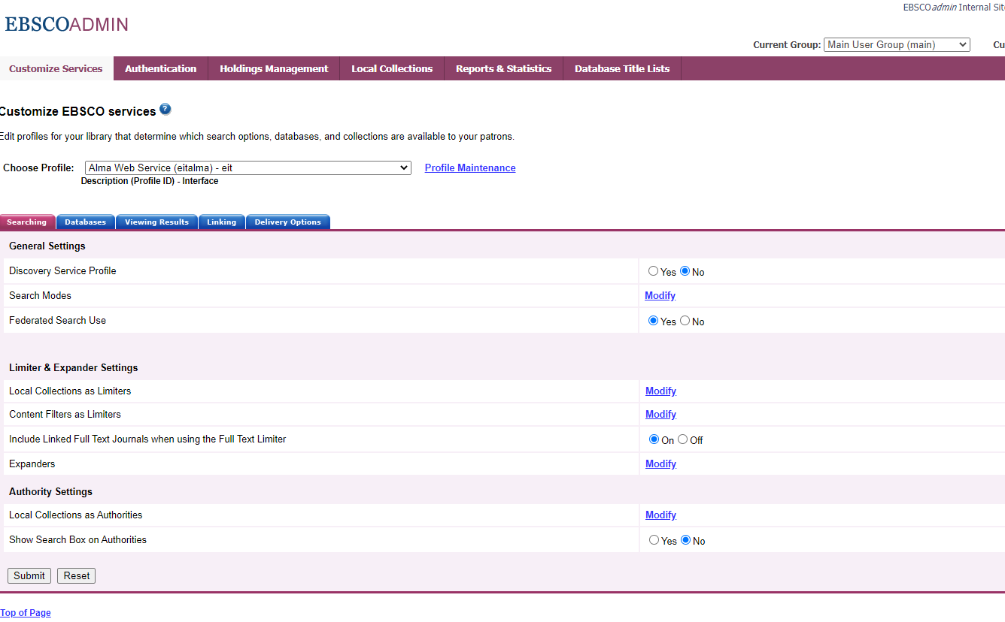

Slide 13
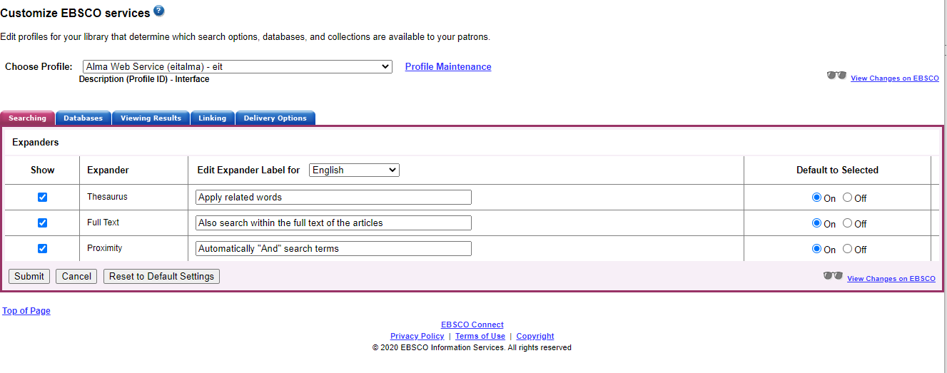

Slide 14
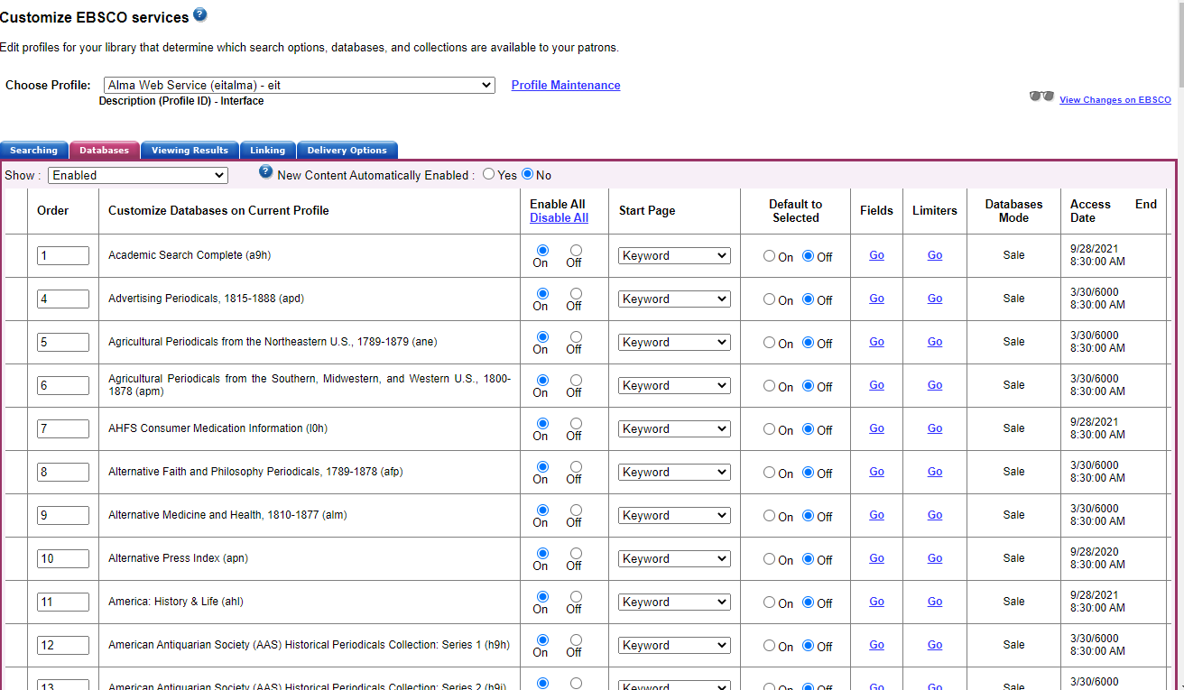

Slide 15
What about Search Modes?
Support can help modify these: https://connect.ebsco.com/s/contactsupport?language=en_US

Slide 19
The EbscoHost API returns only the following facets, which are mapped to Primo facet codes for display in Primo:
JN (Journal) – maps to jtitle in Primo.
ZE (SubjectThesaurus) – maps to topic in Primo.
If the EbscoHost API does not return a SubjectThesaurus facet, it will look for
QZ (Subject)
ZG (SubjectCompany)
ZO (SubjectGeographic)
QN (SubjectNAICS).

Slide 20
Direct Links and Custom Search Boxes
DIY - step-by-step link or search box builder tools
Individual Journals or Combined Databases
Harvard Business Review
CINAHL
Business Source or Academic Search
Your choice!

Slide 21
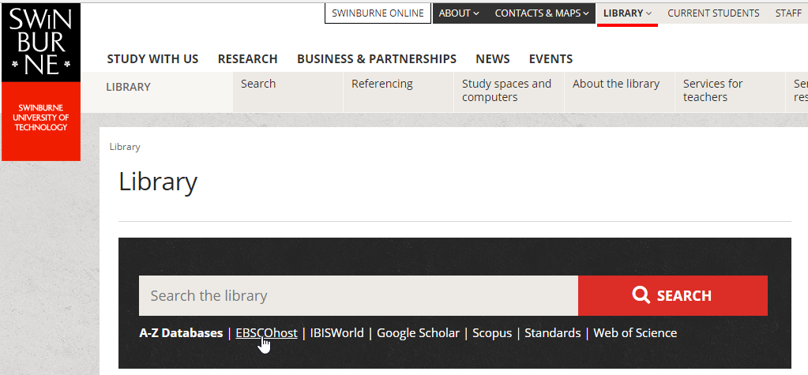
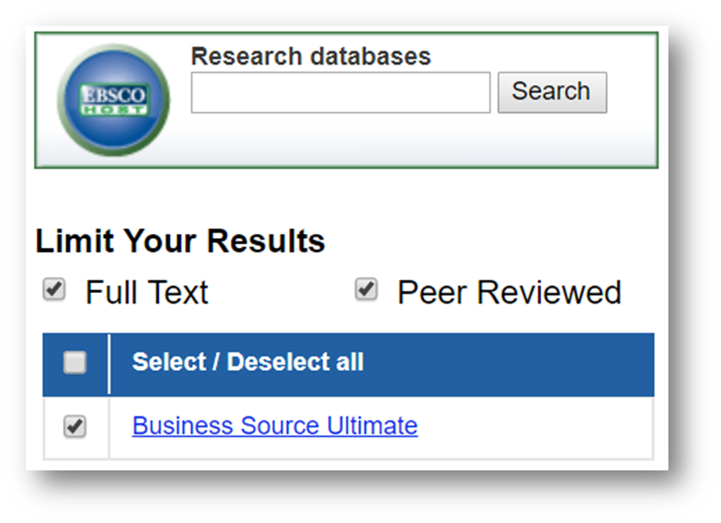
Website Integration Examples
A direct link or search box to search EBSCO databases can be placed on the library website, Libguides or Primo/Alma.

Slide 22
Direct URL and Search Box Builder connect.ebsco.com

Slide 23
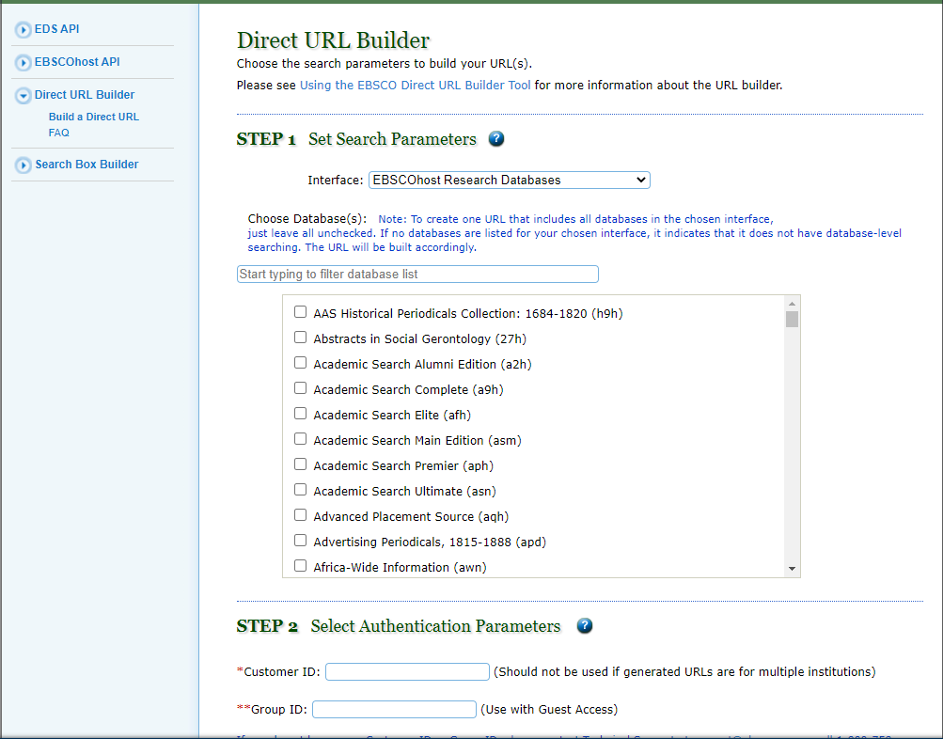
Example of Direct URL Builder Tool
Create mini subject-specific links or search boxes
EBSCOadmin holds Customer ID and Group ID

Slide 24
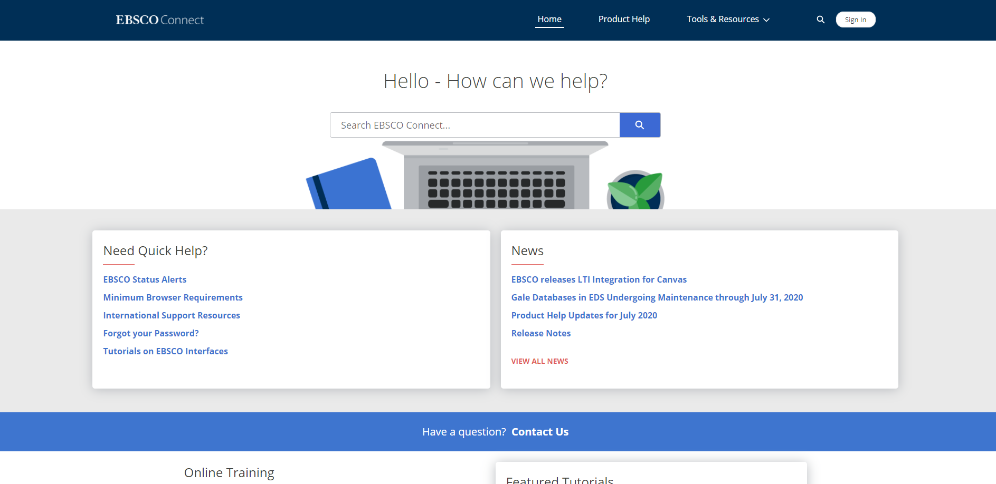
Sign up for EBSCO Connect Account

Slide 25
Thank you from CARLI and the EBSCO team.

