Slide 1

Springshare’s LibInsight:
E-Journals/Databases Dataset
Joanna Kolendo
GWENDOLYN BROOKS LIBRARY

Slide 2
Overview
Gwendolyn Brooks Library collects usage statistics for reporting to ACRL, IPEDs, and the university administration.
Traditionally this information was manually collected in Excel.
This past year, GB Library investigated and began using LibInsight’s E-Journals/Databases Dataset to input and analyze this data. (A newer version of this dataset is now available but will not be discussed here, as it’s based on COUNTER5.)
Notes:
LibInsight offers different types of datasets, such as acquisitions, circulation, ill, etc.
Including E-Resources/COUNTER 5
eBooks
E-Journals/Databases

Slide 3
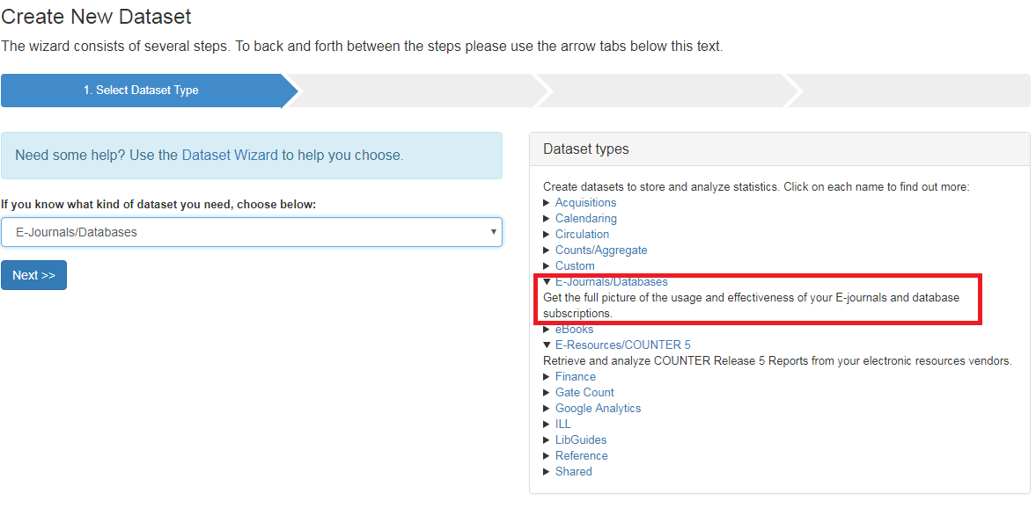
The Basics: Springshare’s
LibInsight
Hosted system, supported, maintained, and updated by Springshare, this tool records and analyzes various library statistics and data points.
Contains pre-designed dataset types, one of which is the e-journals/databases dataset.

Slide 4
E-Journals/Databases Dataset
Stores login information
Provides different levels of permissions for different users
Allows for the collection of usage statistics at different levels:
    e-journals
    Databases
    Platforms (*might be dictated by automated COUNTER reports)
    Usage Data can be collected in the following ways:
    Manual entry
    Using spreadsheet in CSV or EXCEL formats; Supports specific COUNTER reports
    Harvesting data via SUSHI
Provides cost analysis
    Cost data can be entered:
      Manually
      via Invoices
Allows for uploading of license files
Checks for duplicates

Slide 5
COUNTER
COUNTER – “provides the Code of Practice that enables publishers and vendors to report usage of their electronic resources in a consistent way.” (https://www.projectcounter.org/about/)
Accepts automatic downloads of these specific COUNTER reports in CSV or Excel formats
  DB3 (Release 3) – Total Searches and Sessions by Month and Service
  JR1 (Release 3 and 4) – Number of Successful Full-Text Article Requests by Month and Journal
  PR1 (Release 4) – Total Searches, Result Clicks and Record Views by Month and Platform
  DB1 (Release 4) – Total Searches, Result Clicks and Record Views by Month and Database

Slide 6
Demo
Dataset Set-up
Usage Data
Cost Data
COUNTER uploads
Examples of data collected
Data Analysis

Slide 7
Pros & Cons: Lessons Learned
Pros
  Downloading COUNTER reports
  Place to store all database information
  Easy of use
Cons
  Only certain COUNTER reports are supported
  Easier to track databases by platform than by database because of the COUNTER reports supported (do not provide download numbers by database, but rather by platform)

