Slide 1
Central Discovery Index:AN introduction
CARLI Alma Primo VE
Notes:
Introduce myself and read title.

Slide 2
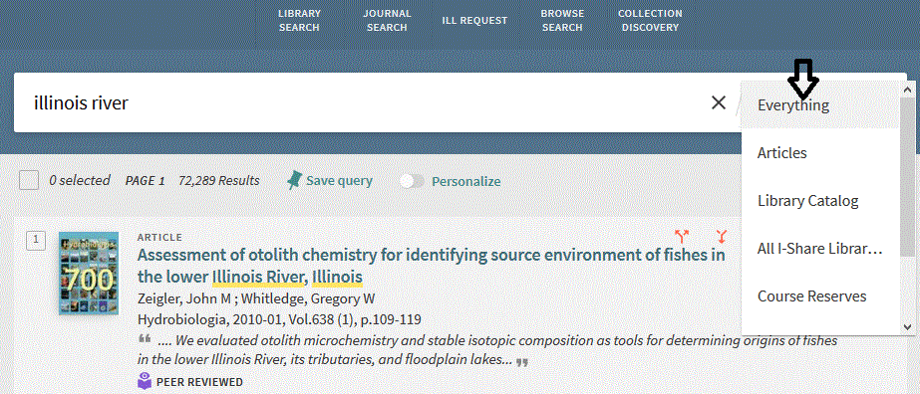
What is PrimoVE Central Discovery Index ? (CDI)
Central Discovery Index (CDI): a database of citations collected from scholarly e-resources including journal articles, e-books, legal documents and more. They are harvested from primary and secondary commercial publishers and aggregators, and from open-access repositories. There are over 13,000 sources of over 4.5 billion CDI citations.
All 89 I-Share Libraries will see in PrimoVE the “Everything” and “Articles” search slots. Note: A Discovery or indexing feature (not delivery/Get Full Text per se.)

Slide 3
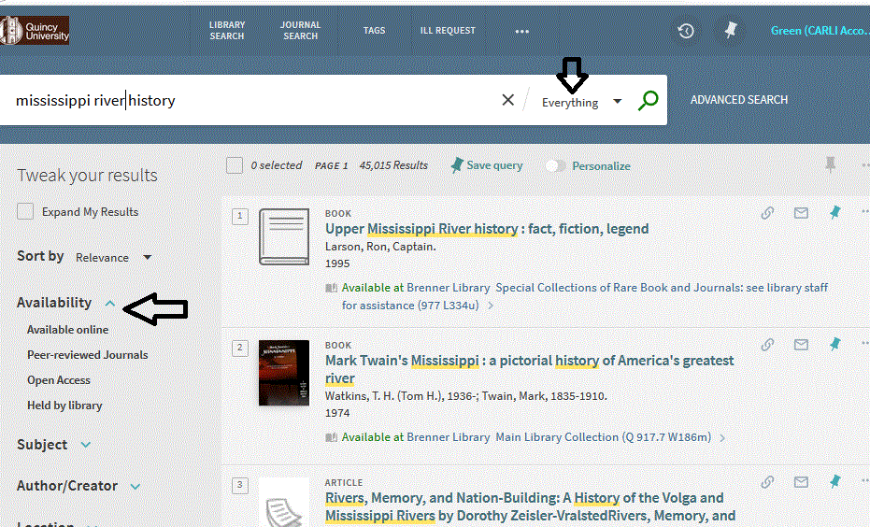
Example Central Discovery Index (CDI) Search
Notes:
After searching for “Mississippi river history” in PrimoVE search “Everything”/CDI see this variety of results. Book chapters, articles, books, etc. How get these results?

Slide 4
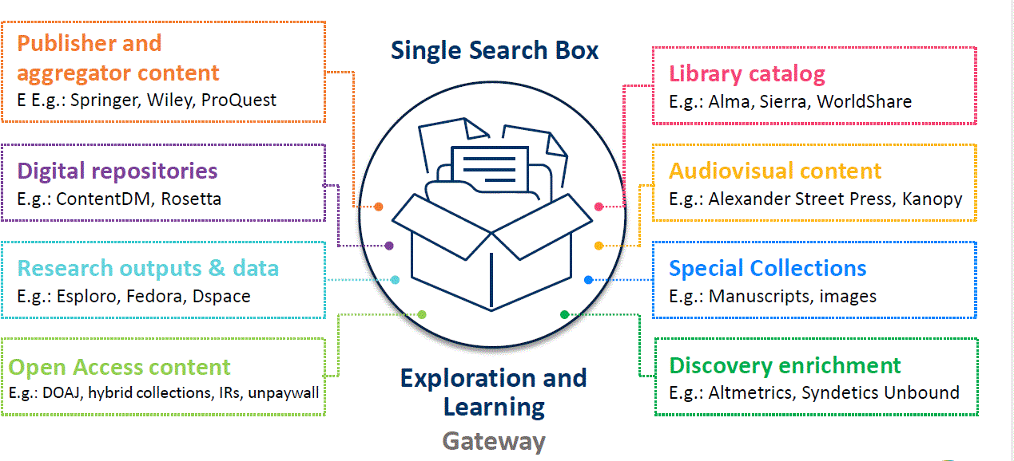
What can be in your Central Discovery Index ? (CDI)
From your Institution Zone (IZ) and the CARLI Network Zone (NZ)
Notes:
What feeds into CDI? All the Ex Libris Alma sources like publishers, open repositories, etc.
Your IZ ,like cataloged materials,
Your active electronic collections in your IZ and the NZ
Can-
Your local metadata from digital repositories- _if activated and loaded_ as P VE external source. And Enrichment tools like Syndetics book cover images for ex.

Slide 5
But what about EBSCOHost e-collections?
Notes:
A

Slide 6
What about EBSCO and CDI? : A different Discovery relationship
NOT directly include EBSCOHost indexing- However, most of the same journals, conferences, etc. indexed by the EBSCOHost e-collections are covered by the CDI sources of bibliographic citations.
For example, the CDI ingested citations from PubMed about "influenza" would overlap with the indexed material in EBSCOHost CINAHL about "influenza".
Now for Delivery: the delivery/View it/link resolver part will link the patron from a citation to the full text as found in EBSCOHost e-resources (whether the all CARLI ones or library purchases.) The origin of the citation should not matter as long as there’s enough accurate metadata to identify the journal, volume, date, etc.
Notes:
not directly in CDI but most, (not 100% but most) indexed in other cdi sources.

Slide 7
Delivery – the “link to full text” part of Primo VE from citations.
Notes:
Regardless of citation source will show delivery links to EBSCO Host full text if enough accurate metadata to form openurls.

Slide 8
Features of CDI and Alma
"Easy Active" setting in Alma so that active eligible e-collections in IZ can automatically send citations to CDI.
No separate admin interface as with older “Primo Central Index”
To make changes need roles Electronic Inventory Operator and CDI inventory operator.
You can deactivate one or more IZ e-collections sending indexing to CDI. (images on next slide.)

Slide 9
CDI Options in Alma
Notes:
Looked up Scielo, the edit collection.

Slide 10
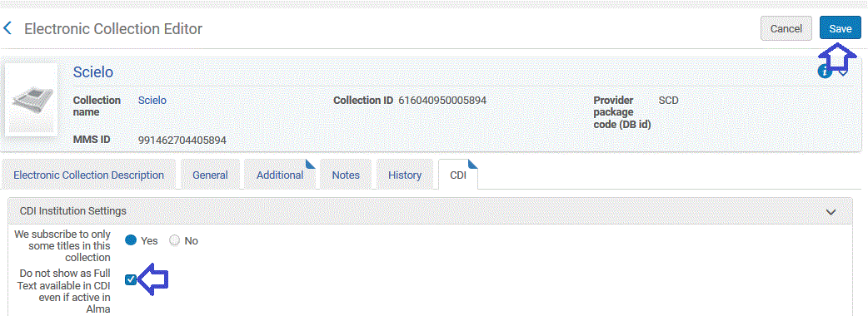
CDI Options in Alma
Then wait for next daily run of job "Publish electronic records to Central Discovery Index“.
Notes:
Looked up Scielo, Look up the e-collection
Go to “Edit Collection”
CDI tab change and save
Run job "Publish electronic records to Central Discovery Index" from the Configuration Discovery Menu. Indeed any changes to CDI inputs from your IZ will take 1 to 3 days to be fully in CDI searching. The “Publish…” job runs automatically every day shortly after midnight.

Slide 11
CDI citations in context and in relation to each other
Notes:
Some more features of CDI, it is “in context” indexing showing connections between the citations, relationships among the data

Slide 12
CDI : a database of citations & relationships between them

Slide 13
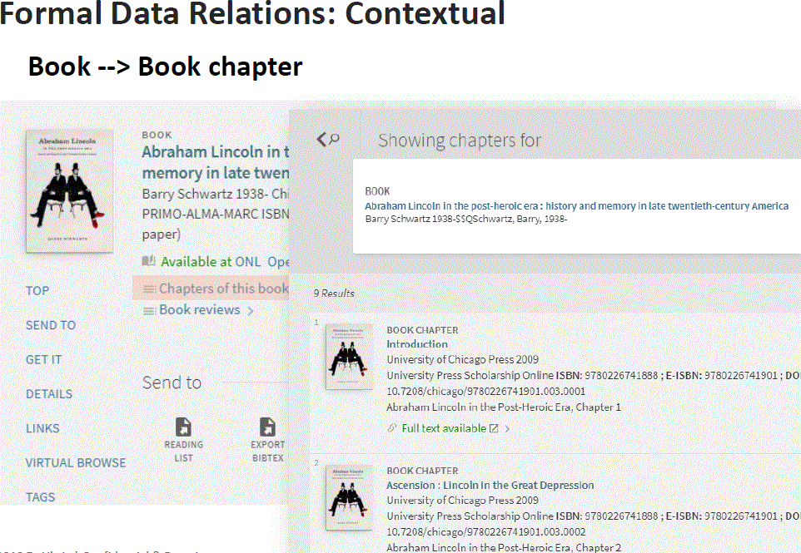
Notes:
Book chapter and review links. Can move in between chapters and also from bib record for entire book to chapters and vice versa.

Slide 14
Need more info?
Central Discovery Index (CDI) https://knowledge.exlibrisgroup.com/Primo/Content_Corner/Central_Discovery_Index/Documentation_and_Training
List of Easy Active CDI sources: https://knowledge.exlibrisgroup.com/Primo/Content_Corner/Central_Discovery_Index/Documentation_and_Training/010Managing_Collections_and_Their_Content_for_Discovery/CDI_Collection_Lists#EasyActive_Collections_List
Alma side: https://knowledge.exlibrisgroup.com/Alma/Product_Documentation/010Alma_Online_Help_(English)/Electronic_Resource_Management/060_Alma_Single_Activation_Source_for_CDI/060Using_the_Central_Discovery_Index_(CDI)_in_Alma
Notes:
For more – see this section of ExLibris documentation. & CARLI documentation

Slide 15
Contact information
CARLI Office:
Phone: 217-244-7593 or 866-904-5843
E-mail: support@carli.illinois.edu
Notes:
We invite comments, questions, and suggestions

