Slide 1
Are You As Conflicted As We Are?
Challenges with Teaching
Subject Headings and Keywords
Frances Brady (Adler University)
Alissa Droog (Northern Illinois University)

Slide 2
Agenda
Background
Discussion
Do you teach subject headings &/or keywords?
What difficulties do you find in teaching subject headings or keywords?
Have you found subject heading indexing errors?

Slide 3
1.
Subject Headings
Errors in indexing within SocINDEX EBSCOhost
Notes:
Frances works exclusively with graduate students in primarily mental health disciplines so has focused instruction on subject headings

Slide 4
Tenure inequities for minority populations
Social Sciences Feminist Network Research Interest Group. (2017). The burden of invisible work in academia: Social inequalities and time use in five university departments. Humboldt Journal of Social Relations, 39, 228-245.
Notes:
Found this article in Fall 2020

Slide 5
Tenure Inequities
Mixed results for gender differences
Important differences for:
  Faculty of color
  Queer faculty
  Working class faculty

Slide 6
Missing Subject Headings
Applied to article:
Equality
Working class
Gender
*Employment tenure
Universities & colleges
University faculty
Not applied to article:
People of color
LGBTQ+ people
Notes:
Frances was surprised “People of Color” and LGBTQ+ subject headings were not applied to the article.
Also, employment tenure was listed, but this subject heading was not listed in the thesaurus
Frances emailed EBSCOhost, reported this, and they fixed it

Slide 7
Subject Heading Not in Thesaurus: Evictions
Thesaurus
No listing for “evictions”
First result in search – “slum clearance”
Keyword search
Relevant articles were indexed with subject heading “evictions”
Notes:
Fall 2021, Frances discovered this, emailed EBSCO, and they fixed it

Slide 8
APA PsycInfo (Ovid): “Trauma”
Hargons, C. N., Malone, N., Montique, C., Dogan, J., Stuck, J., Meiller, C., ... & Stevens-Watkins, D. (2021). “White people stress me out all the time”: Black students define racial trauma. Cultural diversity and ethnic minority psychology.
Subject heading: “stress”, not “trauma”
Scope note for Trauma in Ovid: “Any aspect of the experience of or response to distressing events or injuries.”
Notes:
Frances has found fewer discrepancies for subject heading application in APA PsycInfo
Several articles which discuss racial trauma have “stress” rather than “trauma” as a subject heading. Is this bias or due to a narrow definition of trauma in DSM-V?

Slide 9
Most Recent Citation Additions
Findable in database, but not indexed with subject headings immediately
Notes:
Given the similarities of our student populations, Alissa & Frances discuss instruction tips/ideas frequently, so Frances brought these issues to Alissa and asked how she’s handling them.

Slide 10
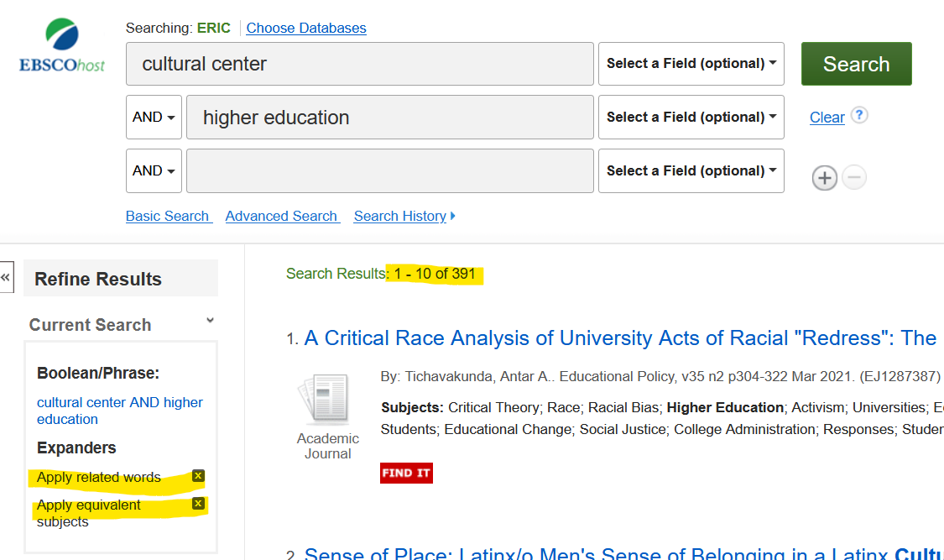
Keyword Search in ERIC

Slide 11
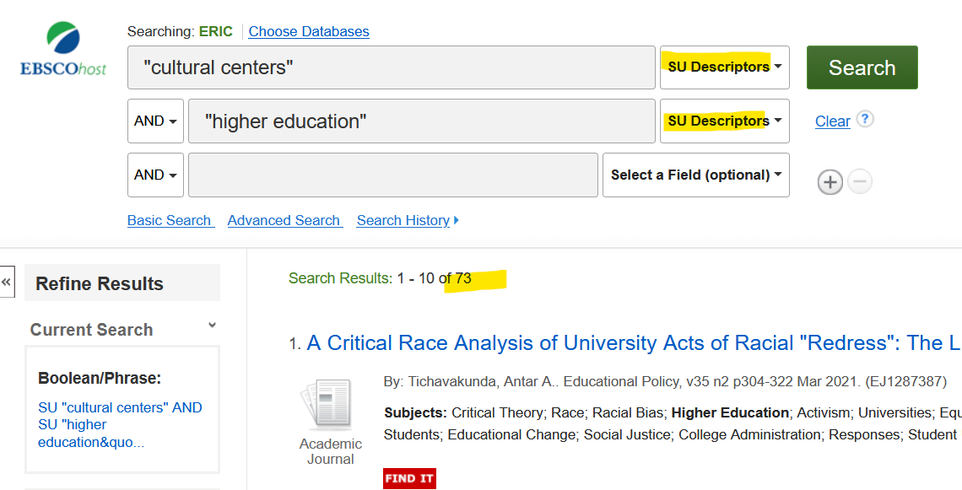
Subject-Heading Search in ERIC

Slide 12
Findings from a (very quick) look at the literature
Most of the research appears to look at subject headings vs. keywords in a library catalog (Rolla, 2011; Gross & Taylor, 2005; Strader, 2009; Salaba, 2009; Andell & Huang, 2008)

Slide 13
Findings: Study Type 1
Tests of searches with subject headings and keywords that conclude that subject headings are necessary for the accuracy and breadth of results (Gross & Taylor, 2005; Gross, Taylor & Journey, 2015)

Slide 14
Findings: Study Type 2
Studies of user behaviour regarding subject headings and keywords in databases (Chu & Law, 2007) and OPAC’s (Salaba, 2009, Antell & Huang, 2008). Findings indicate that novice searchers struggle to apply the correct subject headings (Antell & Huang, 2008, Chu & Law, 2007), and that, as students grow into more experienced searchers, they rely on more accurate subject headings combined with keyword searches (Chu & Law, 2007).

Slide 15
References (skimmed only)
Antell, K., & Jie Huang. (2008). Subject Searching Success Transaction Logs, Patron Perceptions, and Implications for Library Instruction. Reference & User Services Quarterly, 48(1), 68–76. https://doi-org.auth.lib.niu.edu/10.5860/rusq.48n1.68
Chu, S. K. W., & Law, N. (2007). Development of information search expertise: Postgraduates' knowledge of searching skills. portal: Libraries and the Academy, 7(3), 295-316.
Grey, A., & Hurko, C. R. (2012). So you think you're an expert: Keyword searching vs. controlled subject headings. Codex: the Journal of the Louisiana Chapter of the ACRL, 1(4), 15-26.
Gross, T., & Taylor, A. G. (2005). What have we got to lose? The effect of controlled vocabulary on keyword searching results. College & research libraries.
Gross, T., Taylor, A. G., & Joudrey, D. N. (2015). Still a Lot to Lose: The Role of Controlled Vocabulary in Keyword Searching. Cataloging & Classification Quarterly, 53(1), 1–39. https://doi-org.auth.lib.niu.edu/10.1080/01639374.2014.917447
Rolla, P. J. (2011). User tags versus subject headings. Library Resources & Technical Services, 53(3), 174-184.
Salaba, A. (2009). End-User Understanding of Indexing Language Information. Cataloging & Classification Quarterly, 47(1), 23–51. https://doi-org.auth.lib.niu.edu/10.1080/01639370802451983
Strader, C. R. (2009). Author-Assigned Keywords versus Library of Congress Subject Headings. Library Resources & Technical Services, 53(4), 243–250. https://doi-org.auth.lib.niu.edu/10.5860/lrts.53n4.243
Schultz Jr, W. N., & Braddy, L. (2017). A Librarian-Centered Study of Perceptions of Subject Terms and Controlled Vocabulary. Cataloging & Classification Quarterly, 55(7-8), 456-466.

Slide 16
Discussion Question 1
In what contexts do you teach subject headings or keywords?
At what levels?
Which discipline(s)?
Do you use scaffolding of these concepts?

Slide 17
Discussion Question 2
What difficulties do you find in teaching subject headings or keywords?

Slide 18
Discussion Question 3
Tell us about any issues you’ve had with subject heading indexing

Slide 19
Discussion Question 4
Have you collaborated with catalogers (or others responsible for description) to teach subject headings/keywords or to implement improvements that benefit users?

Slide 20
Discussion Question 5
How have you engaged students in thinking critically about outdated or insensitive terminology that they may encounter in catalogs & databases?

Slide 21
Discussion Question 6
How do faculty react when you teach subject heading or keywords?

Slide 22
Citations
Social Sciences Feminist Network Research Interest Group. (2017). The burden of invisible work in academia: Social inequalities and time use in five university departments. Humboldt Journal of Social Relations, 39, 228-245.

