Slide 1
declutter Primo VE’s View Online section
How to Improve “View Online” or Linking to Full Text Options in Primo VE: Part I
Display Logic Rules
Use to show fewer full text options/to declutter
Can prioritize e-collections or interfaces
Order matters for Display Logic Rules
Notes:
How to improve “View Online” or linking to full text options in Primo VE

Slide 2
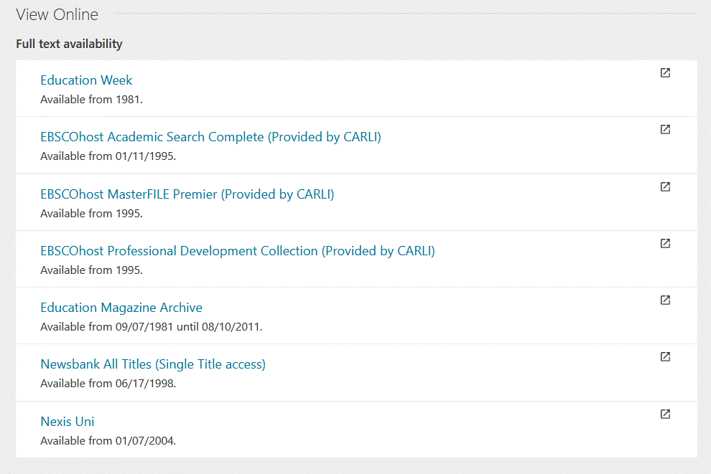
declutter Primo VE’s View Online section
Display Logic Rules
Use to show fewer full text options
Notes:
For example, here’s a long list of possible full text options for this periodical “Education Week”. Which one are your patrons most likely click on? The first one. If indeed that’s the e-collection your library thinks is best, then consider a DLR.

Slide 3
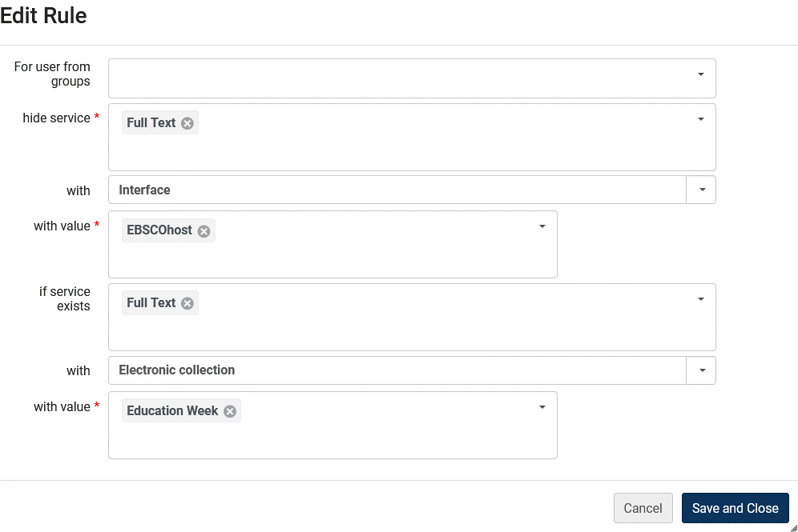
declutter Primo VE’s View Online section
Display Logic Rules
Add a rule like:
Notes:
Let’s read this as a logic exercise, BUT from bottom up. If… implicit is checking for date coverage, if…. Could add more “With interface” Newsbank, Nexis, etc. so that you could have display like next slide

Slide 4
declutter Primo VE’s View Online section
Use to show fewer full text options
Let’s look at “Display Logic Rules for Electronic Resources” documentation and more examples
See also Alma/Primo VE documenation
Notes:
The 7 long list of possible full text options for this periodical “Education Week” is now one.

Slide 5
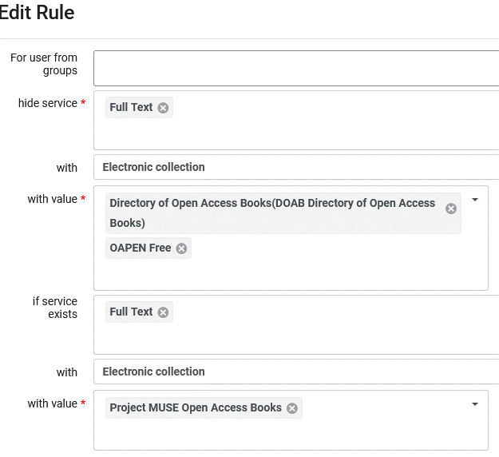
declutter Primo VE’s View Online section
Display Logic Rules To Consider
Prioritize more reliable Open Access sites
Example: Publishers over aggregators
Notes:
Librarians decided publisher Open Access/free site was more uptodate and reliable in general than DOAB. So if in Project MUSE’s own site, don’t show these other two more compilation Open Access/free ebook sites.

Slide 6
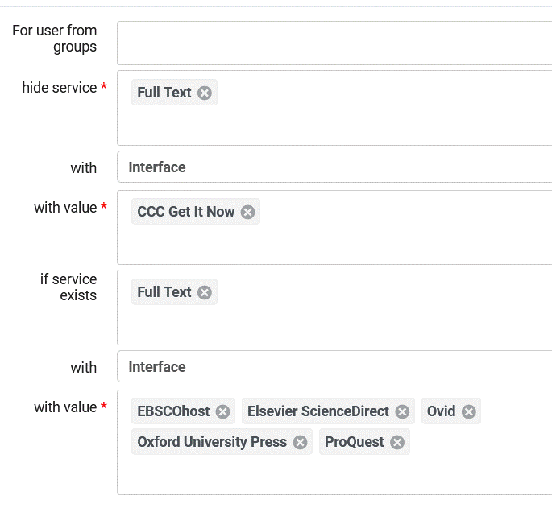
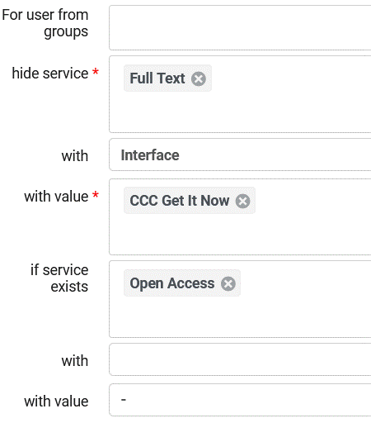
declutter Primo VE’s View Online section
Prioritize less expensive e-collections
Example: Copyright Clearance House Document Delivery – pay per article.
Notes:
So if in other e-collections listed, don’t show the “on demand” CCC type collection(s). (Pay per article type e-collection) Potentially save $$ and less clutter, remember tend to click on first in the “View Online” display. Remember DLRs are in priority order.

Slide 7
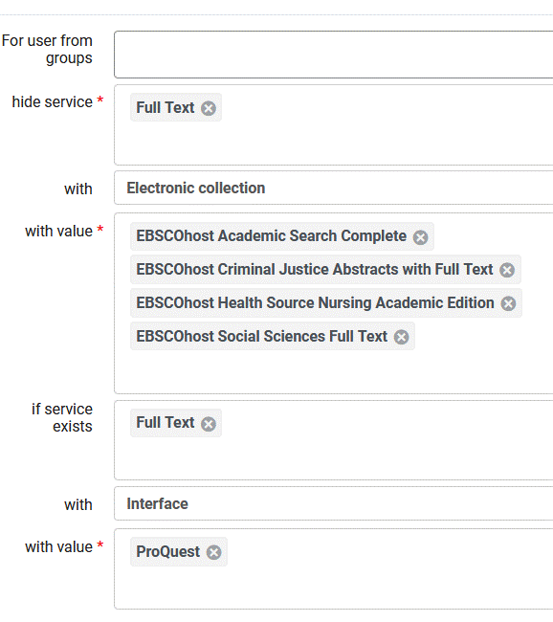
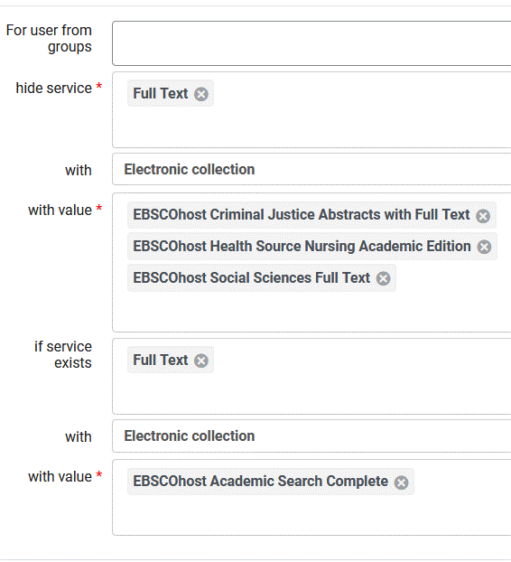
declutter Primo VE’s View Online section
Remember: Order Matters in Display Logic Rules
Example: applies #13 before #14
Notes:
Remember DLRs are in priority order. Rule 13, for this IZ, says if this article or journal is available from any ProQuest e-collection, hide any links from these 4 EBSCOhost e-collections. Rule 14 is applied next in effect saying, if the article or journal isn’t in any ProQ e-collections and is available from EBSCOhost Academic Search Complete, don’t show links from these 3 EBSCOhost e-collections.

Slide 8
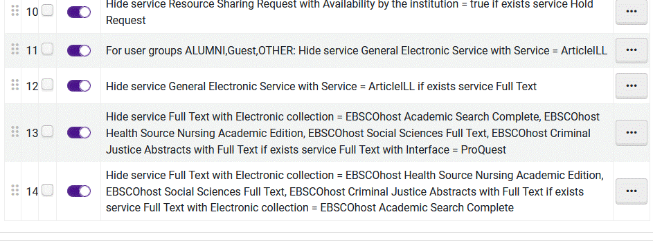
declutter Primo VE’s View Online section
Remember: Order in Display Logic Rules in Fulfillment Configuration Matters.
Example: applies #13 before #14
Notes:
Here’s how this looks in the roster of DLRs in Fulfillment configuration. They are in priority order in list in your IZ Configuration Fulfillment, Display Logic Rules (DLRs).

Slide 9
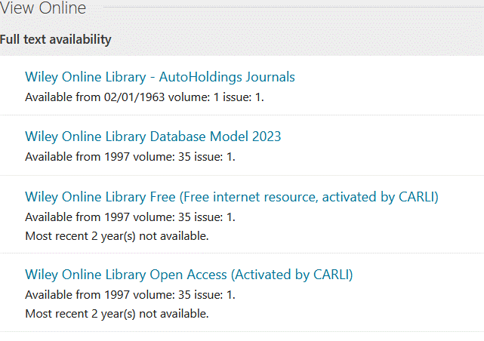
declutter Primo VE’s View Online section
Other Techniques for Improving
“View Online/Get Full Text” type Displays
Link Order/Configuring the Order of Online Services
Alma Link Order Documentation
Direct Linking - pros and cons
Alma Direct Linking Documentation
Notes:
We don’t have time to go into these in any detail today. Default link order is alphabetical as this example shows. Can change that. Direct Linking offers the full text links in the brief results list. Like this example . For information see these links. These are not mutually exclusive. Can use mix of Link Order, Direct Linking, DLRs, etc. One or more can work together. Would you like more presentations about improving “View Online”… displays in Primo VE?

