Slide 1
Analytics and Advocacy for Service Development
Module 6: Methods and Participants
Content is based on CARLI Counts: Analytics and Advocacy for Service Development, a project made possible in part by the Institute of Museum and Library Services (Grant Number RE-95-18-0084-18).
Notes:
Welcome to Module 6, which takes a deep dive into the methods used to gather data for your research project and the ways your local AASD project may engage participants.

Slide 2
Cycle of Inquiry
Area of Interest/Problem
Research Question
Data and Methods
Analysis
Results/Findings
Implications
Adjust Practices
Observe and Reflect
Notes:
We are still exploring the early stages of the cycle of inquiry!

Slide 3
How to gather the data?
The research method is derived from the research question.
Different questions require different methods.
For any given question, more than one method may be a match; however, it is unlikely there is question for which every method be a match.
The plan for participants is driven by the method(s).
Explore?
Explain?
Evaluate?
Experiment?
Notes:
Reminder/refresher: The research method used in your local case study project will be derived from your research question.
It’s likely that more than one question could work, but local context should inform or constrain the method that best suits the research you undertake.

Slide 4
Common Methods in Library Science
Surveys
Interviews
Focus Groups
Observation
Notes:
These are the 4 most common methods utilized in LIS research. There is a heavy reliance on surveys and other methods are used to a lesser degree.
As a researcher, try not to simply default to selecting a survey but broadly consider how each method could be beneficial or might even be paired to give greater depth and impact to your research.

Slide 5
Survey Research
“Survey research is a quantitative method whereby a researcher poses some set of predetermined questions to an entire group, or sample, of individuals.”
https://saylordotorg.github.io/text_principles-of-sociological-inquiry-qualitative-and-quantitative-methods/
Notes:
“Survey research is a quantitative method whereby a researcher poses some set of predetermined questions to an entire group, or sample, of individuals.”
Surveys with open ended questions also gather qualitative data as well.
Survey questions are set in advance and cannot be adjusted. There may be survey logic in which an answer to one question determines the next prompt or question shown to a survey respondent, but the path of the survey is predetermined by researchers. Thus, there is nothing that allows for probing responses provided.

Slide 6
Common Types of Library Survey Questions
Dichotomous Choice
Yes/No
Used/Didn’t Use
Rating/Likert Scale
Satisfaction
Ease of Use
Useful
Important
Expectations
Recommend
Multiple Choice/Nominal Short-Answer
Check One
Check All
Comparative Ranking
Demographic
Open-Ended
Notes:
There are many kinds of survey questions that are supported to varying levels by different survey platforms (Google forms, Microsoft Forms, Qualtrics, Survey Monkey, etc.). Some products require subscriptions to access robust features.
Different Types of Questions
Dichotomous Choice – Guides people through a survey, based on answers given (i.e. survey logic). Examples include:
Yes/No
Used/Didn’t Use
Rating/Likert Scale– collects respondents’ attitudes and opinions in a scale comprised of multiple items measuring the same focal variable in a reliable and valid manner. Examples include:
Satisfaction
Ease of Use
Useful
Important
Expectations
Recommend
*Note: The representation of the middle point of a Likert scale is important because it can serve two different purposes. First, it could be a neutral response or it could be a mid-point in increasing levels of satisfaction or emotion.
Multiple Choice– typically allows respondents to check one or check all, setting another number in between can be difficult for survey respondents to analyze.
Nominal Short-Answer- creates complexity in a survey
Check One
Check All
Comparative Ranking- Give people a set of things and ask for a priority order; these type of questions are more difficult for respondents to analyze. It’s also difficult for researchers to analyze because we don’t know the order of importance or level of importance given to items comparatively ranked.
Demographic- Information about respondents (e.g. race, age, income, etc.), only gather what’s necessary/relevant to a research question
Open-Ended- Allows respondents’ to fill-in-the-blank.
Also consider whether questions are required, can be skipped, or if they can indicate “does not apply” or “do not know” because we don’t want to solicit an inaccurate answer based on the framing of a question

Slide 7
Common Survey Question Mistakes
Questions that are …
Leading/Loaded
Double Barreled
Answers that are …
Not Exclusive
Not Comprehensive
Survey logic that …
Loops
Dead Ends
Notes:
There are a couple categories of common survey mistakes to be aware of and avoid.
Questions that are…
Leading/Loaded: Respondents’ can intuit a desired answer to a question and may want to give the perceived “right” answer (Example: Don’t you agree that the library is important to you?)
Double Barreled: Questions that ask about 2 things in the question. (Example: Was this easy to use and helpful to you?)
Answers that are…
Not Exclusive: When allowing respondents to choose, answers need to be exclusive (e.g. ages: 20-29, 31-39, 40-49)
Not Comprehensive: Not covering all possible respondents (e.g. 18-24, 25-30, 31-36, 37-45 and then a respondent is 50 but there is no option for selecting their age)
Survey logic that…
Loops: People answer a question, but it sends them to a prior point and respondents can’t break out of a loop
Dead Ends: Respondents’ lack a path in response to an answer or they get to a question that can’t answer. Rather than answering inaccurately, people will often just stop taking the survey since they can’t or won’t respond in the way they want to; consider NOT requiring all questions so people can skip if they don’t want to answer or give an option of “no opinion” or “prefer not to answer”

Slide 8
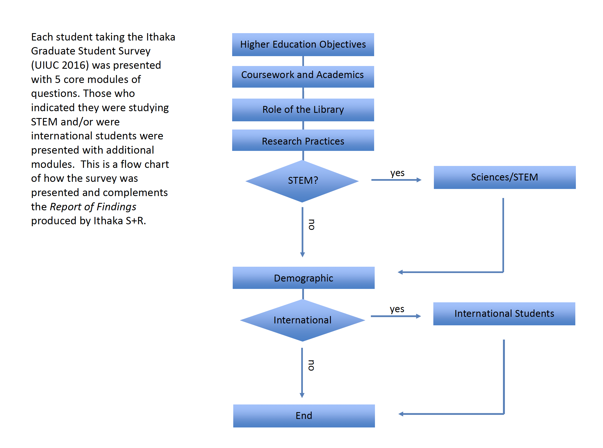
Contingencies and/or Skip Logic Example of Survey Flow
Notes:
This is an example of skip logic in a survey. In this survey, you can see an example of skip logic if/when student affirmed that they were part of a STEM area of study, they were directed to additional relevant questions before continuing to demographic questions. The final demographics question asked if students identified as an international student. Those who answered “yes” were directed to additional relevant questions for this population before the survey ended. For students to answered “no” to each of these questions (STEM and international), they automatically skipped to the end of the survey.

Slide 9
Interview Research
“Interviews are a method of data collection that involves two or more people exchanging information through a series of questions and answers. The questions are designed by a researcher to elicit information from interview participant(s) on a specific topic or set of topics.”
https://saylordotorg.github.io/text_principles-of-sociological-inquiry-qualitative-and-quantitative-methods/
Notes:
“Interviews are a method of data collection that involves two or more people exchanging information through a series of questions and answers. The questions are designed by a researcher to elicit information from interview participant(s) on a specific topic or set of topics.”
Qualitative method of research. Interviews are typically 1:1. Topics can be highly structured, or topics can be semi-structured, but there can also be anticipated pre-planned probing questions as well as introduce questions that probe in response to something an interviewee shares.

Slide 10
Focus Group Research
“Focus groups, on the other hand, are planned discussions designed to elicit group interaction ... The researcher’s aim is to get participants talking to each other and to observe interactions among participants … The researcher takes the role of moderator, posing questions or topics for discussion, but then lets the group members discuss the question or topic among themselves.”
https://saylordotorg.github.io/text_principles-of-sociological-inquiry-qualitative-and-quantitative-methods/
Notes:
“Focus groups, on the other hand, are planned discussions designed to elicit group interaction ... The researcher’s aim is to get participants talking to each other and to observe interactions among participants … The researcher takes the role of moderator, posing questions or topics for discussion, but then lets the group members discuss the question or topic among themselves.”
Focus groups is a qualitative research method in which a moderator orchestrates the collective experience of conversation and dialog among a group. Ideally, the facilitator is not always the person asking questions and seeking answers, but rather observes the group by taking note of individual responses and interactions and reactions among participants. Thus, looking for: 1) individual answers and 2) group process. Skilled moderators seemingly disappear from dialog whereas interviewers remain highly engaged.
The deciding factor with interviews and focus groups is determining if the research question benefits from people talking directly to you or to each other about the question/topic. Interviews can be time consuming but focus groups can be difficult to arrange because everyone must show up on time.

Slide 11
Considerations …
Interviewer(s)/Moderator(s)
Setting – In Person/Virtual, Context
The Script
Open/Closed Questions
Vocabulary/Jargon
Tone
Visual Prompts
Recruitment/Selection
Participants/Group Composition
Recording/Transcription – Notes, Audio, Video
Notes:
Considerations for this methodology…
Interviewers/Moderators – How many? No more than 2 interviewers. Focus groups may be able to have 2-3, but more can get awkward. Clearly delineating roles when multiple interviewers/moderators are present is vital to avoid confusion.
Setting – In-person or virtual. For in-person, what is the context, where are you asking attendees to come? How might the place influence attendees state of mind?
Script— Have an outline or agenda that you will follow. More details on this in the next slide.
Open/Closed Questions—Most questions will be open-ended, though a few closed-end questions can help confirm you are hearing/understanding participants correctly.
Vocabulary— Be mindful of any jargon you might be using and make sure there are definitions or explanations available within your script.
Tone— Will your tone be formal or informal/relaxed tone? The presence of food and type of food can set a type of ethos (coffee in ceramic cups versus paper cups)
Visual Prompts— Determine if/how visual prompts are helpful/beneficial.
Recruitment/Selection – Determine how to recruit and select participants.
Participants/Group Composition– Think carefully about the composition of the collective group. How might the members of the group affect a power dynamic?
Recording/Transcription– Notes, Audio, Video, etc., this time will pass quickly, how will you create a record of the event? If doing a transcription, will it include words only or also reflect/capture non-verbals?

Slide 12
The Script
Beginning
Thanks
Stage Setting
Questions
Deep Dive
Synthesis
Conclusion
Welcome
Contextual
Notes:
For interviews and focus groups, a well-developed script is essential. It has 3 parts:
Beginning – welcome and set the stage– establishing the purpose and parameters/agenda of the interaction.
Focus groups– Researcher can assert that they will keep responses confidential and ask that others do so, but you cannot compel confidentiality.
Interviews- Researcher can assert confidentiality.
Questions– Contextual questions set the stage and get the interviewee/focus group talking. The goal is to establish comfort. Next are deep-dive questions that focus in on the research question. This segment will also likely include follow-up probes. The goal is to get the participant talking. Do everything you can to avoid instruction, explanation, and advising participants. You can share information after the interview– but don’t insert anything amid the data gathering.
Indicate that questions are ending.
Finally, at the conclusion offer thanks and dismissal so that participants know when the interview or focus group is over. At the end, after concluding the research event, you can offer more information if the attendee would like to stay for a moment to learn more. Never demand someone sit and listen to you.

Slide 13
Selecting Interview or Focus Group Method
Interviews
Focus groups
Notes:
In summary, there are similarities between interviews and focus groups, but the key difference in selecting one or the other is considering if you want to converse 1:1 (interview) or hear people conversing with each other (focus group).

Slide 14
Field Research
“Field research is a qualitative method of data collection aimed at understanding, observing, and interacting with people in their natural settings.”
https://saylordotorg.github.io/text_principles-of-sociological-inquiry-qualitative-and-quantitative-methods/
Notes:
“Field research is a qualitative method of data collection aimed at understanding, observing, and interacting with people in their natural settings.”
Natural setting = where people are already. Anecdotal observations such as, “Those chairs seem to get moved every day,” might turn into field research in which a library observes/records how students move the furniture in the evening.
This is the process of observing what people are doing rather than asking them. Obtrusive observation occurs when people realize they are being observed and their behavior may be modified as a result. Thus, the key is unobtrusive observation in order to keep from interfering with subjects being studied. Unobtrusive observation must be done ethically. Gate counts are an example of unobtrusive observation. Library circulation data is another example of unobtrusive observation data.

Slide 15
Unobtrusive Research Methods
“Unobtrusive research refers to methods of collecting data that don’t interfere with the subjects under study … Unobtrusive methods share the unique quality that they do not require the researcher to interact with the people he or she is studying … humans create plenty of evidence of their behaviors … activities leave something behind … are all potential sources of data for the unobtrusive researcher.”
https://saylordotorg.github.io/text_principles-of-sociological-inquiry-qualitative-and-quantitative-methods/
Notes:
Unobtrusive research refers to methods of collecting data that don’t interfere with the subjects under study … Unobtrusive methods share the unique quality that they do not require the researcher to interact with the people he or she is studying … humans create plenty of evidence of their behaviors … activities leave something behind … are all potential sources of data for the unobtrusive researcher.”

Slide 16
Observation Considerations …
Where and when?
Who will observe?
What is the focus?
Which data to collect?
How to collect?
Notes:
When conducting observations, be sure to consider:
Where and when will observations be done? Consider how timing and place of observation impacts consistency of data.
Who will observe? Consider if one person or multiple people will observe and what kind of training might be needed to ensure consistency of data.
What is the focus of the observation? There could be A LOT of information happening in an observation scenario/period, but the research question should guide the focus of observation and data collection.
Which data are you collecting? Defining precisely is key. How will the data be collected? Will there be a checklist, form, rubric, or notes?

Slide 17
Considerations for Methods
Data Practices
With all methods,
think carefully about …
Disclosure of Purpose
Reporting
Incentives
Informed/Voluntary Consent
Notes:
With all these methods of research, it’s important carefully consider and articulate decisions involving data practices, disclosure of purpose, informed/voluntary consent, incentives, and reporting.
Data practices: Understand how data is being gathered/protected.
Disclosure of purpose: In plain language, high level statement of what we’re seeking to understand.
Informed/voluntary consent: Could be a signed document or could be a waiver of informed consent– check box, someone stayed in the room for a discussion/interview
Incentives: Many participants are offered entry into a drawing for some sort of reward. Ultimately, Be careful not to conflict with consent and someone feeling compelled to participate rather than doing so voluntarily.
Reporting: Will pseudonyms be used to protect confidentiality?

Slide 18
Additional Tips and Hints
Document the methodology.
What did you decide to do and why?
What did you consider doing but reject and why?
Pilot test/review your methods.
At least with another librarian.
Preferably with representatives of your participants.
Anticipate the data.
What do you think you will find?
Will it answer your research question?
Notes:
Document the methodology. Note the decision made and why it was made. What else did you consider and reject?
Conduct pilot tests and review your methods. At a minimum with another librarian, but ideally with representative participants.
Anticipate data. Identify what you think you’ll find and determine if it will actually answer your research question.
All of this may help prompt useful revisions!

Slide 19
Participants/Human Subjects
Unit of Analysis
Individual
Object
Library/Unit
Institution
Recruitment
Identification
Invitation
Selection
Sampling
Nonprobability Sampling
Purposive
Snowball/Referral
Quota
Convenience
Probability Sampling
Simple Random
Systematic
Stratified
Cluster
https://saylordotorg.github.io/text_principles-of-sociological-inquiry-qualitative-and-quantitative-methods/
Notes:
Your research will have some sort of unit of analysis– which is the entity being analyzed in your study, this is what you’re going to say something about.
In human subjects research, your unit of analysis could be library users, students, faculty, etc. Alternatively, your unity of analysis could be an object– like the website or an online tutorial or an organization– like a library, a departmental unit or an institution.
Recruitment
How will you identify, invite, and select participants? For objects being analyzed, identification and selection are the only concerns. For human subjects, considering how to identify, invite, and select typically involves one of 2 types of sampling.
Sampling
Probability sampling refers to sampling techniques for which a person’s (or event’s) likelihood of being selected for membership in the sample is known … which means the population is known.
Nonprobability sampling refers to sampling techniques for which a person’s (or event’s or researcher’s focus’s) likelihood of being selected for membership in the sample is unknown. Because we don’t know the likelihood of selection, we don’t know with nonprobability samples whether a sample represents a larger population or not. But that’s OK, because representing the population is not the goal with nonprobability samples. That said, the fact that nonprobability samples do not represent a larger population does not mean that they are drawn arbitrarily or without any specific purpose in mind. Nonprobability sampling is what’s likely to be used for AASD projects.
Four types include:
Purposive: Seeking to hear from certain kinds of people and purposely seeking them out.
Snowball/Referral: Soliciting recommendations for more people to talk with from people already in the sample
Quota: Setting a particular number of participants from several categories. Data gathering isn’t complete until quotas are met.
Convenience: Convenience sampling involves whomever is conveniently accessible– in the library building, subscribed to a listserv and clicked on survey link
The type of sampling affects the claims that can be made from the research data collected.

Slide 20
Team Development Time
What, in Module 6, engaged or surprised you?
Local Case Study Discussion
What type of method(s) are you developing for your local case study project?
Next Steps:
Develop Finalized Assessment Methods/Tools
Apply for IRB Approval
Notes:
What, in Module 6, engaged or surprised you?
Local Case Study Discussion
What type of method(s) are you developing for your local case study project?
Next Steps:
Develop Finalized Assessment Methods/Tools
Apply for IRB Approval

Slide 21
©2022. This work is licensed under a CC BY 4.0 license. How to Cite: Hinchliffe, Lisa Janicke, Mayer, Cathy, & Consortium of Academic and Research Libraries in Illinois. Analytics and Advocacy for Service Development Module 6: Methods and Participants[PowerPoint slides]. Champaign, IL: CARLI, 2022.

