Slide 1
Analytics and Advocacy for Service Development
Module 5: Respect for Human Subjects in Advocacy Work
Content is based on CARLI Counts: Analytics and Advocacy for Service Development, a project made possible in part by the Institute of Museum and Library Services (Grant Number RE-95-18-0084-18).
Notes:
Welcome to Module 5, in which we explore Human Subjects, Data Ethics– both Professional standards and Institutional Review Board (IRB) requirements. We will discuss ethical practice when doing research with human beings as well as compliance requirements.

Slide 2
Data, Ethics, Privacy, IRB … and More!
Notes:
We want to be ethical above all and depending on the kind of local research project you’re undertaking, approval from your local institutional review board (IRB) may be required. IRB can be a bit daunting but we'll take about how to approach that task, strategies for how to manage it.

Slide 3
Library research requires data. *usually data about people. Hence, Professional ethics, laws, etc. apply!
Notes:
Library research requires data-- which is usually about people—typically students. There are ethics, laws, and requirements that must be followed when gathering and managing data about people.

Slide 4
Simplified Logic Model & Data
Library Management Data–
Ethics, Laws and Regulations
(and Maybe IRB)
Human Subjects Data–
Ethics, Laws and Regulations
(and Likely IRB)
Resources
Activities
Outputs
Impact
Your Planned Work
Your Intended Results
Notes:
As a throwback to Modules 1 and 2, we can see what kinds of data come into play within the various stages of research.
In the resources & activities side, data is typically tied to the administration and management of the library (e.g. number of employees & budget). This category would not typically be considered “human subjects data” unless a research project focused on a particular librarian. Human subjects data is gathered by a researcher through intervention of interaction with an individual or is identifiable private information.
Thus, on the outputs and outcomes side of the logic model, it’s highly likely that data to be gathered and evaluated
Most, but not all academic institutions have an IRB. The framework provided by an IRB helps researchers think through the proper approach to respectfully interacting with subjects, providing them with agency, autonomy, and identifying any risks or benefits to participation.

Slide 5
Ethical Frameworks to Consider
Ethics - Librarian
Laws
Regulations
User Preferences
Ethics - Evaluator
Workplace Procedures
Notes:
There are many frameworks for considering ethics! IRB is a regulation based framework.
Workplace procedures can govern and regulate research. For example, your institution may require a survey to be approved and disseminated by a particular office on campus to send a survey to the full-student body or a particular group of students.

Slide 6
ASA Code of Ethics (2018)
Principle C: Professional and Scientific Responsibility
Sociologists adhere to the highest scientific and professional standards and accept responsibility for their work …
Principle D: Respect for People’s Rights, Dignity, and Diversity
Sociologists respect the rights, dignity, and worth of all people. They strive to eliminate bias in their professional activities, and they do not tolerate any forms of discrimination … They are sensitive to cultural, individual, and role differences in serving, teaching, and studying groups of people with distinctive characteristics …
https://www.asanet.org/sites/default/files/savvy/images/asa/docs/pdf/CodeofEthics.pdf
Notes:
LIS does not currently have an explicitly code of ethics for research, but we do have a cold of ethics for the practice of librarianship! To help us reflect on what is ethical in research, we can look at other fields that conduct research similar to ours. In the AASD program, most local projects will mirror research done in applied sociology. Therefore, we can look at thow the sociological community articulates their ethics for research by examining the American Sociological Association’s code of ethics for guidance.
Here are 2 sample principles to give us a sense for what these ethical requirements entail: Principle C: Professional and Scientific Responsibility
Sociologists adhere to the highest scientific and professional standards and accept responsibility for their work …
Principle D: Respect for People’s Rights, Dignity, and Diversity
Sociologists respect the rights, dignity, and worth of all people. They strive to eliminate bias in their professional activities, and they do not tolerate any forms of discrimination … They are sensitive to cultural, individual, and role differences in serving, teaching, and studying groups of people with distinctive characteristics …
It’s especially important that if/when researchers undertake research involving vulnerable populations, that the research does not exacerbate the population’s vulnerability or put them at risk.
Source: https://www.asanet.org/sites/default/files/savvy/images/asa/docs/pdf/CodeofEthics.pdf

Slide 7
Guiding Principles for Evaluators
Systematic Inquiry … conduct data-based inquiries that are thorough, methodical, and contextually relevant.
Competence … provide skilled professional services to stakeholders.
Integrity… behave with honesty and transparency in order to ensure the integrity of the evaluation.
Respect for People … honor the dignity, well-being, and self-worth of individuals and acknowledge the influence of culture within and across groups.
Common Good and Equity … strive to contribute to the common good and advancement of an equitable and just society.
https://www.eval.org/About/Guiding-Principles
Notes:
Another code of ethics example comes from the American Evaluation Association. This example is helpful because a lot of evaluation is applied research.
Systematic Inquiry … conduct data-based inquiries that are thorough, methodical, and contextually relevant. We do work in an evidence based way, not based on opinions.
Competence … provide skilled professional services to stakeholders. If we need to develop a skill, we’ll seek out training.
Integrity… behave with honesty and transparency in order to ensure the integrity of the evaluation. When working with research subjects we are forthcoming.
Respect for People … honor the dignity, well-being, and self-worth of individuals and acknowledge the influence of culture within and across groups.
Respect is foundational to every code of ethics and in IRB.
Common Good and Equity … strive to contribute to the common good and advancement of an equitable and just society.
These principles provide the context and ethos for research that is undertaken.
Source: Guiding Principles for Evaluators. American Evaluation Association. Accessed September 15, 2022. https://www.eval.org/About/Guiding-Principles.

Slide 8
ALA Code of Ethics
We provide the highest level of service to all library users through appropriate and usefully organized resources; equitable service policies; equitable access; and accurate, unbiased, and courteous responses to all requests.
We uphold the principles of intellectual freedom and resist all efforts to censor library resources.
We protect each library user's right to privacy and confidentiality with respect to information sought or received and resources consulted, borrowed, acquired or transmitted.
We respect intellectual property rights and advocate balance between the interests of information users and rights holders.
We treat co-workers and other colleagues with respect, fairness, and good faith, and advocate conditions of employment that safeguard the rights and welfare of all employees of our institutions.
We do not advance private interests at the expense of library users, colleagues, or our employing institutions.
We distinguish between our personal convictions and professional duties and do not allow our personal beliefs to interfere with fair representation of the aims of our institutions or the provision of access to their information resources.
We strive for excellence in the profession by maintaining and enhancing our own knowledge and skills, by encouraging the professional development of co-workers, and by fostering the aspirations of potential members of the profession.
We affirm the inherent dignity and rights of every person. We work to recognize and dismantle systemic and individual biases; to confront inequity and oppression; to enhance diversity and inclusion; and to advance racial and social justice in our libraries, communities, profession, and associations through awareness, advocacy, education, collaboration, services, and allocation of resources and spaces.
http://www.ala.org/tools/ethics
Notes:
ALA’s code of ethics is 9 principles long and applies to the practice of librarianship and our research should not violate any of these principles.
A couple of notes on a few principles: Principle 1: This is especially important for principle #1 because we cannot design a experimental study in an applied setting that creates a control group by denying access to a service or resource for particular library users to study the outcomes (i.e. experimental controls) . Doing so would violate a principle of ethical practice in our profession. Thus, this is an example of our how code of ethics for the practice of librarianship intersects with and impacts our research.
Principle 3: This principle can be challenging in a research setting as we interrogate “What does it mean to uphold privacy and confidentiality? What are the methods for doing so?” An example of the practice of protecting privacy is the deletion of a circulation record after a resource has been returned. Yet, while a book is checked out– privacy is protected by limiting who has access to this record and policies regarding who this record can be shared with. Thus, libraries must operate with practices that protect privacy and confidentiality.

Slide 9
Privacy and Confidentiality
“In a library, user privacy is the right to open inquiry without having the subject of one’s interest examined or scrutinized by others. Confidentiality exists when a library is in possession of personally identifiable information … about users and keeps that information private on their behalf. Confidentiality is a library’s responsibility. This responsibility is assumed when library procedures create records including, but not limited to closed-stack call slips, computer sign-up sheets, registration for equipment or facilities, circulation records, what websites were visited, reserve notices, or research notes.
Libraries should limit the degree to which personally identifiable information is collected, monitored, disclosed, retained, and transmitted while fulfilling their duty to comply with their state’s library confidentiality statute. Libraries involved in training volunteers, new employees, student assistants, or trustees should inform them of the requirements that they not abuse confidentiality and that they protect library users’ rights of privacy.”
http://www.ala.org/advocacy/intfreedom/privacyconfidentialityqa
Notes:
To understand what privacy and confidentiality entails, let’s look at an excerpt of ALA’s Q&A page.
“user privacy is the right to open inquiry without having the subject of one’s interest examined or scrutinized by others.” Thus, privacy is tied to information being sought. Privacy is what a user gets when interacting with the library. Confidentiality is what the library provides when protecting personally identifiable information and keeps it private on behalf of the patron.
Libraries also strive to eliminate data we do not need to minimize risk for privacy or confidentiality to be compromised. Any data that exists is a higher level of risk for violating privacy and confidentiality on account of data breaches or unauthorized access. Thus, we only want to keep data that is essential to provide library services.

Slide 10
Must Maintain Confidentiality
“Regardless of the technology used, everyone who collects or accesses personally identifiable information in any format has a legal and ethical obligation to protect confidentiality.”
https://www.ala.org/advocacy/intfreedom/librarybill/interpretations/privacy
Notes:
ALA’s page Privacy: An Interpretation of the Library Bill of Rights also asserts: “Regardless of the technology used, everyone who collects or accesses personally identifiable information in any format has a legal and ethical obligation to protect confidentiality.” This text is an excerpt of an explanation provided by ALA to expound upon Privacy within the Library Bill of Rights.
The text highlights a principle put in place by the profession of librarianship. We as professionals place high value on confidentiality in a way that other professions may not. Thus, first and foremost we should be making our decisions about research within the framework of our professional ethics.
Source: “Privacy and Confidentiality Q&A.” Advocacy, Legislation & Issues. American Library Association, November 10, 2021. https://www.ala.org/advocacy/intfreedom/privacyconfidentialityqa.

Slide 11
PII to Provide or Improve Library Services
“In all libraries, it is the nature of the service rather than the type of the library that should dictate any gathering of personally identifiable information (PII). Some common library practices necessarily involve close communication with — or monitoring of — library users. Services such as bibliographic instruction, reference consultation, teaching and curriculum support in school libraries, readers’ advice in public libraries, and preservation of fragile or rare library materials in special collections libraries are just a few instances of services that require library staff to be aware of users’ information-access habits.
As part of serving the user, it is often necessary for staff to consult with each other. Staff must be careful to conduct such conversations privately, keep strictly to the purpose, and only divulge PII if necessary. In all types of libraries, any compromise of user privacy by library staff carries with it ethical, professional, and often legal obligations to protect the confidentiality of that PII. Most important, all gathering of PII should be done in the interests of providing, or improving, particular library services. Any knowledge gathered should not be put to use for anything other than providing service to library users.”
http://www.ala.org/advocacy/intfreedom/privacyconfidentialityqa
Notes:
ALA’s Q&A page on Privacy & Confidentiality goes on to define Personally Identifiable Information and understand what data is necessary to provide and improve (evaluate and assess) library services. We cannot know if we are providing equitable or effective services unless we have data about users that can be assessed.
When a library has patron information, we have a high level of ethical, professional, and legal obligations to protect this data. One way libraries protect patron data, like circulation records, is by eliminating/deleting it when the data is no longer needed.
*Note: The word anonymous does not appear in these documents. Library users are not promised or told to expect anonymity. Anonymity is not the standard in our profession. Thus, when collecting research data, adhere to privacy and confidentiality, but know that it’s appropriate and acceptable (at time necessary) to have personally identifiable data as part of research to fulfill high quality, equitable service to library users.
Source: “Privacy and Confidentiality Q&A.” Advocacy, Legislation & Issues. American Library Association, November 10, 2021. https://www.ala.org/advocacy/intfreedom/privacyconfidentialityqa.

Slide 12
Want more information on privacy? Check out these resources!
Prioritizing Privacy: Data Ethics Training for Library Professionals https://prioritizingprivacy.org/
Licensing Privacy https://publish.illinois.edu/licensingprivacy/
Privacy Protections in Public Libraries https://publish.illinois.edu/public-library-privacy-protection-forum/
Notes:
Want to delve into this topic further? Here are some additional resources to consider if additional training or information is desired/helpful.

Slide 13
In addition to professional principles, we must also follow laws, regulations, and workplace procedures…
Notes:
Professional principles provide a foundation for managing data in investigation and research. AND, we must also follow laws, regulations, and workplace procedures.

Slide 14
IRB Policies and Procedures
Foundation is Federal Regulation
“The Common Rule” (CFR Part 46: Protection of Human Subjects)
Institutionally Implemented
Interpretation of Guidelines
Procedures and Forms
Staffing and Timelines
Notes:
IRB is a federally regulated process that institutions are obligated to uphold and administer, especially if the campus receives federally funded research dollars. The federal government dictates certain cases of research that are subject to IRB approval, BUT a local institution can broaden the scope of their IRB. Thus, the federal regulation establishes the minimum demand or expectations on a college or university, but the institution can expand the scope– which results in variation among IRB policies across institutions. The core of IRB policy is the same, but almost all institutions build additional scope.
The government document for IRB can be found by searching for “CFR Part 46: Protection of Human Subjects.” Expanded local guidelines are developed as each campus interprets how to apply the Federal Regulation, such as the processes, forms, staffing, and timelines needed to implement IRB in a local context.

Slide 15
Cycle of Inquiry
Area of Interest/Problem
Research Question
Data and Methods
Analysis
Results/Findings
Implications
Adjust Practices
Observe and Reflect
IRB
Notes:
IRB isn’t an official step on the cycle of inquiry, but it sits alongside steps 2 & 3 because clarity on a research question and desired data and methods for gathering data are important pieces of information to clearly articulate in order to gain IRB approval. Without IRB approval, most research involving human subjects cannot move forward.

Slide 16
IRB Policies and Procedures (Part 2)
Foundation is Federal Regulation
“The Common Rule” (CFR Part 46: Protection of Human Subjects)
Institutionally Implemented
Interpretation of Guidelines
Procedures and Forms
Staffing and Timelines
every institution is (at least a bit) different
Notes:
As a result, EVERY institution’s IRB is a little different, but they can be A LOT different in their scope based on local resources available.
For example, some institutions might require researchers to complete training/certification in IRB expectations before being approved to undertake research. The Collaborative Institutional Training Initiative– commonly referred to as the CITI Program is a subscription training program that is commonly used. According to CITI, 95% of Carnegie R1 Research Universities have paid for subscription access to this training tool for over a decade. Yet, smaller, private institutions may not have the budget to subscribe to the CITI training program and offer alternative in-house training options.
Source: “Research, Ethics, and Compliance Training.” CITI Program. https://about.citiprogram.org/.

Slide 17
Human Subjects - Belmont Report Principles
Respect for Persons - individuals should be treated as autonomous agents; persons with diminished autonomy are entitled to protection
Beneficence - treating persons in an ethical manner by respecting their decisions and protecting them from harm and making efforts to secure their well-being, including an evaluation of risk against benefit
Justice - benefits and burdens of research are distributed fairly
https://www.hhs.gov/ohrp/regulations-and-policy/belmont-report/read-the-belmont-report/index.html
Notes:
The Belmont Report was written by the National Commission for the Protection of Human Subjects of Biomedical and Behavioral Research. The Commission, created as a result of the National Research Act of 1974, was charged with identifying the basic ethical principles that should underlie the conduct of biomedical and behavioral research involving human subjects and developing guidelines to assure that such research is conducted in accordance with those principles. Informed by monthly discussions that spanned nearly four years and an intensive four days of deliberation in 1976, the Commission published the Belmont Report, which identifies basic ethical principles and guidelines that address ethical issues arising from the conduct of research with human subjects.
The Belmont Report identifies three key principles:
Respect for Persons - individuals should be treated as autonomous agents; persons with diminished autonomy are entitled to protection (diminished abilities could include -- children, prison populations, cognitive disabilities)
Beneficence - treating persons in an ethical manner by respecting their decisions and protecting them from harm and making efforts to secure their well-being, including an evaluation of risk against benefit
(in library research, we can almost always claim that the “risks encountered are no greater than what participants encounter in daily life” – key phrase; incentives (extra credit, gift cards, etc.) can be offered to participants, but these must be balanced with any concerns that might lead a participant to feel coerced into participating in a study)
Justice - benefits and burdens of research are distributed fairly
(whoever bears the burden of research should benefit from it; this is not typically an issue in LIS research)
Source: Office for Human Research Protections (OHRP). “Belmont Report.” HHS.gov. U.S. Department of Health and Human Services, September 8, 2022. https://www.hhs.gov/ohrp/regulations-and-policy/belmont-report/read-the-belmont-report/index.html.

Slide 18
IRB Flow Chart
Find Your Institutional Place with IRB
IRB
No IRB and/or In Addition to IRB
Exempt
Expedited
Institutional Research Oversight
Full
Assessment Oversight
Waiver of Informed Consent
Informed Consent
Informed Consent
Library Oversight
Informed Consent
Waiver of Informed Consent
Notes:
This is a flow chart showing how the type of research being undertaken might be classified. There are three categories an IRB uses to classify research: exempt, expedited, and full.
Exempt does not mean “exempt from review” but rather “exempt from full review.” Expedited mean’s it’s an expedited full review– which is done more quickly, and a full review is the length, default comprehensive process.
Exempt reviews apply when the type or scope of research undertaken clearly limits challenges or problems involved in more invasive or extensive research (e.g. medical research).
Most LIS research and library learning analytics projects are exempt from full review.
Within exempt studies, there are 2 additional categories that classify research: Informed consent and waiver of informed consent.
Informed consent requires separate documentation in which a participant physically signs to indicate consent– this is known as a “wet ink” signature requirement.
Waiver of informed consent is used when a participant checks a box or clicks a button to indicate that they consent to participate. Thus the “waiver” in this type of consent is for the “wet ink” portion of agreeing to participate.
Either way, the goal is for participants to know/understand what kind of research they are agreeing to be part of.
It’s also interesting to note, that these two categories can apply to expedited studies, but full consent only allows for the “wet ink” version of informed consent.
If a local institution doesn’t have IRB, there may still be other offices that need to be consulted when research is undertaken.
Prior to this session, you were tasked with reviewing IRB policies (if they exist) for your institution. Can you identify where you anticipate your research fitting on this flow chart?

Slide 19
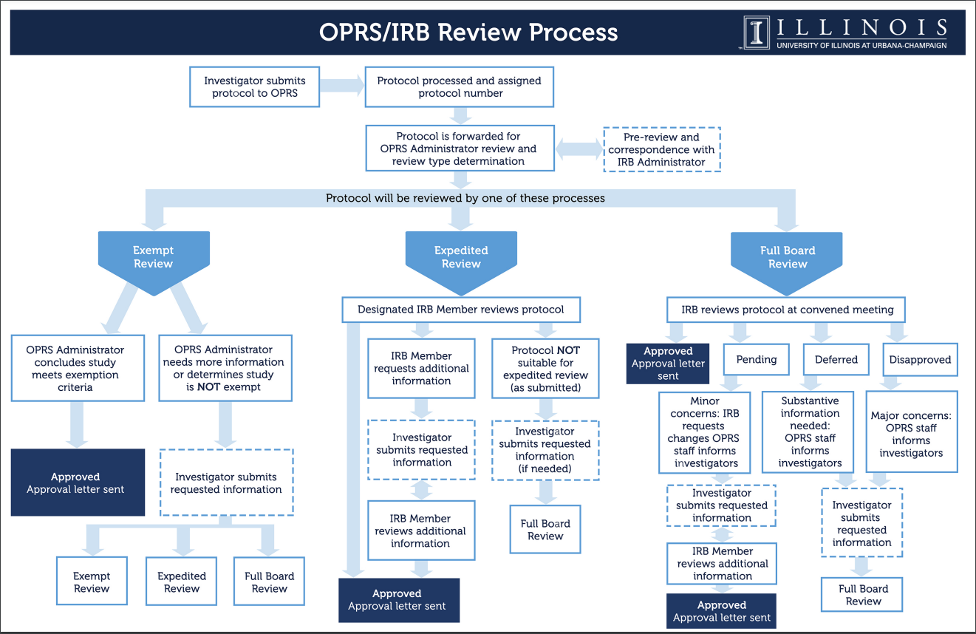
Example: UIUC Process
https://oprs.research.illinois.edu/review-processes-checklists
Notes:
Some institutions provide researchers with extensive guidance to navigate the IRB process. These slides are examples of guidance provided at the University of Illinois at Urbana Champaign. If your institution doesn’t have extensive guidance, reviewing these tools and using them to help you think through the process and focus dialog with your local IRB may be beneficial.
Source: “Review Processes and Checklists: Office for the Protection of Research Subjects.” Review Processes and Checklists - Office for the Protection of Research Subjects. University of Illinois, Urbana-Champaign. Accessed September 15, 2022. https://oprs.research.illinois.edu/review-processes-checklists.

Slide 20
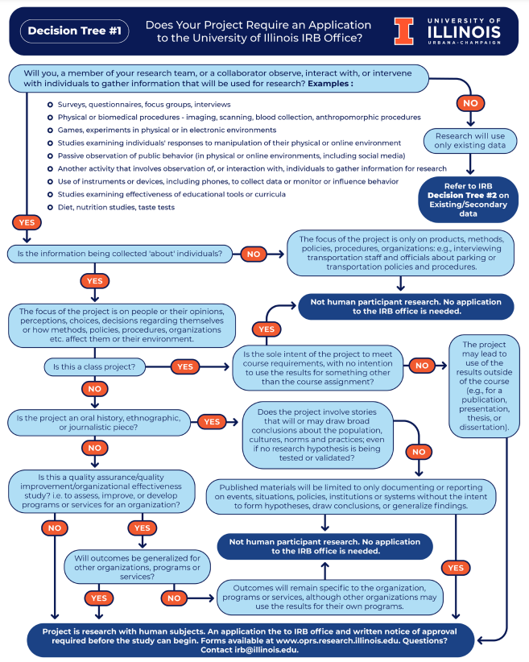
Example Decision Tree

Slide 21
In General - To Fill Out an IRB Form
Investigator(s)
Qualifications
Training Documentation
Description of Investigation
Purpose and Rationale
Participants - Recruitment, Informed Consent, Compensation
Methodology and Procedures - Data Collection, Data Analysis
Confidentiality/Privacy and Data Security
Dissemination Plans
Timeframe
Keep Detailed Records
Notes:
To fill out an IRB form, you must be prepared to detail the following information: Investigator(s)
Qualifications
Training Documentation – CITI training was previously mentioned as a common tool used by institutions. Note that if required by your institution, the training can take approximately 4 hours to complete and MUST be done before submitting paperwork.
Description of Investigation
Purpose and Rationale
Participants - Recruitment, Informed Consent, Compensation
Methodology and Procedures - Data Collection, Data Analysis
Confidentiality/Privacy and Data Security
Dissemination Plans
Timeframe
*A clear research question and plans for operationalizing variables are essential to completing the information above.”
Keep Detailed Records to stay organized!
If/when a local research project is undertaken in collaboration with another institution, researchers must ensure compliance with BOTH institutions’ policies. BUT, one institution should be designated as the lead-IRB institution and all paperwork will be filed there. If there are multiple institution, prioritize selecting one with a med-school because it likely has the most robust and efficient process and staffing support. Next best option is selecting the partner institution with the most extensive research, and or paid staff. If you don’t have any of the above, go with whomever is willing. Ultimately, you are aiming to work with the instution that has the most extensive IRB because having a responsive IRB is incredibly important/beneficial in undertaking research.

Slide 22
A few additional thoughts …
IRB forms can be daunting in length and complexity.
IRB forms are technical documentation.
IRB forms are repetitive.
So …
Follow directions.
Be literal not creative.
Notes:
IRB forms can be daunting in length and complexity. Also, reporting is a technical style of writing– be literal and repetitive. Provide the same information in multiple places– as it is used for different purposes.

Slide 23
IRB Application & Review Process
Submit Application
Revise or Resubmit Application
Application Approved
Prepare Application
Notes:
IRB is a multi-step process. Where are you at in the process of engaging with IRB?
After submitting to IRB, reviewers may ask for revisions and resubmission before approving an application to ensure compliance with Federal and local regulations.

Slide 24
IRB Review Supports Careful planning
Data Practices
IRB / Human Subjects Review Supports Carefully Planning for:
Disclosure of Purpose
Reporting
Incentives
Informed/Voluntary Consent
Notes:
IRB review is supports careful planning for data practices, disclosure of purpose, informed/voluntary consent, incentives, and reporting.

Slide 25
Team Development Time
What are your overall takeaways from the overview of IRB presented in Module 5? Has anyone in your team been involved with IRB approved research in the past? If so, what insights can you share?
Case Study Project Discussion To what extent have you begun to interact with IRB at your institution? What questions do you need to ask about your local IRB policies and procedures? Based necessary information required for completing IRB paperwork, do you need to further clarify your research question or operationalized variables? If so, discuss/brainstorm with your team for help. Next Steps Complete Required Reading for Module 6
Notes:
Attendees will continue to build their community of practice through team development time in which the following content will be explored and discussed:
What are your overall takeaways from getting an overview of IRB in Module 5?
Has anyone in your team been involved with IRB approved research in the past? If so, what tips can your share?
Case Study Project Discussion
To what extent have you begun to interact with IRB at your institution?
What questions do you need to ask about your local IRB policies and procedures?
Based necessary information required for completing IRB paperwork, do you need to further clarify your research question or operationalized variables? If so, discuss/brainstorm with your team for help.
Next Steps
Complete Required Reading for Module 6

Slide 26
©2022. This work is licensed under a CC BY 4.0 license. How to Cite: Hinchliffe, Lisa Janicke, Mayer, Cathy, & Consortium of Academic and Research Libraries in Illinois. Analytics and Advocacy for Service Development Module 5: Respect for Human Subjects in Advocacy Work[PowerPoint slides]. Champaign, IL: CARLI, 2022.

