Slide 1
Analytics and Advocacy for Service Development
Module 3: Research Question Development
Content is based on CARLI Counts: Analytics and Advocacy for Service Development, a project made possible in part by the Institute of Museum and Library Services (Grant Number RE-95-18-0084-18).
Notes:
Welcome to Module 3 in which we will work to develop your research question and research statement!

Slide 2
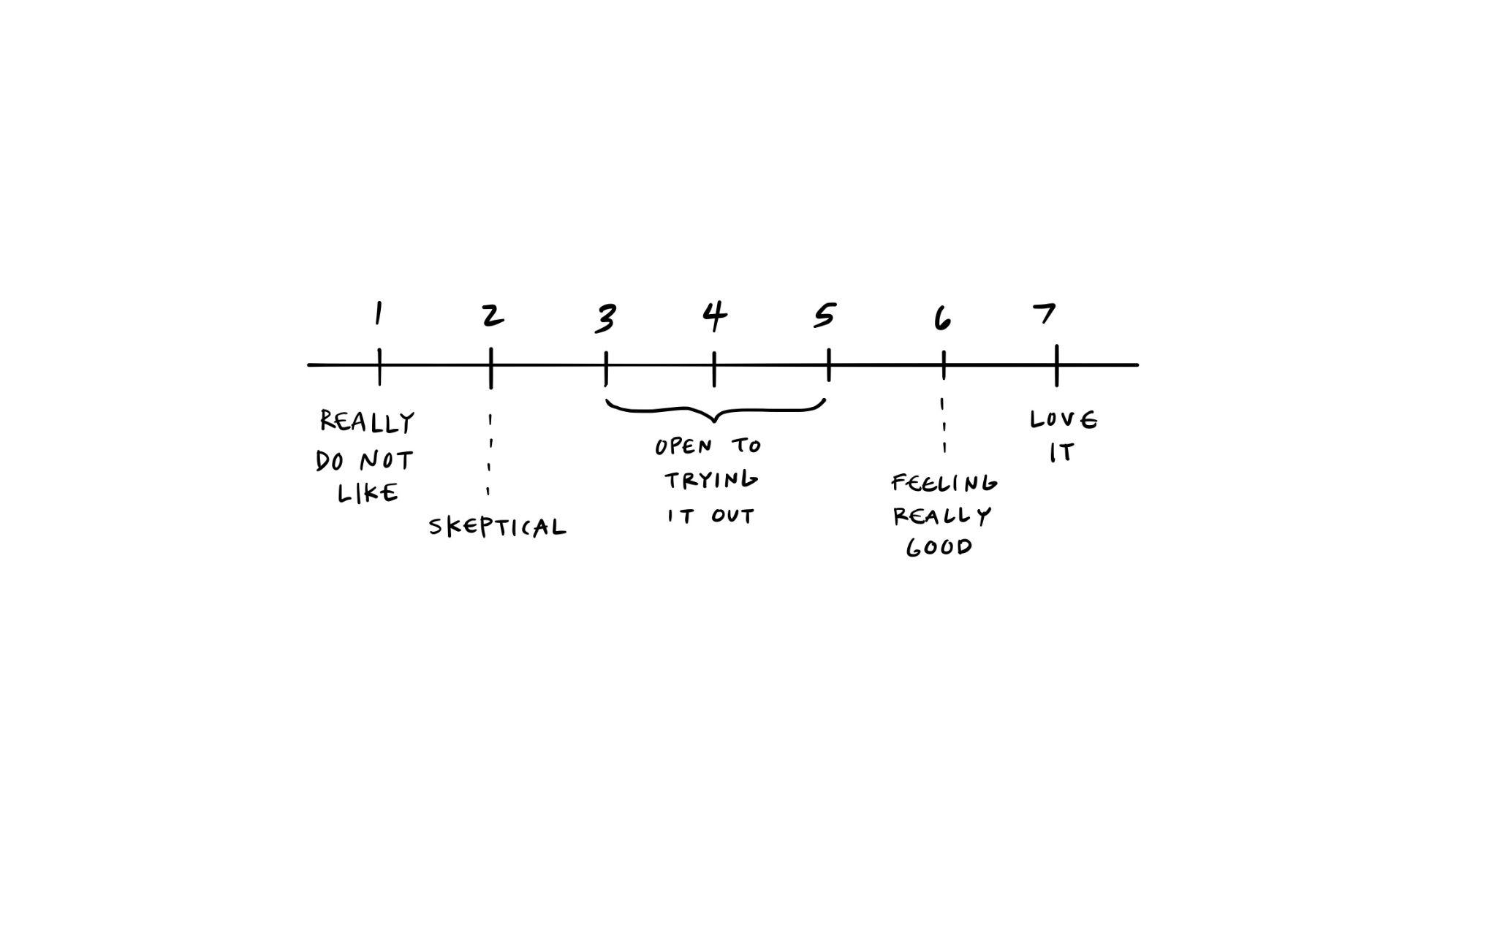
Gradients of Agreement Framework
Source: The Facilitator’s Guide to Participatory Decision Making “Gradients of Agreement” (1996)
Notes:
As we move from brainstorming a topic to committing, the framing offered by a tool called “Gradients of Agreement” can help you discern your level of excitement about or commitment to pursuing a research project topic. Although this tool is typically intended to facilitate group dialog, it can also help you map your reaction when considering possible topics or projects to pursue as you strive to narrow your focus and commit to a particular research question.
As you explore and commit to a particular research question, the hope is that you will move from the center of the scale to the far right– gaining confidence and excitement about the assessment work you undertake.
Take 2 minutes to list an idea or two you are considering for your local case study topic. Where on the Gradients of Agreement framework do these ideas fit best at this stage in the development of your research question?
Source: Kaner, Sam and Lenny Lind. 1996. Facilitator's Guide to Participatory Decision-Making. Gabriola Island: New Society.

Slide 3
Cycle of Inquiry
Area of Interest/Problem
Research Question
Data and Methods
Analysis
Results/Findings
Implications
Adjust Practices
Observe and Reflect
Notes:
In previous modules, we have talked about the goal of AASD, that: “Academic librarians will be able to effectively and systematically leverage data to communicate impact narratives and convey to stakeholders how their libraries bolster student success.” Undertaking a local research project, that works through the cycle of inquiry pictured here, will move you toward this goal!
As a reminder, the cycle of inquiry includes 8 steps:
Identifying an area of interest or a problem
Developing a research question
Gathering data and selecting methods of assessment
Analyzing data
Reviewing results and identifying findings
Considering implications of the findings
Adjusting practices as needed
Observing the results of changes and reflecting on the need for re-starting the inquiry process.

Slide 4
Cycle of Inquiry (part 2)
Area of Interest/Problem
Research Question
Data and Methods
Analysis
Results/Findings
Implications
Adjust Practices
Observe and Reflect
Notes:
This process is extensive and it may take you longer to move through the cycle than the length of the AASD program. Also, it’s important to recognize that at this stage of AASD training, we’re still only in stages 1 (determining an areas of interest or a problem) and 2 (developing a research question).
The goal for this module is to develop a research question and tentative research statement.

Slide 5
Will Your Research …
Explore?
Explain?
Evaluate?
Experiment?
Notes:
There are lots of different kinds of research questions that can be asked!
Explore: Questions that explore seek to help expand understanding in a quantitative way. Potential questions starters for quantitative exploration might include: How much…? Or How many…? Alternatively, qualitative exploration can help develop a better sense of nuance in regard to one’s experience– whether it’s a user (student or professor) or a library staff member! This type of question ties back to the reading in Module 1 of “Sense Making for Decisionmaking” by providing an exploratory map.
Explain: This research seeks to explain mechanisms. Sometimes an explanation simply seeks to establish or recognize that covariance exists between two variables. A number of articles recommended for exploring variables in module 2 provide examples of this type of research as investigators noted that their findings indicated covariance but could not prove causality. As a reminder, covariance must exist for causality to be a possibility– thus, such research moves towards greater confidence and understanding. Causality, saying “X is causing Y” is another example of explanation– though we have to be careful that evidence actually supports making such claims. If evidence isn’t clear, researchers can and should simply note that there is covariation, but the existence of confounding variables may explain causality.
Evaluate: Evaluation seeks to define quality by asking questions like “How good is a (service or resource?” or “How impactful are (teaching sessions or online tutorials or open textbooks)?
Experiment: Libraries typically don’t engage in experimental research because we don’t believe it’s ethical to offer certain users access to resources or privileges while denying access to others. The one exception to this approach is in user experience (UX) research when websites are altered to observe user behavior to identify what design is most helpful and appealing to users by saving time and getting them to resources effectively. Thus, we only do experiments in libraries when we don’t know what is best for a user.

Slide 6
Kinds of Questions
Why … | seeks causal explanations
When … | locates events in relation to the time at which they happened; processes in relation to when they happened and their duration; and/or setting things in temporal order or sequence
Who … | addresses agency, identifying persons, institutions, or collective bodies responsible for something
How … | seeks mechanisms to describe ways in which things are done which result in a specific outcome
Where … | establishes contextual spaces and circumstances
Byrne, David. "Types of research questions: why? when? who? how? where?." Project Planner, 2017. SAGE Research Methods. 10.4135/9781526408525.
Notes:
Another way to think about development of a research question is to explore different kinds of questions. This framework comes from the “Project Planner,” which is a resource for walking through the stages of conducting a research project, available in the Sage Research Methods database. Check to see if this content is available at your institution as many libraries subscribe to this database.
The kinds of questions that can be asked include:
Why …seeks causal explanations
When …locates events in relation to the time at which they happened; processes in relation to when they happened and their duration; and/or setting things in temporal order or sequence
When is a tutorial an effective mechanism for teaching information literacy?
Who … addresses agency, identifying persons, institutions, or collective bodies responsible for something Who takes advantages of certain services? Who has agency? Who has the ability to advance an initiative? In academic libraries, research has shown a faculty champion for catalyzes library service usage among students.
How … seeks mechanisms to describe ways in which things are done which result in a specific outcome. How does something work? Perhaps we observe expected outcomes and benefits among some users but not others, thus we want to seek to understand how something functions. How is a particular resource used?
Where …establishes contextual spaces and circumstances.
No study will answer ALL of these questions, but they simply provide an opportunity to brainstorm ideas for research

Slide 7
Contextualizing Local Project Within AASD
AASD Framework: What is the relationship between academic libraries and student learning and success?
Local Case Study Topic: What is the relationship between <local topic> and student learning and success?
Local Case Study Research Statement:
Notes:
As a reminder…AASD has an overall research question driving the program design: “What is the relationship between academic libraries and student success? As part of this work, your local case study topic draws on and contributes to a body of knowledge to move towards answering AASD’s question.
The time has now come to narrow your topic for investigation to a draft a single research question that will can be articulated as a research statement.

Slide 8
Brainstorming for <Local Topic> Questions
Why …
When …
Who …
How …
Where …
Notes:
Spend time brainstorming.
As you brainstorm, consider what question(s) will be useful for your institution? This may help you prioritize a particular topic.
(Give participants 5-7 minutes for silent brainstorming. Encourage them to try to develop a potential question for each row above.)

Slide 9
Formulating the Research Statement
Topic
(We are studying …..)
Conceptual Question(s)
(because we want to find out who/what/when/where/whether/why/how ….)
Conceptual Significance
(in order to help understand how/why/whether ….)
Potential Practical Application
(so that … will be able to ….)
Script extracted from The Craft of Research by Wayne C. Booth, Gregory G. Colomb, and Joseph M. Williams
Notes:
Another tool that can be helpful in this process is a mad-lib style approach to writing a research statement. Some people prefer research questions and others prefer research statements. A research statement is a way of describing a research project– detailing why the research has been undertaken and what it hopes to accomplish.
Topic – What are we studying?
Conceptual Question + Significance – Why is a selected topic or question important?
Potential Applications - Discussion + Conclusions – This is how you anticipate responding to data/result of the investigation undertaken.

Slide 10
Brainstorming Additional Project Details:
What’s your theory (or analysis) of the relationship between variables?
What evidence do you have or need… *locally? *externally?
How could your idea connect to… *campus priorities? *AiA or other LIS best practices?
Who could be your collaborators… *in the library? *on campus?
Notes:
Spend some more time brainstorming.
As you brainstorm, make notes for each question to help you discern what’s piques your interest and what is research is meaningful and feasible for your local context.

Slide 11
Sketch and Share!
Photo by KOBU Agency on Unsplash
Notes:
Now, try to think in a different way and create a visualization of your research question or statement.
Drawing can unlock creative ideas and tools in ways that words cannot.
This exercise may help you explore how to effectively tell the story of your research to stakeholders that might benefit from a visualization to effectively conceptualize the context and ideas that are familiar to you (as a researcher) but new to them!
(Give participants 5-7 minutes)

Slide 12
Gradients of Agreement Framework Check
Source: The Facilitator’s Guide to Participatory Decision Making “Gradients of Agreement” (1996)
Notes:
Reflect back on “Gradients of Agreement” framing tool mentioned at the start of this lesson. After spending time brainstorming, where do you fall on the continuum as you anticipate pursuit of a selected topic?
Reminder: the hope is that you will move from the center of the scale to the far right– gaining confidence and excitement about a question and assessment work you undertake!

Slide 13
Team Development Time
What are your overall takeaways from developing a research question and statement in Module 3?
Case Study Project Discussion Each team member should share (8-10 minutes each) about their research question, statement, and visualization. Provide feedback to each presenter on the clarity of their question, statement, and sketch. Next Steps Revisit your research statement by “socializing” it with stakeholders at your institution. Explore Available resources – Experts, Tools, Literature, etc. If you’re stuck or uncertain about your research question: Review projects from CARLI Counts Cohort One and Cohort Two for ideas
Notes:
Attendees will continue to build their community of practice through team development time in which the following content will be explored and discussed:
What are your overall takeaways from developing a research question and statement in Module 3?
Case Study Project Discussion
Each team member should share (8-10 minutes each) about their research question, statement, and visualization.
Provide feedback to each presenter on the clarity of their question, statement, and sketch.
Next Steps
Revisit your research statement by “socializing” it with stakeholders at your institution.
Explore Available resources – Experts, Tools, Literature, etc.

Slide 14
©2022. This work is licensed under a CC BY 4.0 license. How to Cite: Hinchliffe, Lisa Janicke, Mayer, Cathy, & Consortium of Academic and Research Libraries in Illinois. Analytics and Advocacy for Service Development Module 3: Research Question Development [PowerPoint slides]. Champaign, IL: CARLI, 2022.

