Slide 1
Analytics and Advocacy for Service Development
Module 1: Program Overview
Content is based on CARLI Counts: Analytics and Advocacy for Service Development, a project made possible in part by the Institute of Museum and Library Services (Grant Number RE-95-18-0084-18).
Notes:
Welcome attendees! This session introduces the goals and outcomes expected for Analytics and Advocacy for Service Development (AASD) participants. Structure and conceptual foundations of the program will be identified, providing context for available resources and project work to be undertaken.

Slide 2
Program Overview: What and Why
Program Overview:
What and Why

Slide 3
Analytics and Advocacy for Service Development (AASD)
A continuing education library leadership immersion program based on the highly successful I-LEAD and Assessment in Action programs
Prepares librarians to make effective use of research findings on the impact of academic libraries on student learning success for the twin purposes of service development and library advocacy
Participants will learn how to use local library data analytics to improve their services and demonstrate their value in competitive campus budgeting processes, accreditation reports, and program reviews
Notes:
AASD follows curriculum originally presented during CARLI Counts: Analytics and Advocacy for Service Development by the Consortium of Academic and Research Libraries in Illinois.
The program is based on 2 successful principles utilized in 2 previous program models. I-LEAD was developed and led by Anne Craig during her time as the Director of the Illinois State Library. Assessment in Action was developed as a piece of the Association of College and Research Libraries’ (ACRL) Value of Academic Libraries initiative, which Lisa Hinchliffe led as her presidential initiative when serving in the top leadership post for the membership organization. Both programs were immersive and demonstrated the incredible value of utilizing a team approach in fostering a learning community.
AASD is designed to help librarians make effective use of research findings on the impact of academic libraries on student learning success for the twin purposes of service development and library advocacy.
Participants will learn how to see local library data analytics to improve their services and demonstrate value in competitive campus budgeting processes, accreditation reports, and program reviews.

Slide 4
Goal:
Academic librarians will be able to effectively and systematically leverage national and local data in order to communicate impact narratives that convey to stakeholders how their libraries bolster student learning and success.
Notes:
Academic librarians will be able to effectively and systematically leverage national and local data in order to communicate impact narratives that convey to stakeholders how their libraries bolster student learning and success. Such data may be relevant to a single local institution or may demonstrate data among a collective group of libraries (e.g., by size, institution type, student population, geography, etc.).
North star for all the work is student success!

Slide 5
Outcomes:
AASD participants are more confident in their skills and abilities related to service design and library advocacy.
Libraries are better equipped to demonstrate their value to stakeholders.
Notes:
2 Program Outcomes relate to skills and abilities as well as confidence. Program wants to make sure participants have skills to gather data and feel ready to engage in advocacy with the information gleaned through the process of completing the program.
Structure of Participation: -Professional Development Learning Experiences: immersive workshops, webinars, team meetings, and poster session presentation
-Peer-to-Peer Learning: Assigned teams engage in discussion of content in modules and provide feedback on local case study projects
-Affinity groups also engage in focused discussion of chosen areas of research, which yields a Community of practice.

Slide 6
AASD Deliverables
Portfolio of Local Case Studies
Team posters will demonstrate key insights learned from program participation.
Notes:
At the conclusion of the program, each participant will create a local case study to be compiled into a portfolio for other participants to learn from. Assigned teams will create a poster reflecting on their shared learning experience throughout the program, which can be presented via a webinar or an in-person poster session.

Slide 7
Communities of Practice Definition
Communities of practice are groups of people who share a concern or a passion for something they do and learn how to do it better as they interact regularly.
http://wenger-trayner.com/introduction-to-communities-of-practice/
Notes:
AASD teaching and learning functions in a mode known as a community of practice. “Communities of practice are groups of people who share a concern or a passion for something they do and learn how to do it better as they interact regularly. This definition, developed Etienne and Beverly Wenger-Trayner, allows for, but does not assume, intentionality: learning can be the reason the community comes together or an incidental outcome of member’s interactions.” Source: Wenger-Trayner, E. and Wenger-Trayner, B. (2015) An introduction to communities of practice: a brief overview of the concept and its uses. Available from authors at https://wenger-trayner.com/introduction-to-communities-of-practice.

Slide 8
Visualization of Elements of a Community of Practice
Community of Practice
The Domain
The Community
The Practice
Notes:
The domain (a.k.a. area of interest) : A community of practice is not merely a club of friends or a network of connections between people. It has an identity defined by a shared domain of interest. Membership therefore implies a commitment to the domain, and therefore a shared competence that distinguishes members from other people. (You could belong to the same network as someone and never know it.) The domain is not necessarily something recognized as “expertise” outside the community.
AASD Domain: librarianship
The community (a.k.a. identified group of people): In pursuing their interest in their domain, members engage in joint activities and discussions, help each other, and share information. They build relationships that enable them to learn from each other; they care about their standing with each other…But members of a community of practice do not necessarily work together on a daily basis.
AASD Community: All participants, trainers, mentors, etc.; sub community: assigned project team
The practice (a.k.a. the thing participants are getting better at): A community of practice is not merely a community of interest–people who like certain kinds of movies, for instance. Members of a community of practice are practitioners. They develop a shared repertoire of resources: experiences, stories, tools, ways of addressing recurring problems—in short, a shared practice. This takes time and sustained interaction.
AASD Practice: systematic inquiry into topics of interest to make research public in support of demonstrating impact of academic libraries on student success.
Source: Wenger-Trayner, E. and Wenger-Trayner, B. (2015) An introduction to communities of practice: a brief overview of the concept and its uses. Available from authors at https://wenger-trayner.com/introduction-to-communities-of-practice.

Slide 9
Program Overview: How
Program Overview:
How

Slide 10
Collective Impact Definition
Collective impact, the commitment of a group of important actors from different sectors to a common agenda for solving a specific social problem.
Collective impact initiatives involve a centralized infrastructure, a dedicated staff, and a structured process … leads to a common agenda, shared measurement, continuous communication, and mutually reinforcing activities among all participants.
https://ssir.org/articles/entry/collective_impact
Notes:
Collective impact (Defn.): the commitment of a group of important actors from different sectors to a common agenda for solving a specific social problem.
Collaboration is nothing new. The social sector is filled with examples of partnerships, networks, and other types of joint efforts. But collective impact initiatives are distinctly different. Unlike most collaborations, collective impact initiatives involve a centralized infrastructure, a dedicated staff, and a structured process that leads to a common agenda, shared measurement, continuous communication, and mutually reinforcing activities among all participants.
AASD Programmatic Manifestation of Collective Impact Centralized Infrastructure: Group/Organization convening the training
Dedicated Staff: Assigned Team Structured Process: AASD Experience Common Agenda: Research Pursued to Demonstrate Library Impact on Student Success Shared Measurement: Local Project Research Contextualized by Broadly Available Evidence & Research Continuous Communication: Team dialog Mutually Reinforcing Activities Among Participants: shared learning and discussion throughout the program
Source: Kania, John, and Mark Kramer. “Collective Impact.” Stanford Social Innovation Review 9, no. 1 (2011): 36–41. https://doi.org/10.48558/5900-KN19.

Slide 11
Program Overview: Conceptual Foundations
Program Overview:
Conceptual Foundations

Slide 12
Value of Academic Libraries
“Few libraries exist in a vacuum, accountable only to themselves. There is always a larger context for assessing library quality, that is, what and how well does the library contribute to achieving the overall goals of the parent constituencies?”
Sarah Pritchard, "Determining Quality in
Academic Libraries,“ Library Trends, 1996
Notes:
The Value of Academic Libraries report ethos and subsequent trainings like this one can be captured by a quote from Sarah Pritchard, now retired Dean of the Northwestern University Libraries, who wrote in 1996 that: Few libraries exist in a vacuum, accountable only to themselves. There is always a larger context for assessing library quality, that is, what and how well does the library contribute to achieving the overall goals of the parent constituencies?”
How libraries serve institutional purpose, aligning with institutional outcomes and mission is a measure of value. AASD is designed to empower libraries to carry out work locally, create shared knowledge and understanding of the impact libraries have on student success, and contribute to higher education assessment.

Slide 13
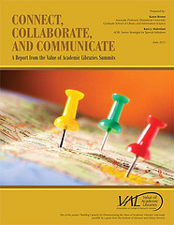
Assessment in Action
Develop Professional Competencies
Foster Collaborative Relationships
Document Practices and Strategies
Notes:
Out of the value of academic libraries project was born Assessment in action with the goals of developing professional competencies, fostering collaborative relationships, and documenting practices and strategies. AASD draws upon a number of these projects as examples to guide our learning.

Slide 14
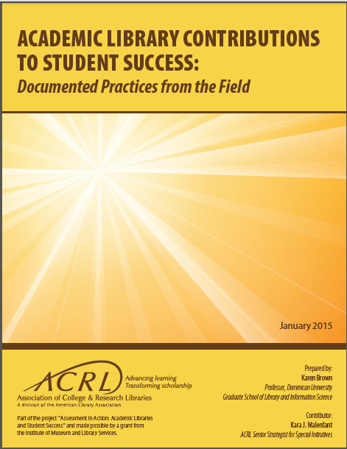
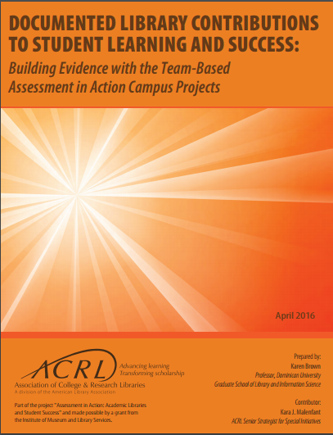
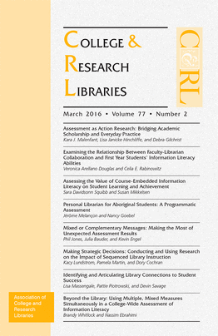
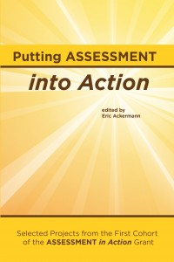
AiA Reports and Publications
Notes:
An immense number of reports came out of AiA, which can be useful understanding how other libraries have approached assessment work. This includes a report from the National Institute for Learning Outcomes Assessment (NILOA), which reported nationally on the AiA program, and is required reading for Module 1 of AASD.

Slide 15
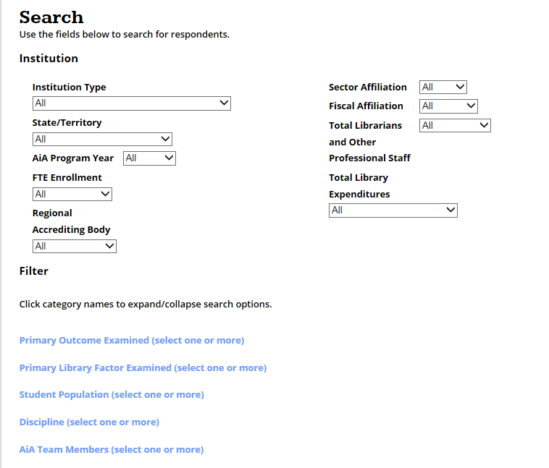
AiA Projects in Detail
http://apply.ala.org/aia/public
Notes:
AiA projects are publicly available and can be searched.

Slide 16
Program Logic Model
“A logic model is a systematic and visual way to present and share your understanding of the relationships among the resources you have to operate your program, the activities you plan, and the changes or results you hope to achieve.”
Resources
Activities
Outputs
Outcomes
Impact
Your Planned Work
Your Intended Results
Excerpted from W.K. Kellogg Foundation’s Logic Model Development Guide
Notes:
To understand how a library impacts a local campus, participants need to develop a logic model. If we claim that the library is serving the campus goals, we need to develop a program logic model.
This is a mental model of how we think a library takes resources and turns them into activities that we do for people to make use of them (outputs) in order for there to be outcomes (e.g. student learning to be fostered, evidence of student success) that demonstrate impact in service of campus goals.
Source: W.K. Kellogg Foundation. Logic Model Development Guide. Battle Creek, MI: W.K. Kellogg Foundation, 2004.

Slide 17
Simplified Program Logic Model
Resources
Activities
Outputs
Impact
Your Planned Work
Your Intended Results
Notes:
Simplified version: As librarians, we take our resources and do activities (e.g., provide services, collections, programs, space). Users then engage with activities in varied ways (e.g., reference questions get answered, resources get downloaded or checked out, etc.), representing the outputs of the library. Then we can ask the question “So what?” We are looking to understand what happened when someone engaged with the library– demonstrating impact.
Through this process, raw materials are converted to valuable goods.

Slide 18
Theory of Change
Resources
Activities
Outputs
Impact
Your Planned Work
Your Intended Results
Notes:
This simplified program logic model is also a theory of change. It’s a theory that asserts the investment campuses make in their libraries allow libraries to provide resources and do work that creates change in the world.

Slide 19
Basis of Claim
Resources
Activities
Outputs
Impact
Your Planned Work
Your Intended Results
Notes:
The simplified program logic model is also the basis of claims made through evaluation in the research process.
We’re asking ourselves, if a particular resource and activity has demonstrated outputs and impact. When you do research and evaluation in AASD local projects, you will seek to demonstrate if/how/to what extent do resources, activities, and outputs impact student success.
If a claim is not clearly proven, we can make a change. The research and data gathering process can be refined until a claim can be effectively tested. If/when a claim is disproven, adjustments can be made to ensure resources are reallocated and new assessment undertaken to ensure continuous improvement in striving for impact of the local campus goals/mission.
Claim example(s) is– “We think a particular resource or activity impacts student retention” or “We think a particular resource or activity helps students succeed.” Research and gathering local data allow for evaluation to prove or disprove a claim. Then, we can say “Yes, it does contribute” and confidently continue the activity based on evidence.
This process is also the basis of research questions to be developed. To research a claim, start by investigating a question that develops evidence that will become the basis of a claim. More detail on this process is undertaken in later modules.
Using a logic model and undertaking research moves one’s understanding of assessment from daily anecdotal forms of evaluation to systematic evaluation, gathering evidence that allows for increased confidence of a library’s impact.

Slide 20
Advocacy
advocacy:
“any activity that a person or organization undertakes to influence policies”
http://www.npaction.org/article/articleview/76/1/248
Notes:
Advocacy (Definition): Any activity that a person or organization undertakes to influence policy.
Much of the policy libraries seek to influence is financial policy. We want libraries to be fully funded to meet our mission. We need to be able to articulate the story of what we can do with increased funding as well.
Source: “Lobbying Versus Advocacy: Legal Definitions.” Internet Archive: Wayback Machine. NP Action, June 1, 2006. Lobbying Versus Advocacy: Legal Definitions.

Slide 21
Evidence-Based Decision Making
Leaders make use of research derived from trials, literature reviews, or other activities that provides objective information on issues of concern in order to help determine whether a particular policy or program will work at their organization and to demonstrate its effectiveness.
http://www.ala.org/llama/leadership-and-management-competencies#Evidence-based%20decision%20making
http://www.ala.org/llama/leadership-and-management-competencies#Evidence-based%20decision%20making
Notes:
The idea that we use research, wherever it comes from, that help us have objective information in order to determine whether a particular policy is worthwhile. It helps demonstrate effectiveness so that we can be confident in our decisions that inform our advocacy.
Source: “Leadership and Management Competencies.” Library Leadership & Management Association (LLAMA). American Library Association.

Slide 22
Evidence Based Decision Making
We must ensure that our libraries are pursuing
evidence-based decision making and
not engaging in “decision-based evidence-making.”
http://old.libraryassessment.org/bm~doc/2-hinchliffe-2016.pdf
Notes:
“We must ensure that our libraries are pursuing evidence-based decision making and not engaging in “decision-based evidence-making.” – Lisa Hinchliffe, 2016 Library Assessment Conference. We want there to be integrity in our research. We need to keep ourselves accountable through gathering data: We want to investigate the theory of change or impact that we/our library operate under. We must be honest about what the evidence shows. If evidence shows that a claim is not supported, then we need to make a change. We aren’t going to ignore or manufacture evidence in order to support or justify a decision that’s already been made.
Integrity in responding to data ensures a firm foundation for advocacy.
You may be wondering, “What happens if the evidence I gather is not as positive as my claim asserts? Won’t that be bad for the library?” DO NOT FEAR data that reveals something is not working!
Higher education administrators appreciate hearing 2 messages: 1) Evidence shows this practice/program/etc. is effective and therefore we are continuing. 2) Evidence shows this practice/program is an opportunity for improvement. Either way, tell a story of how the library is striving to perform at its best and demonstrate success or thoughtful change to seek improvement!
Choosing not to engage in assessment is choosing the status quo and missed opportunity for demonstrating the library’s value.
Source: Hinchliffe, Lisa. “Sensemaking for Decision Making.” Library Assessment Conference. Address presented at the Plenary Address, n.d. http://old.libraryassessment.org/bm~doc/2-hinchliffe-2016.pdf

Slide 23
Assessment Modes
Map - Descriptions
Compass - Directions
Strategic Guide - Decisions
http://old.libraryassessment.org/bm~doc/2-hinchliffe-2016.pdf
Notes:
Assessment as a map provides us with the “lay of the land”—a high-level and holistic view of the terrain, climate, and locations of key landmarks. Assessment can tell us what is happening by gathering data points but then also providing analysis and interpretation in order to reveal the patterns and trends in what has occurred over time. This descriptive information includes inputs, outputs, outcomes, and impacts—placed in context and in comparison. This assessment work reveals different scenarios and possibilities. And, like the beautifully illustrated maps of bygone eras, it might even reveal where “there be dragons!” to work around and guard against.
Assessment as compass reveals possible directions— possibilities for growth, improvement, and new initiatives—and shows these relative to our “north star,” our purpose and mission. This data shows us options and choices that can be made. A compass does not, however, tell us which direction to choose; it only illuminates options and pathways and helps us get our bearings. It illustrates what we will walk away from in order to walk towards other directions.
Assessment as strategic guide empowers making choices and decisions that align resources and activities with our goals, mission, and purpose. Data is not a decision. But decisions should be based on data. Decision making, based on data, must be firmly grounded in values and mission, maximizing impact and efficiency, in pursuit of a vibrant future, which can only emanate from strategic options chosen today
Source: Hinchliffe, Lisa. “Sensemaking for Decision Making.” Library Assessment Conference. Address presented at the Plenary Address

Slide 24
Evidence-Based Advocacy
Leaders make use of research derived from trials, literature reviews, or other activities that provides objective information on issues of concern in order to RECOMMEND OR SUPPORT a particular policy or program at their organization and to demonstrate its effectiveness.
Notes:
Leaders make use of research derived from trials, literature reviews, or other activities that provides objective information on issues of concern in order to RECOMMEND OR SUPPORT a particular policy or program at their organization and to demonstrate its effectiveness.
In an ideal world, advocacy strives to seek additional investment in the library. But, evidence-based advocacy is also a powerful tool for helping to establish a clear understanding of the impact of maintaining current levels of funding or results from cutting resources.

Slide 25
Types of Evidence
Evidence
Research Studies
Program Evaluations
Data Analytics
Professional Standards
Benchmarking
Notes:
A variety of resources can be useful for evidence-based advocacy.
Research studies: published in projects like AiA or professional journals
Professional Standards: ACRL
Data Analytics: May be available through campus partnerships
Benchmarking: Most useful when compared to similar institutions
Program Evaluations: External reviewers, self-studies, etc.

Slide 26
Break Time
Time for a break!
Notes:
(Before dismissing for the break-- check to see if audience members have any immediate questions they’d like to ask!)
LOTS of new information and ideas were shared in this session!
Take some time to let these ideas soak in during a break. Participants are welcome to stretch their legs, use the restroom, or grab a snack as time allows.
We will resume meeting together again at (INDICATE TIME).
After a break, if the schedule allows, give attendees an opportunity to meet with their assigned team to discuss questions (included below) on page 12 of the participant workbook.

Slide 27
©2022. This work is licensed under a CC BY 4.0 license. How to Cite: Hinchliffe, Lisa Janicke, Mayer, Cathy, & Consortium of Academic and Research Libraries in Illinois. Analytics and Advocacy for Service Development Module 1: Program Overview [PowerPoint slides]. Champaign, IL: CARLI, 2022.

