Slide 1
Understanding COUNTER Stats

Slide 2

About the presenter
Jacob Del Rio Electronic Resources Librarian at Southern Illinois University Edwardsville
Member of CARLI E-Resources Management Committee since 2024

Slide 3
About this series
February 9: Understanding COUNTER Stats
March 16, 2026: Interpreting Counter Stats & Storytelling
April 13, 2026: Using Analytics to Pull Your Data/Working
with Vendors/ SUSHI without Analytics

Slide 4
What is COUNTER?
The COUNTER Code of Practice is a standard that allows publishers, aggregators and technology providers to deliver credible, consistent, and comparable usage metrics to libraries and consortia around the world.
Project COUNTER started in 2003. The standard evolves to address the changing nature of publishing, and they release a major update roughly every 5 years.
COUNTER Release 5.1 was first published in 2022 and official compliance started February 2025.

Slide 5
Report types
Platform Report - high-level view of all activity on a platform. No more granular than usage by data type.
Database Report – shows activity for specific databases on a platform.
Title Report - for books and journals. Includes YOP, access type, and access method.
Item Report - includes articles, book sections, database records. Long, granular report.

Slide 6
Why not to use standard views
Standard views only show controlled Access Type. No Open or Free-to-read.
Standard views are filtered results with limited metrics and limited data types.

Slide 7
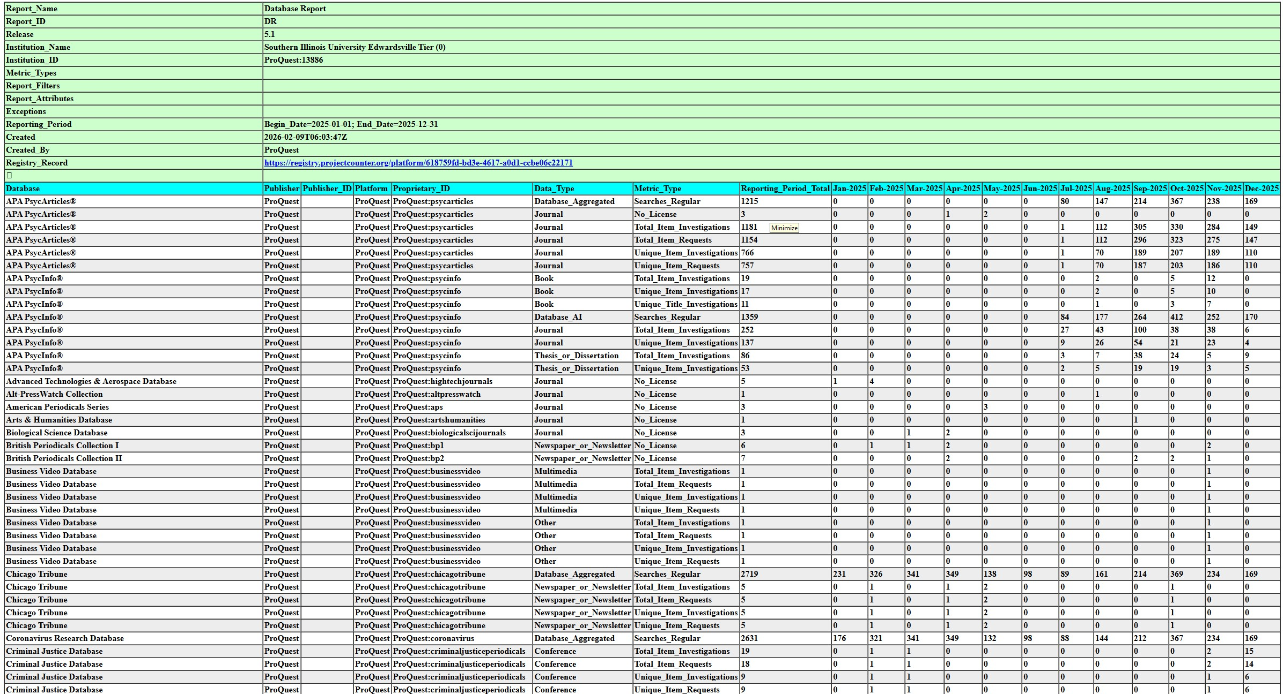
For a quick comparison, here’s a Database Report (R5.1)

Slide 8
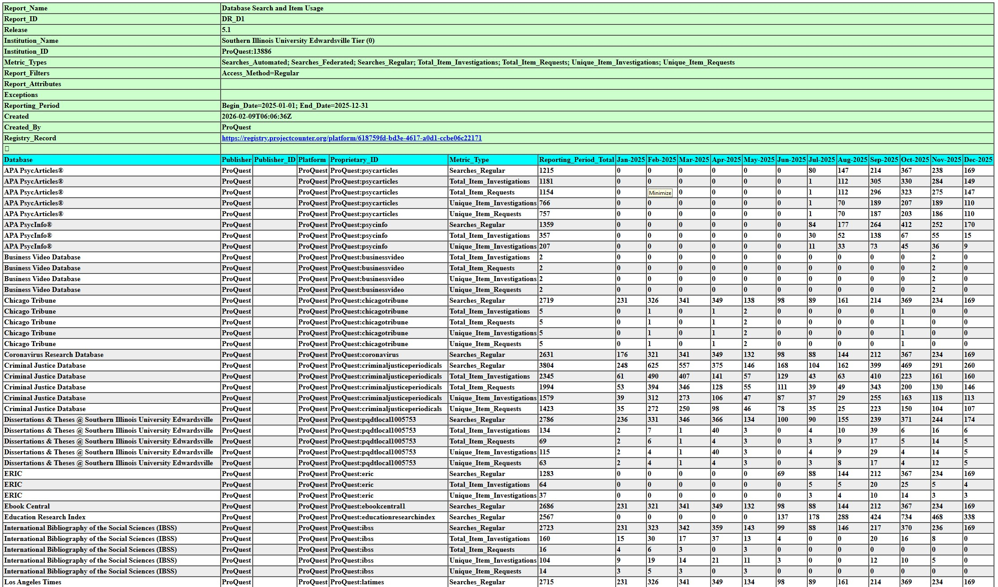
And here’s a DR_D1 for the same content

Slide 9
Retrieving Reports
Manually download tabular reports in .tsv files. Compatible with spreadsheet programs like Excel.
Automatic harvesting with COUNTER API (formerly known as SUSHI) – machine readable files in the JSON schema. Learn more in April.

Slide 10
Metrics
Usage - Total Investigations, Unique Investigations, Total Requests, Unique Requests
Searches - Searches Platform, Searches Regular, Searches Automated, Searches Federated
Denials - No License and Limit Exceeded access denials Unique Item Requests is the recommended metric to calculate cost per use.

Slide 11
Investigations vs. requests
Investigation – viewing of a metadata or an abstract, link to link resolver, link to interlibrary loan.
Request – viewing of full text, downloading an item, playing a media file. Playing a media file counts as a request as soon as the user hits play. There is no minimum playback duration.
Every user interaction with content is an investigation. Some investigations are requests.

Slide 12
Total vs. unique
Total item investigations and total item requests count every interaction with a piece of content.
Unique investigations and unique requests aim to deduplicate usage within a session.
In 5.1, books are now handled to count all chapters toward Investigations and Requests at an item level (20-chapter book downlaod will be 20 total item investigations, 20 unique item investigations, 20 total item requests, and 20 unique items requests) while the book will still count as 1 in Title Reports. Reference Works report similarly.

Slide 13
Denials
No License – a user could not access full text or media content because the institution does not have a license. Limit Exceeded – a user could not access content because the maximum number of simultaneous users were already accessing the same content.

Slide 14
Searches
Searches Platform – human-initiated search at a platform level
Searches Regular – search performed when selecting a specific database
Searches Automated – search across multi-database platform where users cannot limit search by database
Searches Federated – performed on a search engine outside of the publisher platform

Slide 15
Data_Types
Article Audiovisual Book Book_Segment Conference Conference_Item Database_Aggregated Database_AI Database_Full Database_Full_Item Dataset Image Interactive_Resource Journal Multimedia News_Item Newspaper_or_Newsletter Other
Patent Platform Reference_Item Reference_Work
Report Software Sound Standard Thesis_or_Dissertation Unspecified

Slide 16
What's New in 5.1
More consistent focus on Items as the unit of reporting
Improved definitions of Access Types
An extension of the list of Data Types
Upgrades to the COUNTER API (formerly sushi) protocol and associated JSON report structures.

Slide 17
Access Types
Controlled. Material that is only available to authorized users. Paid content. Open. Any content item that the publisher asserts is OA, no matter what the license is or whether the item was originally Controlled (e.g. until after an embargo) and with no end date.
Free To Read. Materials that are temporarily freely available to everyone but with an end date.
In R5.1, TR_B1 and TR_J1 will exclude Free To Read book and journal content in addition to OA content

Slide 18
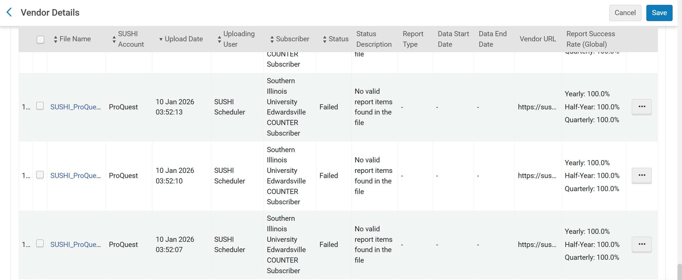
Catching Myself Up to 5.1

Slide 19
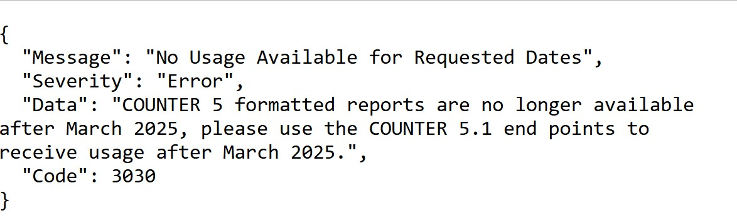
Catching Up to 5.1 Cont'd

Slide 20
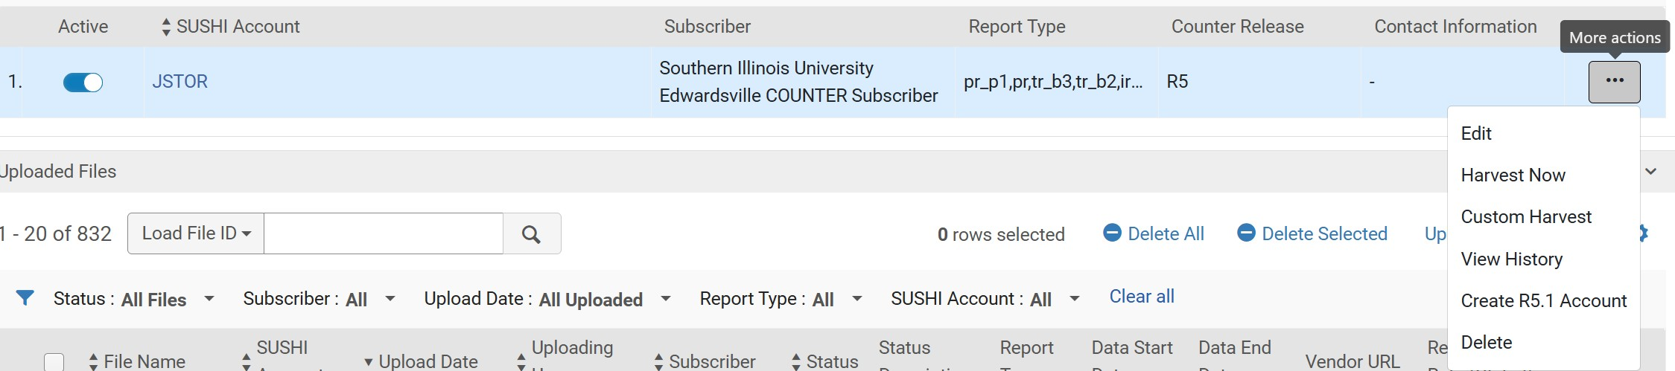
Creating R5.1 Account for Harvesting

Slide 21
After Creating R5.1 Accounts
Some users have noticed R5.1 harvesting going back to January 2023. This resulted in several months where both R5 and R5.1 were counting toward totals.
COUNTER folks recommended running both R5 and R5.1 for 3 months after changing over. May be a moot point in 2026 with R5 no longer supported by most vendors.
To see what vendors are reporting, be sure to check out the COUNTER Registry

Slide 22
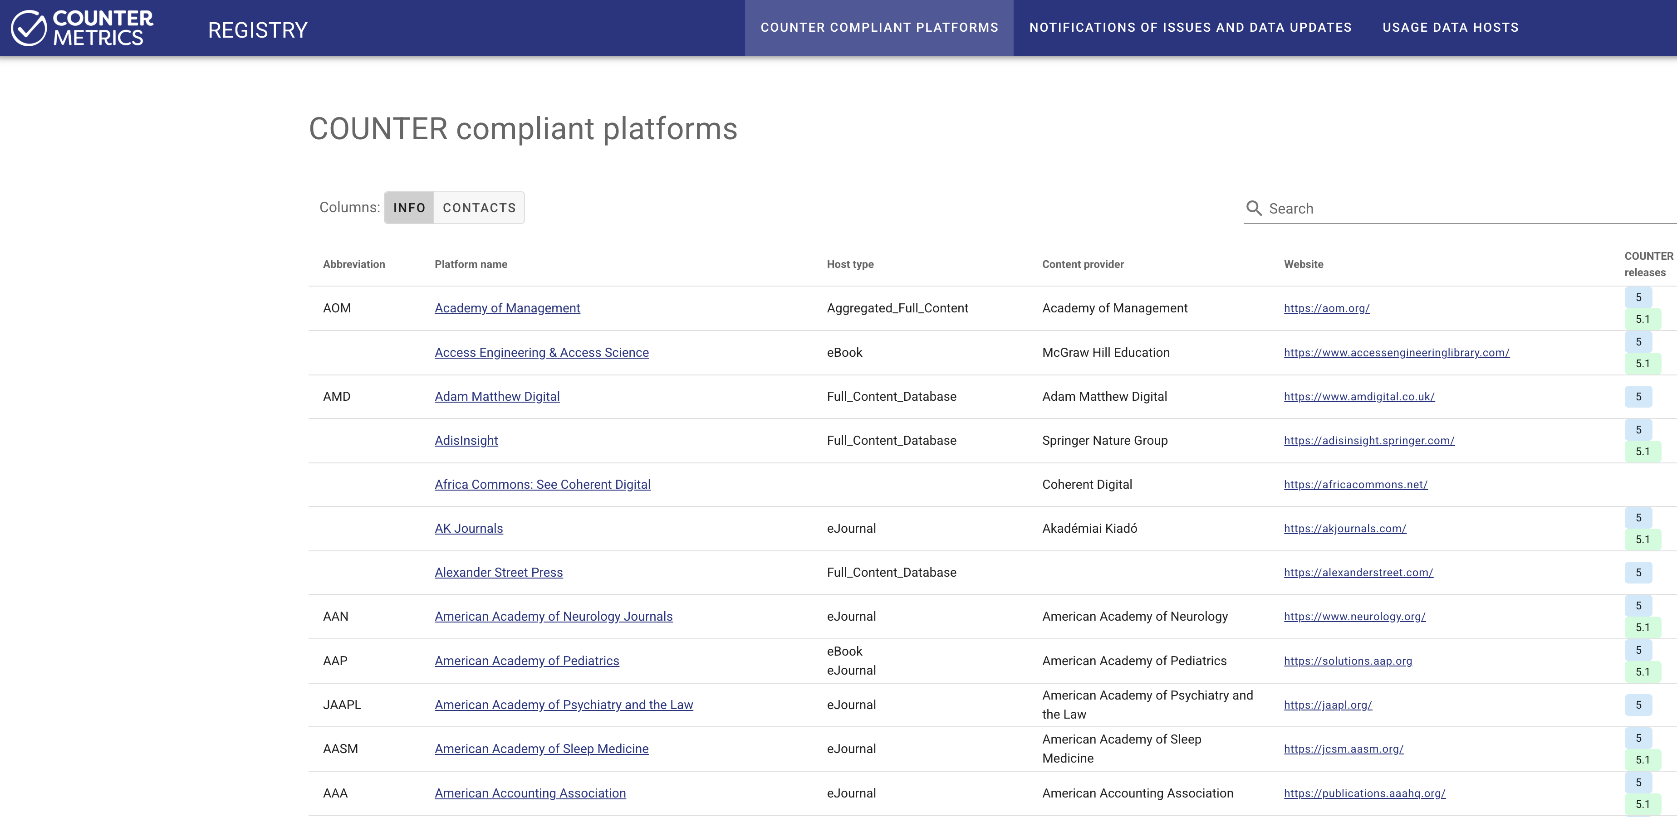
Counter Registry https://registry.countermetrics.org/

Slide 23
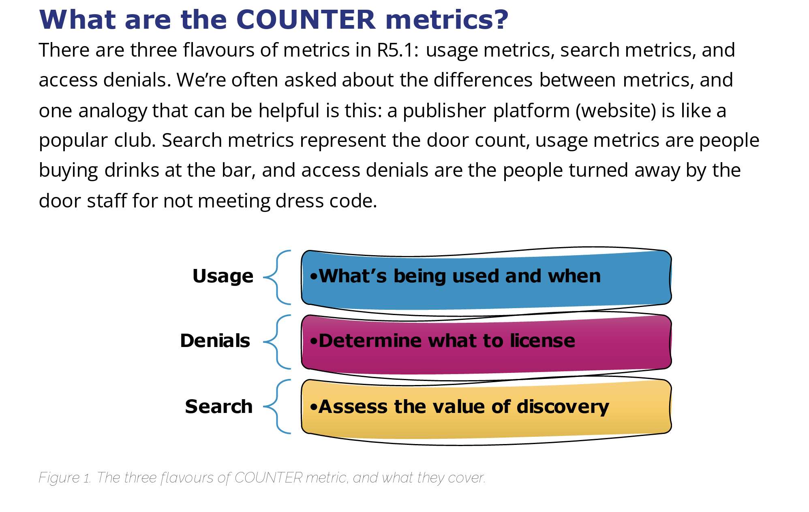
Visit https://www.countermetrics.org/education/
Check out the Friendly Guides available at countermetrics.org. You can also view short recordings from Tasha Mellins-Cohen

Slide 24
Questions? Corrections? Commiserations?

