Slide 1
Review of Electronic Collections Active in the Alma Network Zone
Ted Schwitzner and Marisa Tolbert
Presented on July 7, 2026; July 9, 2026; July 14, 2026; and July 16, 2026
Notes:
(Ted) Hello everyone and welcome to our review of Electronic Collections Active in the Alma Network Zone! Your co-hosts today are Ted Schwitzner and Marisa Tolbert from the CARLI office. This presentation was offered live with open discussion in July 2026, and we have updated our contents to include details from those discussions.

Slide 2
Today's Agenda
Status of Network Zone Electronic Collections
What we learned from EBSCOhost shift
ERMC feedback and libraries who want to opt out
Nuances in electronic collections that are active
Observations and comments from open discussion sessions
Notes:
(Ted)
This presentation came about because we wanted to review what we learned from the project to shift EBSCOhost collections to institutions, while also beginning to answer questions about what this shift means for CARLI and libraries in the future. To that end we’ll describe the current state of the network zone and sharing electronic collections. Next, we will share the questions and comments we received from member libraries and CARLI committees during the transition, and we’ll cover some nuances in managing e-collections that are currently active. This will lead us into a summary of the public discussions held during July 2026 that should help CARLI and member libraries manage these practices in the future.

Slide 3
Network Zone Electronic Collections
Collections for everyone
  CARLI eBooks collections: Wiley, Oxford, Bloomsbury
  ProQuest EBooks collection (2014-2018)
  EBSCOhost Ebooks (2000)
Open Access Resources
  Open Textbook Library
  United States Government Documents
Collections for groups of libraries
  ERead Illinois/Palace Project
  NILRC OverDrive collections
A list of all electronic collections can be viewed on this CARLI page.
Notes:
(Ted)
Though we shifted EBSCOhost collections from the network to institutions in 2025 and 2026, CARLI remains committed to the philosophy of sharing the work on shared collections. We believe having central management of electronic collections provided to all members, or to large numbers of members, helps reduce duplicate efforts and relieves the load on library staff, while allowing corrections and changes to be made at network scale to everyone’s benefit.
CARLI has e-collections active in the Network Zone in the following categories:
Paid collections for all I-Share members – These include the eBooks and eJournal collections that CARLI has fully-funded for all members. The CARLI ebooks collections include perpetual access to resources from Wiley, Oxford University Press, and Bloomsbury. These also include earlier purchases like the ProQuest Ebooks collection acquired from 2014 to 2018 and the EBSCOhost Ebooks collection from 1998 to 2000. Ejournal collections include access to titles from Mary Ann Liebert and Sage.
Open access collections – Include resources such as the United States Government Documents collection and the Open Textbook Library, along with the open access titles of dozens of publishers,
Shared group purchases for selected I-Share members – consist of the eRead Illinois collection from RAILS and the Palace Project, and the OverDrive collection coordinated through NILRC (“nil-rock”).
A complete list of e-collections hosted in the NZ may be found on CARLI’s website, search for Electronic Collections Managed Centrally by CARLI in the Network Zone - https://www.carli.illinois.edu/products-services/i-share/electronic-res-man/carli_nz_collections.

Slide 4
Things We Learned from 2020-2026
EBSCOhost collection management in NZ from 2020-2026
  Manage shared resources at network scale, reduce duplicate cataloging and link maintenance
Inventory groups: what works, what doesn’t.
  Library specific settings—parser parameters, proxy services
Opting Out: Lessons from group collections
Primo VE records display for eBooks
Using API to modify inventory group settings
Notes:
(Ted) When we migrated to Alma in 2020, we believed that the scale and reach of the network zone would allow us to effectively and efficiently share electronic collections used by all members. We could activate and catalog resources once, centrally, and distribute the access to each institution. Sharing the overhead should free member library staff time and energy for resources that were unique to their collections.
The tool in Alma that makes this happen is an inventory group, which allowed CARLI to pull together a group of libraries and assign that group to a collection, or to several collections. Each collection is distributed evenly to the members of the group. This approach works well if the access to all members was the same as far as the platform goes.
EBSCOhost e-collections involve several parameters that coordinate the interface, the collection, the specific resource, and authentication. We found that one large group for inventory did not work well as institutions don’t share the same proxy service or linking parser parameters for individual institutions. CARLI adapted by creating an inventory group for each institution, assigning those groups to each EBSCO e-collection. Proxy settings remained a challenge to manage, as different proxy services would handle network-shared links differently. While all the EZProxy institutions could be set the same way, settings for OpenAthens institutions could vary depending on whether the institution was using the SHIBBOLETH parameter in their EBSCOhost configuration. Then, some parameters provided by EBSCO weren’t always found to be applicable or accurate. For instance, EBSCO would provide OPID values for all collections, but ebook collections would not require that value.
Some libraries expressed interest in opting out of some resources, particularly after the Illinois State Library expanded the number of EBSCOhost collections available to members. However, from our work with the eRead Illinois collection, we learned that removing a library’s inventory group was not always an effective solution. Records shared in from the network zone still appear in searches that target all libraries, and these records would continue to be visible to patrons in the opted-out institution. We also found that removing a library’s inventory group from a collection may not have immediate effects. We found that errant records would continue to display in Primo VE for the opted-out libraries, making it appear that the electronic resource was available to the institution though they had been opted out. In some cases, the record might remain visible for a day or two or a couple weeks before re-indexing adjusted where the record would appear. Similar issues were discovered when libraries would opt back in, as the newly added library might wait several days for resources to begin appearing in their discovery data.
In the process of looking for ways to keep inventory groups viable for EBSCOhost collections, we tinkered with using an API that would review and update the parameter settings. Sadly, we found a lot of inconsistencies with the information EBSCO provided us and with the parameters available for each collection. These variations led us to conclude that an API script couldn’t fully automate review and correction of these values. On the plus side, we did develop a tool that would help us review and compare institution parameter settings effectively.
Marisa has more from our libraries’ perspectives.

Slide 5
Committee Feedback & Opting Out
ERMC Feedback
Libraries Who Want to Opt Out
PRO:
Wants CARLI’s help in managing activations – one person with many non-ERM responsibilities
CON:
Would like autonomy in selecting what OA content is available and what displays to patrons
Uninterested in Middle School and Elementary School Sources
Want only higher level collections to display (Ultimate vs. Complete)
If something is turned off in Admin portal, it should also be deactivated in APVE
Does not fit curricular needs
Notes:
(Marisa)
As we proceeded through the EBSCOhost transition, we started receiving a common theme to questions. Would CARLI consider shifting more collections to institutions? Would CARLI stop sharing all collections from the network zone? Could a library select which collections could be visible locally. We took these questions and other insights from our work to the CARLI Electronic Resource Management Committee for consideration. On our side, we addressed what we saw as the costs and benefits of sharing collections, but we asked for the committee’s input on the pros and cons of network-shared e-collections from the library perspective. We had a split. There were those who want the e-collections shared centrally from the NZ because they are only one person at their library managing more than just electronic resources. There were also those who want autonomy in selecting what content should be active in their IZ and displaying records in Primo VE. Additionally, they want to be able to troubleshoot things on their own without CARLI’s intervention.
As mentioned, since June 2024 purchase of collections by the Illinois State Library, we have also received inquiries in our ticketing system from library staff about opting out. Here are a few responses we have gotten since then:
-We had libraries that did not want the EBSCO Middle School and Elementary School Sources active. Their patronage would not find these useful.
-Libraries had purchased subscriptions from EBSCO like Business Source Ultimate and did not want the lower version Business Source Elite displaying in their Primo VE nor being prioritized over the Ultimate e-collection.
-After EBSCO e-collections were activated in the NZ, libraries started seeing issues between EBSCO Admin and Alma Primo VE. Where a library had turned off a K-8 resource in EBSCO Admin, their patrons would encounter an issue with error messages for the same content in Primo VE because the K-8 e-collection was active in the NZ.
-Additionally many of the EBSCO e-collections provided by the State of IL were ones that did not fit curricular needs like a university having access to Small Engine Repair Source when there was not a discipline or program for auto repair.

Slide 6
Nuances in e-Collections and Discovery
Collections with many parser parameters don't share well.
  E.g., EBSCOhost, OverDrive, ProQuest; sites with specific code for URL host name.
  Stable URLs, DOIs, etc., are more shareable from the NZ.
Collections that are actively curated by CARLI staff.
  E.g., Wiley, Oxford
  The NZ is CARLI's institution zone, and it enables us to scale up collections activity.
Display Logic Rules prioritize one collection or service over another.
  E.g., Hide ILL form if full text is available.
  E.g., Hide full-text for collections X Y and Z if full-text available in collection A
Network-aware display logic rules added to Alma in Feb. 2026.
  E.g., Hide full-text for NZ collection if full-text in IZ collection
Notes:
(Marisa)
As previously shared in the EBSCO example, electronic collections that use parser parameters are not ideal for centrally sharing electronic collections from the Network Zone. If parts of the URL require the institution to be identified to proceed further, access could be limited. For example, OverDrive and ProQuest collections include an institution code as part of the host name. Sometimes, the site will provide other ways to the user to identify their home institution and sign in accordingly, including automatic redirects of the user is using an on campus IP address. Providing access off campus is frequently more challenging.
Collections where the URL is stable and uniform regardless of the subscribing institution are more easily shared from the network. These include URLs that always point to the title level, such as DOIs, and allow IP authentication or single sign-on to handle the institution identification. Since single sign-on and proxy settings are managed at the institution level in Alma, these details are often applied automatically to links in the institution’s Primo VE.
Additionally, e-collections that are actively curated by CARLI staff and do not require parser parameters are more easily managed in the NZ and leave the work of updating to CARLI staff. Frequently, these are collections that we have retrieved records from OCLC or from the vendor, or we have worked to vet the community zone collection for accuracy.
Prior to February 2026, libraries did not have an effective way to prioritize institution zone resources over network zone resources or to reliably hide network zone collections. This changed with the addition of network-aware display logic rules that would allow libraries to display local collections instead of the network collection, or to display certain on screen options like ILL forms.

Slide 7
Not all Open Access is open
Collections that present barriers through account creation and sign-in.
  EBSCO Open Access
  National Academies Press
Open Access to specific contents of non-open titles.
  OA for selected articles within a title.
  OA of specific issues.
  Limitations of Alma and current standards to identify granular OA and new models (e.g., S2O)
Evaluation of Open Access resources takes a village.
  CARLI has used an ad hoc group to evaluate and select OA resources.
  There is a need to refresh the list of participants, as well as choices.
Notes:
(Marisa)
Not everyone adheres to Open Access standards. EBSCO’s Open Access collection requires a login in order to access openly accessible and free content. The National Academies Press links used to land on a screen with a slide out that aims to collect your email address and/or requires an account to access PDFs. There was also an option to view content via HTML, but this is confusing and unclear for the novice user. Since, typing this up, the National Academies Press links were resolved in coordinating the troubleshooting with National Academies Press and Ex Libris.
Other e-collections like the Wiley Free collection contain partial open access content which can look like one issue in one year and no other open access. OR sometimes only one article in one issue in one year and nothing else.

Slide 8
Results from Public Q & A
Audience polls designed to support and guide discussion
  One question: Do you prefer having e-collections active in the network zone.
  Offered prior to and following each public session.
Question and Answer portion filled in gaps
  Finding a path for meeting different libraries’ expectations.
  Evaluating whether knowledge on the issues affects their preference.
  Highlight related topics and Alma or Primo functionality.
Notes:
(Marisa) When this presentation was given live, we offered attendees two polls to help guide discussion and to inform us on ways to move the conversation forward. One question was asked before the presentation and one was asked after the presentation and some discussion had occurred. The results were informative on libraries feel and helpful in identifying nuances that were discussed in the sessions.
During the Q&A portion of each session, the poll results were visible and we frequently probed further into the responses to gain insight into what members expectations are for managing e-resources. We also hoped to evaluate our own presentation and understand if knowledge of the issues affected preferences.
Open discussion also offered a chance to discuss related Alma and Primo functionality and to make sure we included details we had missed.

Slide 9
Poll Question Asked BEFORE Presentation
PRE: Do you prefer having e-collections active in the Network Zone?
Majority Response Across the Four Sessions:
Response Options:
Yes
No
It depends on the e-collection
Indifferent because we are no longer using Alma and Primo VE
It depends on the e-collection.
July 7 – 11 of 21 responses (52%)
July 9 – 18 of 24 responses (75%)
July 14 – 11 of 15 responses (73%)
July 16 – 8 of 13 responses (61%)
Notes:
Marisa – Here is where we are presenting new information that was not previously included in the presentation. As Ted said earlier, we are including the two poll questions we asked and the responses. On this slide, we are showing what the pre- question was. We asked all participants before our presentation began, “do you prefer having e-collections active in the Network Zone?” The responses they had the option to select were: yes, no, it depends on the e-collection, or indifferent because we are no longer using Alma and Primo VE. The Majority response across the four sessions on July 7, 9, 14, and 16 was ”It depends on the e-collection.” 52% of respondents on July 7 answered this way, on July 9 it was 75% of the respondents, on July 14 it was 73% of respondents, and on July 16 it was 61% of the respondents.

Slide 10
Poll Question Asked AFTER Presentation
Majority Split in Response Across the Four Sessions:
POST: After listening to the presentation and discussion, what are your preferences now for having e-collections active in the Network Zone?
Yes
July 7 – 7 of 16 responses (43%)
July 9 – 11 of 19 responses (58%)
It depends on the e-collection.
July 14 – 9 of 13 responses (69%)
July 16 – 7 of 12 responses (58%)
Response Options:
Yes, I want e-collections to continue to be active in the NZ.
No, I do not want e-collections to continue to be active in the NZ.
It depends on the e-collection.
Indifferent because we are no longer using Alma and Primo VE.
Unsure. I am on the fence. I need some time to think about what was shared here today.
Notes:
Marisa – In all sessions, we asked a post- question after the presentation and some discussion had taken place. We asked participants the following: After listening to the presentation and discussion, what are your preferences now for having e-collections active in the Network Zone? The response options were: yes, I want e-collections to continue to be active in the NZ, no, I do not want e-collections to continue to be active in the NZ, it depends on the e-collection, indifferent because we are no longer using Alma and Primo VE, and unsure I am on the fence I need some time to think about what was shared here today.
The Majority response across all four sessions was split between the responses, “Yes” and “It depends.” The July 7 and July 9 sessions were a majority for yes with 43% of respondents on July 7 and 58% of respondents on July 9. Whereas, the July 14 and July 16 sessions were a majority response of it depends on the e-collection with 69% of the July 14 participants and 58% of the July 16 participants responding this way.

Slide 11
Total Number of Responses per Question and Session
Response | 7/7 Q1 | 7/7 Q2 | 7/9 Q1 | 7/9 Q2 | 7/14 Q1 | 7/14 Q2 | 7/16 Q1 | 7/16 Q2
Yes | 8 | 15 | 5 | 11 | 4 | 0 | 3 | 4
No | 2 | 0 | 1 | 0 | 0 | 0 | 1 | o
Depends | 11 | 6 | 18 | 7 | 11 | 9 | 8 | 7
Indifferent | 0 | 0 | 0 | 0 | 0 | 0 | 1 | 1
On Fence | NA | 3 | NA | 1 | NA | 4 | NA | 0
TOTAL | 21 | 16 | 24 | 19 | 15 | 13 | 13 | 12
Notes:
Marisa – a majority of folks attending the sessions voted “yes” and “it depends” on both questions as seen in the table on this slide. The table shows each of the responses going down the far left column with Total number of responses in the last row of this column and each session date with Q1 and Q2 labels showing how each participant responded to the two questions in the same session. While most folks responded as a “yes” or an “it depends,” Ted and I found out in the discussions that these two responses were not always independent of each other. That most of the time a response of Yes, I want e-collections active from the NZ included that it depended on the e-collection. Libraries expressed that the paid e-collections that CARLI manages are best managed from the NZ and that often it depends is the answer when it concerns OA e-collections. Reasons cited were because OA records have messy, inconsistent, and sometimes unreliable metadata which ultimately creates more work for a library. Additionally, libraries shared that while Unpaywall was a feasible option for retrieving open access records in Primo VE that they are now finding that troubleshooting reports are going unanswered and libraries do not want inaccessible and inaccurate records displaying. Libraries want these troubleshooting reports answered in a timely manner from a responsive content provider.

Slide 12
Discussion Themes
Having NZ-shared e-collections saves staff time for consortially-purchased collections.
Small libraries, staff wearing many hats, OA-collections might be lower priority.
Having IZ e-collections as institutional curation, emphasizing current resources
Local control is valued for collections that require a lot of attention.
Appreciation for CARLI support, recommendations, best practices, and regular communication of instructions.
Autoholdings are useful for bridging gaps with some providers.
Notes:
[Ted]
Several themes emerged through the discussion sessions with libraries. Many attendees agreed that having network zone shared collections saves staff time for the consortially-purchased resources. Several attendees pointed out that staff at small libraries might wear many hats in addition to electronic resources management, and that making open access collections available to patrons may be a lower priority, if one addressed at all.
Some folks shared that choosing to manage e-collections in the institution served as an extension of their collection policies for physical materials, allowing them to curate both collections and their contents more directly, and emphasize current resources. Others shared that some electronic collections require a lot of attention, and that if they will be asked about the accuracy of links or data, they may want to have more control.
Overall, attendees expressed that they valued CARLI’s management of electronic collections. They identified that contacting Support with an e-resource problem meant that someone would find an answer. They trust in the recommendations and best practices shared by CARLI and committees, and the appreciate regular communication of instructions and tips.
Additionally, some attendees shared suggestions encouraging the use of auto-holdings collections locally, particularly as a way to bridge gaps with some providers.

Slide 13
Participant Quote
I prefer to have control over troubleshooting electronic collections and portfolios that our institution purchases. It makes troubleshooting and communication with the user easier. For open access and CARLI-purchased collections, it's more convenient to have those managed by CARLI in the NZ.
Notes:
[Ted]
One attendee at the last session shared this sentiment that best captures the comments of many.
I prefer to have control over troubleshooting electronic collections and portfolios that our institution purchases. It makes troubleshooting and communication with the user easier. For open access and CARLI-purchased collections, it's more convenient to have those managed by CARLI in the NZ.
These discussions have been valuable to CARLI in evaluating the effectiveness of managing collections in the network zone. Clearly, member libraries value having choices in how they manage collections locally, while they also appreciate having network-shared resources available. The combination of efforts lets libraries provide a breadth of resources to their patrons. CARLI staff and our committees will continue to evaluate and make recommendations on how to balance these efforts effectively.

Slide 14
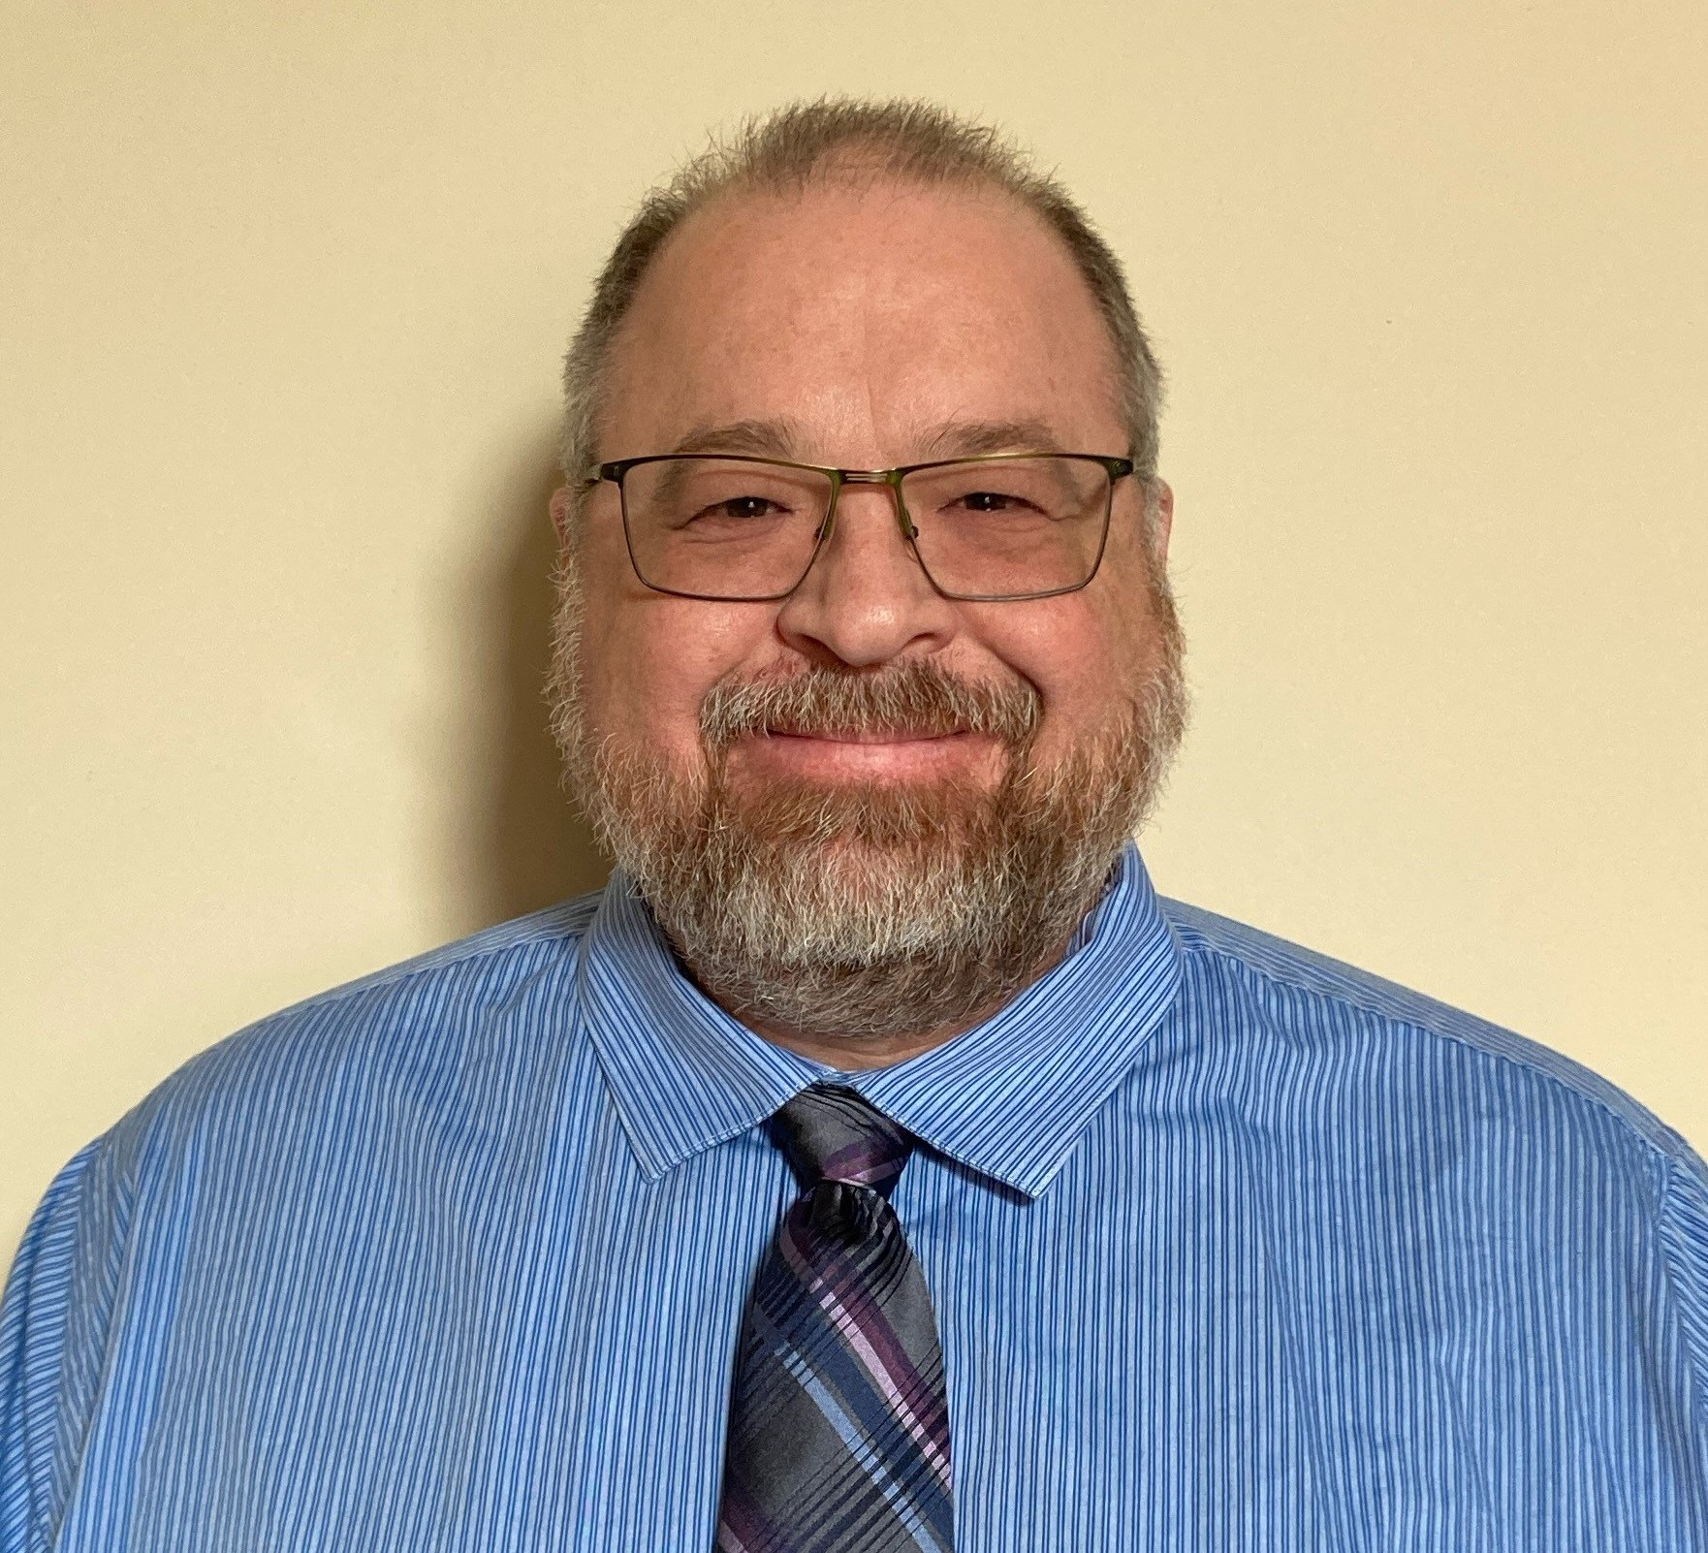
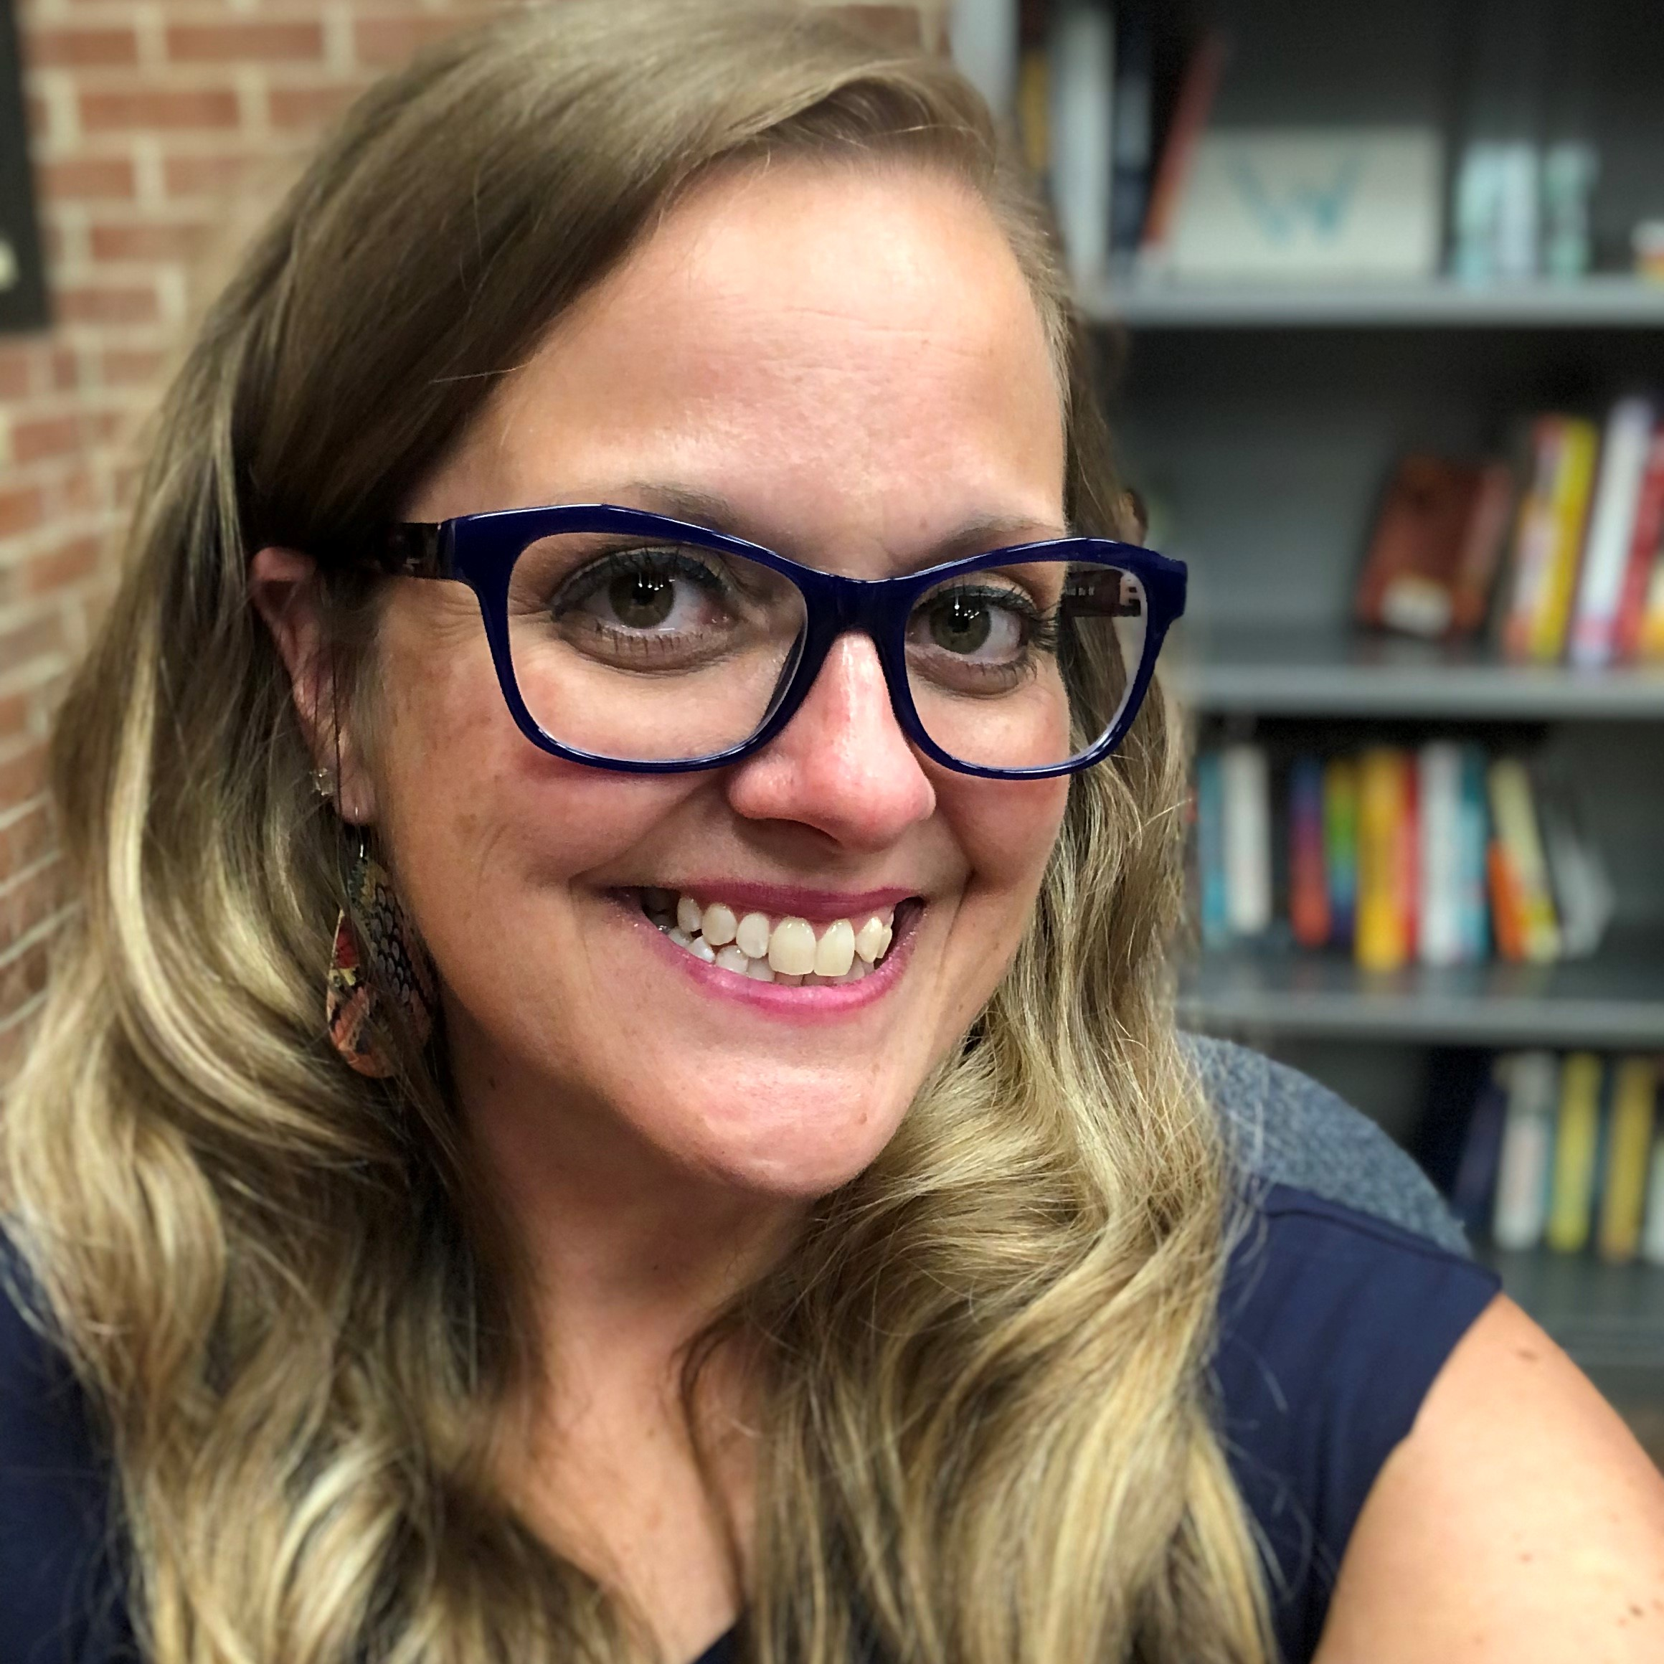
Questions? Contact us:
tschwitz@uillinois.edu
marisab2@uillinois.edu
support@carli.Illinois.edu
Notes:
(Marisa) Thank you again for your time and consideration of this summary. Please let us know if you have questions on this discussion or if there is an aspect that you feel is missing. You may contact either of us at the information listed here, or contact us via CARLI’s support address, support AT carli DOT Illinois DOT edu

