Slide 1
Interpreting Counter Stats & Storytelling

Slide 2
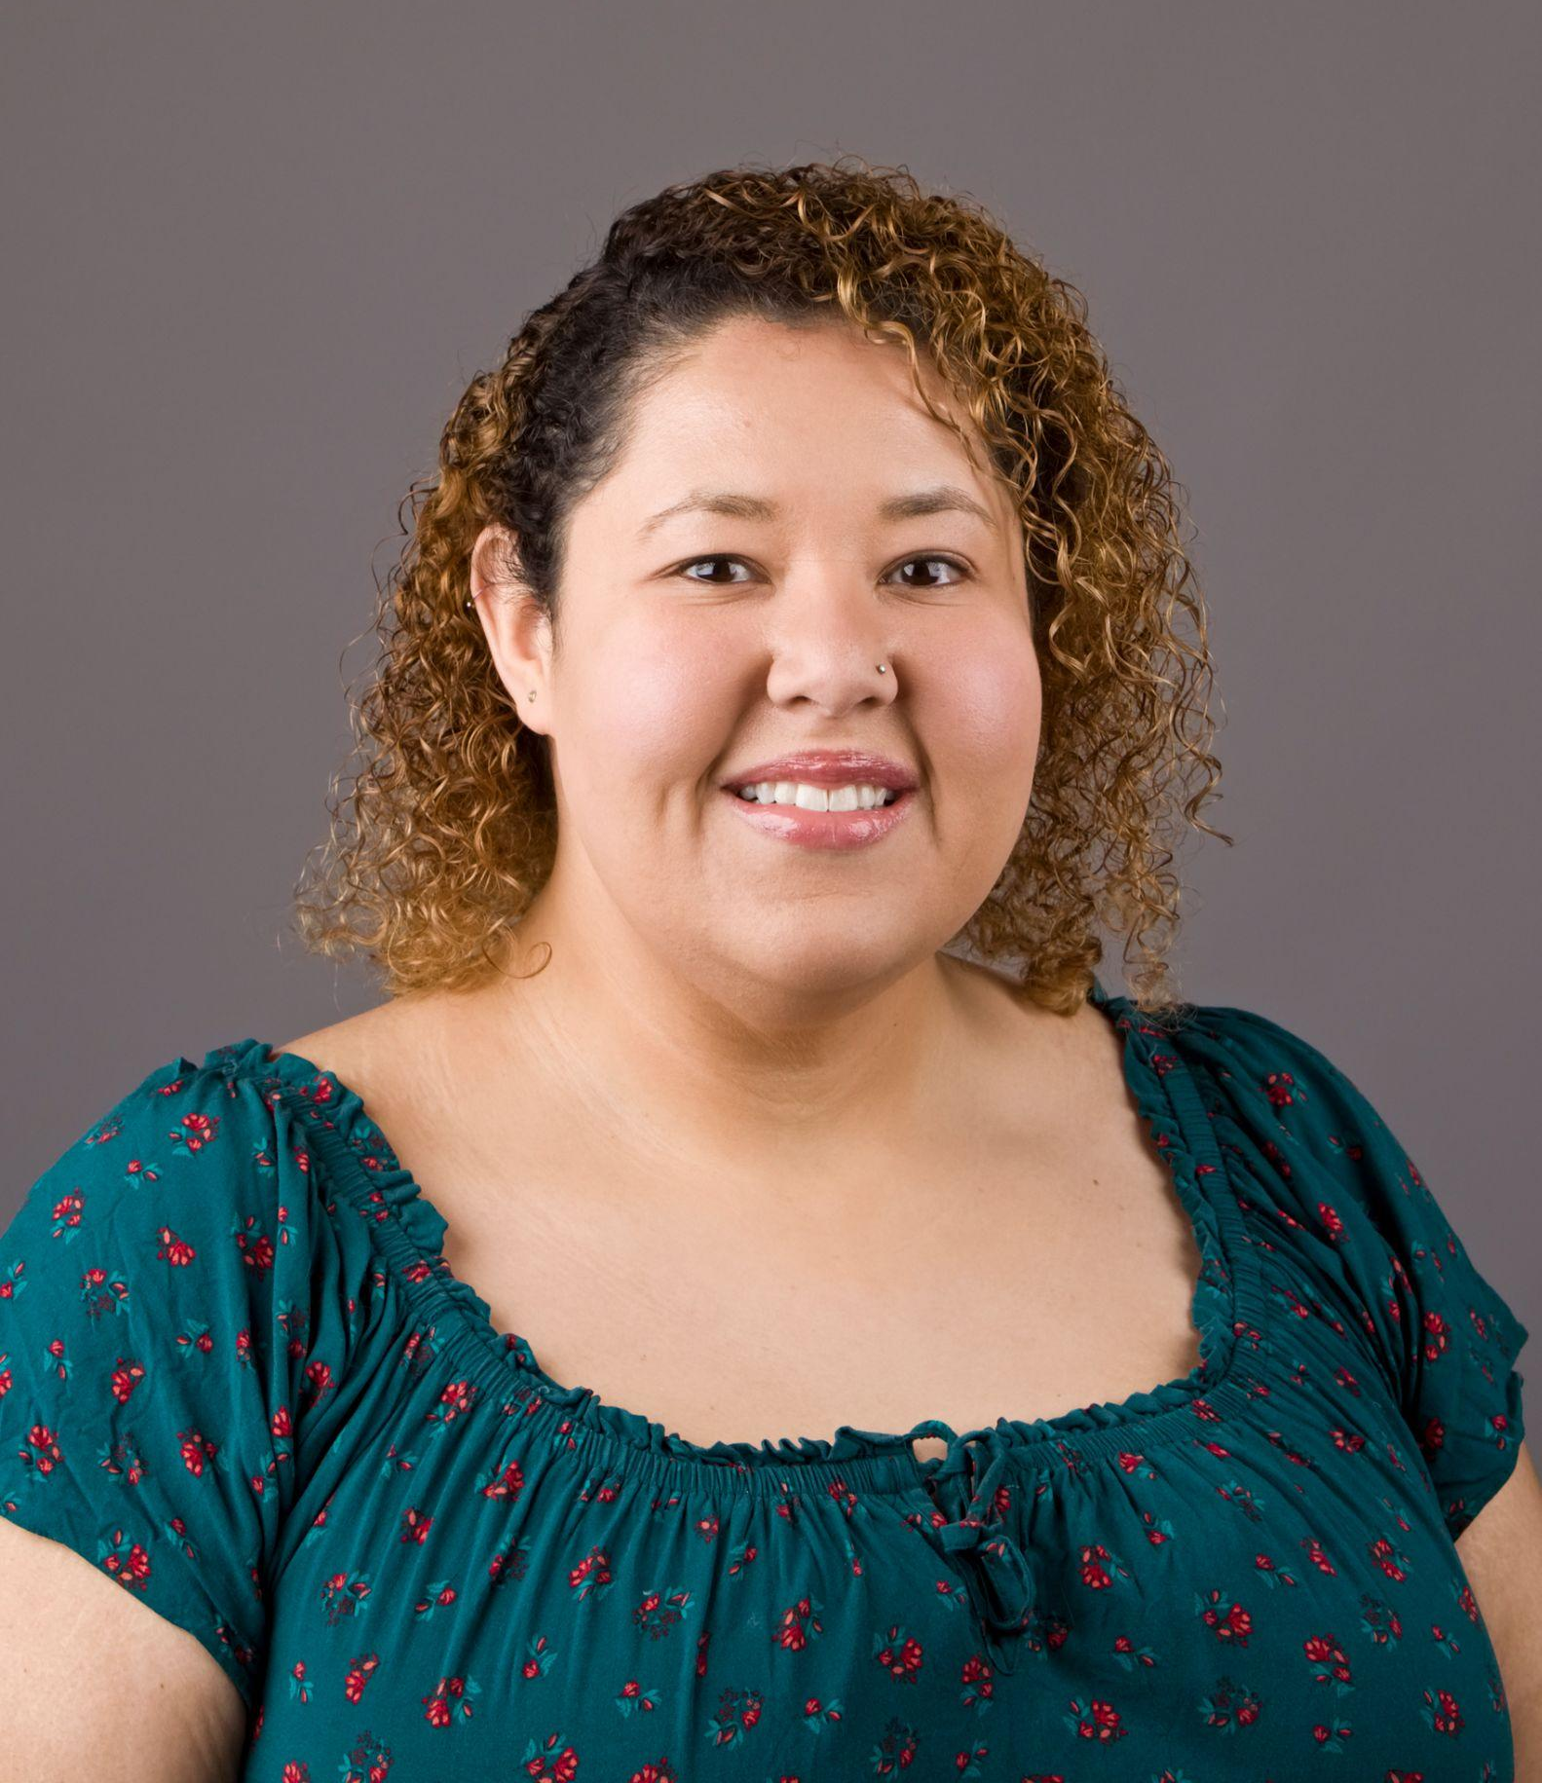
Rosalind Franklin University Case Study - Presenter
Samantha Loster
E-Resource Management Librarian @ RFU
Member of CARLI E-Resources Management Committee since 2025
samantha.loster@rosalindfranklin.edu

Slide 3

About Rosalind Franklin University Case Study
School size: 2067 students
Graduate University - Health Sciences
84 Databases
423 Journals
Collections Team: Associate Vice President, Associate Director + 2 Librarians (Physical & Electronic)

Slide 4
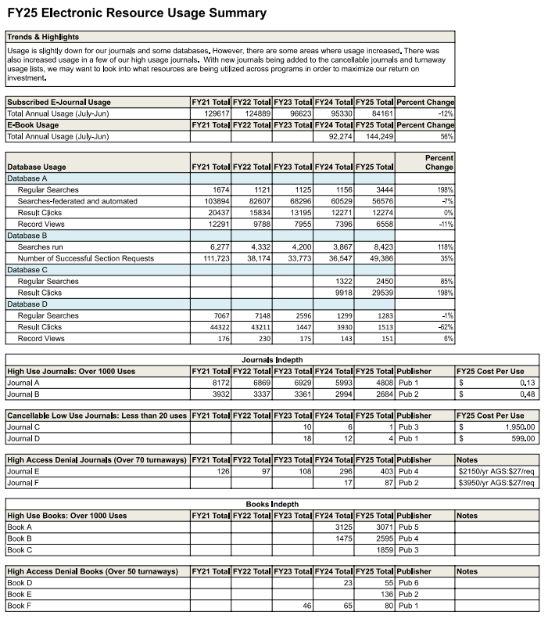
Rosalind Franklin University Case Study - Report
Tracks annual usage
Databases
Journals
eBooks

Slide 5
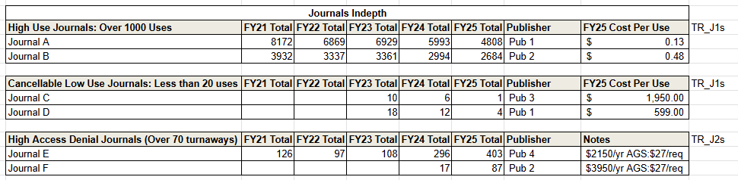
Rosalind Franklin University Case Study - COUNTER to Reports

Slide 6
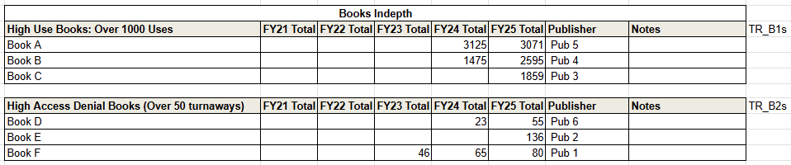

Rosalind Franklin University Case Study - COUNTER to Reports

Slide 7
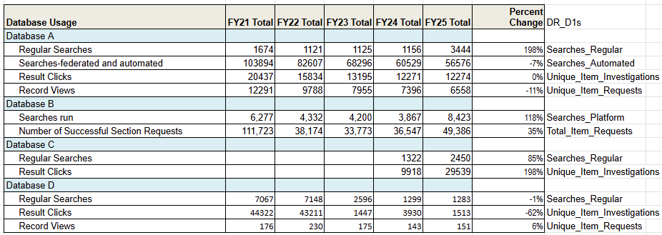
Rosalind Franklin University Case Study - COUNTER to Reports

Slide 8
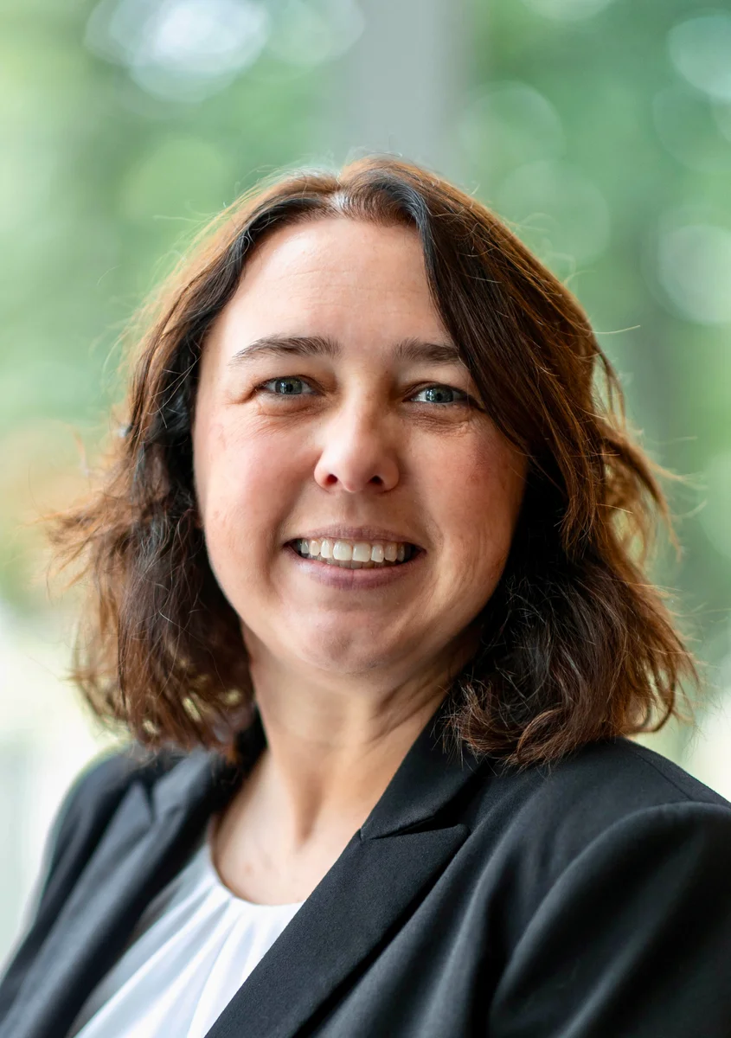
Wheaton College Case Study - Presenter
Megan Ruenz
E-Resources Librarian @ Wheaton College
Member of CARLI E-Resources Management Committee since 2021
megan.ruenz@wheaton.edu

Slide 9

About Wheaton College
School size: ~3000 students
Residential UG + Residential/Online Grad
115 Databases
375 Journal
Collections Team: 1 Dean + 6 Librarians

Slide 10
Wheaton College Case Study - Using Stats
Subject Librarians - monitor usage of resources in subject areas
Teaching Faculty - are resources still applicable to curriculum
Collections Team - ensure fiscal responsibility of acquisition funds
Institutional Reporting - IPEDS, ACRL, annual reporting

Slide 11
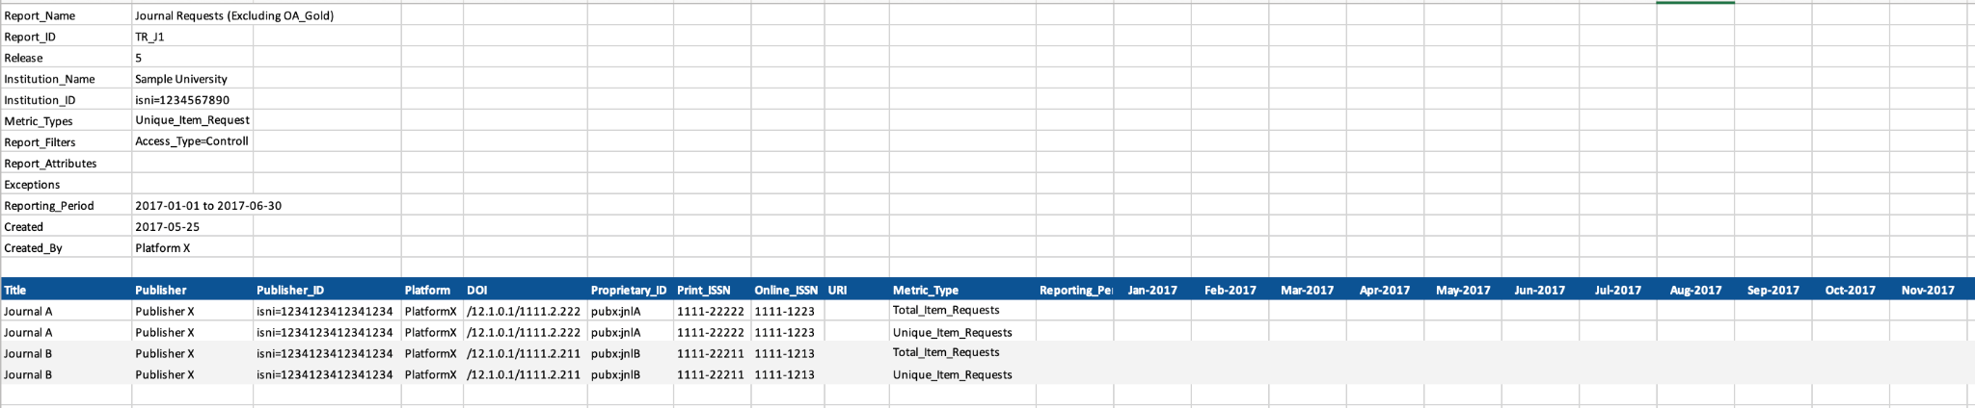
Wheaton College Case Study - Stats Collected
Institutional Reporting:
eSerial usage (TR_J1 + TR_J3)
database searches (DR_D1)
electronic circulations (TR_B1 + IR_M1)
Stakeholder Reporting:
eSerial usage (TR_J1)
database searches (DR_D1)
ebook turnaways (TR_B2 - not owned + license exceeded)

Slide 12
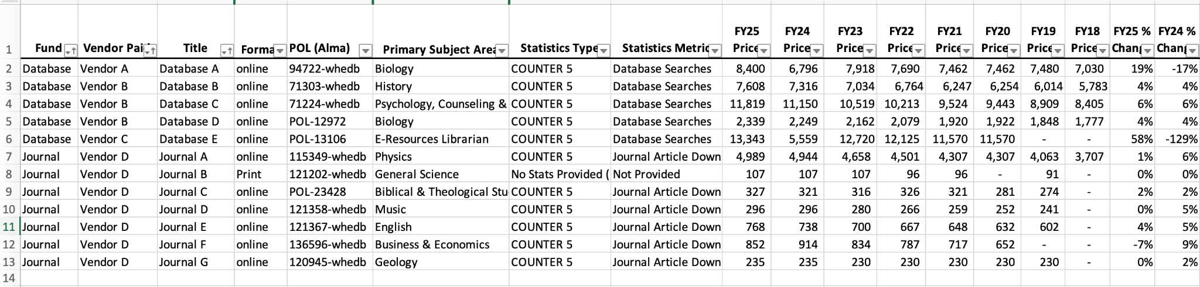
Wheaton College Case Study - Tracking Acquisition + Usage

Slide 13
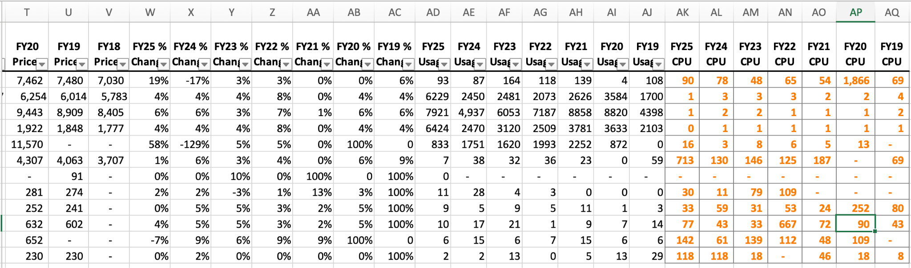
Wheaton College Case Study - Tracking Acquisition + Usage

Slide 14
Wheaton College Case Study - Acknowledgement
Amy Castillo (University of Texas at Arlington Libraries)
&
Tracy Holtman (Tarleton State University)
Connect Four: Visualize Your Annual Database Renewals in Excel
NASIG Autumn Virtual Conference, October 2024

Slide 15
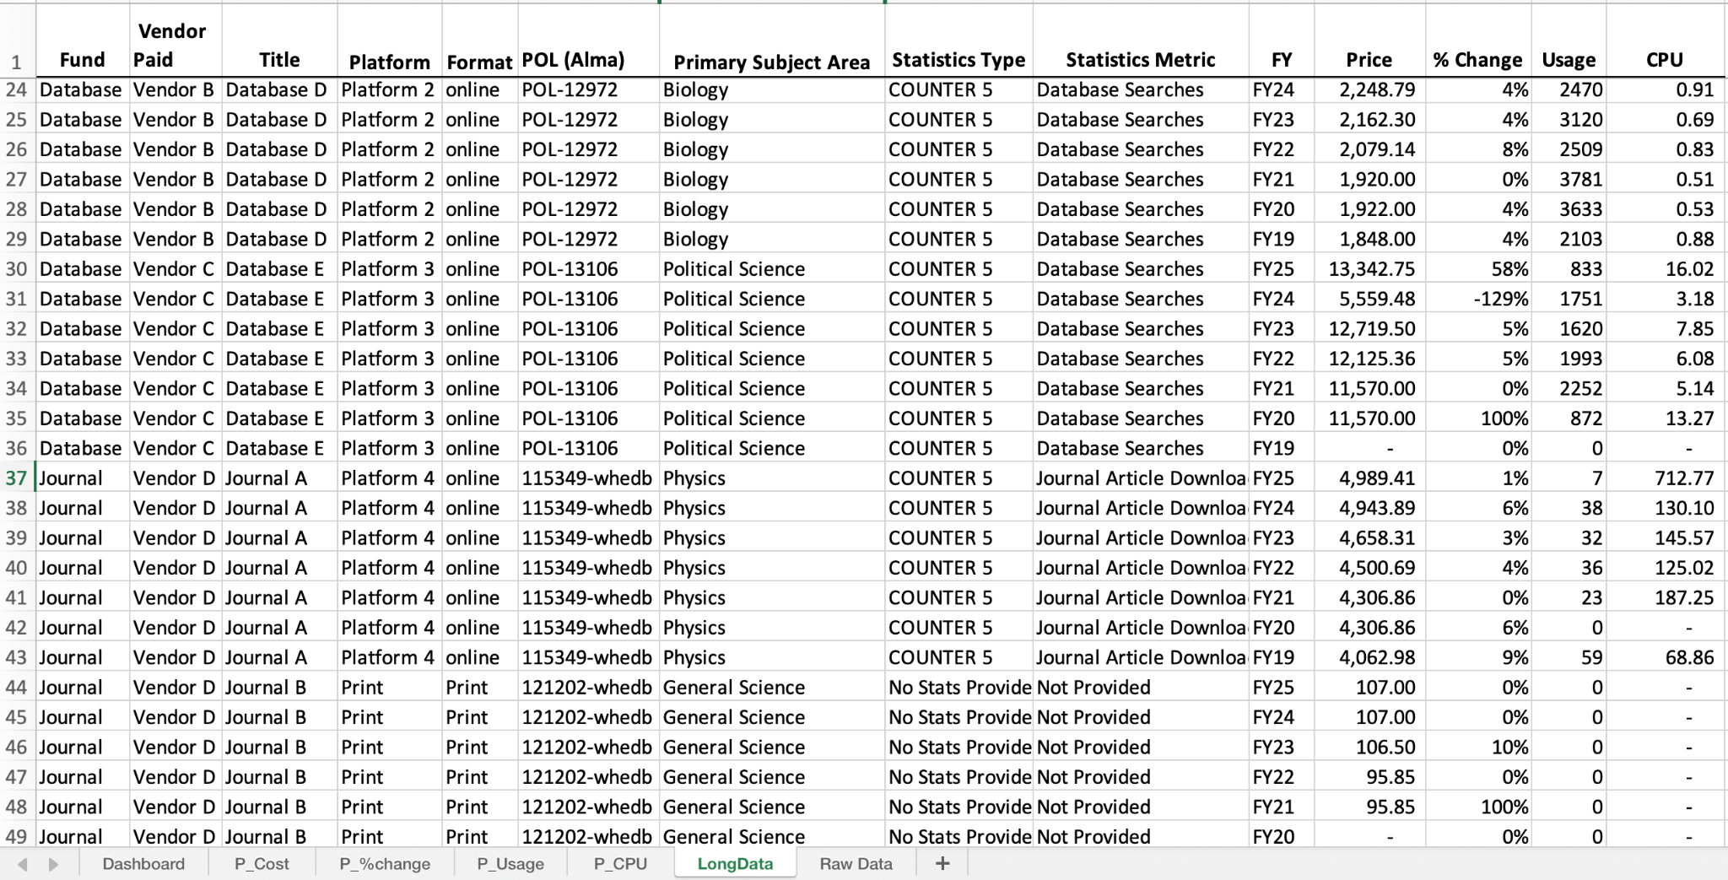
Wheaton College Case Study - Tracking Acquisition + Usage

Slide 16
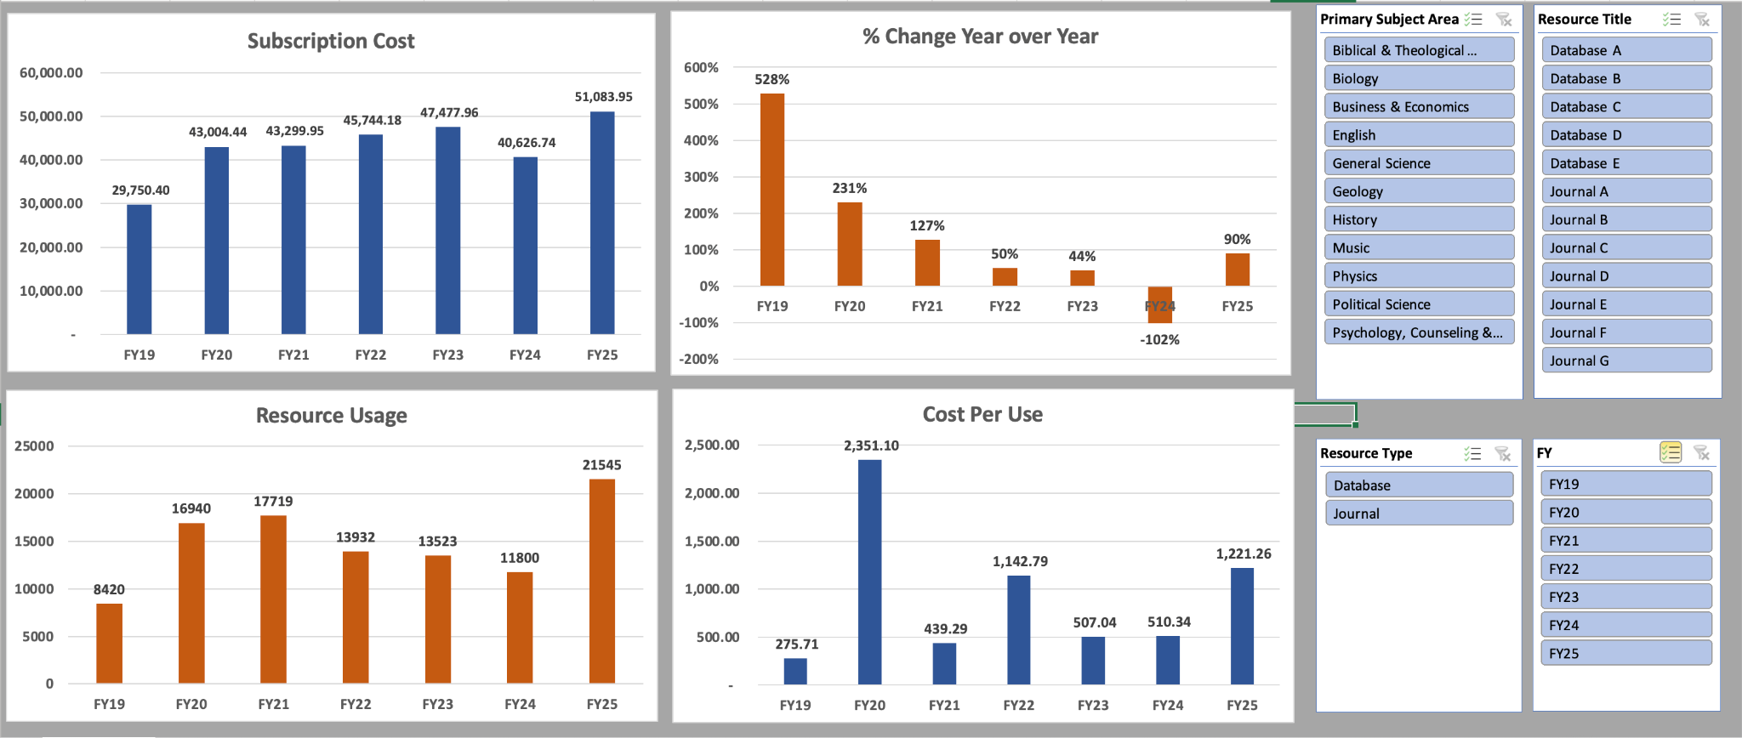
Wheaton College Case Study - Dashboard

Slide 17
Questions?
samantha.loster@rosalindfranklin.edu
megan.ruenz@wheaton.edu

