Slide 1
ERMC presents: Using Analytics to Pull Your Data / Working with Vendors / SUSHI without Analytics
Presenters:
Elizabeth Nelson, Cataloging & Collection Development Librarian, McHenry County College
Andrea Imre, Electronic Resources Librarian, Southern Illinois University Carbondale

Slide 2
Using LibInsight

Slide 3

McHenry County College
FTE: ~4,000
Headcount: ~11,000
2 Full-Time Faculty Librarians
2 Full-Time Staff
3 Part-Time Staff
1 Administrator
I-Share library, but we don't use acquisitions in Alma

Slide 4
Connects to other Springshare products like LibGuides Collects your library data in one place Supports SUSHI and Counter 5
What is LibInsight?

Slide 5
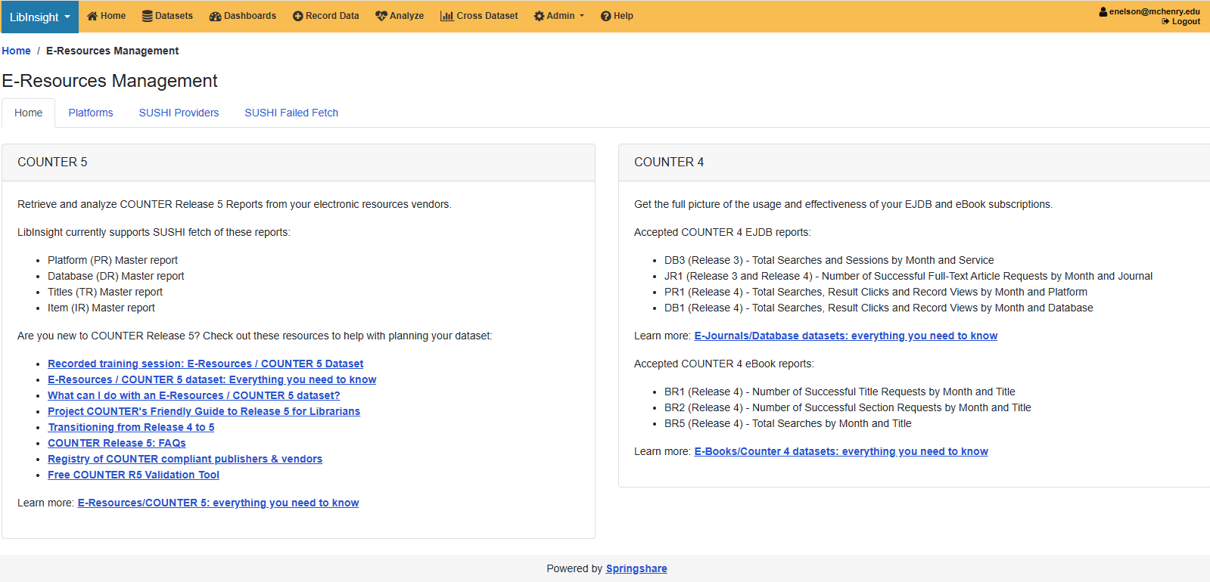
Admin > E-Resources Management

Slide 6
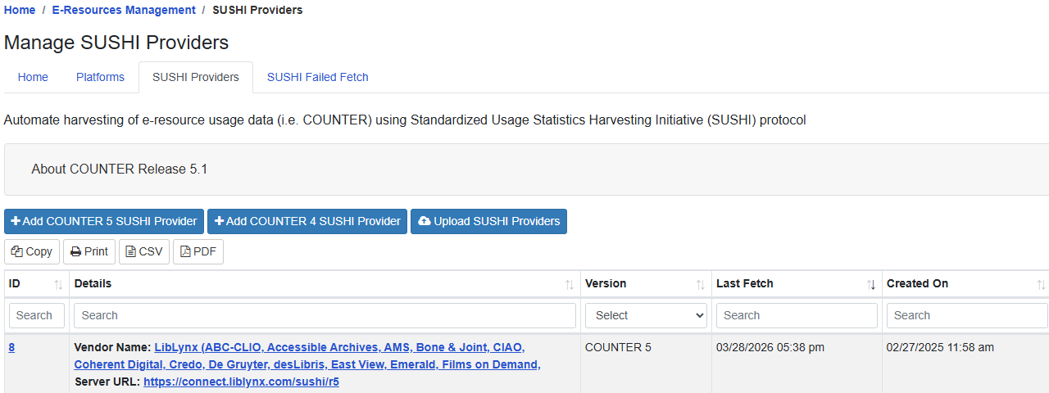
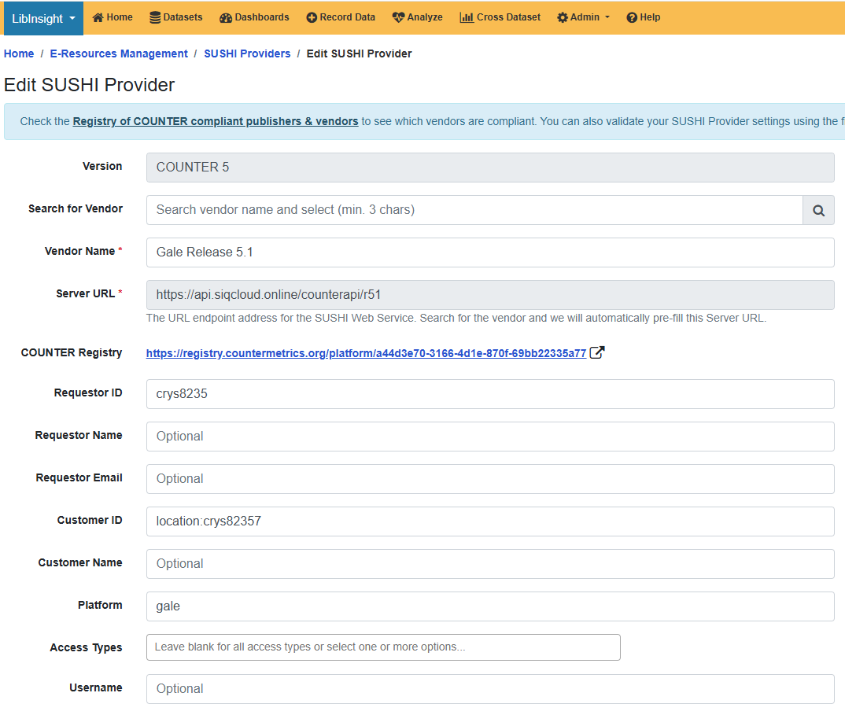
Set Up Sushi Provider First

Slide 7
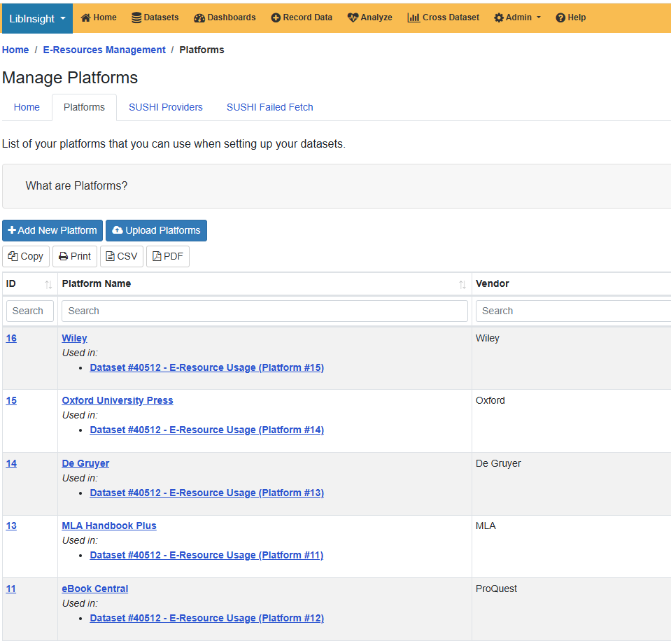
Set up Platforms
-these are containers that are used when you create the dataset in LibInsight

Slide 8
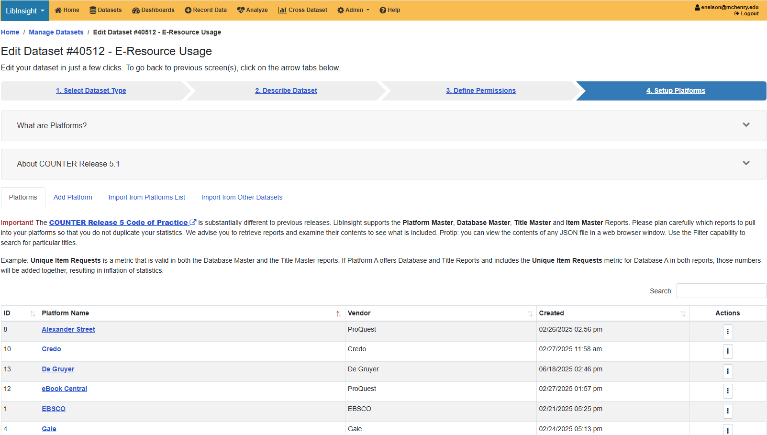
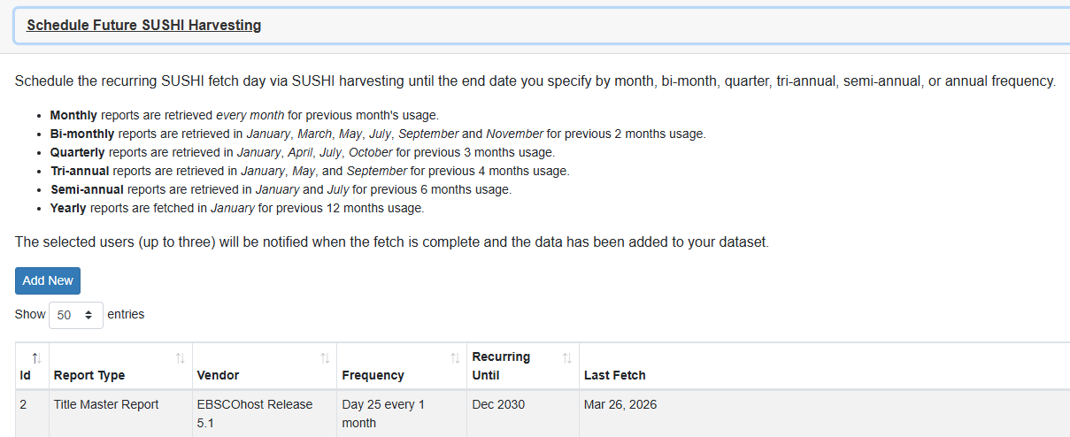
Add Platforms to Dataset

Slide 9
And then the magic happens...

Slide 10
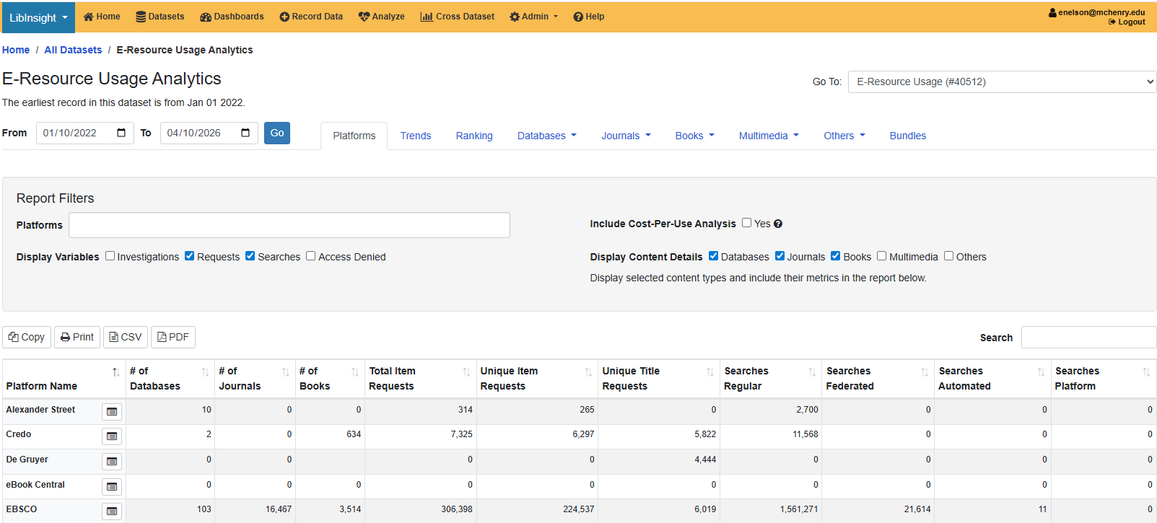
Sorting data and reporting
All of the reports in the dataset go into the "Analyze" portion of LibInsight. You can filter and sort to get the data you want to look at.

Slide 11
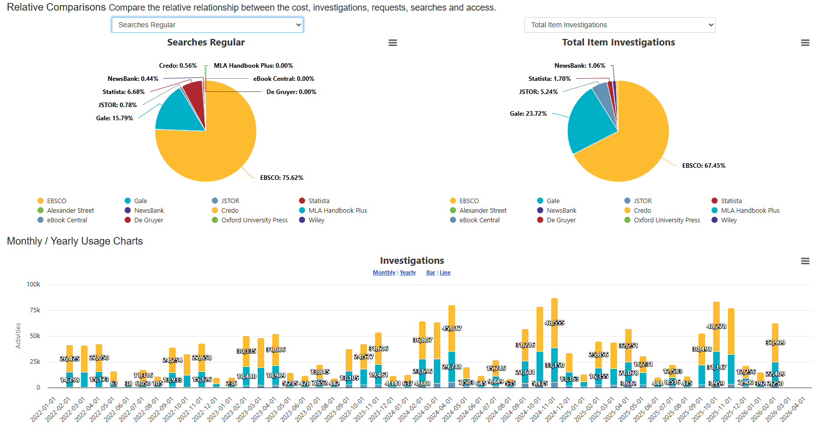
Charts
Charts are also created automatically. You have a few options.

Slide 12
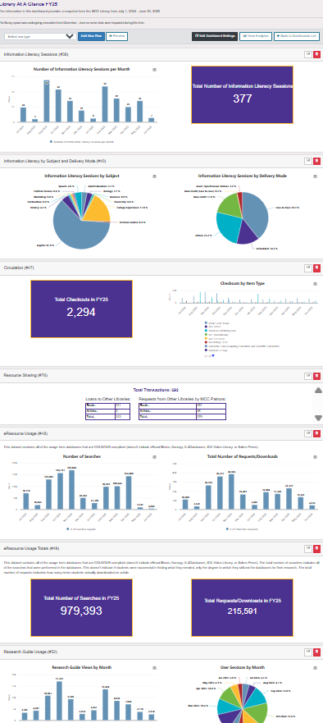
Datasets
Datasets can be used to create dashboards. Different types of data goes into a single page.
We use some dashboards in the library to inform our decisions and different ones for other stakeholders.
...but it all relies on the same datasets, so it saves time.

Slide 13
Using Alma Analytics

Slide 14
Switching SUSHI vendor info from COP 5.0 to COP 5.1
Most vendors provide COUNTER 5.1 statistics starting with January 2025. Migration from COP 5.0 to COP 5.1 happened sometime in 2025 with most vendors converting their data to COP 5.1 with Jan 2025 start date.

Slide 15
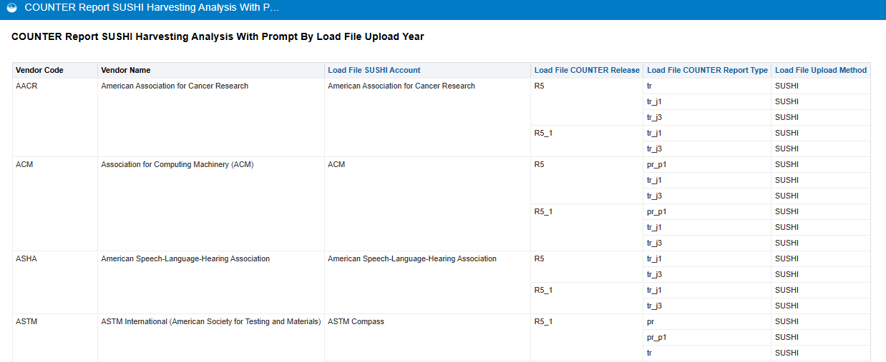
Copy report from Shared Analytics folder to “My folder”: Location/shared/Community/Reports/Consortia/CARLI/Shared Reports/COUNTER 5 E-Resource Usage/COUNTER Report SUSHI Harvesting Analysis With Prompt By Load File Upload Year Open report -> Select Load File upload year (start with 2025 and 2026) Find vendors without R5.1 value in “Load File COUNTER Release Report Type” column Update those vendor SUSHI connections

Slide 16
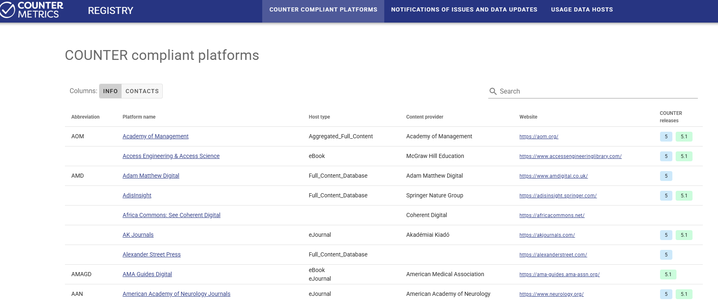
COUNTER REGISTRY - searchable
Notes:
https://registry.countermetrics.org/

Slide 17
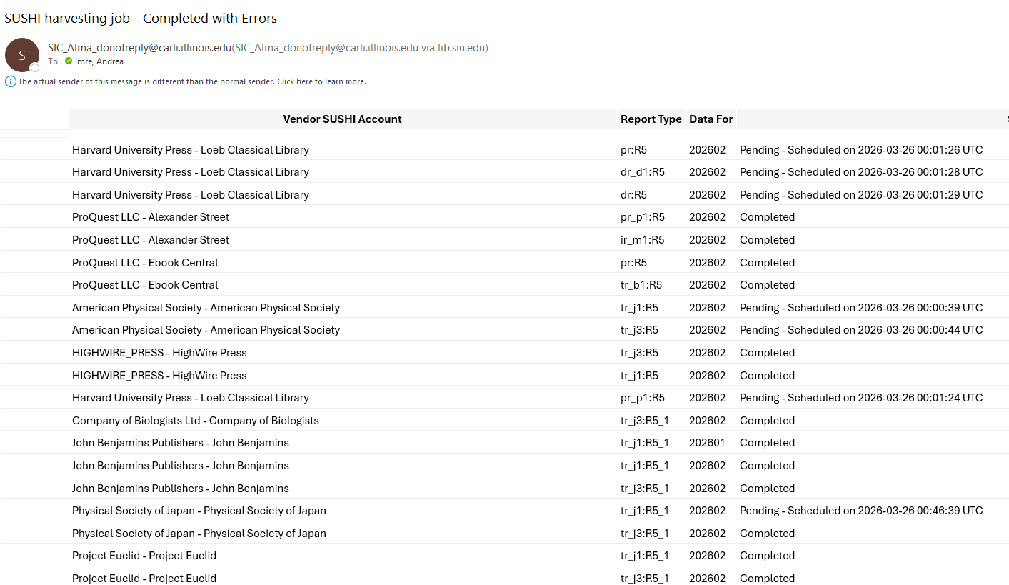
Email summary after monthly SUSHI harvest
Several vendors with pending status after SUSHI load indicating issues

Slide 18
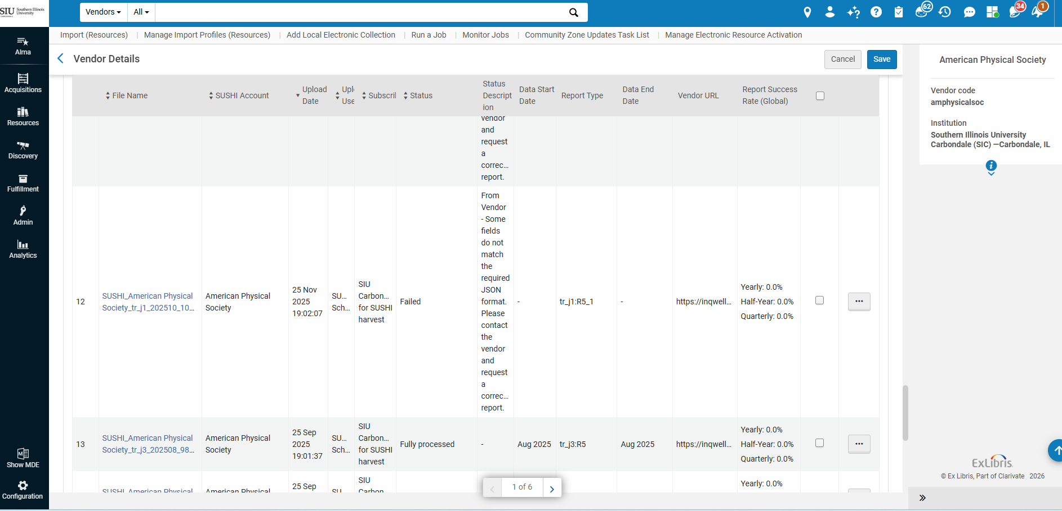
American Physical Society did not load correctly Search vendor in Alma –> Usage Statistics Tab -> Check Status Description for detailed info on error

Slide 19
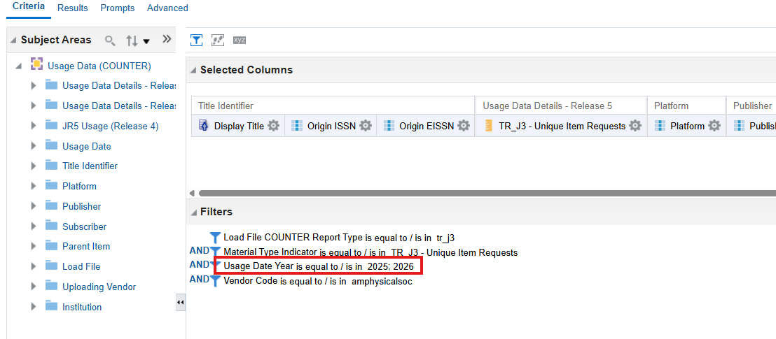
Run Analytics report to see load history
Copy report from Shared Analytics folder to “My folder”: Location/shared/Community/Reports/Consortia/CARLI/Shared Reports/COUNTER 5 E-Resource Usage/TR_J3 monthly report with prompts
Open report and Select prompts OR Edit report and edit criteria (Edit –> Click on desired Column’s wheel icon –> Filter –> Select value -> OK)

Slide 20
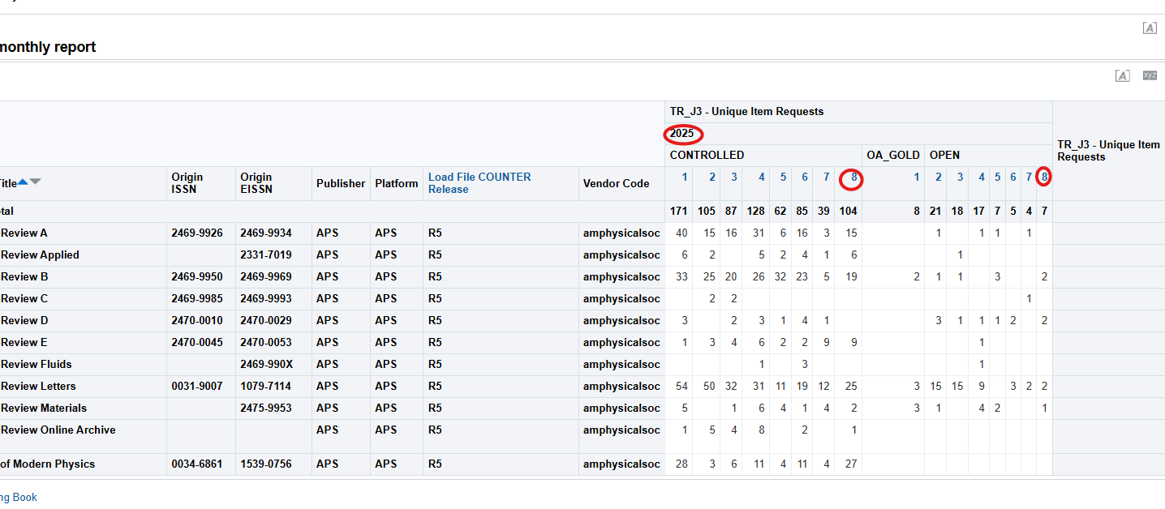
COUNTER 5 data ends in August 2025
There has not been any COP 5.1 data harvested (see Load File COUNTER release column showing R5 only.)
Last harvest date is 2025/8

Slide 21
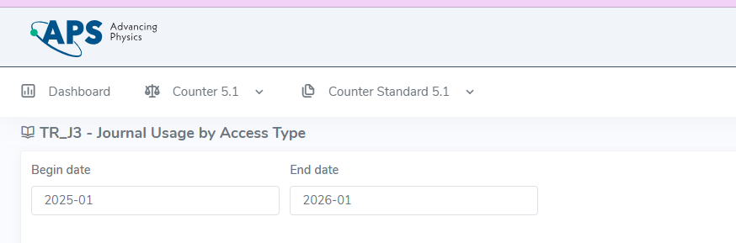
APS provides COP 5.1 back to at least 2025 Jan which is the preferred COP 5.1 start date at SIUC
Most vendors provide COP 5.1 data with a Jan 2025 start date. APS only started to provide COP 5.1 in August 2025 but they made their usage data COP 5.1 compliant from earlier than August 2026.

Slide 22
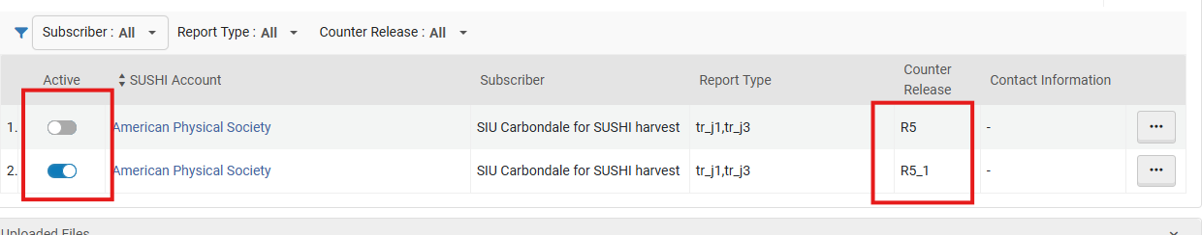
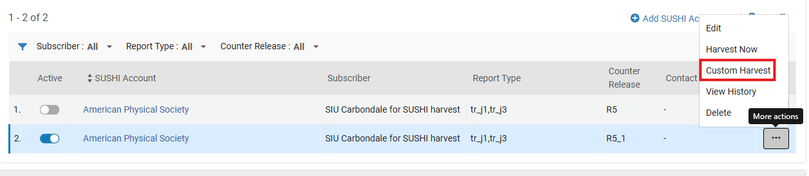
1. Update Alma vendor’s SUSHI information 2. Optional and for some reports, recommended: Delete any old reports in COP 5.0 3. Run a custom harvest

Slide 23
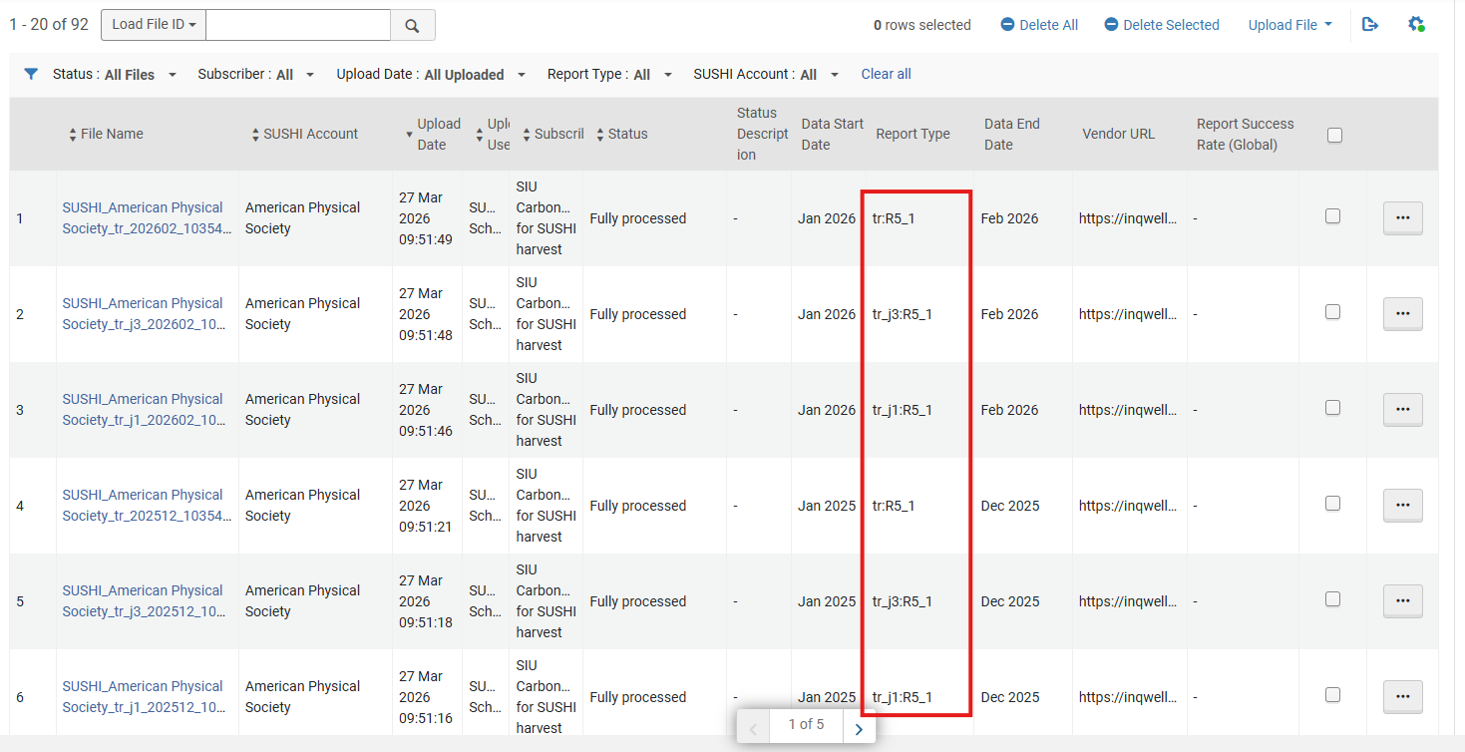
Check harvest history after custom harvest

Slide 24
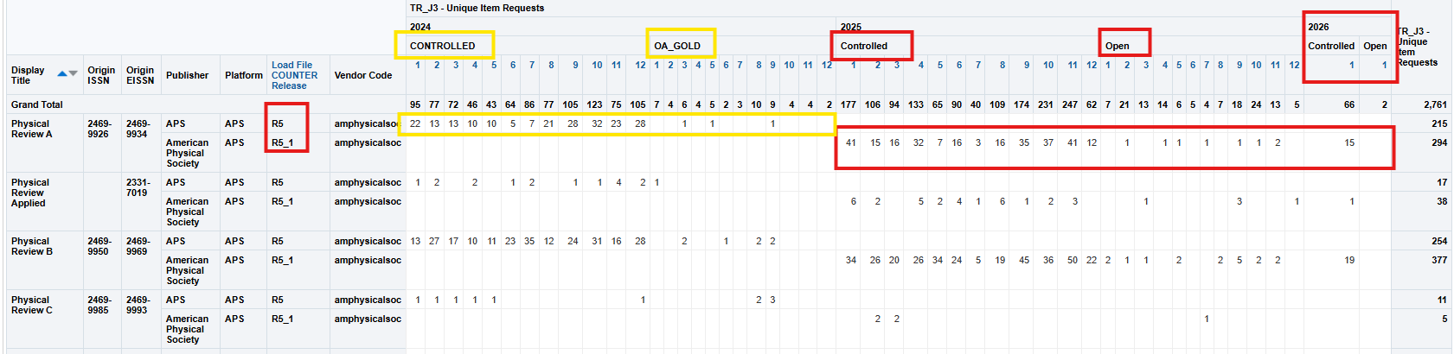
After overnight server refresh, run an Analytics report
Notes:
Copy report from Shared Analytics folder to “My folder”: Location/shared/Community/Reports/Consortia/CARLI/Shared Reports/COUNTER 5 E-Resource Usage/TR_J3 monthly report with prompts

Slide 25
Analyzing database usage
DR usage report

Slide 26
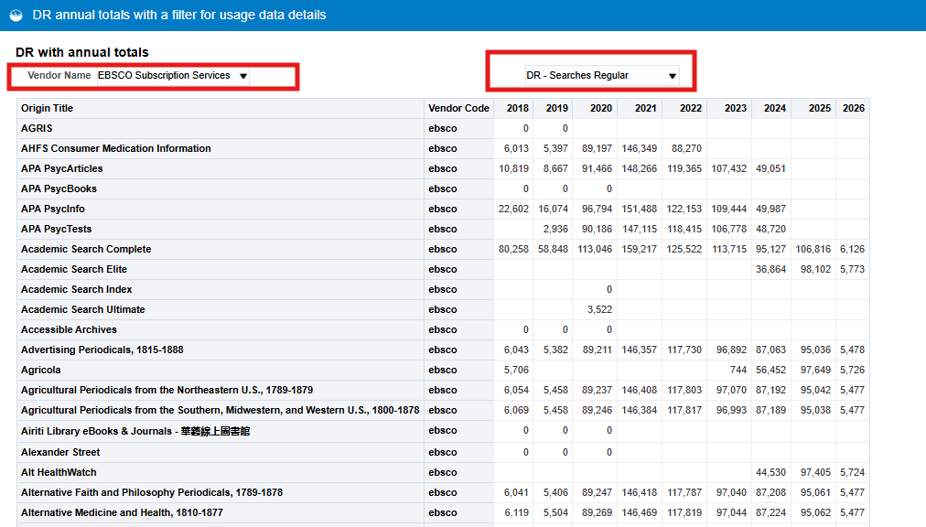
Alma Analytics DR reports
Copy report from Shared Location to “My Folder”: /shared/Community/Reports/Consortia/CARLI/Shared Reports/COUNTER 5 E-Resource Usage/DR annual totals with a filter for usage data details
Open Report
Adjust vendor name and Usage data filters as desired

Slide 27
Analyzing journal usage
TR_J3 usage report – checking vendors’ COP 5.0 and COP 5.1 reports

Slide 28
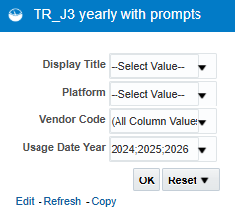
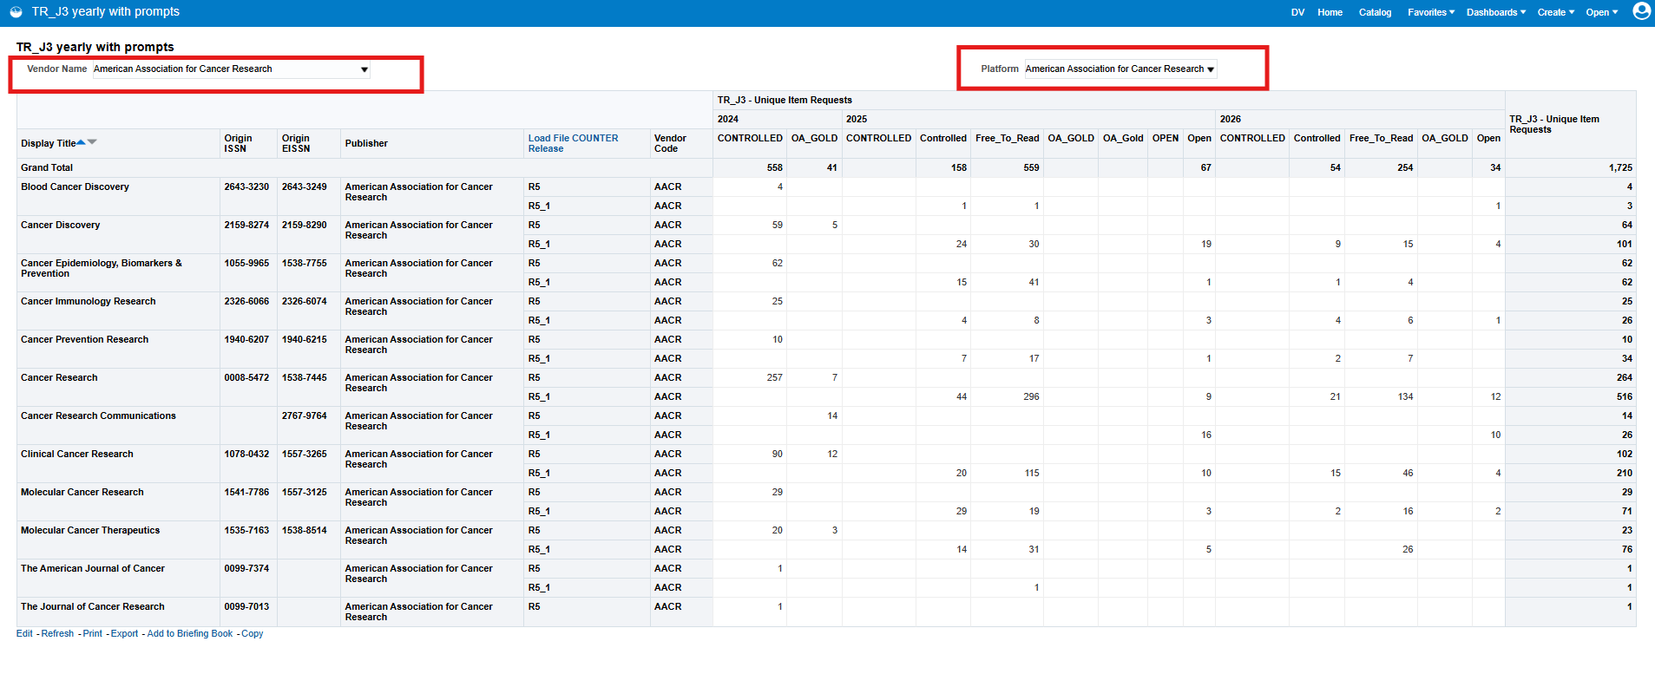
Yearly TR_J3 reports
Yearly TR_J3 Journal reports
Copy report from Shared Analytics folder to “My folder”: Location/shared/Community/Reports/Consortia/CARLI/Shared Reports/COUNTER 5 E-Resource Usage/TR_J3 yearly report with prompt
Open report -> Select any prompt or click on OK to see all values
Use built in filters on results page

Slide 29
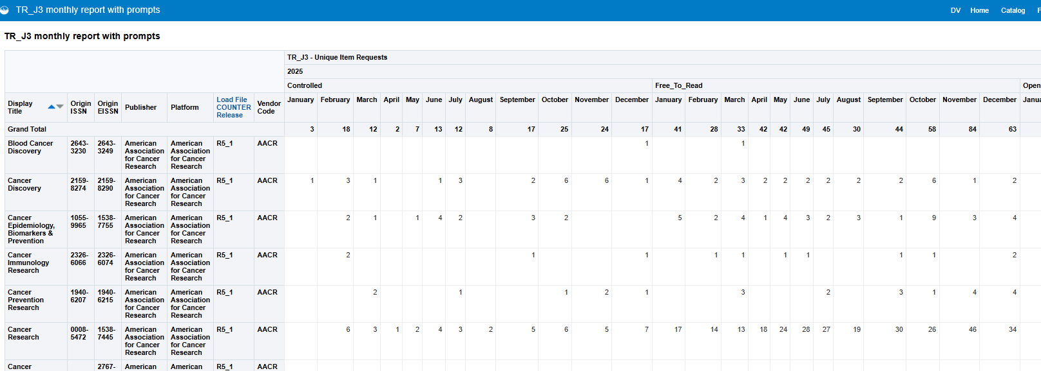
Monthly TR_J3 reports
Monthly TR_J3 reports
Copy report from Shared Analytics folder to “My folder”: Location/shared/Community/Reports/Consortia/CARLI/Shared Reports/COUNTER 5 E-Resource Usage/TR_J3 monthly report with prompts
Open report and adjust prompts

Slide 30
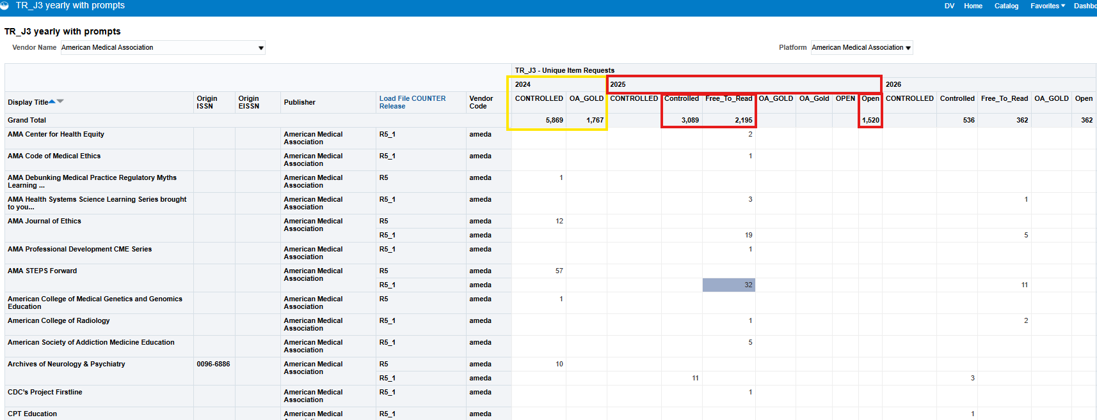
TR_J3 yearly reporting of access types
COP 5.1– Controlled, Free_to_Read, Open vs. COP 5.1 - CONTROLLED and OA_GOLD
TR_J1 only includes Controlled
You may notice a big drop in counts for CONTROLLED in COP 5.0 vs. Controlled in COP 5.1 for some vendors / platforms

Slide 31
Merging Analytics usage with cost data in Excel

Slide 32
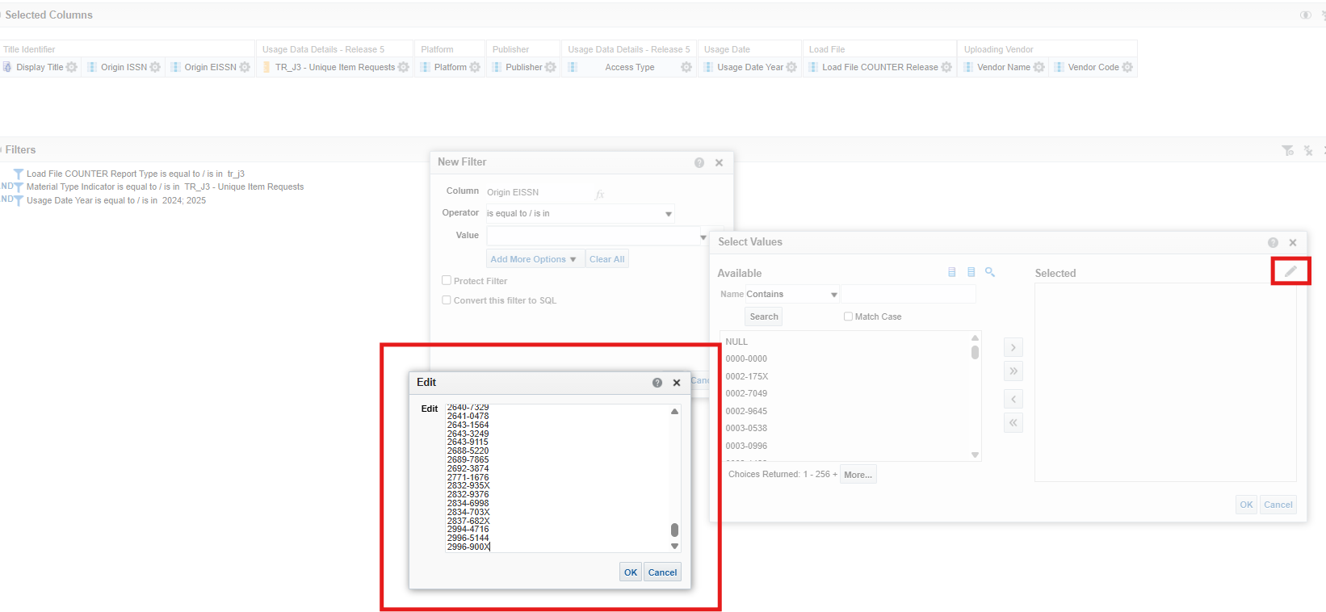
Running a TR_J3 report on a custom set of ISSNs
Create a list of eISSNs for subscribed journals
Copy report from Shared Analytics folder to “My folder”: Location/shared/Community/Reports/Consortia/CARLI/Shared Reports/COUNTER 5 E-Resource Usage/TR_J3 yearly report all journals
Go to Edit report
Adjust Filter for Usage Date Year
Edit Filter for eISSN: copy list of ISSNs from step 1 and edit filter (use pencil icon to open and edit pop window and paste eISSNs)

Slide 33
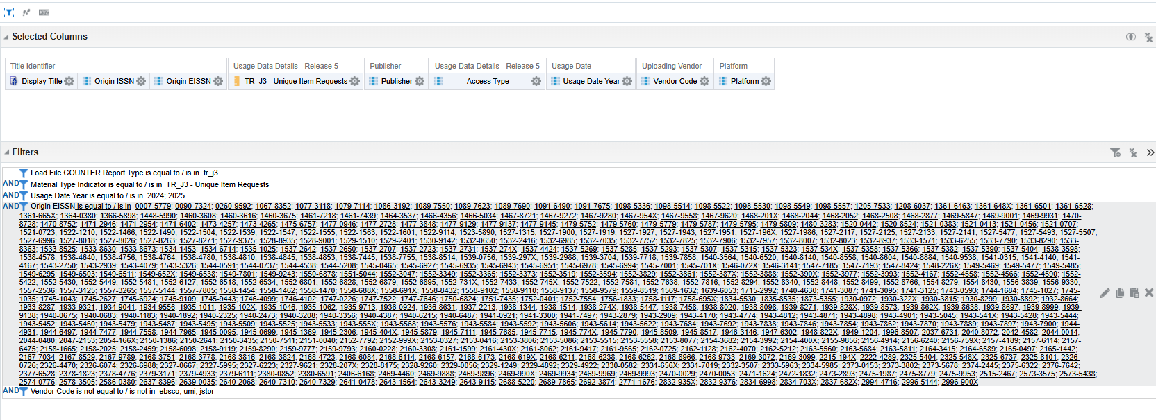
Check results Consider excluding aggregator vendors/platforms Export Formatted Excel version from Alma

Slide 34
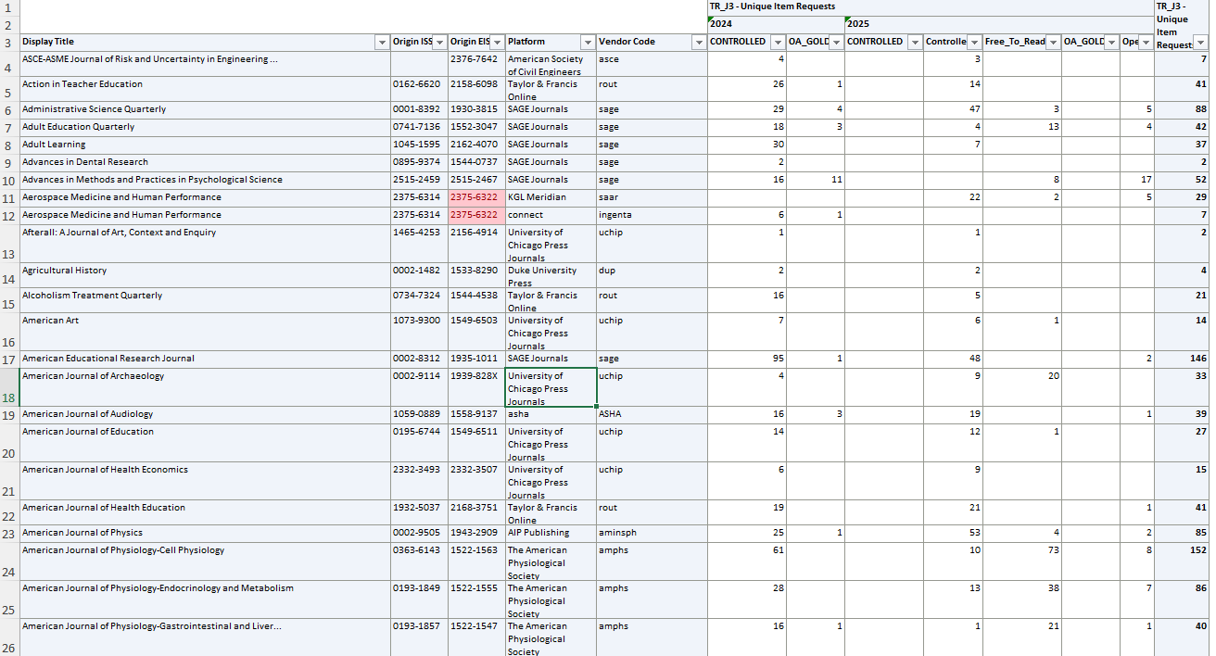
In excel check for duplicate values and clean up any dirty data – this will be your source file
Notes:
Vendor change, platform change, title available from more than one provider, ISSN(s) are not sent consistently in all monthly reports (some months may have missing print ISSNs0

Slide 35
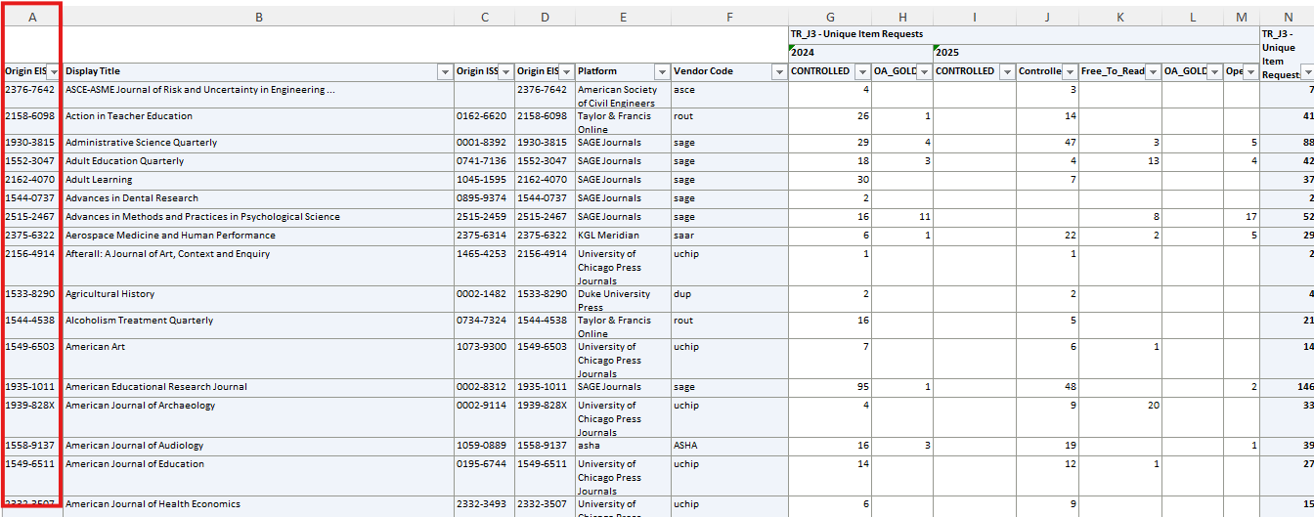
Source file is the file with Alma usage data Add a new column to the left of Column A and copy Origin EISSN column here Identify the index from source data column, in this case 2025 Controlled is the 10th column from left to right, Free to Read is 11th

Slide 36
VLOOKUP formula
Syntax
=VLOOKUP(search_key, range, index, [is_sorted])
Inputs
search_key: The value to search for in the first column of the range.
range: The upper and lower values to consider for the search.
index: The index of the column with the return value of the range. The index must be a positive integer.
is_sorted: Optional input. Choose an option:
FALSE = Exact match. This is recommended.
Source : https://support.google.com/docs/answer/3093318?hl=en

Slide 37
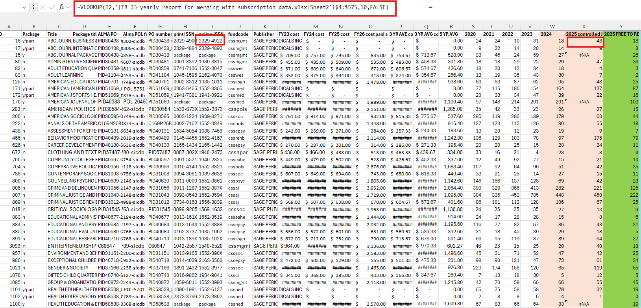
Using VLOOKUP to pull in usage stats from one Excel file into another
In target file add formula to cell where you want usage to be pulled into
Type =VLOOKUP( ; then click into cell you want to match data on, here cell I2; ADD COMMA, go to source file and select all rows with usage data, ADD COMMA, enter column number from source data file where you want to pull data from (here column 10), ADD COMMA, TYPE FALSE to get exact match, ADD closing bracket )
Copy and paste formula to all cells in column
Notes:
=VLOOKUP(I2,'[TR_J3 yearly report for merging with subscription data.xlsx]Sheet2'!$4:$575,10,FALSE)

Slide 38
LIVE DEMO / Q&A

Slide 39
Questions?
Andrea Imre
Aimre@siu.edu
Elizabeth Nelson
Enelson@mchenry.edu

Slide 40
Additional resources
The R5.1 Friendly Guide from COUNTER
Introducing the COUNTER 5 Report Tool – Melissa Belvadi’s SUSHI harvesting Tool
COUNTER Registry list of COUNTER compliant platforms

