Slide 1
H5P Interactive Content
Emily Boles, eLearning Specialist
University of Illinois Springfield

Slide 2
What is H5P?
Free & Open-source content creation tool
  Purchased by Desire2Learn in July 2024
Wide range of rich interactive content types available
Some content types may be integrated with LMS gradebooks
Objects are downloadable and can be used on multiple platforms.
Notes:
HTML5 package: a free and open-source content collaboration framework based on JavaScript that allows the user to create, share, and reuse self-contained, interactive, dynamic learning content objects

Slide 3
Pedagogical Facilitation
H5P learning objects facilitate and encourage:
Opportunities for dynamic engagement and interaction with content
Learner-centred approach to learning (self-paced; instant feedback)
Autodidactic (self-directed) learning in a S.M.A.R.T. (specific, measurable, attainable, realistic, and timely) manner
Branching is possible in some interactions (branching and interactive video); allows students to follow custom paths

Slide 4
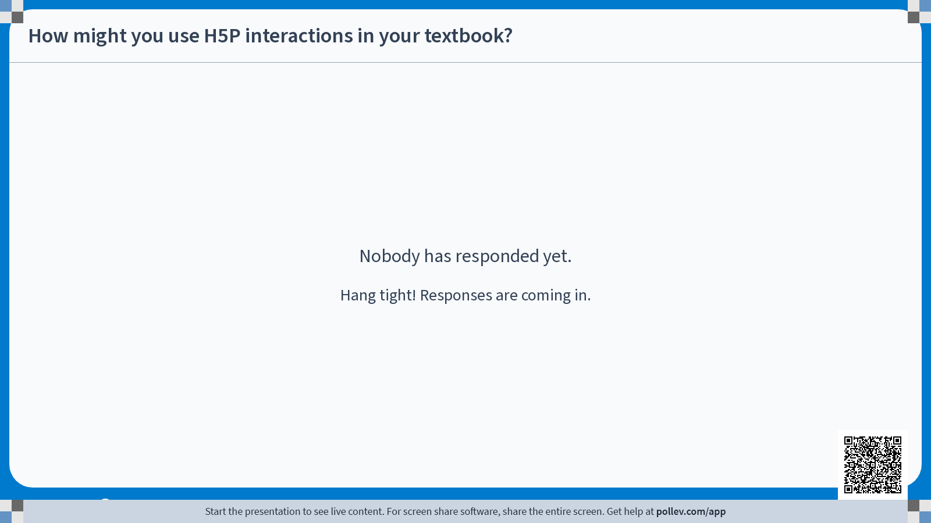

Slide 5

.org
.com
The developer of the free open source HTML5/Java.
A for-profit version of H5P that provides LTI integration for LMS and website use. Now owned by D2L.

Slide 6


Lumi
Installed on your computer for HTML or SCORM download
Cloud builder for sharing H5P content by links (no recording, but good for self-checks)
LUME
H5P Content Builders
cloud

Slide 7
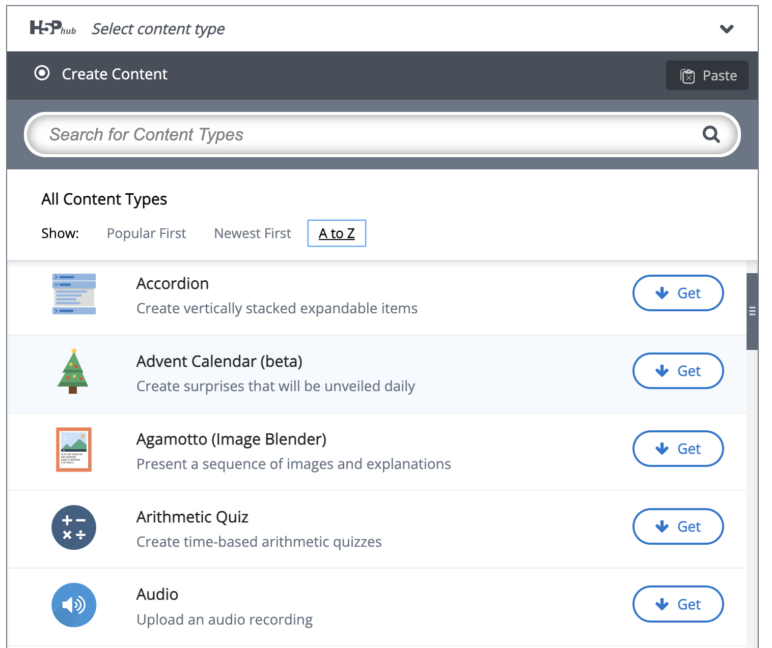
Content Types
40+ accessible content types

Slide 8


Accessibility
H5P maintains a list of content type recommendations based on accessibility.
Interactions are not innately accessible. Authors must ensure accessibility.
Add Assistive Technologies (AT) label [used by screen readers]
Click on all Metadata links to check for AT labels
Add alt text for all images
Use captioned YouTube videos or add subtitles for all videos (WebVTT format)
Check for color contrast on images uploaded and LUMI settings on some interactions

Slide 9
Integrating H5P with Open Textbooks

Slide 10
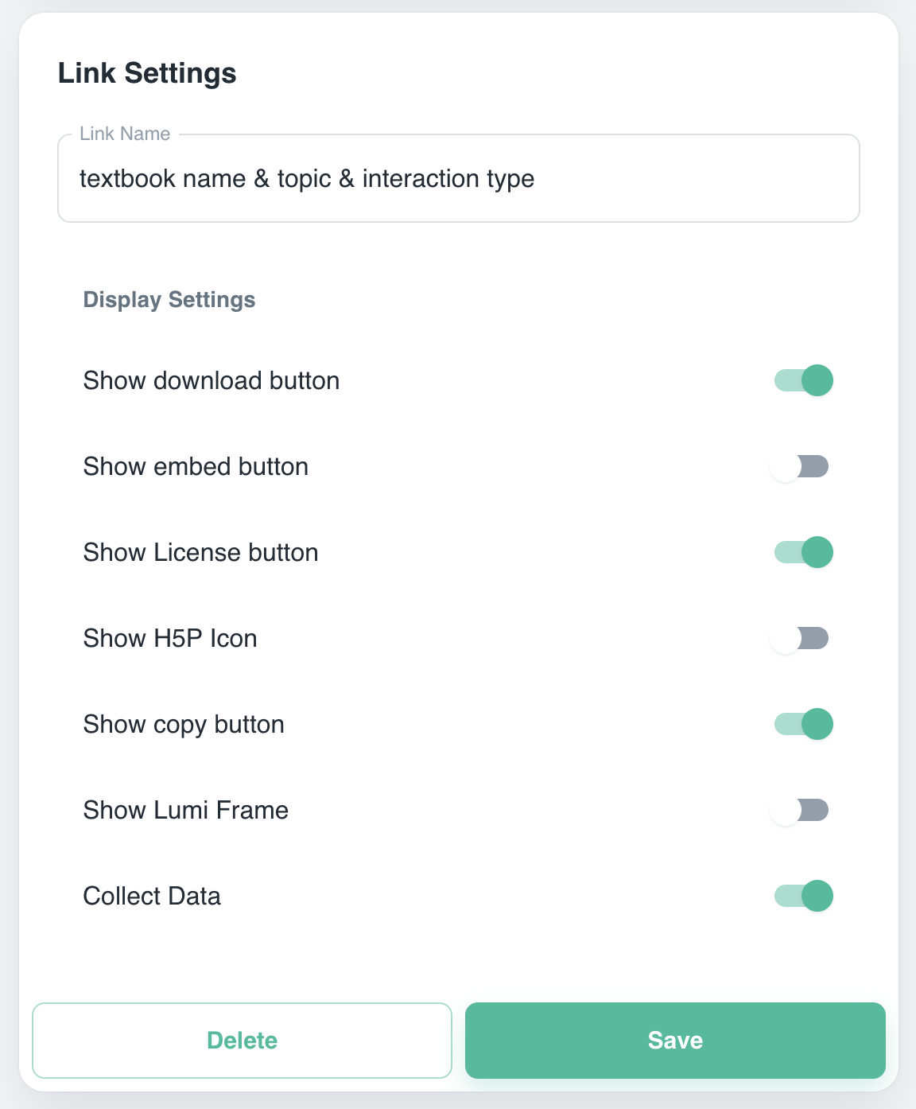
Lumi Cloud
Must create free user account to create interactions
Allows you to add links to public H5P in your textbook (will open in an external site)
Students will benefit from your instructional design whether their instructor adds the interaction to the LMS or not
Anonymous response data may be collected (warns users)
Enter a clear label for the question, including textbook name, topic, interaction type.
Allow downloads, open licensing, copying

Slide 11
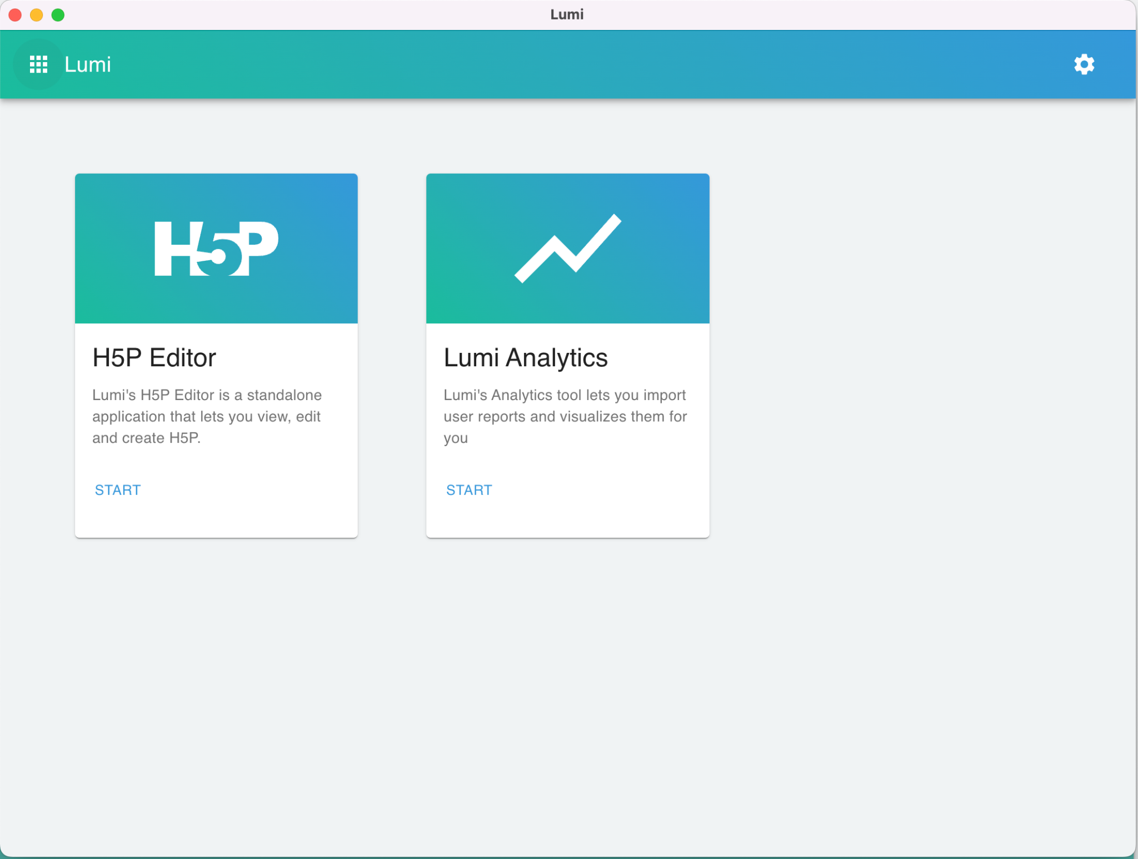
Lumi Desktop
No account needed
Upload .h5p format to instructor notes in textbook
Allows instructors to modify and reuse H5P interactions as H5P or export to SCORM for use in any LMS

Slide 12
Exploration Time!
Use this time to explore H5P and ask questions!

Slide 13
Resources
H5P Content Types & Applications
H5P Authoring Options - On Call newsletter article September 2022
Color contrast checker from WebAIM
Lumi H5P
H5P Interaction Accessibility
College of Charleston H5P resource
Ask Me Anything - H5P
H5P Kitchen
Image Pairing Example
NIH Overview of H5P

