Slide 1
Instructional Design
and Open Educational Resources
Emily Boles | University of Illinois Springfield

Slide 2
What is Instructional Design?
The process of designing, developing, and delivering instruction.
Notes:
The process of designing, developing, and delivering instruction. Broadly, instructional design determines the needs of learner, define the goal of the instruction, and create the interventions to close the learning gap. The learning experience strives to be consistent, efficient, effective, appealing, engaging. All instructional design models generally embody the following qualities.

Slide 3
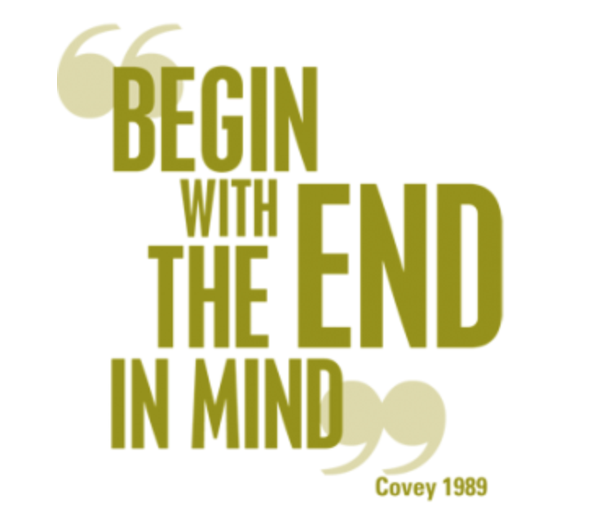
Learning Outcome:
Participants will understand how we can use Backwards Design to build a textbook

Slide 4
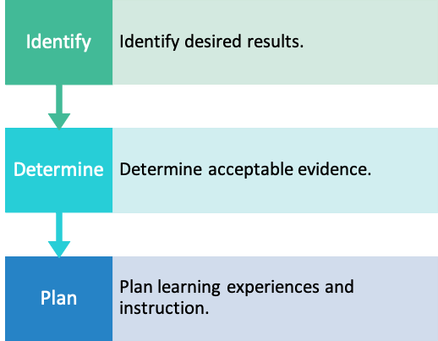
Stages of Backward Design
Plan with the end in mind. What are the topics critical for student mastery?
What assessments, assignments, and reflections will demonstrate learning?
What content & experiences will empower students to reach mastery?

Slide 5

Student Centered = Focused on the Learning Process
Image from willyrenandya.com

Slide 6
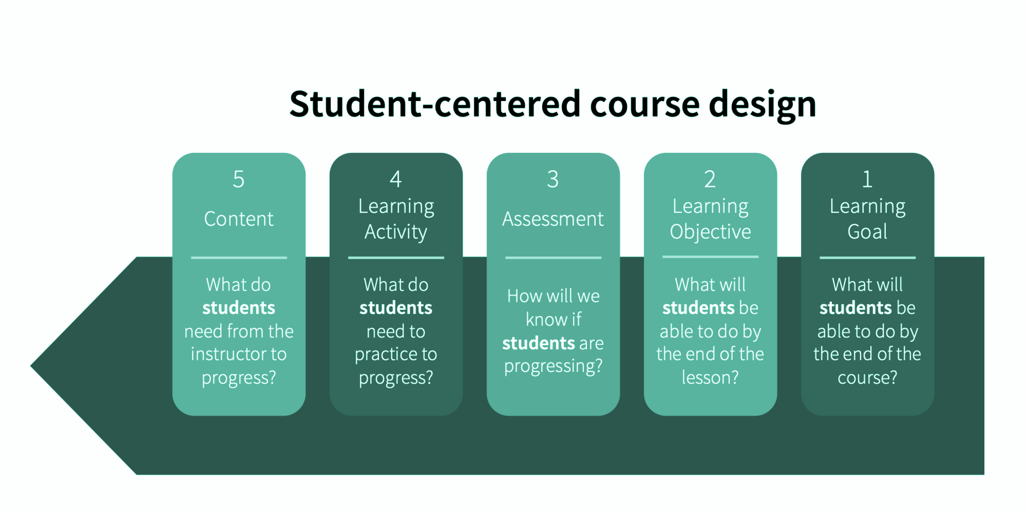
Student Centered Course Design
Teacher-centered course design image from the Teaching Commons

Slide 7
How do we translate parts of a course to a text?
Text, images, tables, charts, graphs
Assignments, quiz questions
Self-check questions
Start of each chapter
Scope of the text
Teacher-centered course design image from the Teaching Commons

Slide 8

Parts of a Book
Title
Author
Creative Commons License
Acknowledgements
Table of Contents
Glossary of Terms
Index

Slide 9
Ancillary Materials
Videos - save editable mp4 outside player for remixing
H5P - Lumi save as H5P/SCORM
PowerPoints
Test/Quiz Questions - HTML or Word
Answer Keys
Organized by chapter or included in each chapter
Stored in Instructor Resources
Notes:
Build intro videos (4-8 minutes) for chapters or key concepts. Micro-lecture to frame the week. Learn where to start in this video guide from Kent State.

Slide 10

Consistent Design Elements
Video splash screen
Features of chapters
Slide backgrounds
Colors
Bullets
Fonts

Slide 11
Content & Learning Experiences
This is the majority of your textbook, including text, images, charts, graphics, and more.

Slide 12
Features of a Chapter
Chapter Title
Learning Outcomes
Topic and Subtopic Titles
Text
Images, Tables, Charts, Graphs (captions & ALT Text)
Self-Checks (H5P or answers at end of chapter)
Discussion Questions
Assignments (+ 3D Printing)
Ancillaries can be embedded where appropriate
Notes:
Include module level objectives to help frame the topic and expectations. This is a metacognitive teaching strategy. You are controlling how they view and integrate the information in the module.
Chunking your materials reduces the cognitive load. Organizing materials assists students with metacognition (Stavredes 48-49)
Repetition, reorganizing to include the new info & reframing based on new information
Use images, tables, charts, graphics to illustrate and repeat important concepts from the text.
Vary your instructional content and assessments performances. Can you present ideas in charts or illustrations? Can you provide activities for instructors to include in their courses?

Slide 13
Format of the text
Bolded key terms
Definitions as pulled quotes
Headings and Subheadings
Make the text scannable!

Slide 14
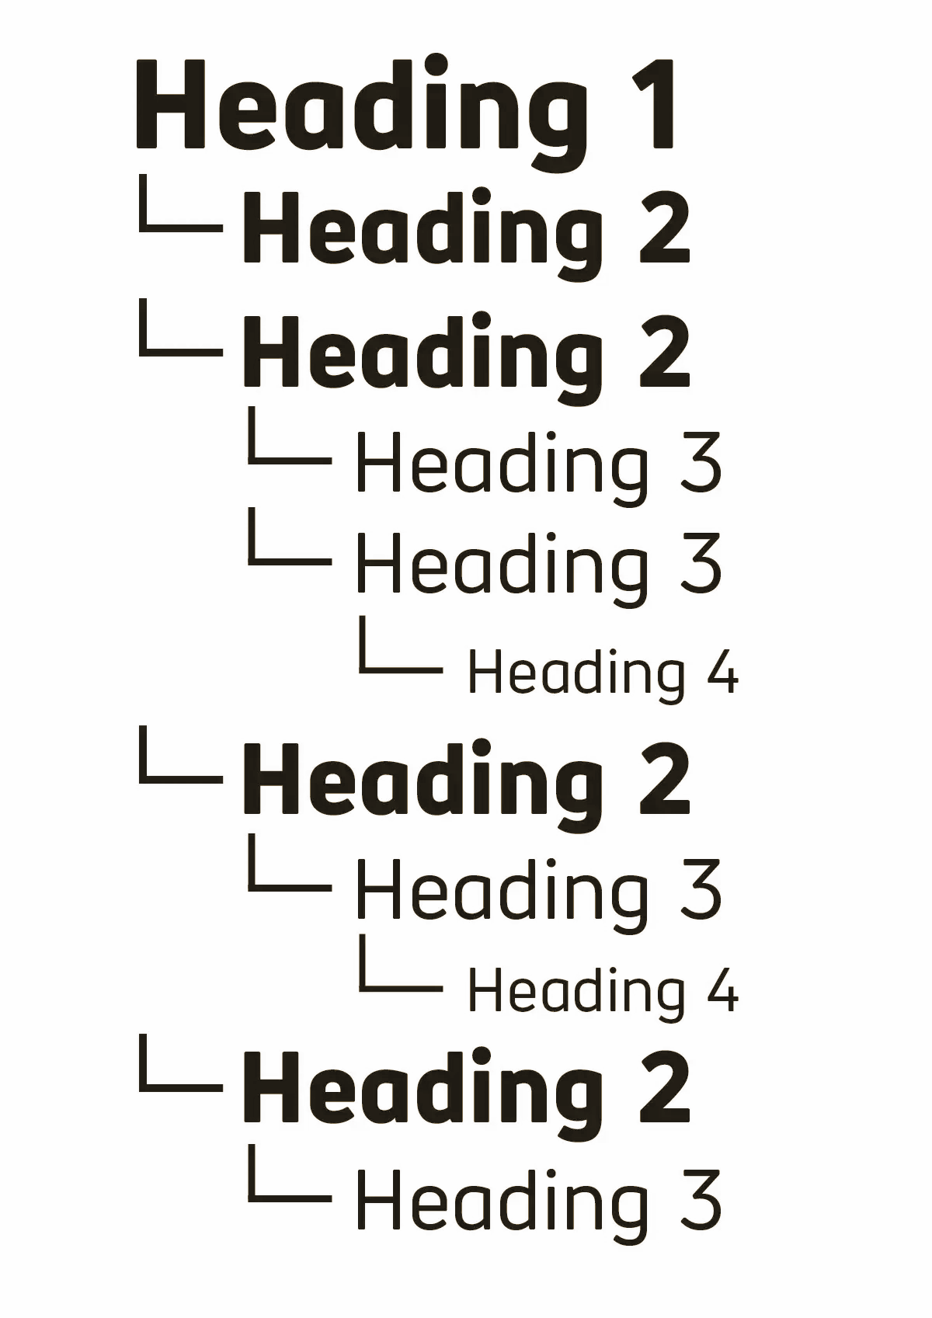
Semantic Structure
Notes:
Semantic means "relating to meaning".
Adding semantic structure to your text means using elements to structure your content based on each element's meaning, not its appearance.
It allows both humans and machines to understand and interpret the structure of a document or web page.

Slide 15
As you write
Consider WHERE your students are going & HOW you will get students there
Notes:
Curate the journey

Slide 16
W.H.E.R.E.T.O
W | Where are we going? What is expected?
H | How will we hook the students?
E | How will we equip students for expected performances?
R | How will we rethink or revise?
E | How will students self-evaluate and reflect on their learning?
T | How will we tailor learning to varied needs, interests, learning styles preferences?
O | How will we organize the sequence of learning?
Wiggins & McTighe (2005) UbD, pg 354. See also, this great handout from Montgomery, NC Schools. Edit by E. Boles
Notes:
The WHERETO framework helps us remember to tell students where we are going and why.
W – How will I help students know what they should be learning? Why is this worth learning? What evidence will show their learning?
H – How will I hook and engage the learners? In what ways will I help them connect desired learning to their experiences and interests?
E – How will I equip students to master identified standards and succeed with the targeted performances? What learning experiences will help develop and deepen understanding of important ideas?
R – How will I encourage the learners to rethink previous learning? How will I encourage ongoing revision and refinement?
E – How will I promote students’ self-evaluation and reflection?
T – How will I tailor the learning activities and my teaching to address the different readiness levels, learning profiles, and interests of my students?
O – How will the learning experiences be organized to maximize engaging and effective learning? What sequence will work best for my students and this content?

Slide 17
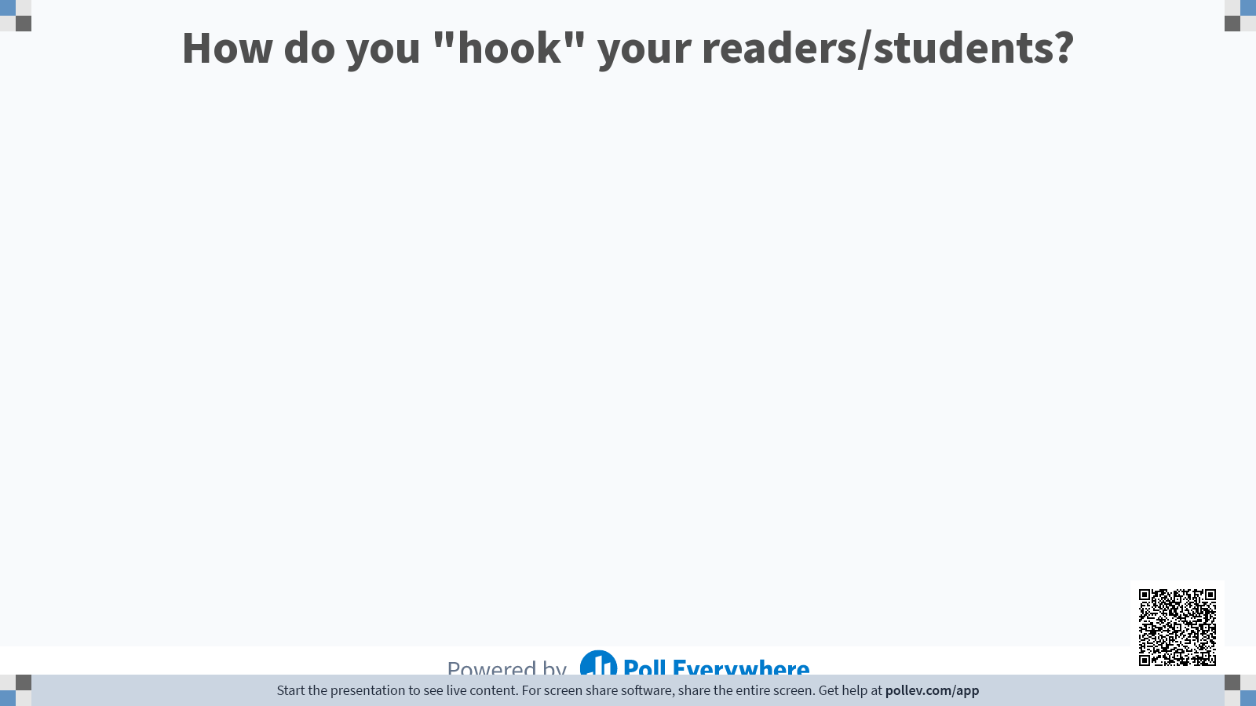

Slide 18
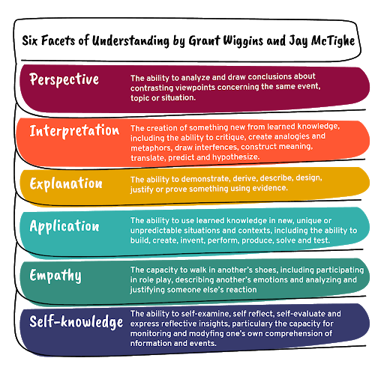
Address multiple facets of understanding in each chapter
Provide multiple entry points to a topic
Allows students to connect to topics from where they are
Framing of text
Questions
Assignments
Image from Gosia
Notes:
The six facets signal the types of performance evidence that reveal understanding/ability of your students. You can use them as a blueprint for building assessments. When the facets are combined, they become very powerful -- doing something and then explaining or reflecting (write dissertation and then defend, for example).
Explanation asks students to tell the ‘big idea’ in their own words, make connections, show their work, explain their reaosning, and induce a theory from data.
Interpretation
Interpretation requires the student to make sense of stories, art works, data, situations, or claims. Intepretation also involves translating ideas, feelings, or work done in one medium into another.
Application - Students who understand can use their knowledge and skill in new situations (and) place emphasis on application in authentic contexts with a real or simulated audience, purpose, settings, constraints, and background noise.
Perspective is demonstrated when the student can see things from different points of view, articulate the other side of the case, see the big picture, recognize underlying assumptions, and take a critical stance.
Empathy - Intellectual imagination is essential to understanding and it manifests itself not only in the arts and literature but more generally through the ability to appreciate people who think and act differently than us.
Self-Knowledge - …through self-assessment we gain complete insight into how sophisticated and accurate students’ views are of the tasks, criteria, and standards they are to master.
Using The 6 Facets of Understanding In Your Classroom
Unlike Bloom’s Taxonomy, the 6 Facets of Understanding is a non-hierarchical framework–meaning that there are not ‘lower levels’ and ‘higher levels’ of thinking. ‘Self-Knowledge’ isn’t prioritized over ‘Explanation,’ for example. Nor is one facet ‘superior’ over another. Rather, Wiggins and McTighe intended for the ‘facets’ to be used to support teachers and students by providing strategies to help assess understanding. And since traditional content areas range so dramatically–from arts and literature to language and math–the idea is to create a framework flexible enough to work in variety of contexts and needs.

Slide 19
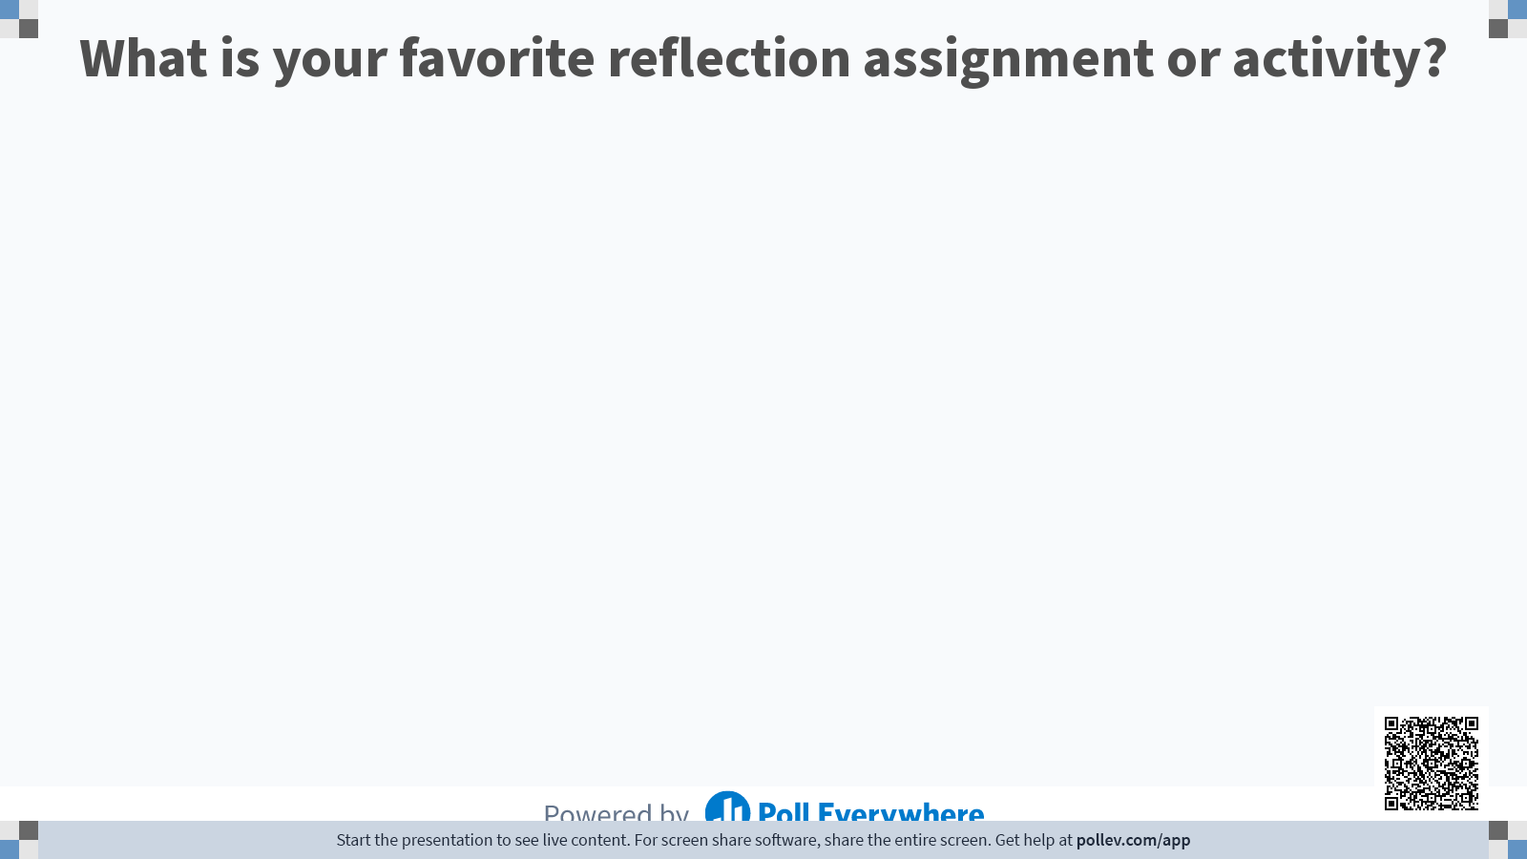

Slide 20
Emily’s Favs
Create a meme about the most important thing you learned this chapter/semester/unit
  IMGflip meme generator
Reflective essays or discussion posts
  Clemson has a great handout on 5 types of reflection writing
  U. Minnesota resource on Using Reflective Writing to Deepen Student Learning
Reflection Cube
  Paper or 3D printed Cube with reflective questions or numbers/symbols. [#8 is a K-12 reflection cube sample; adapt!]

Slide 21
Recap
Identify Desired Results
Determine Assessment Evidence
Plan Learning Content & Activities
Backwards Design

Slide 22
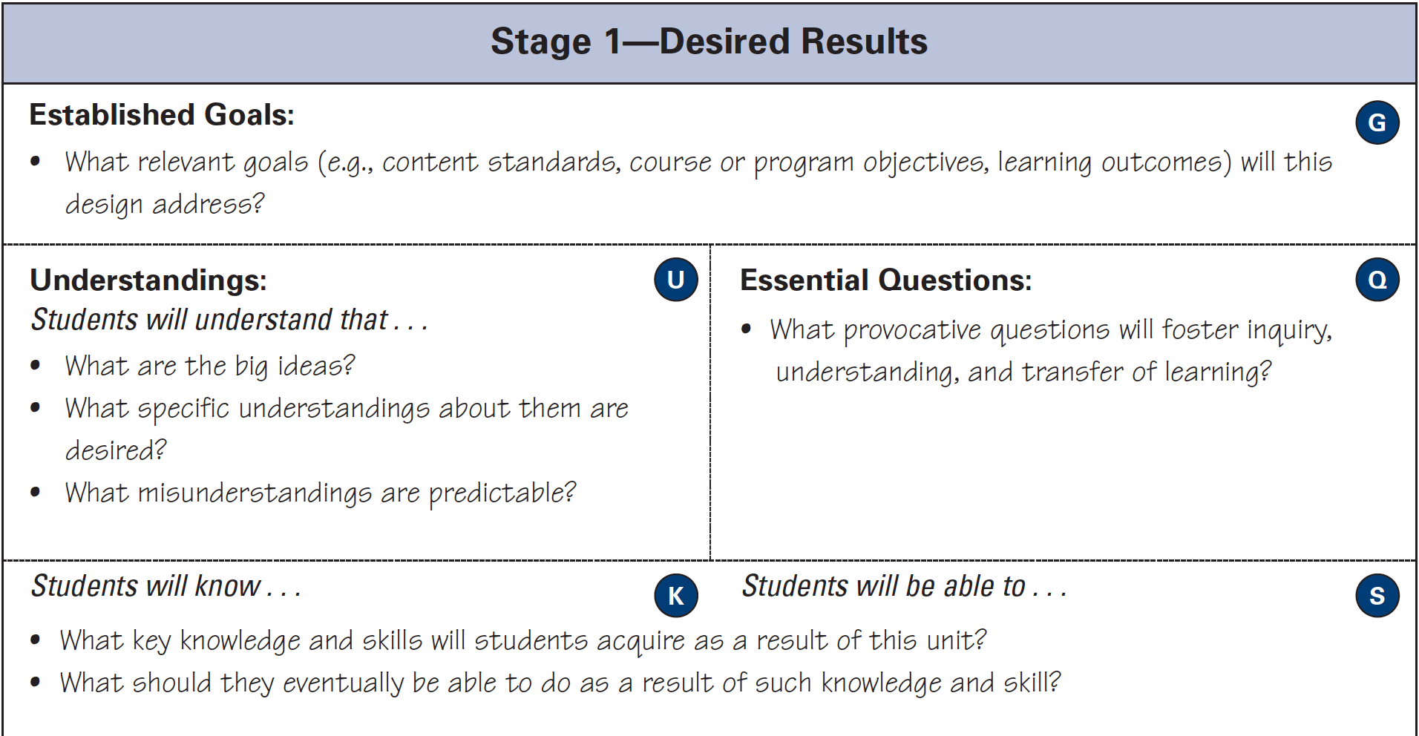

Slide 23
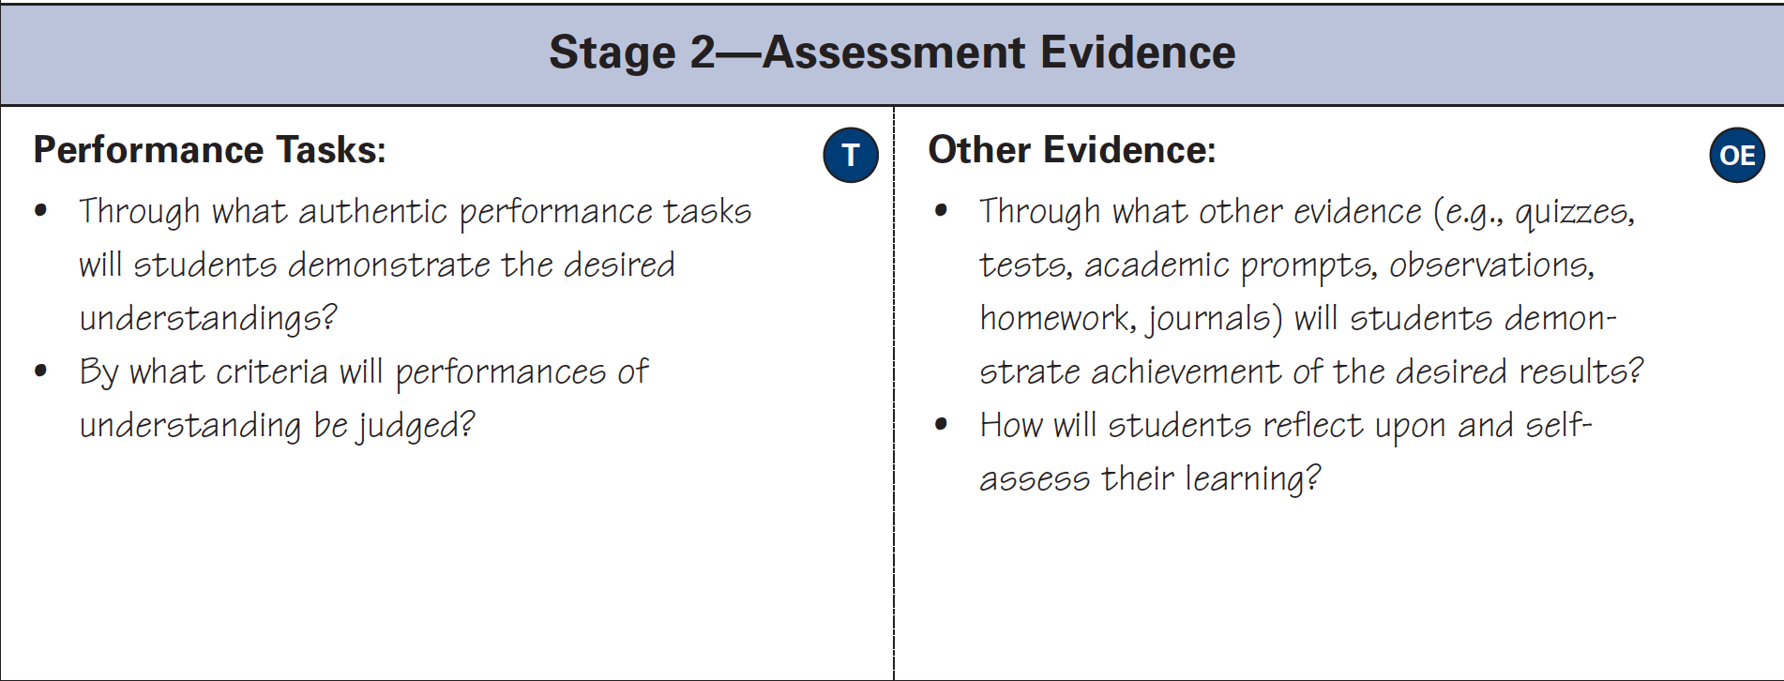

Slide 24
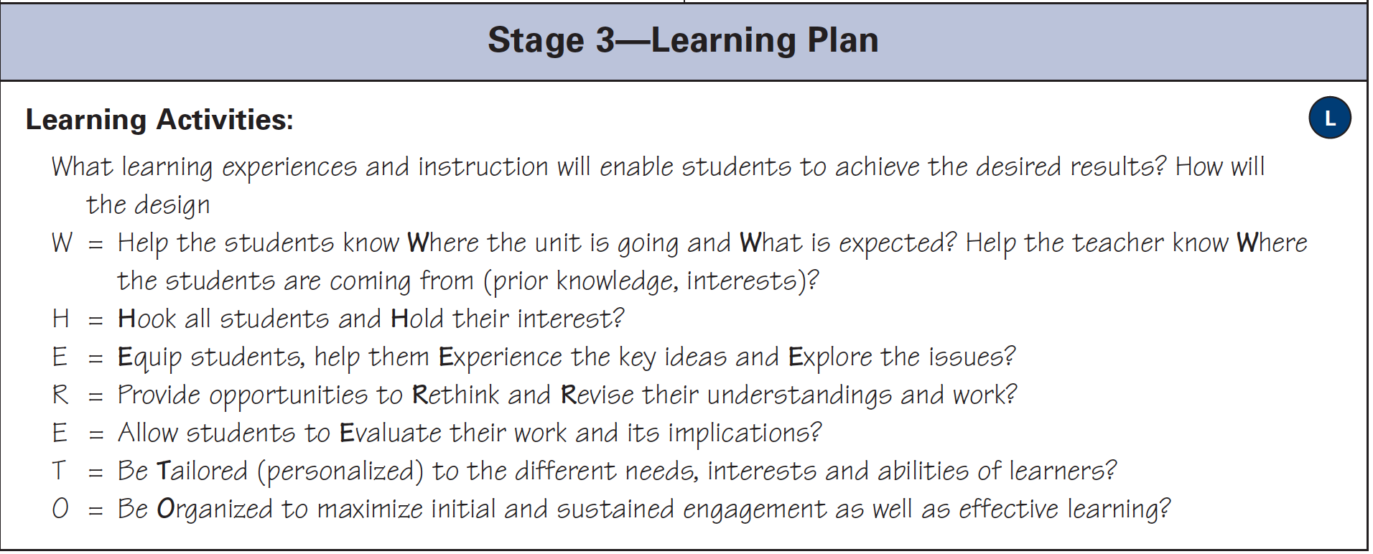
Three Stages of Backward Design Handout

