Slide 1
Archival Supplies and Vendors
Pam Hackbart-Dean, University of Illinois Chicago

Slide 2
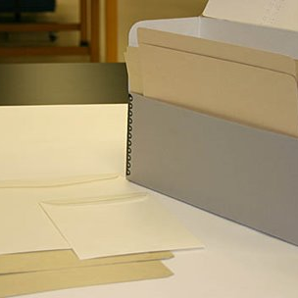
Archival Supplies Terminology
“Archival quality”​
“Acid-free”​
“Lignin”/ “Lig-free”​
“Alkaline Buffered”​
“Photo safe”​
Notes:
Archival Quality
A non-technical term suggesting a material or product is permanent or chemically stable and can be used safely for preservation purposes. The phrase is not quantifiable; no standards exist that describe how long an "archival" or "archivally sound" material will last.
Acid-free
Paper or board that has a pH of 7.0 or higher, meaning it's not acidic. Sometimes people incorrectly call it "alkaline" or "buffered," but "acid-free" just means it's not acidic. Acid-free paper can be made from different materials like cotton or wood, but the important thing is that the acid is removed during the paper-making process. However, even if paper is acid-free when it's manufactured, it can still become acidic over time because of acid migration from stored materials. To prevent this, paper is sometimes treated with a special ingredient called a buffer, which helps to neutralize any acid that might form later on.
Lignin
This is a natural substance found in plants, along with cellulose. It's what makes plants strong and stiff. But, when lignin is present in paper, it's believed to speed up the paper's breakdown over time. That's why paper companies often try to remove as much lignin as possible during the paper-making process. You might see paper labeled "lignin-free," but there's no official standard for what that means. Scientists are still learning about exactly how lignin affects paper, so "lignin-free" doesn't guarantee that the paper will last a super long time.
Buffer, Buffering Agent
An alkaline substance used to neutralize acid in paper and boards.
Photo safe—pass the PAT test; The Photographic Activity Test (PAT) is a worldwide standard (ISO Standard 14523) for archival quality in photographic enclosures. Developed by the Image Permanence Institute at the Rochester Institute of Technology, this test predicts possible interactions between photographic images and the enclosures in which they are stored. The PAT is also used to test the components of enclosures, such as adhesives, inks, paints, labels, and tapes.

Slide 3
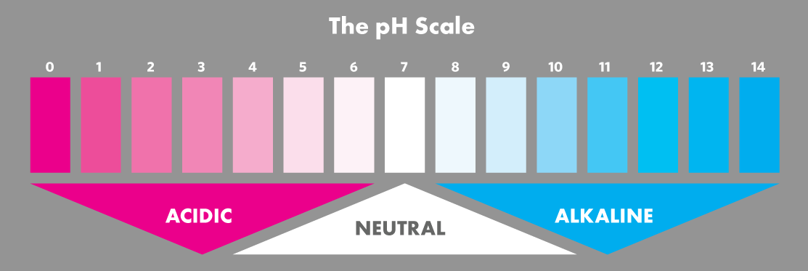
Specify pH range and alkaline buffering (7 is pH neutral)
Notes:
In chemistry, pH- the measure of the concentration of hydrogen ions in a solution- determines acidity or alkalinity. The pH scale runs from 0 to 14, and each number indicates a ten-fold increase. Seven is pH neutral; numbers below 7 indicate increasing acidity, with 1 being most acid. Numbers above 7 indicate increasing alkalinity, with 14 being most alkaline. Paper with a pH below 5 is considered highly acidic. Buffered storage materials typically have a pH between 7 and 9.

Slide 4
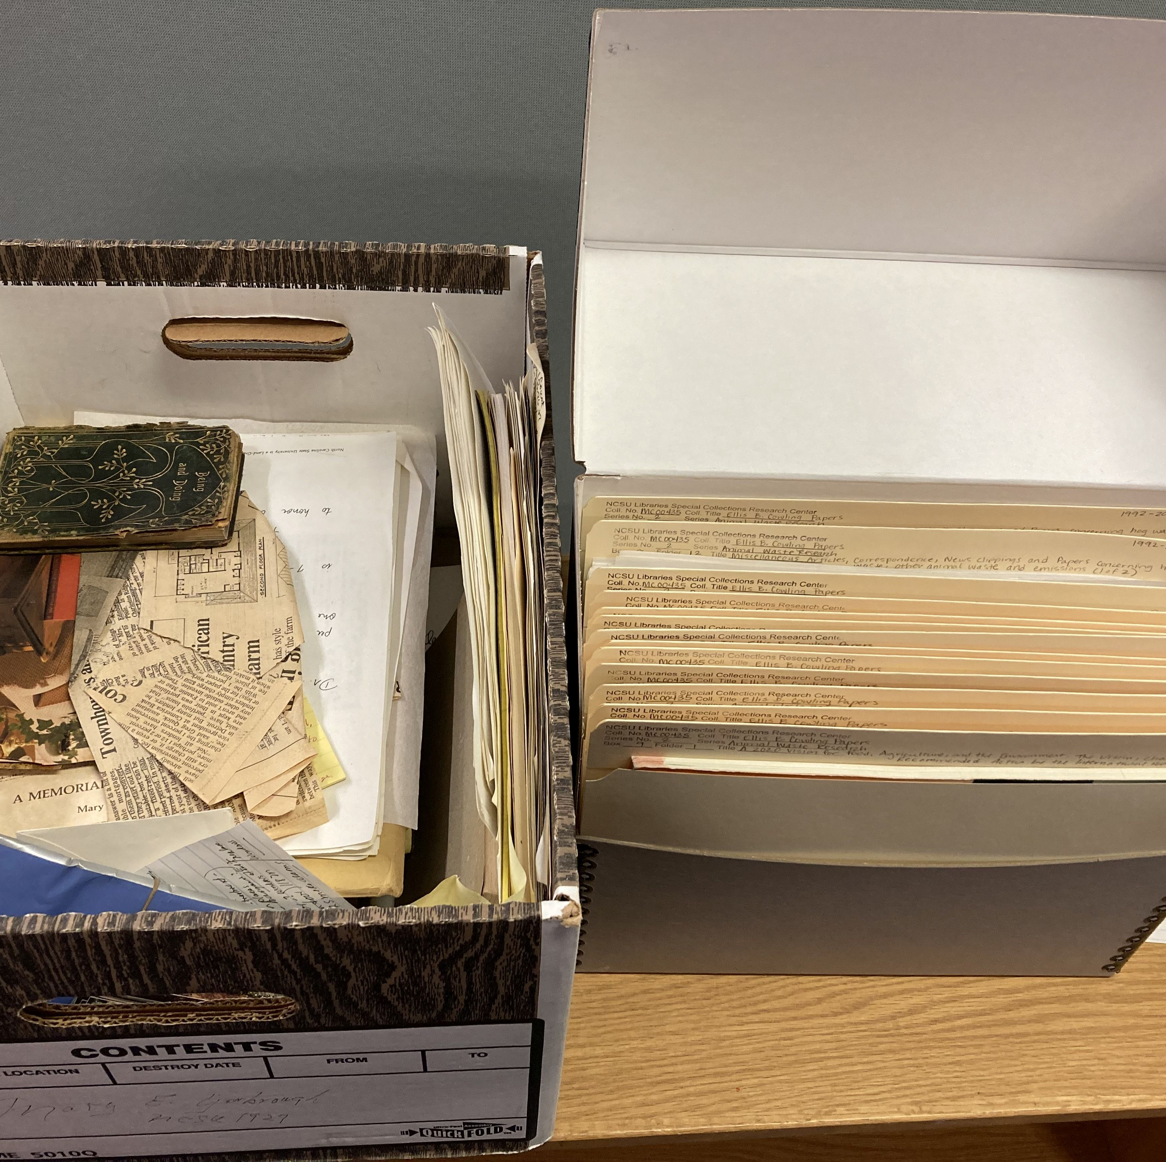
Basic Supplies for processing
No. 2 pencils
Magic Rub block erasers
Brushes (soft, clean, and natural bristled)
Micro-spatula to remove rusty paperclips and rubber bands
Archival quality clips—No Plastic Paper Clips
Nitrile disposable gloves (for working with photographs or really dirty papers)
Image from North Carolina State University Libraries

Slide 5
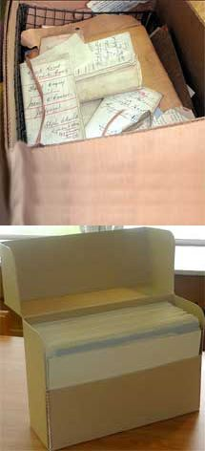
Basic Supplies for processing
Archival-quality file folders (I prefer folders with full tabs)
Vertical file archival boxes (i.e., document boxes, flip-top)
Bankers boxes for when you have a lot of files (Paige No. 15 Miracle Boxes are the easiest to construct and durable).
Oversized document boxes
Clear “plastic” enclosures for items such as pamphlets, fragile papers, photographs, and small maps.

Slide 6
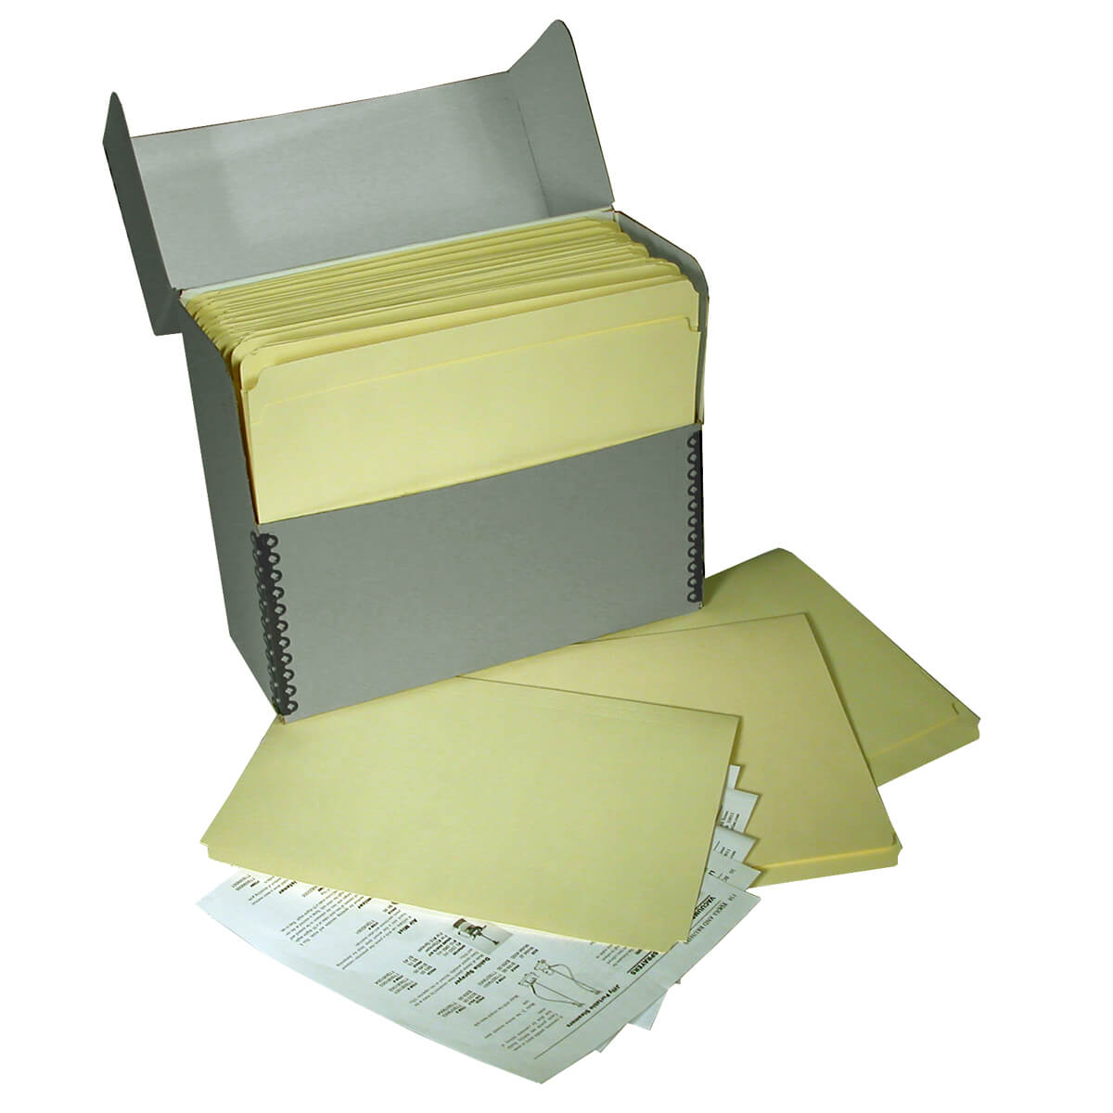
Storage Enclosures -- Basics
Image from Gaylord Archival
Storage enclosures should be lignin-free (i.e., no recycled products)
Best fit container for items
Papers in boxes should be supported appropriately, neither bulging nor slumping
Notes:
Select a box large enough to hold the records without having to add additional folds, or having to roll or bend records to fit into the box.
If a standard letter or legal-size box will not accommodate the records, use a custom-sized box.
Ensure that the box is not overfilled or underfilled.
Avoid packing records so tightly that they put pressure on each other and make retrieval difficult. Damage can happen when records are forced in or out of a box.

Slide 7
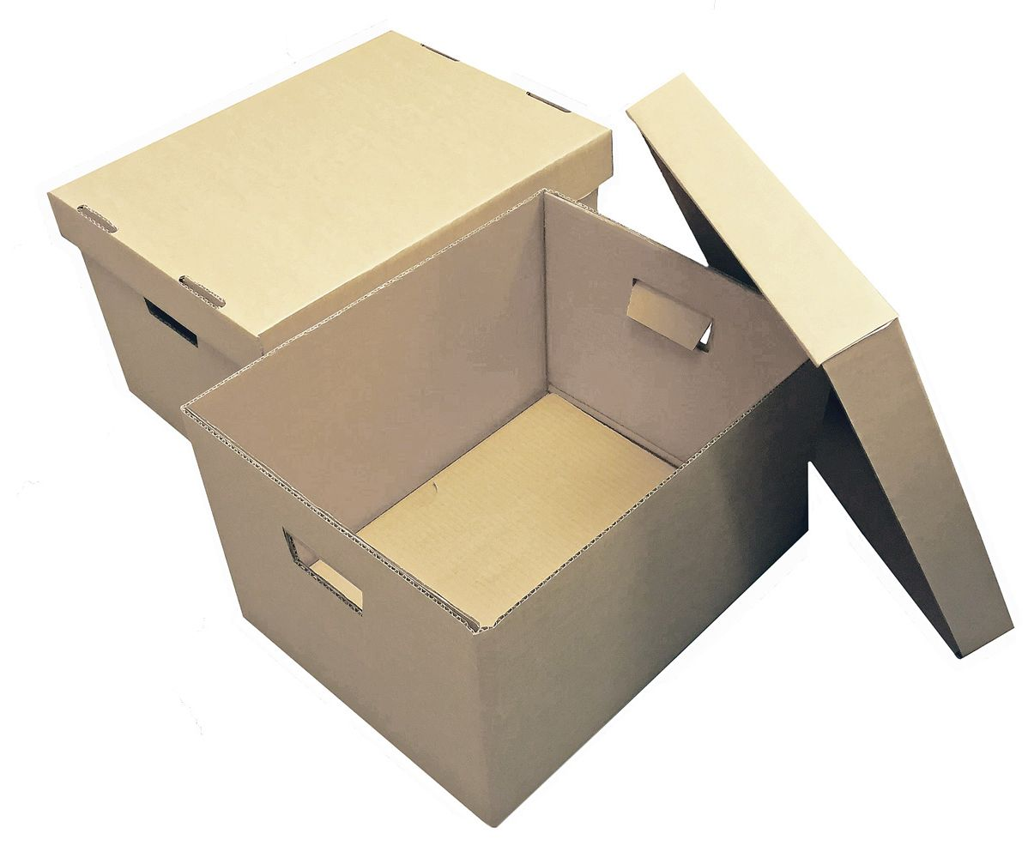
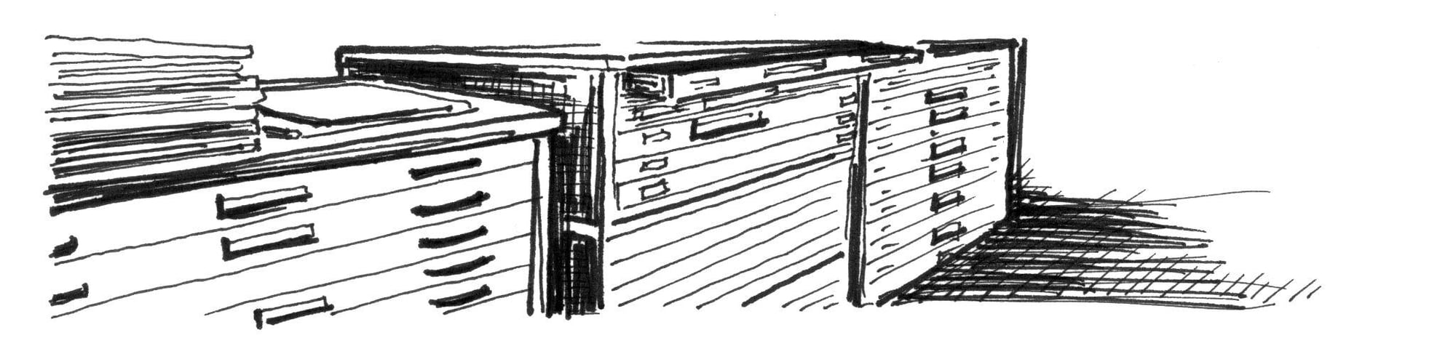
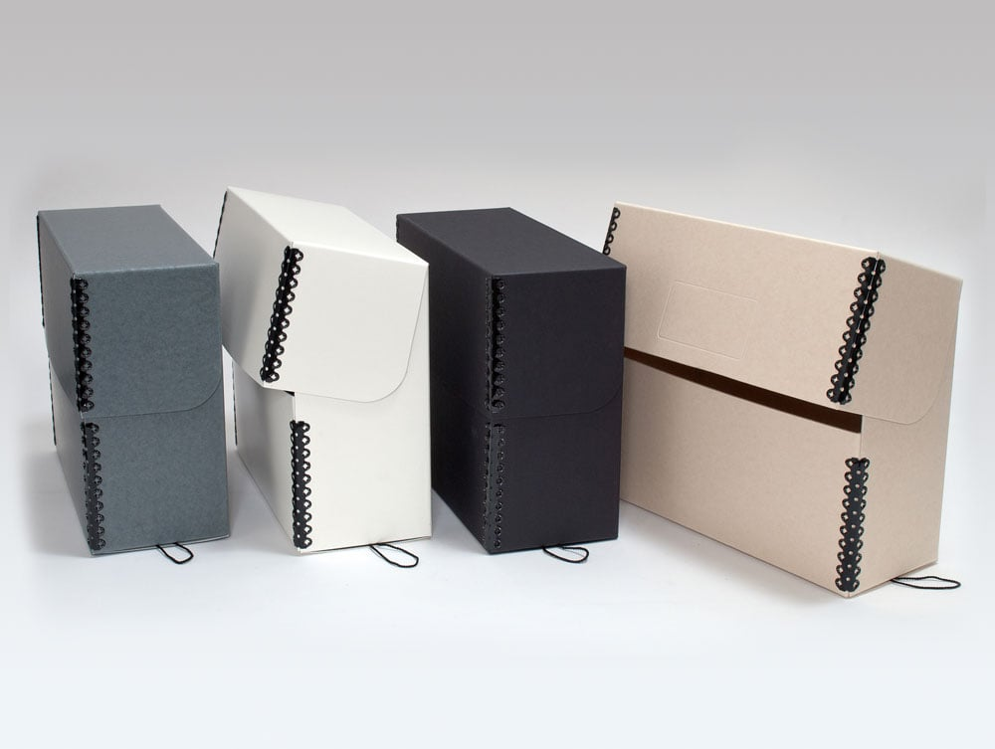
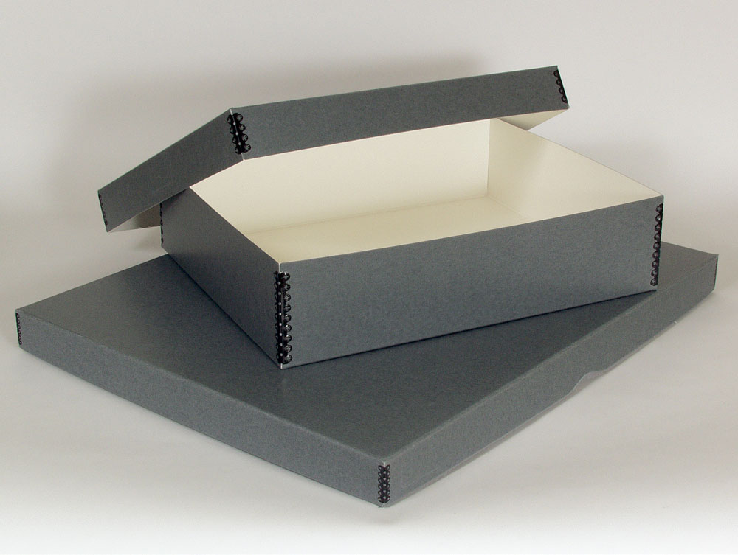
Record carton (aka banker box)
Images from Gaylord Archival
Map cases
Flat boxes for oversized materials, aka clamshell boxes
Document boxes, i.e., flip-top boxes

Slide 8
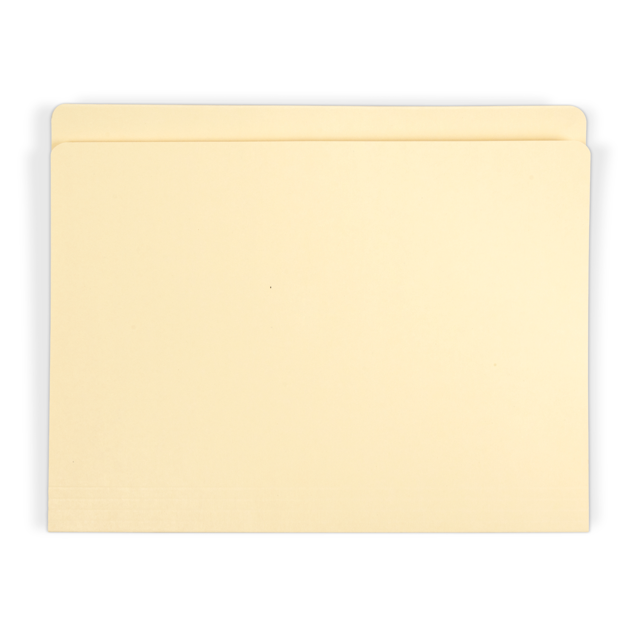
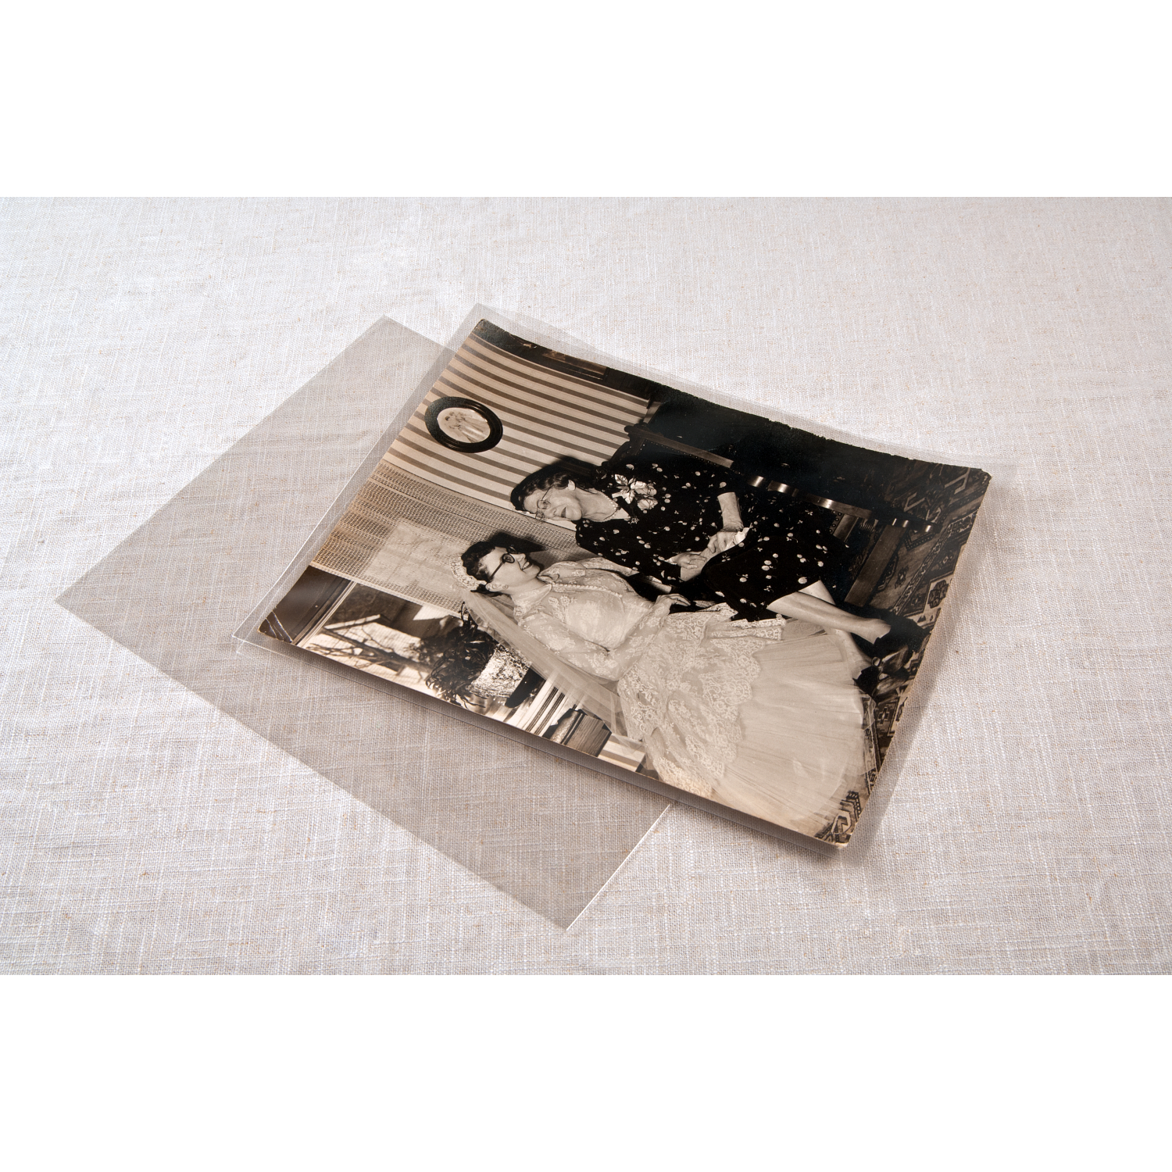
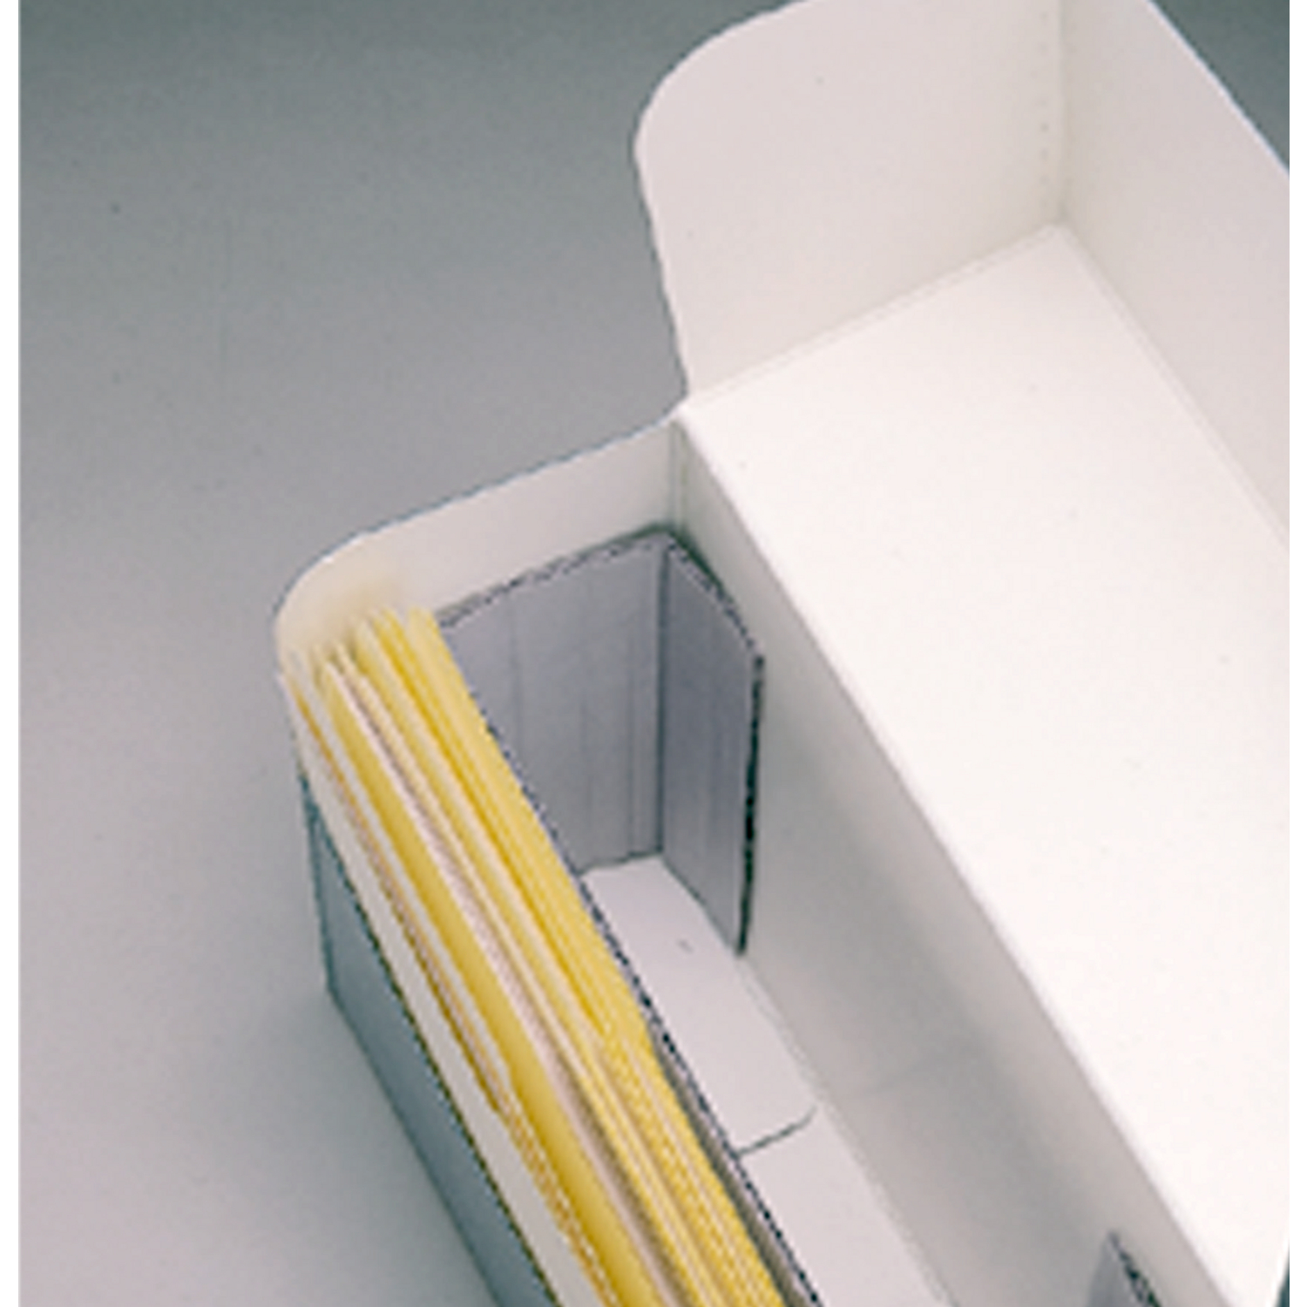
Folders
Polyester l-velopes
Spacer boards
Images from Gaylord Archival
Notes:
Folders: Paper-based records within a storage box are typically organized and protected in folders or other enclosures.
Polyester L-Sleeves: Protect a very brittle, badly torn, or otherwise fragile record during handling with a polyester film sleeve sealed along two adjacent edges, commonly called an “L-sleeve.” Only sleeve a damaged record that needs extra support for safe handling, or a smaller item that could become lost, overlooked, or misfiled when left loose among other larger records.
Spacer boards: Records bend and slump in an underfilled box, eventually becoming curved and distorted. se a corrugated acid-free spacer board in an underfilled archives box to keep records upright. A slight gap of two inches or less that allows a gentle curve is acceptable; use a spacer board to prevent significant curl and bending.

Slide 9
Paper vs. Plastic
Paper​ | Plastic​
Alkaline buffering​ | Inert​
Physical support​ | Limited physical support​
Opaque​ | Translucent/transparent​
Requires removal for use​ | Easy handling and viewing​
Protection from light, dust​ | No light protection​
Less expensive​ | More expensive​
 | Adds weight and bulk​

Slide 10
Acceptable archival paper
Used for long-term storage (like folders), interleaving, or making copies
Acid-free: A pH of 7 or higher (ideally, neutral pH)
Lignin-free: Lignin is a naturally occurring acid in plant fibers that causes yellowing and brittleness. No groundwood or unbleached pulp or optical brighteners (OBAs)
Natural Fibers: e.g., 100% cotton rag paper or pure alpha cellulose fibers

Slide 11
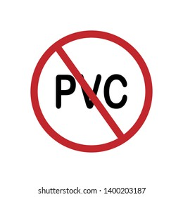
Acceptable Plastics
Polyester film (1960) ​
  DuPont Mylar D​
  ICI Mellinex 516​
Polyethylene (1942) High density (HDPE)​
Polypropylene (1957)​
Must pass PAT test for photographic materials
Polyvinyl Chloride (PVC)
Notes:
Clear plastic enclosures are useful for items that are delicate or frequently handled. Clear plastic provides no protection from light, so items in these enclosures should be placed in boxes for long-term storage. Polyester is used for folders, sleeves, and envelopes. Polypropylene is used for containers. Polyethylene for sleeves and bags is flexible and frosted.
Polyester
It's strong, see-through, and doesn't have any color. Because it doesn't react with other chemicals, it's great for preservation. You'll often find it as clear sheets or film used to make things like folders, protective sleeves for documents (encapsulation), and book covers. The thickness of the plastic is measured in "mils" (very tiny units). You might know it by brand names like Mylar® or Melinex®
Polyethylene
This is a type of plastic that's flexible, clear (or partly clear), and doesn't react with other chemicals. It's used in preservation to make protective sleeves for photos, among many other things.
Polypropylene
A stiff, heat-resistant, chemically inert plastic. Common uses in preservation include sleeves for photographic materials.
Polyvinyl Chloride (PVC)
A plastic, often abbreviated as PVC. It is not as chemically stable as some other plastics and will emit hydrochloric acid (which, in turn, can damage library materials) as it deteriorates. It is not safe for the preservation of any materials. S
Polyvinyl Chloride (PVC)
A plastic, often abbreviated as PVC. It is not as chemically stable as some other plastics and will emit hydrochloric acid (which, in turn, can damage library materials) as it deteriorates. It is not safe for the preservation of any materials.

Slide 12
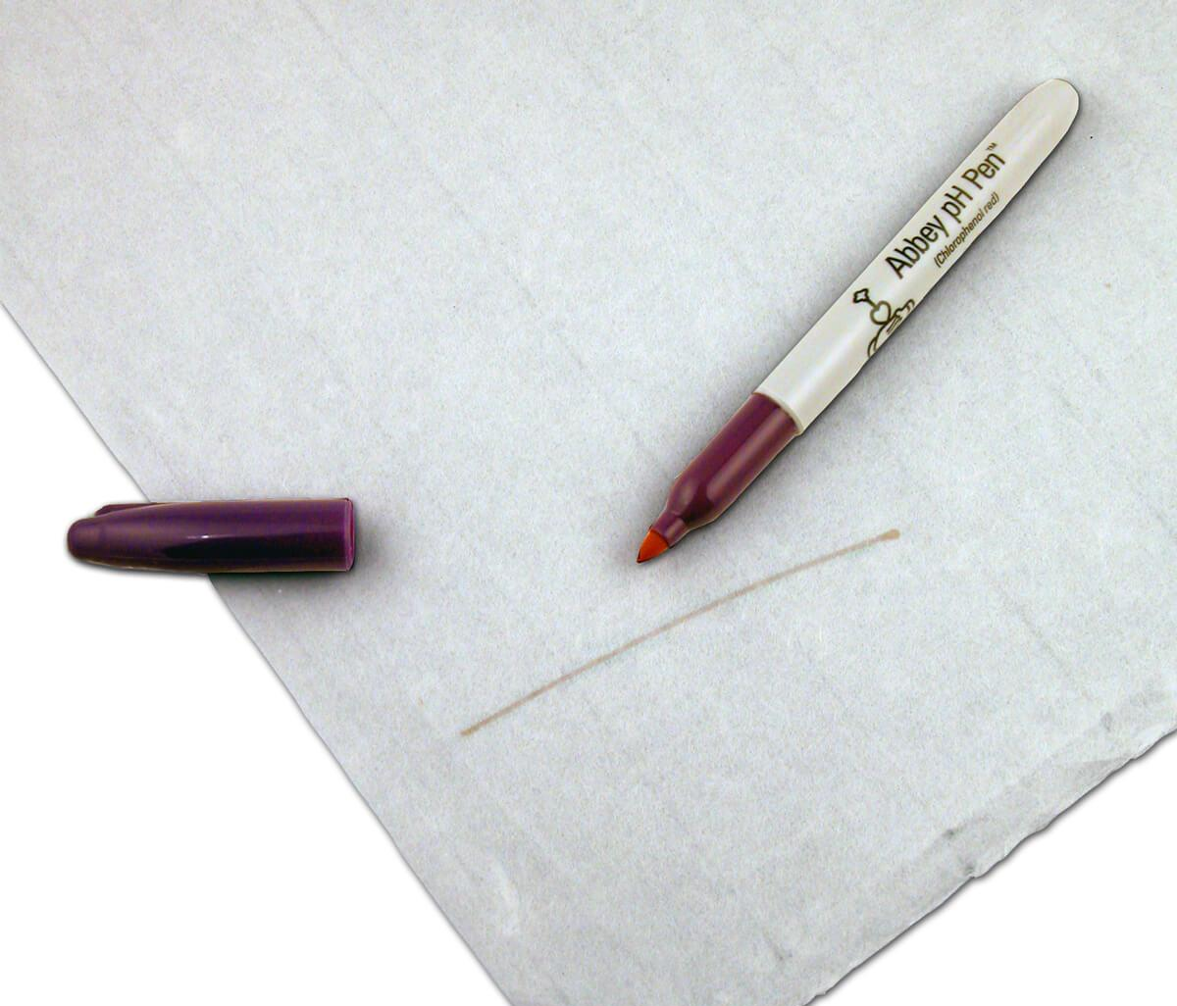
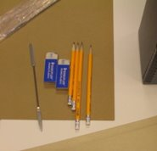
Purchasing Supplies
Order from conservation (or library) suppliers ​
Do not accept substitutions​
Remember the terminology​
  “Acid-free” ≠ “lignin-free”​
  “Photo-safe” ≠ passed the PAT​
  Archival ≠ fade-proof​
Test purchases​
  pH testing pen
Notes:
Storage containers should be made of materials that are strong, durable, and chemically stable. Enclosures should be tailored to the size, condition, and use of the items being enclosed. Evaluate the specific characteristics of each product and chose the appropriate ones. You should consider the acidity, alkalinity, and the presence of lignin.
Neutral: having a pH 7; neither acidic nor alkaline—supplies should be between 7-8.5
Be an educated consumer

Slide 13
Archival Supplies Vendors
Purchase from reputable companies
Conservation Resources
Gaylord Archival
Hollinger Metal Edge
Light Impressions
University Products
Sometimes Amazon and the Container Store (boxes, folders, and enclosures in their photo storage section)

