Slide 1
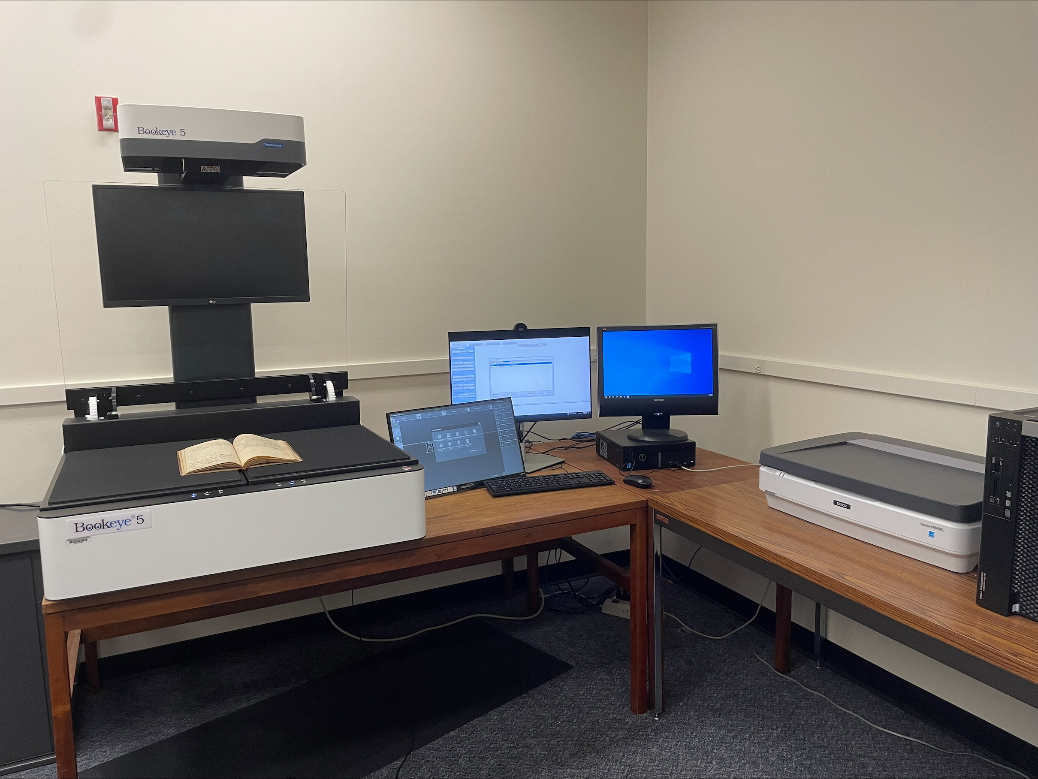
BUILDING DIGITAL ARCHIVES WITH MINIMAL STAFFING: OUTREACH PRESENTERS: ASHLEY HOWDESHELL, NORTHEASTERN ILLINOIS UNIVERSITY AND REBECCA FITZSIMMONS, ILLINOIS STATE UNIVERSITY
"SIUE Digitization Lab" by Marcella Lees used under CC0
Zoom’s live transcript is available on the Show Captions menu.
Notes:
<CARLI Staff set up:>
<CARLI Staff: Enable transcription>
<CARLI Staff: Give presenters co-host permissions>
<NAME will be progressing slides>
<CARLI Staff: Watch for access issues (RT and email)>
<start recording>
<NAME: Welcome>
Hello everyone, I’m NAME from INSTITUTION and am a member of the CARLI Archives Task Force. We are pleased to welcome you all to this 2-day Building Digital Archives with Minimal Staffing program.
<NAME: Introduction>
Just a few reminders:
A few reminders:
Please ensure your microphones are muted.
We will be recording the program today. Once we’ve had the opportunity to add captions for accessibility, we will be sharing the recording along with any handouts on the CARLI website. We will share the link when it is available with the attendees.
Questions will be taken at the end of each program and are welcome via the chat box or by unmuting. If you are unmuting, please also share your video if you are able. It helps those of us who benefit from lip reading.
We are not enabling Zoom’s AI Companion features during this session, but Otter.ai transcription is enabled. Select Show captions at the bottom of the screen to turn on captions, or from the Show Captions arrow menu you can select view full transcript.
<NAME: Introduction>

Slide 2
ATTRIBUTION
Except where otherwise noted, this presentation “Building Digital Archives with Minimal Staffing: Outreach” created by Rebecca Fitzsimmons and Ashley Howdeshell is © 2025 by Rebecca Fitzsimmons and Ashley Howdeshell and is released under a Creative Commons Attribution-NonCommercial-ShareAlike 4.0 International License.
Notes:
Please update with author and license information.

Slide 3
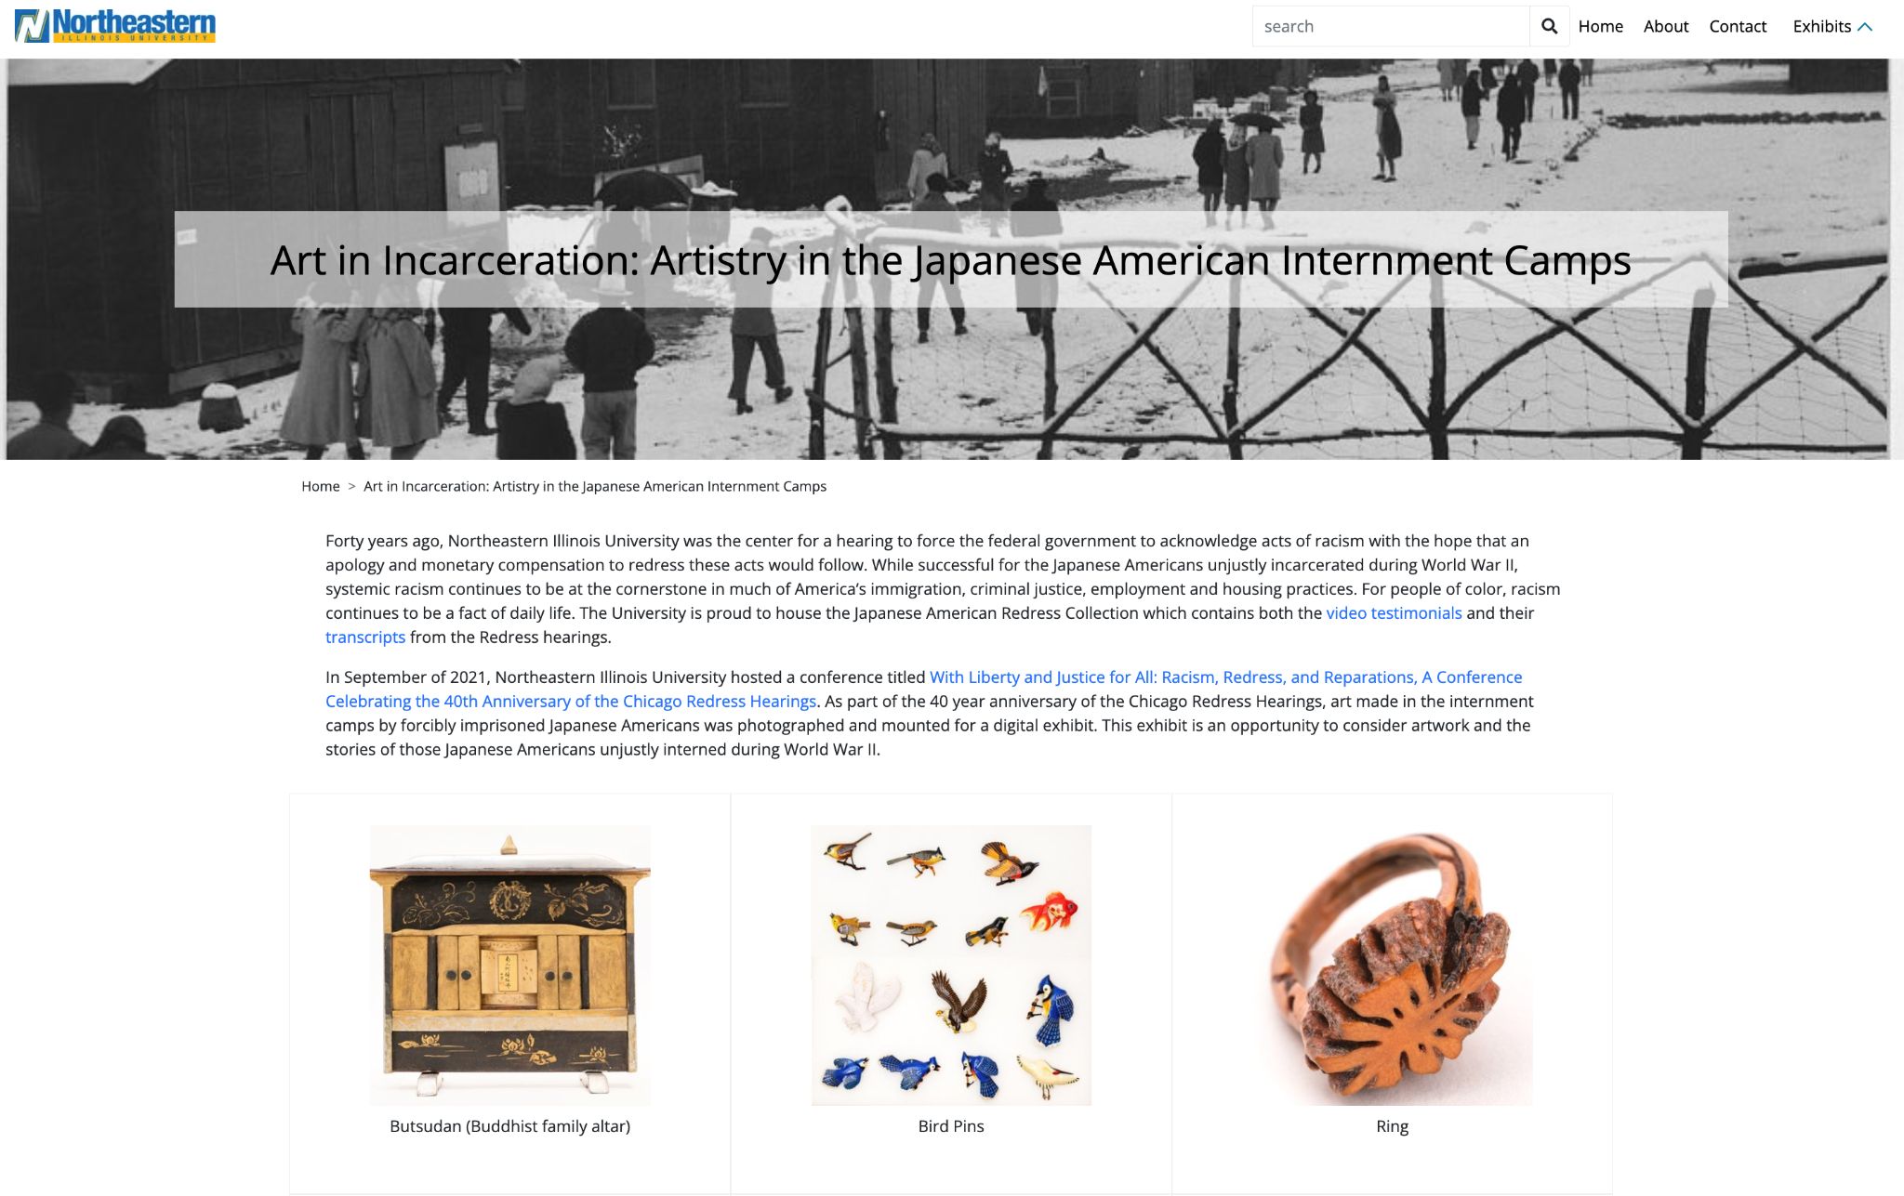
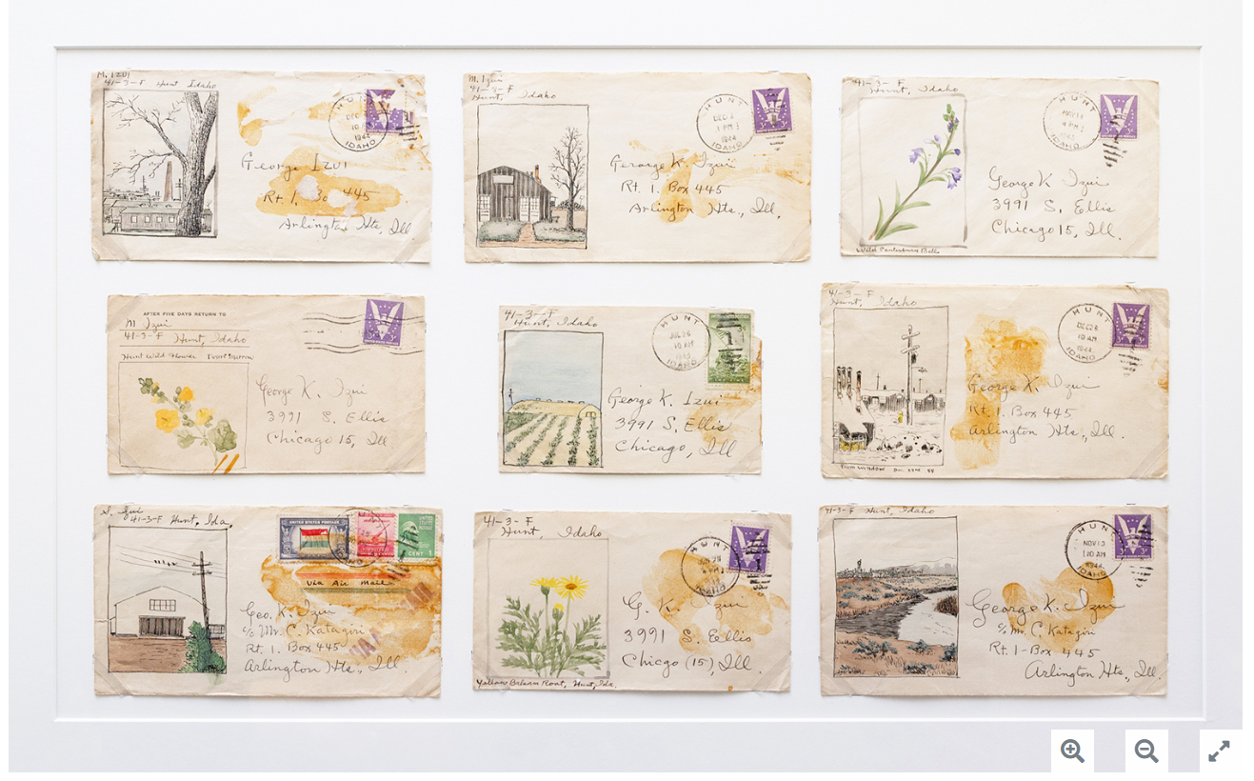
Digital Commons and Exhibits
1981: NEIU hosted the CWRIC hearing on Executive Order 9066 and Japanese American internment
NEIU Archives holds collections on internment camps and post-war resettlement
A physical exhibit of internment camp art objects was created for the 2021 conference, with some pieces now in the Archives collections
The digital exhibit recreated in Digital Commons has increased engagement with both physical and digital collections, offering deeper human context
Collections are now widely used by high school students during the Chicago Metro History Fair
Images: Digital Commons exhibit Art in Incarceration: Artistry in the Japanese American Internment Camps

Slide 4
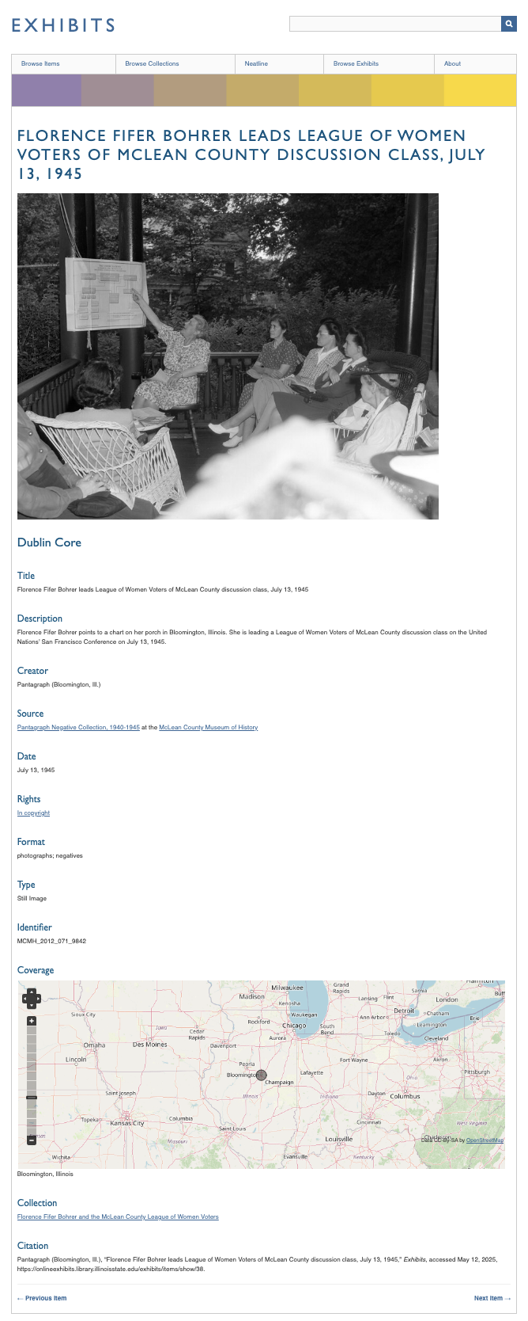
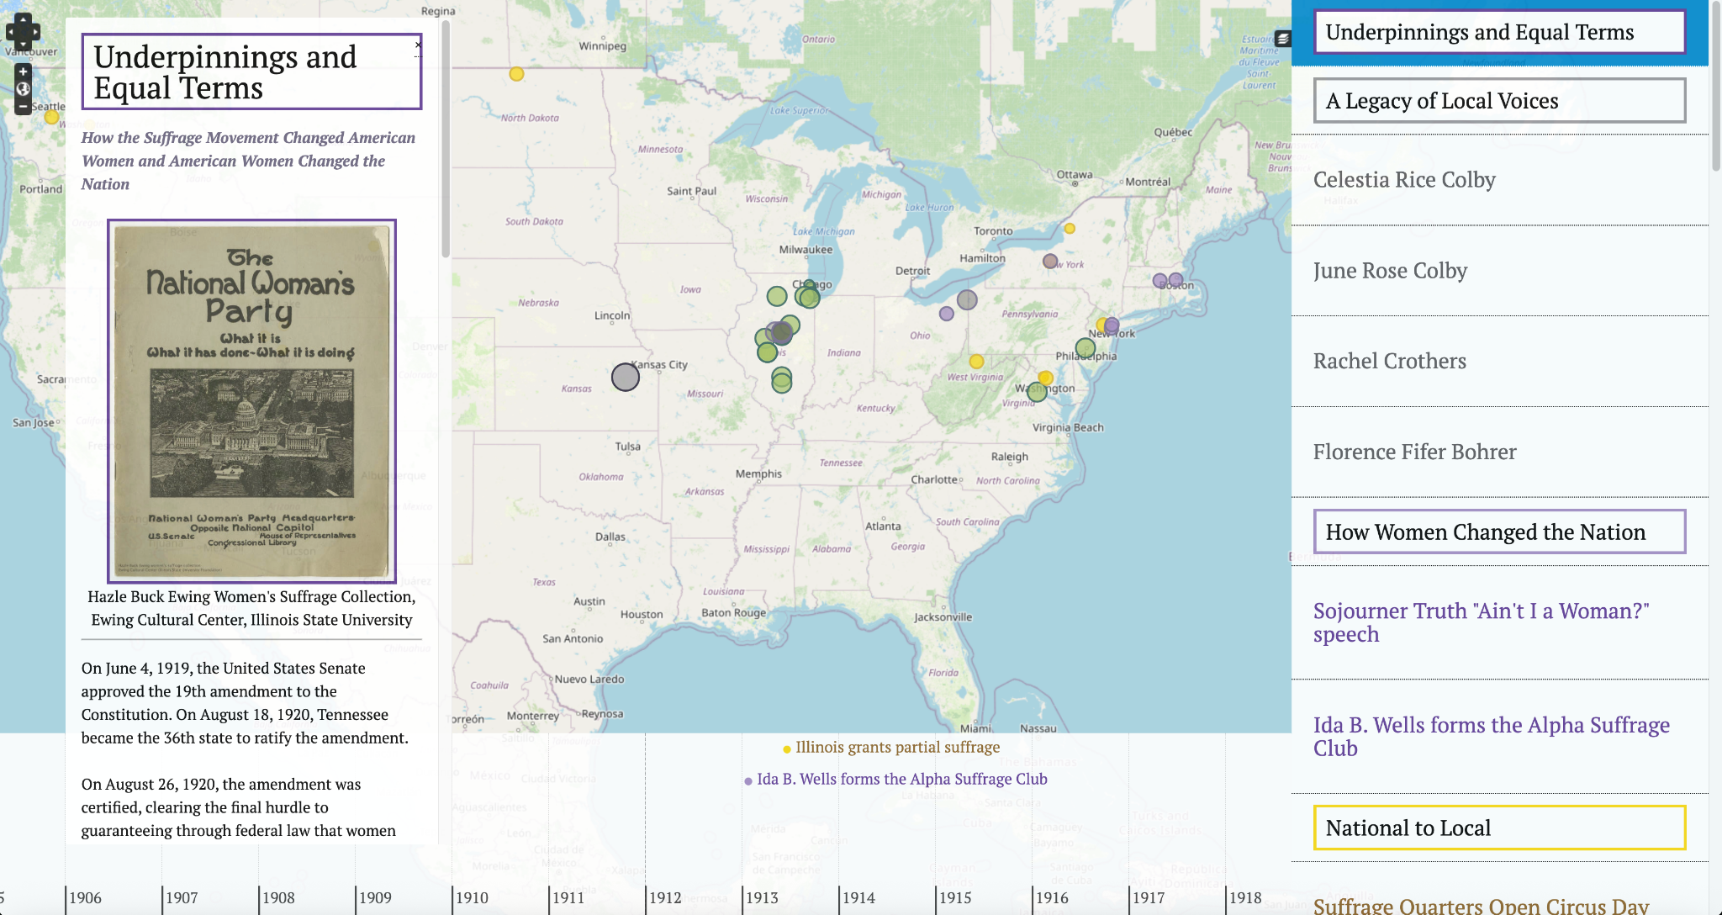
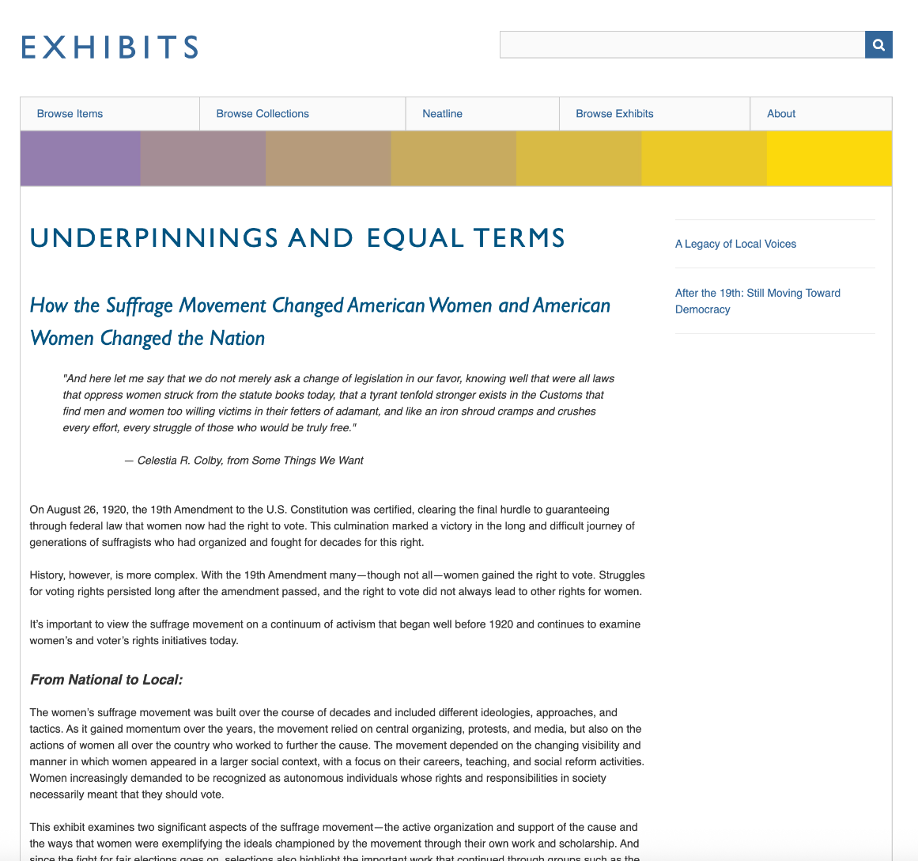
Building Exhibits in Omeka
Underpinnings and Equal Terms: How the Suffrage Movement Changed American Women and American Women Changed the Nation
Pair of digital exhibits built using Omeka Exhibit Builder and Neatline plugins
Uses materials from several collections
https://library.illinoisstate.edu/exhibits/ongoing/suffrage/

Slide 5
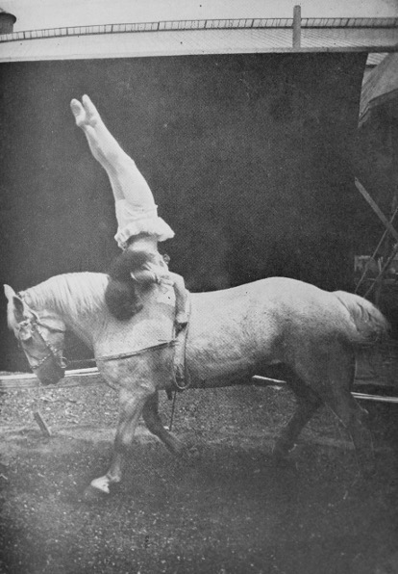
Teaching with digital exhibits
“There is no class of women who show better that they have a right to vote than the circus women, who twice a day prove that they have the courage and endurance of men.”
– Elizabeth Cook, Suffragist, 1912
Photos c. 1890s, 1917, and 1920 courtesy of Milner Library Special Collections and news clipping, New York Times, 1912 CC0 1.0

Slide 6
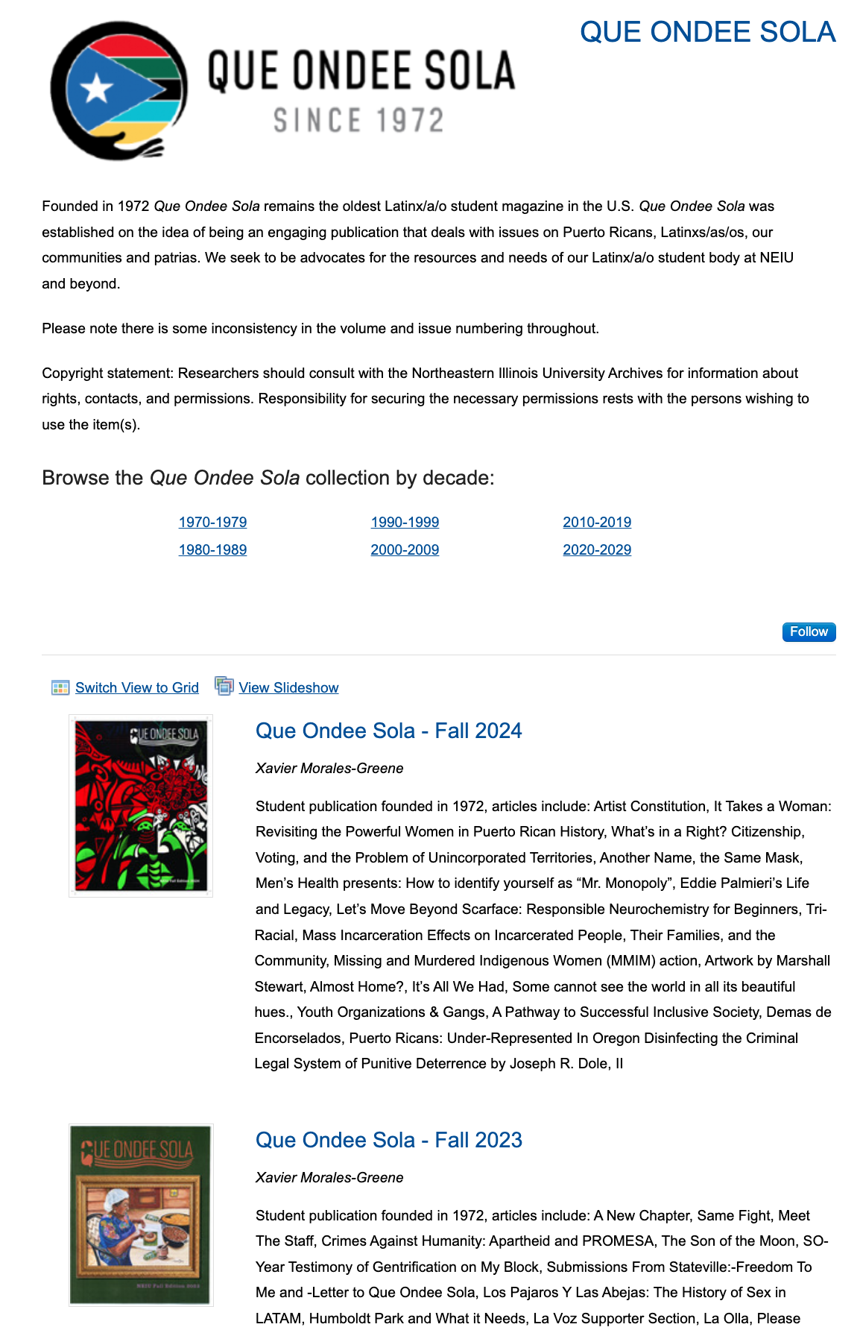
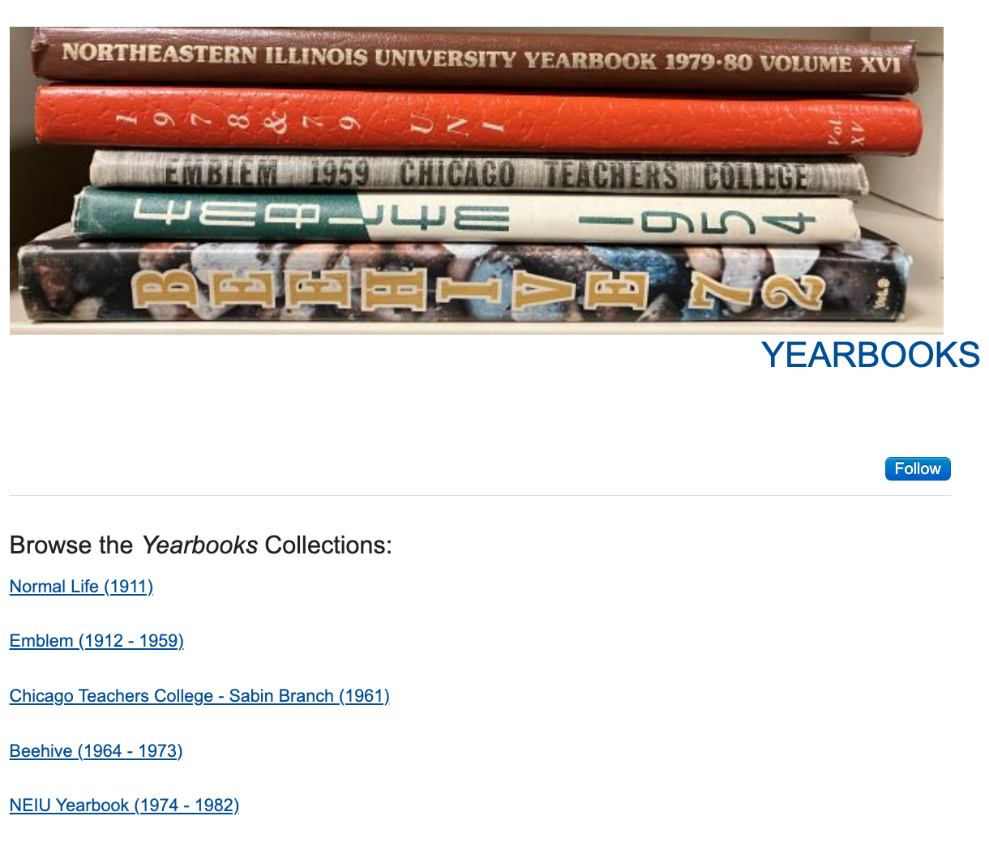
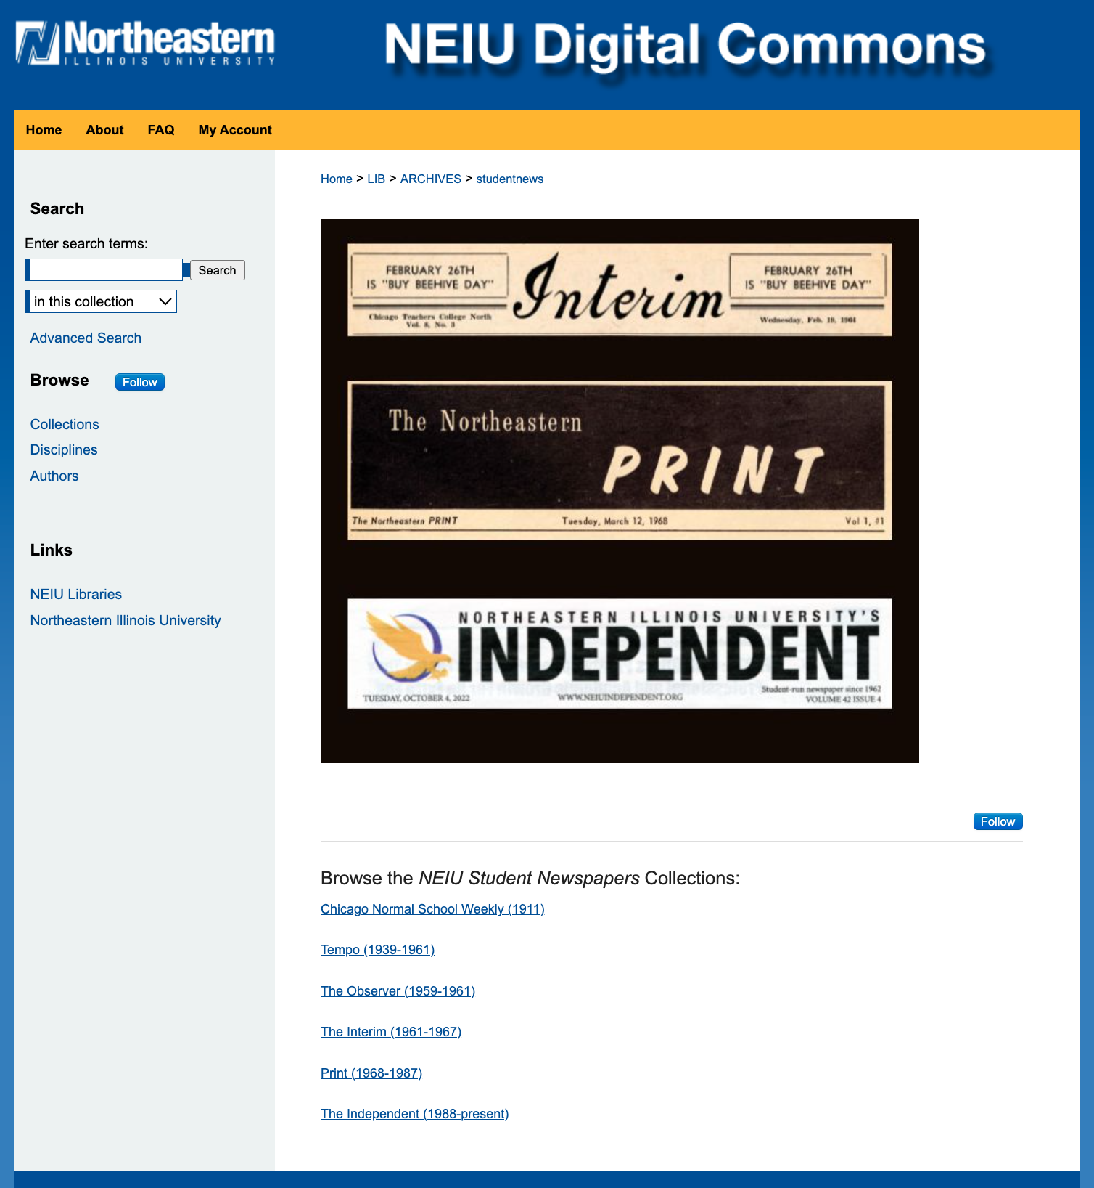
Teaching with Digital Collections - School of Education
Faculty member partnered with the Archives for a graduate-level assignment on teaching with primary sources
Graduate students were tasked with building a lesson plan that introduced students to using archival materials
With limited in-person availability, students used digital collections to begin their research and planning
During class, physical items selected from the digital collections were brought in to complete the activity
The accessibility of our digital collections made this teaching opportunity possible
Image: Student publications in the NEIU Digital Commons

Slide 7
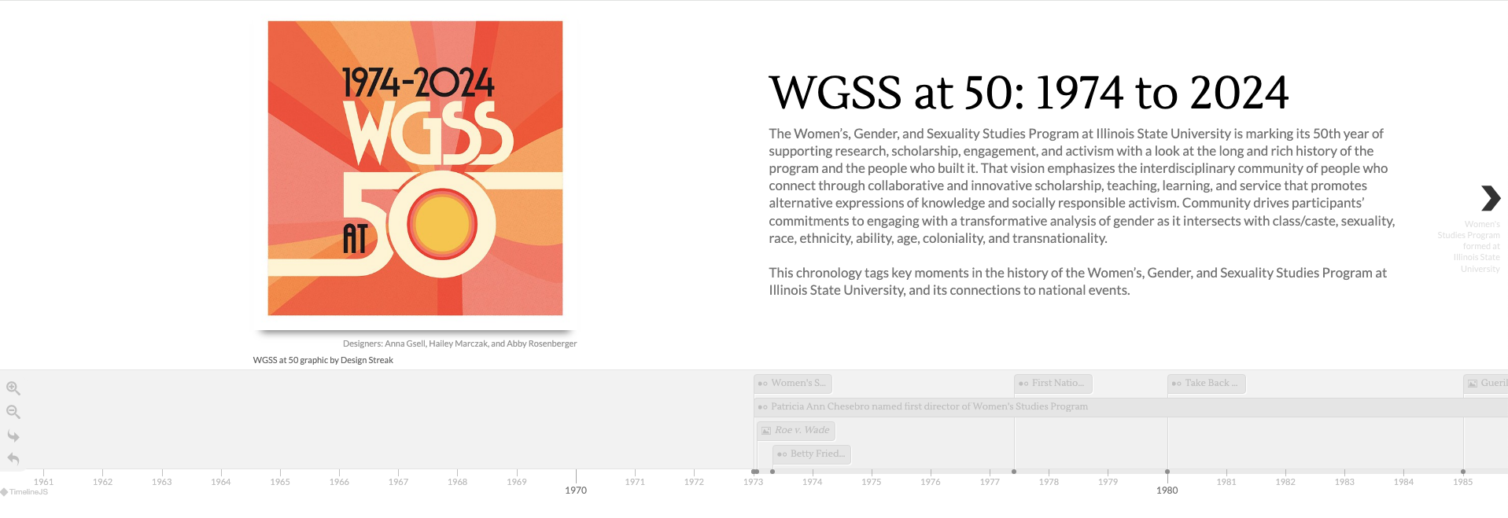
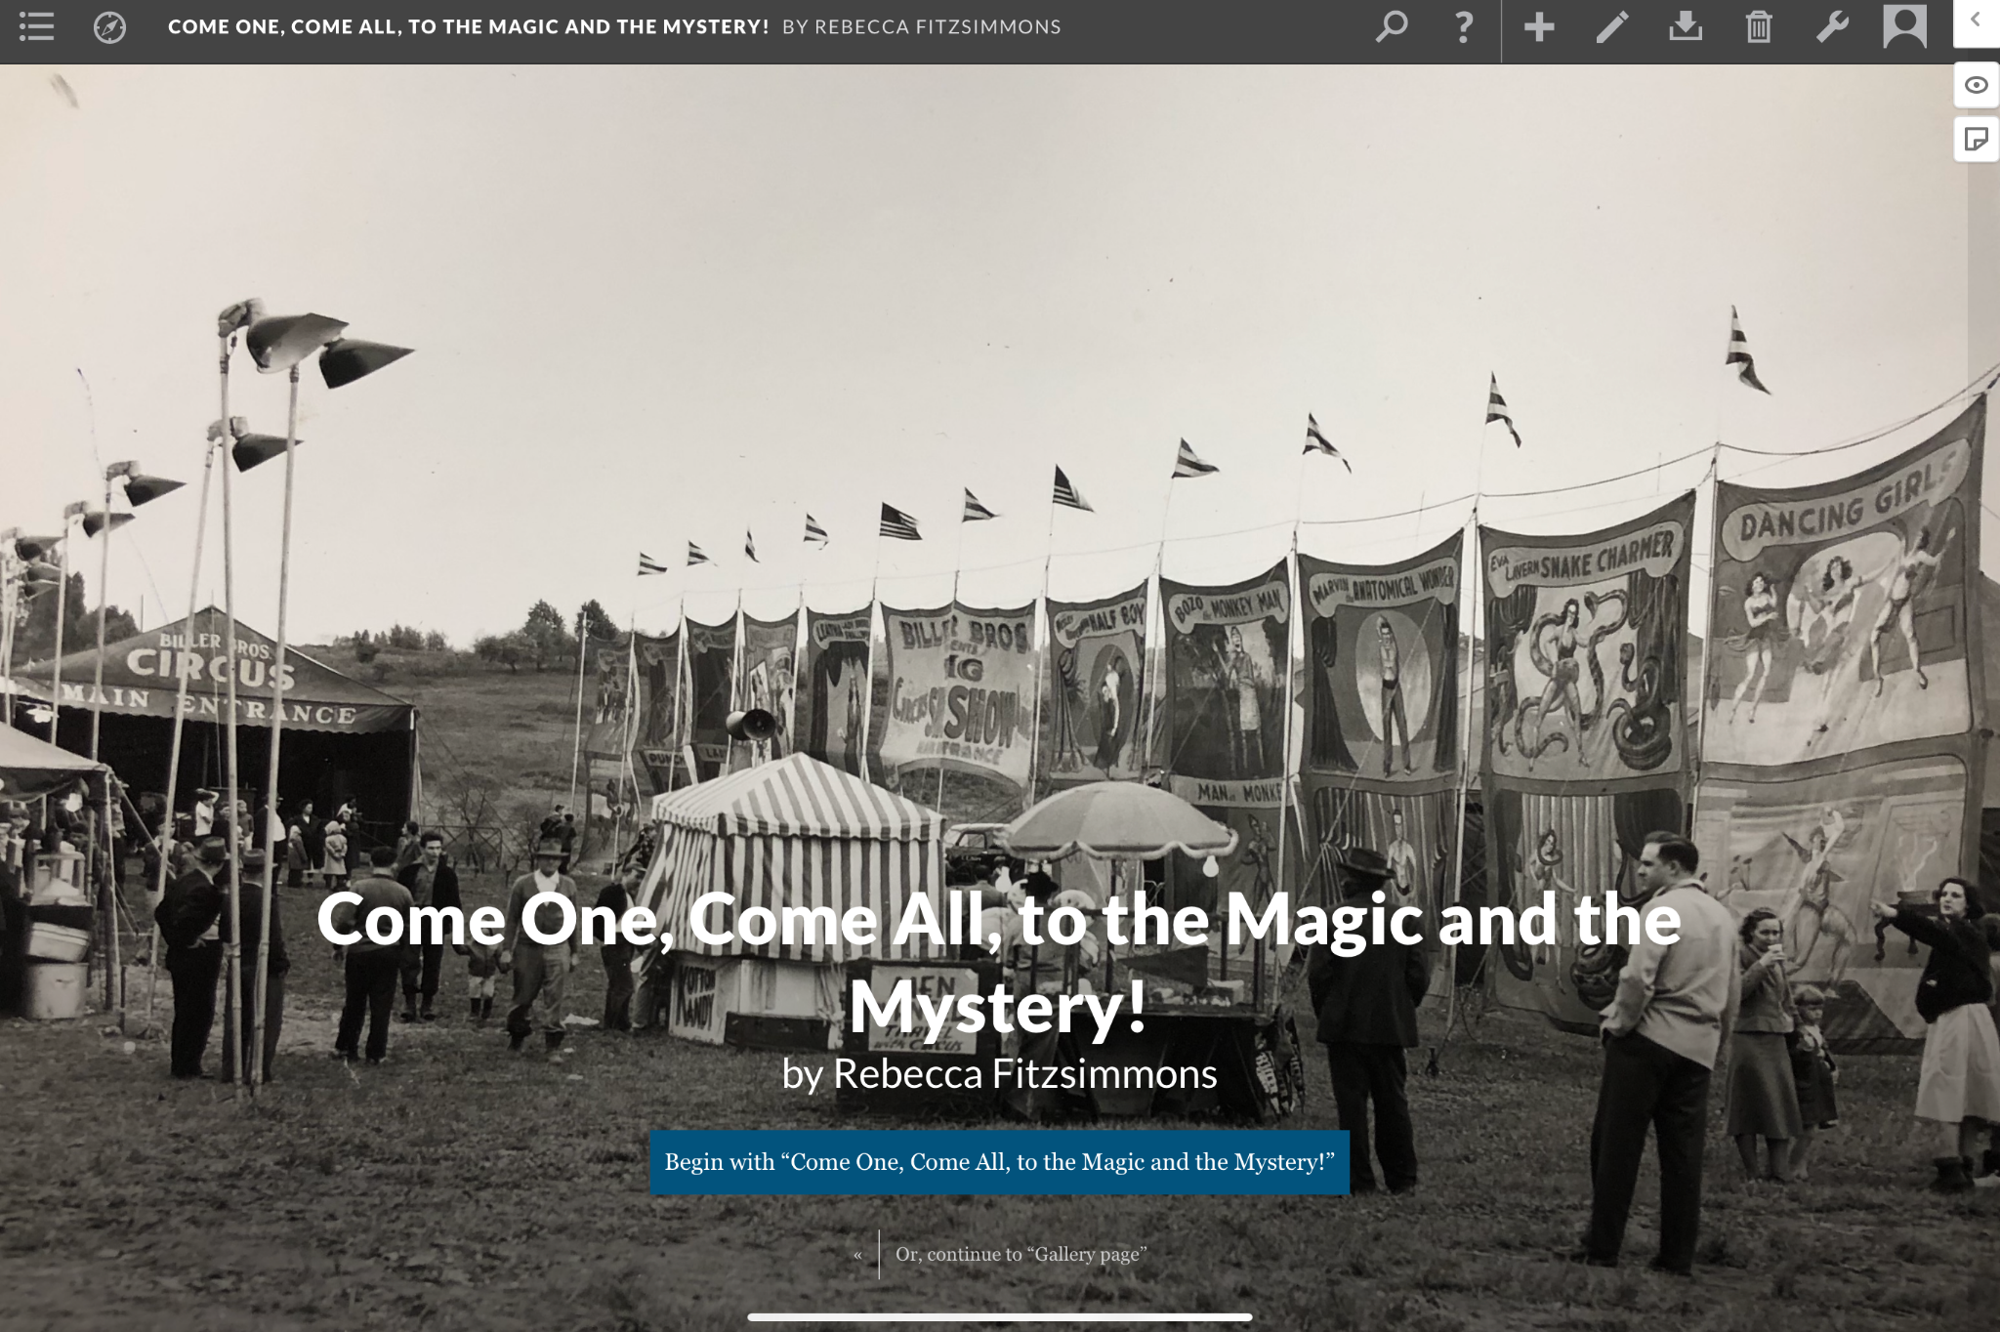
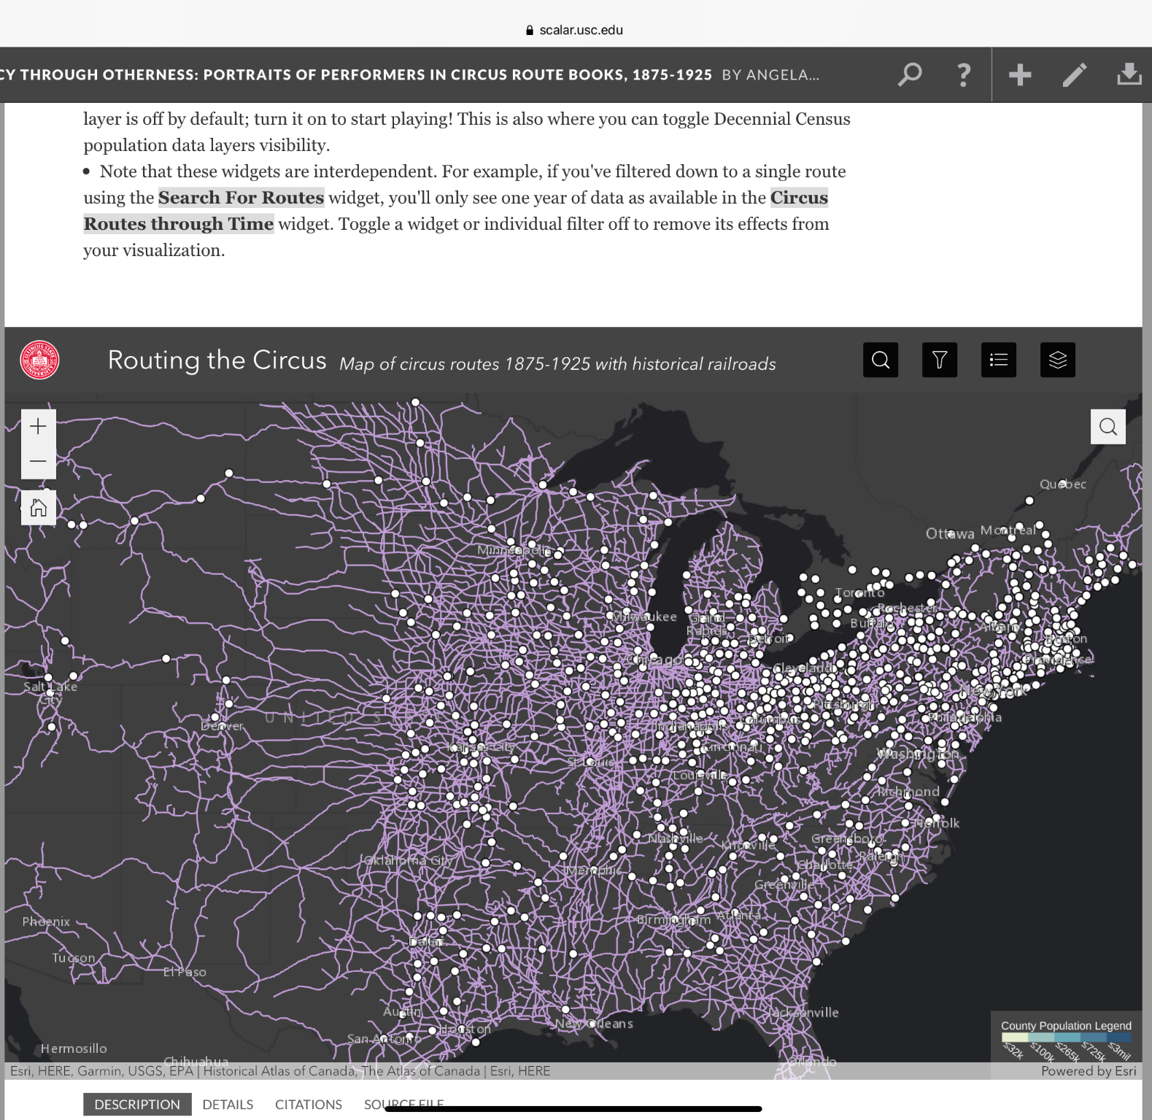
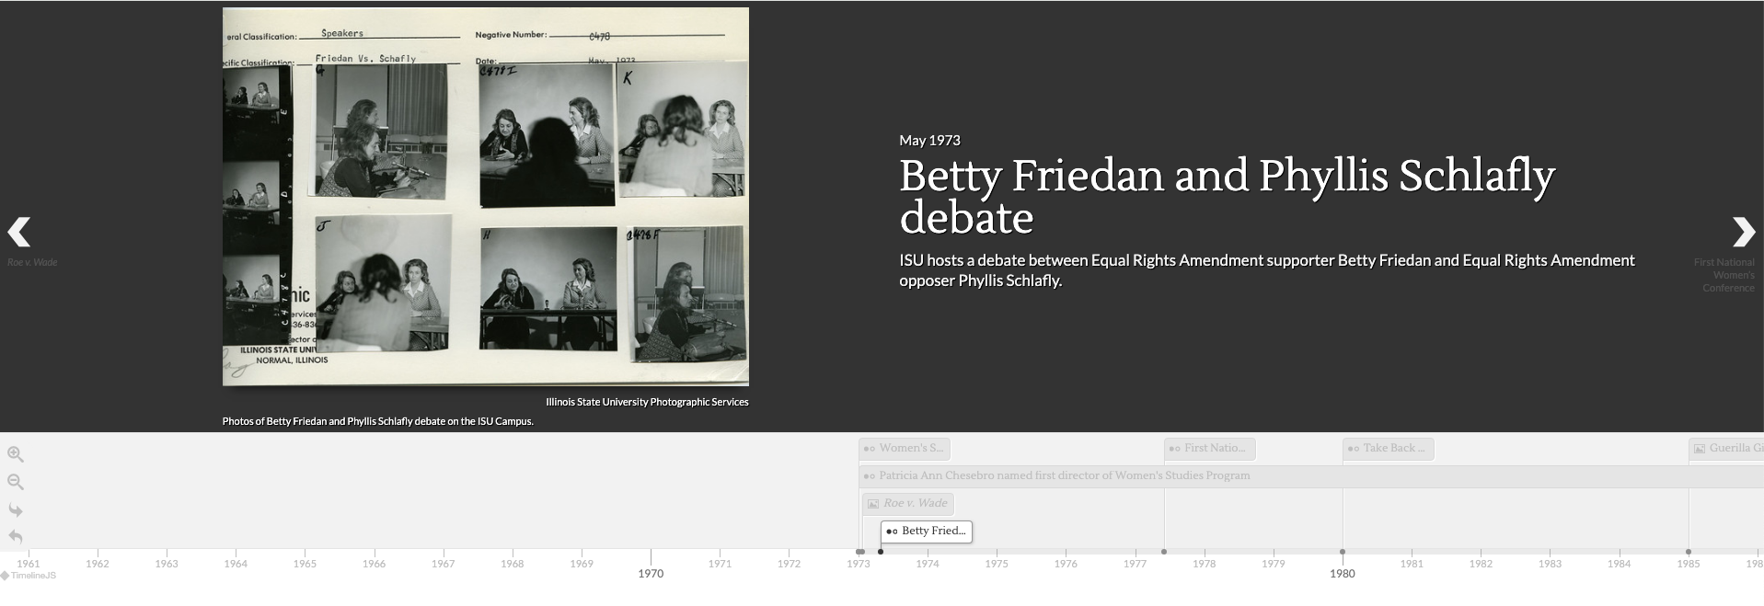
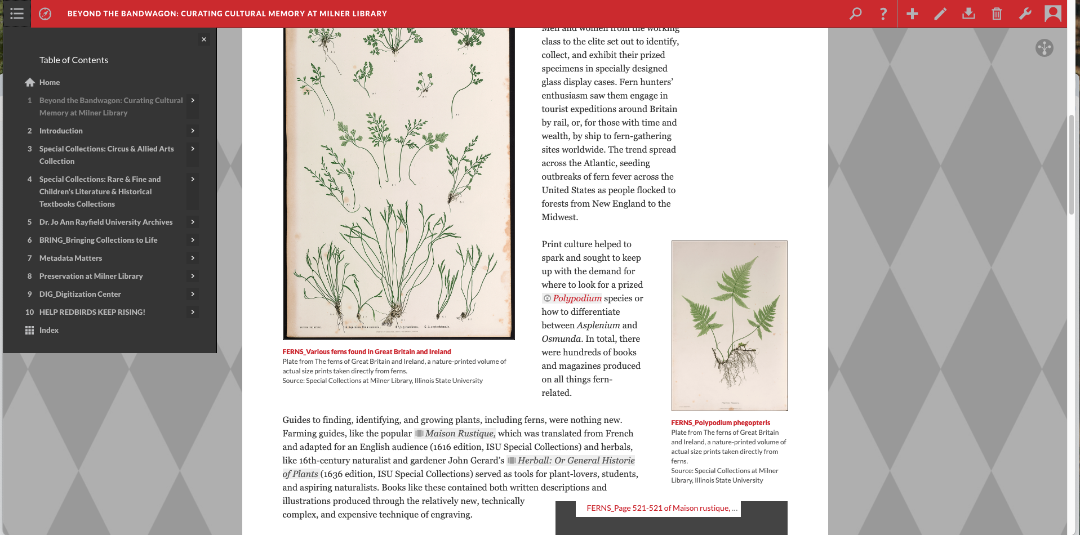
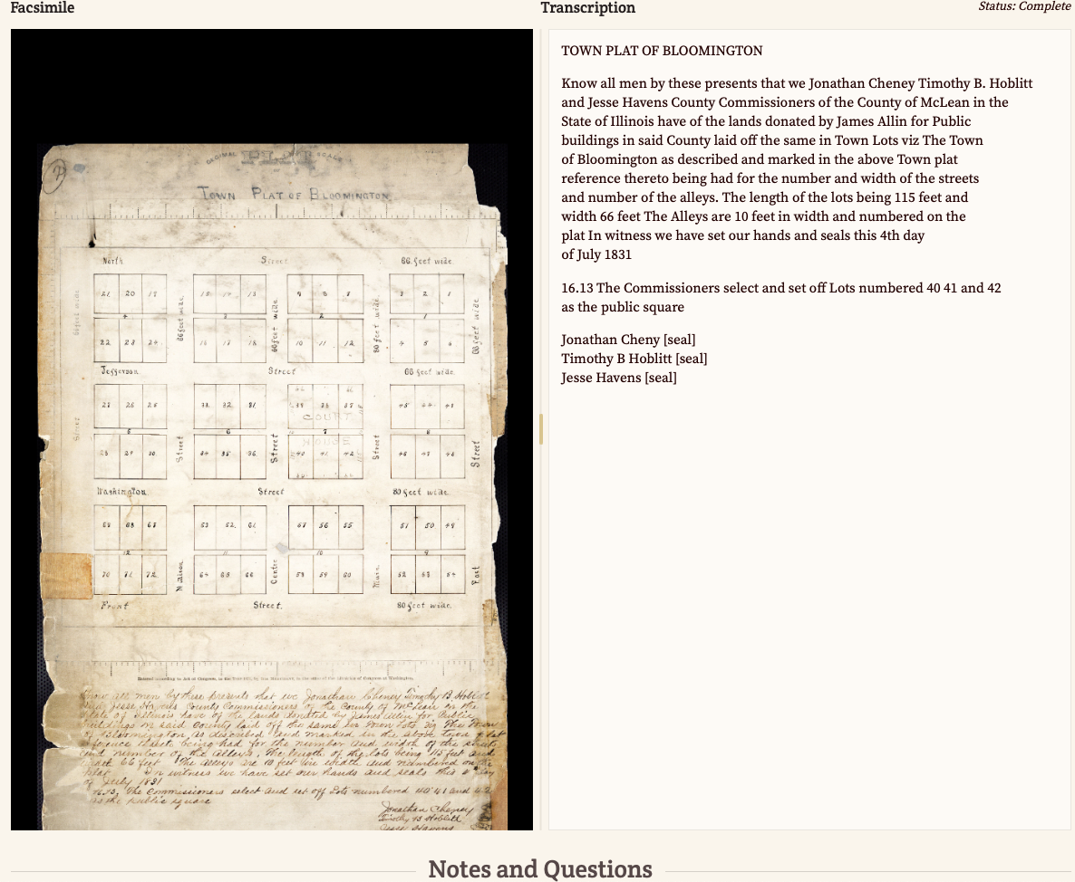
Additional platforms for leveraging your digital collections
Scalar
TimelineJS and other
Knight Lab platforms
From the Page
[transcriptions]
Above projects also use embedded ArcGis maps, Histropedia timelines, StoryMaps, etc. Also, check out your institutional platform for possible exhibit options!

Slide 8
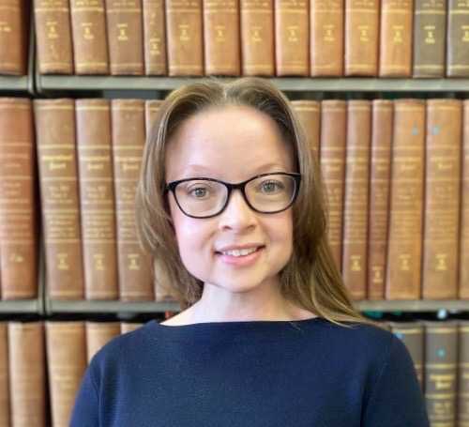
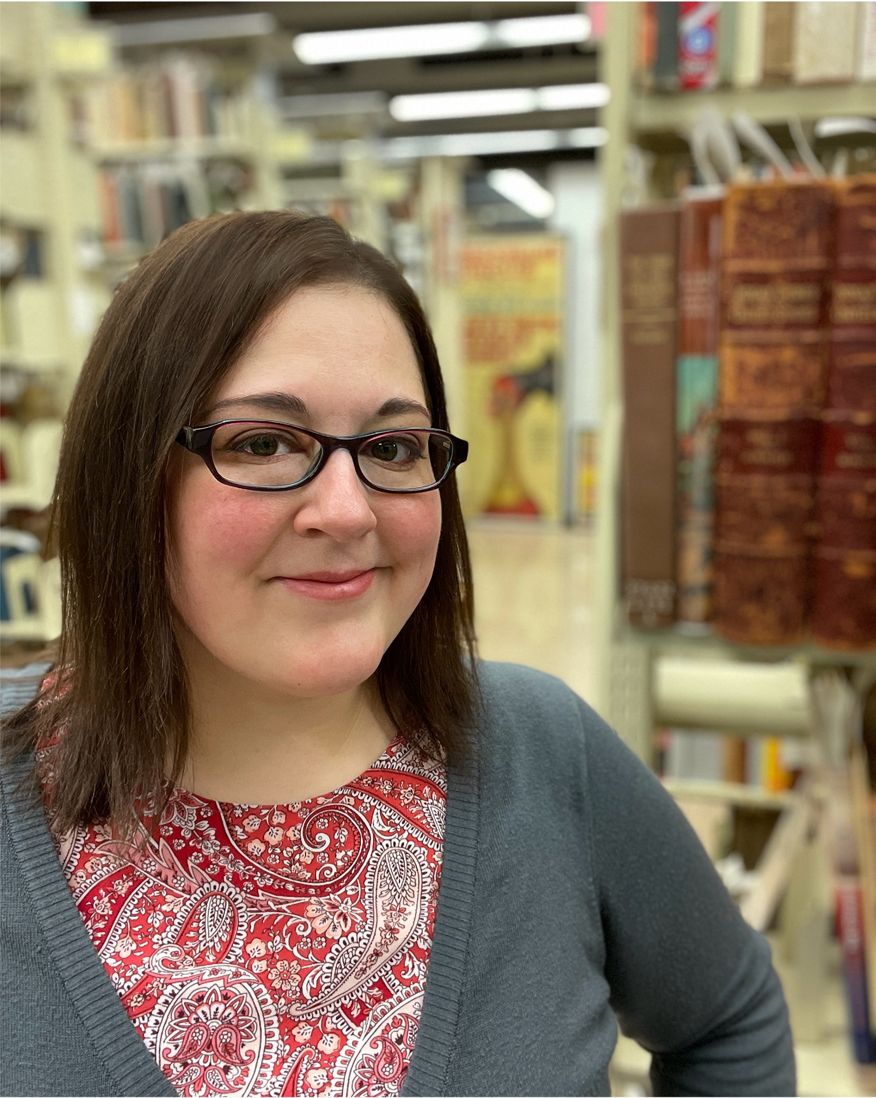
QUESTIONS?
Rebecca Fitzsimmons
Special Collections Librarian
Illinois State University
rlfitzs@ilstu.edu
Ashley Howdeshell University Archivist Northeastern Illinois University (NEIU) A-Howdeshell@neiu.edu

