Slide 1
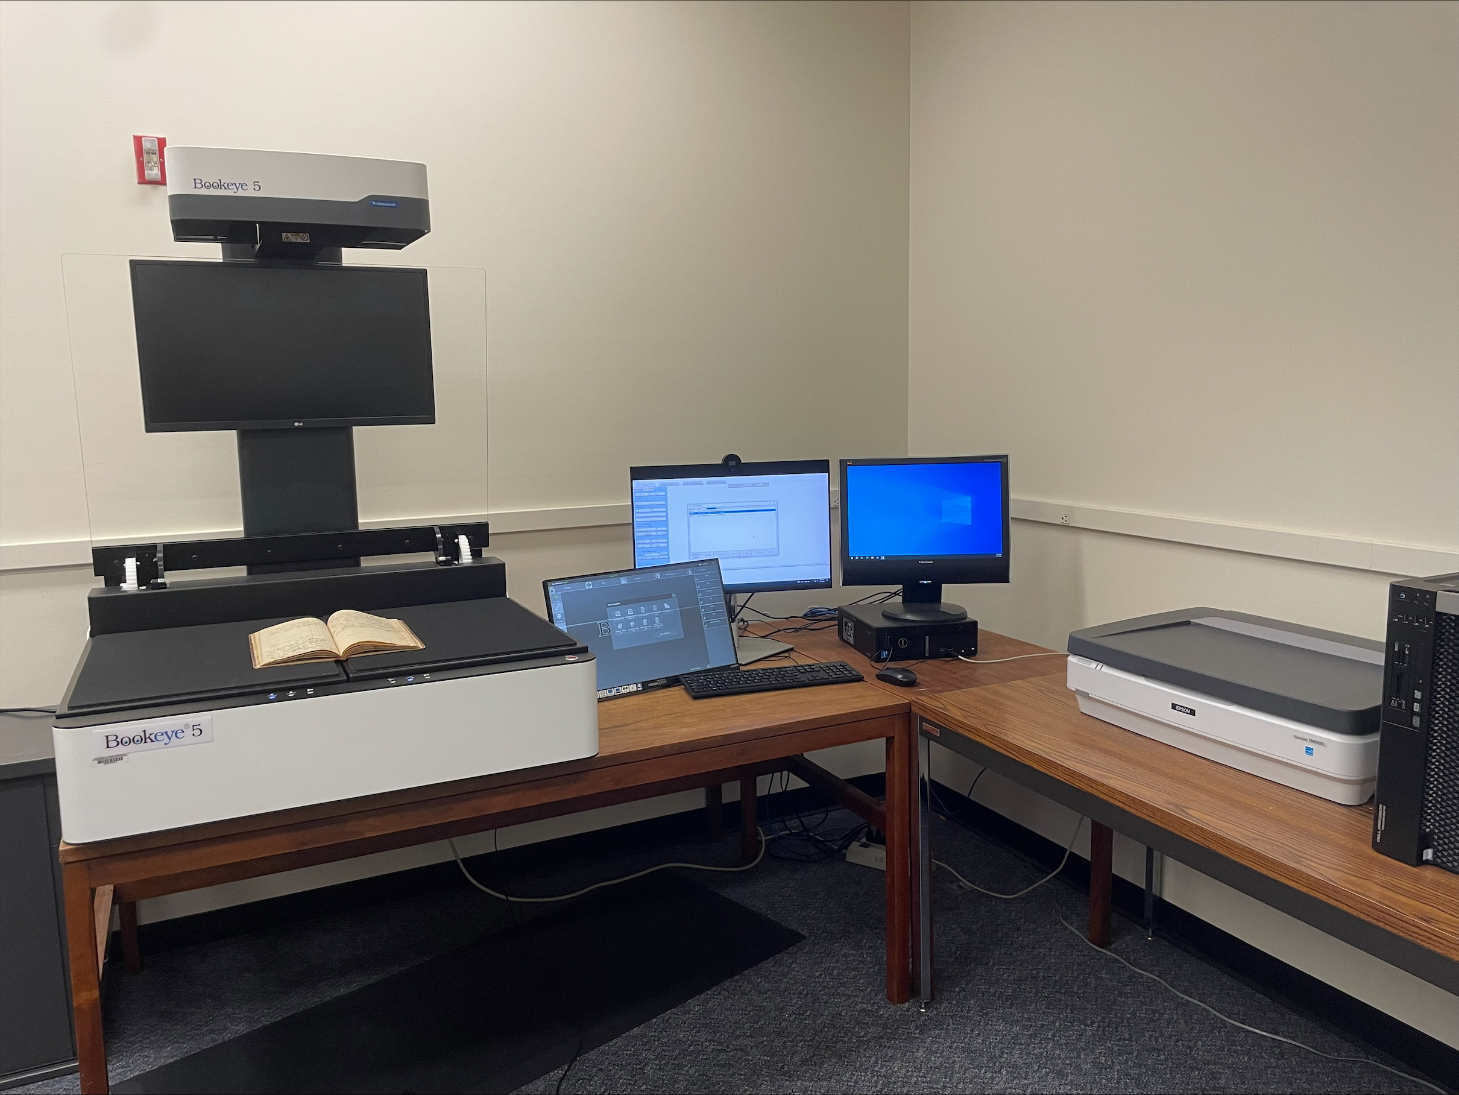
BUILDING DIGITAL ARCHIVES WITH MINIMAL STAFFING: PLATFORMS AND TOOLS – DEMONSTRATION OF OMEKA PRESENTER: REBECCA FITZSIMMONS, ILLINOIS STATE UNIVERSITY
"SIUE Digitization Lab" by Marcella Lees used under CC0
Zoom’s live transcript is available on the Show Captions menu.
Notes:
<CARLI Staff set up:>
<CARLI Staff: Enable transcription>
<CARLI Staff: Give presenters co-host permissions>
<NAME will be progressing slides>
<CARLI Staff: Watch for access issues (RT and email)>
<start recording>
<NAME: Welcome>
Hello everyone, I’m NAME from INSTITUTION and am a member of the CARLI Archives Task Force. We are pleased to welcome you all to this 2-day Building Digital Archives with Minimal Staffing program.
<NAME: Introduction>
Just a few reminders:
A few reminders:
Please ensure your microphones are muted.
We will be recording the program today. Once we’ve had the opportunity to add captions for accessibility, we will be sharing the recording along with any handouts on the CARLI website. We will share the link when it is available with the attendees.
Questions will be taken at the end of each program and are welcome via the chat box or by unmuting. If you are unmuting, please also share your video if you are able. It helps those of us who benefit from lip reading.
We are not enabling Zoom’s AI Companion features during this session, but Otter.ai transcription is enabled. Select Show captions at the bottom of the screen to turn on captions, or from the Show Captions arrow menu you can select view full transcript.
<NAME: Introduction>

Slide 2
ATTRIBUTION
Except where otherwise noted, this presentation “Building Digital Archives with Minimal Staffing: Platforms and Tools – Demonstration of Omeka” created by Rebecca Fitzsimmons is © 2025 by Rebecca Fitzsimmons and is released under a Attribution-NonCommercial-ShareAlike 4.0 International License.
Notes:
Please update with author and license information.

Slide 3
Omeka Classic and OmekaS
Hosted (Omeka Classic only): Omeka.net Self-hosted (Omeka S or Omeka Classic): Omeka.org

Slide 4
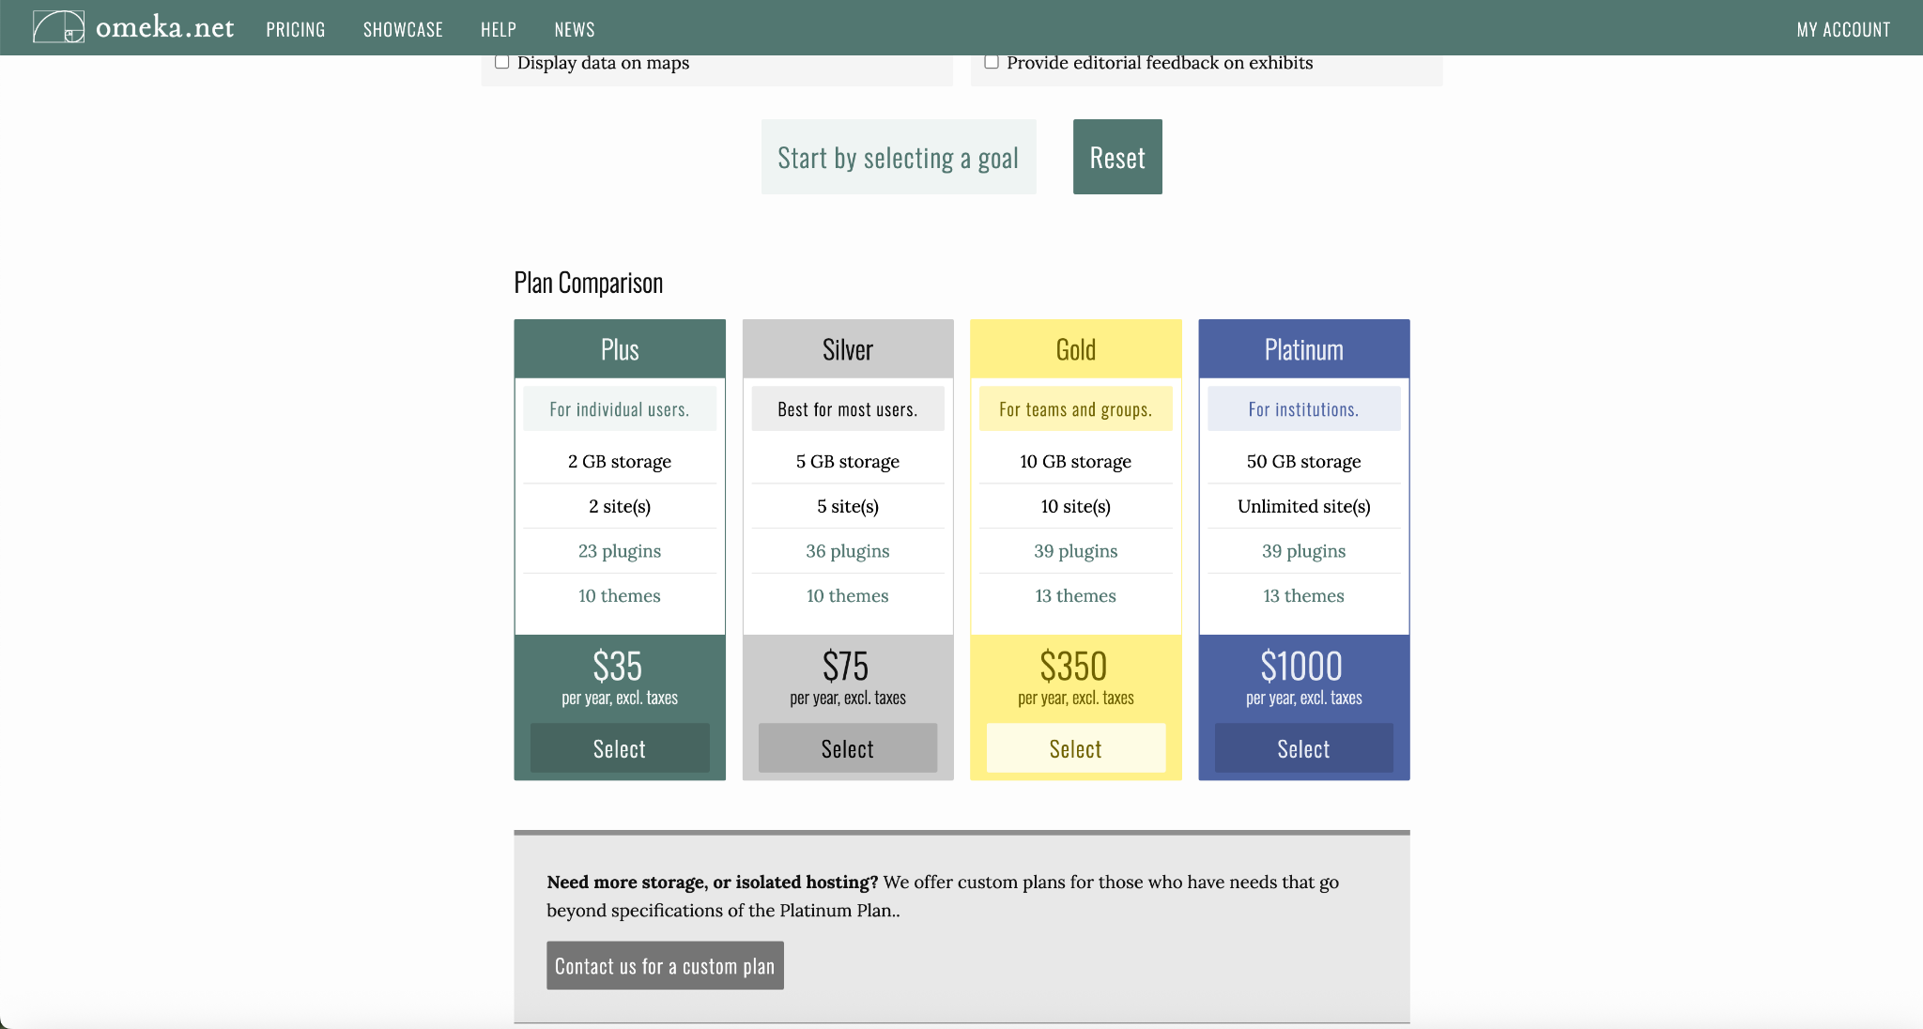
Omeka.net
Hosted (Omeka Classic only): Omeka.net
Pros:
Inexpensive
Doesn’t require much institutional IT maintenance
Range of plan options
Easy and fast to get started
Access to quite a few plugins, including Timeline, Maps, and Exhibit Builder
Cons:
Fewer options to customize
Limited plugins with some plans
No Omeka S, Classic only
Does not include some useful plugins such as Scripto (transcription) or Neatline (maps and timelines)

Slide 5
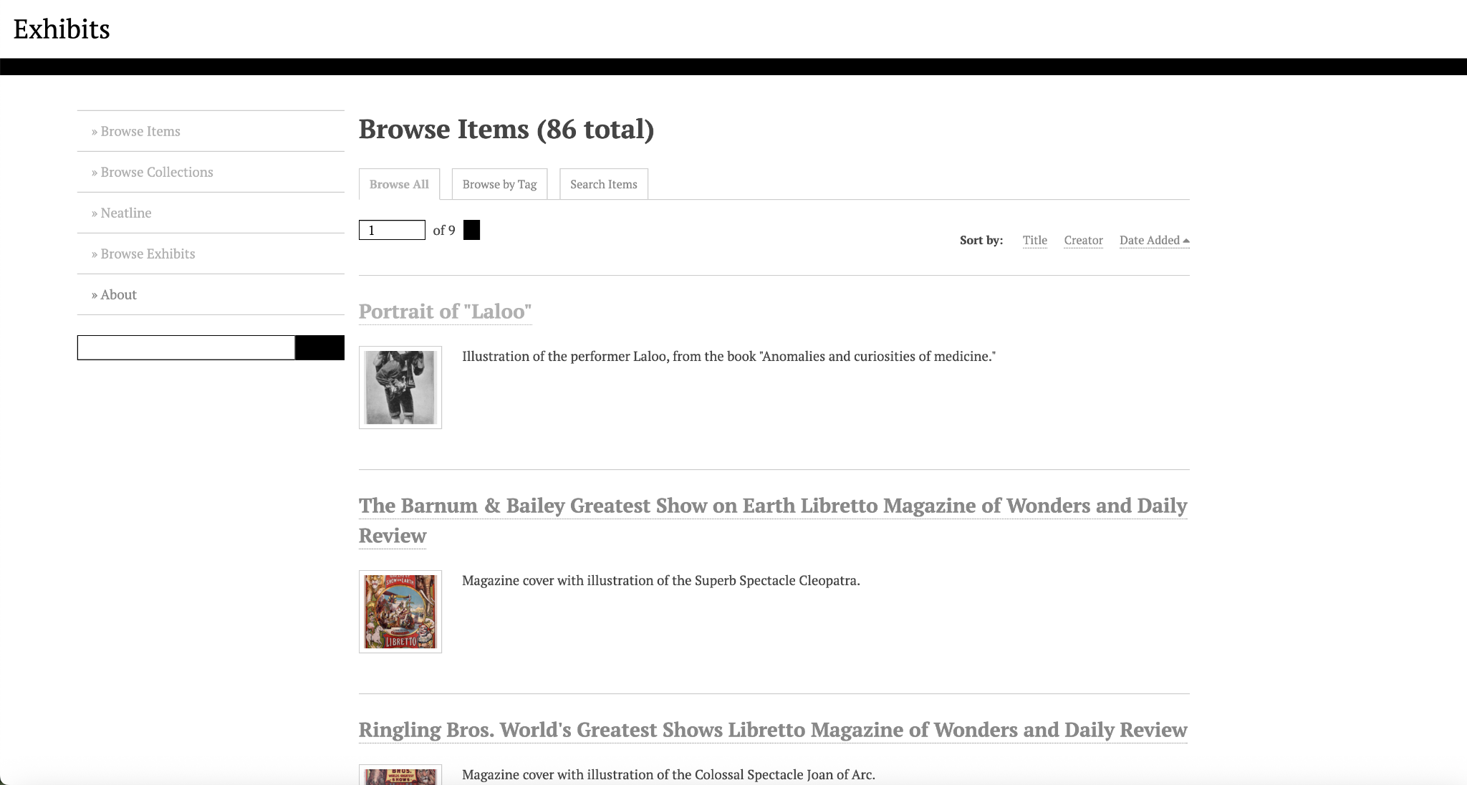
Platform demonstration

Slide 6
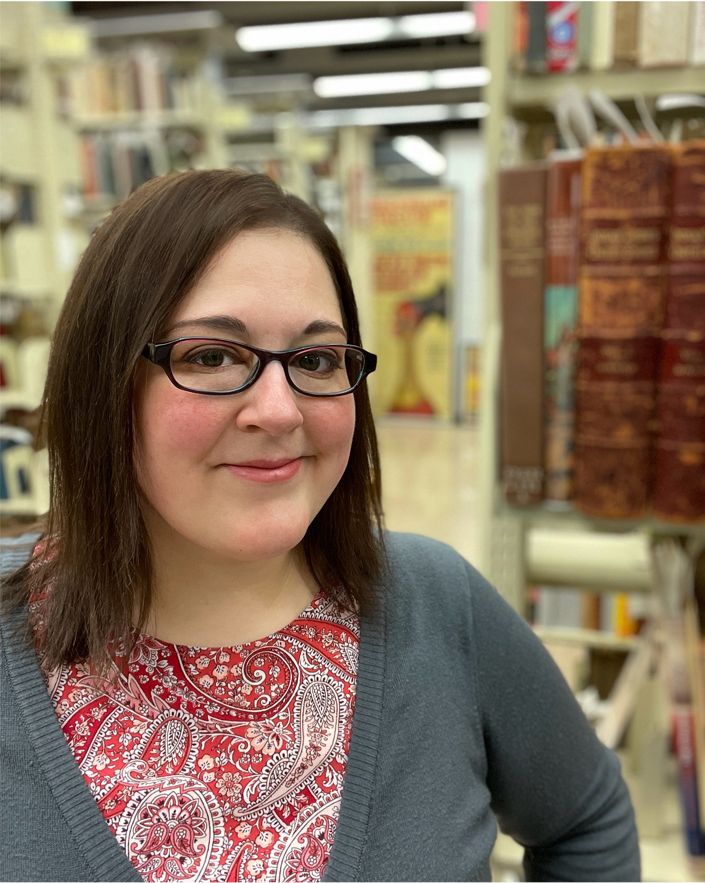
QUESTIONS?
Rebecca Fitzsimmons
Special Collections Librarian
Illinois State University
rlfitzs@ilstu.edu

