Slide 1
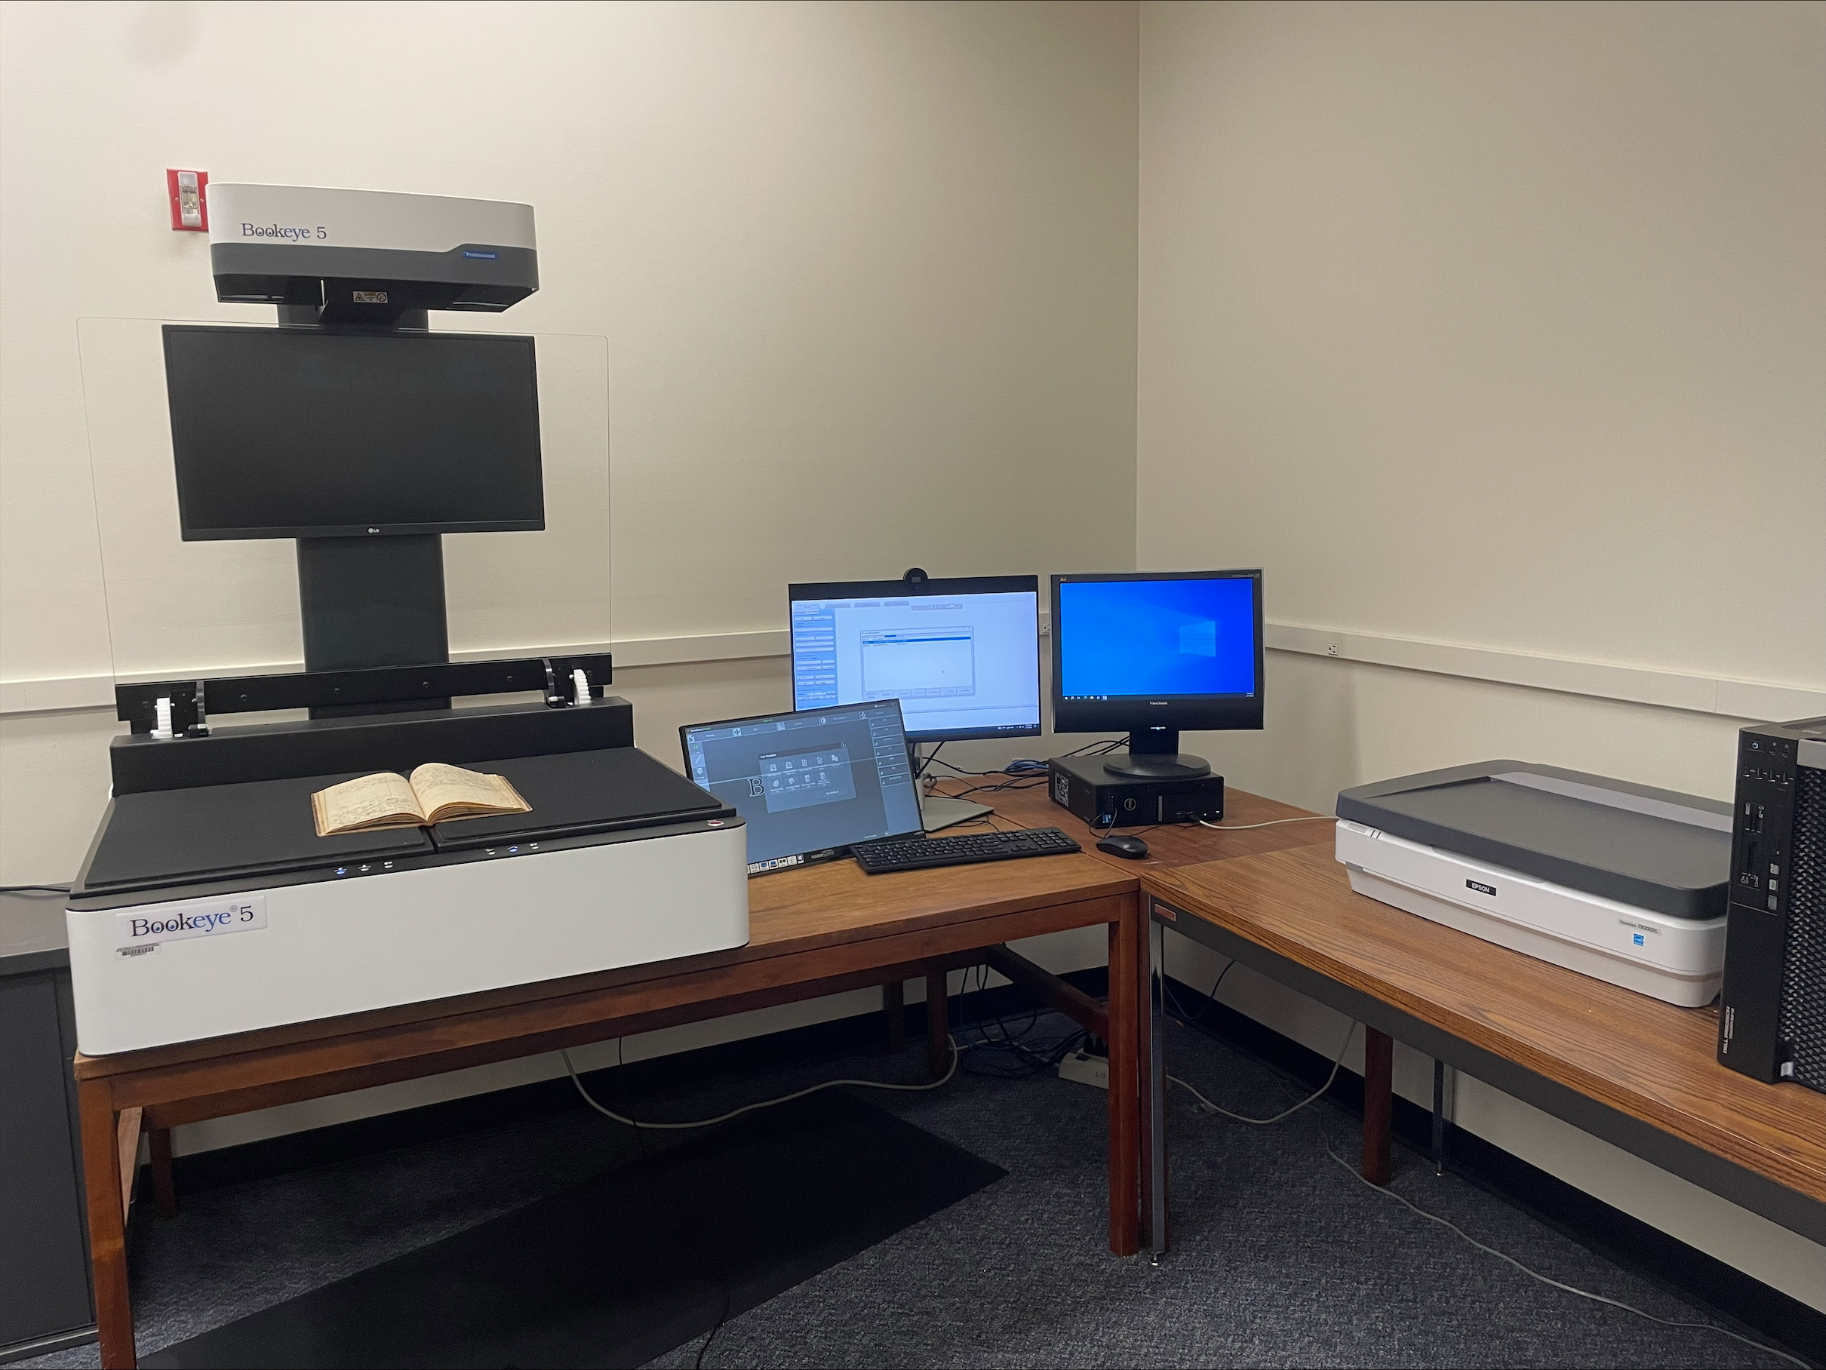
BUILDING DIGITAL ARCHIVES WITH MINIMAL STAFFING: PLATFORMS AND TOOLS – DEMONSTRATION OF DIGITAL COMMONS PRESENTER: ASHLEY HOWDESHELL, NORTHEASTERN ILLINOIS UNIVERSITY
"SIUE Digitization Lab" by Marcella Lees used under CC0
Zoom’s live transcript is available on the Show Captions menu.
Notes:
<CARLI Staff set up:>
<CARLI Staff: Enable transcription>
<CARLI Staff: Give presenters co-host permissions>
<NAME will be progressing slides>
<CARLI Staff: Watch for access issues (RT and email)>
<start recording>
<NAME: Welcome>
Hello everyone, I’m NAME from INSTITUTION and am a member of the CARLI Archives Task Force. We are pleased to welcome you all to this 2-day Building Digital Archives with Minimal Staffing program.
<NAME: Introduction>
Just a few reminders:
A few reminders:
Please ensure your microphones are muted.
We will be recording the program today. Once we’ve had the opportunity to add captions for accessibility, we will be sharing the recording along with any handouts on the CARLI website. We will share the link when it is available with the attendees.
Questions will be taken at the end of each program and are welcome via the chat box or by unmuting. If you are unmuting, please also share your video if you are able. It helps those of us who benefit from lip reading.
We are not enabling Zoom’s AI Companion features during this session, but Otter.ai transcription is enabled. Select Show captions at the bottom of the screen to turn on captions, or from the Show Captions arrow menu you can select view full transcript.
<NAME: Introduction>

Slide 2
ATTRIBUTION
Except where otherwise noted, this presentation “Building Digital Archives with Minimal Staffing: Demonstration of Digital Commons” created by the Archives Task Force of the Consortium of Academic and Research Libraries in Illinois is © 2025 by the Board of Trustees of the University of Illinois System and is released under a Creative Commons Attribution 4.0 International License.
Notes:
Please update with author and license information.

Slide 3
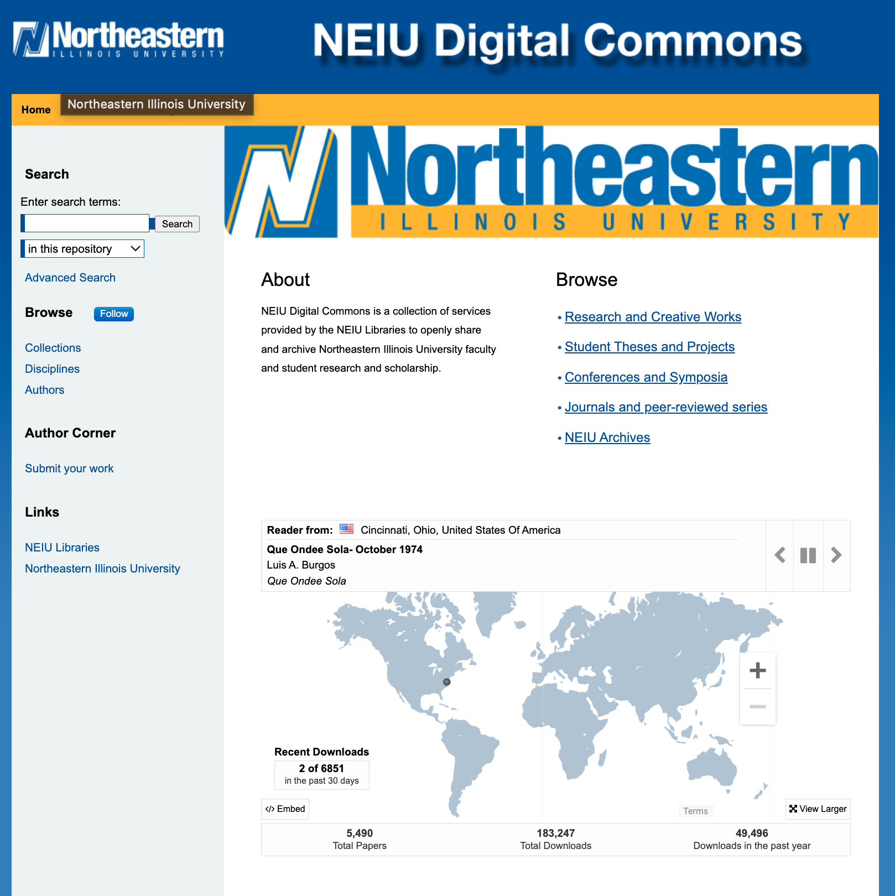
Digital Commons and Digital Archives
Digital Commons is traditionally used for faculty articles, theses, and conference proceedings but also useful for digital archives and special collections
Cloud-hosted platform built on the bepress infrastructure
Can provide access to digital archival materials like digital exhibits, oral histories, photographs, publications, and archival collections
Offers custom metadata, browseable interfaces, and keyword searching across collections or within individual collections
Institutions already using Digital Commons can add digital collections at no additional cost
Allows bulk uploads and bulk metadata editing
Can expand access and visibility while creating teaching and engagement opportunities

Slide 4
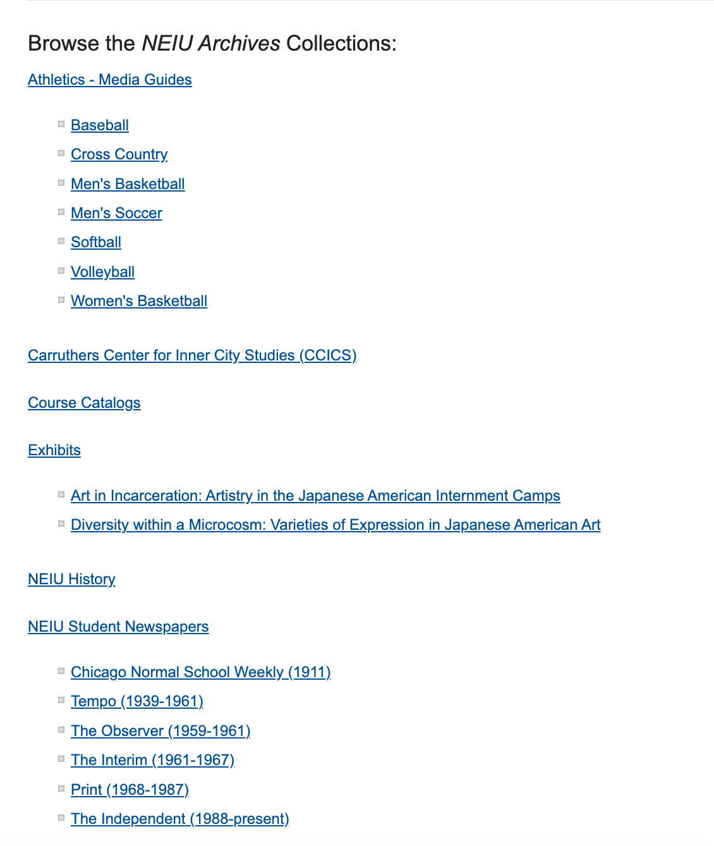
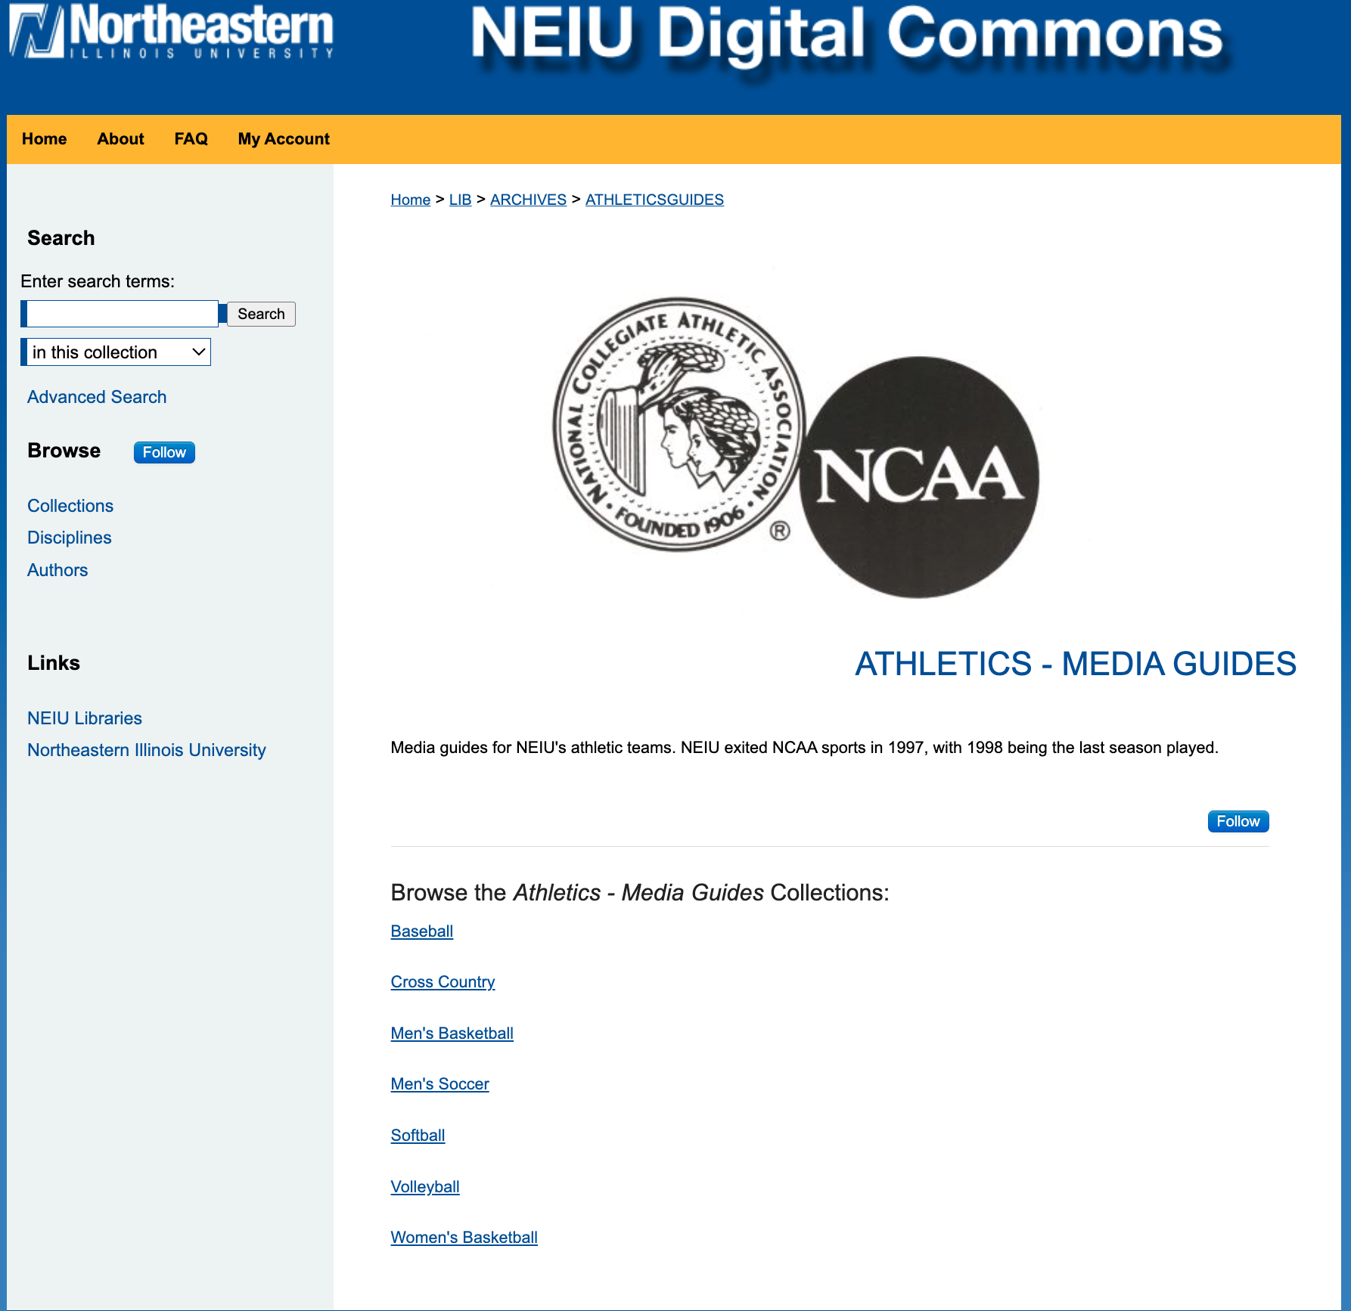
Creating Collections in Digital Commons
Collections can be hierarchical
Only Digital Commons Reps can create collections and other structures
Create custom url tags
Allows for collection description and hero image/logo

Slide 5
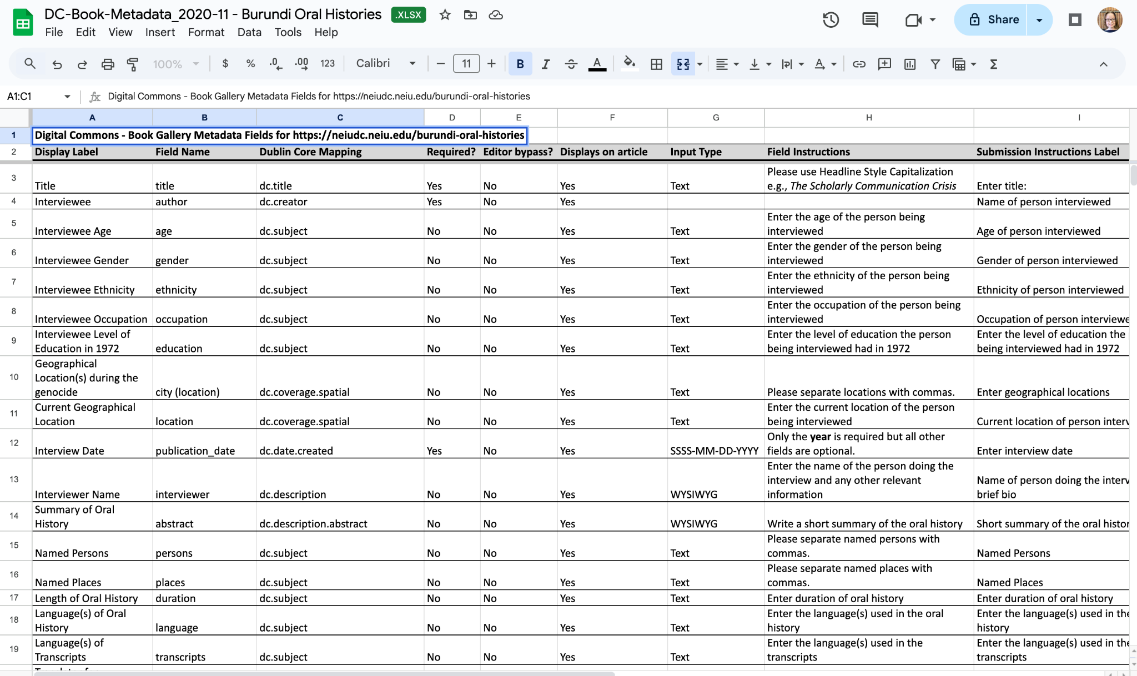
Setting Metadata Fields

Slide 6
Start the Demo
https://neiudc.neiu.edu/archives/

Slide 7
Pros and Cons of Digital Commons
Pros:
If your institution is already using Digital Commons, adding digital collections comes at no additional cost
Easy to bulk upload and edit items
Handles most formats
Customizable metadata
Good documentation
Fairly easy to use
Cons:
Expensive
Rigid structure and functionality
Not designed with archival collections in mind
Very limited display options (ex: multi-page objects cannot be ‘flipped’ through)

Slide 8
NEIU Digital Collections
https://neiudc.neiu.edu/archives/
Documentation and Resource Guides for Digital Commons
https://digitalcommons.elsevier.com/
My Email:
Ashley Howdeshell a-howdeshell@neiu.edu

