Slide 1
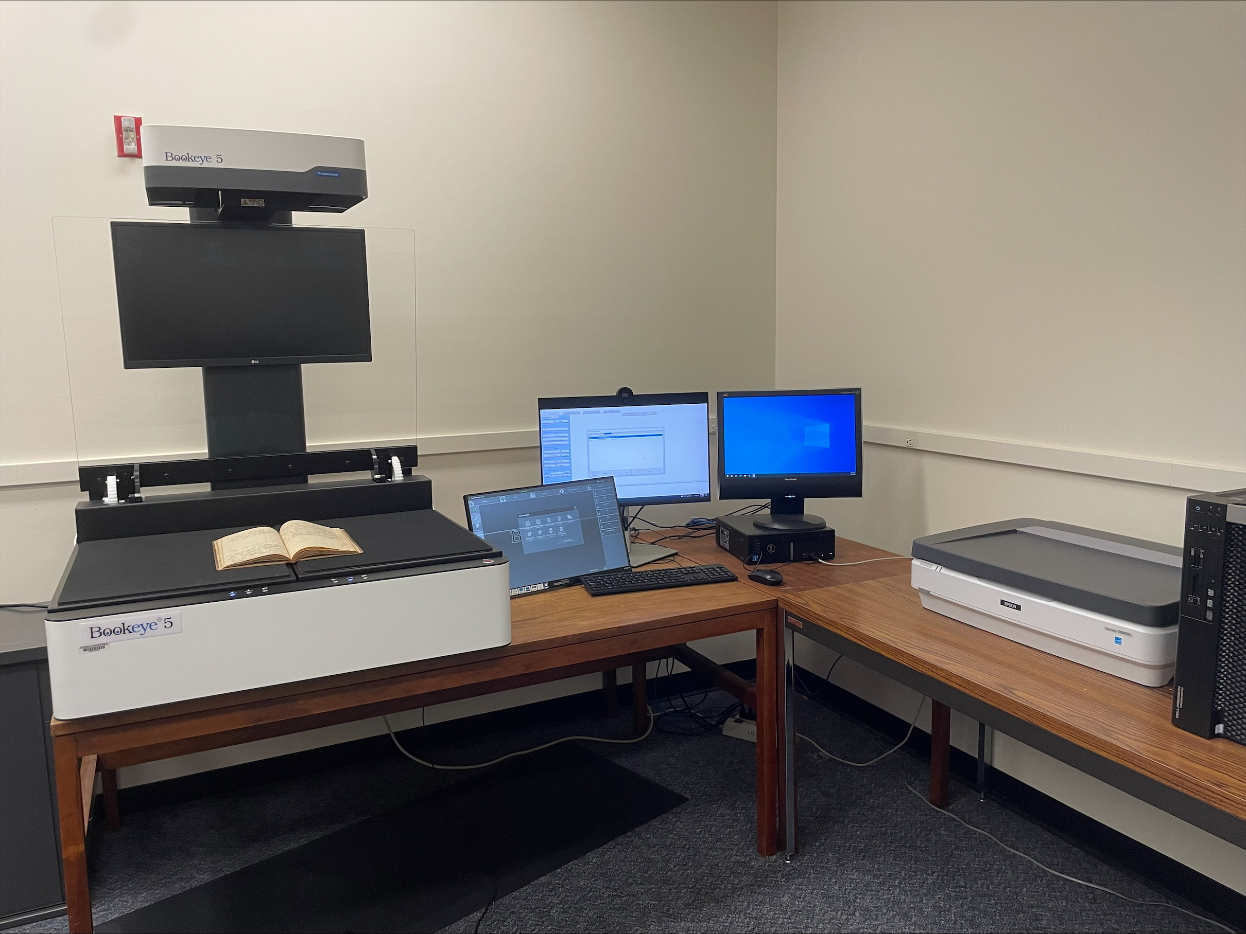
BUILDING DIGITAL ARCHIVES WITH MINIMAL STAFFING: PLATFORMS AND TOOLS – DEMONSTRATION OF CONTENTDM PRESENTER: EMILY BALDONI, ILLINOIS STATE UNIVERSITY
"SIUE Digitization Lab" by Marcella Lees used under CC0
Zoom’s live transcript is available on the Show Captions menu.
Notes:
<CARLI Staff set up:>
<CARLI Staff: Enable transcription>
<CARLI Staff: Give presenters co-host permissions>
<NAME will be progressing slides>
<CARLI Staff: Watch for access issues (RT and email)>
<start recording>
<NAME: Welcome>
Hello everyone, I’m NAME from INSTITUTION and am a member of the CARLI Archives Task Force. We are pleased to welcome you all to this 2-day Building Digital Archives with Minimal Staffing program.
<NAME: Introduction>
Just a few reminders:
A few reminders:
Please ensure your microphones are muted.
We will be recording the program today. Once we’ve had the opportunity to add captions for accessibility, we will be sharing the recording along with any handouts on the CARLI website. We will share the link when it is available with the attendees.
Questions will be taken at the end of each program and are welcome via the chat box or by unmuting. If you are unmuting, please also share your video if you are able. It helps those of us who benefit from lip reading.
We are not enabling Zoom’s AI Companion features during this session, but Otter.ai transcription is enabled. Select Show captions at the bottom of the screen to turn on captions, or from the Show Captions arrow menu you can select view full transcript.
<NAME: Introduction>

Slide 2
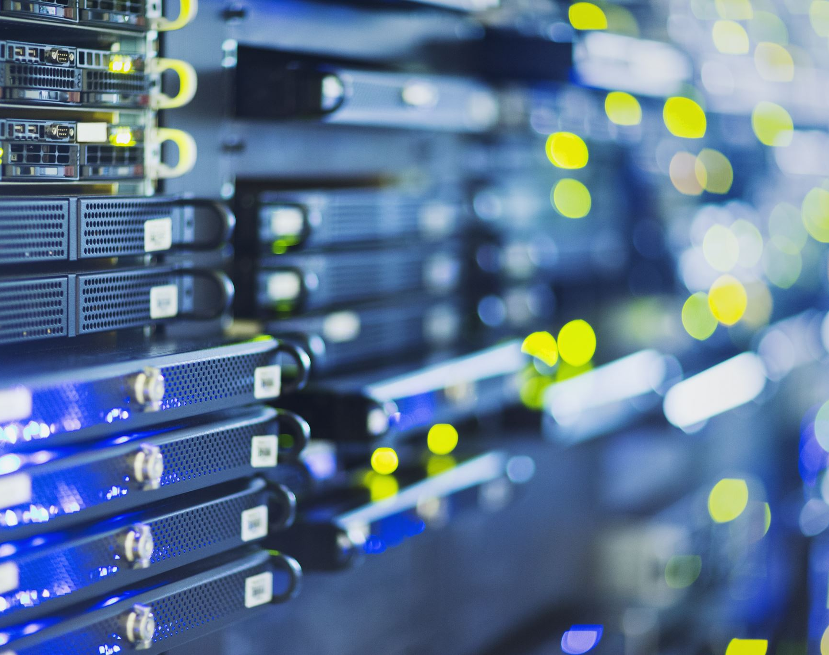
CONTENTdm Overview
Proprietary system administered by OCLC
Items are organized into collections
Metadata is highly customizable
Custom metadata terms mapped to Dublin Core
Supports OAI-PMH harvesting

Slide 3
Big changes are coming soon!
Fully overhauled system in development
New system available for demo in…a few months?
Migrations to new system might be available in late 2025, but full functionality not expected until well into 2026

Slide 4
“Old” CONTENTdm Components
CONTENTdm Administration interface
CONTENTdm Project Client
Browser-based
High-level collection management (e.g., harvesting, website configuration, user accounts, creation of new collections) occurs here
Windows-based software for adding content to CONTENTdm collections
Collection-building (e.g., adding digital items and metadata singly or in batch, generating OCR text, editing structural metadata) occurs here

Slide 5
“Old” CONTENTdm Capabilities
Custom metadata schema defined for each collection
Metadata fields can be mapped to qualified Dublin Core
Controlled vocabularies can be defined for individual fields
OCR can be run in the Project Client; or upload transcripts as .txt files
New items can be added in batch, but batch editing of existing items is somewhat limited
Upload-and-approve workflow

Slide 6
CONTENTdm Demo

Slide 7
“New” CONTENTdm
Administration and collection-building will be entirely browser-based – no more Project Client!
Tools for standardizing metadata across collections
Enhanced support for controlled vocabularies, including LCSH, FAST, AAT, DCMI Type
Support for linked data
Far superior batch update tools

Slide 8
Takeaways
CONTENTdm has robust features for metadata customization, OCR/transcripts/full-text searching, batch upload, compound objects
Good for image- and manuscript-based collections
Most high-level administration tasks occur in browser; does not typically require intensive development/technical support
Current limitations related to Project Client, batch editing, and metadata standardization are expected to improve in new system

Slide 9
Resources
Documentation: https://help.oclc.org/Metadata_Services/CONTENTdm
CONTENTdm training: https://help.oclc.org/Metadata_Services/CONTENTdm/CONTENTdm_training
Examples: https://www.oclc.org/en/contentdm/collections.html

Slide 10
Thank you!
ejbaldo@ilstu.edu

Slide 11
ATTRIBUTION
Except where otherwise noted, this presentation “Building Digital Archives with Minimal Staffing: Demonstration of ContentDM” created by the Archives Task Force of the Consortium of Academic and Research Libraries in Illinois is © 2025 by the Board of Trustees of the University of Illinois System and is released under a Creative Commons Attribution 4.0 International License.
Notes:
Please update with author and license information.

