Slide 1
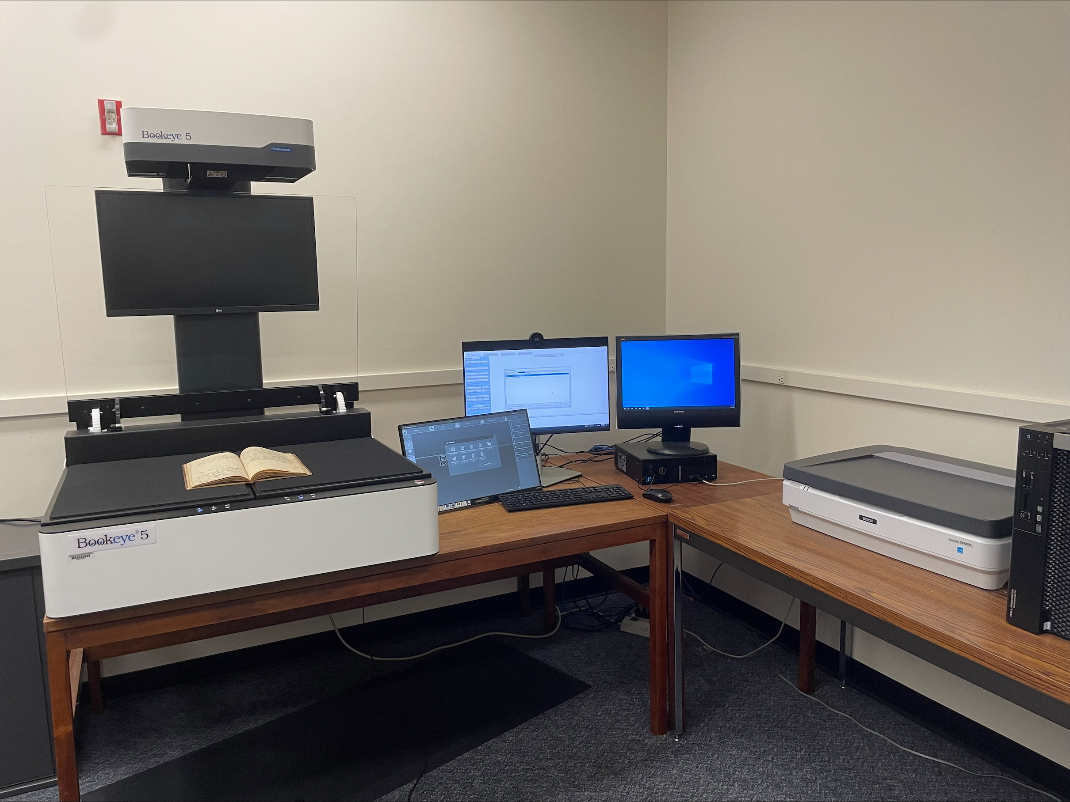
BUILDING DIGITAL ARCHIVES WITH MINIMAL STAFFING: PLATFORMS AND TOOLS – DEMONSTRATION OF COLLECTION BUILDER PRESENTER: GREER MARTIN, LOYOLA UNIVERSITY CHICAGO
"SIUE Digitization Lab" by Marcella Lees used under CC0
Zoom’s live transcript is available on the Show Captions menu.
Notes:
<CARLI Staff set up:>
<CARLI Staff: Enable transcription>
<CARLI Staff: Give presenters co-host permissions>
<NAME will be progressing slides>
<CARLI Staff: Watch for access issues (RT and email)>
<start recording>
<NAME: Welcome>
Hello everyone, I’m NAME from INSTITUTION and am a member of the CARLI Archives Task Force. We are pleased to welcome you all to this 2-day Building Digital Archives with Minimal Staffing program.
<NAME: Introduction>
Just a few reminders:
A few reminders:
Please ensure your microphones are muted.
We will be recording the program today. Once we’ve had the opportunity to add captions for accessibility, we will be sharing the recording along with any handouts on the CARLI website. We will share the link when it is available with the attendees.
Questions will be taken at the end of each program and are welcome via the chat box or by unmuting. If you are unmuting, please also share your video if you are able. It helps those of us who benefit from lip reading.
We are not enabling Zoom’s AI Companion features during this session, but Otter.ai transcription is enabled. Select Show captions at the bottom of the screen to turn on captions, or from the Show Captions arrow menu you can select view full transcript.
<NAME: Introduction>

Slide 2
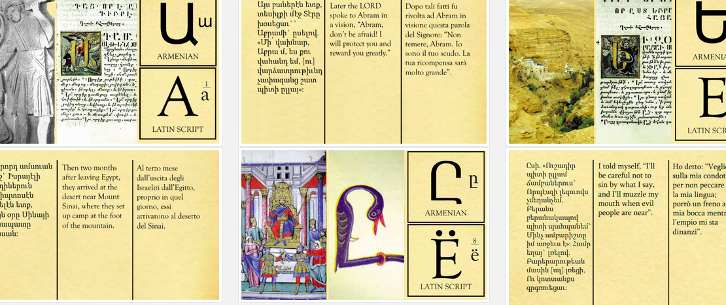
INTRODUCTION
Image: Antonella Fabbri, “Chronologia.” Edificati sulla parola. https://m8net.github.io/collectorbuilder/
.

Slide 3
What is CollectionBuilder?
Free, open-source program for digital collections
Uses static site technology (no database needed)
Consists of HTML pages and images
Based on Jekyll, GitHub Pages, and Bootstrap
Examples: https://collectionbuilder.github.io/cb-examples/

Slide 4
Key Benefits
No server software or databases to maintain
Minimal technical expertise required
GitHub-hosted option requires no local installation
Self-hosted options available

Slide 5
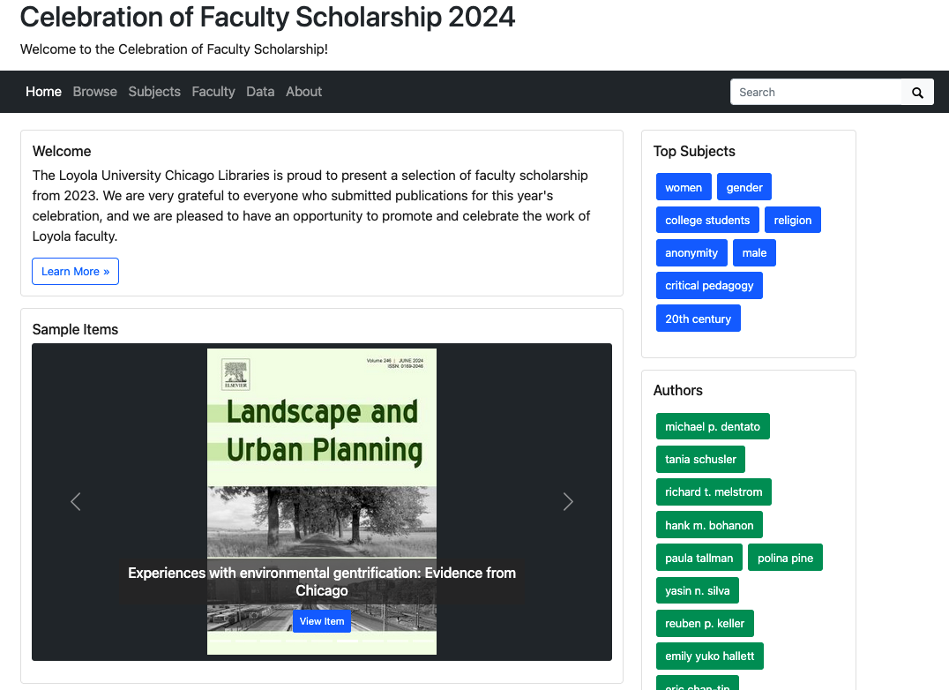

Slide 6
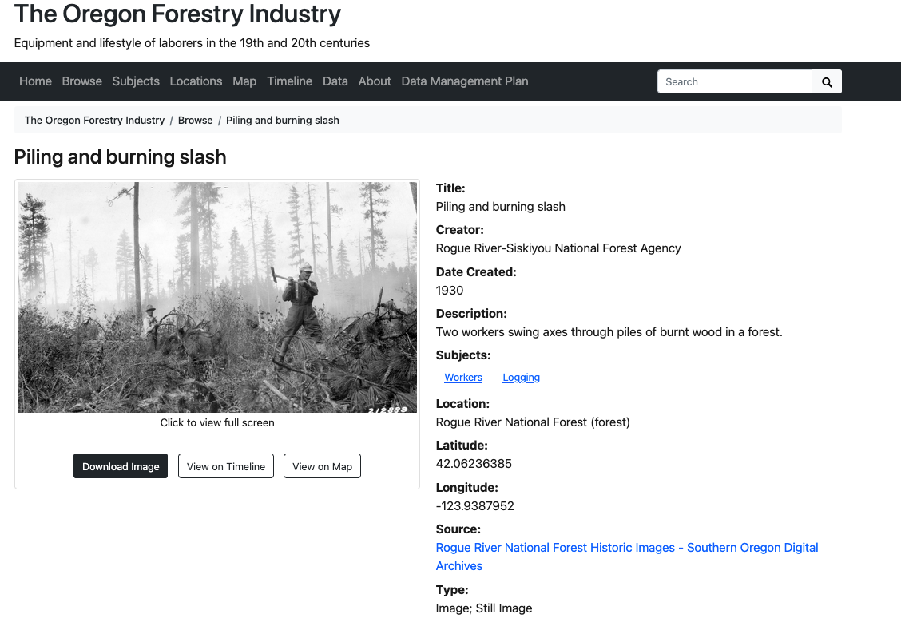

Slide 7
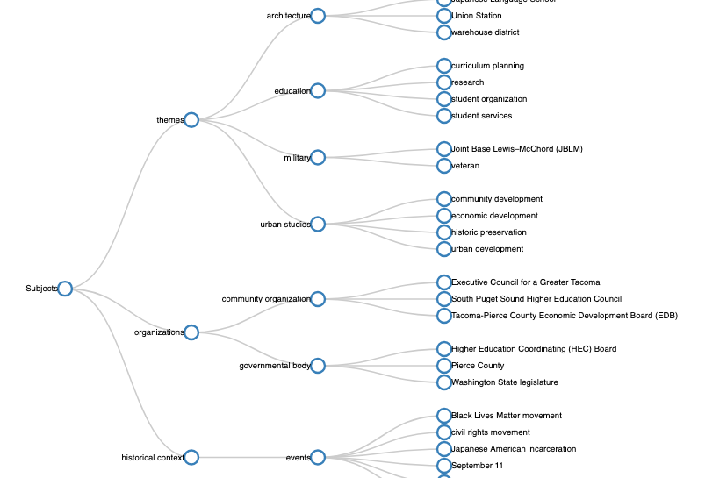
USE CASES AND LIMITATIONS
Image: UWTacomaLibrary, University of Washington Libraries Digital Collections. “Tree Map.” Founding Stories. https://uwtacomalibrary.github.io/foundingstories/
.

Slide 8
CollectionBuilder is Good For:
Digital exhibits
Digital collections with a defined scope (not thousands of items)
Organizations with limited IT support
Projects needing quick implementation
Projects that are not meant to be maintained forever

Slide 9
CollectionBuilder is Not For:
Digital preservation
Born-digital archives (flat hierarchy, limited format support)
Enterprise-scale digital collections repositories
Collections requiring mediated or restricted access

Slide 10
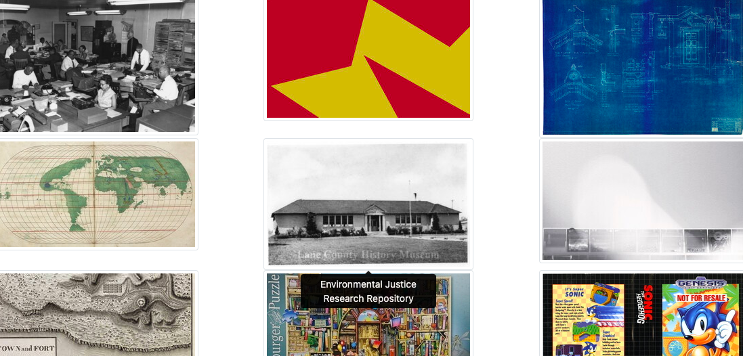
TECHNICAL OVERVIEW
Image: “Timeline.” CollectionBuilder Examples. https://collectionbuilder.github.io/cb-examples/
.

Slide 11
Template Overview
Three templates with different complexity levels:
CollectionBuilder-Sheets: Quick prototyping via Google Sheets
CollectionBuilder-GH: Full collections with GitHub hosting *(our focus today)*
CollectionBuilder-CSV: Advanced option for maximum customization

Slide 12
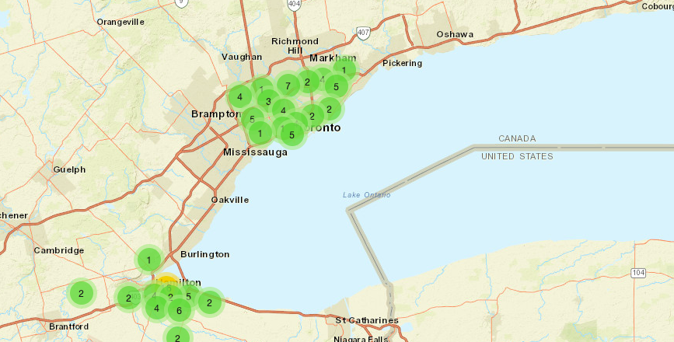
DEMO
Image: “Map.” Mapping Makerspaces in Southern Ontario. https://lis9704.github.io/
.

Slide 13
CollectionBuilder-GH (Featured Template)
Good for: Complete digital collections with GitHub hosting
Key feature: GitHub hosts site and its components (images + metadata)
Requirements:
GitHub account (free)
Basic familiarity with GitHub interface
Willingness to use a GitHub URL (or configure a custom domain)
Example: https://luc-libraries.github.io/loyolahistory

Slide 14
Customization Options
Header images, fonts, buttons, and color schemes
Theme customization
Features like timelines, maps, subject term word clouds
Advanced customization with code knowledge

Slide 15
Supported Formats & Metadata
Formats: jpg, png, pdf, mp3
External media: YouTube, Vimeo, external links
Metadata: Dublin Core-based
Required fields: id, filename, title, format

Slide 16
CONCLUSION
Image: “Subjects” To the Happy Couple. https://casemach.github.io/tothehappycouple/

Slide 17
Key Takeaways
Collection Builder makes building and serving digital collections possible with minimal staffing, budget, and IT support
GitHub-based workflow requires minimal technical infrastructure
Easily customizable to meet basic collection or exhibit needs

Slide 18
Getting Started Resources
Documentation: collectionbuilder.github.io/cb-docs/
Includes walkthroughs for each template
Examples: https://collectionbuilder.github.io/cb-examples/

Slide 19
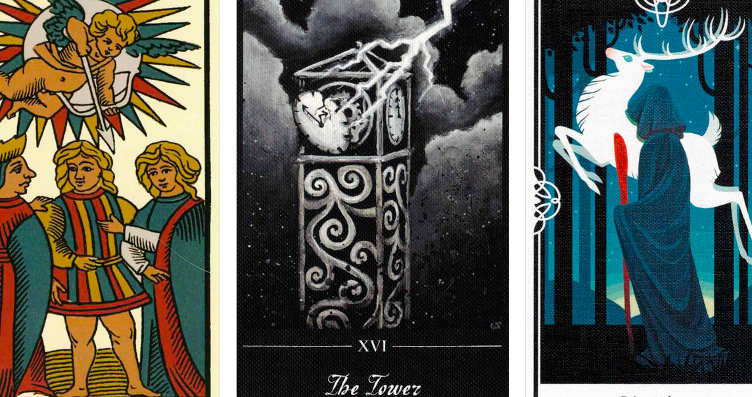
Thank you!
Greer Martin
gmartin5@luc.edu
Image: Julia Parkinson, The Art of Tarot. https://jwparkinson.github.io/tarotlibrary/

Slide 20
ATTRIBUTION
Except where otherwise noted, this presentation “Building Digital Archives with Minimal Staffing: Collection Builder” created by Greer Martin is © 2025 by Greer Martin and is released under a Creative Commons Attribution 4.0 International License.
Notes:
Please update with author and license information.

