Slide 1


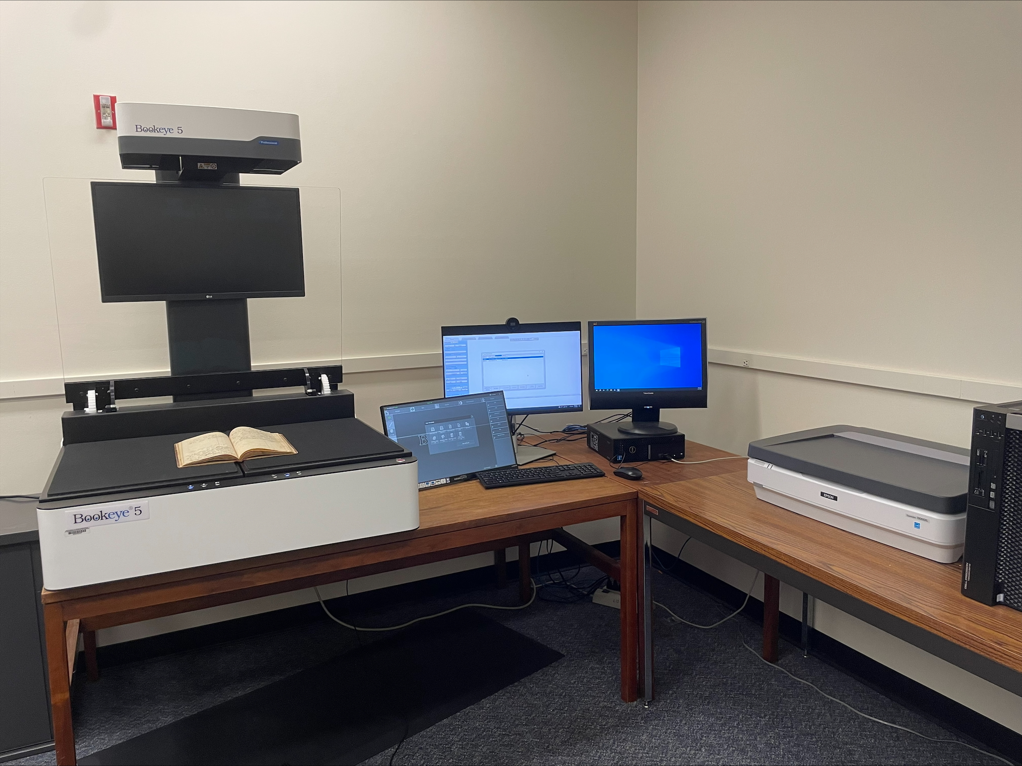
BUILDING DIGITAL ARCHIVES WITH MINIMAL STAFFING: METADATA
PRESENTERS: REBECCA FITZSIMMONS, ILLINOIS STATE UNIVERSITY AND ASHLEY HOWDESHELL, NORTHEASTERN ILLINOIS UNIVERSITY
"SIUE Digitization Lab" by Marcella Lees used under CC0
Zoom’s live transcript is available on the Show Captions menu.
Notes:
<CARLI Staff set up:>
<CARLI Staff: Enable transcription>
<CARLI Staff: Give presenters co-host permissions>
<NAME will be progressing slides>
<CARLI Staff: Watch for access issues (RT and email)>
<start recording>
<NAME: Welcome>
Hello everyone, I’m NAME from INSTITUTION and am a member of the CARLI Archives Task Force. We are pleased to welcome you all to this 2-day Building Digital Archives with Minimal Staffing program.
<NAME: Introduction>
Just a few reminders:
A few reminders:
Please ensure your microphones are muted.
We will be recording the program today. Once we’ve had the opportunity to add captions for accessibility, we will be sharing the recording along with any handouts on the CARLI website. We will share the link when it is available with the attendees.
Questions will be taken at the end of each program and are welcome via the chat box or by unmuting. If you are unmuting, please also share your video if you are able. It helps those of us who benefit from lip reading.
We are not enabling Zoom’s AI Companion features during this session, but Otter.ai transcription is enabled. Select Show captions at the bottom of the screen to turn on captions, or from the Show Captions arrow menu you can select view full transcript.
<NAME: Introduction>

Slide 2

ATTRIBUTION
Except where otherwise noted, this presentation “Building Digital Archives with Minimal Staffing: Metadata” created by Rebecca Fitzsimmons and Ashley Howdeshell is © 2025 by Rebecca Fitzsimmons and Ashley Howdeshell and is released under a Creative Commons Attribution-NonCommercial-ShareAlike 4.0 International License.
Notes:
Please update with author and license information.

Slide 3
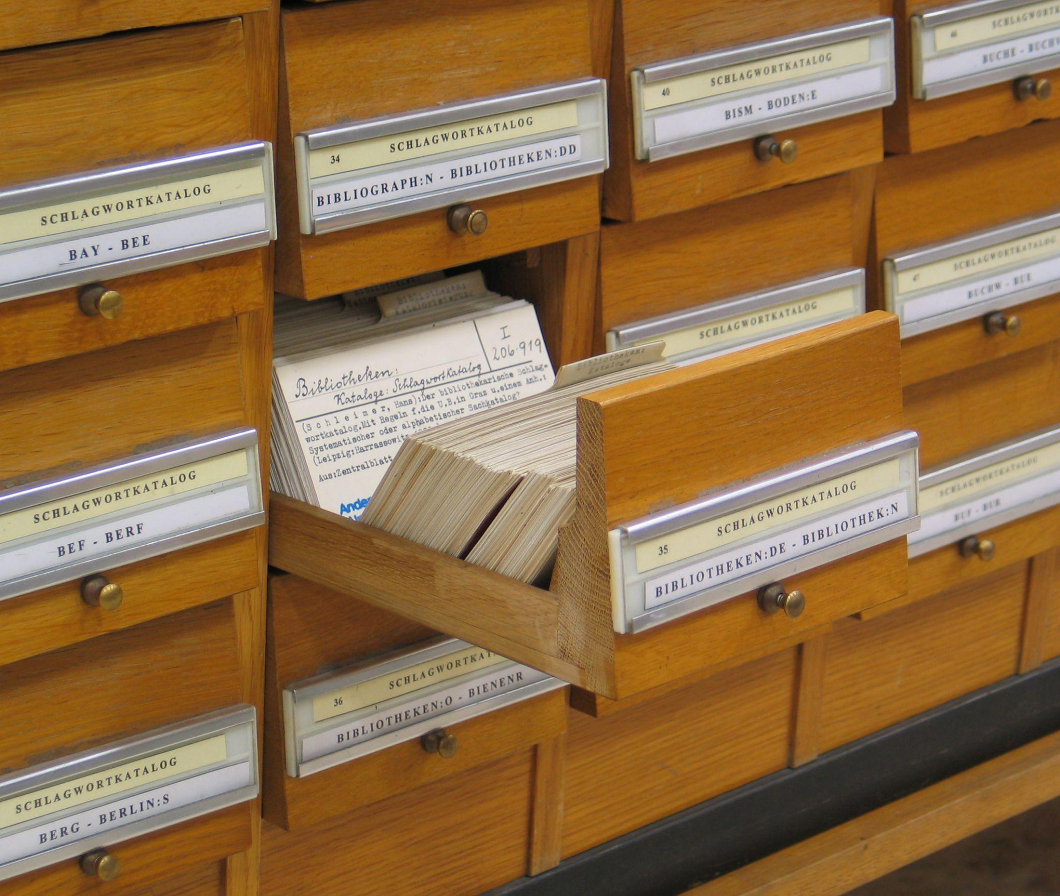
"Schlagwortkatalog" by Dr. Marcus Gossler used under CC BY-SA 3.0
Metadata
n. information about data that promotes discovery, structures data objects, and supports the administration and preservation of records
– from the Dictionary of Archives Terminology, Society of American Archivists
https://dictionary.archivists.org/entry/metadata.html

Slide 4
Metadata Types
Descriptive metadata
For finding or understanding a resource
Administrative metadata:
Technical metadata - For decoding and rendering files
Preservation metadata - Long-term management of files
Rights metadata - Intellectual property rights attached to content
Structural metadata - Relationships of parts of resources to one another
Riley, Jenn. Understanding Metadata: What Is Metadata, and What Is It For? Baltimore, MD: National Information Standards Organization, 2017. https://perma.cc/8J7Q-LXMU

Slide 5
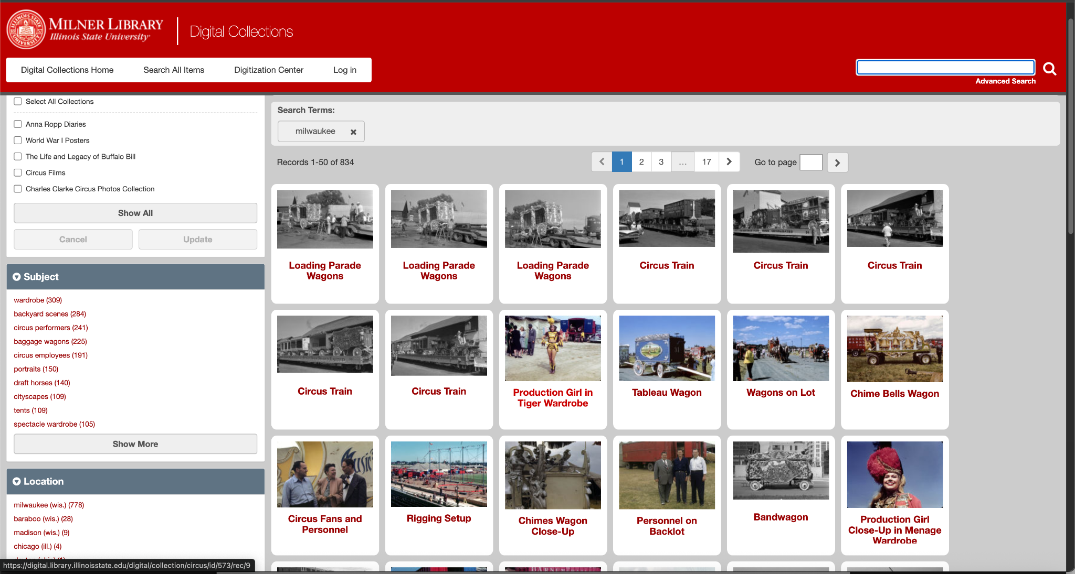
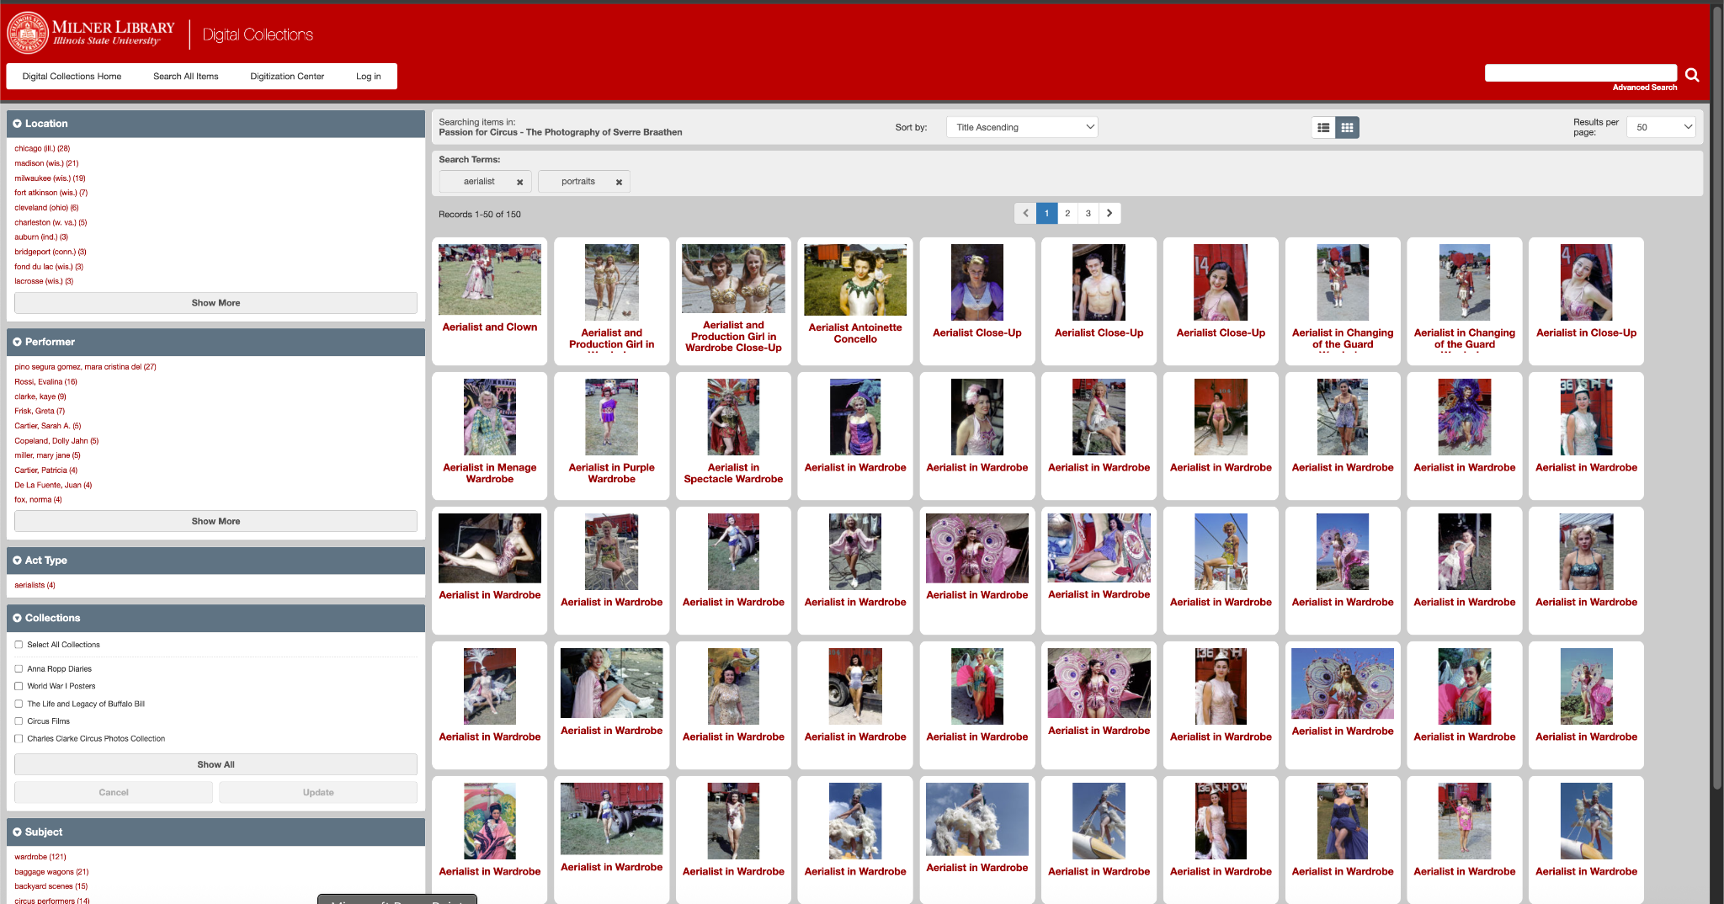
Images of searches using subject terms in the Passion for Circus digital collection at Milner Library
Metadata Types
Descriptive metadata
High quality descriptive metadata allows effective search and retrieval

Slide 6
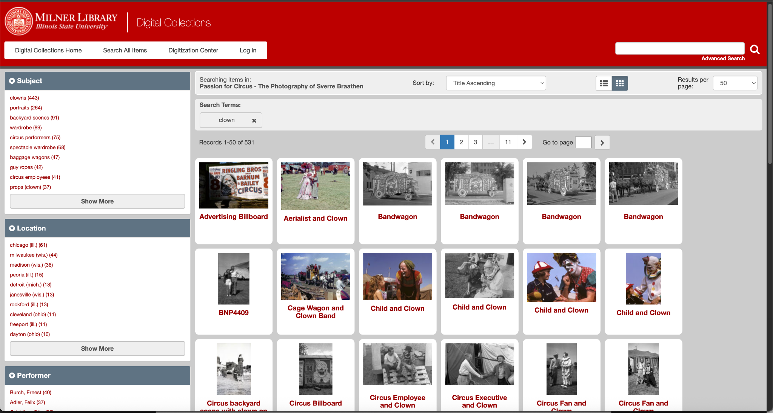
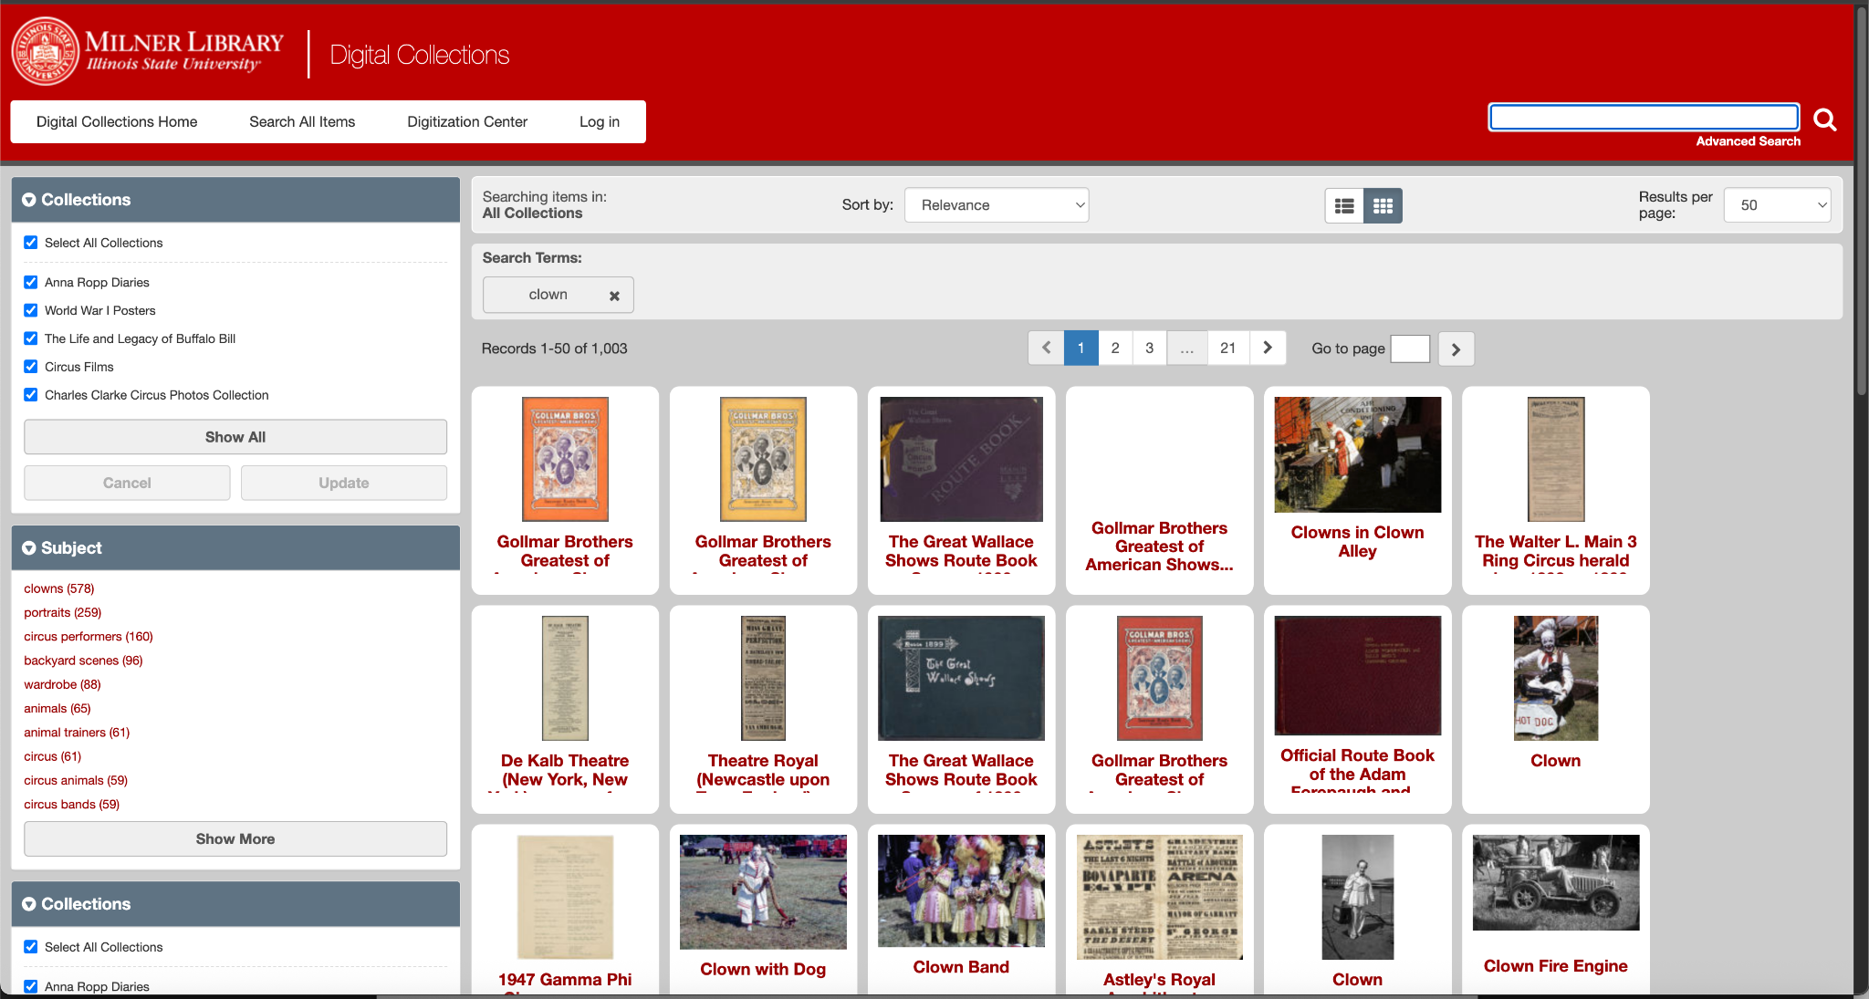
Images of searches using subject terms in the Passion for Circus digital collection and across all collections at Milner Library
Metadata Types
Descriptive metadata

Slide 7
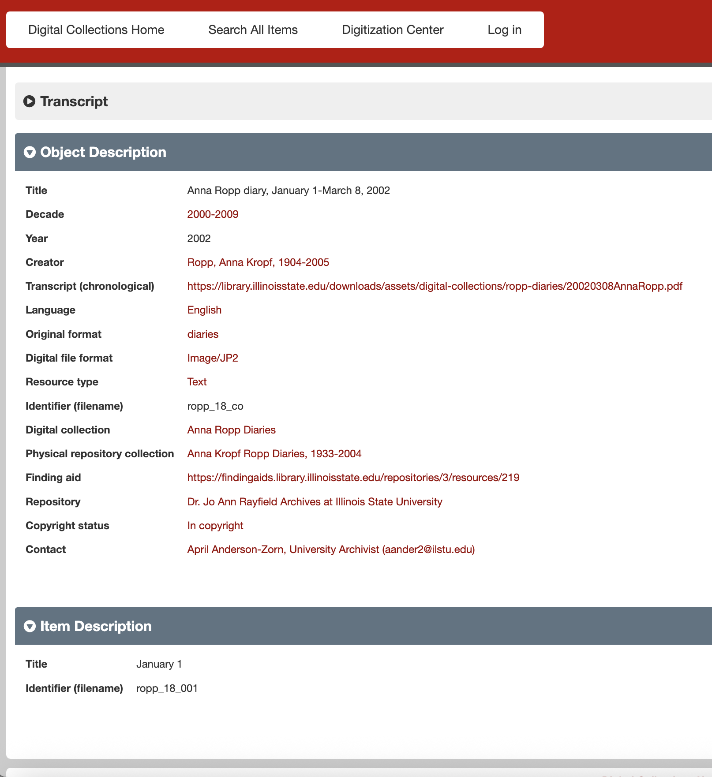
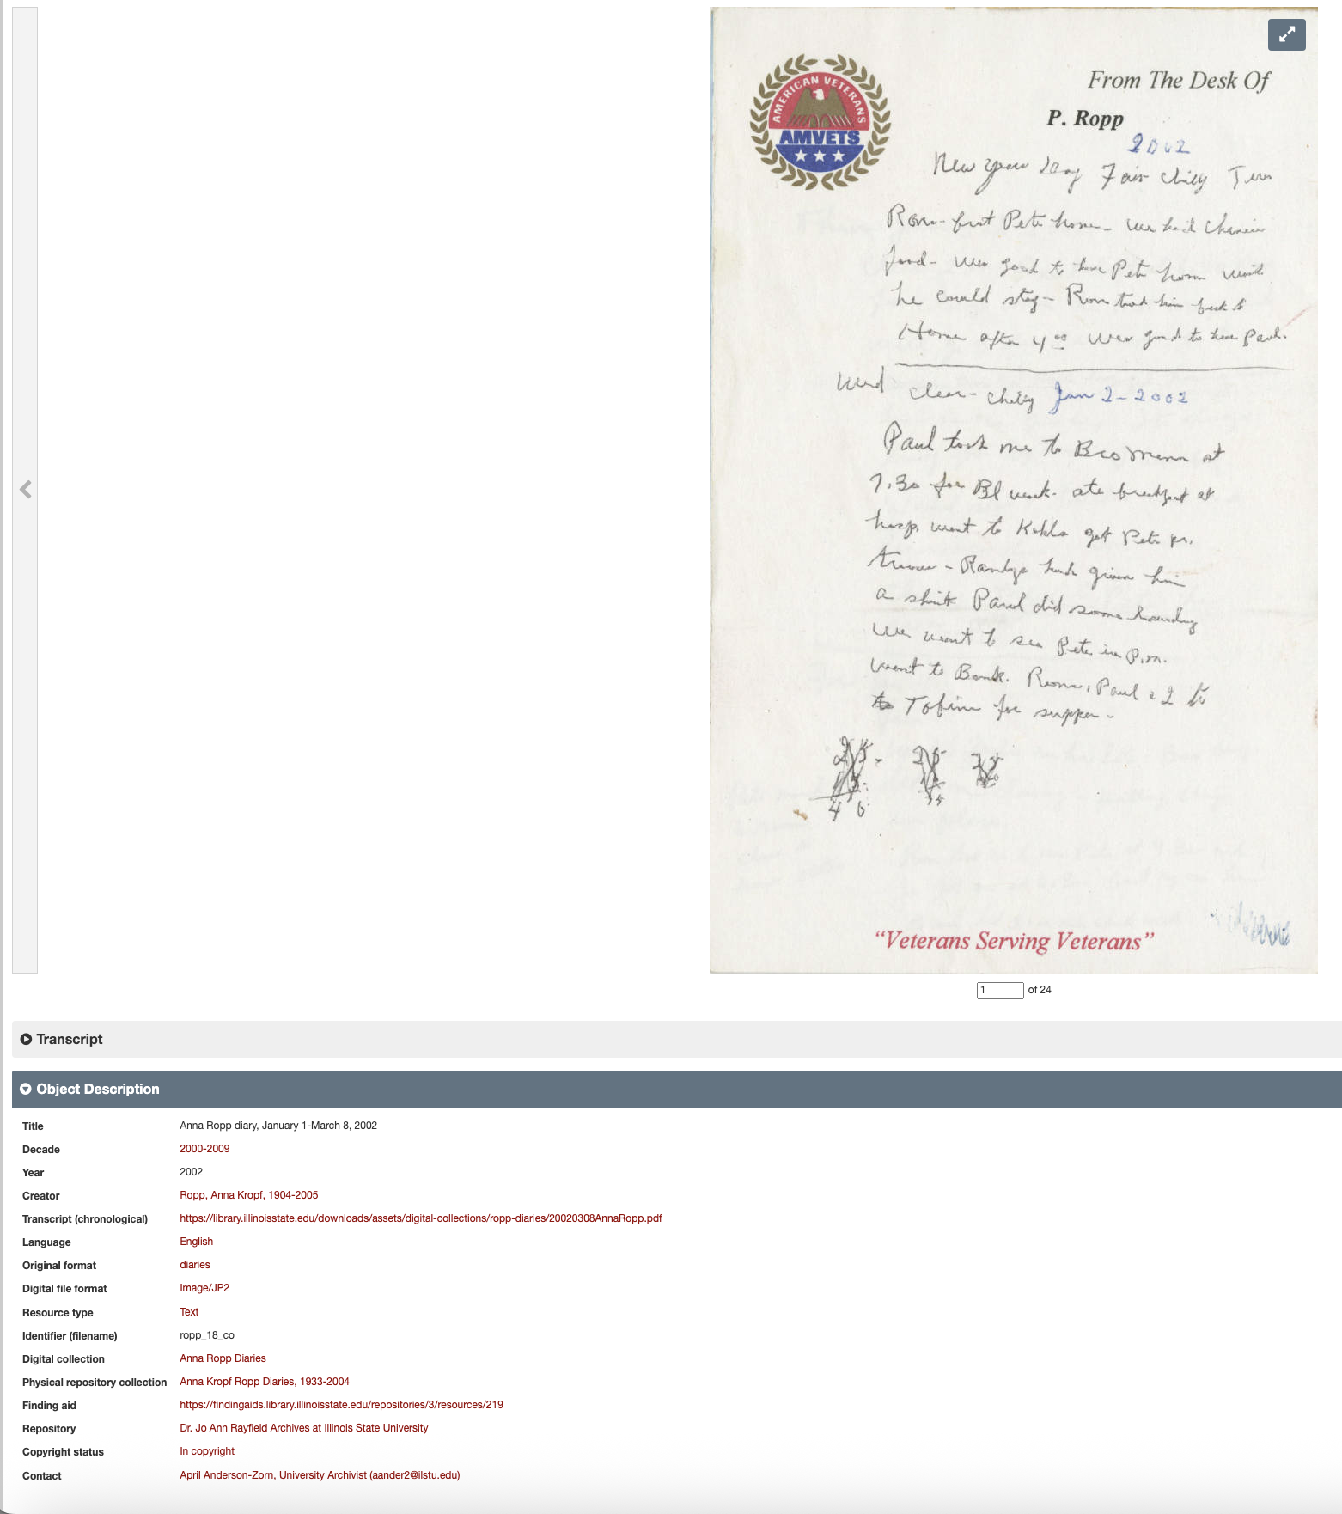
Images: Object in ContentDM and closeup of metadata for that object
Metadata in a digital collection

Slide 8
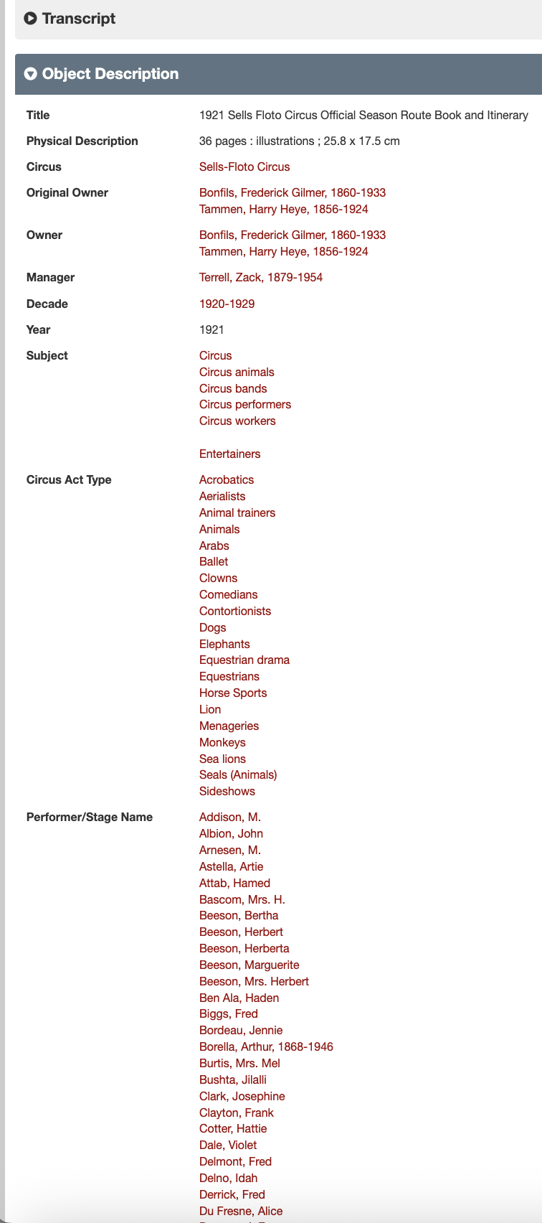
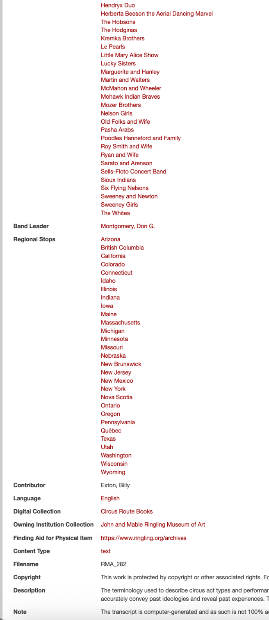
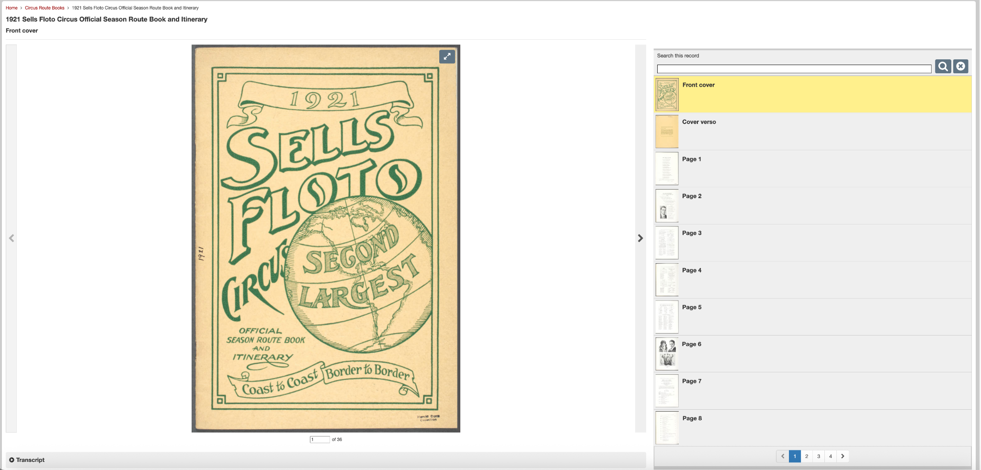
Images: Item in the Circus Route Book Collection with controlled vocabulary terms
More metadata in a digital collection

Slide 9
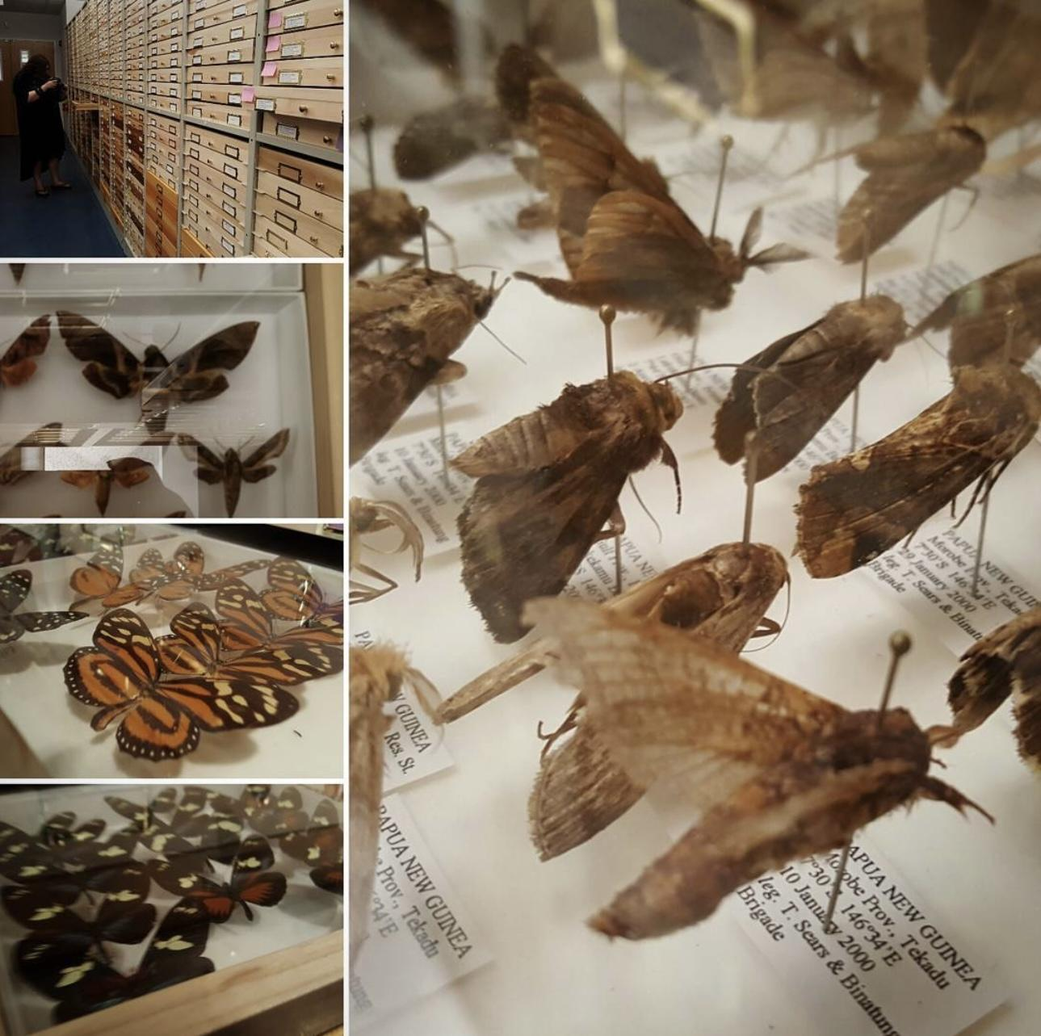
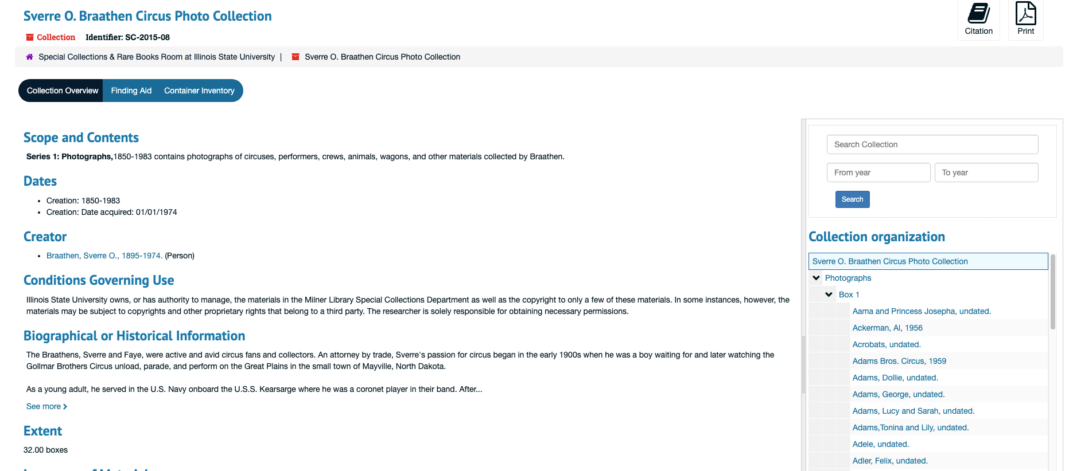
Where should you look for information?
Finding aid for the Sverre O. Braathen Photo Collection in Milner Library Special Collections.
Pinned insect specimens with labels at the Florida Museum of Natural History.

Slide 10
Metadata Schemas and Standards
General (used by many libraries, archives, and cultural heritage organizations)
Dublin Core
MODS (Metadata Object Description Schema)
Discipline or type specific:
Darwin Core (science) – describing biological specimens, including their occurrence in nature as documented by observations, samples, and related information.
PBCore – sound and moving images.
PREMIS (Preservation Metadata: Implementation Strategies) – used for creating preservation metadata for digital objects.
VRA Core (Visual Resources Association) – description of works of visual culture as well as the images that document

Slide 11
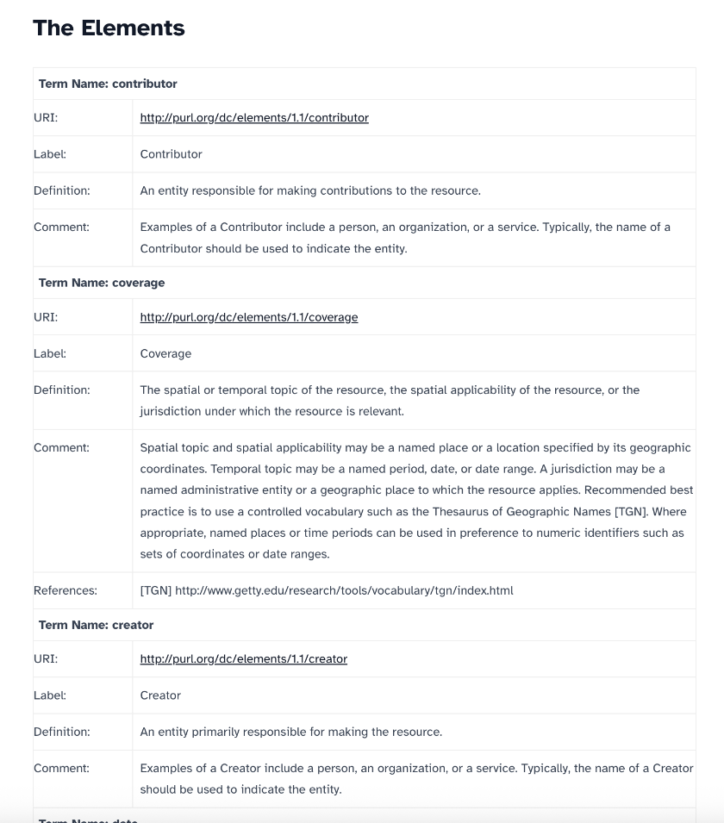
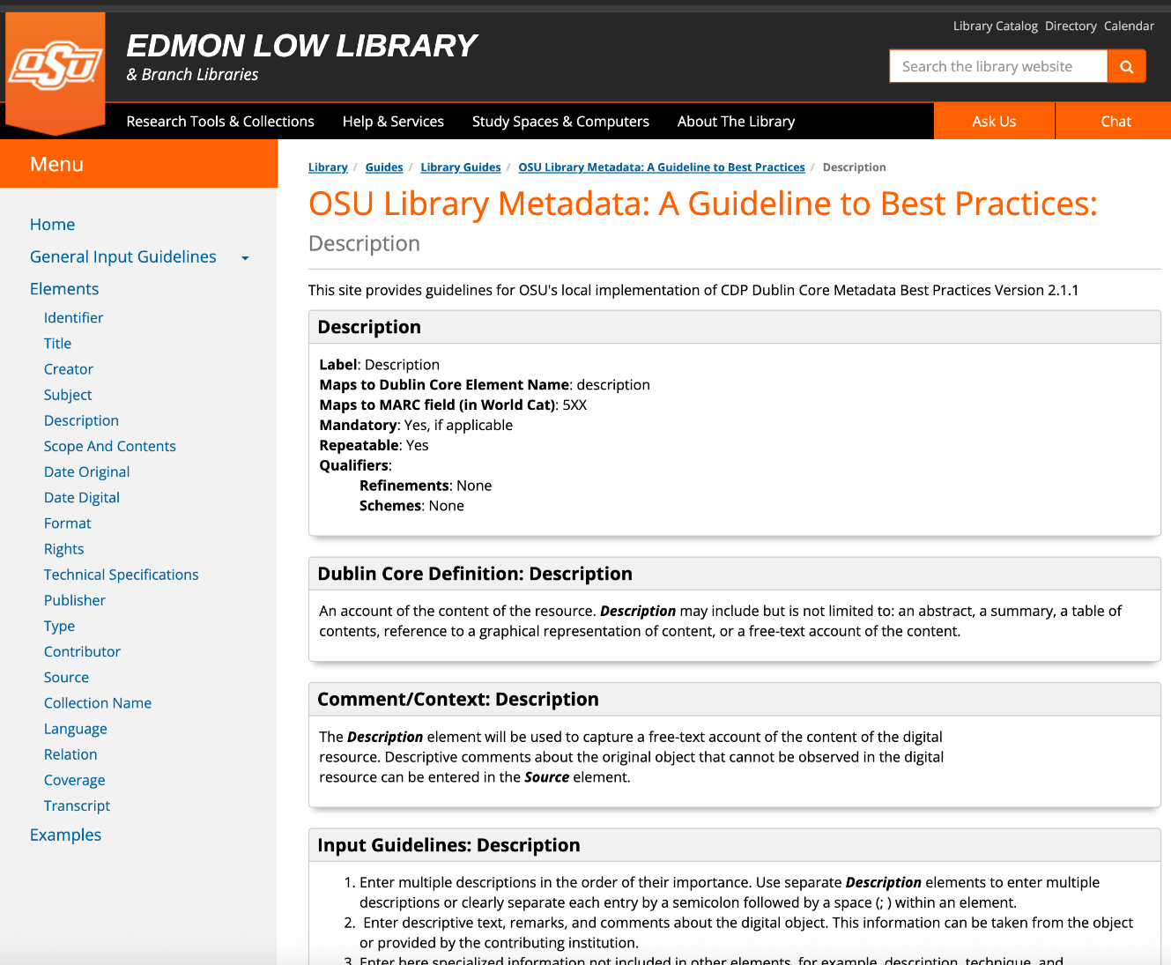
Dublin Core
Flexible and easy to learn, widespread use across many institutions, easy to crosswalk
15 elements
Title
Identifier
Creator
Contributor
Coverage
Date
Description
Subject
Type
Format
Source
Language
Publisher
Relation
Rights
Images: Screenshots from the Dublin Core elements description page and the metadata guide for Dublin Core at OSU Libraries

Slide 12
Controlled Vocabularies
General Purpose
Dublin Core Metadata Initiative (DCMI) Type Vocabulary
ISO 639-3 Code Tables (for language names)
Library of Congress Subject Headings (LCSH)
Library of Congress Name Authority File (LCNAF)
Virtual International Authority File (VIAF)
Arts & Humanities
Art and Architecture Thesaurus (AAT)
Cultural Objects Name Authority (CONA)
Getty Thesaurus of Geographic Names (TGN)
Nomenclature for Museum Cataloging
Rare Books and Manuscripts Section (RBMS) Controlled Vocabularies
Thesaurus for Graphic Materials (TGM)
Union List of Artist Names (ULAN)
Physical & Life Sciences
AGROVOC Multilingual Agricultural Thesaurus
GeoNames
International Classification of Diseases (ICD)
Medical Subject Headings (MeSH)
National Agriculture Library Thesaurus (NALT)
U.S. Geological Survey GNIS Domestic Names
Social & Behavioral Sciences
Data Documentation Initiative (DDI) Controlled Vocabularies
Inter-university Consortium for Political and Social Research (ICPSR) Thesaurus
United Nations Educational, Scientific and Cultural Organisation (UNESCO) Thesaurus

Slide 13
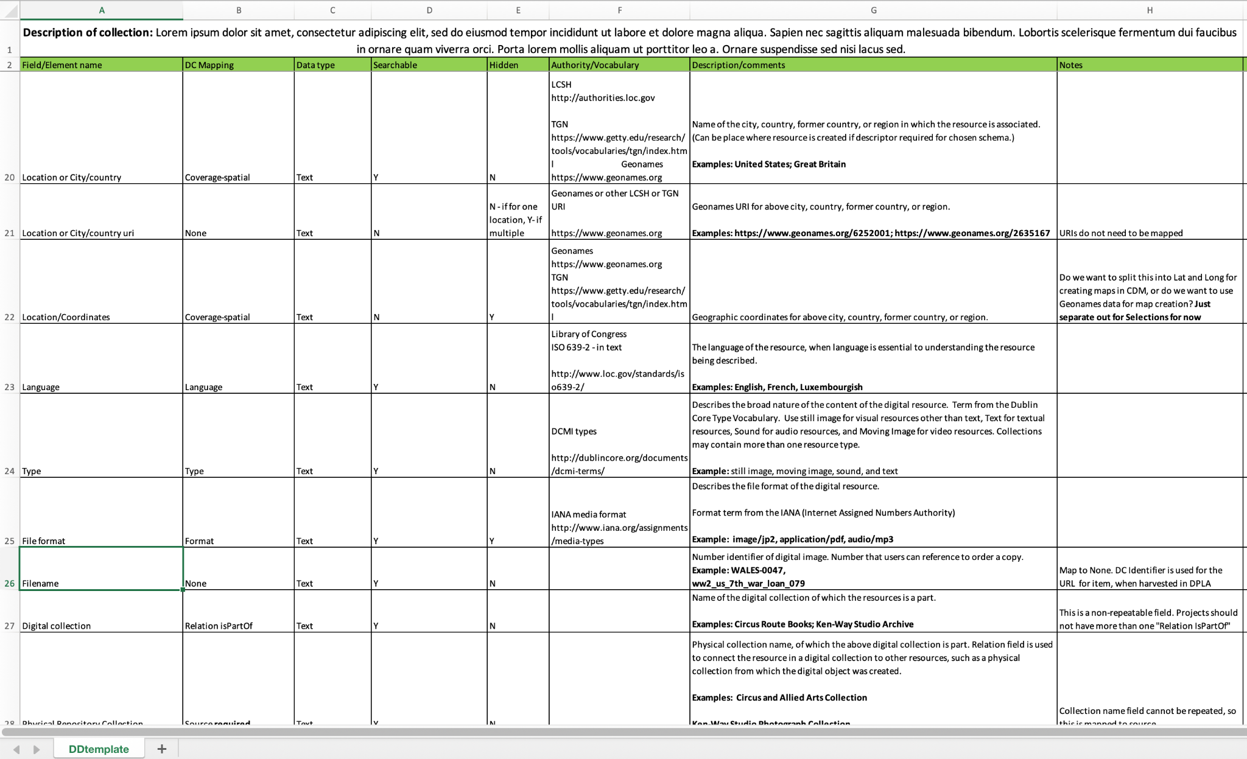
Data Dictionary
Consistency
Record for the future

Slide 14
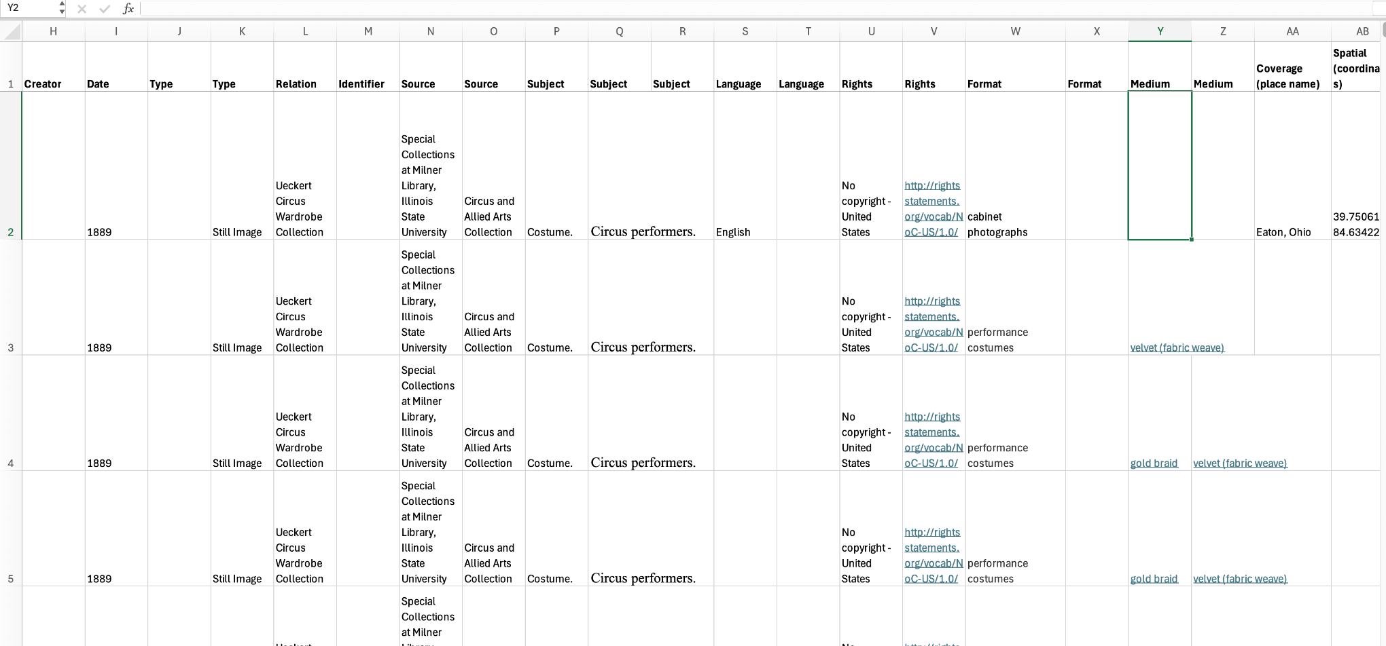

Slide 15
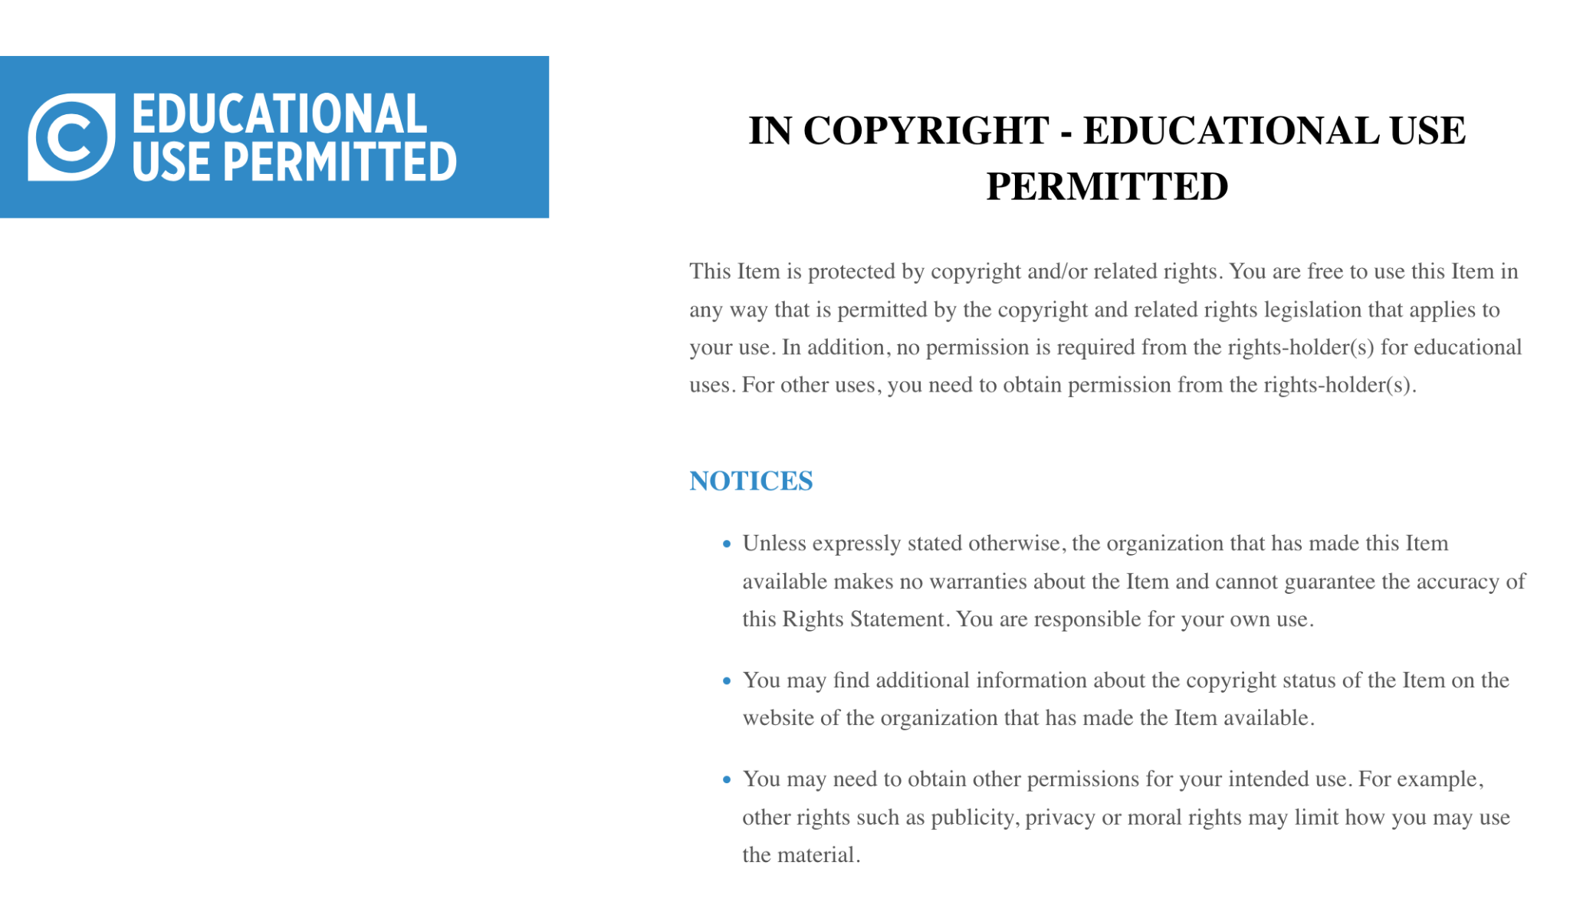
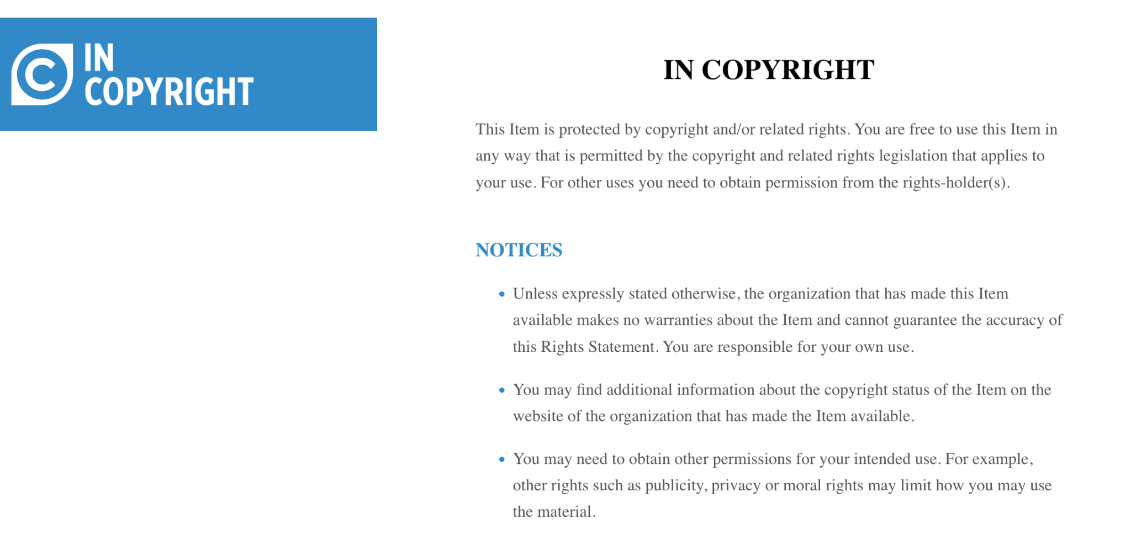
Rights Statements
Include key metadata fields such as rights statements during planning.
Tailor rights statements to reflect the specific needs of each collection—one size does not fit all.
Be aware of institutional policies—some items may be subject to take down notices issued by General Counsel or Administration.
Use RightsStatements.org for clear, standardized examples tailored to online cultural heritage.
Images: Samples statements from RightsStatements.org.

Slide 16
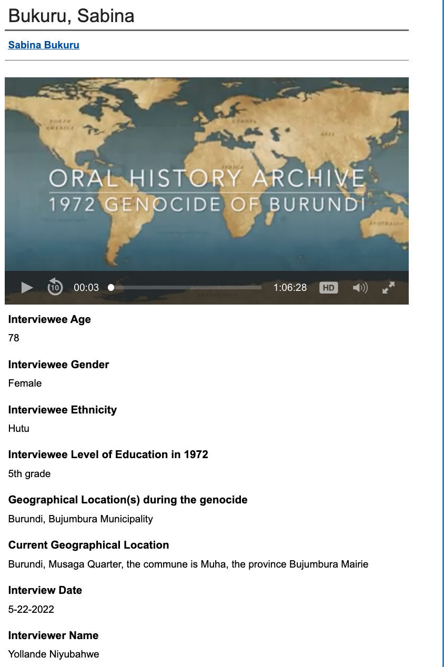
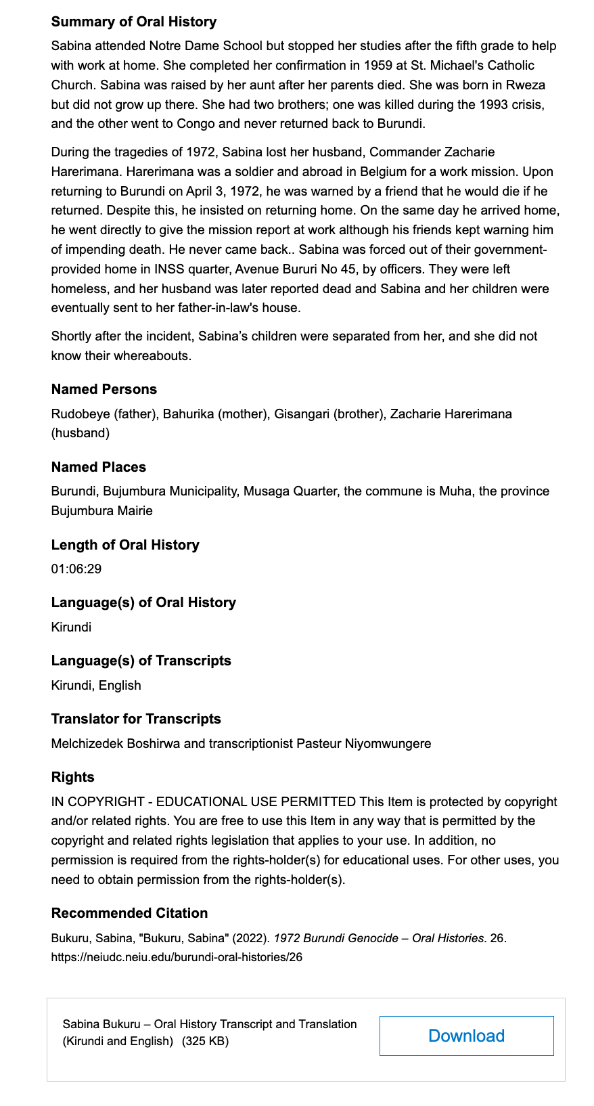
Adapting Metadata for Complex Collections
1972 Burundi Genocide Survivors Oral History Collection
Expanded beyond standard Dublin Core fields to provide necessary context and depth for this collection.
Introduced custom metadata fields such as ethnicity, education level, age, and locations during and after the genocide.
This unique set of fields is not used in other Digital Commons collections but was essential for understanding the testimonies.
Don’t hesitate to create custom metadata when needed—enhancing usability and comprehension should always be the priority.
Image: Oral history of Sabina Bukuru in the 1972 Genocide of Burundi collection

Slide 17
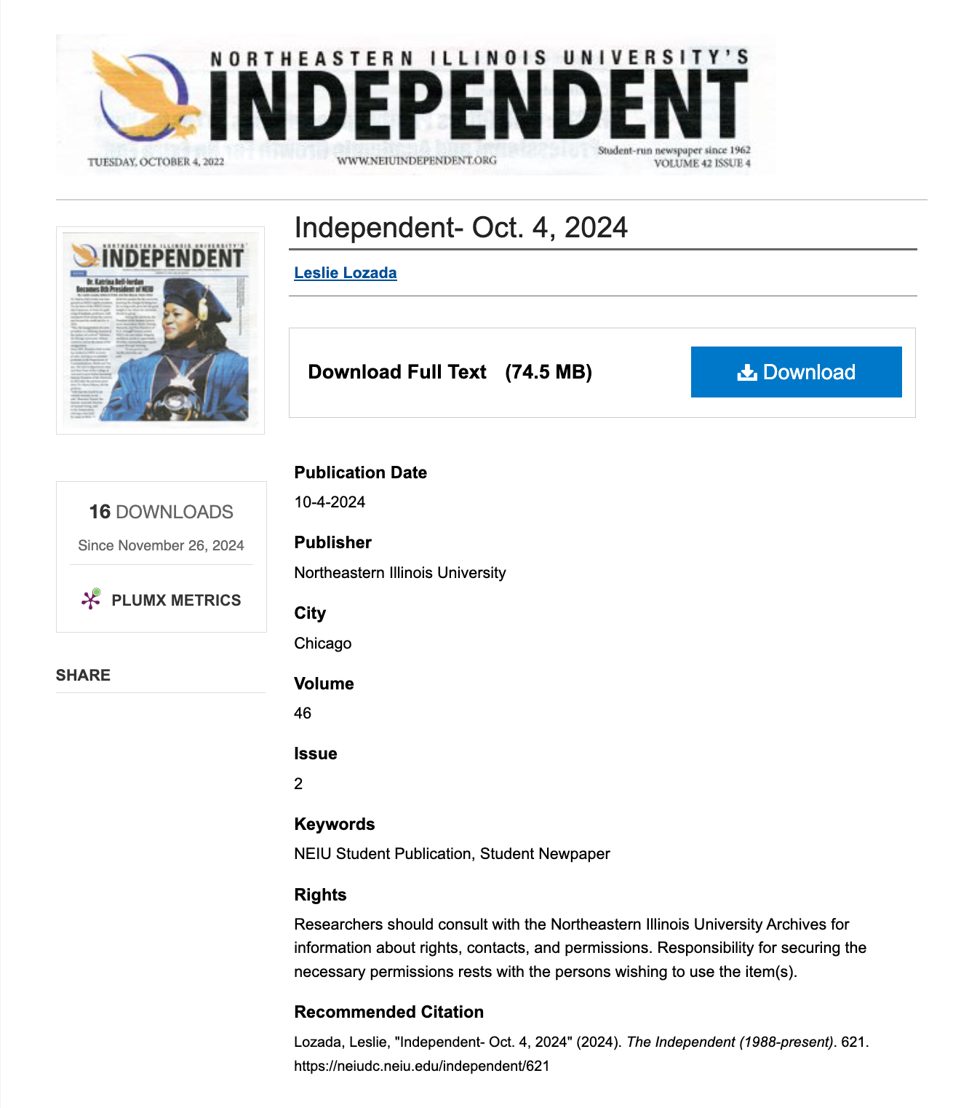
Minimal Metadata, Maximum Access: NEIU Student Newspapers
Metadata for the student newspapers was intentionally kept minimal to align with the level of description in the finding aid.
Newspapers are a well-known format, reducing the need for detailed metadata.
Focused on providing access and discoverability quickly, rather than exhaustive description.
Uploaded OCR’d PDFs, enabling full-text keyword searching within Digital Commons.
Outcome: 6 student newspaper titles and nearly 1,400 issues now available to researchers online.
Image: October 4, 2024 issue of the student newspaper the Independent

