Slide 1
What is Creative Commons?
CC BY 4.0, 2023, Chris Chang
“What is Creative Commons?” by Chris Chang is licensed under a Creative Commons Attribution 4.0 International License.

Slide 2
Introduction

Slide 3
The Fundamental Tension
Historical Background
What are the issues?
Why they matter?

Slide 4
Historical Background
The birth of internet in 1989 sparked many exciting new ideas, one of which is the dissemination of knowledge and information. Eric Eldred, a literacy advocate, started to re-publish works of others in public domain. The works in public domain are free to be used or recreated without paying fee or credit to the owners.

Slide 5
CTEA
In 1998, the Sonny Bono Copyright Term Extension Act (CTEA) was introduced, which extended copyright terms in the United States by 20 years. Unlike the original Copyright Act of 1976 which allowed the copyright term of the life of the author plus 50 years, or 75 years from publication or 100 years from creation, the new 1998 CTEA extended these terms to life of the author plus 70 years and for works of corporate authorship to 120 years after creation. It ended up preventing many works from entering the public domain in 1998 and following years.

Slide 6
Eldred v. Ashcroft
Eric Eldred, an internet publisher of the public domain works, became the lead petitioner to challenge the new CTEA law in court was represented by Lawrence Lessig. The Supreme Court of the United States decided that 20-year retroactive extension of existing copyright terms in the 1998 CTEA did not violate the Copyright Clause or the First Amendment of the Constitution and was constitutional (a 7-2 decision on January 15, 2003).

Slide 7
Creation of Creative Commons
Despite the setback in court, Lessig and others were inspired by Eldred, who had the pioneering idea of freely sharing the public domain contents through the internet. Thus, the Creative Commons was created as a non-profit organization in order to provide free, public licenses that would allow creators to retain their copyrights, but still share them with public on more flexible terms. Once created, it has become a global movement.

Slide 8
What is CC?
What is CC?
What is CC trying to accomplish with its licenses?
The number of CC-licensed works available today
Ways to get involved with CC and the CC Global Network

Slide 9
What is Creative Commons?
Creative Commons is an internationally active non-profit organization that provides free licences for creators to use when making their work available to the public.
Creative Commons works within copyright law. It allows creators to grant permission to everyone in the world to use their work in certain ways.
Creative Commons continues to assist and advocate for users to overcome obstacles to the sharing of knowledge and creativity.

Slide 10
What are CC licenses trying to accomplish?
Creative Commons licenses give everyone from individual creators to large institutions a standardized way to grant the public permission to use their creative work under copyright law.
The Creative Commons copyright licenses and tools forge a balance inside the traditional “all rights reserved” setting that copyright law creates.
With Creative Commons licenses, creators are empowered to give permission to everyone to use, share, and remix their work without needing to ask.

Slide 11
Creative Commons Licences - 3 Layers
The Legal Code - The legal code is the terms and conditions of the license that are enforceable in court. This layer makes the base of the license.
Common Deeds - The common deeds are the web pages that lay out the terms of the licenses in language for a layperson.
Machine Readable Version - The final layer of the license is a machine readable version that helps software with the creation, distribution, reproduction, and discovery of Creative Commons works.

Slide 12




Creative Commons License - 4 Elements
Attribution or BY. All licenses must include this element. | Non-Commercial or NC. This means the work is only available to use for non-commercial purposes. | Share Alike or SA. This symbol means that if any adaptations or derivatives are made that they must be shared using the same license type as the original. | No Derivatives or ND. This means that users cannot share derivatives or adaptations of the work.

Slide 13
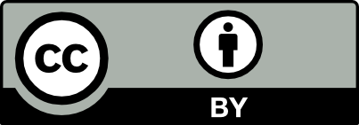

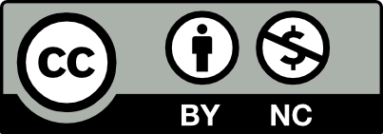
Creative Commons License - 6 Types
 | CC BY | This license is the most permissive of the licenses. It requires users to give attribution to the creator. From there, users can distribute, build upon, remix, and adapt the source. Commercial use is allowed with this license.
 | CC BY-SA | This license also requires the user to give attribution to the creator and allows user to distribute and use the work in the same way as the CC BY license, including commercial use. However, for users who create a derivative of the work, they must use the same license as the original work.
 | CC BY-NC | This license also requires attribution to the creator. Users can distribute, adapt, remix, and build upon the original work, as long as it is for non-commercial purposes.

Slide 14

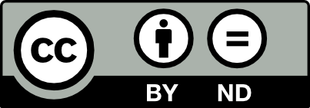
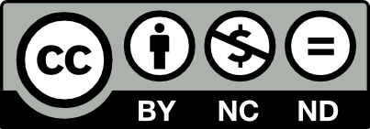
Creative Commons License - 6 Types
 | CCBY-NC-SA | This license has the same requirements as the CC BY-SA license. If the user creates a derivative of the work, then the user must use the same type of license. The use must also be for non-commercial purposes.
 | CC BY-ND | This license allows users to copy and distribute materials with attribution to the creator. However, this license does not allow you to build upon, adapt, or remix the content. The distribution can be for commercial use.
 | CC BY-NC-ND | This license has the same parameters as the BY-NC license, however, the distribution can only be for non-commercial use.

Slide 15


Creative Commons License - Public Domain
 | CC Zero or CC0 | This tool allows creators to donate their work to the public domain to the greatest extent that they can. It allows creators to take a "no rights reserved approach." It has the same three layers as a CC License. The legal code includes a fall back license for jurisdictions that do not allow a creator to fully dedicate their work to the public domain.
 | Public Domain Mark | This is a mark that is used on works that have no copyright restrictions. This mark has no legal implications when attached to a work. It's purpose is only to inform others that the work is in the public domain.

Slide 16
CC Licensed Works
How many CC licensed works are there?
Currently over 2 billion CC-licensed works, including literary works, videos, photos, audio, open education, and scientific research, exist across millions of websites, such as Wikipedia, Flickr, YouTube, DeviantArt, Wikimedia Commons, Stack Exchange, MDN, Internet Archive, Khan Academy, LibreTexts, OpenStax, MIT OpenCourseWare, WikiHow, TED, OpenStreetMap, GeoGebra, Doubtnut, Fandom, Afruino, ccmixter.org, Ninjam, etc.

Slide 17
Creative Commons Global Network
The Creative Commons Global Network, formal affiliate network restructured as a network organization in 2018, is the home for a community of advocates, activists, scholars, artists, and users working to strengthen the Commons worldwide.
Creative Commons is the global standard for sharing content for use and re-use, but the organization relies on people to be able to exist. Get involved!

Slide 18
Timeline

Slide 19
Sonny Bono Copyright Term Extension Act (CTEA) enacted
Creative Commons HQ opens on the ground floor of Stanford Law School on May 16, 2002
MIT OpenCourseware adopts CC 1.0 license on January 18, 2003
1998
2001
2002
2002
2003
Creative Commons founded on January 16, 2001
First set of Creative Commons Licenses, version 1.0, released on December 16, 2002

Slide 20
Cory Doctorow publishes first CC licensed novel: Down and Out in the Magic Kingdom
One million works officially CC licensed on December 31, 2003
Over 50 millions of works are CC licensed and CC Search launches
2003
2003
2003
2004
2006
Rice Connexions (now OpenStax CNX) publishes OER with CC license
Version 2.0 of CC licenses released and nearly 5 million works CC licensed

Slide 21
CC launches version 3.0 of the licenses on February 23, 2007
CC0 introduced: CC0 1.0 Universal (CC0 1.0) on March 11, 2009
Version 4.0 of CC licenses released on November 26, 2013
2007
2008
2009
2012
2013
First appearance of CC0 in the wild
UNESCO Paris OER Declaration approved by world governments

Slide 22
CC publishes Intergovernmental Organization (IGO) licenses
CC Open Education Platform launches on May 31, 2017
CC joins six other organizations to launch the Movement for a Better Internet
2013
2014
2017
2019
2022
First CC Institute for Open Leadership on January 9, 2014
2 billion works licensed on December 31, 2019

Slide 23
Thank You!

