Slide 1
What is Copyright Law?
CC BY 4.0, 2023, Chris Chang
Notes:
Licensed under a Creative Commons Attribution 4 International License

Slide 2
The purpose of copyright

Slide 3
What is copyright?
Copyright is a form of protection grounded in the U.S. constitution and granted by intellectual property law for original works of authorship fixed in a tangible medium of expression. Copyright covers both published and unpublished works.
The purpose of copyright is to protect the authorship of original works “fixed in a tangible medium of expression”.

Slide 4
Copyright owner can control who can…
make copies of the work,
distribute copies of the work
perform or display the work publicly, and
make derivative works, like translations, adaptations, and reinterpretations.
Everyone is a copyright owner and user!

Slide 5
Economic and social reasons
The U.S. copyright law enables creators control and receive economic compensation for their work, so that more creative works can benefit the society.
Some other countries also recognize the “moral rights” of the creators in connection with their works.
For additional information on copyright theory, see here.

Slide 6
Copyrightable?

Slide 7
What does copyright protect?
Copyright protects original works of authorship including literary, dramatic, musical, and artistic works, such as poetry, novels, movies, songs, computer software, and architecture.
See Circular 1, Copyright Basics, section "What Works Are Protected."

Slide 8
What is copyrightable?
literary works, musical works, dramatic works, pantomimes and choreographic works, pictorial and graphic works, motion pictures, sound recordings, sculptural and architectural works can be copyrighted
Works must contain something “original” and “fixed in a tangible medium of expression” to be copyrighted.

Slide 9
What is NOT copyrightable?
procedures, processes, systems, methods of operation
ideas, concepts, principles, or discoveries
titles, names, short phrases
familiar symbols or designs, typefaces, fonts, and lettering
recipes
layout and design
blank forms
Unoriginal or unfixed works cannot be copyrighted!

Slide 10
Copyright vs. Intellectual Property

Slide 11
What is intellectual property?
Intellectual property refers to any intellectual creation, such as literary works, artistic works, inventions, designs, symbols, names, images, computer code, etc.
Types: patens, copyright, trademarks, industrial designs, geographical indications, and trade secrets
IP is protected in law by, for example, patents, copyright, and trademarks, which enable people to earn recognition or financial benefit from their works.

Slide 12
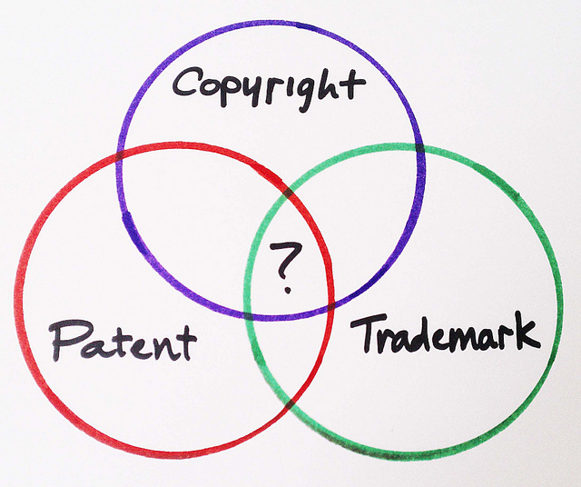
Copyright vs. other IP laws
IP is an umbrella term encompassing both copyright and industrial property
Other industrial property includes inventions, patents, trademarks, industrial designs, and geographical indications.
("Copyright, Patent, or Trademark?" by BusinessSarah, CC-BY.)

Slide 13
How to receive copyright protection

Slide 14
Getting a copyright
When an original, fixed on a tangible medium work is born, the creator automatically receives its copyright.
Registration is optional.
Copyrights can be registered with the U.S. Copyright Office. There is a nominal fee when registering, and a copy of the work must be deposited.
For more information on copyright, see here.

Slide 15
Duration of copyright
The term of copyright for a particular work depends on several factor.
For works created after January 1, 1978, copyright protection lasts for the life of the creator plus an additional 70 years.
Once that period of time expires, the work enters the public domain!

Slide 16
The public domain

Slide 17
What is public domain?
The term “public domain” encompasses those materials that are not protected by intellectual property laws such as copyright, trademark, or patent laws. No individual owns these works; rather, they are owned by the public. Anyone can use a public domain work without obtaining permission and without citing the original author, but no one can ever own it.

Slide 18
5 ways to arrive in the public domain
The copyright has expired.
The copyright failed to affix the required notice.
The copyright owner failed to follow renewal rules.
The copyright owner deliberately places the item in the public domain.
Copyright law does not protect this kind of work.
Welcome to the Public Domain! (Stanford Libraries)

Slide 19
Using works in the public domain
When using works from the Public Domain, you do not need to credit the author nor do you need to get permission, according to a https://supreme.justia.com/cases/federal/us/539/23/.
However, it is wise to cite your sources, so crediting the original author or the source is a best practice.

Slide 20
Exceptions and limitations

Slide 21
Built in exceptions and limitations
Copyright always allows some uses without any permission.
The classroom use exemption: both instructor and students can perform or display any works. It only applies to a usage in a classroom, at a nonprofit educational institution, for people there in person.
Fair use: s flexible exception but difficult to predict.

Slide 22
Other exceptions, exemptions, and limitations
First sale: once a single copy of a creative work has been sold, that particular copy can be redistributed by anyone. Libraries can lend the copies they own due to this.
Libraries are allowed to provide copiers and scanners without being liable for copyright infringement.
Small businesses are allowed to have radios and TVs where customers can see and hear them.

Slide 23
Fair use - what is it?
Fair use is a legal doctrine that promotes freedom of expression by permitting the unlicensed use of copyright-protected works in certain circumstances.
The major fair use decisions are summarized in the fair use index, which is searchable.
The distinction between what is fair use and what is not is not always clear.

Slide 24
Fair use - the four factors
The purpose and character of the use, including whether such use is of commercial nature or is for nonprofit educational purposes
The nature of the copyrighted work (e.g., whether it is factual or creative in nature)
The amount and substantial of the portion used in relation to the copyrighted work as a whole
The effect of the use upon the potential market for or value of the copyrighted work

Slide 25
Reference
Copyright.gov
WIPO
Copyright & Fair Use (Stanford Libraries)
Legal Information Institute at Cornell Law School

Slide 26
Thank You!

