Slide 1
Welcome
  CARLI Libraries Assessing Library Impact:
  Engaging a National Initiative
  Lisa Hinchliffe, University of Illinois at Urbana-Champaign
  Sarah Horowitz, Augustana College
  Amy Glass, Illinois Central College
  Heather Jagman, DePaul University
  Mary Thill, Northeastern Illinois University
  CARLI Annual Meeting – November 1, 2013

Slide 2
Abstract/Proposal
“Assessment in Action: Academic Libraries and Student Success” (AiA) is a three-year of the Association of College and Research Libraries (ACRL) in partnership with the Association for Institutional Research and the Association of Public and Land-grant Universities, funded through a National Leadership Grant from the Institute of Museum and Library Services. Four CARLI libraries were selected through a competitive application process to participate in the inaugural year of the program. The libraries and the research questions/topics being investigated are:
Augustana College - Explore the impact of using and engaging with original primary source materials on student learning for a population of first-year liberal studies (general education) students.
DePaul University - After having participated in a self-directed library activity as part of their first-year experience curriculum, will students be able to provide evidence of how the library supports their success as an academic learner?
Illinois Central College - How does library instruction provided for an ENG111 class impact student success within a research project?
Northeastern Illinois University - What is the best role for a librarian in IL instruction: online tutorial, curriculum designer, flipped classroom mediator, or lecturer in a traditional classroom?
The AiA program is being co-lead by Lisa Hinchliffe, University of Illinois-Urbana, and Debra Gilchrist, Pierce College-Washington. The proposed research session will focus on the four research projects investigating library impact student learning and success; all four librarians serving as campus team leaders have agreed to work together in creating/presenting this session. A short mention of the process for applying to participate in years two and three of the AiA program will also be made.
Information literacy and user education are still relatively nascent as consortial activities in CARLI though forums are well-attended and much appreciated by members. This session is envisioned as an opportunity to build our shared knowledge base about effective instruction and engagement practices. Over time it is hoped such research will also identify the most cost-effective practices for achieving instruction goals. Though the AiA assessment effort is not directed by CARLI per se, the AiA program may also be a model CARLI could consider for supporting library research and assessment efforts in the future.

Slide 3

Value of Academic Libraries Report
Freely available
http://acrl.org/value

Slide 4
Institutional Context
“Few libraries exist in a vacuum, accountable only to themselves. There is always a larger context for assessing library quality, that is, what and how well does the library contribute to achieving the overall goals of the parent constituencies?”
(S. Pritchard 1996)

Slide 5

Recommendations
Define outcomes
Create or adopt systems for assessment management
Determine what libraries enables students, faculty, student affairs professionals, administrators and staff to do.
Develop systems to collect data on individual library user behavior, while maintaining privacy.
Record and increase library impact on student enrollment.
Link libraries to improved student retention and graduation rates.
Review course content, readings, reserves, and assignments.
Document and augment library advancement of student experiences, attitudes, and perceptions of quality.
Track and increase library contributions to faculty research productivity.
Contribute to investigate library impact on faculty grant proposals and funding, a means of generating institutional income.
Demonstrate and improve library support of faculty teaching.
Create library assessment plans.
Promote and participate in professional development.
Mobilize library administrators.
Leverage library professional associations.

Slide 6

ACRL’s IMLS Collaborative Planning Grant
Building Capacity for Demonstrating the Value of Academic Libraries

Slide 7
Themes from Summits
Accountability
Unified approach
Student learning/success
Evidence-based

Slide 8
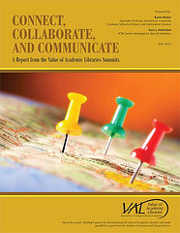
“The White Paper”
Freely available
http://acrl.org/value

Slide 9
Recommendations
Increase librarians’ understanding of library value and impact in relation to various dimensions of student learning and success.
Articulate and promote the importance of assessment competencies necessary for documenting and communicating library impact on student learning and success.
Create professional development opportunities for librarians to learn how to initiate and design assessment that demonstrates the library’s contributions to advancing institutional mission and strategic goals.
Expand partnerships for assessment activities with higher education constituent groups and related stakeholders.
Integrate the use of existing ACRL resources with library value initiatives.

Slide 10

Assessment in Action Grant

Slide 11
Assessment in Action Goals
Professional Competencies
Collaborative Relationships
Approaches, Strategies, Practices

Slide 12
Team Approach
Librarian Leader
Institutional Researcher/ Assessment Officer
Faculty Member

Slide 13
Components of Program Design
Blended Learning
Community of Practice
Action Learning Projects
Sharing Results

Slide 14
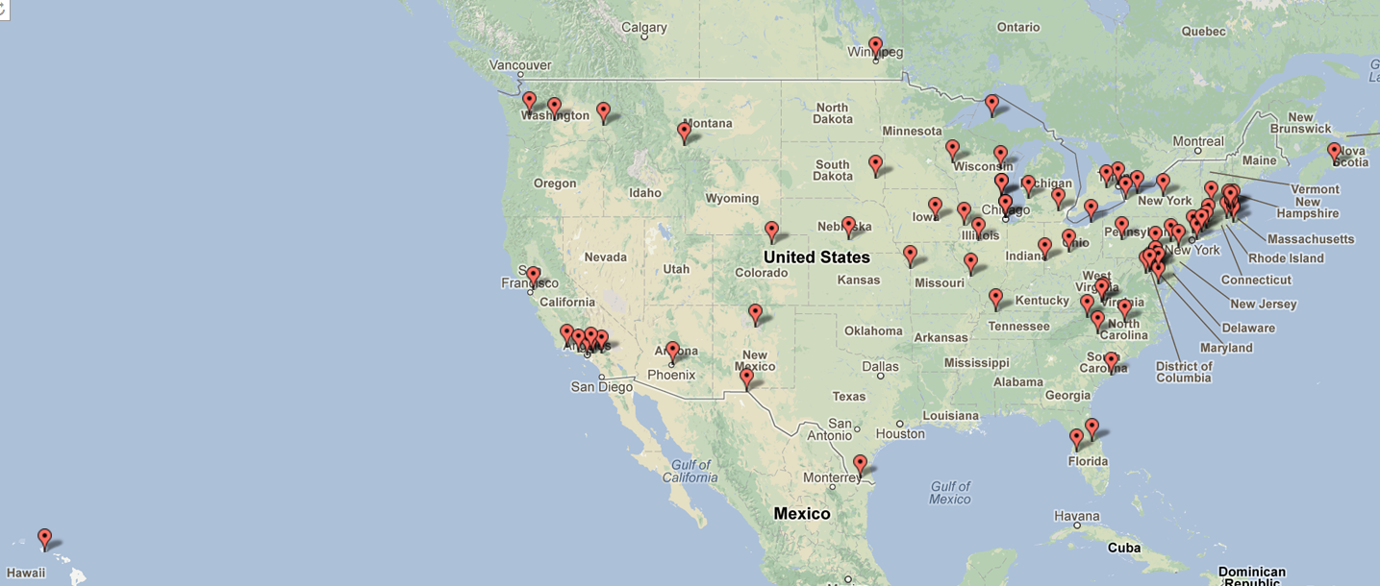
AiA 2013 Institutional Teams

Slide 15
YEAR 1: FOUR CARLI LIBRARIES

Slide 16
Augustana College

Slide 17
Research Question and Outcomes
What is the impact of using and engaging with original primary source materials on student learning for a population of first-year liberal studies (general education) students?
Critical thinking
Information literacy

Slide 18
Why Special Collections?
~25% of Augustana students, including 25% of first-year students, use Special Collections each year
Very little has been done to assess student learning in special collections
Ability to sort through paper documents important real-world skill (Project Information Literacy)

Slide 19
Population
Seven first-year classes using primary sources in Special Collections
All working on some aspect of Augustana College history
Using a wide variety of sources

Slide 20
Document Analysis
Document analysis exercise both before and after time in Special Collections
Analyzed using a rubric
  Observation, Interpretation, Materiality, Evaluation/critical thinking, Engagement/cultural understanding
Looking for improvement in their scores and skills

Slide 21
Paper Analysis
Student submit a copy of their paper that uses Special Collections sources
Papers are evaluated against a modified version of the American Association of Colleges & Universities information literacy rubric
Comparisons with papers of students who did not use Special Collections

Slide 22
Illinois Central College

Slide 23
Illinois Central College
How does library instruction provided for an ENG111 class impact student success within a research project?

Slide 24
Team members from English faculty, administrators, our assessment committee, and Institutional Research
Collaboration has strengthened relationships with each department
Creating rubric to determine “success”

Slide 25
Kept this very small to start
  One project within ENG 111
  Comparison of sections using variety of delivery methods
    F2F/Online
    Faculty who do not ask for library instruction
Needed to get our “foot in the door” regarding assessment
Future plans – to expand to other departments

Slide 26
DePaul University

Slide 27
DePaul University
After having participated in a self-directed library activity as part of their first-year experience curriculum, will students be able to provide evidence of how the library supports their success as an academic learner?

Slide 28
DePaul Team Members
Heather Jagman, DePaul University Library
Lisa Davidson, Advising
Lauri Dietz, University Center for Writing Based Learning (UCWbL)
Jodi Falk, Center for Students with Disabilities
Toni Fitzpatrick, New Student and Family Engagement (NSFE)

Slide 29
The Assignment
Prior to class, first year students will visit the a DePaul Campus library, figure out how to locate an item of interest to them, check out the item, and reflect on the process.

Slide 30
The Reflection Essay
Why are you interested in this item?
Did you look for a specific item, or just any book or other material about your topic?
Did you find it, or did you end up checking out another related item?
Please detail the steps you took to find your item. Please be as specific as possible. Was it easier or harder to find something than you expected?
What about this experience was new to you?
What was familiar?
What would you still like to know?
Based on this activity, describe at least one way the library can support your role as a university learner.

Slide 31
Collecting/Analyzing the data
Outcome 1 – Students will visit the DePaul University Libraries and gain familiarity with the physical attributes of the libraries.
Outcome 2 – Students will complete a successful search for material and check out at least one item.
Outcome 3 – Students will identify and articulate novel features of the academic library relative to their prior experience with libraries.
Outcome 4 – Students will articulate at least one way the library can support their success as university learners.

Slide 32
Other analysis…
Qualitative analysis: what are students saying, and how are they saying it?
Survey questions: NSFE survey, other data from IR we can potentially use to triangulate

Slide 33
Northeastern Illinois University

Slide 34
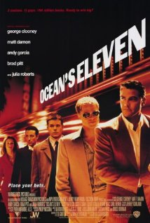
Background
The right time.
The right job.
The right team.

Slide 35
Lessons Learned (So Far)
Summer 2013 Planning
Fall 2013 Pilot
Spring 2014 Study

Slide 36
Will Your Library Participate?

Slide 37
Apply for Year 2
Application available January 14, 2014
Virtual information session in January
Applications due March 7, 2014
Notifications April 8, 2014
Program starts mid April

Slide 38
FYI: Basics of Applying
1. Identify a team:
  • one librarian
  • minimum two people from other campus units
2. Write two essays:
  • team’s project goals
  • librarian team leader’s goals
3. Secure two statements of support:
  • library dean/director
  • chief academic officer

Slide 39
Thank You!
Questions or Comments?

