Slide 1
swimming instead of drowning in data: Usage statistics management @ SIUC
Andrea Imre
Southern Illinois University Carbondale
CARLI SYMPOSIUM on USAGE STATISTICS, March 26, 2019

Slide 2
Background
Collection budget: $4.7Million (about 90% spent on electronic)
Size of collection: about 3000 active subscriptions (either individual journals or journal packages)
Usage statistics tools:
MS Excel
MS Access
Ustat from Ex Libris (2012)
CORAL (2013)
Notes:
USTats – implemented in 2012 but it was not satisfactory to our librarians for collection evaluation

Slide 3
Challenges
Organizing login info for vendors/platforms
Consolidating statistics from different vendors
Making statistics easily available to other librarians
UNDERSTANDING and Interpreting data
Notes:
4 challenges

Slide 4
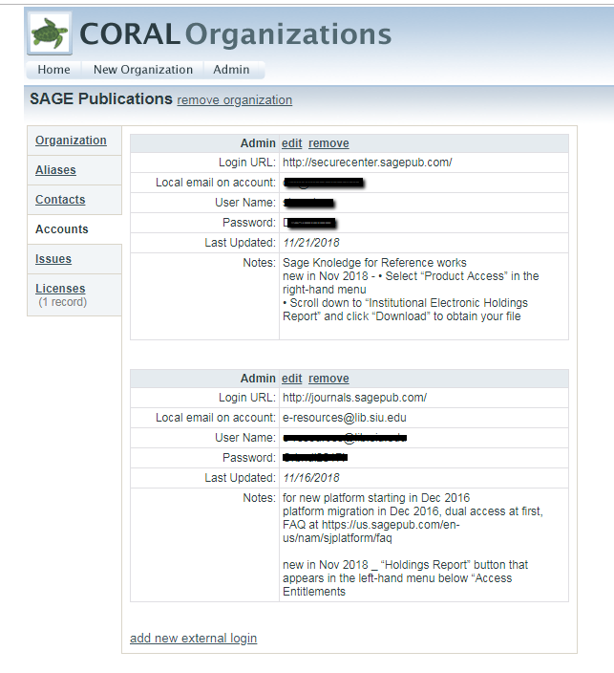
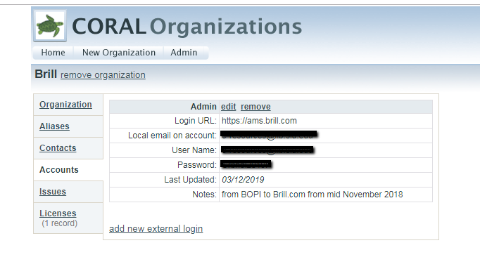
Challenge 1: Organizing library admin account info
Notes:
SIUC stats are harvested from 87 different platforms/vendors (Silverchair, Atypon, Scholar IQ)
CORAL is an open sources ERM originally developed in 2010
3 modules installed at SIUC in 2011
Resources
Organizations
Licensing
Usage statistics installed in 2013, used for journal stats management
Tracking platform migrations
Tracking log in info changes (some platforms require login to be updated frequently)
admin login, associate platforms or vendors with parent organizations/vendors, record notes about the platform or our account.

Slide 5
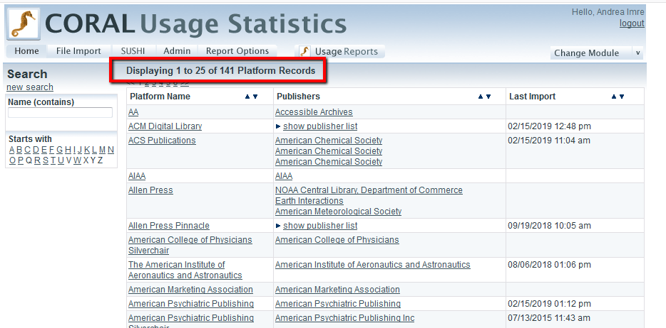
Notes:
Platforms /publishers constant change, since 2013 we have loaded statistics from 141 different platforms. Currently we have 87 active platforms.

Slide 6
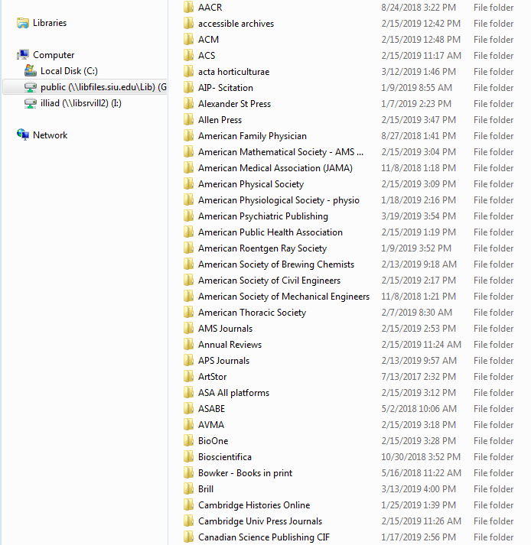
Challenge 2: Consolidating statistics from different vendors

Slide 7
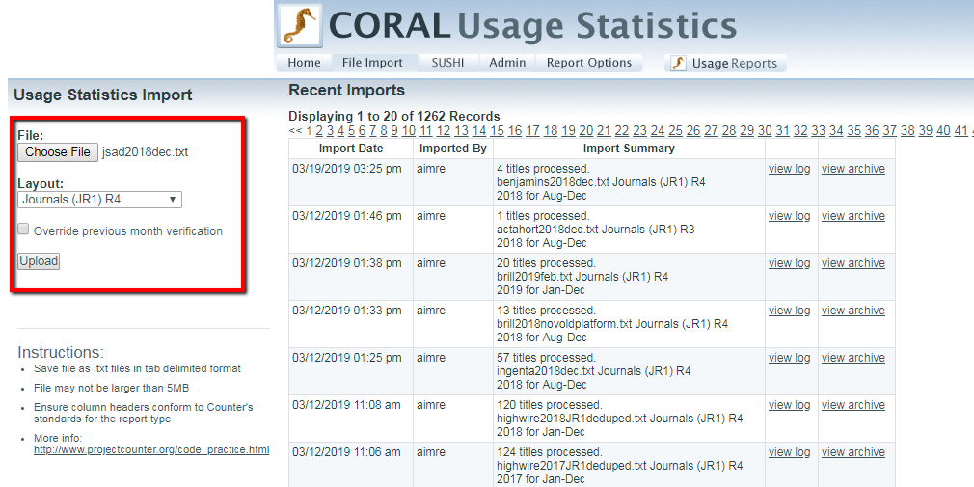
Upload COUNTER journal stats
Notes:
SUSHI note : we have not configured CORAL with SUSHI yet. Our update schedule is manual and takes places about 2x/year or as needed for collection development. Complete calendar year data is used for annual journal evaluations/cancellations while fiscal year data is used for reporting purposes (ACRL, ARL, institutional statistics).

Slide 8
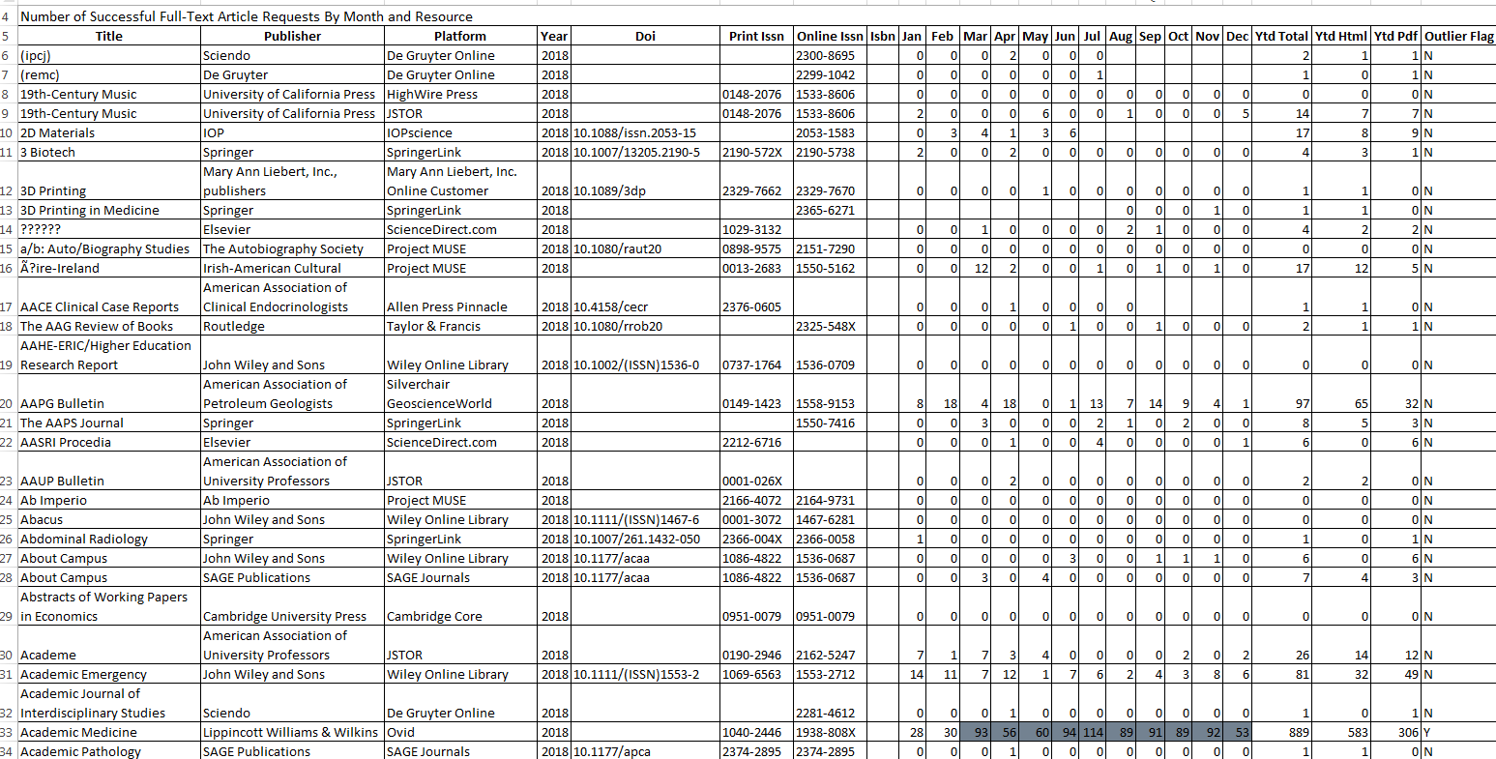
Notes:
Over 13,000 lines in 2018 usage consolidated usage file (we do not include aggregator data in this file)

Slide 9
MS Access
Acquisition data + CORAL usage data

Slide 10
Data cleanup after Access reports
Platform changes
Timing
Title changes
Vendor website design and handling of title changes affect usage
Title transfers
archival backfiles (https://tinyurl.com/y2gaf3zh)

Slide 11
Analysis of data
Collection development use of stats: annual review and vendor negotiations
Cost per use
Overall cost
Overall use

Slide 12
Challenge 3: Making Stats Accessible
Notes:
Web interface

Slide 13
Challenge 4: UNDERSTANDING and Interpreting data
COUNTER compliance
COUNTER standard changes
Considering aggregator database coverage and Archival Collection use in ANALYSIS
vendor platform design and implications on usage stats
Inbound links (HTLM view or Abstract VIEW)

Slide 14
COUNTER 5
Goals:
Reduce complexity and redundancy
Increase clarity and consistency and flexibility
More adaptable for future changes
Effective in Jan 2019
Audit status listed at https://www.projectcounter.org/about/organisations-working-towards-release-5-compliance/
New definitions introduced, equivalencies available at https://www.projectcounter.org/code-of-practice-five-sections/13-transitioning-previous-releases-new-reporting-services/#rfourtofive
Notes:
prior-release reports must be made available from the content provider’s transition date through to 3 full months after the effective date of the new release
Reduce complexity and redundancy (4 master reports, fewer metric types, new attributes)
Increase clarity and consistency and flexibility (report layouts and formats, vocabulary & terminology)
Investigation vs. requests (HTML, PDF, or multimedia, i.e. watching video)
TR_J1 excludes Gold OA (Standard view) - includes total item requests and unique item requests
COUNTER Youtube channel tutorials, email forums, webcasts organized by publishers (Elsevier), webpages created by publishers

Slide 15
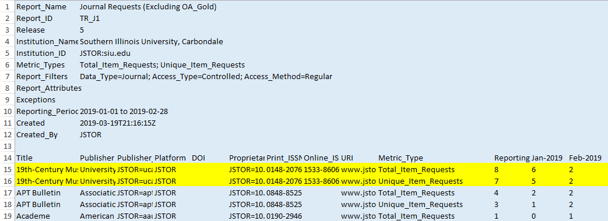
Notes:
An HTML article downloaded and then the user downloads the PDF in the same session =
Unique_Item_Requests = 1
Total_Item_Requests = 2

Slide 16
Future plans
Alma
CORAL

Slide 17
Questions?
Andrea Imre
aimre@lib.siu.edu

