Slide 1
E-Resources Linking Troubleshooting Part II: OpenURL and CTO
Alma/Primo VE Open Office Hours
April 13, 2023
Notes:
(Jen

Slide 2
Troubleshooting patron reports of e-resources linking problems.
The Link _Still_ Doesn't Work:
E-Resources Linking Troubleshooting Part II:
OpenURL and CTO
Denise Green, CARLI
For I-Share Alma/PrimoVE Librarians working with e-resources’ linking.
Questions & Comments at the end of presentation.
Notes:
<NS - Welcome> I am Denise Green, today’s audience, keep Q & A for end.
Hello everyone, I’m Denise Green, CARLI.

Slide 3
Advanced: Troubleshooting e-resources linking problems.
Learning Goals
Build on Dec. 8, 2022 presentation “The Link Didn’t Work…”
Become Familiar with OpenURL
What is OpenURL?
How to interpret OpenURL
Steps in the Alma/Primo VE Link resolver process
Diagrams
What’s Alma CTO?
How to display and decipher CTO
Notes:
Today we will build on presentation: slides at https://www.carli.illinois.edu/sites/files/i-share/documentation/OfficeHours_20221208-Slides.pdf recording: via https://www.carli.illinois.edu/products-services/i-share/alma/CARLIOfficeHours
Learn more about OpenURL, how to interpret them, how to use in troubleshooting, Alma’s link resolver esp. OpenURL and CTO

Slide 4
Advanced: Troubleshooting e-resources linking problems.
Library e-resource
Google Scholar
Vendor’s interface
If Off Campus- Authentication/Proxying
Alma builds an OpenURL/ Context Object, etc.
Link Resolver- Alma as seen via Primo VE
On to publisher, repository or vendor interface
Full Text: html/pdf/ streaming media, etc.
Notes:
In our first presentation we looked at problems with authentication, collection activation and metadata, Here’s a simplified map of the usual process for e-resources discovery and access. Typically , your patrons or students or faculty /staff are looking for information in an index of some kind whether from Google or your library’s e-resources’ catalog/discovery tools or a Vendor’s interface like ACS Publications, EBSCOhost, ProQuest, etc. They find a promising citation and then we’re off to get through authentication, the building and use of OpenURL, matching with available & active full text e-resources and on to the full text.
Simple process, right? , NOT! Today focus on this part of process in blue box- Alma building OpenURL and CTO and how link resolver processes the bibliographic and e-title information.

Slide 5
Advanced: Troubleshooting e-resources linking problems.
Review of First “Troubleshooting Linking Problems” December 2022 Office Hours
1. Always Start with a Do Over-
Re-create the search and Try another web browser than what the patron used.
2. Authentication issues: On Campus/Off Campus
the off-campus patron is getting "Access denied" or "You must authenticate..." type messages.
3. E-Collection or E-title activation problems:
Correct e-resource activated?
Need a Customer ID/Code/Subscriber number, etc.?
Dates of coverage or Open Access status wrong in active resource?
Notes:
In our December 2022 presentation: we learned to start with recreating the search & checking the reported dud link. Could be temporary issue with web browser, ISP or vendor’s site. Could be Authentication…,
Also source of poor linking may be a collection or title Alma activation matter…

Slide 6
Advanced: Troubleshooting e-resources linking problems.
4. Is The Citation accurate? Metadata issues.
The journal/periodical/ebook is different. Or has different versions/editions? Ex. “New York Times”
Could numbers have been flipped or typed incorrectly?
Is important information missing like date or ISSN/ISBN?
Is the article very new? Or in “members only” section?
Does genre not match bibliographic info?
Notes:
Final area we examined are when the citation just isn’t right, something’s off with this reference’s metadata.
Look up the article or ebook/monographic citation in a different index or Google Scholar or Web of Science or a publisher’s website or what ever is available. Compare with the dud linking citation. Any of these errors?
https://www.carli.illinois.edu/products-services/i-share/electronic-res-man/primove-broken-links , see section “Outside Citation Data Issues
“. In short the old “Garbage in, Garbage out” still applies.

Slide 7
Advanced: Troubleshooting e-resources linking problems.
So how do you investigate cases of poor linking due to bibliographic citation inaccuracy, too brief or skimpy citations or other metadata issues?
These are cases where the generated OpenURL is not working as expected and hence, is helpful to examine the OpenURL and related CTO in detail.
First, we’ll explore how Alma processes a citation into an OpenURL for the link resolver Primo VE “View Online” menu.
Notes:
But how see the possibly faulty citation data?
To build on our first presentation, we’ll examine how to investigate cases of poor linking related to citation mistakes or missing information. And where (for whatever reasons) the OpenURL is not working as expected….

Slide 8
Advanced: Troubleshooting e-resources linking problems.
Your patron finds a citation like this example:
Kader M, Hossain MA, Reddy V, Perera NKP, Rashid M. Effects of short-term breathing exercises on respiratory recovery in patients with COVID-19: a quasi-experimental study. BMC sports science, medicine & rehabilitation. 2022; vol.14(issue 1): pp. 60-70. doi:10.1186/s13102-022-00451-z
- Next the Alma link resolver builds an OpenURL building on citation/metadata elements like ISSN/ISBN, DOI, PMID, periodical title, author, date, volume, pages, etc.
Notes:
Here’s citation for a typical journal or periodical article. I added some underlining and other formatting to help distinguish the citation elements like author, article title, journal title, date, volume, issue , pages, DOI, etc.
Next…

Slide 9
Advanced: Troubleshooting e-resources linking problems.
Kader M, Hossain MA, Reddy V, Perera NKP, Rashid M. Effects of short-term breathing exercises on respiratory recovery in patients with COVID-19: a quasi-experimental study. BMC sports science, medicine & rehabilitation. 2022; vol.14(issue 1): pp. 60-70. doi:10.1186/s13102-022-00451-z
OpenURL
http://i-share-uic.primo.exlibrisgroup.com/view/uresolver/01CARLI_UIC/openurl?rft_val_fmt=info:ofi/fmt:kev:mtx:journal&rft.epage=60&rft.volume=14&rft.pub=BioMed Central Ltd&rft.place=England&rft_id=info:&rfr_id=info:sid/primo.exlibrisgroup.com-gale_doaj_&resource_typdoi/10.1186/s13102-022-00451-z&rft_id=info:pmid/35382885e=articles&rft.jtitle=BMC sports science, medicine & rehabilitation&rft.genre=article&rft.issue=1&rft.pages=60&rft_galeid=A699551545&vid=01CARLI_UIC:CARLI_UIC&rft.date=2022-04-05&rft_pqid=2652020974&rft.spage=60&rft.au=Kader, Manzur&rft_dat=<gale_doaj_>A699551545</gale_doaj_>&rft.atitle=Effects of short-term breathing exercises on respiratory recovery in patients with COVID-19: a quasi-experimental study&rft.issn=2052-1847&rft.eissn=2052-1847 ]
Notes:
So this citation becomes this OpenURL. Believe it or not, I looked for a relatively simple example of an OpenURL to start this OpenURL presentation, then can be much messier and longer. This citation to BMC Sports journal had the advantage of having lots of numeric identifiers. Alma uses those first in matching the OpenURL to available full text e-resources,
such as DOI, PMID, ISSN & EISSN, plus starting page number 60, volume 14, etc.

Slide 10
Advanced: Troubleshooting e-resources linking problems.
What’s OpenURL?- see https://en.wikipedia.org/wiki/OpenURL
A standard of how to organize bibliographic citation data. How to map standard id numbers, author, titles, page, date, etc. into machine readable strings like:
http://i-share-uic.primo.exlibrisgroup.com/view/uresolver/01CARLI_UIC/openurl?rft_val_fmt=info:ofi/fmt:kev:mtx:journal&rft.epage=60&rft.volume=14&rft.pub=BioMed Central Ltd&rft.place=England&rft_id=info:doi/10.1186/s13102-022-00451-z&rft_id=info:pmid/35382885&rfr_id=info:sid/primo.exlibrisgroup.com-gale_doaj_&resource_type=articles&rft.jtitle=BMC sports science, medicine & rehabilitation&rft.genre=article&rft.issue=1&rft.pages=60&rft_galeid=A699551545&vid=01CARLI_UIC:CARLI_UIC&rft.date=2022-04-05&rft_pqid=2652020974&rft.spage=60&rft.au=Kader, Manzur&rft_dat=<gale_doaj_>A699551545</gale_doaj_>&rft.atitle=Effects of short-term breathing exercises on respiratory recovery in patients with COVID-19: a quasi-experimental study&rft.issn=2052-1847&rft.eissn=2052-1847 ]
Notes:
To understand how the citations go bad you need to learn more about how link resolvers process bibliographic citation information. So what’s an OpenURL

Slide 11
Advanced: Troubleshooting e-resources linking problems.
From Wikipedia:
Format
OpenURL consists of a base URL, which contains the address of the user's institutional link-server, followed by a query string, consisting of key-value pairs serializing a ContextObject. The OpenURL ContextObject and/or rft_val_fmt is most often bibliographic data, but as of version 1.0 OpenURL can also include information about the requester, the resource containing the hyperlink, the type of service required, and so forth. For example:
http://resolver.example.edu/cgi?ctx_ver=Z39.88-2004&rft_val_fmt=info:ofi/fmt:kev:mtx:book&rft.isbn=0836218310&rft.btitle=The+Far+Side+Gallery+3
is a version 0.1 OpenURL describing a book.[11] http://resolver.example.edu/cgi is the base URL of an example link-server.
ctx_ver=Z39.88-2004 – specifying the OpenURL ContextObject version
rft_val_fmt=info:ofi/fmt:kev:mtx:book – specifying the metadata format for the referent (in this case, a book)
Then key-value pairs:
Fields from this format describing the referent object:
rft.isbn=0836218310 – the ISBN identifying the book
rft.btitle=The+Far+Side+Gallery+3 – the title of the book
Notes:
More on what’s an OpenURL – parts base url, context, then key-value pairs. Context object has different but related meaning in Alma that we’ll get to in a few minutes.

Slide 12
Advanced: Troubleshooting e-resources linking problems.
Kader M, Hossain MA, Reddy V, Perera NKP, Rashid M. Effects of short-term breathing exercises on respiratory recovery in patients with COVID-19: a quasi-experimental study. BMC sports science, medicine & rehabilitation. 2022; vol.14(issue 1): pp. 60-70. doi:10.1186/s13102-022-00451-z
http://i-share-uic.primo.exlibrisgroup.com/view/uresolver/01CARLI_UIC/ openurl?rft_val_fmt=info:ofi/fmt:kev:mtx:journal&rft.epage=60&rft.volume=14&rft.pub=BioMed Central Ltd&rft.place=England&rft_id=info:doi/10.1186/s13102-022-00451-z&rft_id=info:pmid/35382885&rfr_id=info:sid/primo.exlibrisgroup.com-gale_doaj_&resource_type=articles&rft.jtitle=BMC sports science, medicine & rehabilitation&rft.genre=article&rft.issue=1&rft.pages=60&rft_galeid=A699551545&vid=01CARLI_UIC:CARLI_UIC&rft.date=2022-04-05&rft_pqid=2652020974&rft.spage=60&rft.au=Kader, Manzur&rft_dat=<gale_doaj_>A699551545</gale_doaj_>&rft.atitle=Effects of short-term breathing exercises on respiratory recovery in patients with COVID-19: a quasi-experimental study&rft.issn=2052-1847&rft.eissn=2052-1847 ]
Notes:
Back to our simple example:
What’s the a base URL? http://i-share-uic.primo.exlibrisgroup.com/view/uresolver/01CARLI_UIC/openurl
The context? After question mark have the metadata format for the referent (in this case, a journal article) …rft_val_fmt=info:ofi/fmt:kev:mtx:journal&rft.epage=60&rft.volume=14&rft.pub=BioMed Central Ltd&rft.place=England&rft_id=info:doi/10.1186/s13102-022-00451-z&rft_id=info:pmid/35382885&rfr_id=info:sid/primo.exlibrisgroup.com-gale_doaj… note sid or source id of the citation.
Other key-value pairs - several like rft.genre=article, issue, page's, vendor ids from gale and pq, article or atitle, issn and eissn…

Slide 13
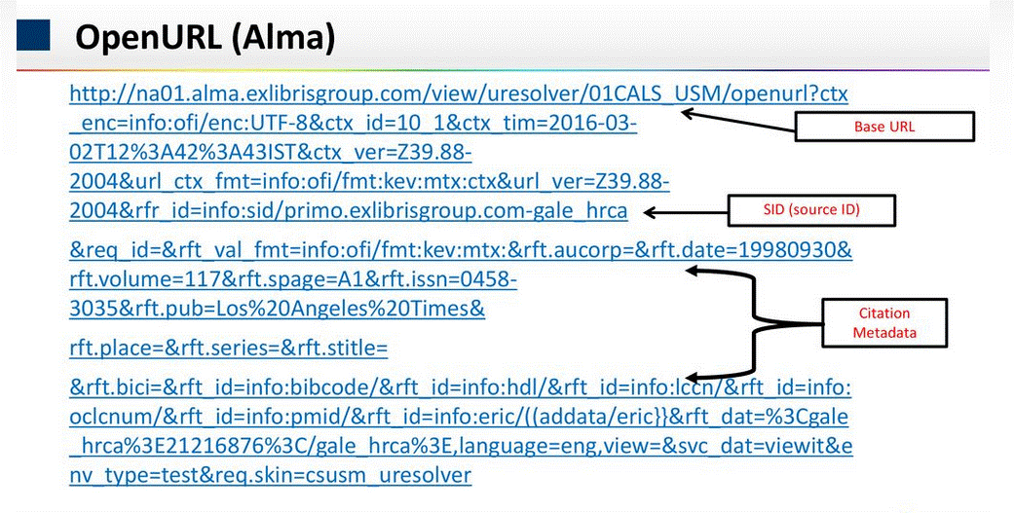
Advanced: Troubleshooting e-resources linking problems.
Sections Highlighted:
Notes:
OpenURL error from Linking with Alma April 2021 Video Presentation -focus on CDI.

Slide 14
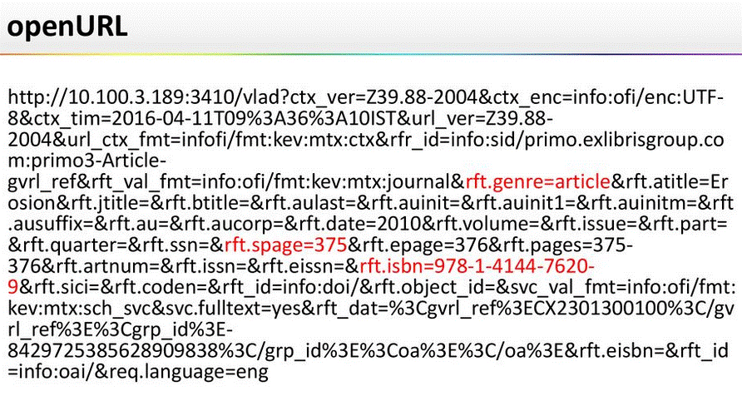
Advanced: Troubleshooting e-resources linking problems.
URL With an Error Highlighted:
Notes:
OpenURL error from
Linking with Alma April 2021 Video Presentation -focus on CDI.

Slide 15
Advanced: Troubleshooting e-resources linking problems.
For more details see
Introduction to OpenURL – see NISO for introduction or DOI org
OpenURL both a standard of how to organize bibliographic citation data and used to describe the URL output of that mapping.
How to map standard id numbers, author, titles, page, date, etc. into machine readable strings like this sample OpenURL:
http://resolver.example.edu/cgi?genre=book&isbn=0836218310&title=The+Far+Side+Gallery+3
There are 4 general categories of OpenURL attributes that may be returned by Alma’s Link Resolver:
Requester (prefix = .req)
ReferringEntity (prefix = rfe.)
Referent ( prefix = rft.)
ServiceType (prefix = svc.)
Details at Commonly Used OpenURL Attributes for the Alma URL Template
Notes:
More info and tech details at NISO or DOI.org
To review OpenURL is both….,
To understand how the citations go bad you need to learn more about how link resolvers process bibliographic citation information.

Slide 16
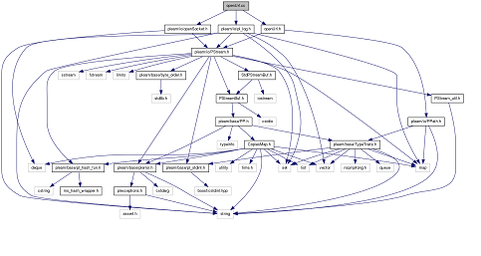
Troubleshooting patron reports of e-resources linking problems.
OpenURL construction quite complicated building on citation/metadata elements like ISSN/ISBN, title, author, date, pages, etc.
Diagram from Plearn, openUrl.cc File Reference https://www-labs.iro.umontreal.ca/~lisa/LibraryReference/html/d3/db7/openUrl_8cc.html
Notes:
Needless to say constructing OpenURLs can get very complicated as this diagram illustrates. And also messy if there’s inaccurate or just poor quality information sharing between vendor X and vendor Y - interfering in the mapping of citation elements into an OpenURL. Alternately an OpenURL is not very useful if there’s not much information in the citation- missing standard numbers, dates, full titles or the like.
To understand how the citations go bad you need to learn more about how link resolvers process bibliographic citation information.

Slide 17
Advanced: Troubleshooting e-resources linking problems.
How does Alma/Primo VE use the OpenURL?
Diagrams of Alma link resolver and presentation or display via Primo VE
Introduction to Alma’s Context Object (CTO)
Getting OpenURL details via “CTO” XML– other the “under the hood” info.
Notes:
Now Part two of today’s presentation: Well look at how Alma/PVE uses OpenURL, some diagrams to illustrate and the role of the CTO. CTO take us “under the automobile’s hood” so to speak, into the inner workings and source data of the link resolver.

Slide 18
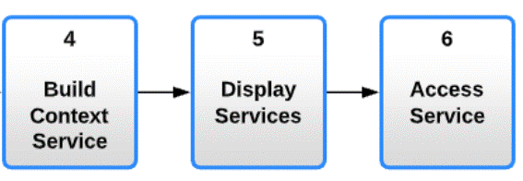
Advanced: Troubleshooting e-resources linking problems.
Diagram from “Alma Link Resolver Workflow”
Notes:
Show and talk through https://knowledge.exlibrisgroup.com/Alma/Product_Documentation/010Alma_Online_Help_(English)/Electronic_Resource_Management/051Link_Resolver/010Alma_Link_Resolver_Workflow
3 is when Alma match the CTO to active portfolios with e-services in your IZ (or NZ) that can match the standard numbers, publication title and date of the citation.
5 is in Primo VE forming the “View Online” menu, 6- is when patron clicks on a “View Online” link and (hopefully) goes to full text of the citation.

Slide 19
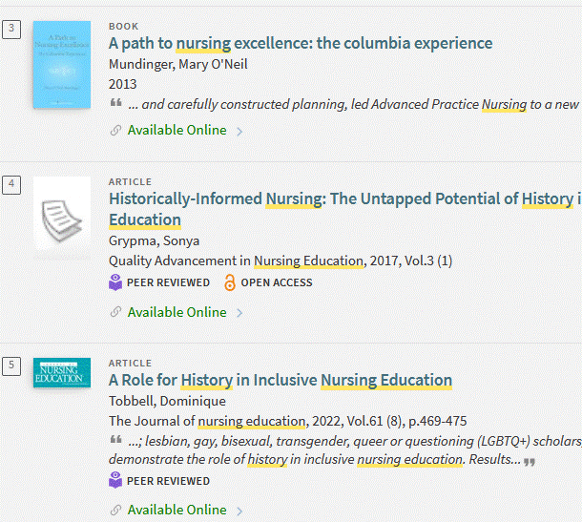
Advanced: Troubleshooting e-resources linking problems.
Search Finds Results
Select one to look at more. Click on “Available Online”
Notes:
Here’s an example, I searched… selected #4…
https://i-share-trt.primo.exlibrisgroup.com/permalink/01CARLI_TRT/1eflh7h/cdi_doaj_primary_oai_doaj_org_article_0cf9c712dd52419ca039ca246eb1897c
When I click on “Available Online” builds the OpenURL, step one from previous slide and starts building the CTO.

Slide 20
Advanced: Troubleshooting e-resources linking problems.
Alma Creates OpenURL For Selected Result
http://i-share-trt.primo.exlibrisgroup.com/view/uresolver/01CARLI_TRT/openurl?rft_val_fmt=info:ofi/fmt:kev:mtx:journal&rft.volume=3&rft.pub=Canadian Association of Schools of Nursing&rft_id=info:doi/10.17483/2368-6669.1099&rfr_id=info:sid/primo.exlibrisgroup.com-doaj_cross&resource_type=articles&rft.jtitle=Quality Advancement in Nursing Education&rft.genre=article&rft.issue=1&vid=01CARLI_TRT:CARLI_TRT&rft.date=2017-04-13&rft.au=Grypma, Sonya&rft_dat=<doaj_cross>oai_doaj_org_article_0cf9c712dd52419ca039ca246eb1897c</doaj_cross>&rft.atitle=Historically-Informed Nursing: The Untapped Potential of History in Nursing Education&rft.issn=2368-6669&rft.eissn=2368-6669
Notes:
https://i-share-trt.primo.exlibrisgroup.com/permalink/01CARLI_TRT/1eflh7h/cdi_doaj_primary_oai_doaj_org_article_0cf9c712dd52419ca039ca246eb1897c

Slide 21
Advanced: Troubleshooting e-resources linking problems.
Creates CTO, Match Bib Records, Build Context Services & Display Services for Selected Result
Notes:
https://i-share-trt.primo.exlibrisgroup.com/permalink/01CARLI_TRT/1eflh7h/cdi_doaj_primary_oai_doaj_org_article_0cf9c712dd52419ca039ca246eb1897c,
Match bib records = what active e-collections / portfolios match with this journal and for this time coverage. Show request, services, etc.

Slide 22
Advanced: Troubleshooting e-resources linking problems.
Introduction to Alma Context Object (CTO) –
(not OpenURL same named component.)
What is Context Object? – All the OpenURL bibliographic metadata parsed and organized for Alma to read the information (plus any augmentations from Alma**.)
Alma uses CTO to look for any matching full text resources (or GES) with priority searching for:
Numeric Identifiers: EISSN,ISSN, EISBN, ISBN, LCCN, CODEN, OCLC number.
Within numeric identifiers prioritize EISSN/ISSN for article/journal/issue genres.
Other genres or blank in genre field give a higher priority to EISBN/ISBN.
Definition from this Alma Documentation.
** More on augmentations later in presentation.
Notes:
If the patron can’t get to full text, often very helpful to look at the Context Object or CTO. Defined as…
Let’s see CTO for the last example on nursing education history: https://i-share-trt.primo.exlibrisgroup.com/permalink/01CARLI_TRT/1eflh7h/cdi_doaj_primary_oai_doaj_org_article_0cf9c712dd52419ca039ca246eb1897c&displayCTO=true
Definition from https://knowledge.exlibrisgroup.com/Alma/Product_Documentation/010Alma_Online_Help_(English)/Electronic_Resource_Management/051Link_Resolver/010Alma_Link_Resolver_Workflow

Slide 23
Advanced: Troubleshooting e-resources linking problems.
Take the permalink and add “ &displayCTO=true” to end
Ex. i-share-trt.primo.exlibrisgroup.com/permalink/ 01CARLI_TRT/1eflh7h/cdi_doaj_primary_oai_doaj_org_article_0cf9c712dd52419ca039ca246eb1897c&displayCTO=true
Click on “Display CTO” in result
Notes:
How get to the CTO for a specific citation? Easiest way is to Add &displayCTO=true
To end of permalink, look for it again, click on “Display CTO”. Leave PPT and show it and other examples.
https://i-share-trt.primo.exlibrisgroup.com/permalink/01CARLI_TRT/1eflh7h/cdi_doaj_primary_oai_doaj_org_article_0cf9c712dd52419ca039ca246eb1897c&displayCTO=true
Leave PPT and show files of CTO

Slide 24
Advanced: Troubleshooting e-resources linking problems.
How interpret CTO? How use in troubleshooting linking problems?
Compare CTO details with an accurate citation for the article or Ebook. Any typos or mistakes in dates, volumes, ISSNs, ISBNs, etc.
Check source (sid) of the citation in CTO to help check on availability & accuracy.
CTO is in XML (Extensible Markup Language.)
CTO can change over time. Is a snapshot of the available OpenURL info at the time of generation.
Note some Alma documentation and web pages call CTO “Debug URL” or source of XML to help “debug” OpenURLs.
Notes:
Example calling it “debug…”
https://ideas.exlibrisgroup.com/forums/308176-primo/suggestions/44631129-add-target-url-to-displaycto-outpu

Slide 25
Advanced: Troubleshooting e-resources linking problems.
Diagram from “Alma Link Resolver Workflow”
We didn’t cover Alma “Link in Record” method for linking to full text via Primo VE.
Notes:
This make a bit more sense now?
Final detail about linking from citations to full text via Primo VE, not all #3 matches will use link resolver-to OpenURL to CTO process. Some Alma e-collections use “Link in Record” rather than link resolver. This links using a template based on an internal vendor or publisher’s id for the material. Used mostly for streaming video and ebooks. For example, Alexander Street Press e-titles use “link in record.” Today we’ve covered only Alma full text linking via link resolver

Slide 26
Advanced: Troubleshooting e-resources linking problems.
Diagram II of link resolving
Notes:
Like this one because shows more circular, not so straightforward and linear and previous one implies.
Dalnet presentation, from “Where Does THAT Come From? How Primo Uses and Displays Data
from Alma (2018)”
https://dalnet.org/kb/more/eluna/Where_Does_THAT_Come_From

Slide 27
Advanced: Troubleshooting e-resources linking problems.
Can we make citations work better with CTO generation?
Yes!
Good place to start is enrich or augment citations used by the Alma Link Resolver via activating your Institution Zone’s “Augmentations.”
see Improving Alma/PrimoVE linking with CrossRef DOI and PubMed ID
Alma link resolver will overwrite or augment the referring source’s citation elements with metadata from CrossRef or PubMed if the OpenURL has a DOI or PMID. This helps ensure that we use the most accurate and up-to-date metadata to connect users with full text.
Notes:
Yes make better by enriching with standard identification numbers like DOI (digital object identifier) or Pub Med unique identifier? CARLI and Alma have documentation that can help. Many I-Share libraries already set this up. If you aren’t sure, check these instructions. Mentioned earlier in presentation that CTO will incorporate any additional PMID, DOI or other info that can come in from having these augmentation features configured and active.
Start thinking and typing in chat questions/comments about Augmentations, OpenURL, CTO…

Slide 28
Wrap up & Questions
Resources for Further Learning
Dec. 2022 Office Hours on troubleshooting linking
CARLI Web Page on troubleshooting-https://www.carli.illinois.edu/products-services/i-share/electronic-res-man/primove-broken-links
Alma Link Resolver workflow- from Ex Libris Alma

Slide 29
Wrap up & Questions
Diagrams and Info from these Presentations
Linking with Alma April 2021 Video Presentation -focus on CDI.
What’s Wrong With This Link? Troubleshooting Common Linking Issues (2019) - reviews OpenURL and CTO among other factors.
Where Does THAT Come From? How Primo Uses and Displays Data from Alma (2018)
Notes:
Ex Libris and ELUNA presentations: NOTE: given the age of these presentations, example screens & editing steps in Alma or Primo not always applicable today. However, what's an OpenURL and CTO and how Alma uses them has not changed significantly.

Slide 30
Wrap up & Questions
How did we do on these learning goals ?
Become Familiar with OpenURL definitions.
How to interpret OpenURL
Steps in the Alma/Primo VE Link resolver process
Diagrams
What’s CTO?
How to display via “&displayCTO=true” and decipher CTO
Time for your Questions and Comments?
Denise Green, dgree1@uillinois.edu

Slide 31
Next Office Hours May 11 Quarterly Release Review
Notes:
(Debbie)

