Slide 1
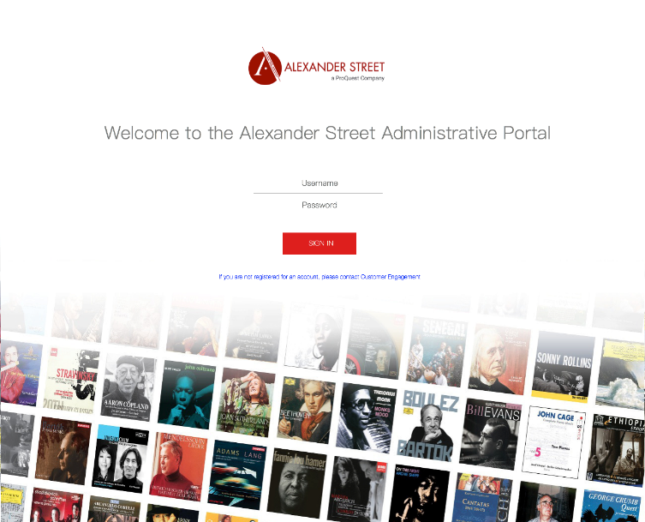
CARLI: Emerging Issues in
E-Resources: Using Statistics and Streaming Video
Usage Statistics in Streaming Video Resources: Current State, Future Directions
David Parker Senior Director
Product Management
david.parker@proquest.com
201-673-8784

Slide 2
Topics to Address Today 1. Counter 5 status and AS integration into ProQuest 2. The Alexander Street Admin Portal 3. The new Alexander Street video UX and usage tracking 4. Some, certainly not all, open video usage questions …

Slide 3
1. Counter 5 status and AS integration into ProQuest

Slide 4
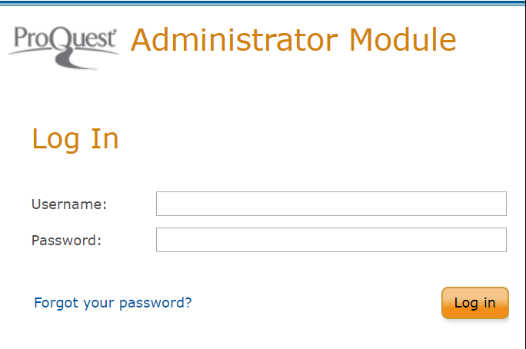
Counter 5 and Alexander Street Admin Integration with ProQuest Administrator Module
Counter 5
ProQuest platform is Counter 5 compliant, audited and confirmed as of February 2019
Alexander Street platform will be Counter 5 compliant as of H2 2019
Integrated administrator tools for Alexander Street, E-book Central and ProQuest platform
Single-Sign-On access to usage data for all three platforms with links to each admin experience – 2019
Integrated access to usage, MARC, etc. across all products/content, i.e. one platform, one ProQuest administrator module – 2020+

Slide 5
ProQuest One Academic
Notes:
We’ve recently launched ProQuest One Academic, a new multidisciplinary package that combines the four multidisciplinary collections of Academic Complete, ProQuest Central, Academic Video Online (AVON), and ProQuest Dissertations & Theses Global

Slide 6
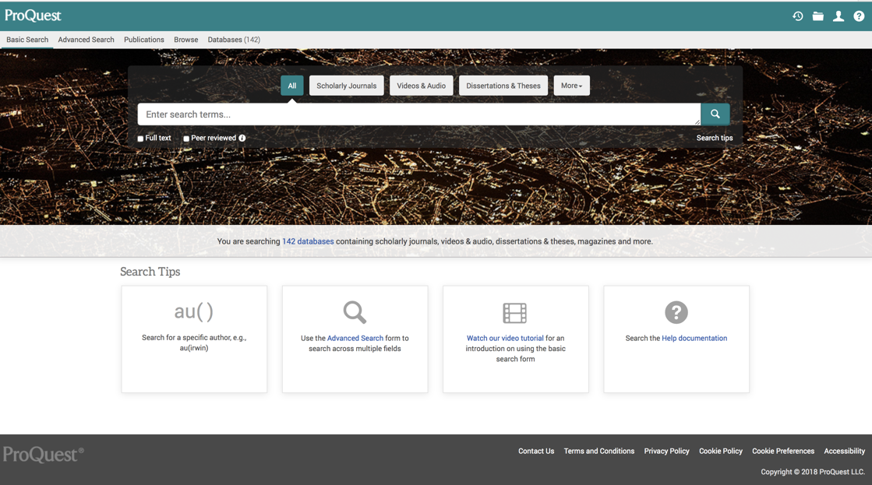
Access Academic Video Online in the ProQuest Platform

Slide 7
2. The Alexander Street Admin Portal

Slide 8
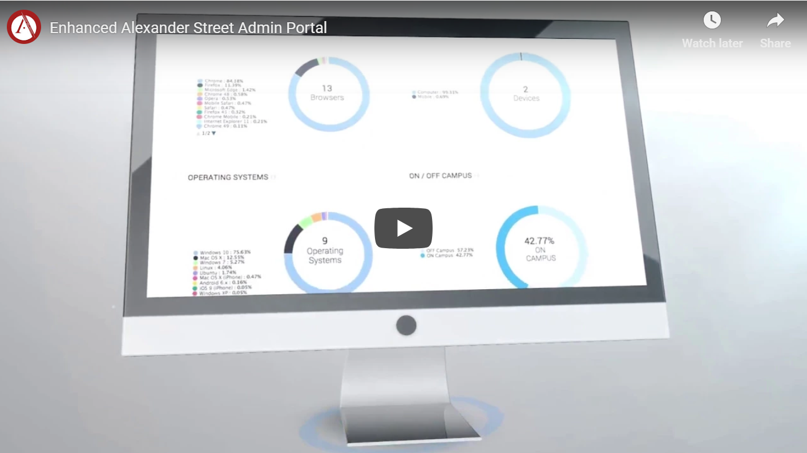
https://alexanderstreet.com/page/alexander-street-enhanced-admin-portal

Slide 9
Usage Overview: Searches, Views, Top Subjects, Top Collections

Slide 10
Usage Overview: Top Publishers, Top Titles, Top Referring URLs

Slide 11
Usage Overview: Views by Title, % Viewed, Day’s Volume of Views

Slide 12
Engagement: Cited, Segmented, Embedded in LMS = Curated

Slide 13
Engagement: Digging in … Why a “view” is more than a “view.”

Slide 14
Engagement Deep Dive: Browsers, Devices, OS, On/Off Campus, Time of Day

Slide 15
Impact – Why are you watching this video?

Slide 16
Impact – How would you rate this video?

Slide 17
3. The new Alexander Street video UX and usage tracking

Slide 18
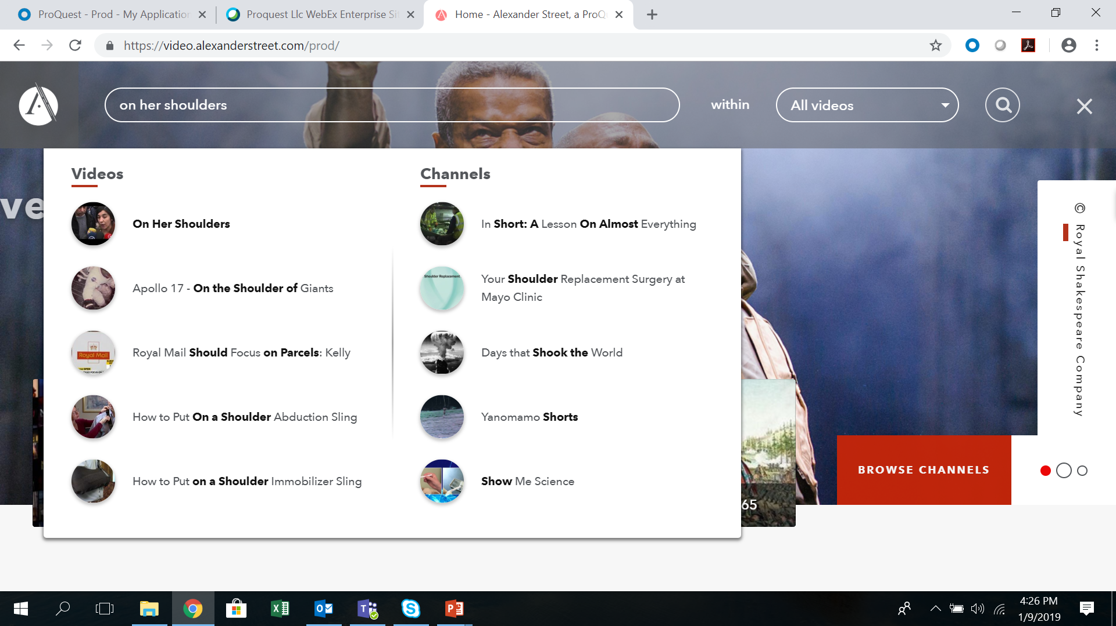
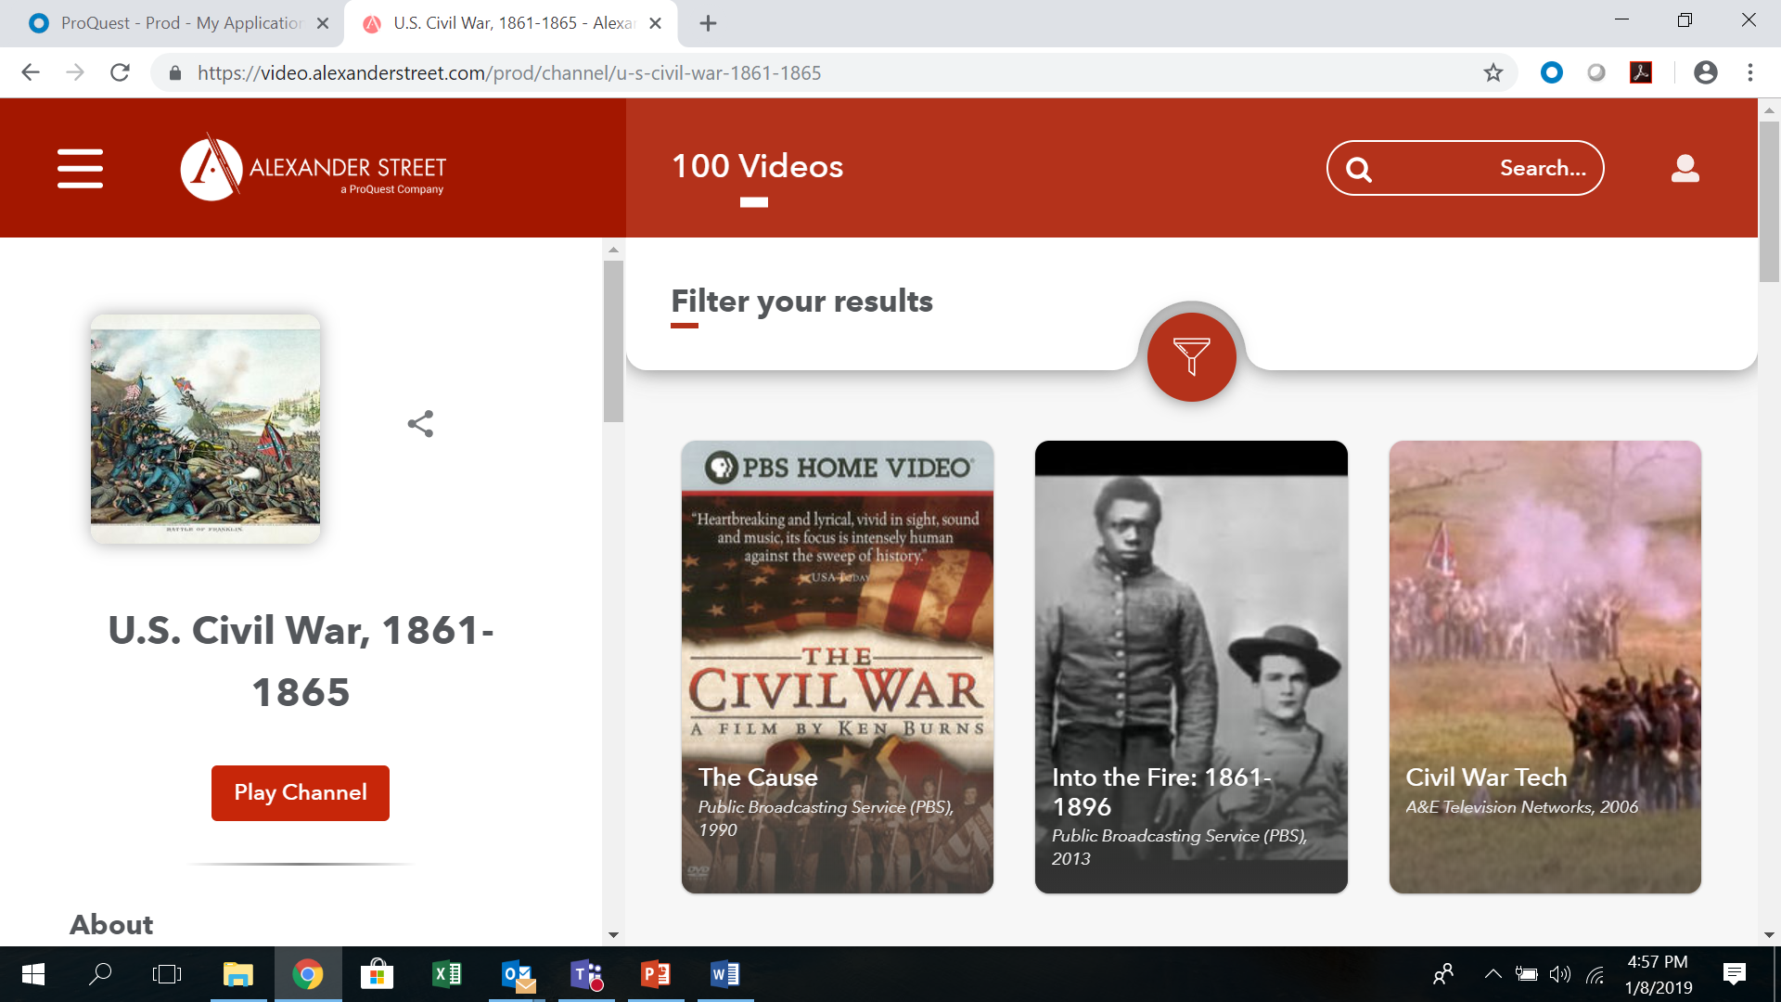
Search Auto-Suggests Titles and Channels
Channel Example - US Civil War

Slide 19
New video interface platform supports new, deeper analytics on usage – Coming soon!
Page views per session
Conversion rate/path/time from search results
How often users click the popular channel tiles on the home page
How often users click on “Exclusive Content” tab, or others
How often users click on recommended titles below the player
How often users click “Play Channel”

Slide 20
4. Some, certainly not all, open video usage questions …

Slide 21
Open questions in the specific context of measuring video usage
How do we know if the length of a view was a productive/complete view?
Can we ever measure “eyeballs” on a video?
Can we distinguish between viewing for course, learning, entertainment? Does it matter?
How can we support quick and intuitive analysis of cost-per-use, by institution, across access models?

